Slide 1
Elements of cancer immunity and the cancer immune set point
Jclub by Leonidas Salichos

Slide 2
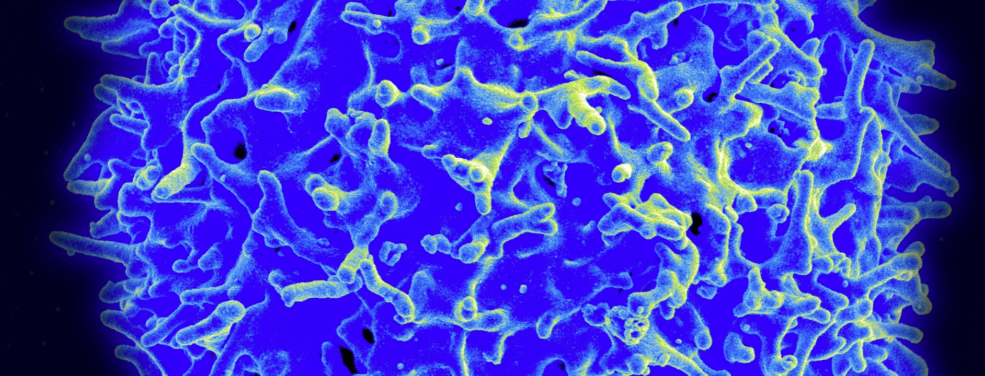
T cell
IS_A type of lymphocyte (type of white cell), part of the adaptive system
Has_A T-cell receptor on the surface
They are called T cells because they mature in Thymus from thymocytes
The majority of T cells rearrange their alpha and beta chains
Effector: actively respond to a stimulus. Helper, Killer, regulatory
T helper cells: CD4+ cells, become activated when presented antigens by MHC II
Cytotoxic cells : Killer cells or CD8+ cells. They express CD8, destroy virus and tumor
Memory cells: antigen specific
Regulatory cells : aka suppressor cells , immunological tolerance

Slide 3
In a few words
Immunotherapy is an effective therapeutic approach
Despite clinical success only a subset exhibit durable responses
Immunity is influenced by a complex set of tumor, host and ENV factors
Clinical studies define these factors as immune profiles that can predict responses

Slide 4
The cost of mutational burden:
The further the cancer cell diverges the more likely to be recognized
Mutational burden may determine a person’s response to cancer immunotherapy
Rizvi et al 2015
(I have found very similar preliminary results for expressional landscapes :
The more diverged the landscape the less aggressive the tumor)

Slide 5
MHC class

Slide 6
Tumors suppress immune responses
by activating negative regulatory pathways that are associated with immune homeostasis
By adopting features enable them to escape detection
Two popular checkpoints: CTLA4 (negative regulator of T cells) and death protein PD-1 (binds to PD-L1 and PD-L2, inhibitory signal)
Blocking these checkpoints elicits antitumour responses
Topalian et al, Cell 2015

Slide 7
Cancer Immunotherapy
Unlike chemotherapy or oncogene-targeted therapies relies on promoting anticancer response
Not limited to targeting a single oncogenic derangement
CI targets many of the abnormalities that differentiate cancer cells

Slide 8
The tumor genome as a driver of cancer immunity
T cells can recognize new epitopes (neoepitopes) generated by mutation or transcriptional aberration
Many antigenes have been found to generate T-cell epitopes in some people, without success in vaccination
In mouse syngeneic tumor models point mutations can yield mutant antigents to generate protective endogenous immunity by injecting synthetic peptides or mRNA

Slide 9
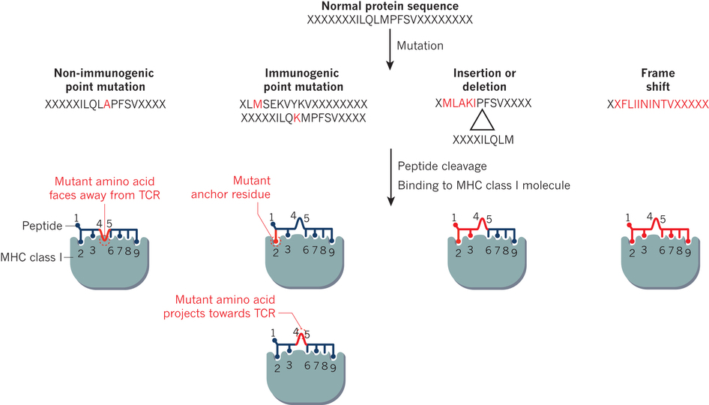

Slide 10
The role of T cells (largely unknown)

Slide 11
T-cell memory
Mice generate a memory response to tumor-associated antigens
Tumour-infiltrating lymphocytes that express CD4 or CD8 have the features of memory T cells
Can possess an activated or exhausted phenotype
  Expressing markers such as PD-1, protein TIM-3 and LAG-3

Slide 12
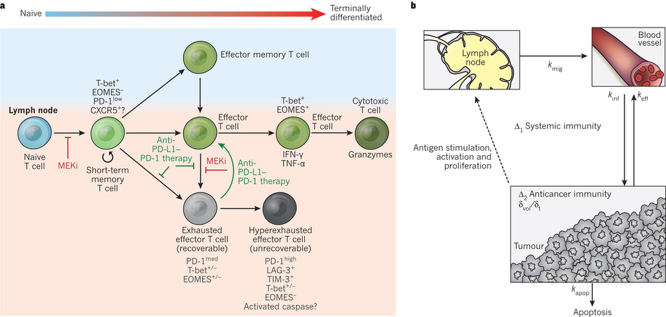
The development of CD8-expressing population of T cells
Naïve CD8+ T cells reside in lymph nodes and spleen
After activation by antigene short term memory T-cells differentiate
With chronic antigen exposure effector T cell can become progressively exhausted

Slide 13
The development of CD8-expressing population of T cells
Anti-PD-L1/PD-1 treatment or with inhibitors of MEKi may block or slow T-cell exhaustion
MEKi treatment seems to work better with lees exhuasted populations

Slide 14
Even when individuals respond, the tumor burden often fails to disappear
Development of alternative mechanisms of immunosuppression
The evolution of the tumor to lose immunodominant epitopes
Acquire mutations that facilitate resistance
Overall, a new equilibrium may have been reached between the tumor and the number of T cells
Perhaps (even after anti-PD-L1 therapy) T cell compartment to small to keep up.
Continuing priming of naïve T cells may be needed

Slide 15
The lymph nodes, the blood and tumours represent the main compartments in which elements of detected Anti-Cancer response.
Biomarker sampling take into account :
Timing of activation
The rate of migration from lymph to blood
Rate of infiltration into tumors
Rate of efflux from tumours into blood
Other factors include tumour size and apoptosis

Slide 16
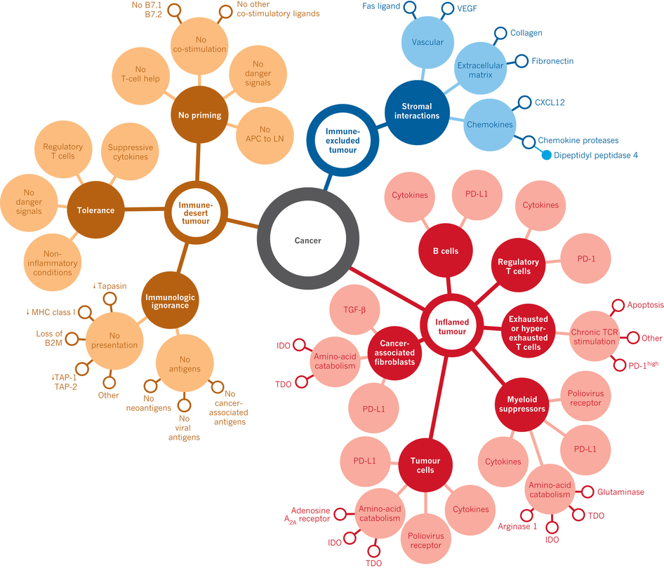
Immune cells don’t penetrate the parenchyma
Tumor cells close to immune cells
Non inflamed tumor micro-environment with a few or no CD8-carrying T cells
No response to PD-L1/PD-1 therapy
Cytokines: detectable mRNA
Response is necessary but insufficient

Slide 17
Inflamed vs non-inflamed tumors
Inflamed tumors
  The presence fo immune cells
  Proinflammatory cytokines
  Tumour necrosis factors
  Unclear whether the cause or the consequence
Non Inflamed tumors
  Associated with immune suppression or tolerance cytokines
  Associated with immune suppression or tissue homeostasis
  Regulatory T cells
  Myeloid-derived suppressor cells
  M2 macrophages (unactivated)

Slide 18
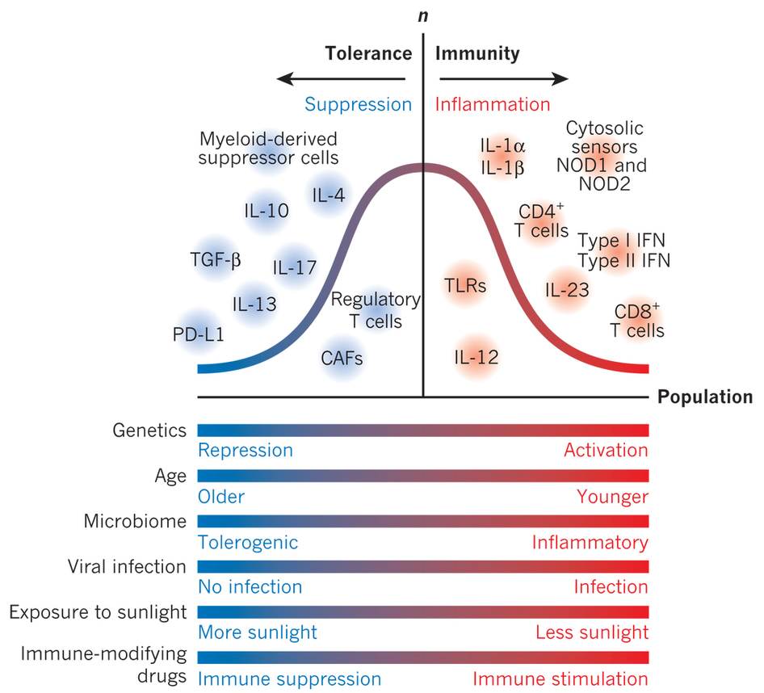
Multivariate factors influence tolerance and immunity
The bell curve represents the population distribution of variability in these factors
> Related to the likelihood that a given person’s tumour will adopt a more inflamed or a non-inflamed phenotype

Slide 19
Tumor genetics and epigenetics
Amongst others…
The mutation burden contribute to its immune profile
the greater the number of mutations , the more probably it is that some of the mutations will be immunogenic, providing targest
Early mutations may generate more effective T –cell respones
Mutations in KRAS and BRAF or other mutational activations of MAP kinase pathway will decrease the transcription of MHC class I molecules, or peptide loading
Tumors can selectively increase, the expression of genes that encode immunosuppression, including PD-L1, lkipoxygenases, IDO-1 and IDO-2
miRNAs by determining the immune microenvironment and immunogenicity

Slide 20
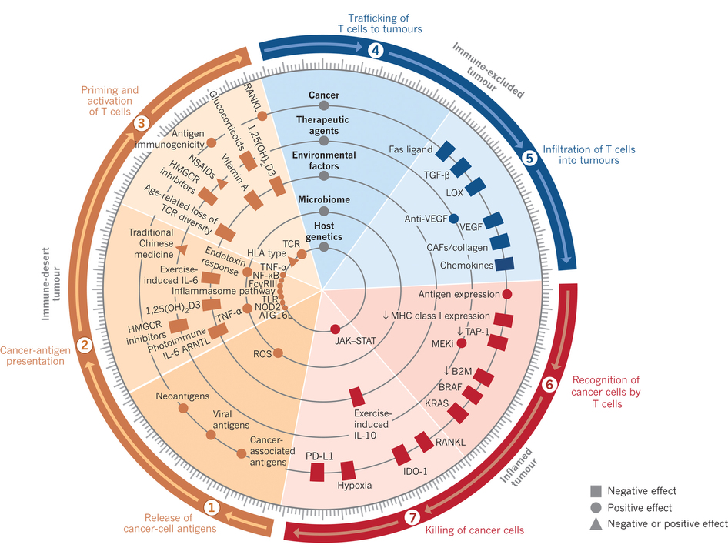

Slide 21
Host genetics
Various responses and different susceptibilities
Variation in the population in several immune response genes
  TLR4 in breast cancer affect the priming of antigen T cells
  People with germline loss-of function allele respond less well
  Other related loci: TNF-α, NF-kΒ, JAK/STAT proteins etc

Slide 22
The importance of the cancer-immune set point
∫ (F_{stim}) ⁻ ∫ (F_{inhib}) ≥ 1 ∕ ∑_{n=1,y} (TCR_{affinity} x frequency)
The set point is defined by
  the summation of the frequency of peptide MHC-TCR interactions and TCR signaling in all anticancer CD8+ Tcell clones
  Against antigenes present in the cancer celsl, including neoantigens and cancer –associated antigenes
A low set point makes it easier to generate an anticancer immune response

Slide 23
Cancer immunotherapy-based combination studies underway in 2016

Slide 24
Supplementary Figure 1. Cancer immunotherapy-based combination studies underway in 2016. A dramatic and unprecedented increase in clinical cancer immunotherapy combination studies (across Phase I, II and III trials) has occurred in recent years. The studies in this figure represent many of the current studies that include a PD-L1/PD-1 pathway inhibitor in combination with other immune modulators, targeted therapy, chemotherapy and/or radiation therapy. These studies are designed to characterize the efficacy, safety and biology related to combinability, synergy or antagonism associated with these combinations. Adapted from Vanessa Lucey of the Cancer Research Institute.
atezo, atezolizumab; ave, avelumab; chemo, chemotherapy; CRC, colorectal cancer; durva, durvalumab; Haem, haematologic; IFN, interferon; IMiD, immunomodulatory drug; nivo, nivolumab; pembro, pembrolizumab; NSCLC, non-small cell lung cancer; RCC, renal cell carcinoma; SCCHN, squamous cell carcinoma of the head and neck; SCLC, small cell lung cancer; TNBC, triple-negative breast cancer; UC, urothelial carcinoma.

