Slide 1
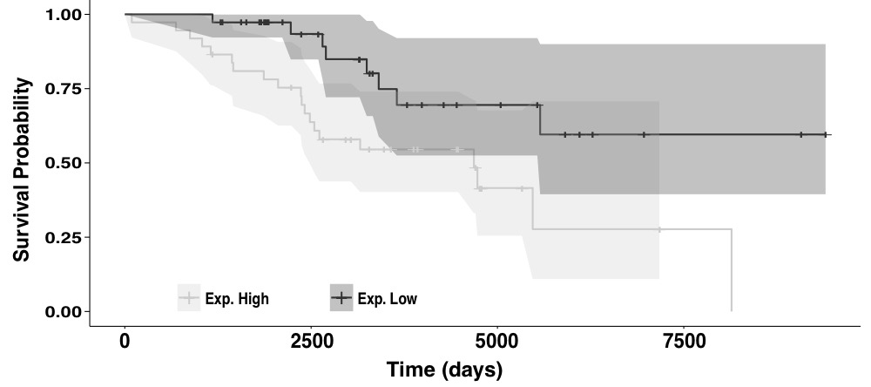
Matched
PC22-112
HeLa-S3
PC1-10
Final

Slide 2
Forward selected was used to select the final model
Best RepTime -> (Best RepTime + 1PC) -> (Best RepTime + 2PCs) -> …
Run ANOVA for the new and old model until P>0.05 as the final model

Slide 3
1st Point: HeLa replication timing
2nd Point: Matched replication timing, if no matched (A549), use best RepTime
3rd Pint: Remove only the Matched/Best replication timing, Do PCA of the remaining features, out the many PCs, select on that best improve the performance
Choose PCs sequencially until ANOVA Pvalue <0.05

Slide 4
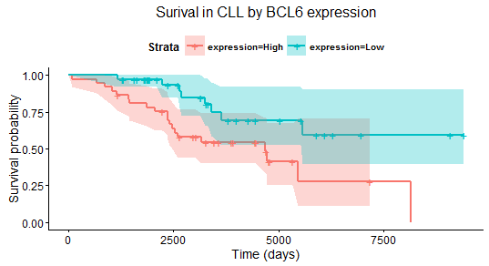
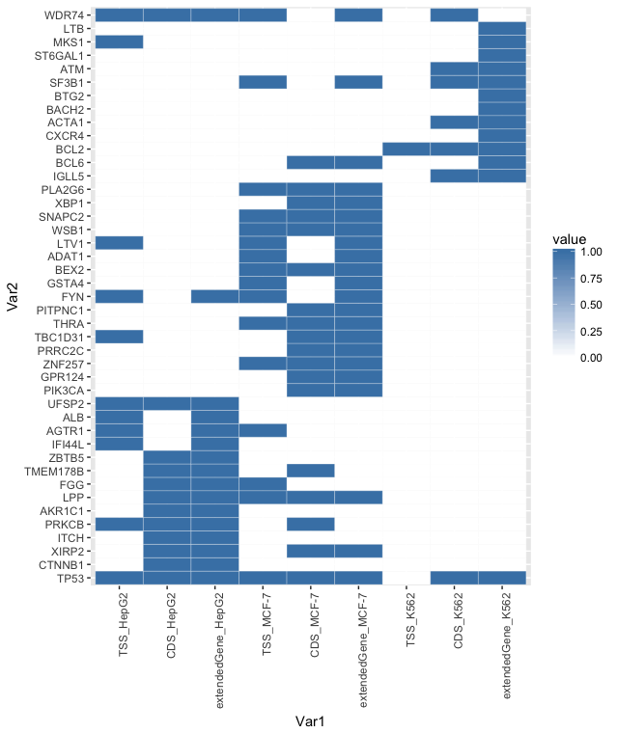
A
C
D
B

Slide 5
1st Point: HeLa replication timing
2nd Point: Matched replication timing, if no matched (A549), use best RepTime
3rd Pint: Remove ALL replication timing, Do PCA of the remaining features, out the many PCs, select on that best improve the performance
Choose PCs sequencially until ANOVA Pvalue <0.05

Slide 6
A
C
D
B

Slide 7
A
C
D
B

Slide 8
A
C
D
B

Slide 9
A
C
B
D

Slide 10
A

Slide 11
Matched
Progressive
Incremental
HeLa
Final

Slide 12
PC1-10, progressive
PC22-112, incremental
Matched
HeLa
Final

