Slide 1
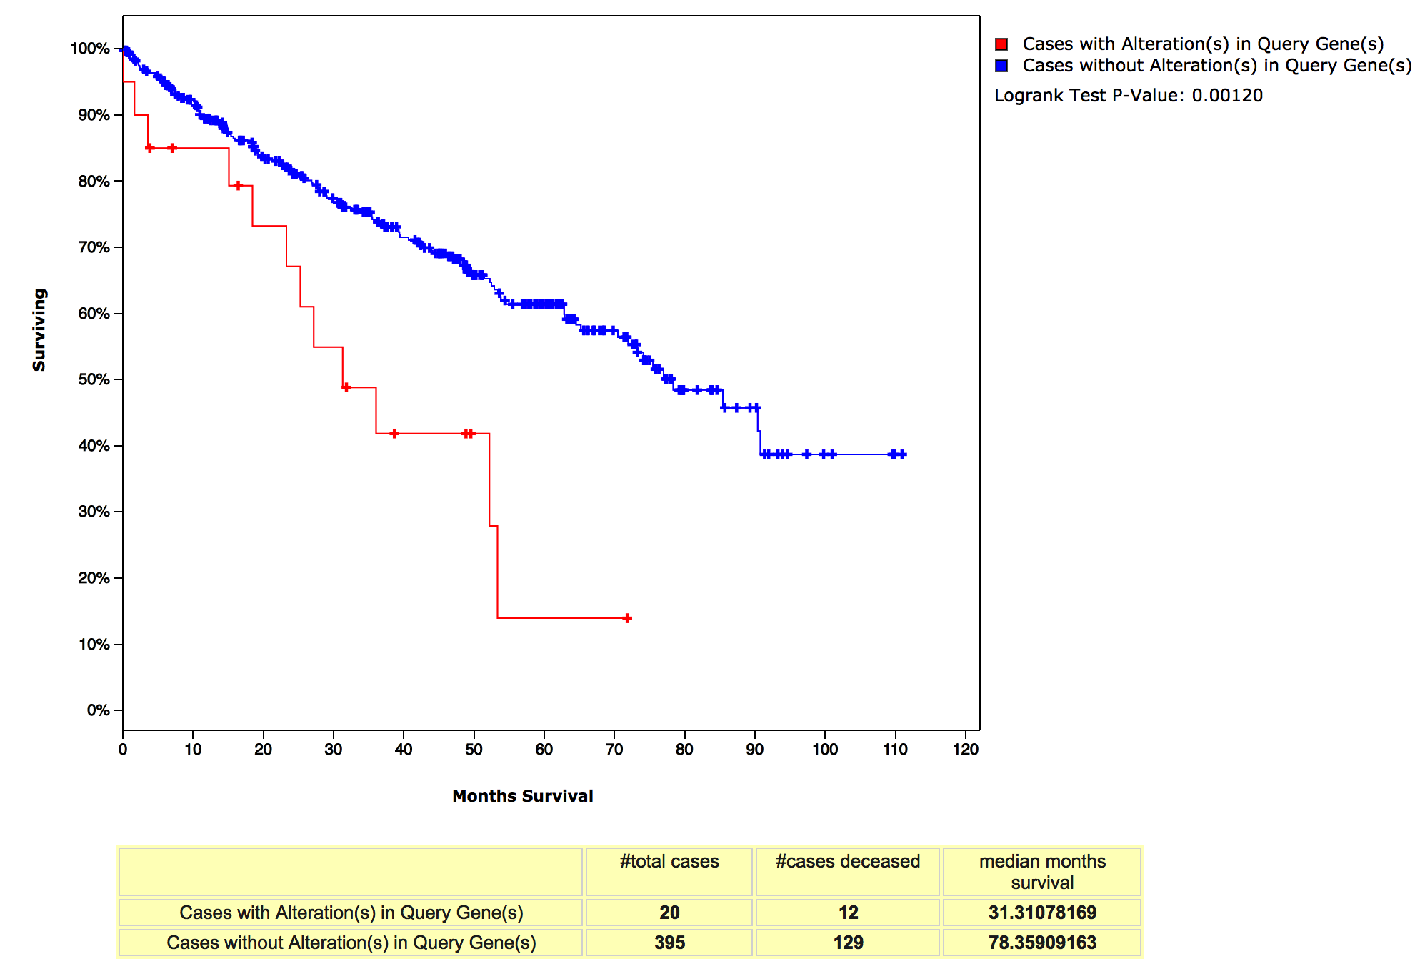
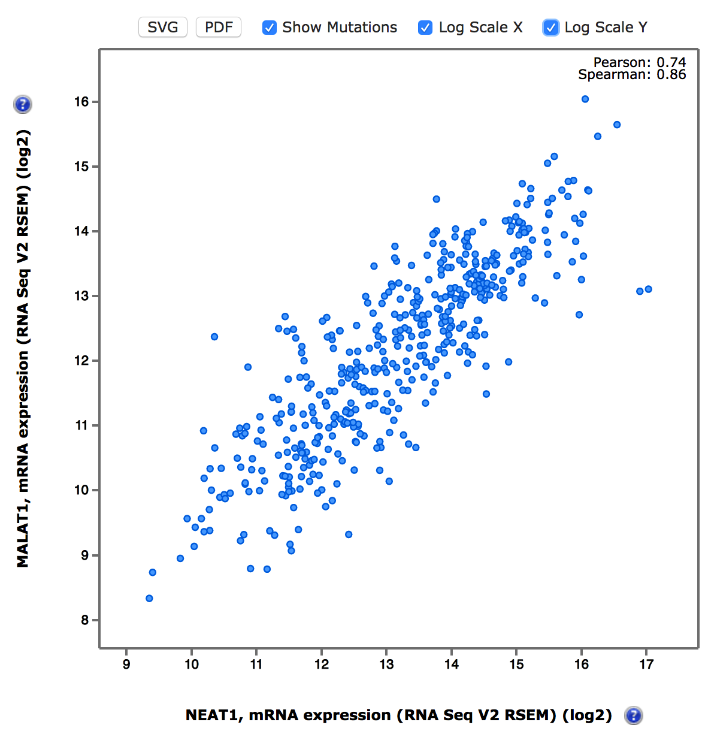
NEAT1 in ccRCC
6.6% (31/469) overexpression (z-score>2)
Rank 1(Pearson’s) or 4(Spearman’s)
out of all genes

Slide 2
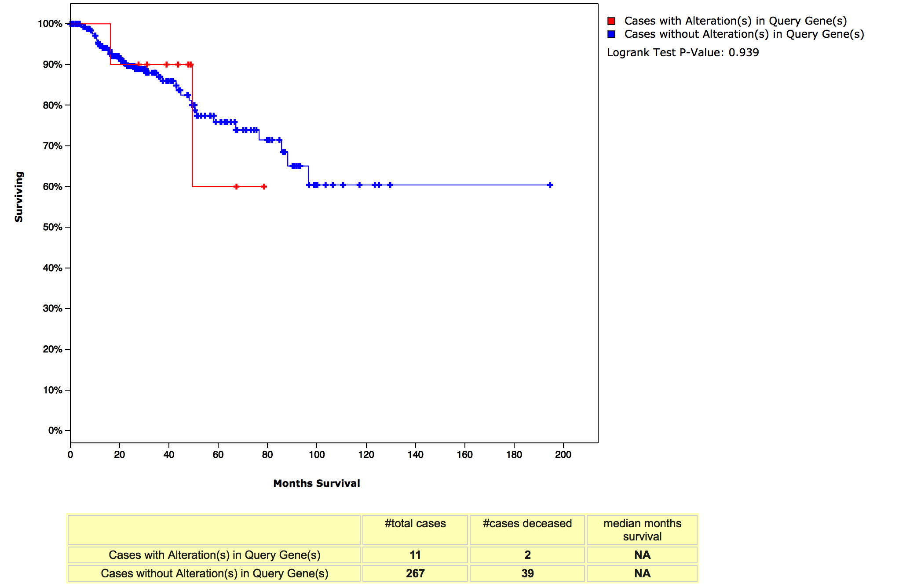
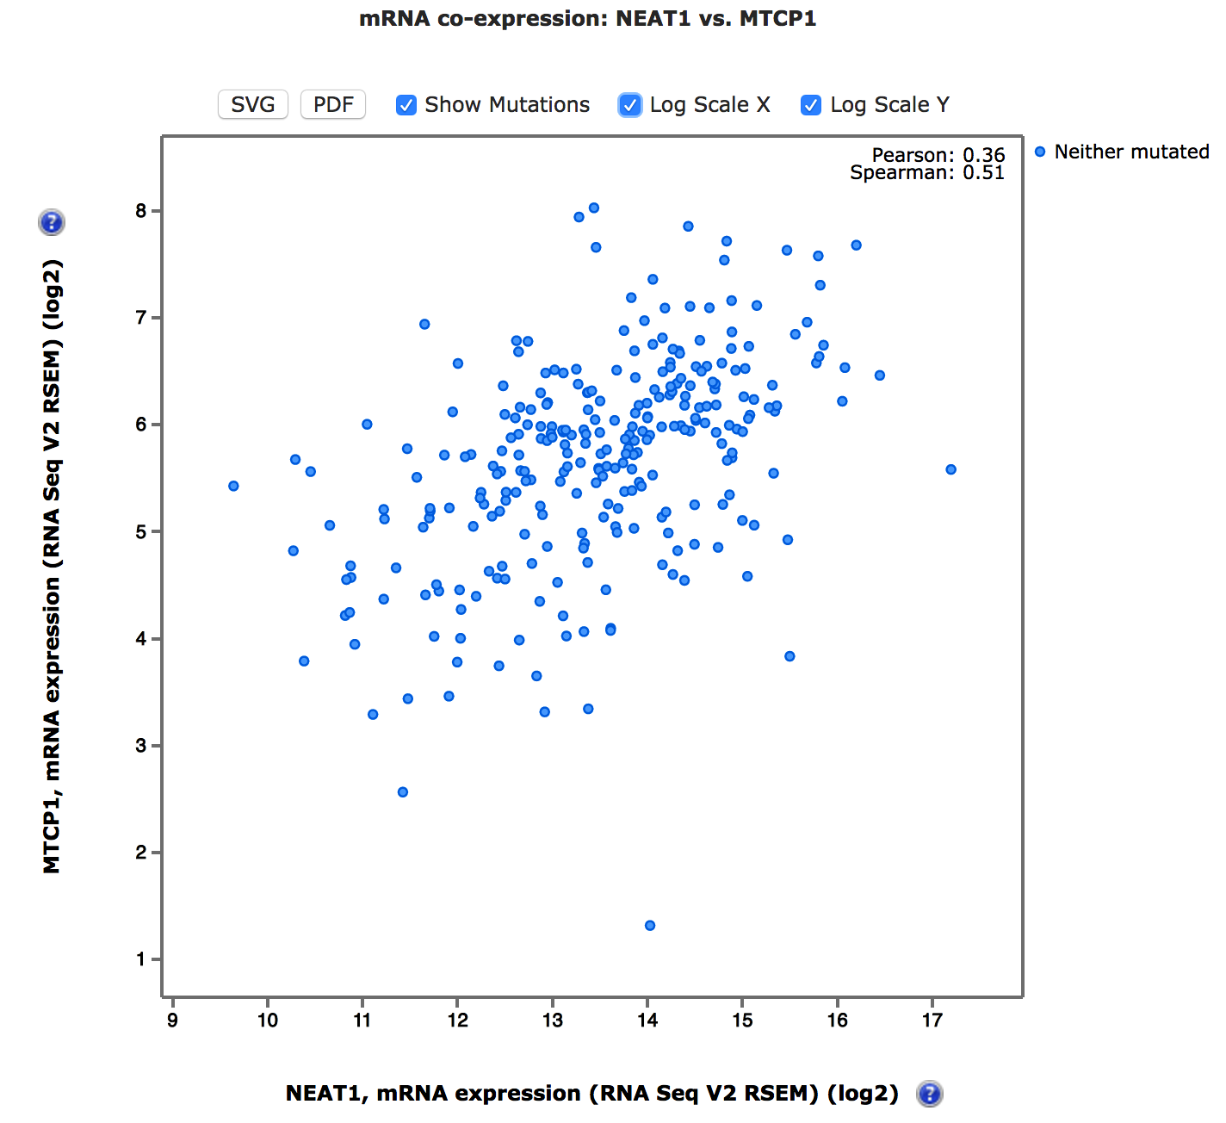
Not in pRCC
Rank 1(Pearson’s) or 3(Spearman’s)
out of all genes

Slide 3
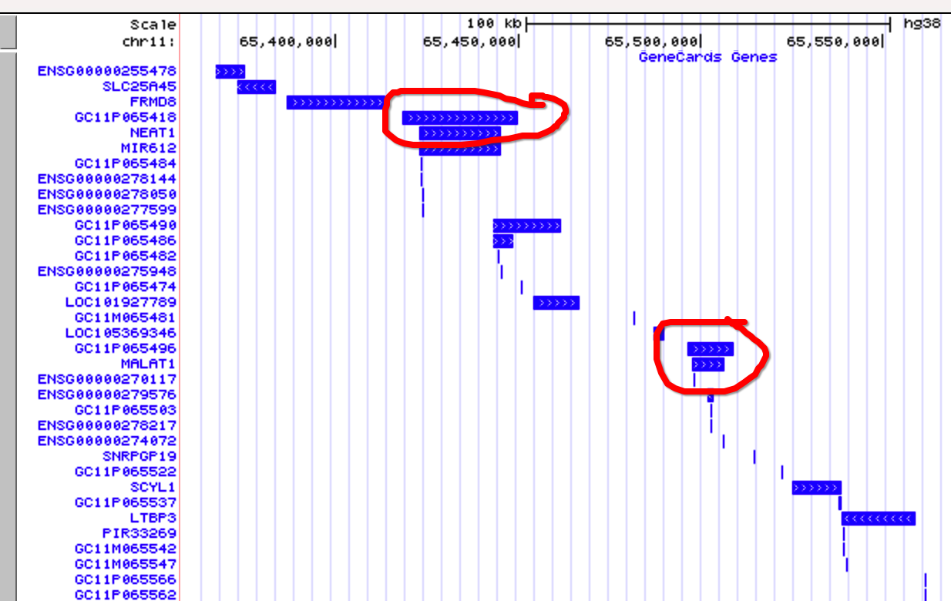

Slide 4
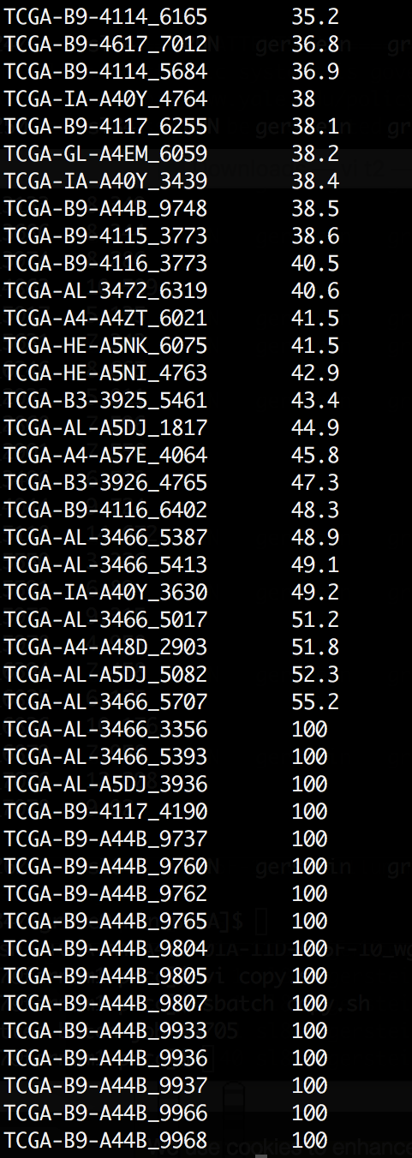
Severe germline contamination
So I filtered the results against all germline calls
with 1/0, and 0/0 with low Phred score (30)
Filter somatic genotype Phred score (20)
400 in ~35 samples?
Median SV in PCAWG: 14

Slide 5
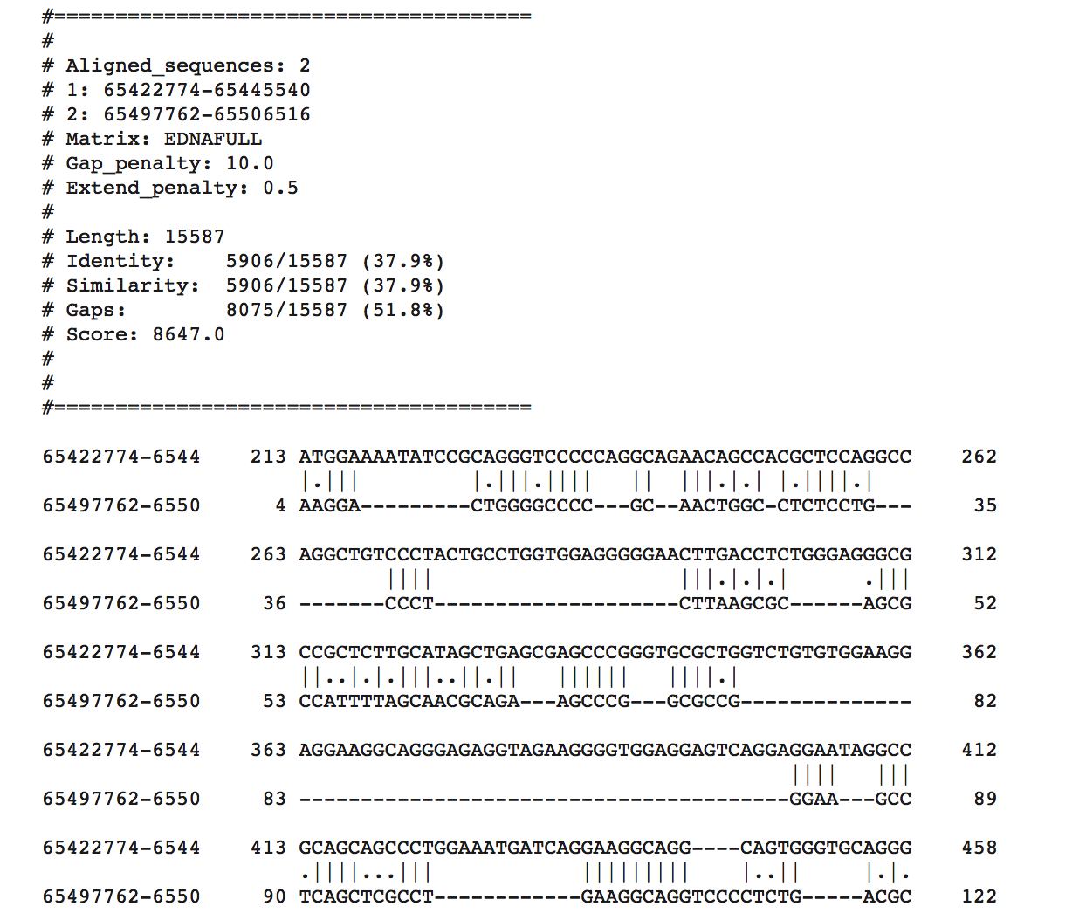
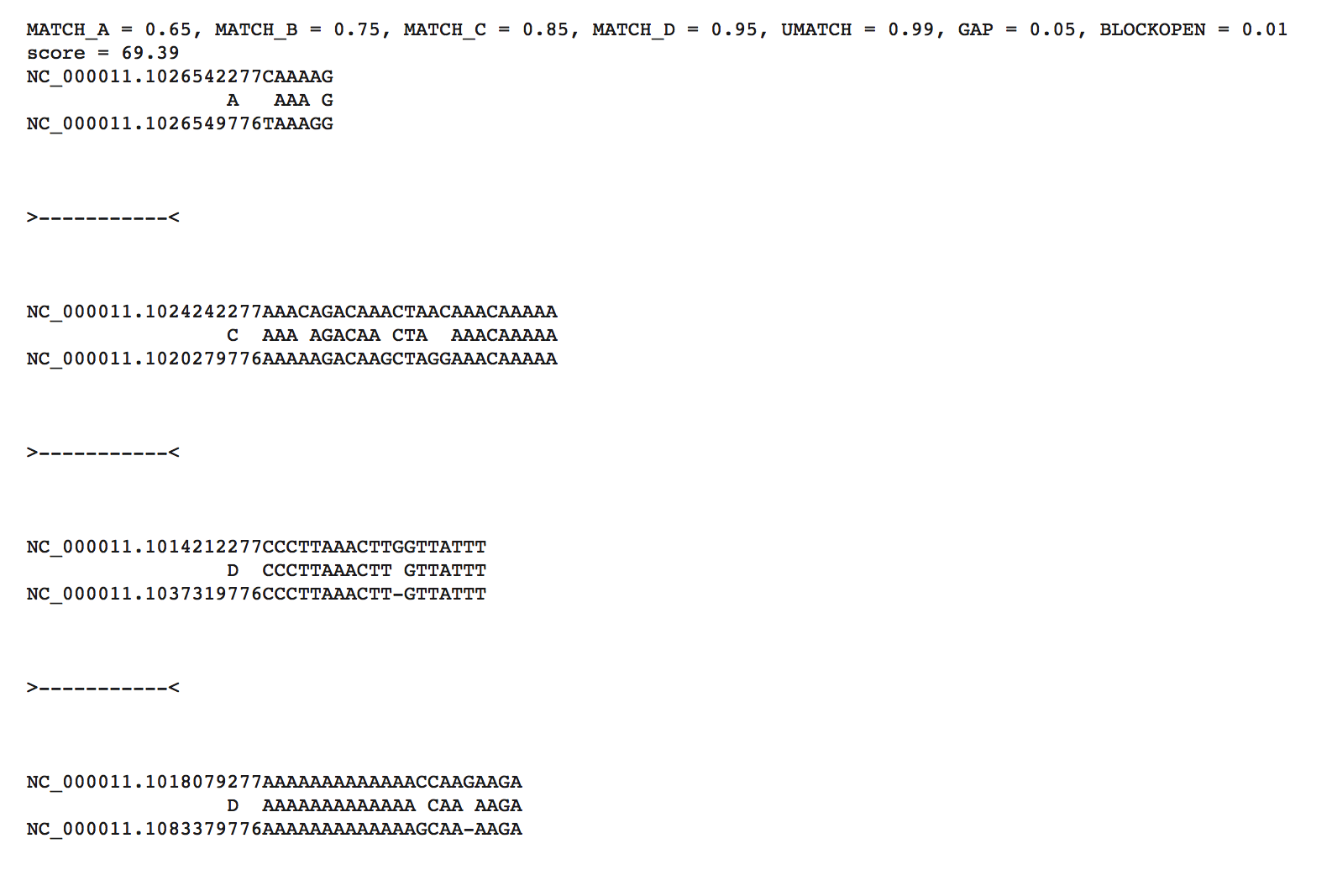
Sequence Similarity?
99% unmatch!

Slide 6
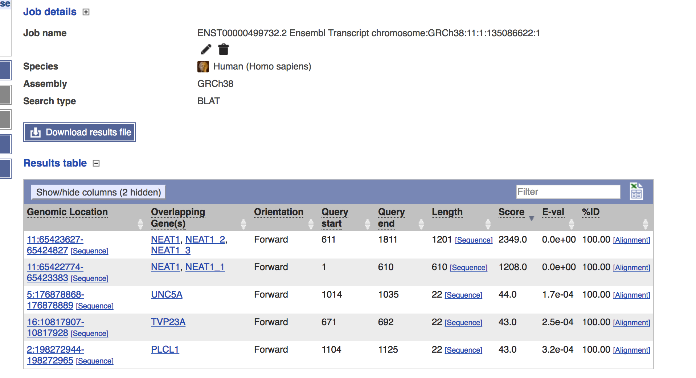
NEAT1 Major Transcription BLAST

Slide 7
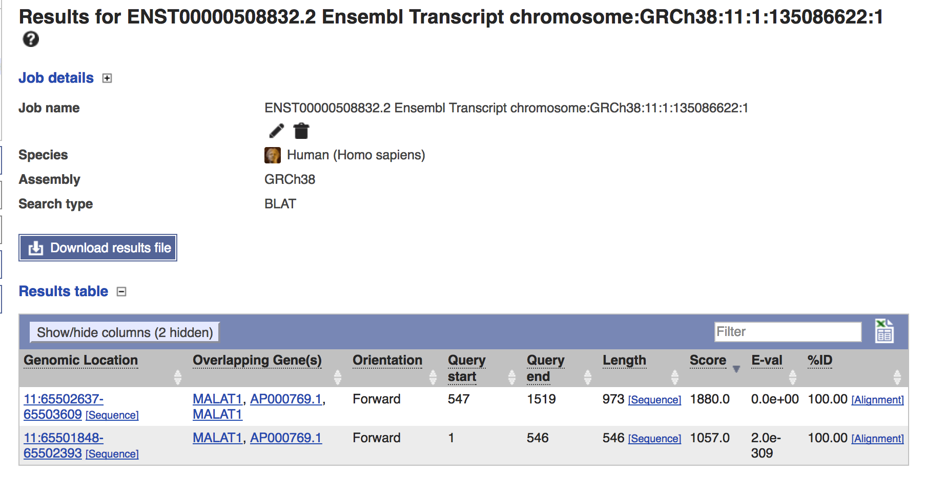
MALAT1 Major Transcription BLAST

