Slide 1
Introduction and Zimmerome slides

Slide 2
Personalized genomics and precision medicine

Slide 3
Expanding personalized medicine beyond the genome.
Analysis of Carl Zimmer’s genome was limited due to a lack of accompanying phenotypic data.
  Researchers didn’t have data beyond a genome sequence.
An integrated personal omics profile (iPOP) is an example of a more detailed version of personalized medicine.
  Michael Snyder had his genome sequenced and collected many other large scale datasets over an extended period of time.

Slide 4
Integrated personal omics profile (iPOP)
Key additions in iPOP analysis:
  Parental genome sequence enables creation of a high confidence diploid genome.
  Additional omic and phenotypic data (transcriptomic, proteomic, metabolomic, blood glucose, etc.)
  Time course data enables analysis of dynamic changes in cellular components during times of health and infection.
Drawbacks:
  Intensive data collection was only performed on a single individual.

Slide 5
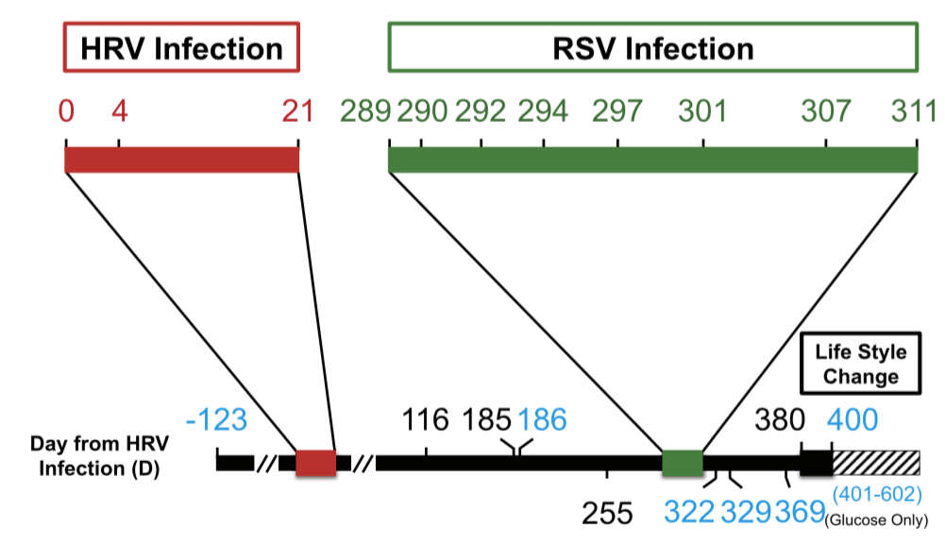
Personal omics profiling time course
Subject observed for 726 days.
During this period, he had two viral infections during which the frequency of data collection was increased.
  Higher resolution picture of the dynamics underlying response to viral infection.
Chen et al. Cell 2012

Slide 6
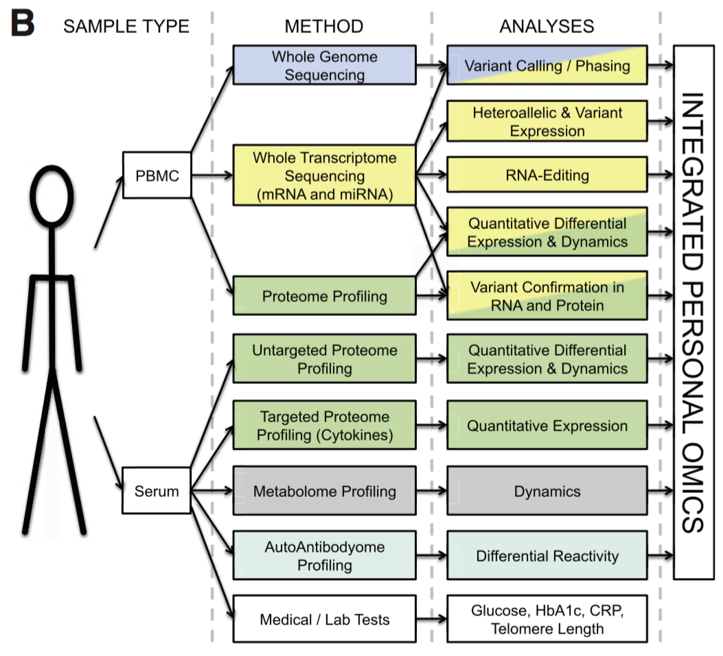
Types of data collected
Numerous types of data were collected, primarily from blood samples. The datasets include:
  Transcriptomic
  Proteomic
  Metabolomic
  Autoantibody profiling
  Medical tests
Chen et al. Cell 2012

Slide 7
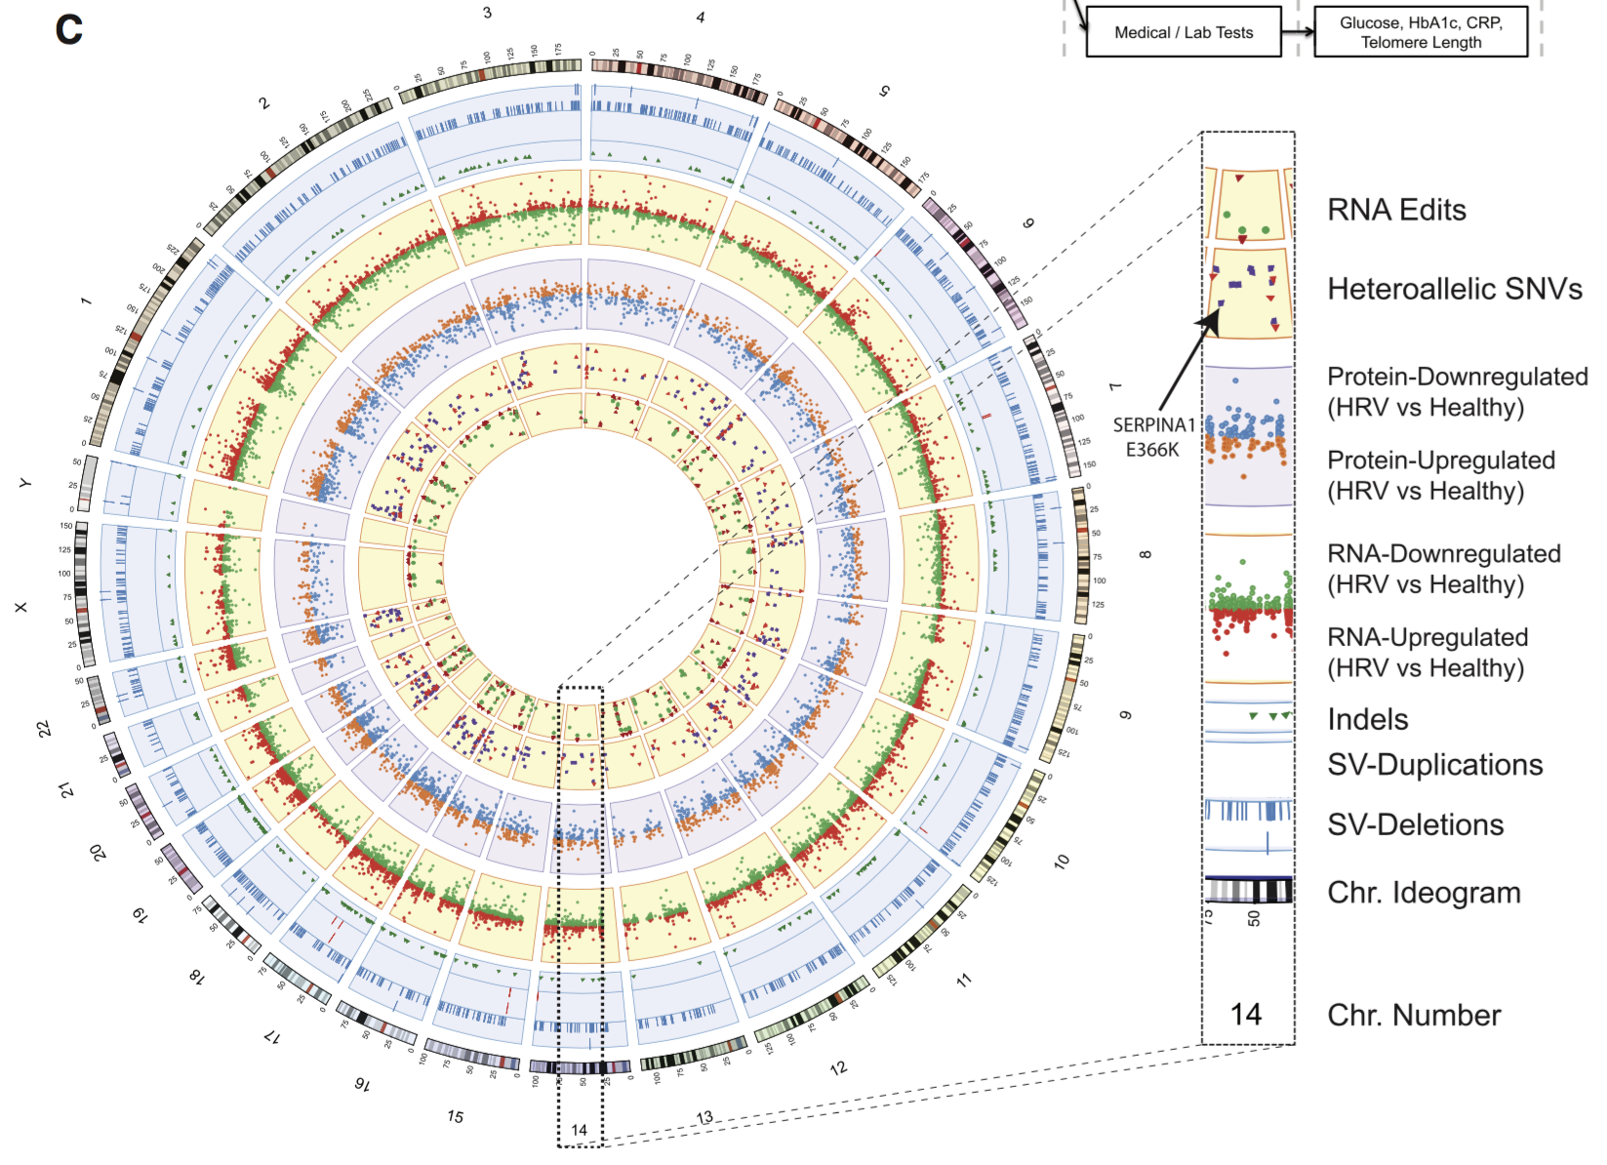
Genomic variant annotation and gene expression changes
Analysis of the sequenced genome identified SNVs, indels, and structural variants.
Transcriptomic and proteomic data revealed expression differences between healthy and infected states.
Chen et al. Cell 2012

Slide 8
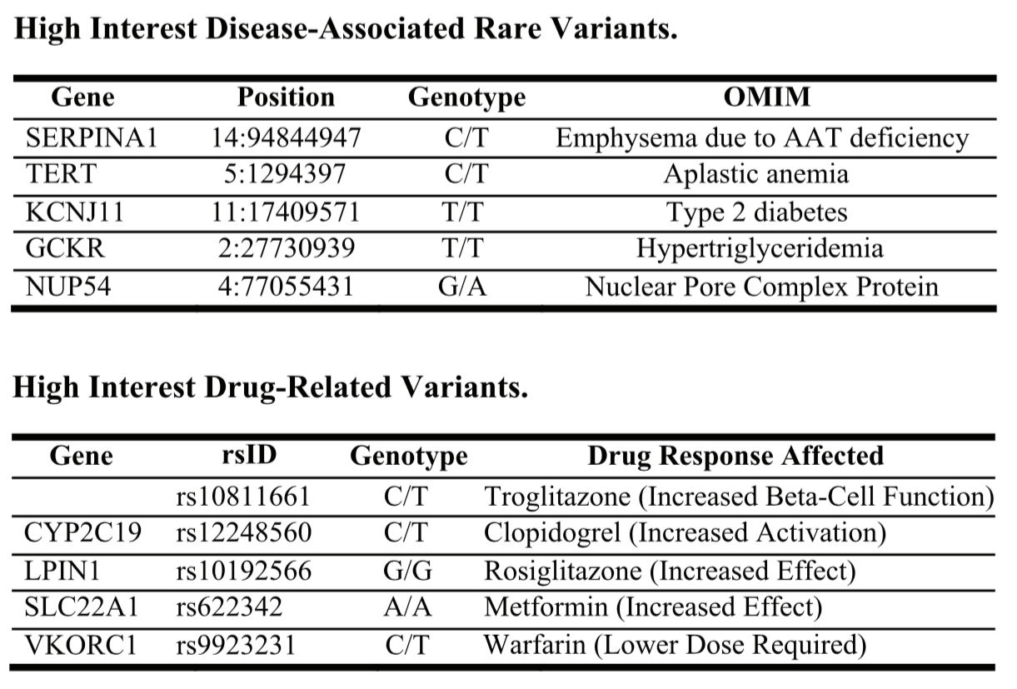
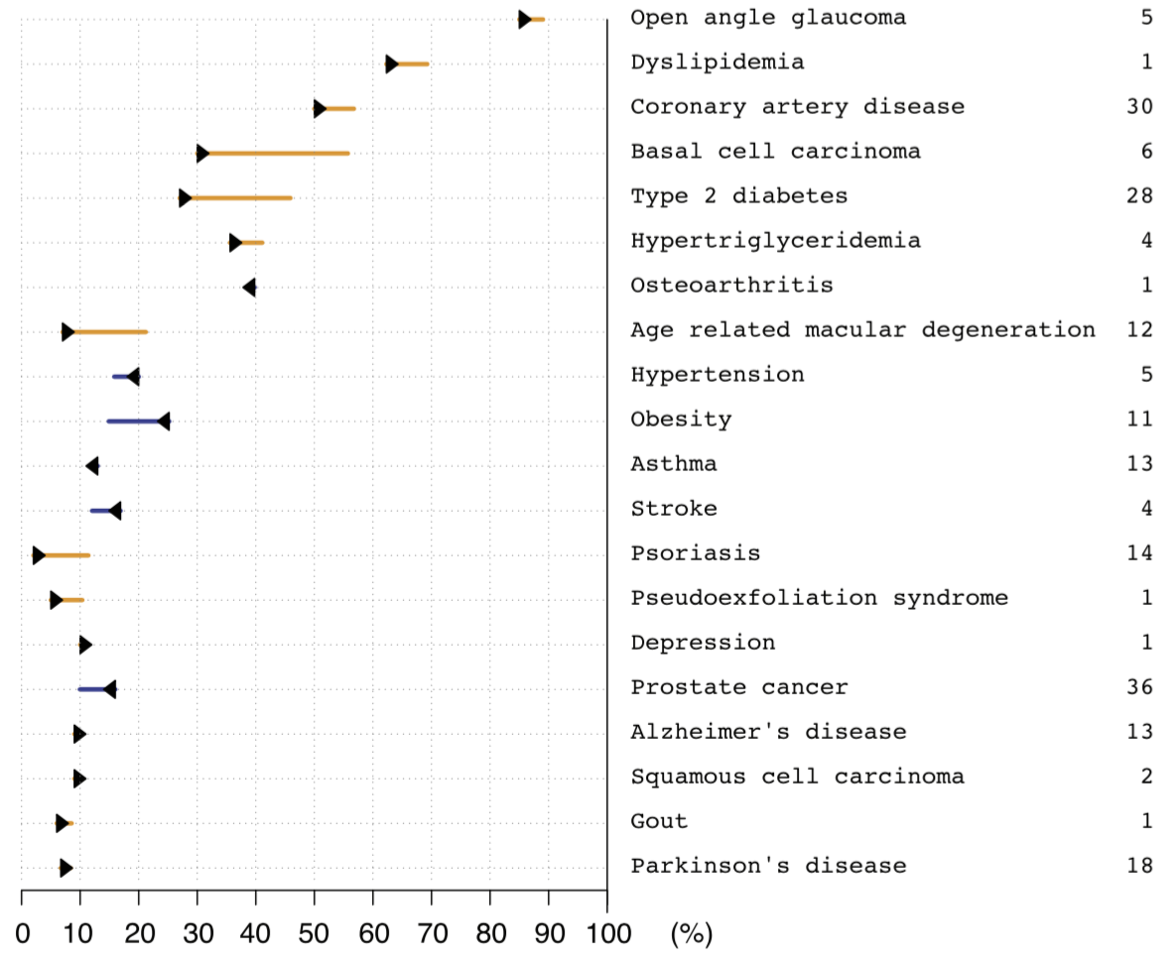
Prioritizing variants
Using existing databases of population level genetic variation, rare and disease associated variants could be identified.
This helped prioritize medical conditions for monitoring (e.g. glucose for diabetes)
Chen et al. Cell 2012

Slide 9
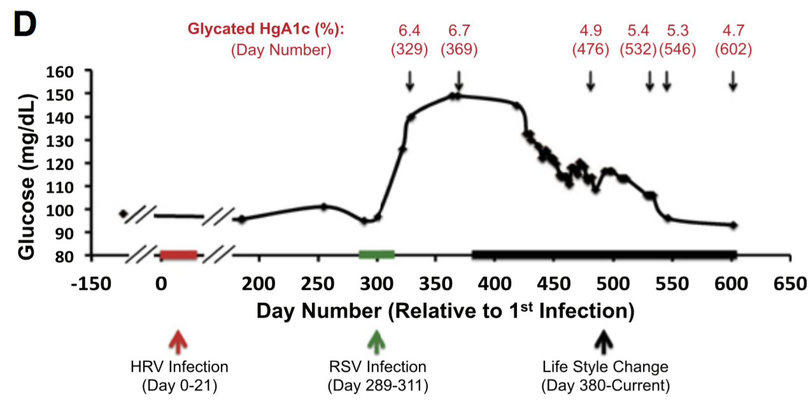
Longitudinal medical data
Measurement of blood glucose levels over time revealed significant increase after RSV infection.
Lifestyle change helped reduce glucose levels.
Chen et al. Cell 2012

Slide 10
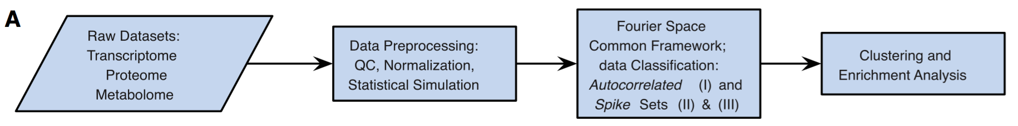
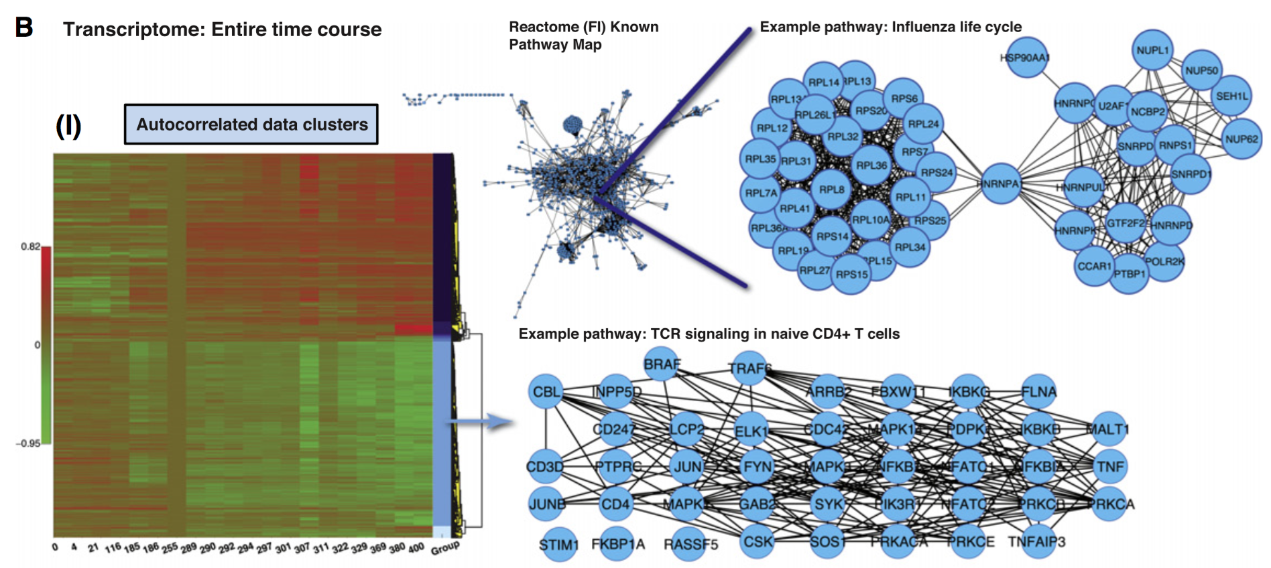
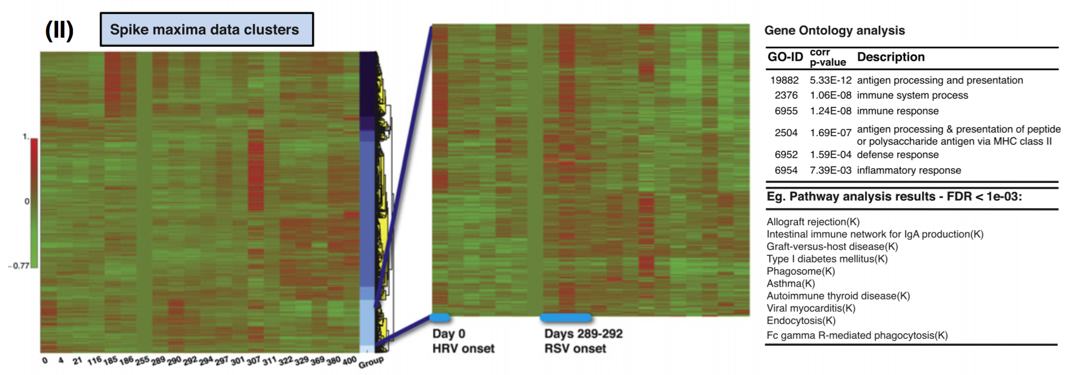
Transcriptomic time course
Transcriptomic time course data enabled studying expression dynamics before, during, and after viral infection.
  Clustering, pathway analysis, and Gene Ontology term enrichment help identify key cellular processes undergoing change.
Chen et al. Cell 2012

Slide 11
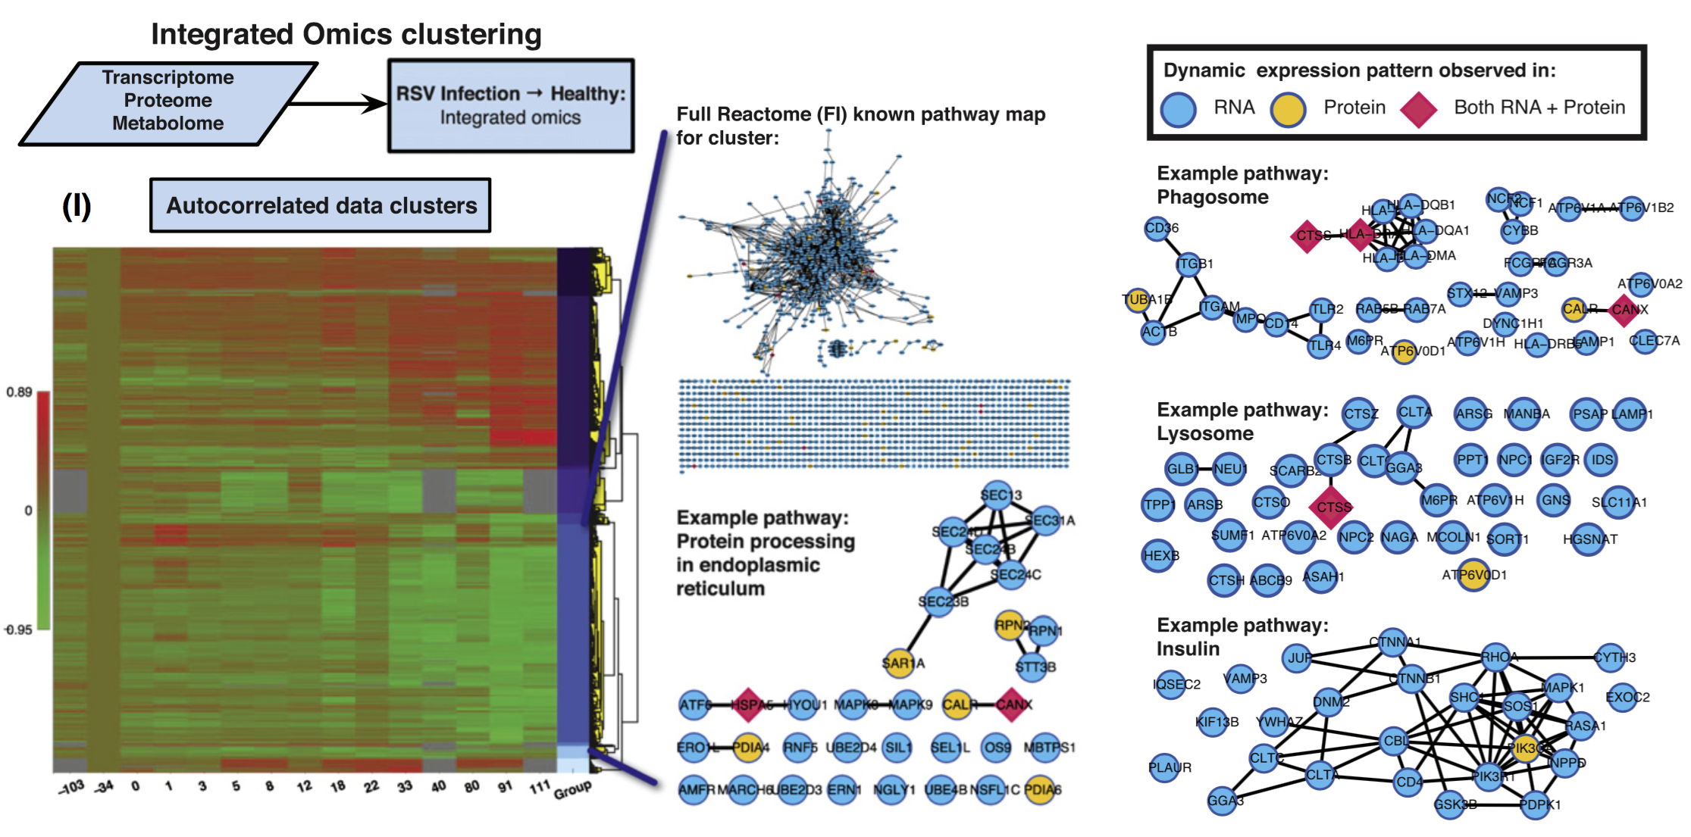
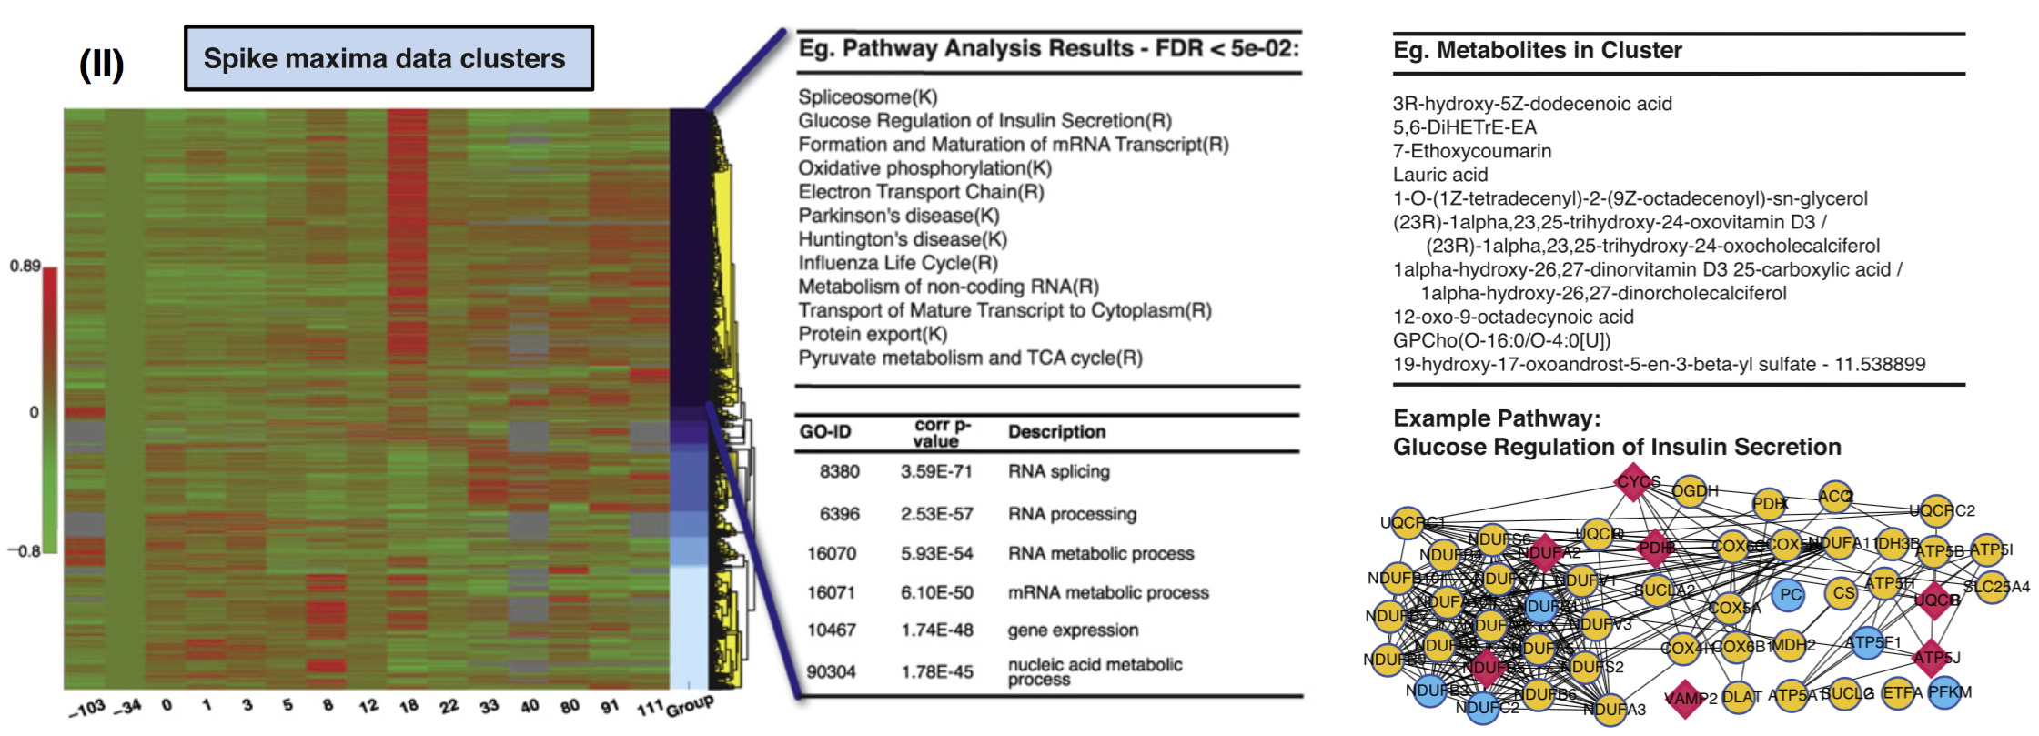
Integration of multiple omics datasets
  Integration of proteomic and metabolomics data helps refine and expand on the results of the transcriptomic analysis.
Chen et al. Cell 2012

Slide 12
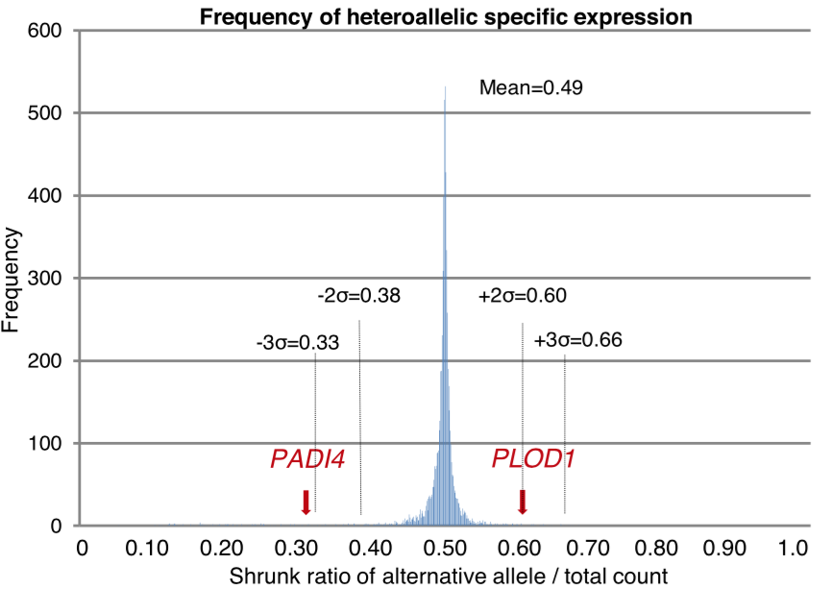
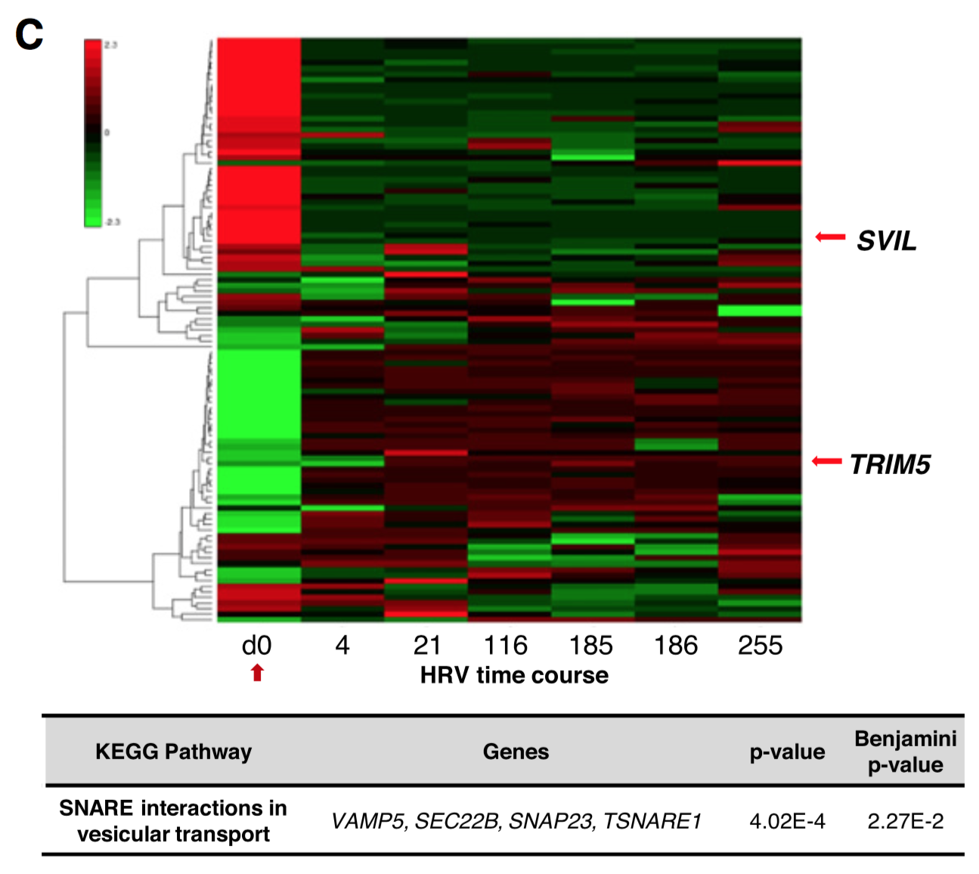
Allele specific expression
  The combination of transcriptomic data and a personal diploid genome also enabled the identification of allele specific expression patterns.
  Changes in response to infection were observed for genes involved in immune function.
Chen et al. Cell 2012

Slide 13
Conclusion: integrated personal omics profile
Detailed phenotypic and multi omic data collection provides additional insight into a personal genome.
Time course data enables the study of dynamic changes in response to environmental conditions.
Together these data help guide preventative medical monitoring and treatment.
Expansion to additional patients will improve our understanding of the transitions between healthy and disease states.

Slide 14
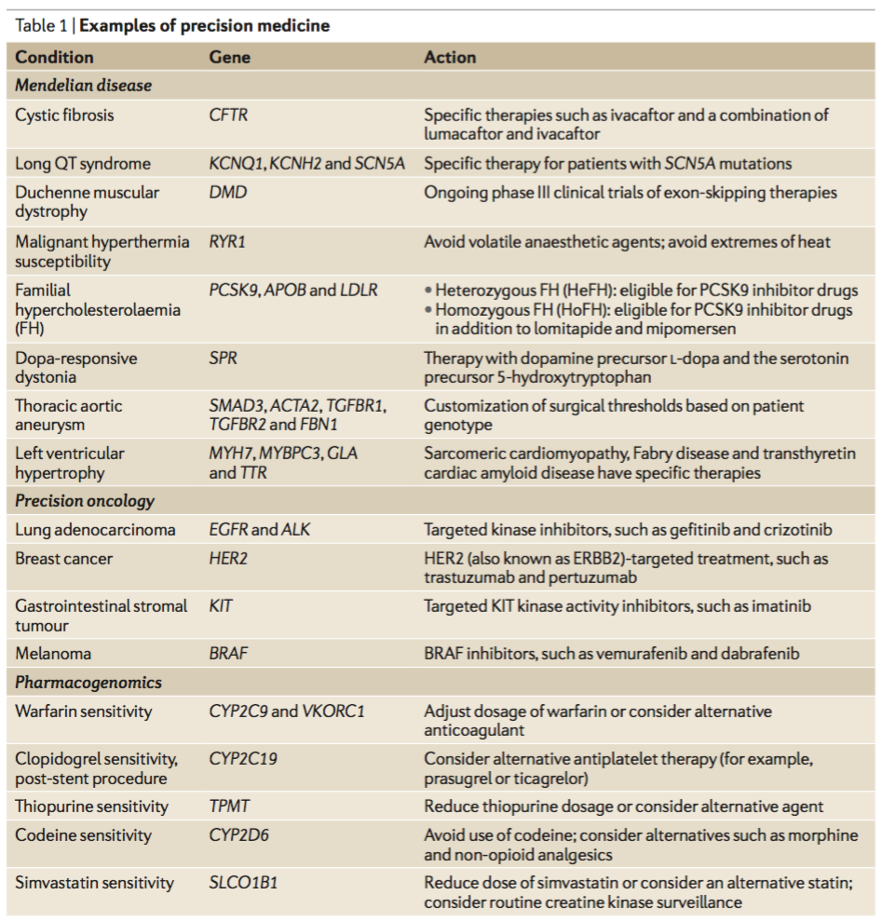
Precision medicine in the clinic
Increasingly genomic information is playing a role in the clinic.
  Targeted therapeutics
  Pharmacogenomics informing treatment options based on patient drug sensitivity.
Ashley. Nat. Rev. Genetics 2016

Slide 15
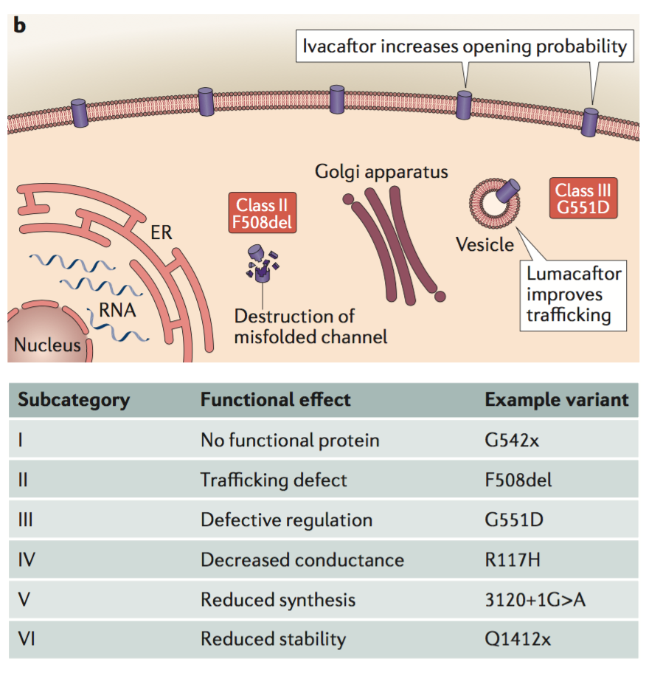
Example: cystic fibrosis
The type of mutation in the CFTR gene informs treatment options.
Patients with a G551D mutation receive Ivacaftor.
Patients with F508del might take both Lumacaftor and Ivacaftor.
Ashley. Nat. Rev. Genetics 2016

Slide 16
Clinical considerations for genomic medicine
Analysis of the Zimmer and Snyder genomes were done for journalistic and research purposes. If we want to implement genomic medicine in the clinic a number of additional considerations must be taken into account.
High quality genome coverage is of paramount importance.
  The risk of false positive or false negative genomic variants could adversely impact patients by improperly changing therapeutic strategies.

Slide 17
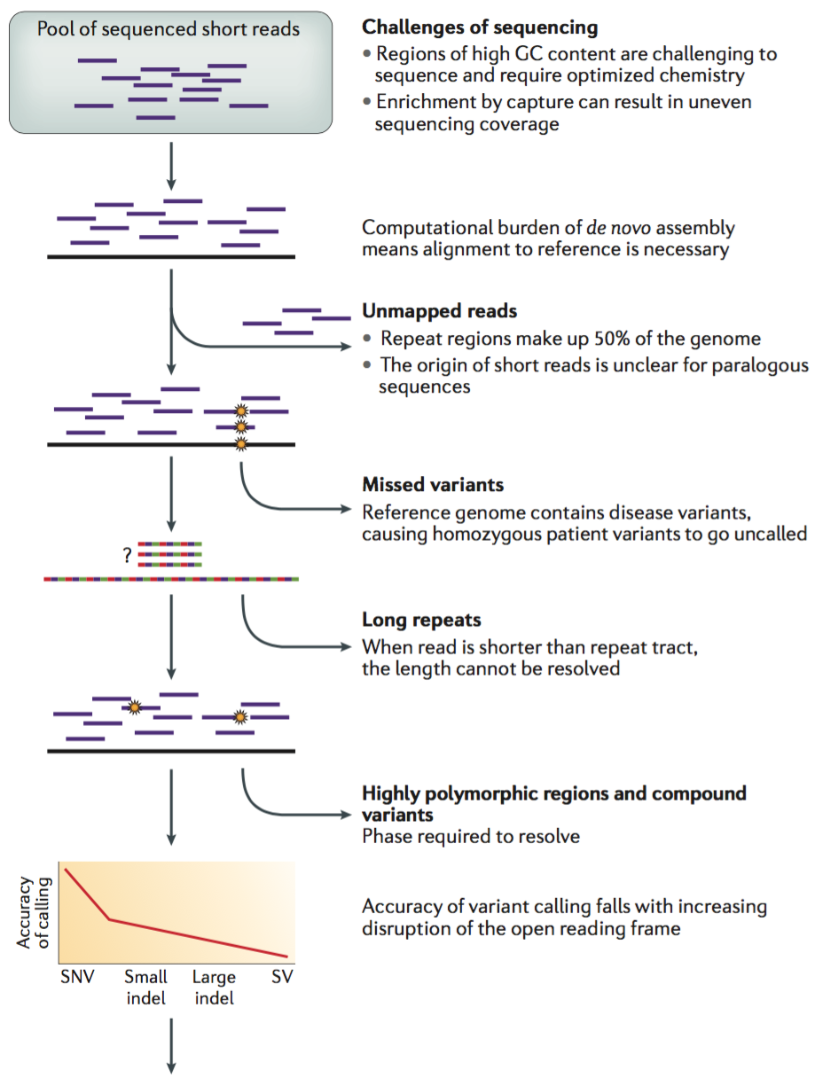
  Challenges in assembly of clinical-grade genome sequences
Difficult to sequence or map regions of the genome lead to approximately 5% of reads not mapping to the genome. These regions include:
      High GC content
      Repeats
      Paralogous regions (gene families, pseudogenes)
Ashley. Nat. Rev. Genetics 2016

Slide 18
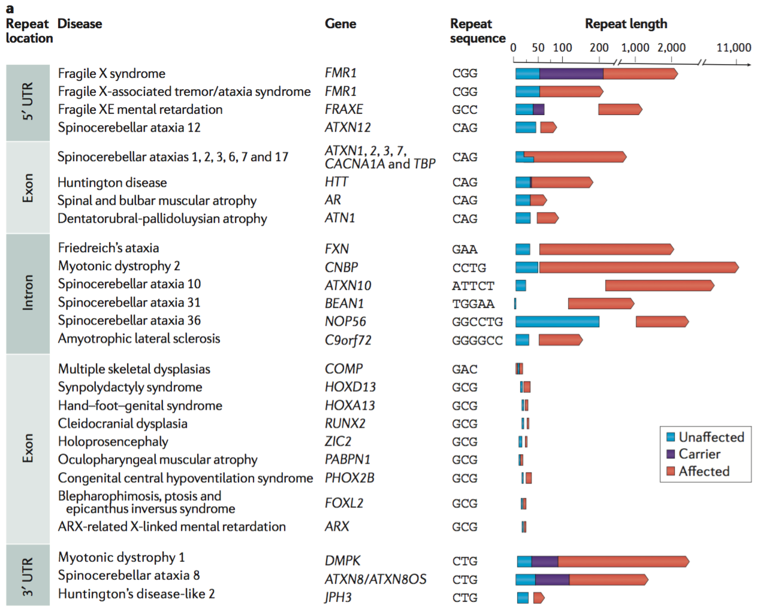
Difficulty with short repeat regions
Repeat regions are both difficult to sequence and medically relevant.
Longer stretches of repeats underlie a number of diseases
  e.g. Huntington’s disease
Ashley. Nat. Rev. Genetics 2016

Slide 19
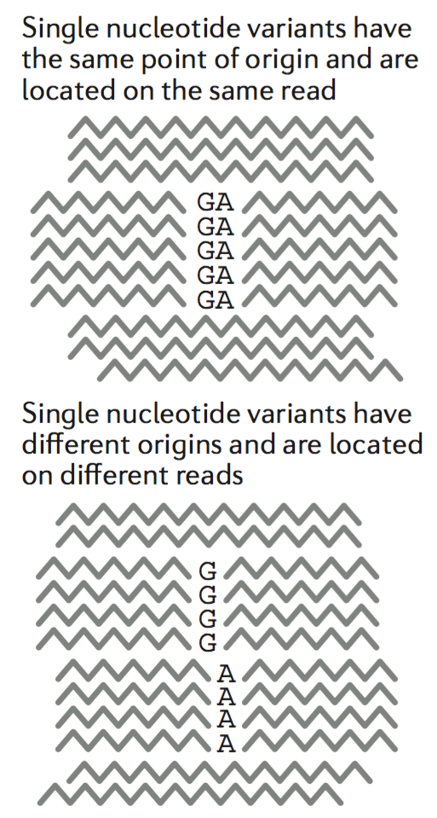
Diploid genomes and compound variant phasing
    If a gene contains multiple variants that aren’t spanned by a single read it is hard to determine if there are two singly mutated alleles or one variant allele with two mutations and one wildtype copy.
    A diploid personal genome would help resolve variant phasing.
Ashley Nat. Rev. Genetics 2016

Slide 20
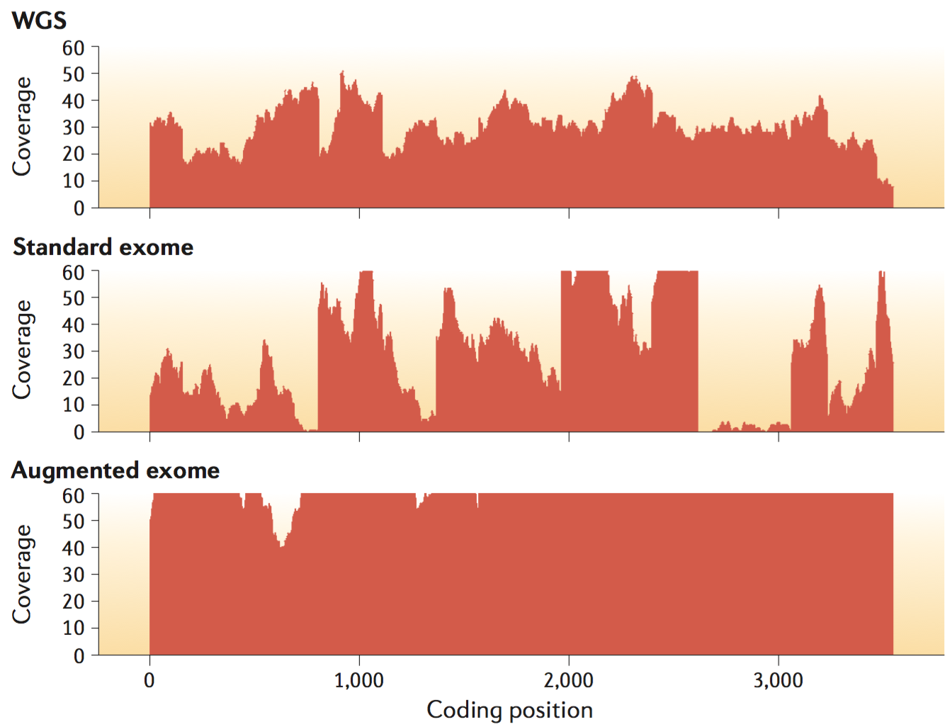
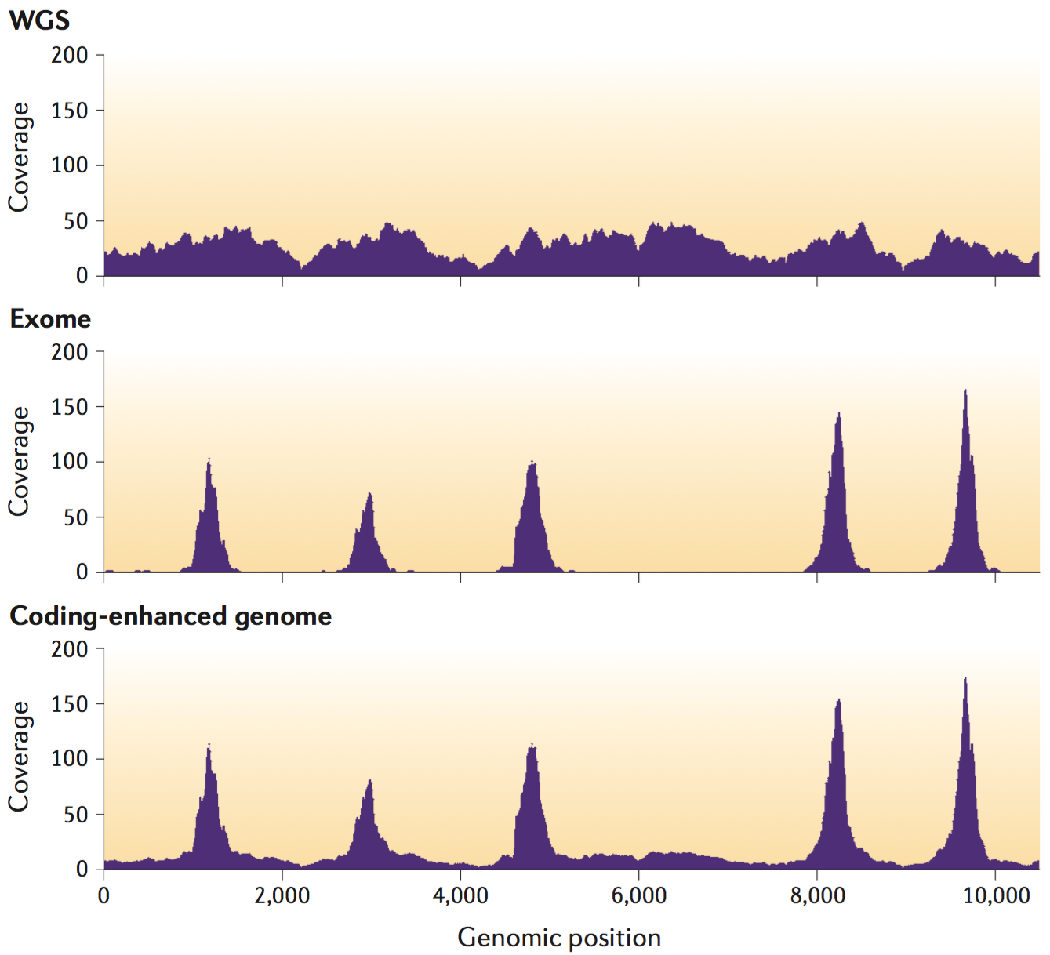
Exome sequencing vs. whole genome sequencing
Tradeoff between depth and breadth of sequencing at a given cost constraint.
  Augmented exome sequencing enables higher depth sequencing of coding regions than WGS.
  WGS provides more uniform coverage and also includes regulatory regions or unknown coding regions of relevance.
Ashley. Nat. Rev. Genetics 2016

Slide 21
Conclusion: precision medicine in the clinic
Precision medicine is leading to better defining and treating disease at the molecular level.
It is both changing the prescription of existing medications and inspiring new targeted therapies.
However, to bring the benefits of genomics into the clinic, precision medicine requires high quality patient genome sequences be obtained at reasonable cost.

