Slide 1
1. SV pipeline
Other issues:
1. RG got lost!
2. Large temp space
3. Sorting too slow
4. Battenberg dependencies
~12 hr.
~2 hr.
BWA, samtools, Picard
BWA Map
Sort/index
Markdup.
Discordant RPs
~12 hr.
Lumpy
RocksDB from FB
SVs
sort -n
SR
RG is lost
BAM
Read pairs
SVTyper
Simple bash script
SLOW!
SLOW!
Battenberg
BAM
~30 hr.
SNV
Alternative: filter SNV based
on CNV from array
SVScorer
CNV
WGSPhylo
~12 hr.

Slide 2
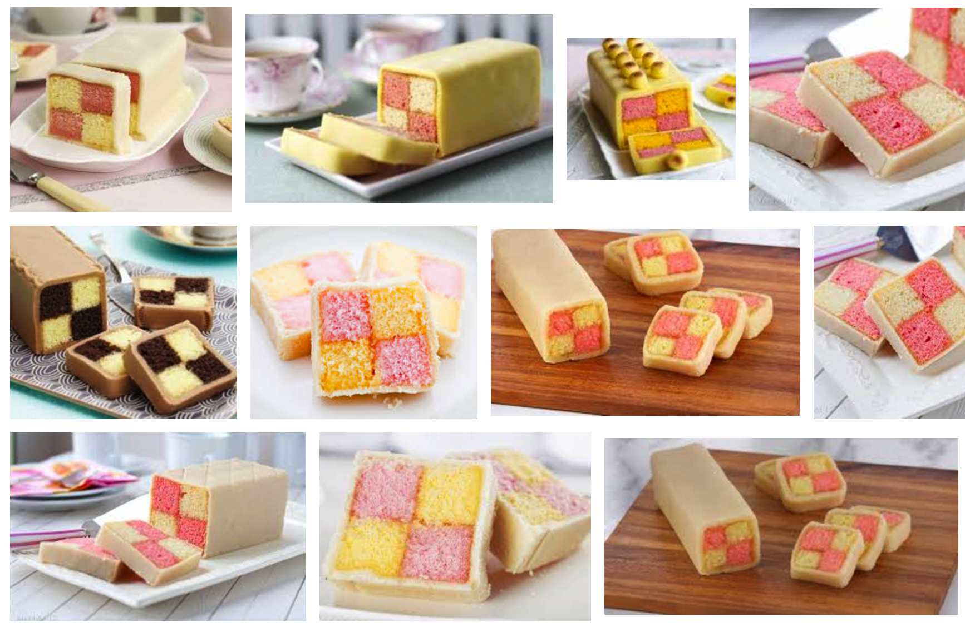
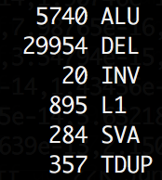
Alternatives to Battenberg
1. Filter SNVs out of CNV regions
segment files with log(T/N) > 0.3/< -0.3
2. Filter SNVs out of K1G SV regions
(maybe I should only consider DEL/DUP)
We probably lost one sample, with
extremely low SNV counts and many SVs

Slide 3
1. SV pipeline
CNVnator
RD
Delly2
Lumpy
BWA, samtools, Picard
Hydra?
Discordant RPs
SVs
BAM
BAM
SR
Read pairs
SVTyper
Battenberg
SNV
CNV
SVScorer
WGSPhylo

Slide 4
1. SV pipeline
WUSTL: Speedseq
CNVnator
RD
Lumpy
Discordant RPs
SVs
BAM
BAM
SR
Read pairs
SVTyper
Battenberg
SNV
CNV
SVScorer
WGSPhylo

Slide 5
1.2. SV pipelines
LUMPY discovers bkpt w/ prob. distribution
  PR, SR; DP optional (CNVnator on T/N pairs?)
SVTyper genotypes samples (shaky)
SVScore evaluates SVs
  Bkpt. score: CADD, prob. distribution normalized
  Spanning score: engulfing score….

Slide 6
1.2. SV pipelines
Pre-filtering
SVTyper
Post-filtering
1KGP3 SV
Tumor: 1/0 or 1/1
&& Normal: 0/0
Lumpy Discovery

Slide 7
SV results
36 samples: <500 (avg. 364)
One outlier with >1,000….problems with GT
100: 576(4.4%)
90% 95% 98%
22.58 38.80 45.50

Slide 8
2. NEAT1
Aim: reviewers wants more analyses on NEAT1
  Hotspots in NEAT1
  Associated with high exp. & survival
Results:
  NEAT1 exp. not correlate with survival in pRCC but in ccRCC
  NEAT1 co-exp. with MALAT1 in pRCC & ccRCC

Slide 9
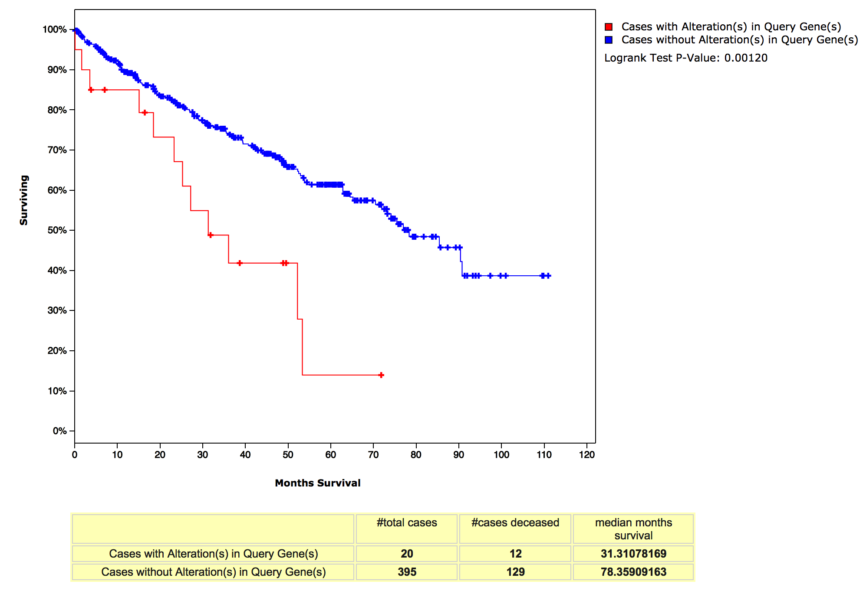
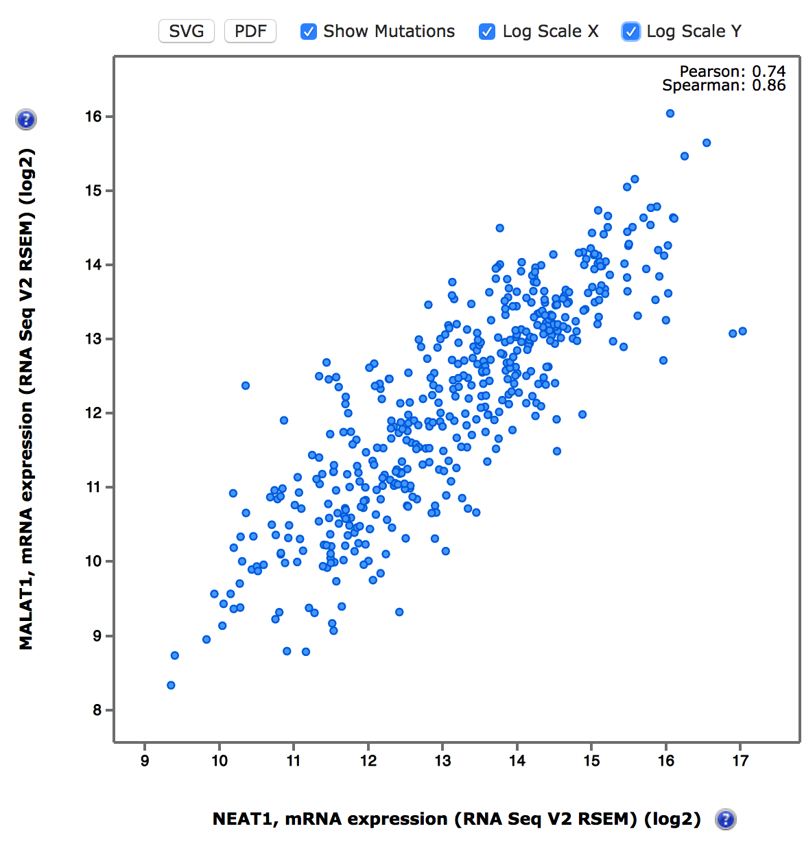
NEAT1 in ccRCC
6.6% (31/469) overexpression (z-score>2)
Rank 1(Pearson’s) or 4(Spearman’s)
out of all genes

Slide 10
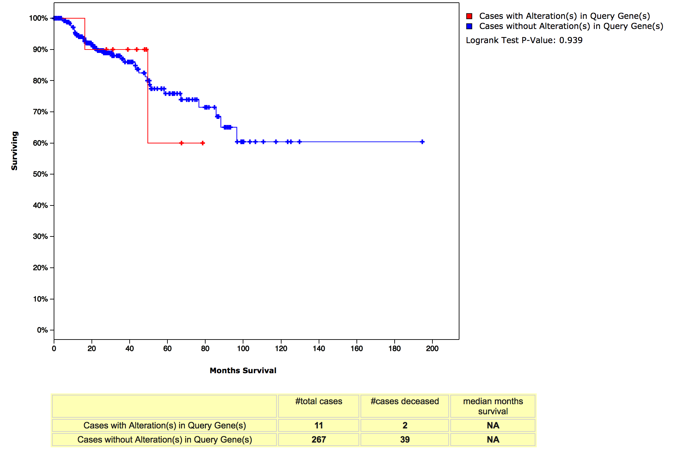
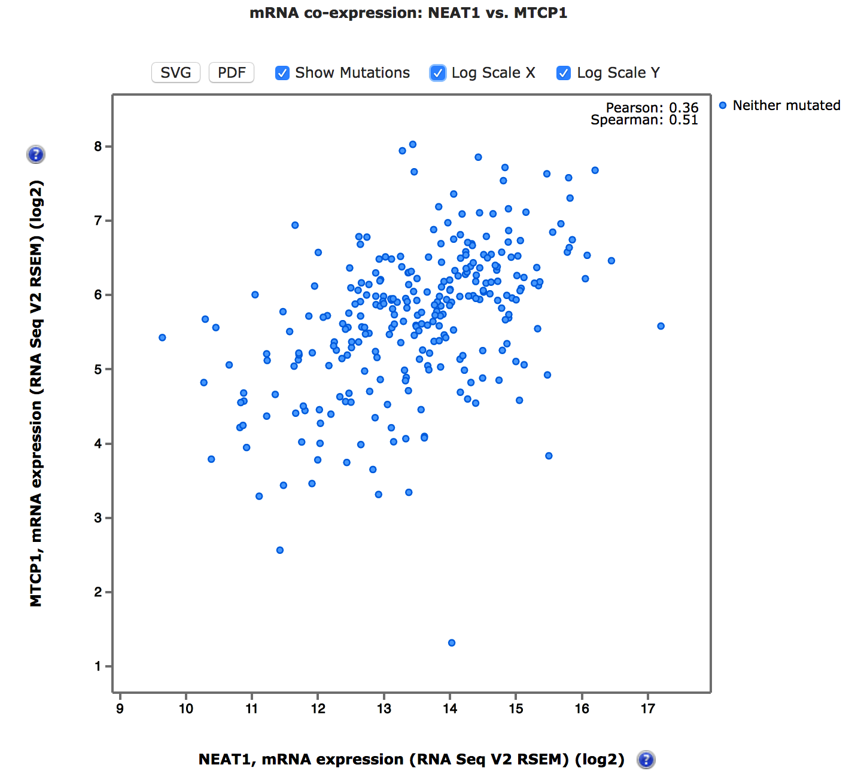
Not in pRCC
Rank 1(Pearson’s) or 3(Spearman’s)
out of all genes

Slide 11
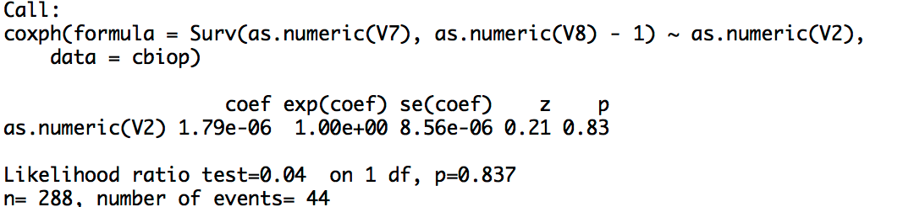
Cox regression on continuous…

Slide 12
3. Methylation: [C>T]G
Two problems:
  [C>T]G directly results from methylation
  More [C>T]G has functional impact
Two comparisons:
  [C>T]G versus other mutations
  [C>T]G between two methylation groups

Slide 13
[C>T]G directly results from methylation
[C>T]G not enriched around hypermethylated probes ☹ [done last summer…]
Probes around [C>T]G not hypermethylated probes ☹
[C>T]G enriched in CpG island (OR=1.22) but p=0.14
Hypermethylation Group
Lower methylation Group

Slide 14
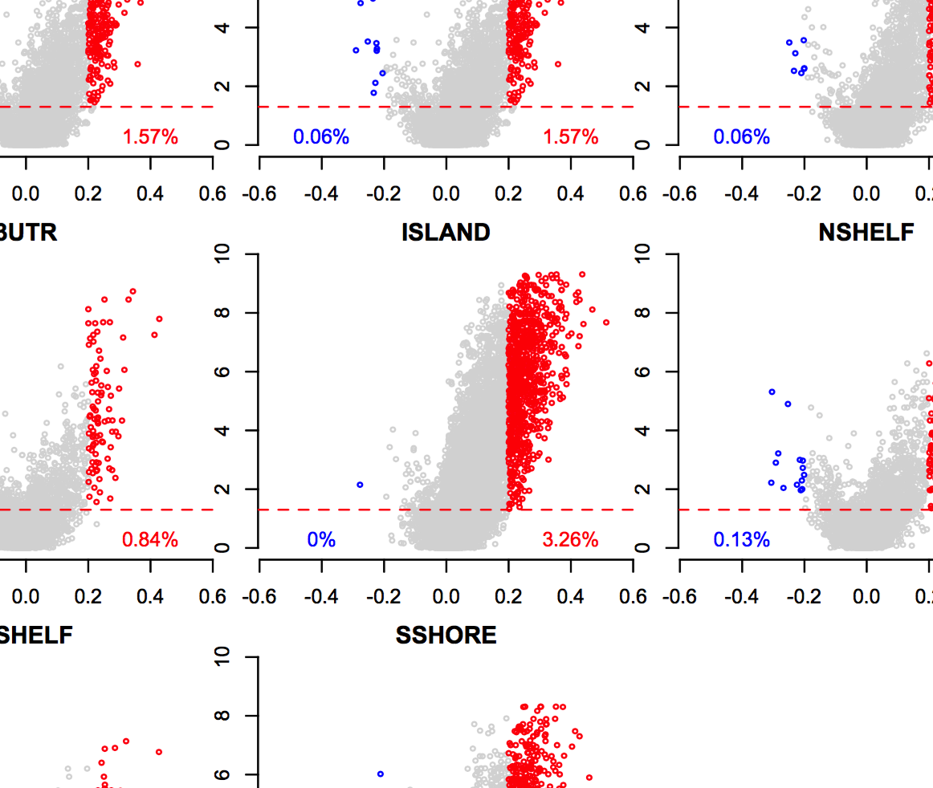
Why CpGIs
CpGIs are usually unmethylated
Hypermethylation happens mostly in CpGIs. The extreme group, is CIMP
We show hyper-
methylation is
largely driven by CpGIs
(OR=1.29, p<0.0001)

Slide 15
3. Methylation: [C>T]G
Enriched in coding regions (OR=1.54, p=0.0001) but not in non-coding
  [C>T]G between two methylation groups
  [C>T]G versus other mutations

