Slide 1
Tumor evolution as integrative systems Biology: Understanding Tumor Progression, Aggressiveness and Fitness
LS - Gpmtg 1/25/17

Slide 2
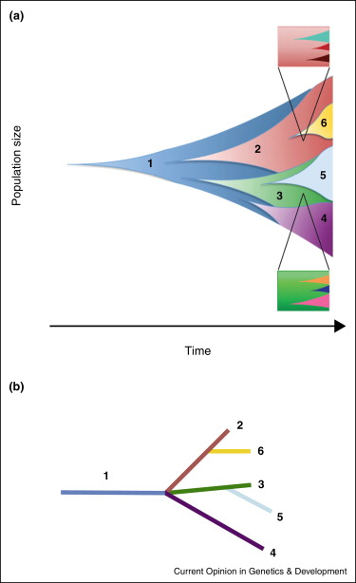
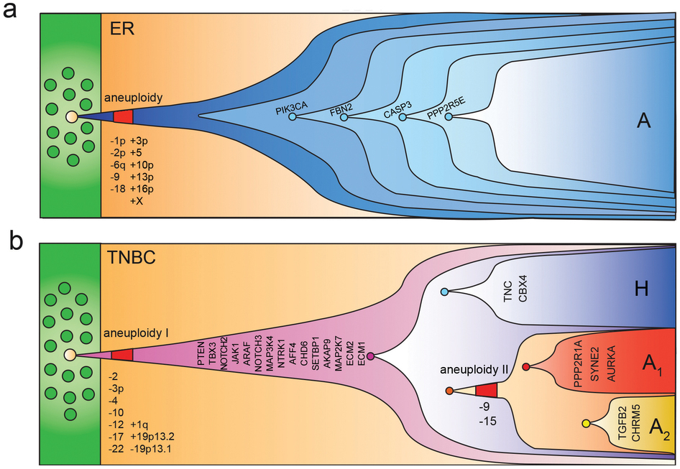
Tumor Evolution with Subclones
Wang et al, 2014
Barber et al, 2015

Slide 3
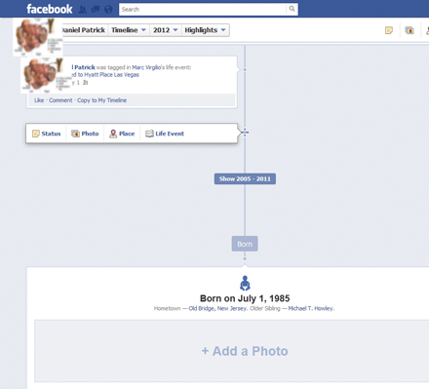
Tumor Evolution with Subclones
Wang et al, 2014
My first subclone!!
A PIK3CA mutation
TP53 mutation
Barber et al, 2015

Slide 4
Tumor evolution as as integrative systems Biology: Questions that I am interested
Is there a set of genes defining an expressional profile that explains the tumor’s aggressiveness?
How does selection formalize tumor progression (Replication rate, coevolution with immune system, escape mutations etc)
Does Subclone Architecture matter for tumor development?
Can we estimate Subclone fitness with respect to subclone architecture?
Can we identify fitness and escape mutations?
Combine these to an integrative biology system

Slide 5
Evaluation of Gene expression profiles with regards to somatic evolution

Slide 6
Pipeline - Methodology
Quantile normalization across patients
Regress each gene (and each cancer separately) to identify correlation between gene expression and clinical information
Select top X (x=1000) genes or genes with R² > Y (y=0.5)
Test for critical profile convergence
Scale and center for PCA
Perform Principal Component Regression with cross validation
to identify whether critical landscapes converge

Slide 7
Individual Gene function

Slide 8
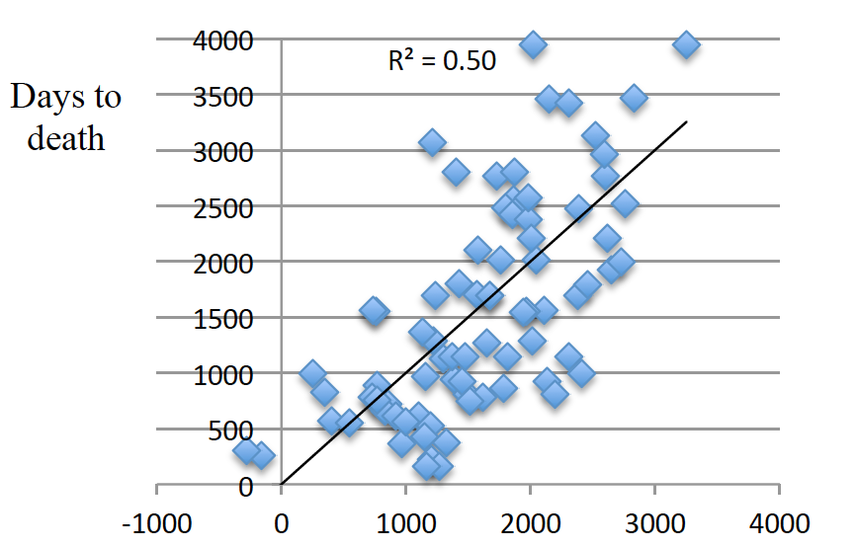
Previously on Breast Cancer from TCGA
Prediction of DtD

Slide 9
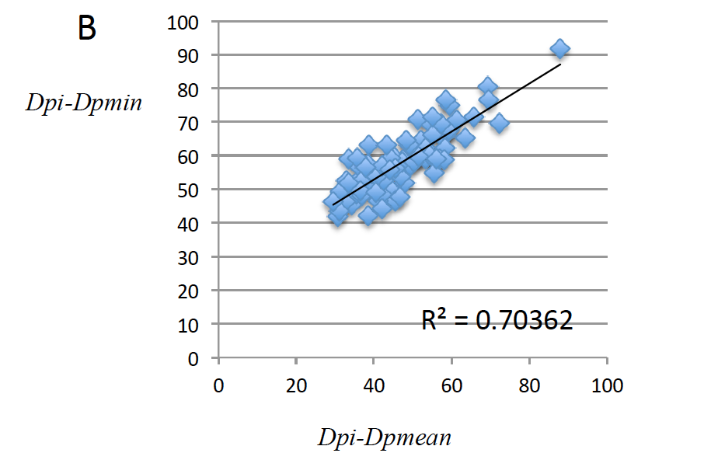
Previously on Breast Cancer

Slide 10
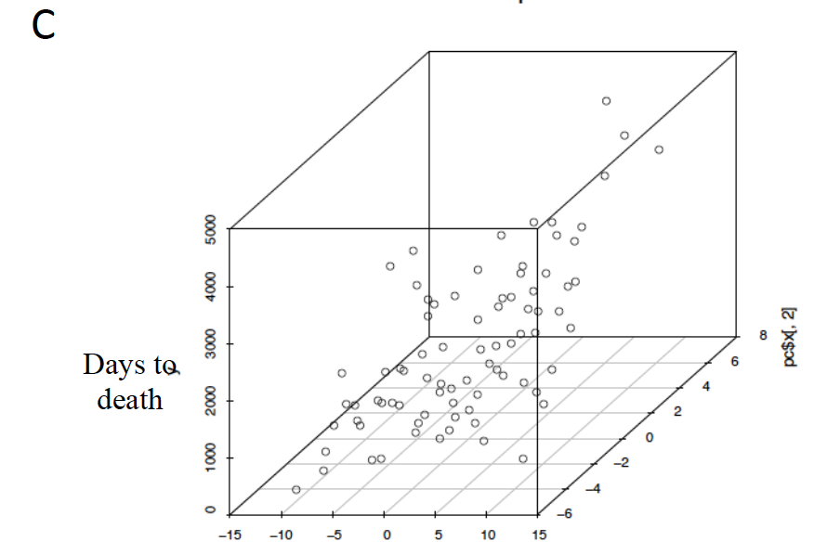

Slide 11
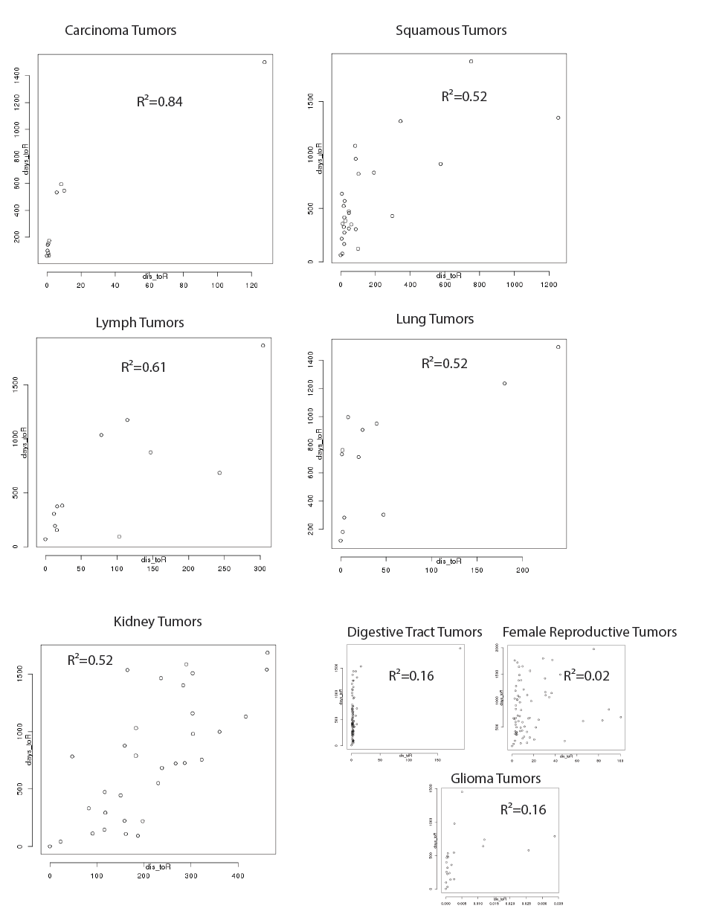
Converging expressional profiles in PCAWG
Notes:
For each gene, we have performed linear regression between gene expression and number of days to death since sample collection. Then we selected the top 100 genes with highest Pearson values and estimated the geometric distance in R¹⁰⁰ for each expressional profile compared to the most aggressive profile (least days to death since sample collection).
The correlation between the estimated geometric R¹⁰⁰ distance for each expressional profile and the days to death (representing profile aggressiveness) is depicted across different tumors.
Carcinoma, Squamous, Lymph, Lung and Kidney Tumors show high correlation denoting the existence of critical expressional profiles
Similar analysis (not shown here) has been performed showing the predictive values for profile aggressiveness based on each patient’s expressional profile

Slide 12
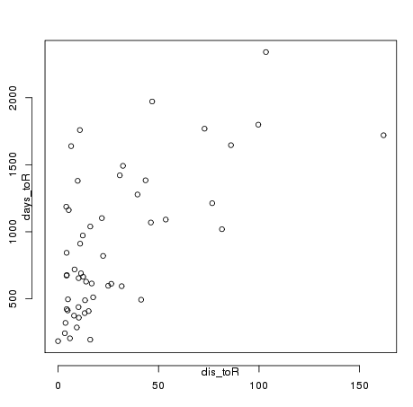
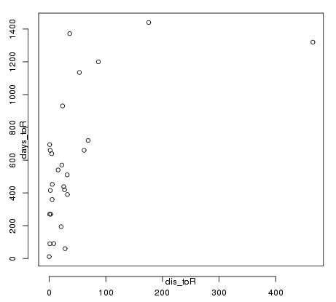
Converging expressional profiles
Ovary- AdenoCA R²=0.41
Liver R²=0.39
Notes:
For each gene, we have performed linear regression between gene expression and number of days to death since sample collection. Then we selected the top 100 genes with highest Pearson values and estimated the geometric distance in R¹⁰⁰ for each expressional profile compared to the most aggressive profile (least days to death since sample collection).
The correlation between the estimated geometric R¹⁰⁰ distance for each expressional profile and the days to death (representing profile aggressiveness) is depicted across different tumors.
Carcinoma, Squamous, Lymph, Lung and Kidney Tumors show high correlation denoting the existence of critical expressional profiles
Similar analysis (not shown here) has been performed showing the predictive values for profile aggressiveness based on each patient’s expressional profile

Slide 13
For different number of Genes
R²
Number of genes used for expressional profile
Notes:
For each gene, we have performed linear regression between gene expression and number of days to death since sample collection. Then we selected the top 100 genes with highest Pearson values and estimated the geometric distance in R¹⁰⁰ for each expressional profile compared to the most aggressive profile (least days to death since sample collection).
The correlation between the estimated geometric R¹⁰⁰ distance for each expressional profile and the days to death (representing profile aggressiveness) is depicted across different tumors.
Carcinoma, Squamous, Lymph, Lung and Kidney Tumors show high correlation denoting the existence of critical expressional profiles
Similar analysis (not shown here) has been performed showing the predictive values for profile aggressiveness based on each patient’s expressional profile

Slide 14
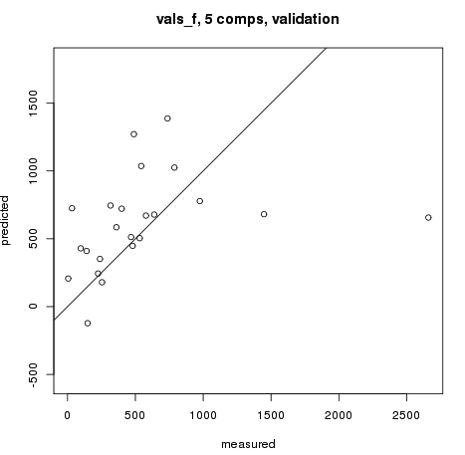
Same for meta-cohort: Some have higher predictability
Glioma 5 pr.cmp.
Predicted
Measured
gencode::MTND5P31::tc_ENSG00000227841.1 0.8190408 + 192.6832 186409.6 y~poly(x,1)
mitranscriptome::G011508::tc_G011508 0.8164425 + 192.0778 146289.5 y~poly(x,1)
gencode::RN7SL71P::tc_ENSG00000264205.1 0.805809 + 258.4896 7980.01 y~poly(x,1)
gencode::RP11-3N2.8::tc_ENSG00000227035.1 0.8035907 + 318.9328 81400.62 y~poly(x,1)
gencode::snoU13::tc_ENSG00000238940.1 0.7947177 + 386.5101 9677.986 y~poly(x,1)

Slide 15
Frequency variations in E miner
Are driver genes selected?

Slide 16
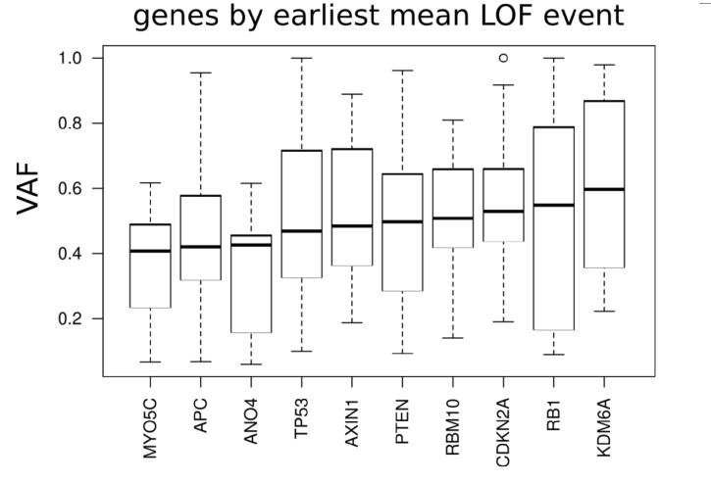
Are cancer mutations born equal?
Courtesy of Patrick

Slide 17
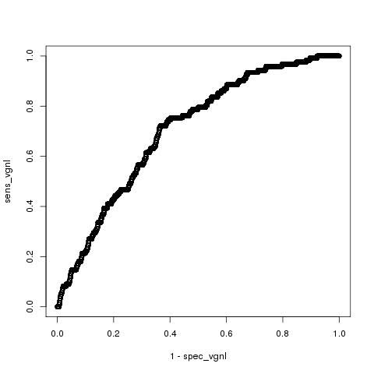
We are very confident that driver genes get higher variant allele frequency
Vogelstein's 125 driver genes
"sens" = sensitivity
"spec"=specificity
"vg" = for finding vogelstein's 125 driver genes
"nl" = "no laplace"

Slide 18
Magic Bins Pipeline
VAF for each patient
Subclonal or Frequency Bin Assignement
Modules
Gene Regions
Funseq score
Aloft Score
Signatures
Evaluate differences between Subclones, patients, cancers

Slide 19
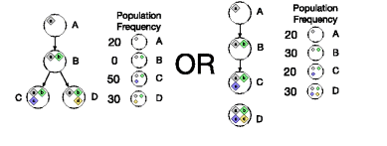
Magic Bins
Mutations of High vs Low Frequency
Divide mutations into 3 groups based on Frequency
Compare Group 1 (Highest Freq) to Group 2 (Lowest Frequency)
Mutations of Early vs Late Clones
Parse the clonal tree
Compare Parent to Children mutations
A vs (C & D)
A vs D

Slide 20
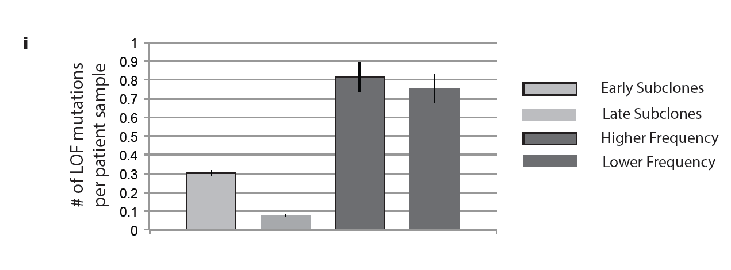
LOF mutations are enriched in early subclones and bins with higher frequency mutations
Notes:
LOF mutations are not just functional impact mutations. It’s gene loss mutations.
A Pancancer LOF mutation shows enrichment in early/dominant Subclones
Similarly there is enrichment in bins with higher frequency

Slide 21
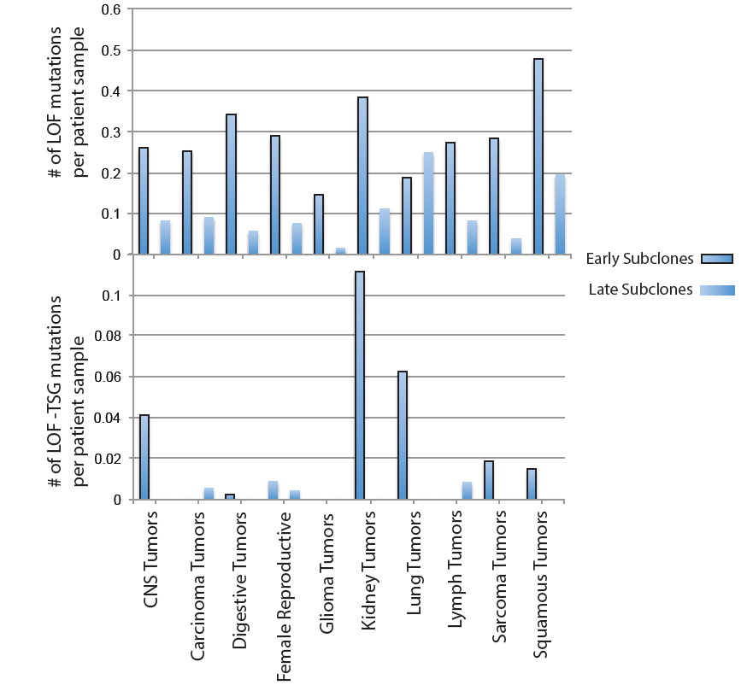
Average number of LOF mutations in early vs late Subclones
Notes:
Relative prevalence of LOF mutations across different meta-cohort tumor types
We expect: a) either higher fitness for each cell and therefore in higher prevalence or b) lower fitness and lower prevalence
Tumor Suppressor gene LOF should -by definition- provide a higher fitness for tumor cells and therefore exist in higher than expected prevalence

Slide 22
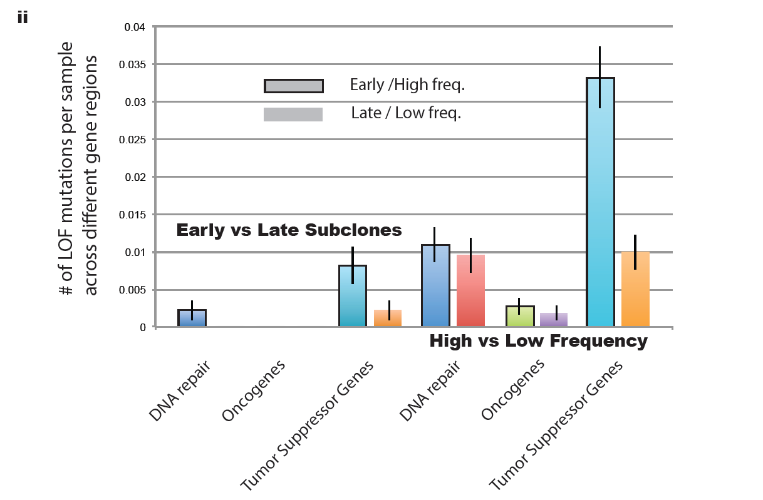
Notes:
in i) early vs late subclones and ii) High vs Low frequency analysis, as expected:
TSG are enriched in early subclones and high frequency bins
Oncogenes are depleted in all categoriies

Slide 23
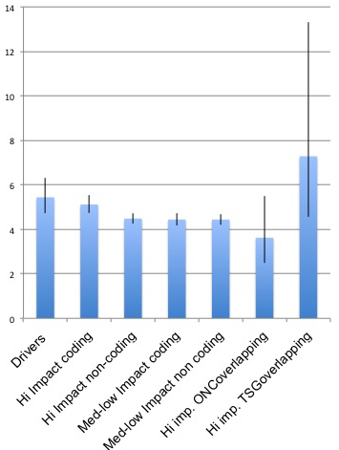
Subclonal Functional Enrichment

Slide 24
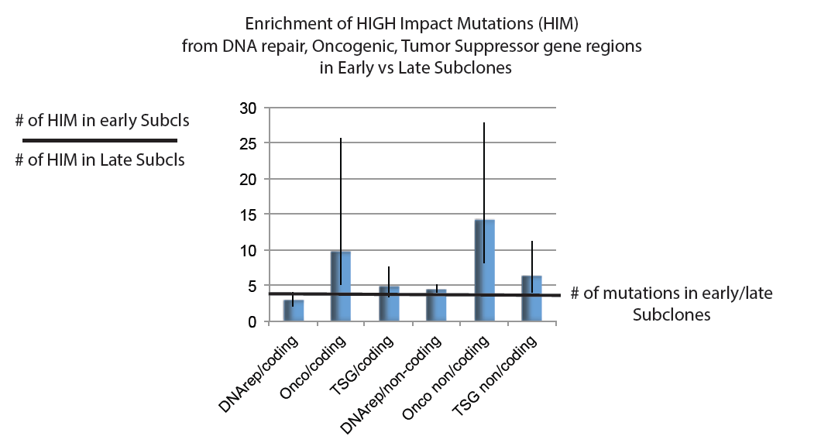

Slide 25
Signature Changes

Slide 26
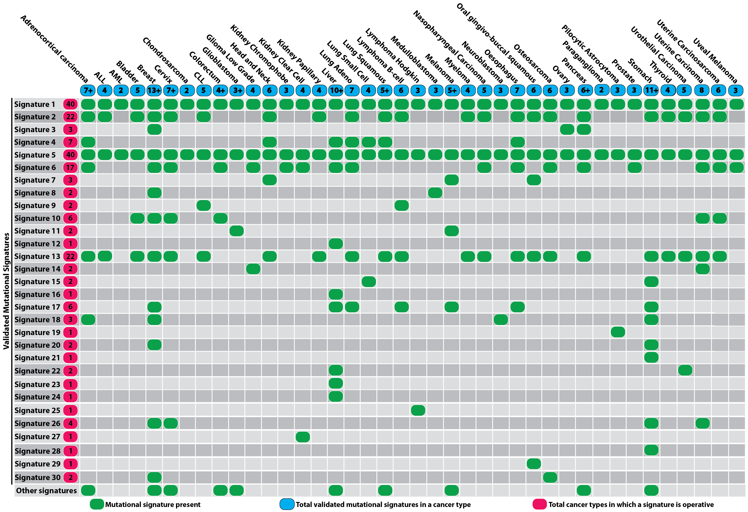
Part I: Signatures between groups

Slide 27
Signature probabilities

Slide 28
Solving a regression problem with constraints
Solve with Quadratic programming where A>=0, B=0 AND A1+A2+…A30=1

Slide 29
With package QuadProg in R
Patient 007aab66-2f07-459d-8952-3041d6ea24a8_sigs
Clone 2
Clone 1

Slide 30
Basically compare any two groups of mutations A vs B
Deconvolute both groups as a mix of 30 signatures
Regress the mutational probabilities of group B into group’s A signatures (obtain R and p values)
Measure the change in entropy for signature prevalence

Slide 31
Quantitative Changes in Signature proportion in Early vs Late Subclones
Change in Signature Entropy ~ δSΕ = |SE_{Early}| - |SE_{Late}|)
Notes:
Values of change in entropy closer to 1 signify higher Entropy in early signatures (Fewer of higher prevalence). Negative values signify higher entropy for late signatures .Closer to 0 Signify no change in signature proportions.
Female Reproductive, Lymph and CNS tumors show the most conservative nature, remaining mostly unchanged.
Sarcoma and Glioma show fewer and more dominant signatures in early/dominant subclones
Kidney, Lymph, Squamous and Digestive tumors show fewer signatures in later subclones

Slide 32
Pancancer Subclonal Signature comparison

Slide 33
Subclonal Signature comparison Across Cancer types
R²

Slide 34
Mutational impact on r (P. correlation) and δE Patient: 1f8d8720-30ca-4057-90f7-a34b8383eafe
Correlation:
Bin_{X} vs Bin_{X-1}
Mut Freq
Mut dE:
Bin_{X} vs Bin_{X-1}
Ordered mutations based on Mut Freq
T (now) <- T₀

Slide 35
Clonal Fitness

Slide 36
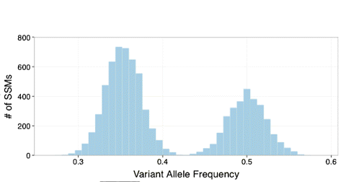
Calling Subclones

Slide 37
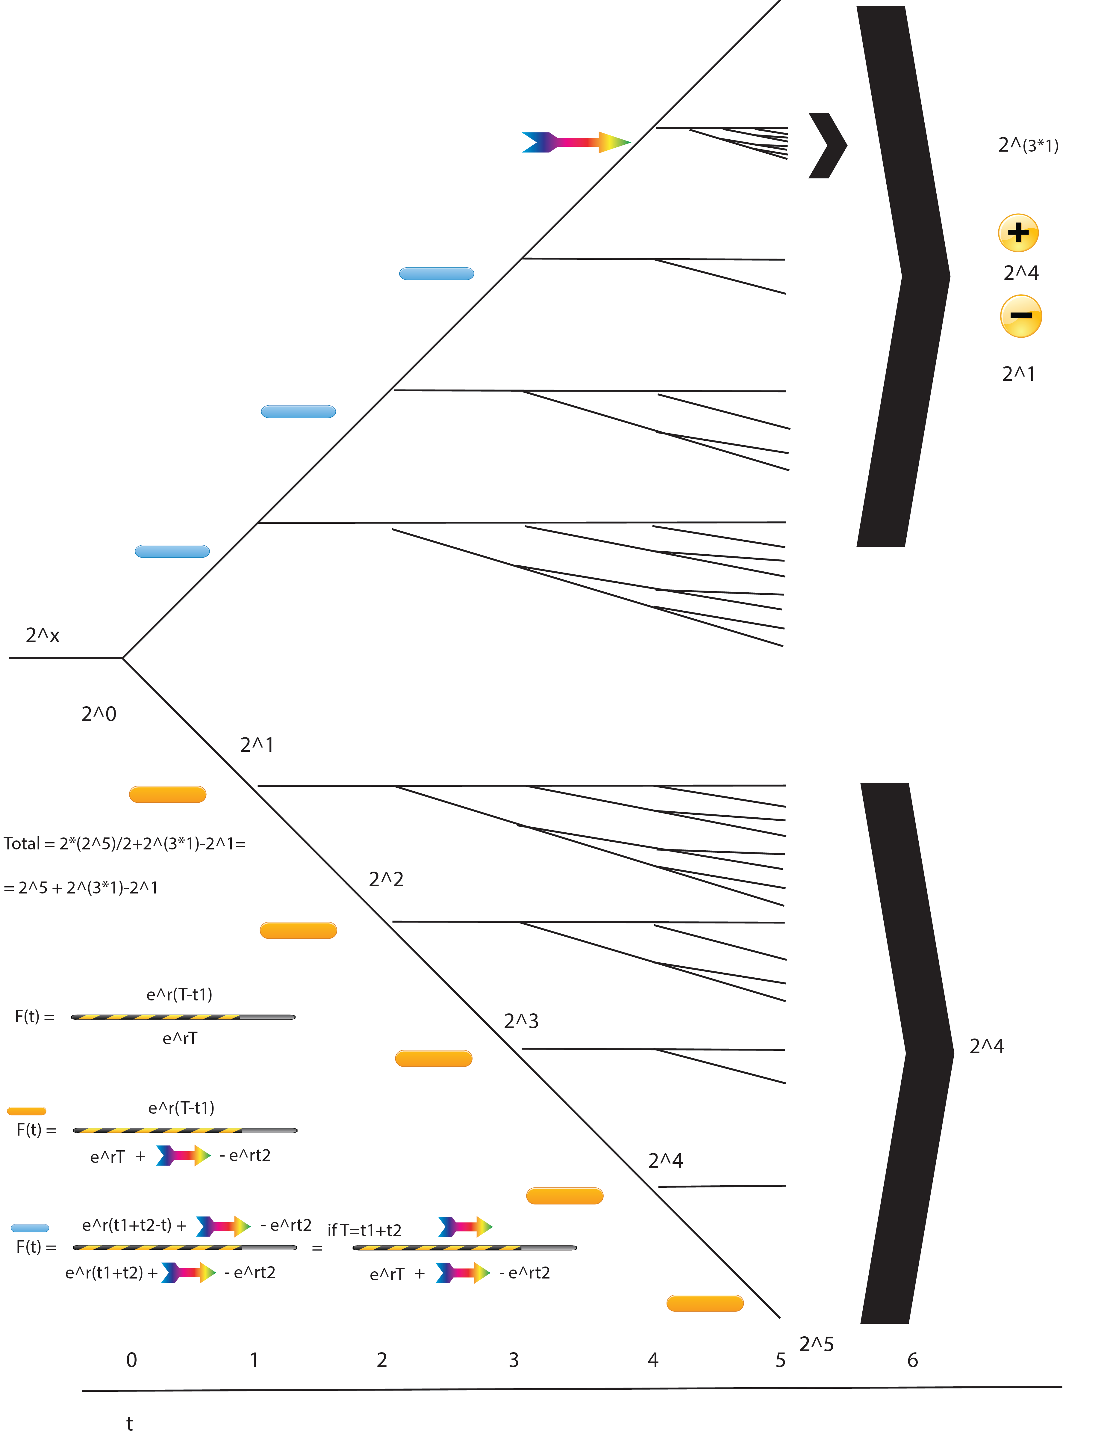
Identifying Variant allele frequency Fr(T) in a simple population growth model

Slide 38
Green mutations with lower Freq

Slide 39
T=t1+t2, t1 the moment of driver mutation

Slide 40
Hitchhiked mutations with higher Freq

Slide 41
Calling Subclones
Early Hitchhiked Mutations with Fitness r
New Fitness Mutations (NFM)
with fitness K*r
0.6
0.4
0.2
Mutations with fitness r
Dominant or early Subclone

Slide 42
Sampling ‘r’ from hitchhiking freqs

Slide 43
Identifying the fitness mutation
Out of 1987 simulations
TPs:1983
FPs:850
TPrate(Sensitivity):0.998
FPrate(per simulation):0.572

Slide 44
Different ways of estimating fitness effect k
By calculating ‘r’ from hitchhike mutations
(total or local)
By optimizing the algorithm statistically to stop at best k
(So far the most stable to errors)
C) By sampling k from well optimized ‘r’s
(Bayesian approach, obtain ‘k’ probability)

Slide 45
Estimating K from simulations
By calculating ‘r’ from hitchhike mutations
By optimizing the algorithm statistically to stop at best k
(So far the most stable to errors)
C) By sampling k that for well optimized ‘r’s
(Bayesian approach, obtain ‘k’ probability)
(Should have used a Poisson distribution)

Slide 46
To do list
Required imminent action:
Estimate K for Pcawg subclones (in progress)
Identify fitness mutations within range
Identify factors that influence Critical expressional landscapes (PPI, TFs, Pho, Regulatory networks, In progress)
Potentially associate fitness effects with clinical data
Near action:
Use Integrative approach (Mutation –region/impact-, Signature change, network impact) to re(de)fine fitness mutations
Include and compare more models (linear, exponential, logistic)
Ultimate action
Model the coevolution between tumor progression and immune system

Slide 47
Thank you!
Mark
Will
The Variation team
Joel and Jing

