Slide 1
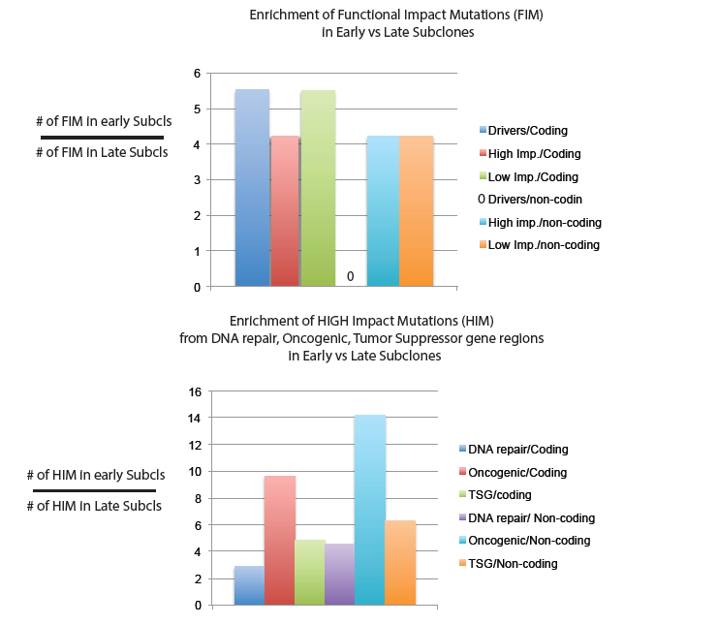
Enrichment of functional Impact mutations in Early vs Late Subclones
Notes:
- Mutations of positive fitness should appear with higher frequency (cell prevalence) or enriched in early/dominant subclones. Mutations of negative fitness should wash off the population
Functional Impact mutations are enriched in Early vs Late Subclones and High Freq vs Low Frequency bins (Frequency graph not shown here)
High Impact mutations in oncogenic regions are particularly enriched in early subclones showing higher fitness

Slide 2
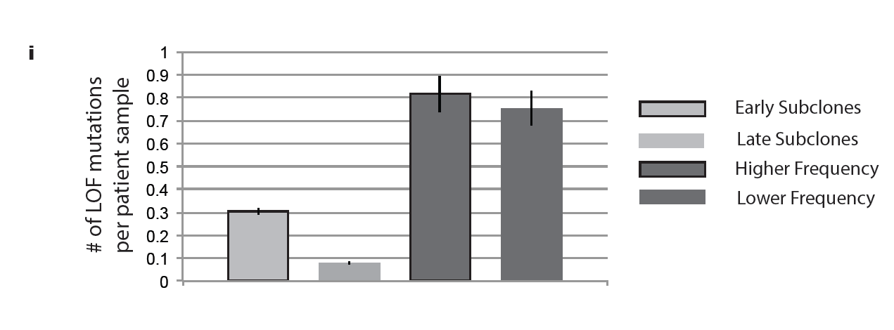
LOF mutations are enriched in early subclones and bins with higher frequency mutations
Notes:
LOF mutations are not just functional impact mutations. It’s gene loss mutations.
A Pancancer LOF mutation shows enrichment in early/dominant Subclones
Similarly there is enrichment in bins with higher frequency

Slide 3
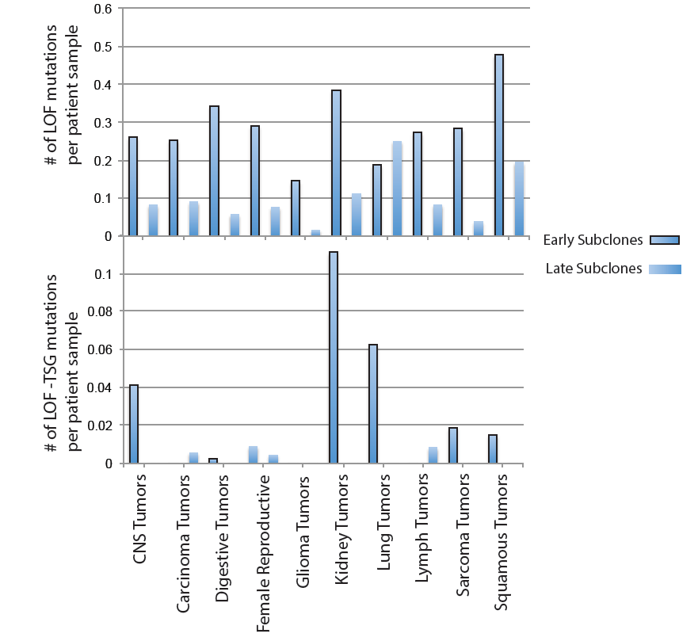
Average number of LOF mutations in early vs late Subclones
Notes:
Relative prevalence of LOF mutations across different meta-cohort tumor types
We expect: a) either higher fitness for each cell and therefore in higher prevalence or b) lower fitness and lower prevalence
Tumor Suppressor gene LOF should -by definition- provide a higher fitness for tumor cells and therefore exist in higher than expected prevalence

Slide 4
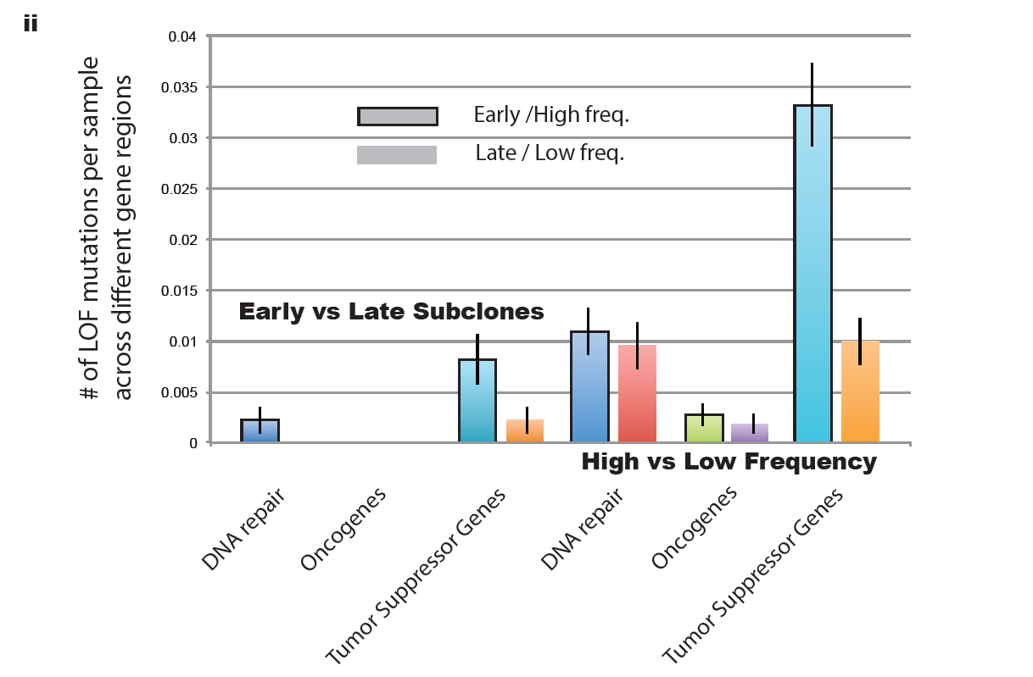
Notes:
in i) early vs late subclones and ii) High vs Low frequency analysis, as expected:
TSG are enriched in early subclones and high frequency bins
Oncogenes are depleted in all categoriies

Slide 5
Quantitative Changes in Signature proportion in Early vs Late Subclones
Change in Signature Entropy ~ δSΕ = |SE_{Early}| - |SE_{Late}|)
Notes:
Values of change in entropy closer to 1 signify higher Entropy in early signatures (Fewer of higher prevalence). Negative values signify higher entropy for late signatures .Closer to 0 Signify no change in signature proportions.
Female Reproductive, Lymph and CNS tumors show the most conservative nature, remaining mostly unchanged.
Sarcoma and Glioma show fewer and more dominant signatures in early/dominant subclones
Kidney, Lymph, Squamous and Digestive tumors show fewer signatures in later subclones

Slide 6
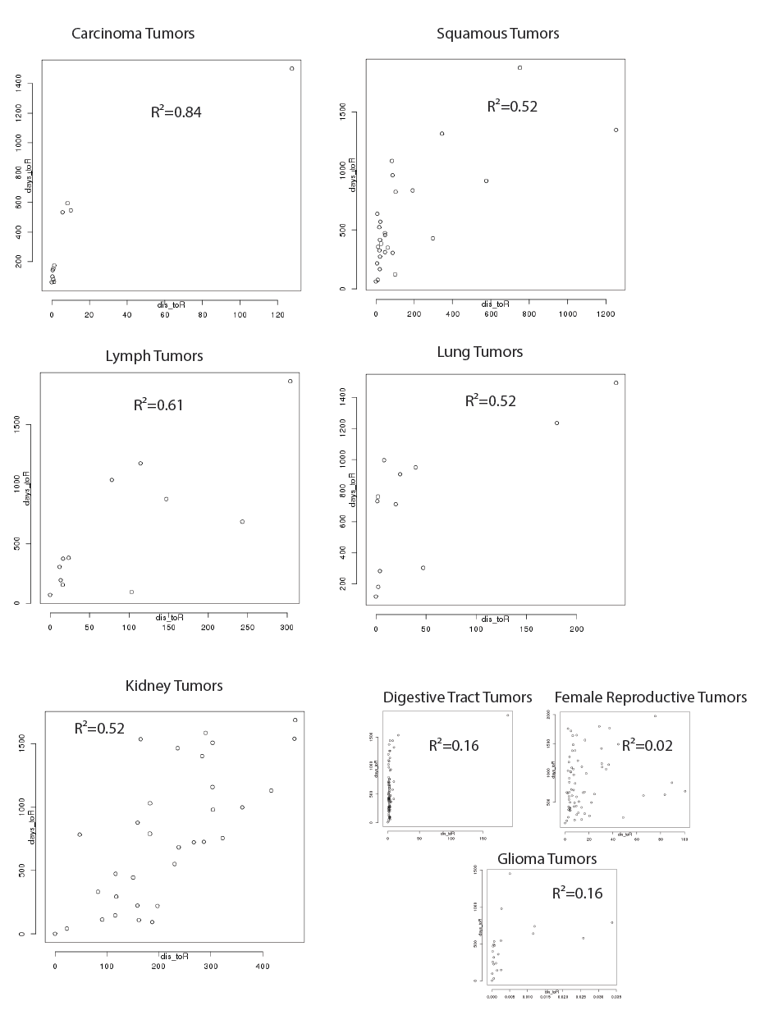
Converging expressional profiles
Notes:
For each gene, we have performed linear regression between gene expression and number of days to death since sample collection. Then we selected the top 100 genes with highest Pearson values and estimated the geometric distance in R¹⁰⁰ for each expressional profile compared to the most aggressive profile (least days to death since sample collection).
The correlation between the estimated geometric R¹⁰⁰ distance for each expressional profile and the days to death (representing profile aggressiveness) is depicted across different tumors.
Carcinoma, Squamous, Lymph, Lung and Kidney Tumors show high correlation denoting the existence of critical expressional profiles
Similar analysis (not shown here) has been performed showing the predictive values for profile aggressiveness based on each patient’s expressional profile

Slide 7
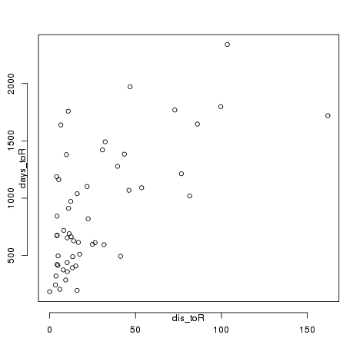
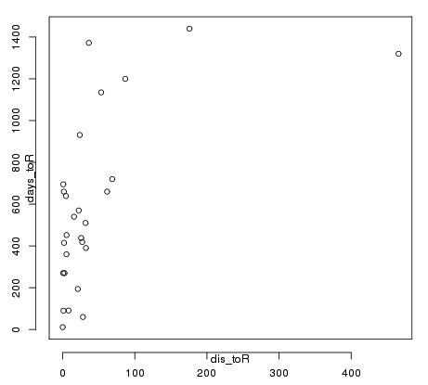
Converging expressional profiles
Ovary- AdenoCA R²=0.41
Liver R²=0.39
Notes:
For each gene, we have performed linear regression between gene expression and number of days to death since sample collection. Then we selected the top 100 genes with highest Pearson values and estimated the geometric distance in R¹⁰⁰ for each expressional profile compared to the most aggressive profile (least days to death since sample collection).
The correlation between the estimated geometric R¹⁰⁰ distance for each expressional profile and the days to death (representing profile aggressiveness) is depicted across different tumors.
Carcinoma, Squamous, Lymph, Lung and Kidney Tumors show high correlation denoting the existence of critical expressional profiles
Similar analysis (not shown here) has been performed showing the predictive values for profile aggressiveness based on each patient’s expressional profile

Slide 8
For different number of Genes
R²
Number of genes used for expressional profile
Notes:
For each gene, we have performed linear regression between gene expression and number of days to death since sample collection. Then we selected the top 100 genes with highest Pearson values and estimated the geometric distance in R¹⁰⁰ for each expressional profile compared to the most aggressive profile (least days to death since sample collection).
The correlation between the estimated geometric R¹⁰⁰ distance for each expressional profile and the days to death (representing profile aggressiveness) is depicted across different tumors.
Carcinoma, Squamous, Lymph, Lung and Kidney Tumors show high correlation denoting the existence of critical expressional profiles
Similar analysis (not shown here) has been performed showing the predictive values for profile aggressiveness based on each patient’s expressional profile

Slide 9
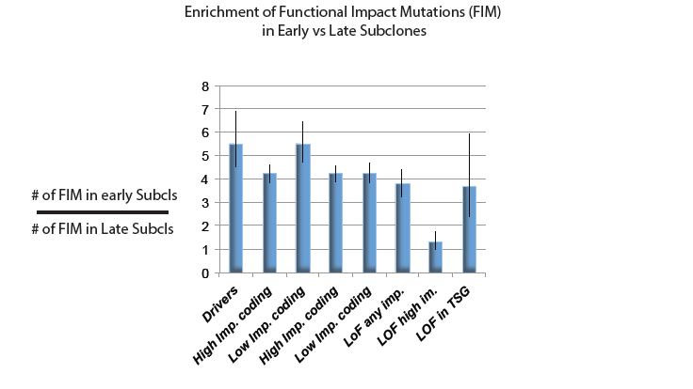
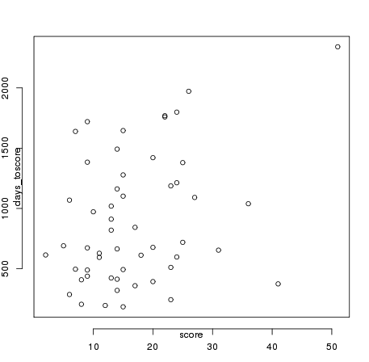
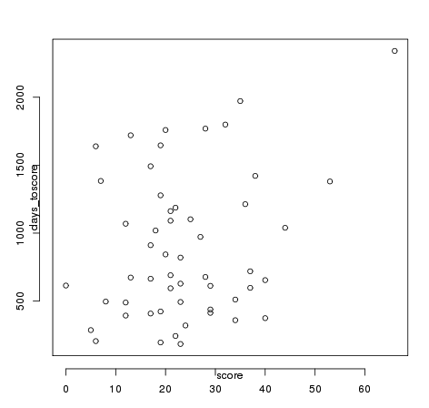
# of mutations in regulatory and ppi regions
Ovary-AdenoCA
Regulatory genes for 50 genes
R²⁼ 0.11
Ovary-AdenoCA
PPI genes for 50 genes
R²⁼ 0. 08
Days
Days
Total Number of mutations
Total Number of mutations

Slide 10
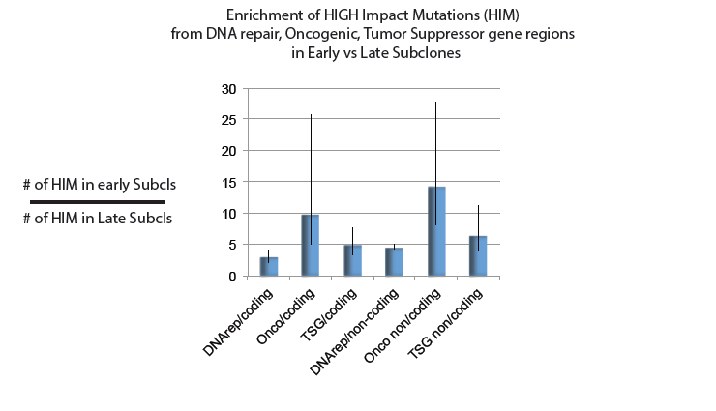

Slide 11
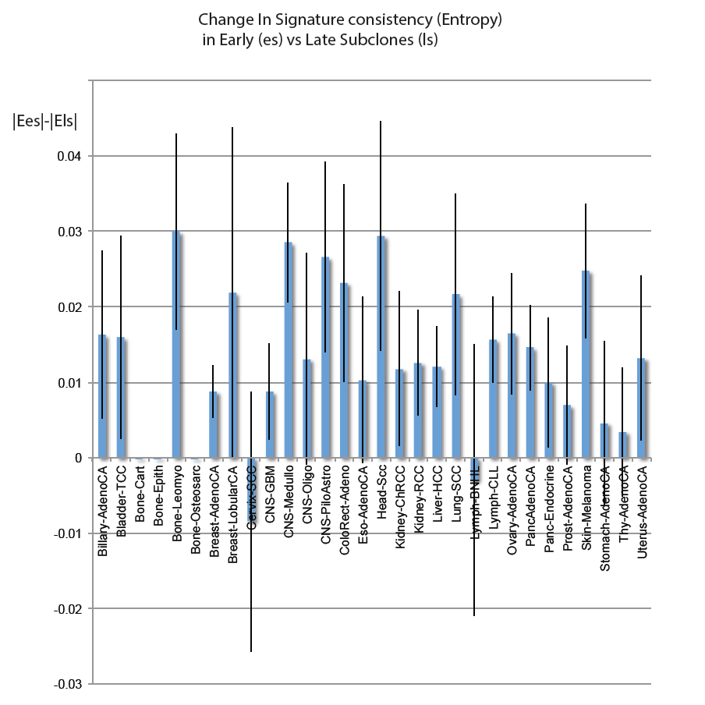

Slide 12
Regressing late mutations on early signatures
R²

Slide 13
Subclonal enrichment
Mode | Ratio
subsize 100, min freq:0.01 | 4.38
subc size: 200 | 3.49
min freq:0.05 | 3.57

Slide 14
Pancancer Subclonal Signature comparison

Slide 15
Subclonal Signature comparison Across Cancer types
R²

