Slide 1
Bias correction in Synergy Analysis
Paper E
Will Meyerson
24 January 2017

Slide 2
Synergy Status
Old way of calculating p-values: I found gene-pairs with significant adjusted p-values in favor of co-mutation
Problem with old way: two biases
Edge drop-out
Failure to take into account the possibility of combinations of patients in which co-mutations might occur in null
New way corrects p-values
Undoes gene-patient permutations that lead to edge drop-out
Uses cohort-level rather than patient-level # of co-mutations
Results with new way:
no individual gene-pairs meet adjusted significance for positive co-mutation
still some gene-pairs meet pan-cancer significance for anti-correlation
We see signal of co-mutation in cancer subtypes, even if we can’t pick out gene-pairs

Slide 3
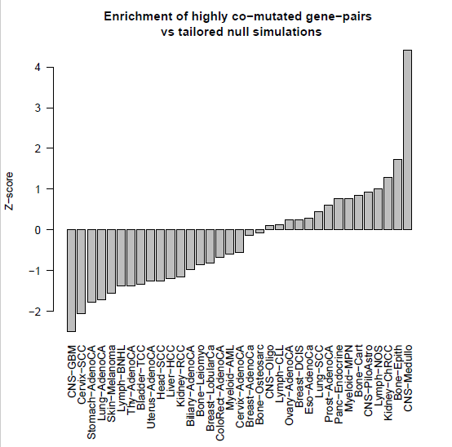
Take CNS-Medullo.
Take just gene-pairs including up to 1 pcawg driver and 1 or 2 cosmic genes that are not pcawg drivers.
What is the maximum number of co-mutations in any considered gene-pair? Say it’s 12
Then what’s 2/3 of that value? 8
What fraction of the eligible gene-pairs have 8 or more co-mutations in observed set? Say 0.04
What fraction of those same gene-pairs have 8 or more co-mutations in tailored null sets? Say 0.1 with standard deviation 0.1. Hence Z-score 4.

Slide 4
Next steps
Would be nice to have individual gene-pairs (but not super necessary in my opinion). How might I do it?
Filter gene-pairs based on synergistic VAF? (I’ve started this, it’s really frustrating)
Combine subtypes into meta-cohorts (I’m not happy with this option ‘cause synergy most convincingly shows selection only when we keep signatures relatively constant)

