Slide 1
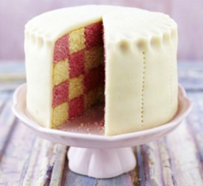
SV calling
The original BAMs were mapped using an old BWA that does not support SR
BWA Map
Sort/index
Markdup.
Discordant PR
Lumpy
SVScorer
sort -n
SR
Read pairs
BAM
Battenberg
BAM
SNV
(Subclonal) CNV
WGSPhylo

Slide 2
SV calling
BWA, samtools, Picard
BWA Map
Sort/index
Markdup.
No BQRC!
Discordant PR
Lumpy
RocksDB from FB
Picard
SVs
sort -n
SR
RG is lost
BAM
Read pairs
Simple bash script
SVScorer
Battenberg
BAM
Other issues:
1. RG got lost!
2. Large temp space
3. Sorting too slow
4. Battenberg dependencies
SNV
CNV
WGSPhylo

Slide 3
SV calling
Major issues: space requirement
  Deleted 1KG, incl. all low-cov & high-cov BAMs
BWA Map
Sort/index
Markdup.
12 h
Discordant PR
12 h
2 h
Lumpy
SVScorer
sort -n
SR
RG; Slow
BAM
Read pairs
Battenberg
BAM
Other issues:
1. RG got lost!
2. Large temp space
3. Sorting too slow
4. Battenberg install
SNV
CNV
WGSPhylo

Slide 4
Methylation
The NEJM methylation process is sloppy
  Most data thrown
  We show 3 clusters

Slide 5
Methylation
Column1 | non-coding | coding | Coding%
HyperMeth.(N=1432) | 280.6 | 6.4 | 2.23%
NormalMeth.(N=5235) | 190.0 | 4.9 | 2.49%
 | 1KG | 1KG% | non-coding | coding | Coding%
CpG | 72 | 1.09% | 6411 | 131 | 2.00%
non-CpG | 1359 | 0.92% | 144214 | 2252 | 1.54%

Slide 6
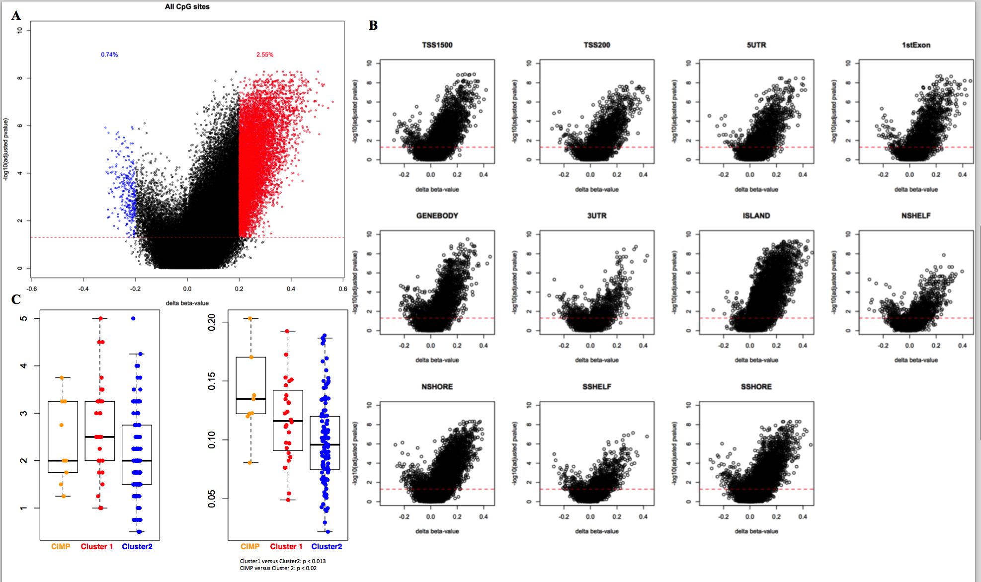
Methylation

Slide 7
Lists
SV calling & evaluation
Evolution tree
N[C>T]G functional impacts
NEAT1 exp. survival analysis

