Slide 1
MOAT Germline Analysis Update
Lucas Lochovsky
Cancer subgroup, Misc subsubgroup
2017-01-19

Slide 2
Overview
Previously
Aggregate exon counts into gene counts
Create the “exome-genome” for permutation purposes
  Imagine the entire genome consisted of only the exons, and permute variant locations over this
Since Then
Filter ExAC TCGA variant for rarity
  AF<0.005 (0.5%)
  But very few variants were filtered out (most are already rare)
Use Funseq2 to filter for variants with functional impact
Use PCAWG CDS annotations (previously used GENCODE v15)

Slide 3
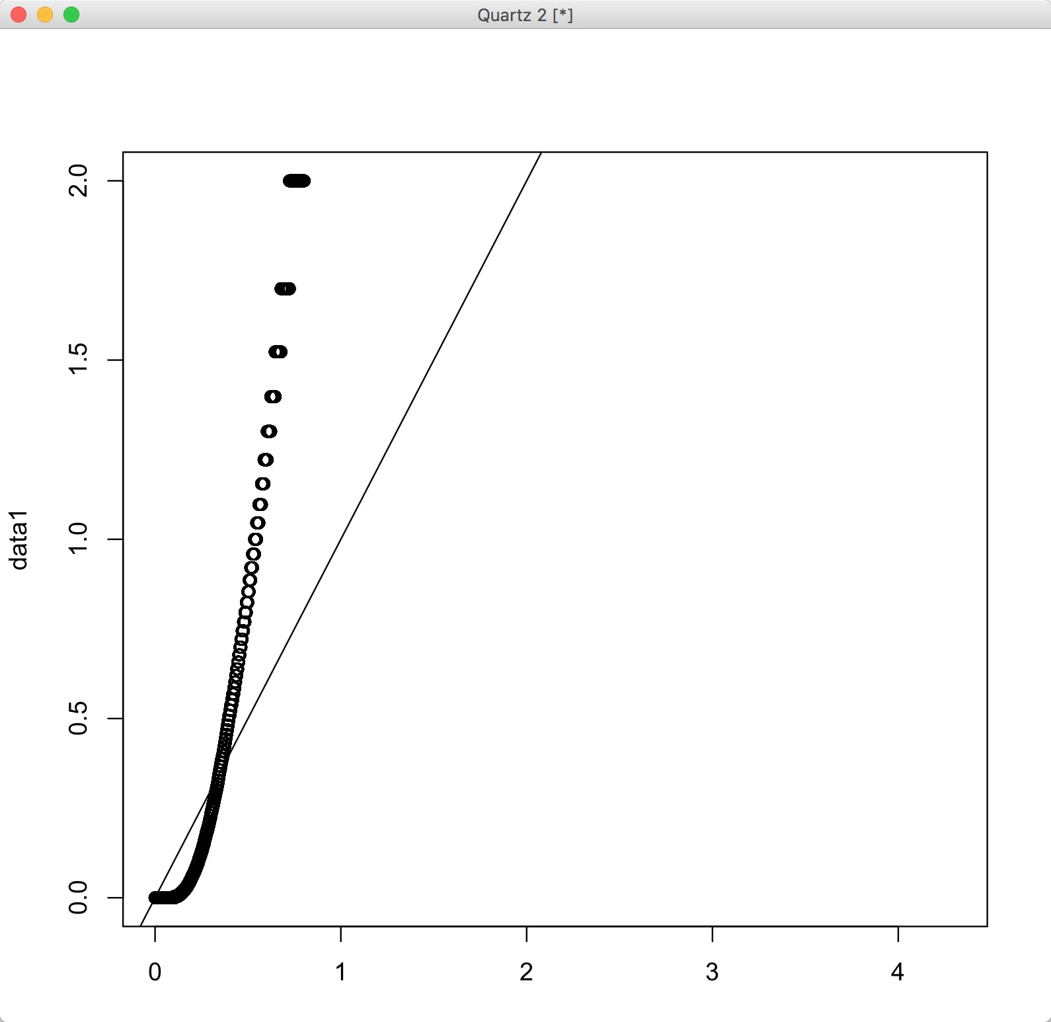
QQ-plot of p-values vs. uniform dist
Then – 3193 sg (BH-adjusted)
Now – 601 sg (BH-adjusted)
Sample Quantiles
Theoretical Quantiles

