Slide 1
Misc. Paper E Work
WM
18 January 2017

Slide 2
VAF distribution of high-impact genes validates the existence of both Deleterious Passengers and Latent Drivers
SUBTYPE | P-value for Enrichment of High-Impact Variants among High-VAF Genes | P-value for Enrichment of High-Impact Variants among Low-VAF Genes
Pan-Cancer | 0.165 | 0.01
Prost-AdenoCA | 1.73E-08 | 0.023
Stomach-AdenoCA | 0.016 | 7.60E-05
Ovary-AdenoCA | 3.48E-04 | 0.001
CNS-Medullo | 0.005 | 0.094
Skin-Melanoma | 0.006 | 0.05
Kidney-RCC | 0.145 | 0.014
Liver-HCC | 0.022 | 0.016
Lymph-CLL | 0.016 | 0.286
CNS-PiloAstro | 0.02 | 0.985
Bone-Leiomyo | 0.29 | 0.028
ColoRect-AdenoCA | 0.462 | 0.032
Panc-AdenoCA | 0.076 | 0.05
Eso-AdenoCa | 0.052 | 0.707
Kidney-ChRCC | 0.811 | 0.057
Thy-AdenoCA | 0.096 | 0.732
Uterus-AdenoCA | 0.125 | 0.353
Lymph-BNHL | 0.146 | 0.128
Biliary-AdenoCA | 0.982 | 0.136
Head-SCC | 0.291 | 0.138
CNS-GBM | 0.196 | 0.303
Bladder-TCC | 0.21 | 0.286
Lung-AdenoCA | 0.219 | 0.243
Breast-AdenoCa | 0.273 | 0.278
Breast-LobularCa | 0.307 | 0.851
Panc-Endocrine | 0.482 | 0.321
Bone-Epith | 0.383 | 0.459
Bone-Osteosarc | 0.41 | 0.608
Cervix-SCC | 0.515 | 0.75
CNS-Oligo | 0.549 | 0.971
Lung-SCC | 0.556 | 0.564
Myeloid-MPN | 0.715 | 0.715
Myeloid-AML | 0.768 | 0.733
Bullets
Assessed whether genes with high VAF or low VAF are statistically enriched in high-impact variants compared with random, which would serve as evidence of latent drivers and deleterious passengers, respectively
Pan-cancer analysis found statistical evidence of deleterious passengers but not latent drivers
Subtype-specific analysis found some subtypes with evidence of deleterious passengers, some subtypes with evidence of latent drivers, and some subtypes with evidence for both kinds of mutation classes
Intriguingly, Lymph-CLL was one of few subtypes with simultaneous evidence of latent drivers and lack of evidence of deleterious passengers, and Renal-RCC was one of few subtypes with the opposite pattern, which could explain the survival trends we observe in these cancer subtypes. [can make an even stronger narrative … see response to review comments]

Slide 3
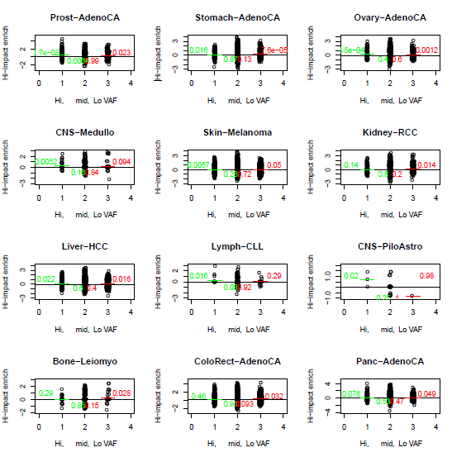
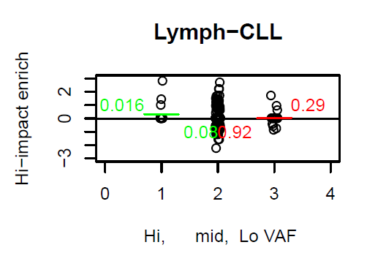
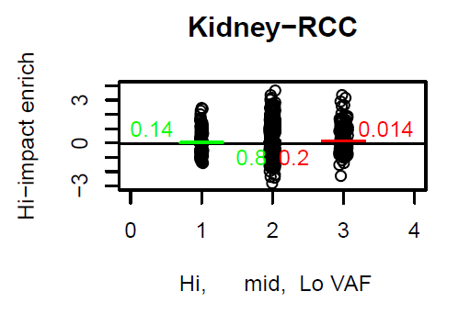
They said I had to make plots for my table but this one doesn’t make me super happy

Slide 4
The steering committee was right to be worried about the confounding potential of the fact that there are two molecular subtypes of CLL

Slide 5
CLL survival results are robust to correction of tumor IGH mutation status
Unadjusted for IGH mut count
Adjusted for IGH mut count
And continue to trend appropriately after stratification (shouldn’t be surprised by nonsignificance below since effectively smaller sample size, trend is what matters here)
The 45 pts with unmutated IGH
The 50 pts with mutated IGH

Slide 6
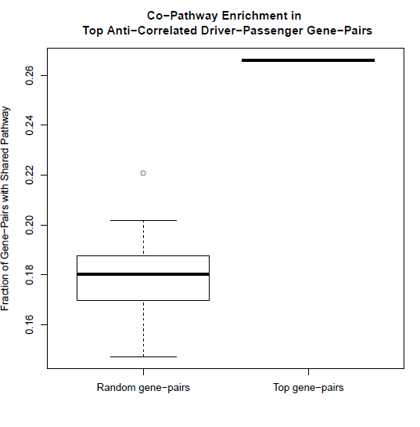
Redundant Gene-Pair Analysis Supports the Influential Passenger Hypothesis
take the gene-pairs that involve one pcawg known-or-predicted driver gene and one cosmic gene that is not a pcawg known-or-predicted driver.
of those, find the gene pairs that are co-mutated less often than by chance after fdr correction.
of those, look at what fraction of those gene-pairs participate in the same reactome pathway. That fraction is substantially higher than what you find in random draws from the eligible gene-pairs.
this offers explanations for why these gene-pairs are co-mutated less than chance:
the mutated forms of the least co-mutated gene pairs perform partially redundant functions for the cancer cells and cease to be selected once their partner is mutated …*interesting*
Cell requires some normal pathway activity to function. Hypothetically deleterious together. …*subjunctive, a little less interesting on its own, would need VAF corroboration to be declarative*

Slide 7
Comutation results
Determine 10% FDR threshold “th” by finding the largest “th” for which
Sum(obs.p.value <= th) / Sum(sim.p.value <= th) <= 0.1
Pancan:
Synergty: 0 cases of synergy meet FDR synergy threshold.
Redundancy: 7820 gene-pairs meet FDR redundancy threshold, of which 4093 include at least one nominal passenger gene
Expect to find subtype-specific synergistic gene-pairs

Slide 8
 | Observed Mutation Set |  |  |  |  |  |  | One of Many Simulated Mutation Sets
 | Pt1 | Pt2 | Pt3 | Pt4 | Pt5 | All Pts |  | Pt1 | Pt2 | Pt3 | Pt4 | P5 | All Pts
Gene1 | 1 | 1 | 0 | 0 | 1 | 3 |  | 0 | 1 | 1 | 1 | 0 | 3
Gene2 | 0 | 1 | 0 | 0 | 1 | 2 |  | 1 | 1 | 0 | 0 | 0 | 2
Gene1 & Gene2 | 0 | 1 | 0 | 0 | 1 | 2 |  | 0 | 1 | 0 | 0 | 0 | 1
Gene 3 … | … |  |  |  |  |  |  | …
All Genes | 100 | 1000 | 100 | 100 | 100 |  |  | 100 | 1000 | 100 | 100 | 100
Schematic describing co-mutation procedure:
There are 2 co-mutations of Genes 1 and 2 in the observed mutation set for this toy example, but only 1 co-mutation of these genes in a corresponding simulated mutation set. If other simulated mutation replicates agree with this pattern, it is determined that Genes 1 and 2 are co-mutated more often than null expectations. Note that the observed co-mutation of Genes 1 and 2 in Patient 2 is not surprising, given the large number of mutations in that patient – which the simulated mutation sets take into account. Unlike the randomized mutation sets designed for driver gene discovery, the null co-mutation simulations preserve the number of patients harboring mutations in each gene, as appropriate. See Supplemental Methods for details.

Slide 9
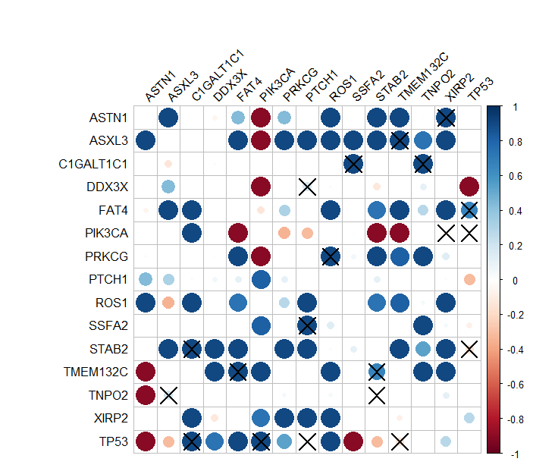
Kind of format might present results in
X denotes that the indicated gene-pair achieves adjusted significance of (positive) co-mutation in at least one cancer subtype
Deprecated values though

