Slide 1
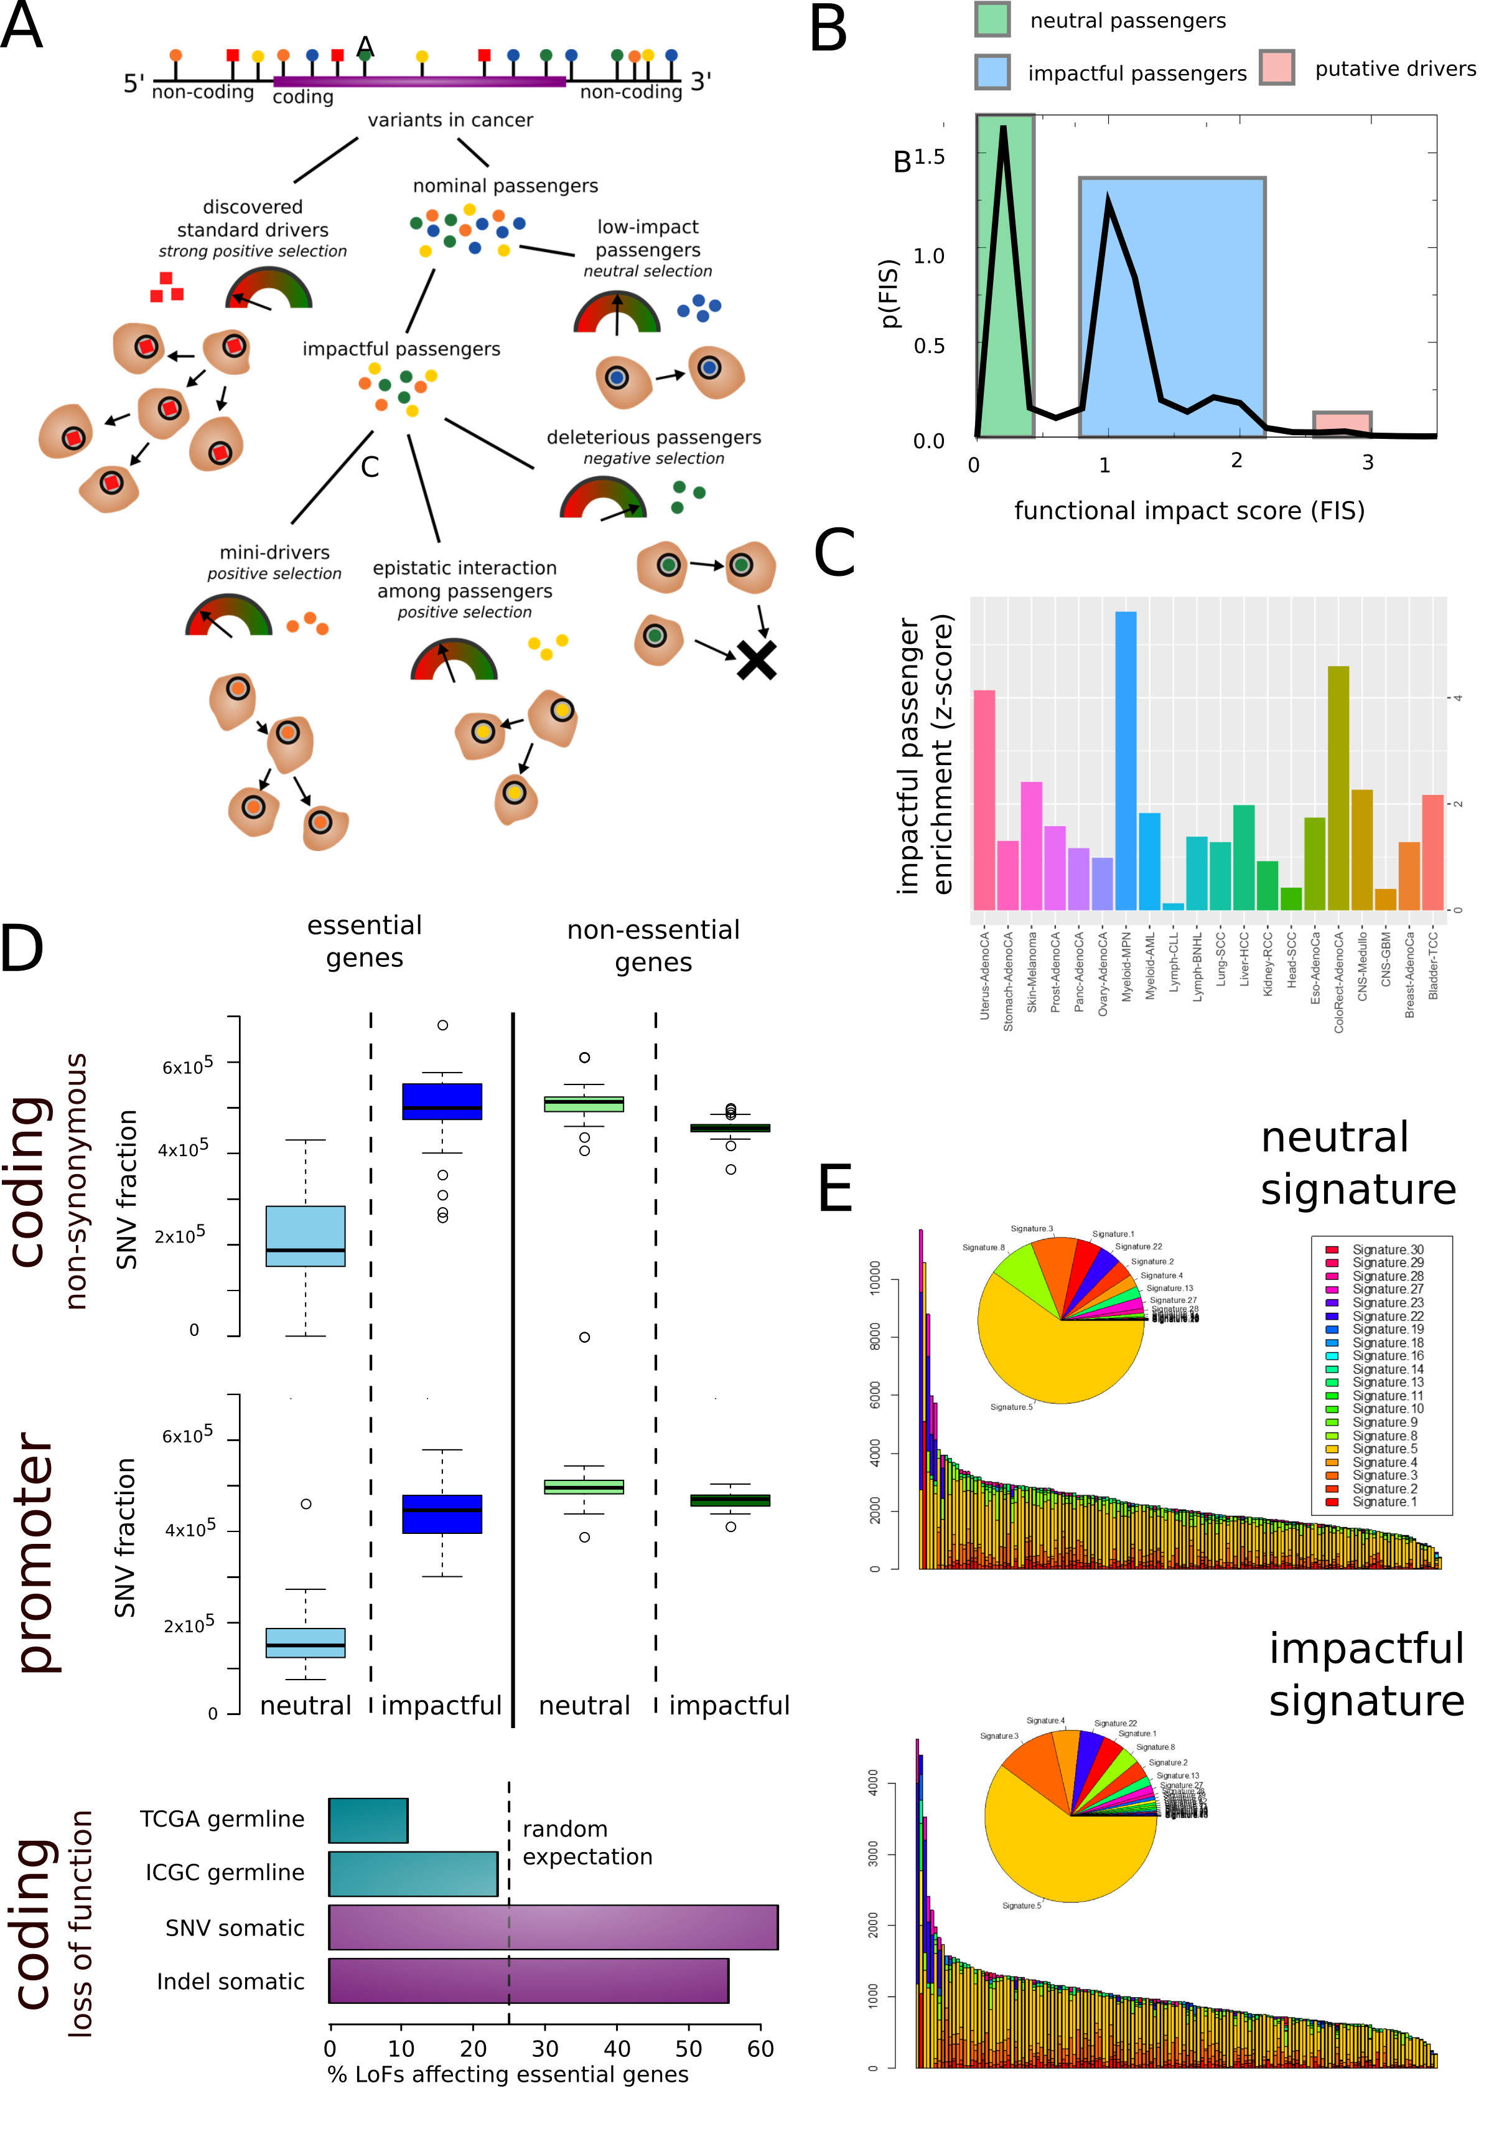

Slide 2
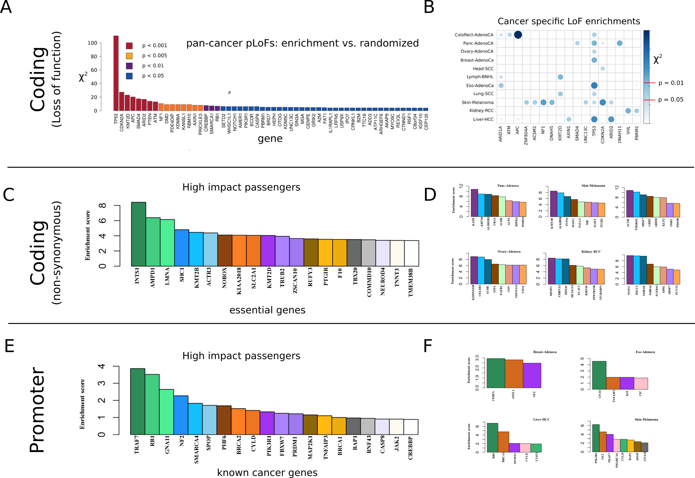

Slide 3
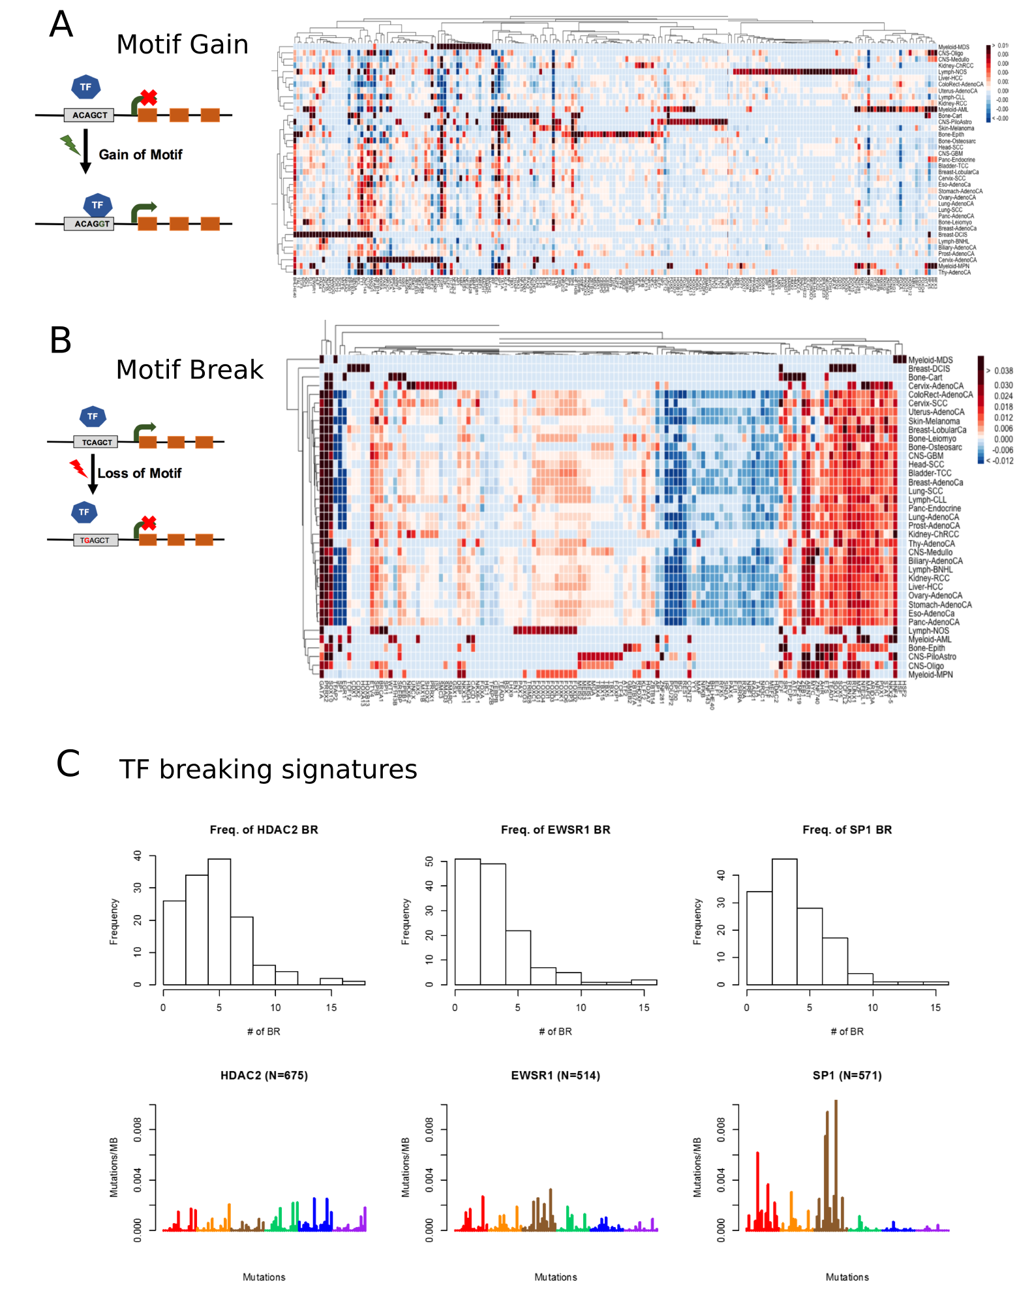

Slide 4
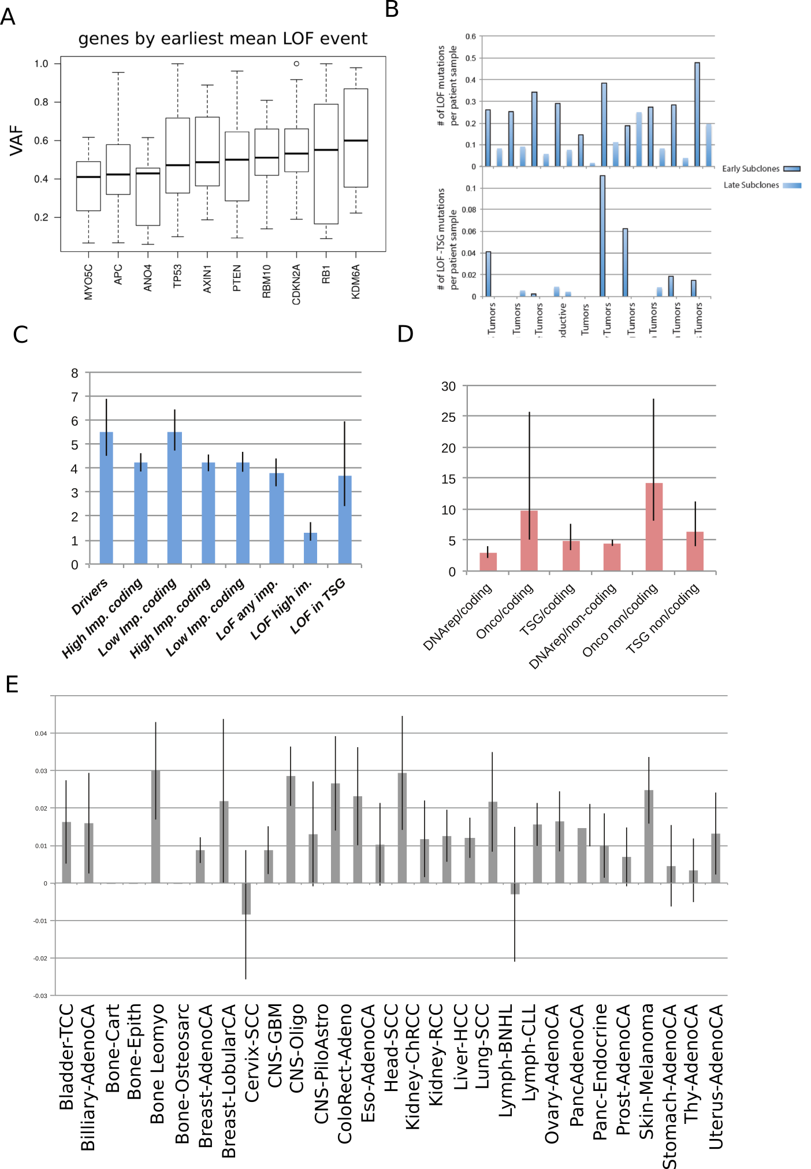

Slide 5
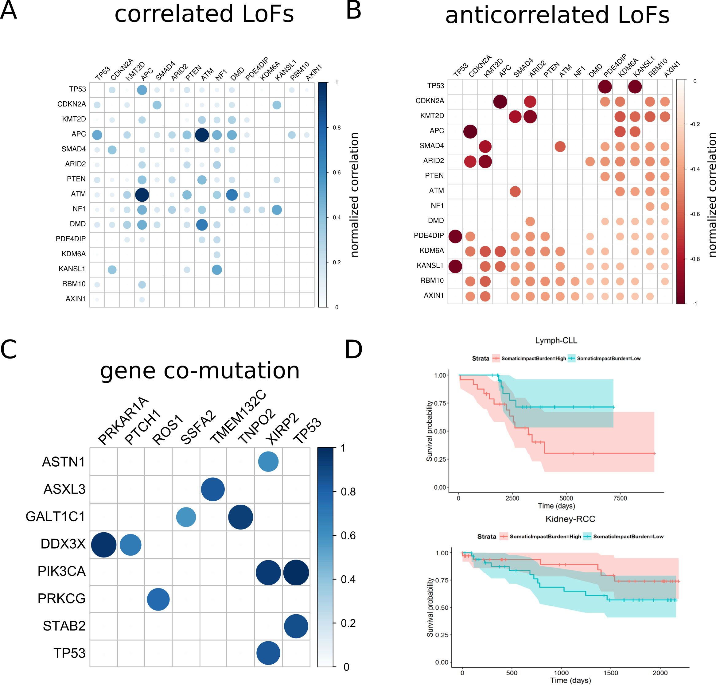

Slide 6
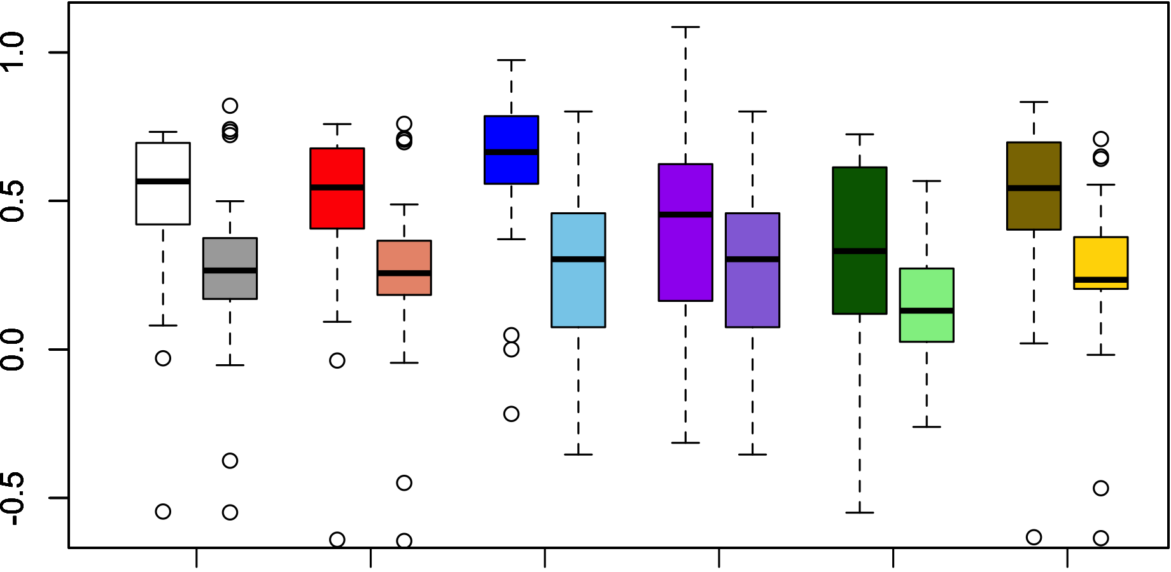
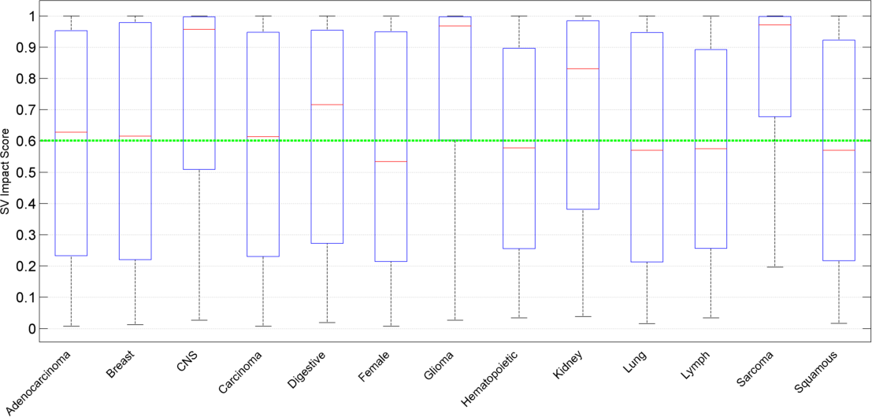
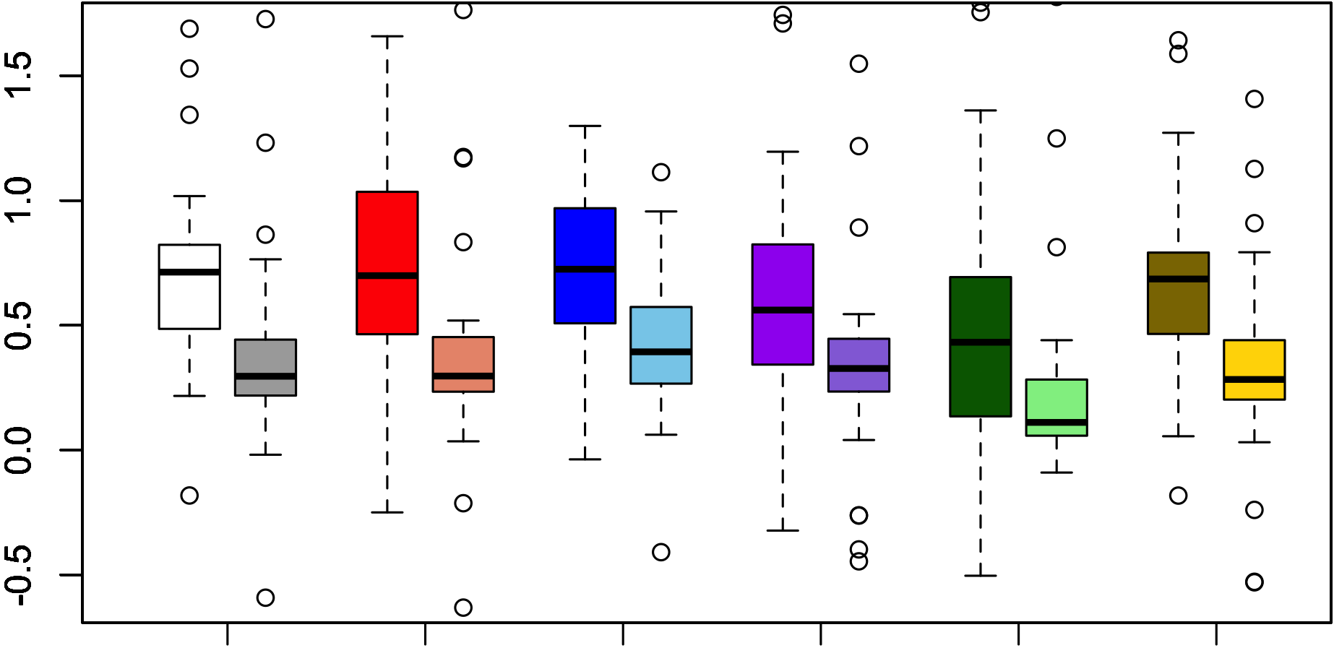
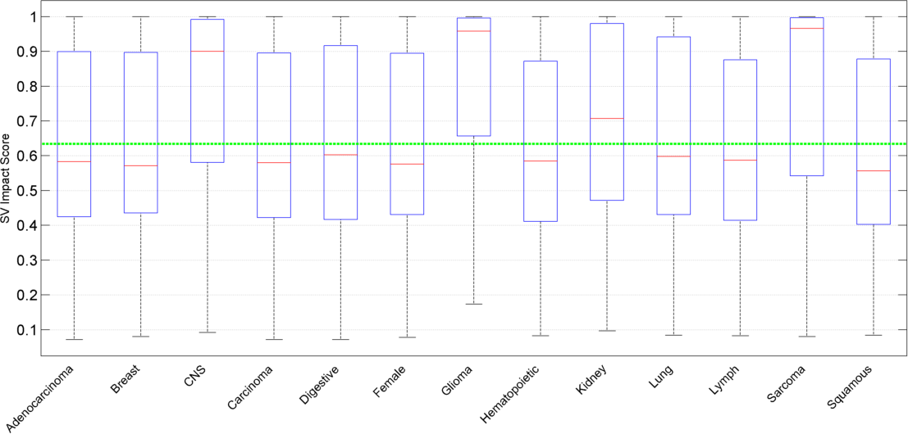
A
B
SV enrichment
CDS
UTR
PGN
lincRNA
Ultra Conserved
TF peaks
C
D
SV enrichment
CDS
UTR
PGN
lincRNA
Ultra Conserved
TF peaks

Slide 7
Relevant tables

Slide 8
Somatic Functional Burden & Survival [1]
Subtype | HR | CI95 | p.value
Breast-AdenoCa | 0.94 | [0.66-1.34] | 0.746
CNS-GBM | 1.03 | [0.75-1.4] | 0.871
Eso-AdenoCa | 1.01 | [0.78-1.31] | 0.939
Kidney-RCC | 0.73 | [0.54-0.98] | 0.038
Liver-HCC | 1.02 | [0.83-1.26] | 0.842
Lymph-CLL | 1.48 | [1.09-2.02] | 0.012
Ovary-AdenoCA | 1.04 | [0.87-1.24] | 0.698
Panc-AdenoCA | 1 | [0.88-1.15] | 0.956
Skin-Melanoma | 1.14 | [0.87-1.5] | 0.338
Table <Surv1> Primary findings: Relation of Somatic Impact Burden to survival.
The hazard ratio experienced for every quartile increase in Somatic Impact Burden (of observed minus randomized impact scores) over baseline, with associated 95% confidence intervals and p-values, including Low-Impact Load and patient age at diagnosis as covariates. Elevated Somatic Impact Burden is associated with shorter survival in Kidney-RCC and longer survival in Lymph-CLL.

Slide 9
Somatic Functional Burden & Survival [2]
Subtype | HR | CI95 | p.value
Breast-AdenoCa | 0.87 | [0.57-1.33] | 0.51897
CNS-GBM | 0.64 | [0.42-0.97] | 0.03602
Eso-AdenoCa | 0.91 | [0.7-1.2] | 0.50601
Kidney-RCC | 1.06 | [0.76-1.47] | 0.74877
Liver-HCC | 1.09 | [0.87-1.35] | 0.46297
Lymph-CLL | 0.65 | [0.47-0.88] | 0.00567
Ovary-AdenoCA | 0.73 | [0.61-0.87] | 0.00054
Panc-AdenoCA | 0.96 | [0.84-1.1] | 0.58399
Skin-Melanoma | 0.9 | [0.69-1.16] | 0.40197
Table <Surv2> Secondary findings: Relation of Low-Impact Load to survival.
The hazard ratio experienced for every quartile increase in Low-impact Load from baseline, with associated 95% confidence intervals and p-values including Somatic Impact Burden and patient age at diagnosis as covariates. Elevated load of low-impact SNVs is associated with longer survival in CNS-GBM, Lymph-CLL, and Ovary-AdenoCA.

Slide 10
SUBTYPE | P-value for Enrichment of High-Impact Variants among High-VAF Genes | P-value for Enrichment of High-Impact Variants among Low-VAF Genes
Pan-Cancer | 0.165 | 0.01
Prost-AdenoCA | 1.73E-08 | 0.023
Stomach-AdenoCA | 0.016 | 7.60E-05
Ovary-AdenoCA | 3.48E-04 | 0.001
CNS-Medullo | 0.005 | 0.094
Skin-Melanoma | 0.006 | 0.05
Kidney-RCC | 0.145 | 0.014
Liver-HCC | 0.022 | 0.016
Lymph-CLL | 0.016 | 0.286
CNS-PiloAstro | 0.02 | 0.985
Bone-Leiomyo | 0.29 | 0.028
ColoRect-AdenoCA | 0.462 | 0.032
Panc-AdenoCA | 0.076 | 0.05
Eso-AdenoCa | 0.052 | 0.707
Kidney-ChRCC | 0.811 | 0.057
Thy-AdenoCA | 0.096 | 0.732
Uterus-AdenoCA | 0.125 | 0.353
Lymph-BNHL | 0.146 | 0.128
Biliary-AdenoCA | 0.982 | 0.136
Head-SCC | 0.291 | 0.138
CNS-GBM | 0.196 | 0.303
Bladder-TCC | 0.21 | 0.286
Lung-AdenoCA | 0.219 | 0.243
Breast-AdenoCa | 0.273 | 0.278
Breast-LobularCa | 0.307 | 0.851
Panc-Endocrine | 0.482 | 0.321
Bone-Epith | 0.383 | 0.459
Bone-Osteosarc | 0.41 | 0.608
Cervix-SCC | 0.515 | 0.75
CNS-Oligo | 0.549 | 0.971
Lung-SCC | 0.556 | 0.564
Myeloid-MPN | 0.715 | 0.715
Myeloid-AML | 0.768 | 0.733
Bullets
Assessed whether genes with high VAF or low VAF are statistically enriched in high-impact variants compared with random, which would serve as evidence of latent drivers and deleterious passengers, respectively
Pan-cancer analysis found statistical evidence of deleterious passengers but not latent drivers
Subtype-specific analysis found some subtypes with evidence of deleterious passengers, some subtypes with evidence of latent drivers, and some subtypes with evidence for both kinds of mutation classes
Intriguingly, Lymph-CLL was one of few subtypes with simultaneous evidence of latent drivers and lack of evidence of deleterious passengers, and Renal-RCC was one of few subtypes with the opposite pattern, which could explain the survival trends we observe in these cancer subtypes.

Slide 11
Germline functional burden predisposes patients to earlier age of cancer diagnosis
Subtype | Coef | P.value
Biliary-AdenoCA | -3.397 | 0.068
Breast-AdenoCa | -2.911 | 0.020
CNS-GBM | 1.320 | 0.509
CNS-Medullo | -1.352 | 0.024
CNS-PiloAstro | -0.044 | 0.953
ColoRect-AdenoCA | -0.638 | 0.805
Eso-AdenoCa | 1.366 | 0.112
Head-SCC | -3.899 | 0.125
Kidney-ChRCC | -1.692 | 0.354
Kidney-RCC | -0.058 | 0.947
Liver-HCC | -0.146 | 0.822
Lung-AdenoCA | 1.892 | 0.263
Lung-SCC | 0.009 | 0.994
Lymph-BNHL | 0.458 | 0.807
Lymph-CLL | 1.165 | 0.244
Ovary-AdenoCA | 1.609 | 0.120
Panc-AdenoCA | -0.072 | 0.925
Panc-Endocrine | -4.260 | 0.002
Prost-AdenoCA | -0.089 | 0.877
Skin-Melanoma | -0.195 | 0.883
Stomach-AdenoCA | 0.123 | 0.958
Thy-AdenoCA | -5.580 | 0.072
Uterus-AdenoCA | 5.064 | 0.106
Linear regression predicting age in years of cancer diagnosis as a function of combined coding and noncoding germline burden. Patient race, and low-impact somatic load used as additional covariates.

