Slide 1
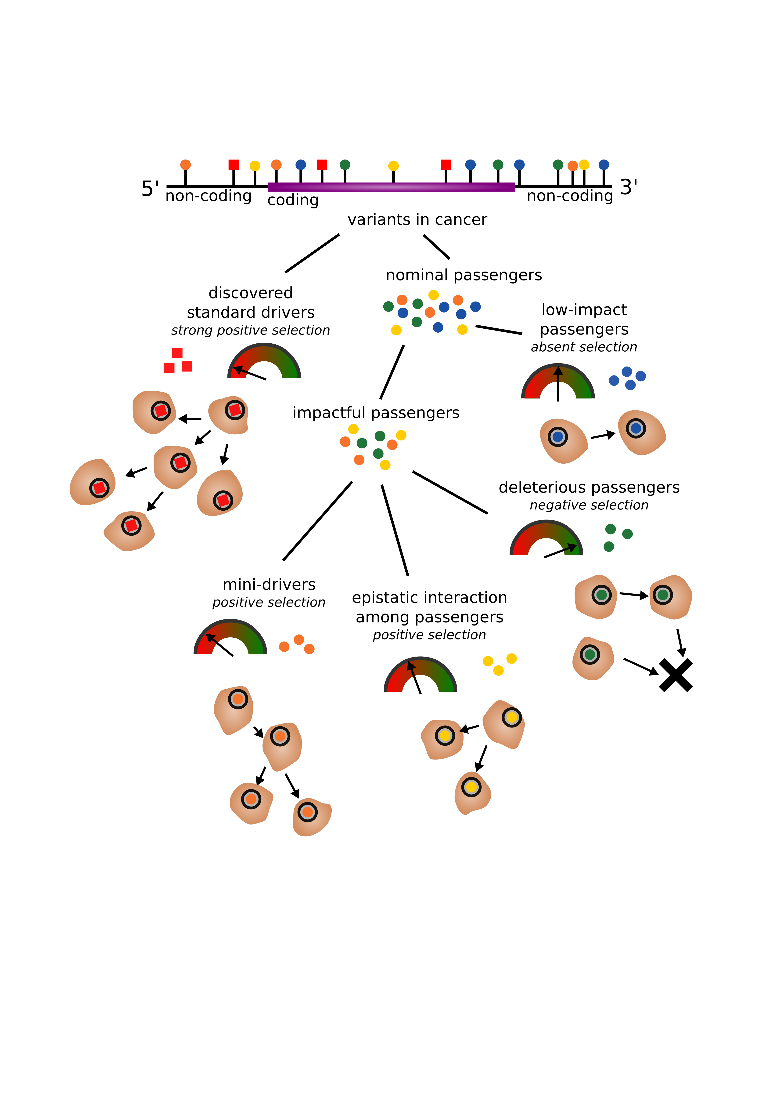
Introductory figure.
Delineates principle somatic mutation categories we will further describe.
Emphasis on differences in relative cellular fitness effect among somatic mutations.

Slide 2
Genes affected by pLoFs, pan-cancer
Arranged in order of enrichment vs. randomized (chi-square)
Significance levels colorized on plot.

Slide 3
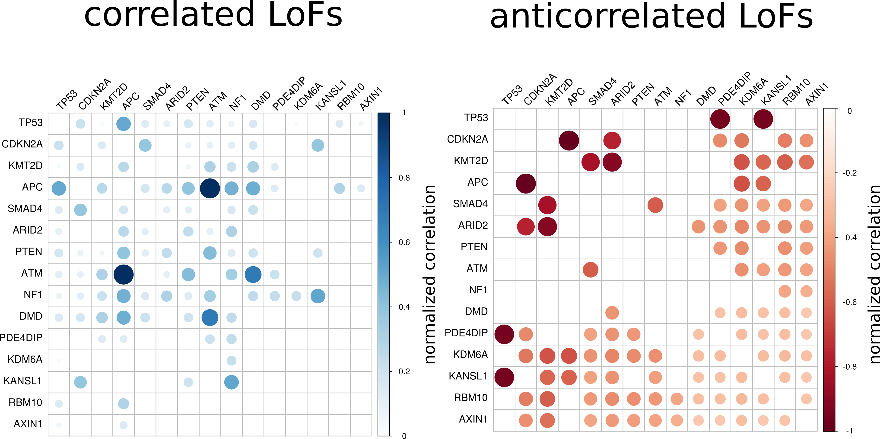
Correlated and anti-correlated LoF genes, pan-cancer.
Suggests dependence/independence/redundancy among LoF events
E.g. PDE4DIP – TP53 (anti-corr.) vs. ATM – APC (corr.)

Slide 4
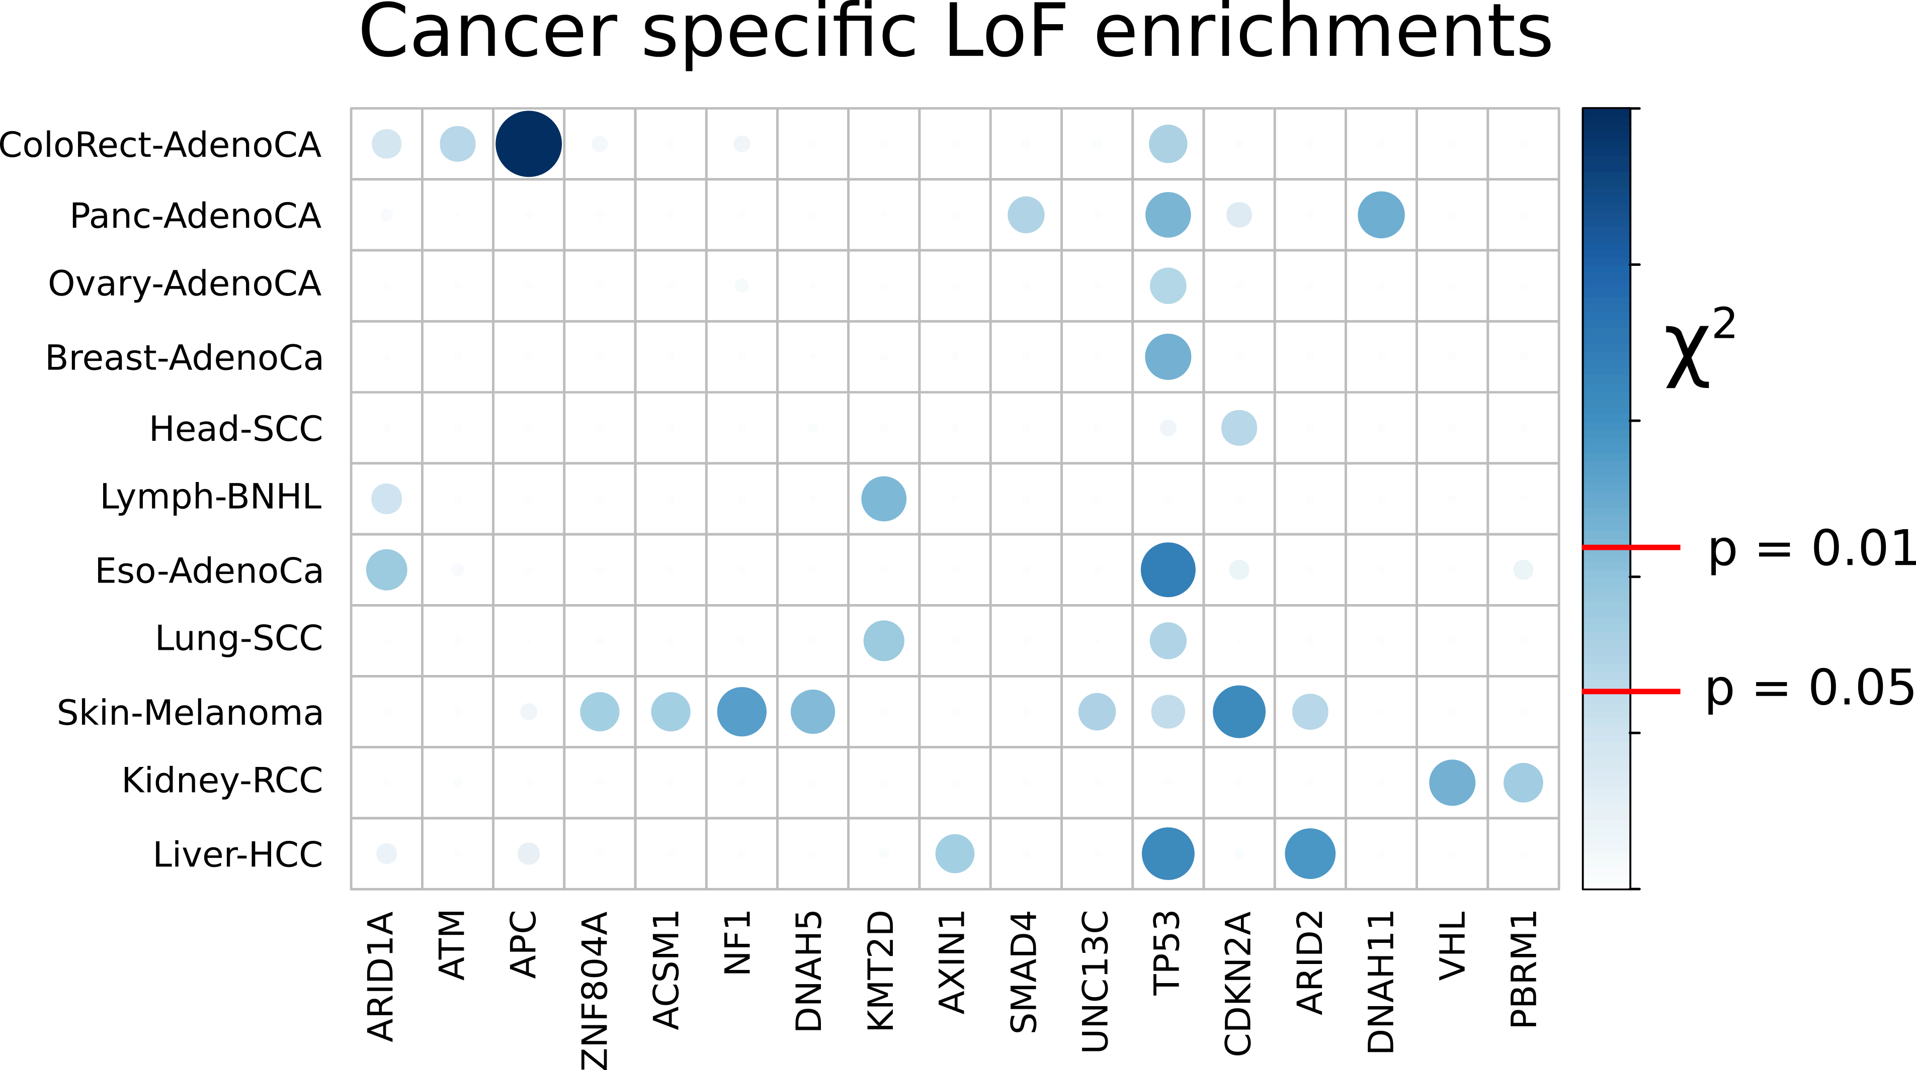
Cancer types with statistically significant associated gene LoF (vs. random).
Demonstrates that the landscape of LoFs is cancer specific.
E.g. (APC/ATM → Colorectal; Panc-AdenoCA DNAH11).

Slide 5
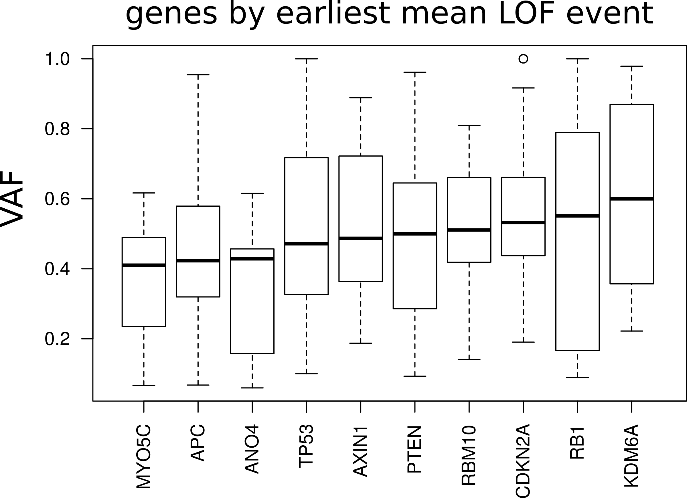
Demonstrating which LoF mutations occur earlier, or are fitness enhancing.
(Higher associated mean VAF).

Slide 6
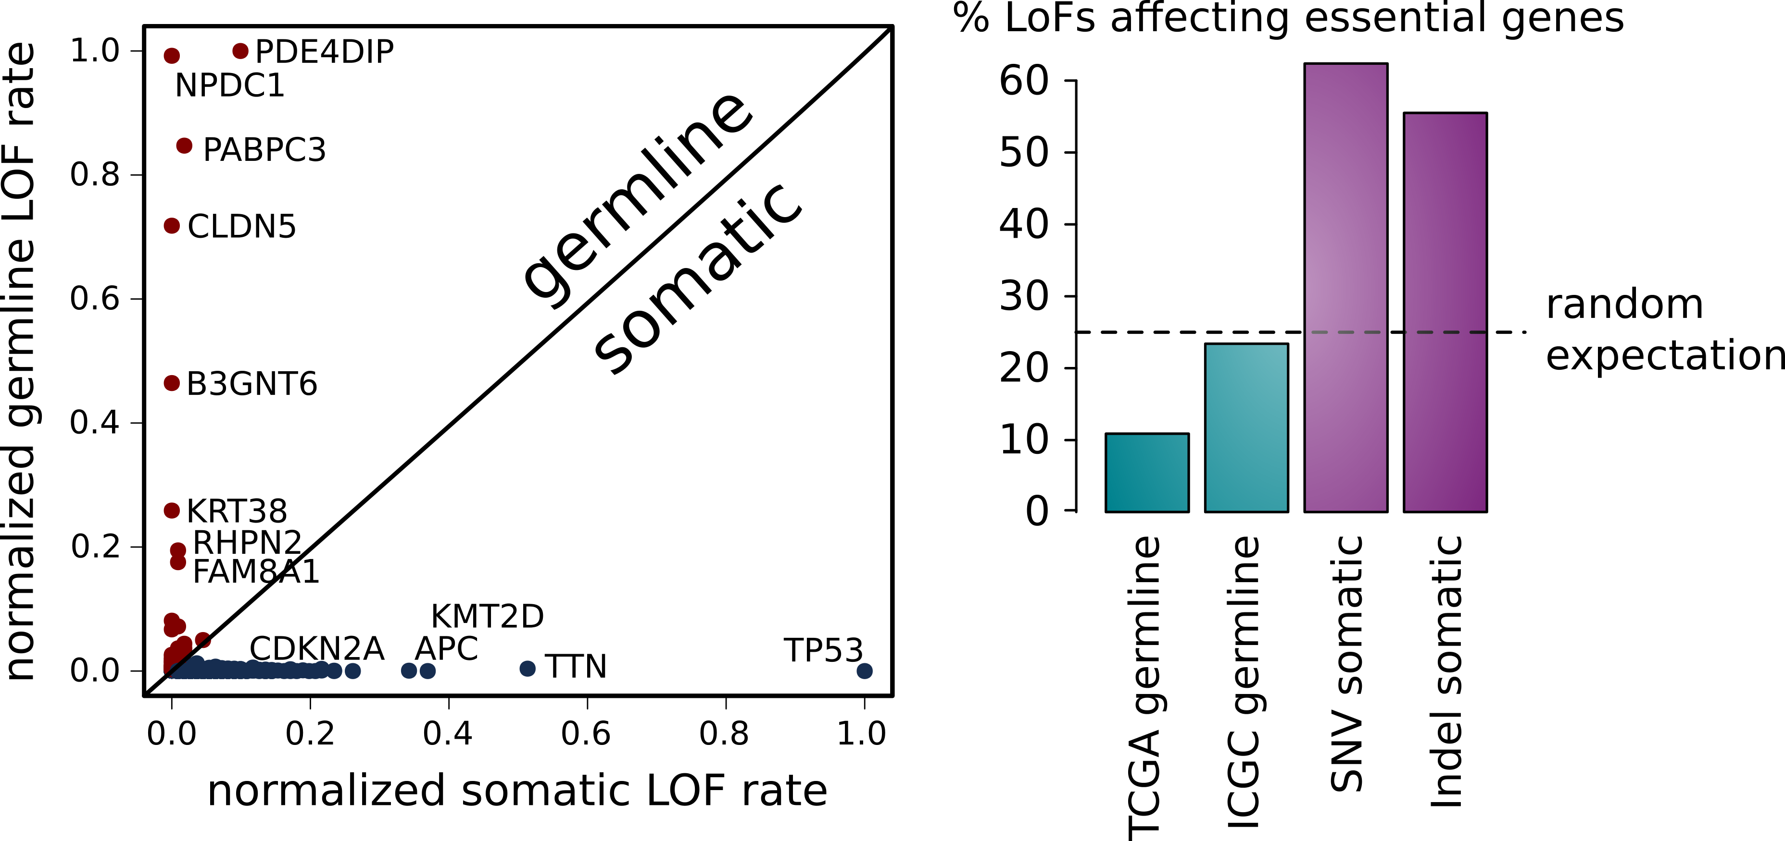
A. Showing heterogeneity between germline + somatic LoF events.
Related to negative LoF selection (germline) + positive LoF selection (somatic).
LoF events are generally off-axis (sole outlier – PDE4DIP).
B. Somatic LoFs showing greater tendency to affect essential genes.

Slide 7
To do
ORFs?
Somatic/germline synergies (LoF, rare mutations)?

