Slide 1
Framework:
In-house-eQTL SNV Gene beta t-stat p-value
GTEx-eQTL SNV Gene beta t-stat p-value
beta 5.3 percent of the ID'ed eQTLs differ by >= 5%
t_stat 10.1 percent of the ID'ed eQTLs differ by >= 5%
p-val: 57.1 percent of the ID'ed eQTLs differ by >= 5%

Slide 2
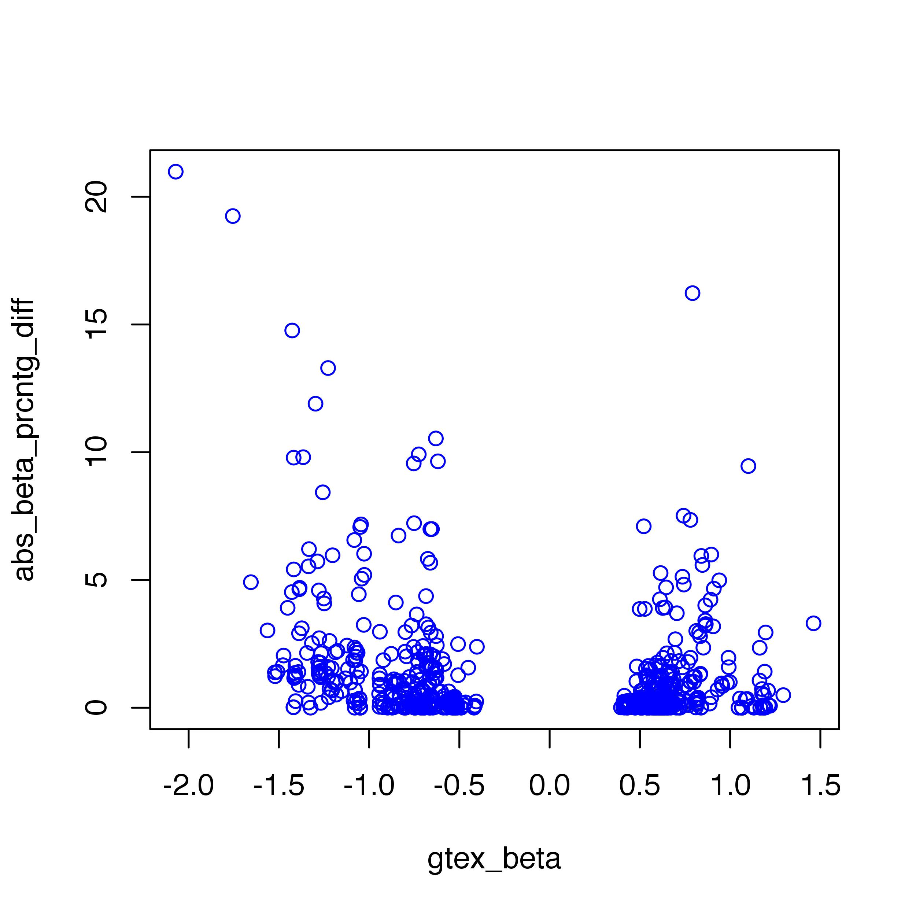
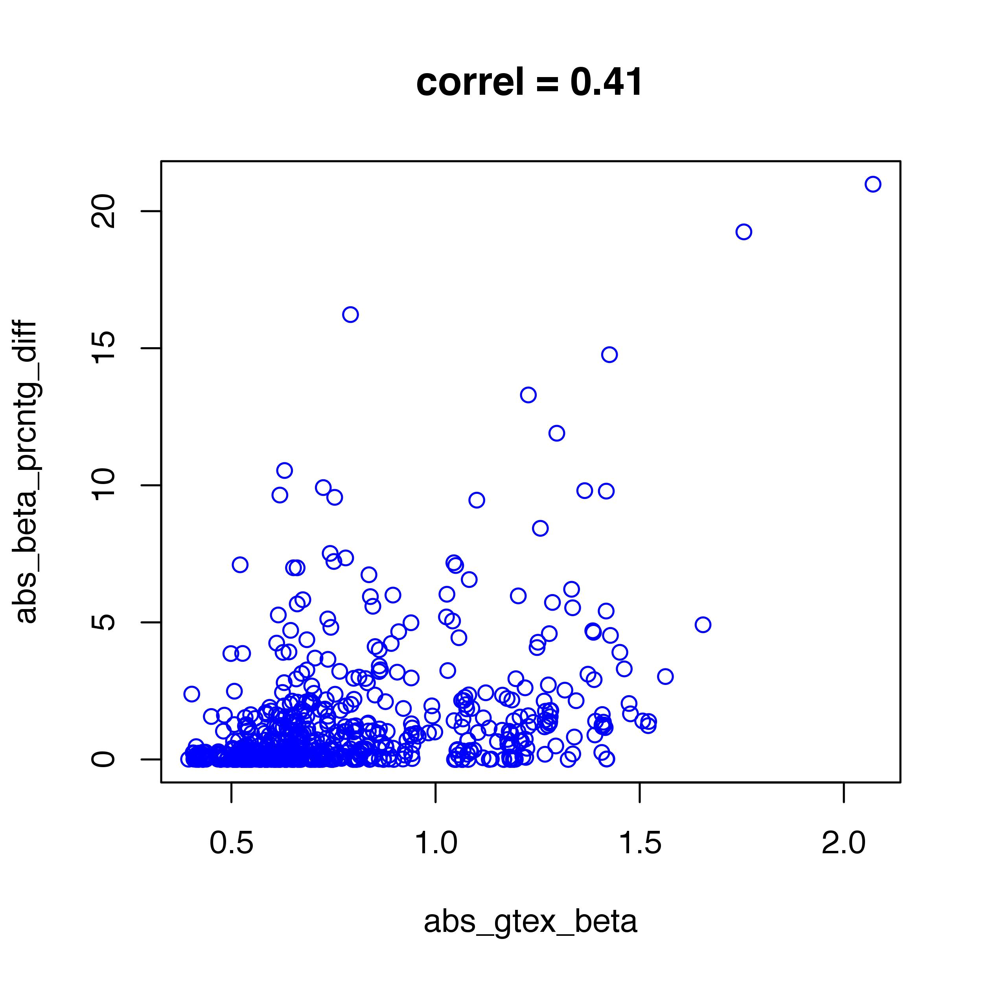
Are extreme beta values associated with disparities?
(considering “true” beta values)

Slide 3
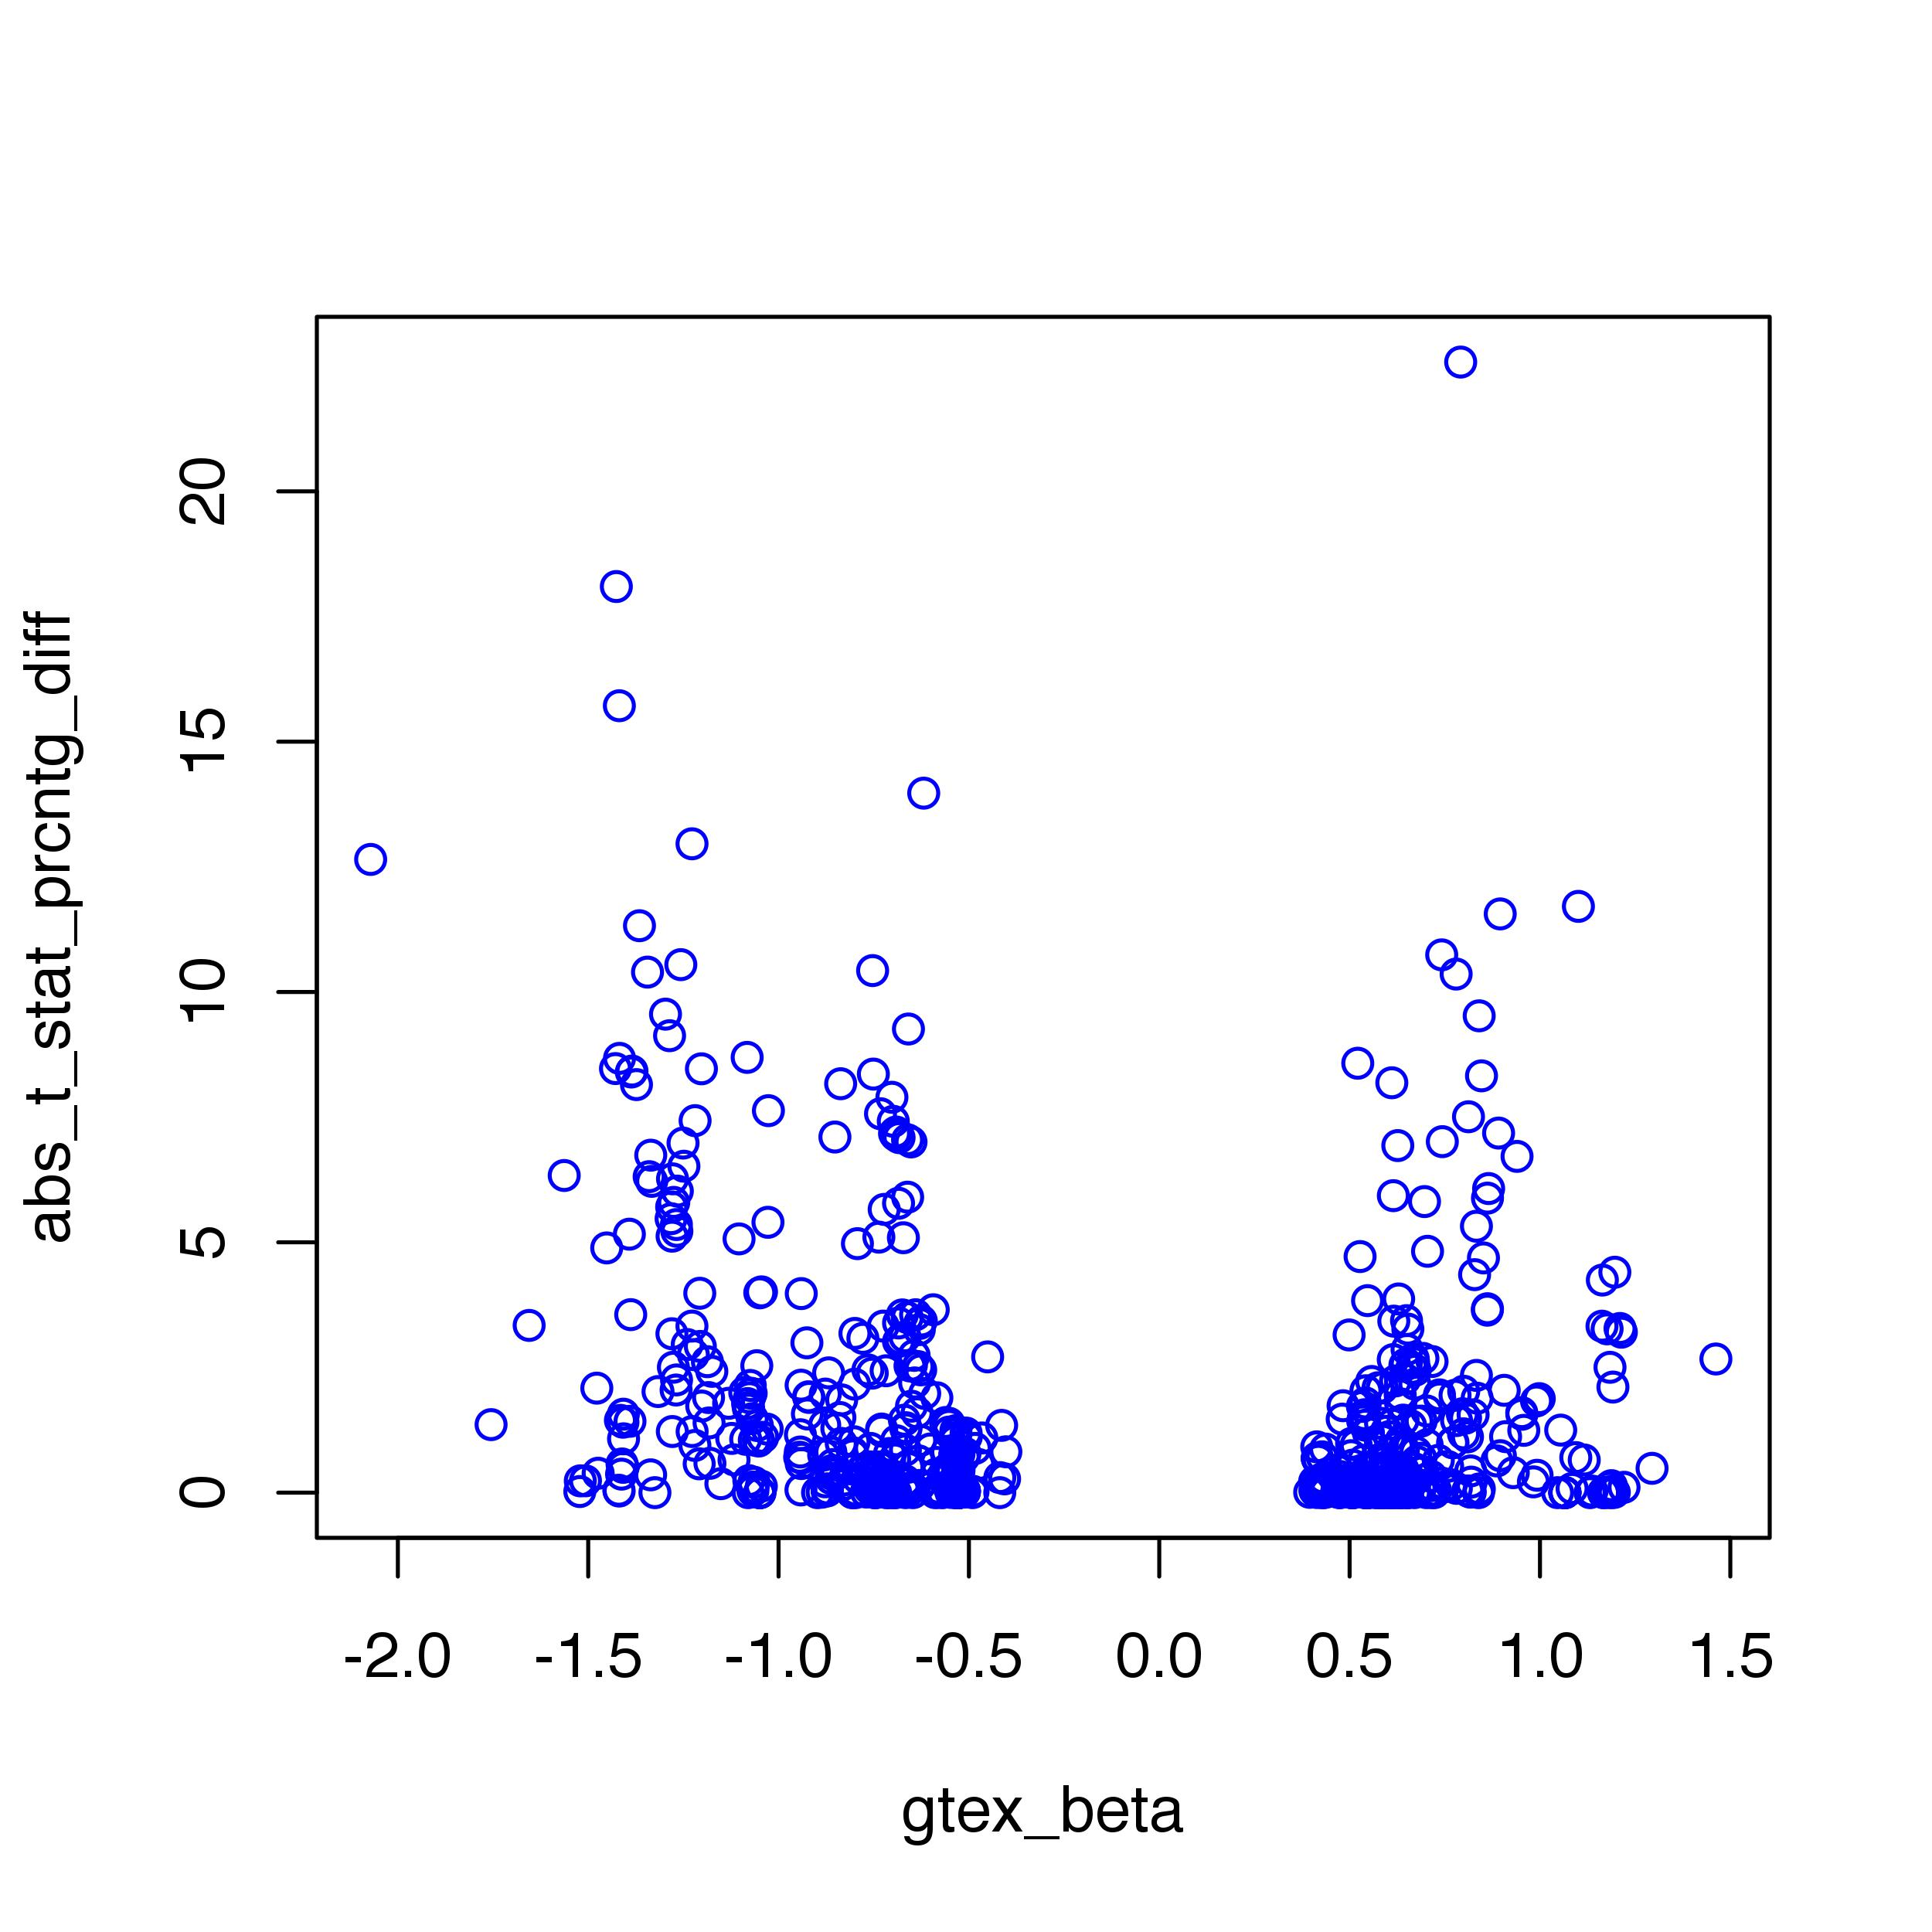
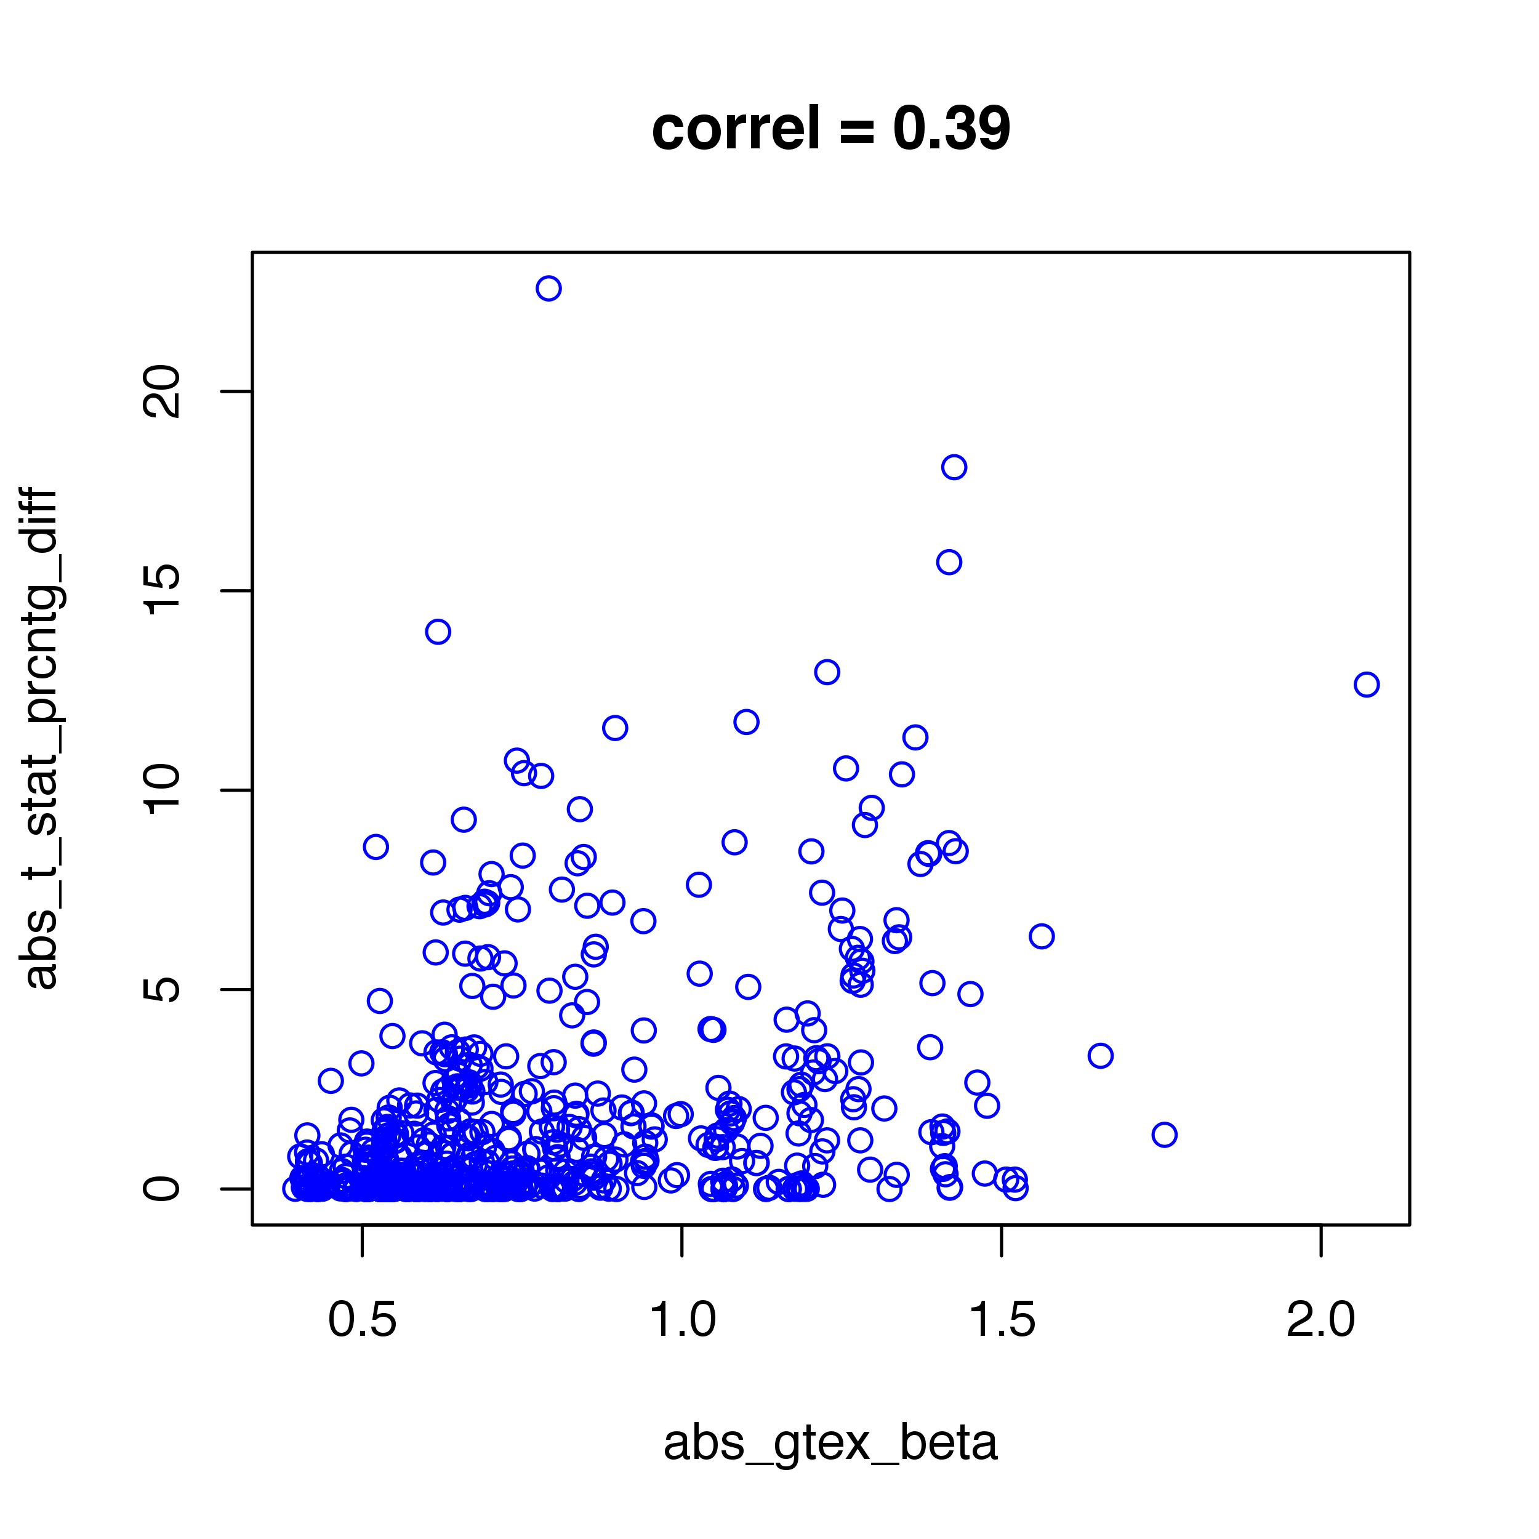
Are extreme beta values associated with disparities?
(considering “true” t-statistics)

Slide 4
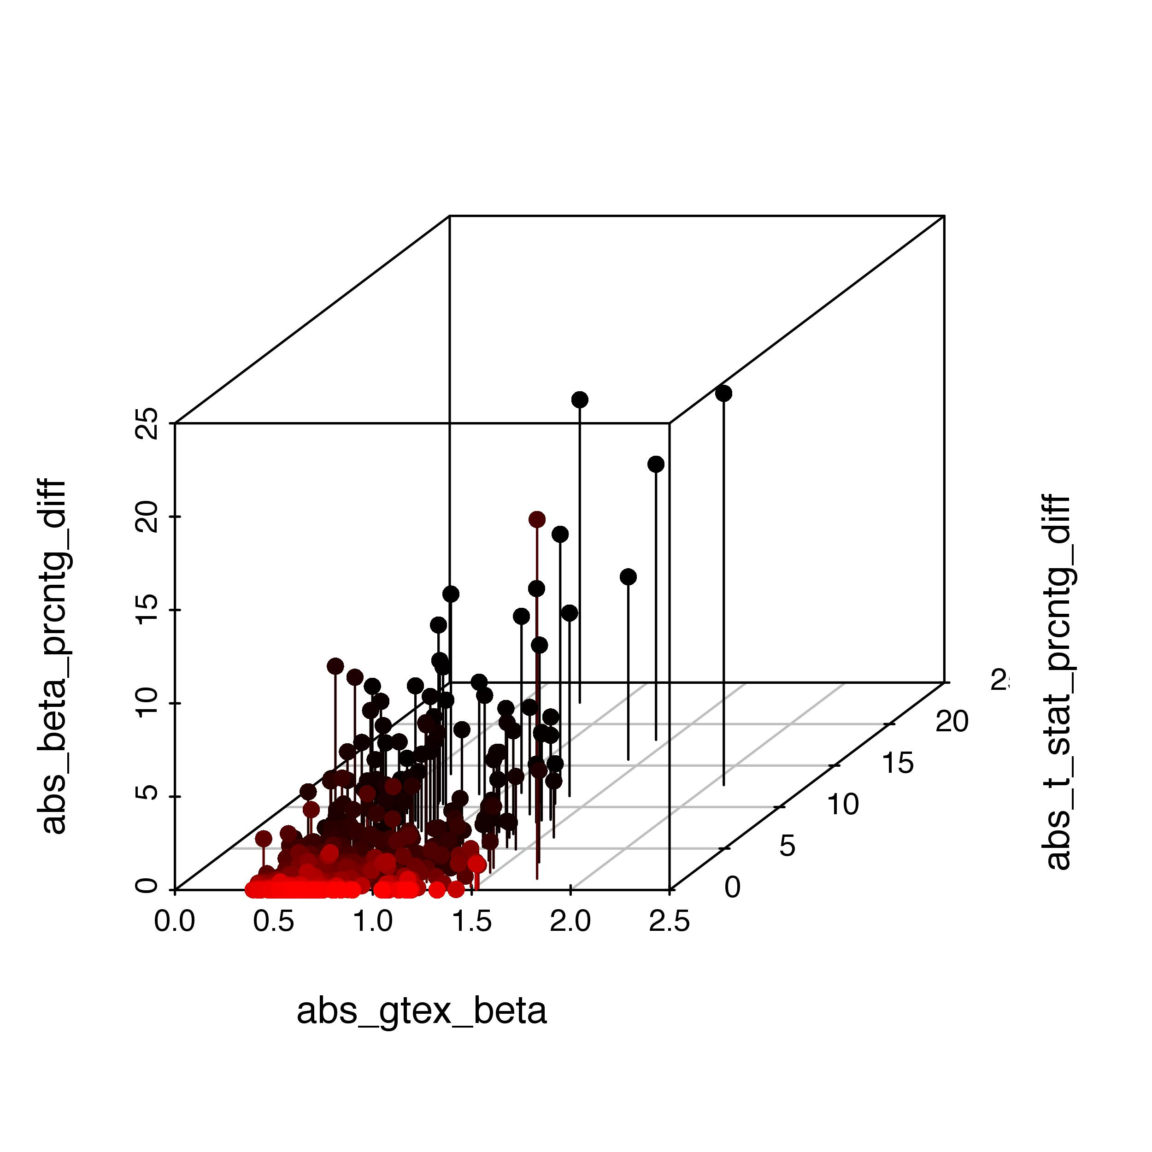
Are extreme beta values associated with disparities?
(considering both t-statistics & beta values)

Slide 5
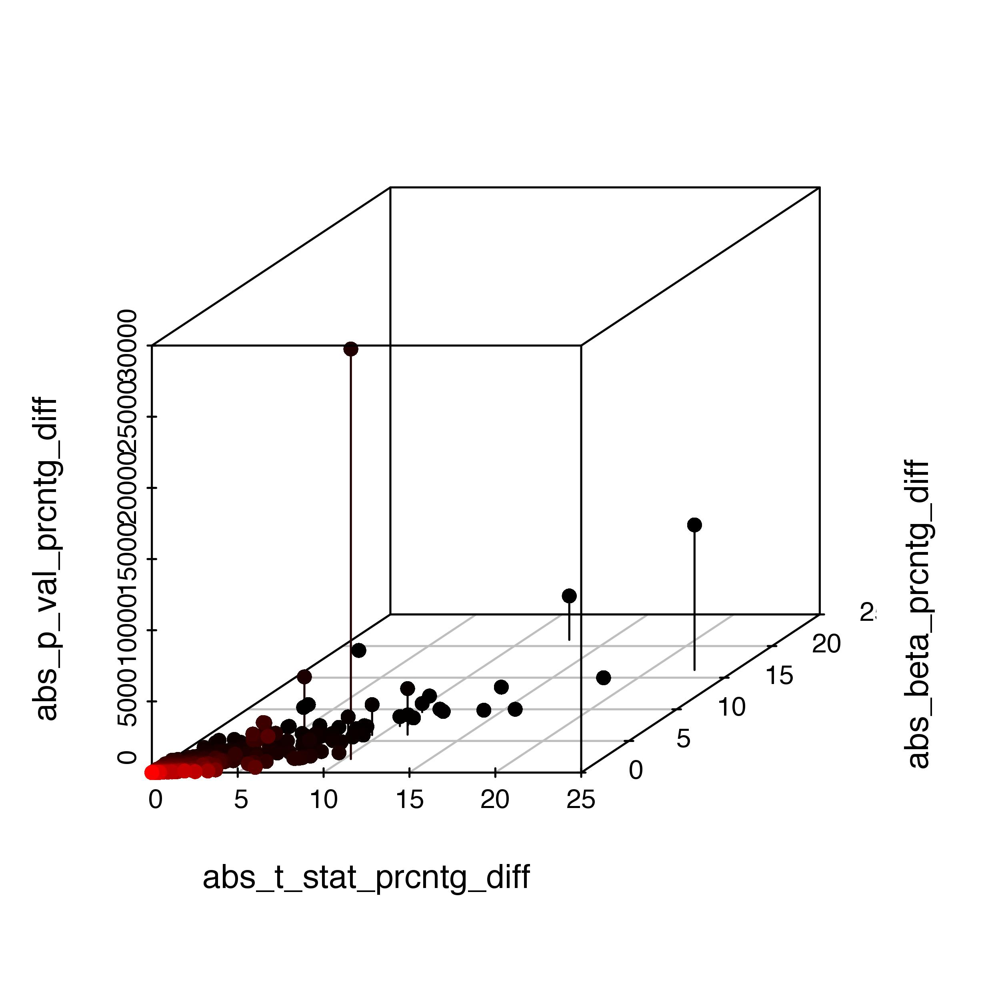
Which parameter values are ultimately associated
with poor p-value reproducibility?

Slide 6
Misc notes
Take-home message: Control inconsistencies in beta stats (much stronger concordance w/GTEx likely to follow)
current status w/GTEx staff
results reported here were for ~800 eQTLs in brain_cerebellum
GO Analysis: Idea that outliers have specific biol roles? --> seems not to be the case (tried both standard analysis and also tried using the popular ”amiGO" enrichment tool)

