Slide 1
Investigating links to GTEx eQTLs. -- ie, are there detectable eQTLs in GTEx Whole Blood samples that actually arise from miRNA-eQTLs (available in published Framingham dataset), wherein the “GTEx gene” is the target of the associated miRNA?
Framingham miR-eQTL
?
miRNA
Protein-coding gene
SNV
GTEx eQTL

Slide 2
Evaluating coupled effects
Effect Directionality: evaluate SNV effects by measuring the slope ('beta') of from linear regression – compute as the effect of the ALT relative to the REF allele in the human genome reference GRCh37/hg19
Model w/Simple Linear regression
expr = α + βs + ε
expr: gene expression
s: genotype
ε: noise
C A
C A
Fig modified from Albert and Kruglyak, NRG (2015)

Slide 3
Total # w/“opposite beta” values: 3052 / 4731
GTEx eQTLs
(Beta signs)
miR
Gene
847
2357
3204
Framingham mirQTLs
(Beta signs)
695
832
1527
1542
3189
miR
Gene
* NOTE: total # of genes: 63

Slide 4
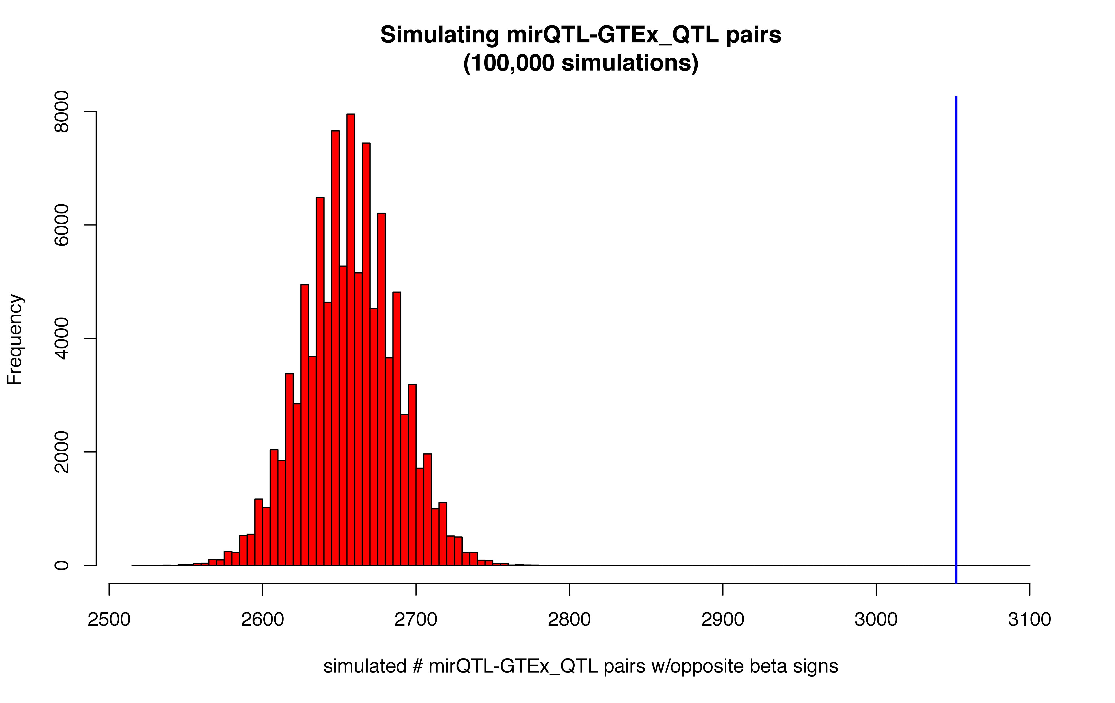
Analytically-derived 2-sided p value for num_opposite_beta_vals (3052) = 1.319E-30 (derived w/pen-and paper calculation & normal approx to binomial distribution)
Also: 100,000 simulations to check for significance
+ most_extreme__num_w_opposite_sign: 2784
+ mean value from simulations: 2657.5
+ 2-sided p-value = 0.0
Observed = 3050

Slide 5
miRNAs within
the genes themselves
N = 43 pairs( < 1%)
6 miRNAs, 4 genes
miRNAs outside
the genes
N = 4688 pairs
39 miRNAs, 59 genes
miR
Gene
miR
Gene
# w/opposite beta vals: 8/ 43
# w/opposite beta vals: 3044/ 4688
21
4
826
2353
4
14
691
818

Slide 6
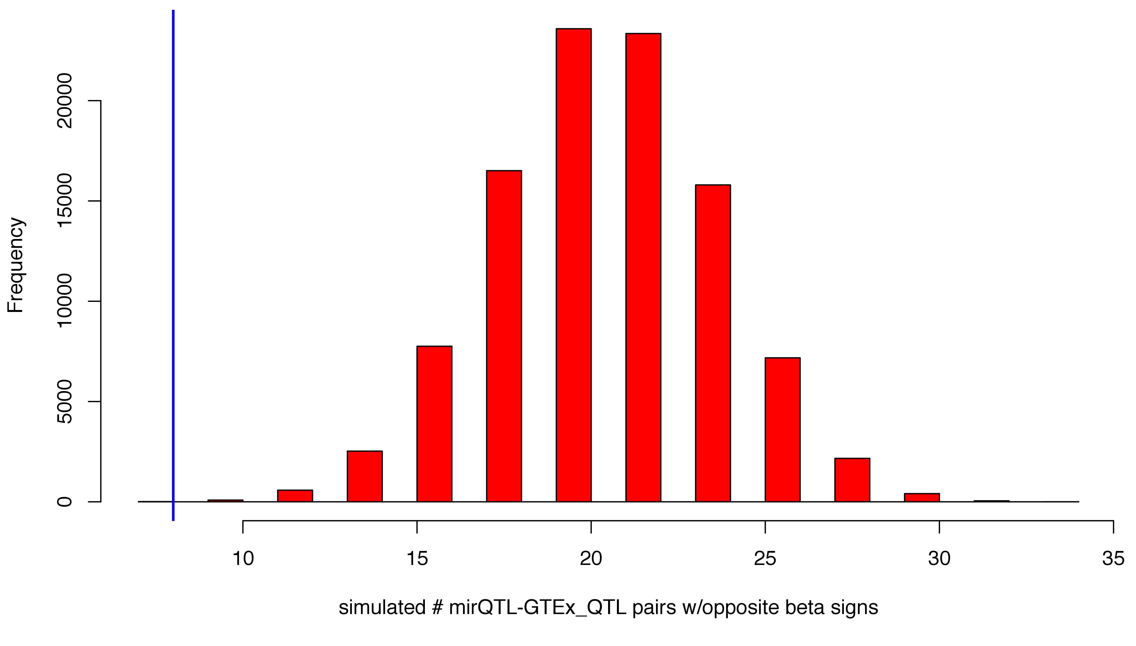
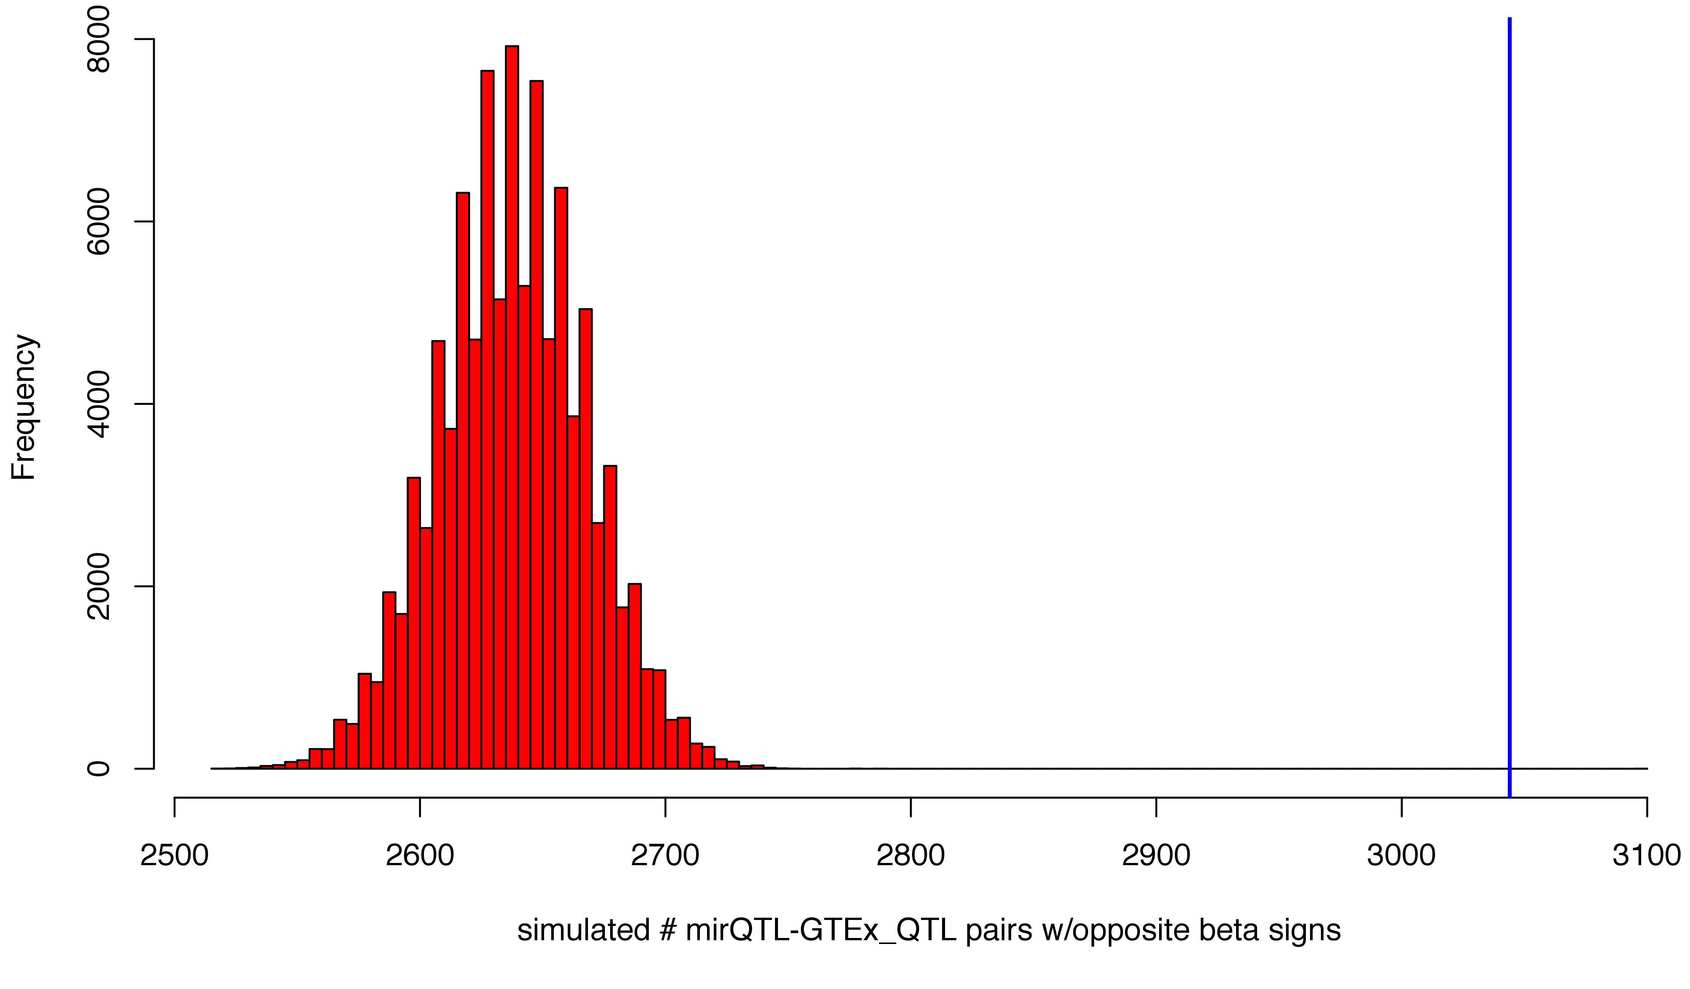
miRNAs within
the genes themselves
N = 43 pairs( < 1%)
6 miRNAs, 4 genes
miRNAs outside
the genes
N = 4688 pairs
39 miRNAs, 59 genes
miR
Gene
miR
Gene
Obs = 8
Obs = 3044
* P-val ≈ 9.2 E-16
* P-val ≈ 1.3 E-30
P-val derivations in supplementary slides

Slide 7
No direct miRNA-gene linkages identified
- Possible that the miRNA is acting on gene expression indirectly – in which case, networks based methods may prove useful
- one caveat w/this reasoning: if this is the case, then why is it that the “primary target” is not captured as a GTEx eQTL?
Intermediary
Factor A
Intermediary
Factor B
Gene
miR
Next steps
- used mirTARbase for targets of miRNAs, but will also try with updated TARbase
- investigate trans eQTLs from processed Freedman dataset (lower confidence)
- sanity checks:
> reverse the question: among any "true" linkages -- see if beta values match, and also t-values, etc
> check other tissues (we expect it to be lower)
- if any "true" linkages found, search for overlap w/gwas datasets
- If discovered, miRNAs as “brokers of eQTL signals” would be a simple explanatory mechanism behind a subset of eQTLs in GTEx
- Implications for miRNAs as therapies

Slide 8
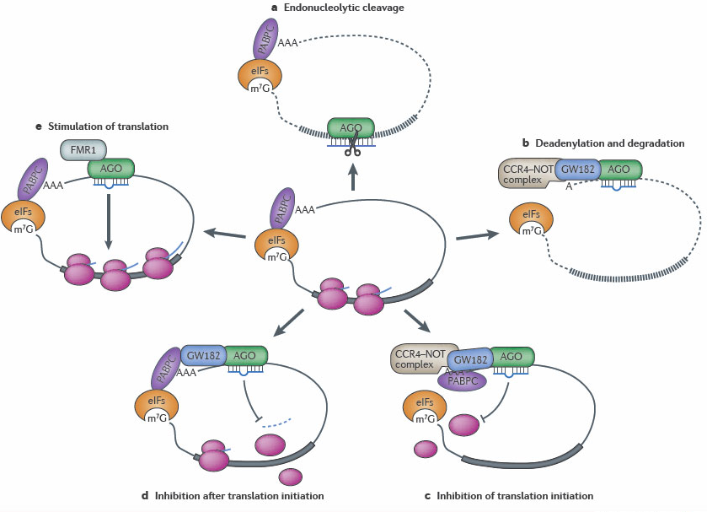
A note on miRNA mechanisms (canonical mechanism may not be the only one in play!)
A.E. Pasquinelli, NRG (2012)

Slide 9
Supplementary slides

Slide 10
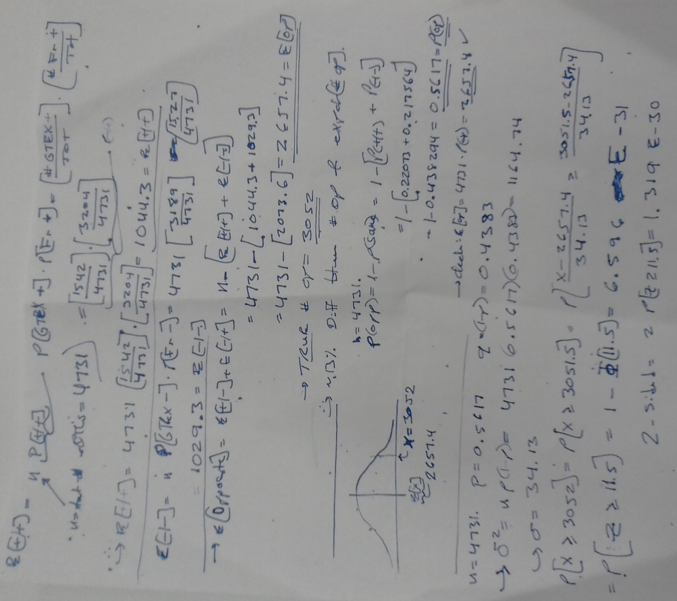
p_value_derivation_all_miRNAs

Slide 11
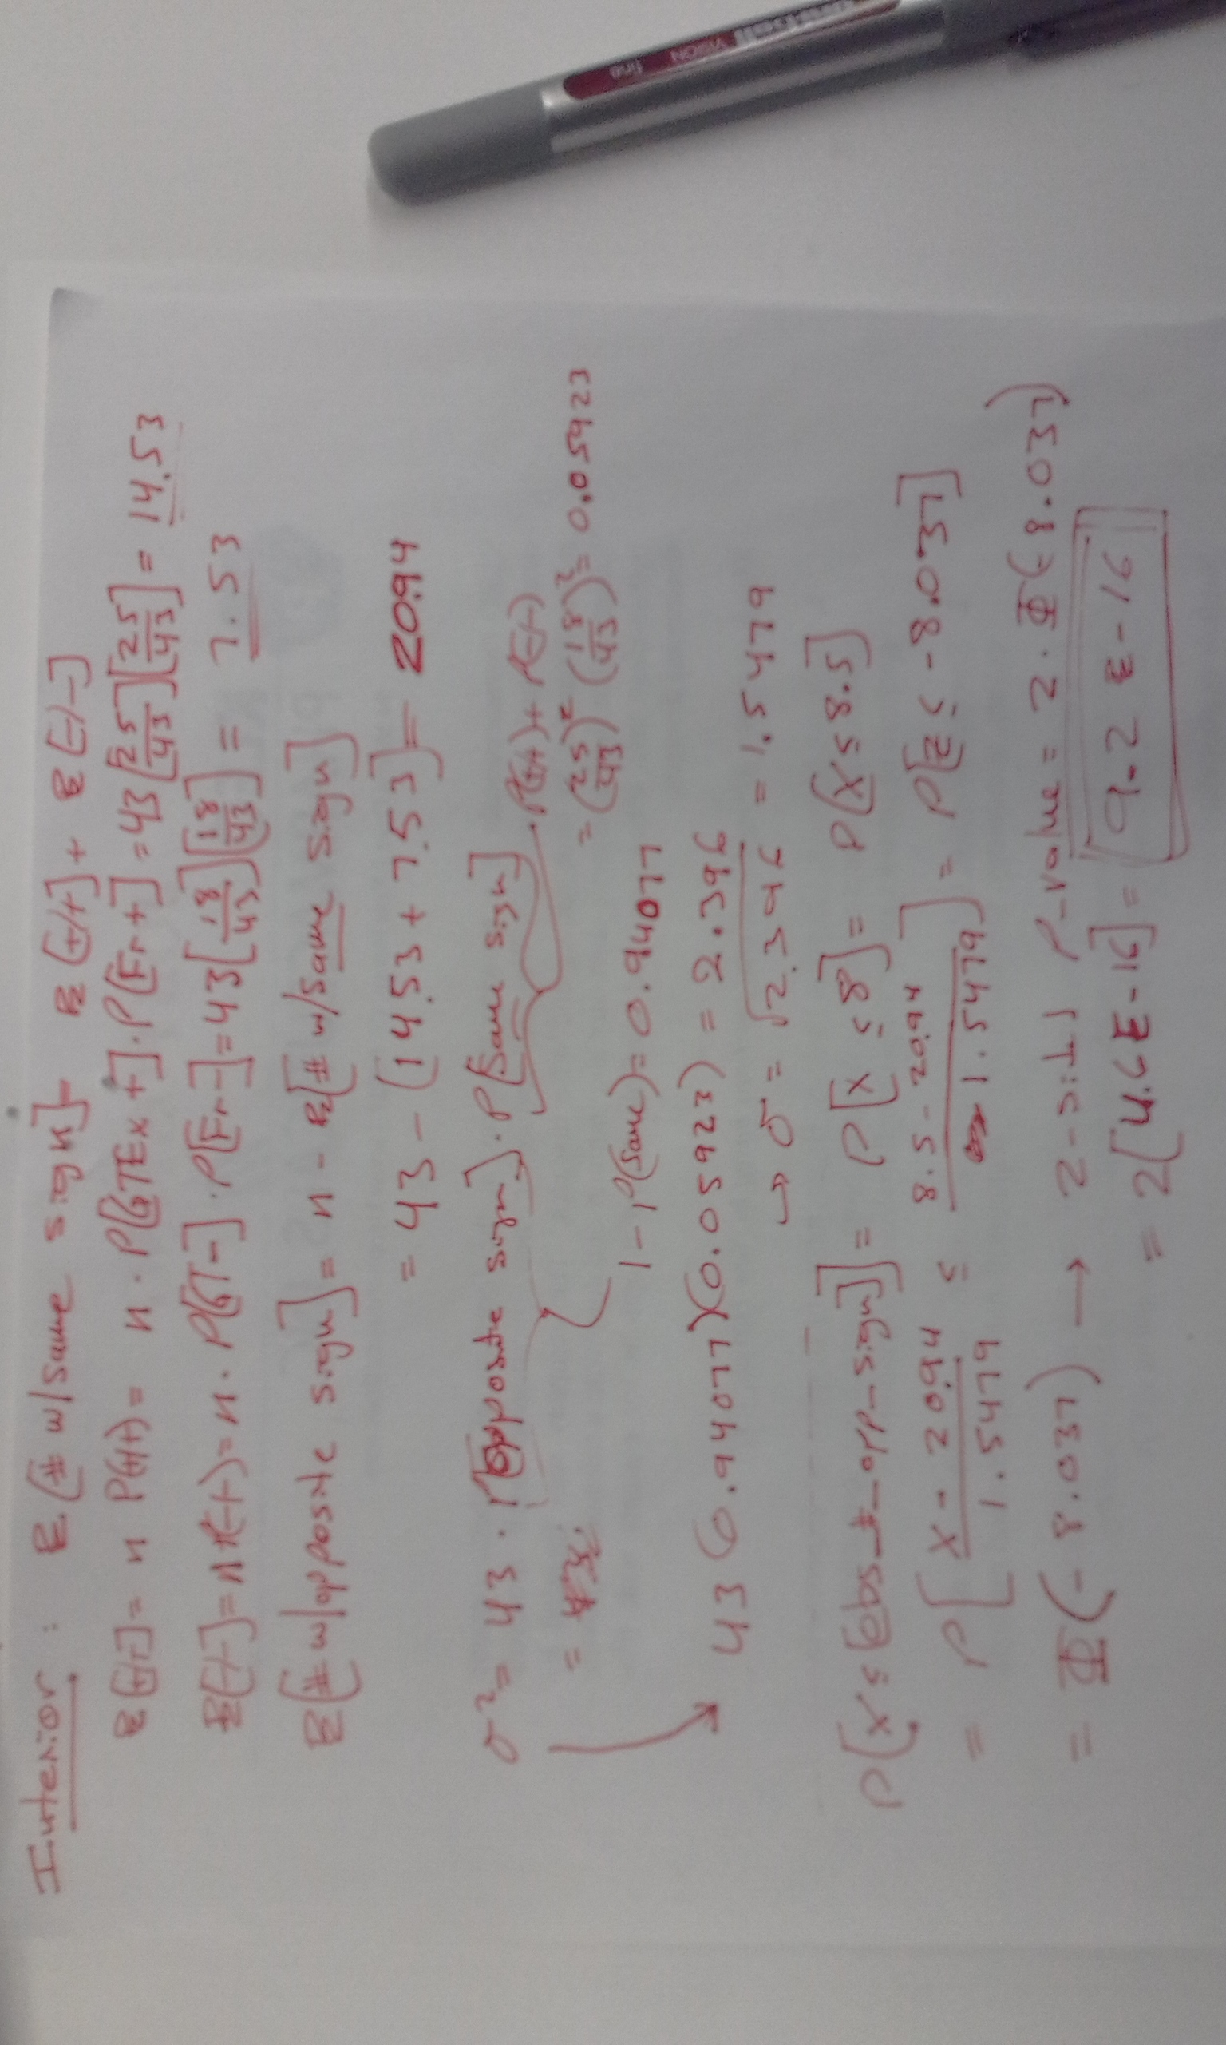
p_value_derivation_interior_miRNAs

