Slide 1
PsychENCODE CAPSTONE project #4
Integrative analysis with CommonMind,GTEX,ENCODE and ROADMAP
PsychENCODE CAPSTONE project #4 group
12/07/2016

Slide 2
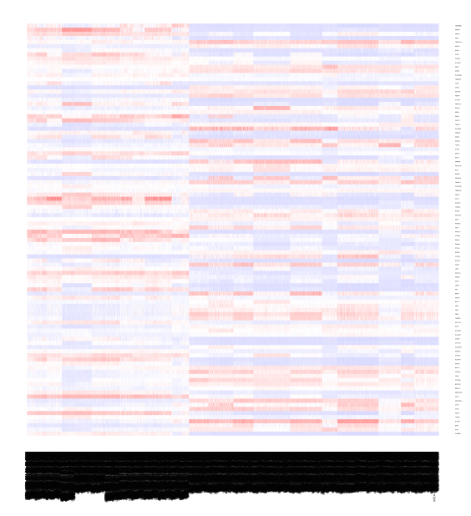
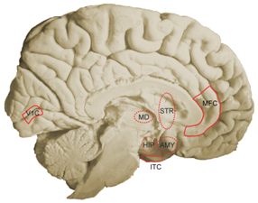
Figure 1 Brain specific gene expression patterns and functions
A. Brain specific genes
B. Brain region specific genes
C. Co-expression patterns of brain genes
Regions
AMY
MD
HIP
CBC
Developmental stages (or tissues)
STR
NCX
D. Pathways and functions of brain genes
E. Summary table
# of brain genes
# of region genes
# of common co-expressed genes across regions
# of region spec. co-expressed genes

Slide 3
Figure 2 Novel (non-coding) transcriptional regions in Brain
A. Brain specific TARs
B. Brain region specific TARs
C. Associations with brain genes and functions
D. Summary table
# of miRNAs, lincRNAs, eRNAs, pseduogenes, …
Notes:
Figure 2 A,B-> top fig 1

Slide 4
Figure 3 Brain eQTLs
A. Integration
B. Pipeline for novel prediction
GTEx
CMC
GTEx+CMC+PEC
Enhancer region
GTEx+CMC+PEC
C. Enrichments of cis-eQTL compared to all eQTL in sequence-defined elements
D. Distribution of Brain eQTLs?
enhancers
eRNA
Notes:
(a) Enrichments of cis-eQTL compared to all eQTL in sequence-defined
elements
(b) Distribution of cis-eQTL location relative to the gene.
eqtls associated enhancers
QTL with Non coding TAR
eRNA QTL

Slide 5
Figure 4 Brain gene regulation
A. Brain enhancers
B. Specific enhancers vs. gene expression for brain samples
Heatmap
C. Matched brain genes and enhancers
Tissues-matched
Developmental-matched
D. eQTLs on brain enhancers

Slide 6
Table 1. Data resource: Brain genomics, transcriptomics and regulatomics
Brain gene
eQTLs
Expressed tissues: brain regions, other tissues
Enhancers
  Tissue or development
Pathways and functions
Gene regulation
  eQTLs vs. TFBSs on enhancers

