Slide 1
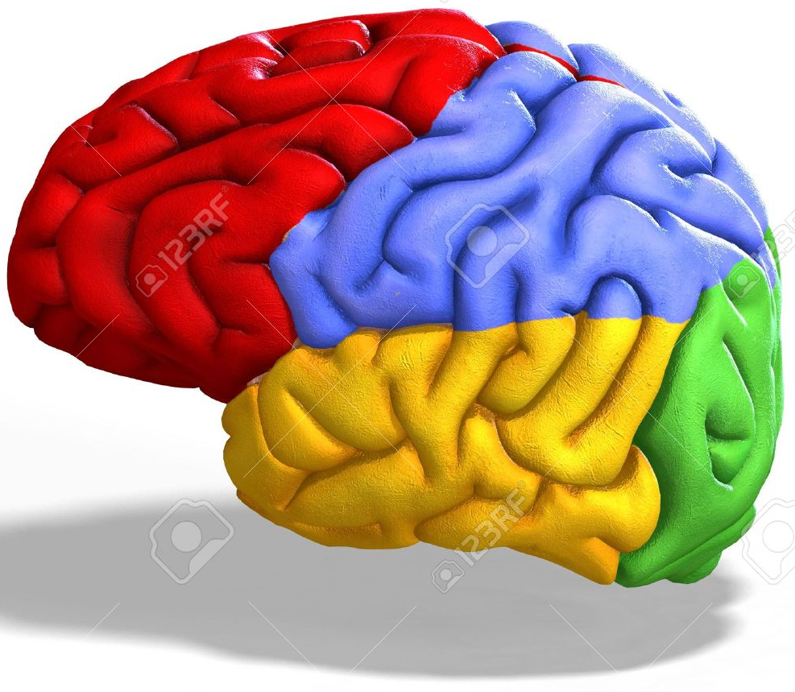
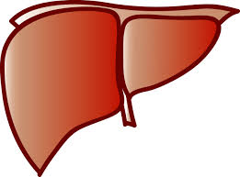
What regulatory elements or factors drive/govern brain-specific eQTLs?
→ (and esp. relative to what’s observed in other organs)
Gene
SNV
“generic eQTLs”
Brain-specific
eQTLs
region-specific
eQTL

Slide 2
What regulatory elements or factors drive/govern brain-specific eQTLs?
a) To what extent are brain-specific eQTLs governed through brain-specific enhancers? Available as roadmap data:
Cortex derived primary cultured neurospheres
Brain Angular Gyrus
Brain Anterior Caudate
Brain Cingulate Gyrus
Brain Germinal Matrix
Brain Hippocampus Middle
Brain Inferior Temporal Lobe
Brain Dorsolateral Prefrontal Cortex
Brain Substantia Nigra
b) Mutations within “brain-specific TFs” (or eQTLs therein)
c) Annotated promoter regions of “brain-specific genes” (from JP’s set)?
d) HiC data available for brain regions? Search for brain-specific chromatin features (specifically: do chromatin contacts specific to the brain lie close to brain-specific eQTLs? – suggests roles for enhancers)

Slide 3
Example scenarios
Relative to other tissues, brain-specific eQTLs are enriched for SNVs within 5’ untranslated regions
Non-coding SNVs associated with psychiatric disorders (through GWAS studies, etc) are more likely to affect enhancer elements relative to non-coding SNVs associated with diabetes.
Different diseases associated with different brain regions (ex: disease “a” affecting “region A” vs. disease “b” affecting “region B”) are marked by differential eQTL landscapes. – ex: disease a results from broken promoters, whereas SNVs associated w/disease b results from eQTLs within transcripts

