Slide 1
Survival5
Response to Steering Committee

Slide 2
Steering Committee Critiques
Response to Critique
Could these results be explained by patient age?
Could these results be explained by total mutation load?
Could these results be explained by differing mutational signatures?
Tabular effect sizes and p-values were already reported after adjusting for patient age (although the survival curves themselves do not yet represent this adjustment)
Tabular effect sizes and p-values were already reported after adjusting for total mutation load (although the survival curves themselves do not yet represent this adjustment)
This is a valid criticism, which I have now addressed by comparing functional burdens in observed vs randomized samples

Slide 3
What do I exactly do?
Cox proportional hazard
Survival ~ NormalizedFunctionalBurden + MutationLoad + PatientAge
NormalizedFunctionalBurden = a number from 0 (low) to 4 (high) that increases with the rank of two subscores:
NormalizedCodingFunctionalBurden
Sum of the FunSeq scores of mutations in essential coding genes that are not also PCAWG-driver-genes-in-this-subtype in the observed samples, minus the same in randomized samples
NormalizedNoncodingFunctionalBurden
Sum of the FunSeq scores of mutations in sensitive noncoding regions in the observed samples, minus the same in randomized samples
MutationLoad = count of noncoding mutations with FunSeq score < 0.5

Slide 4
Properties of my analysis
It is truly a passenger-based analysis
It appropriately addresses important confounders

Slide 5
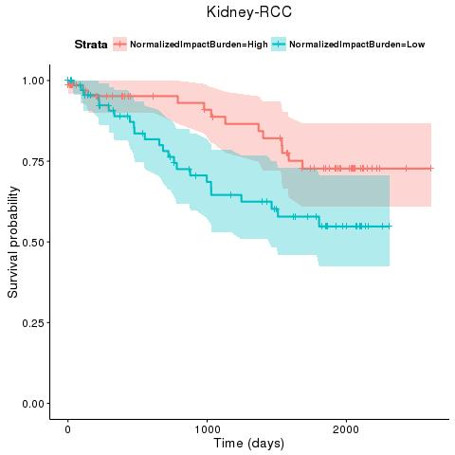
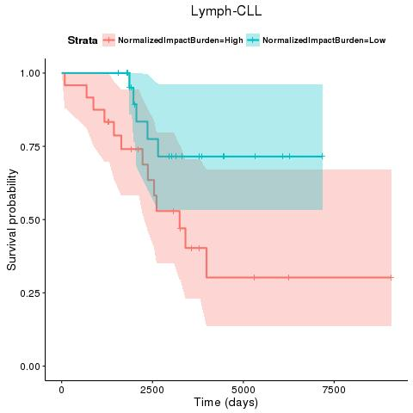

Slide 6
[1] "Lymph-CLL"
coef exp(coef) se(coef) z Pr(>|z|)
quart_Burden 0.3902771434 1.4773902 0.1558985882 2.503404 1.230051e-02
NC_count -0.0006531121 0.9993471 0.0002980615 -2.191200 2.843735e-02
Age 0.0775046872 1.0805873 0.0192201075 4.032479 5.519146e-05
[1] "Kidney-RCC"
coef exp(coef) se(coef) z Pr(>|z|)
quart_Burden -3.071326e-01 0.7355531 1.497812e-01 -2.0505421 0.04031156
NC_count -2.086096e-05 0.9999791 6.376404e-05 -0.3271587 0.74354785
Age 1.848090e-02 1.0186527 1.694859e-02 1.0904092 0.27553292

Slide 7
Secondary Findings
In the course of controlling for confounders we observed some interesting associations, which replicate literature findings
For every quartile in low-impact noncoding mutation count,

