Slide 1
ENCODE Cancer Supplementary

Slide 2
Figure 1 related Supporting Figures

Slide 6
Figure S1.x mutational heterogeneity due to local context effect
3mer model was used to predict the context specific mutation rate base on 1mb bins. The median mutation rate for each 3mer was shown in the radial plot. In general, we observed higher mutation rate in all positions with *C* and *G* context. The max and min median mutation rate among different 3mers ranges from 5.085 (liver cancer) to 25.278 (CLL), even after adusting the effects from genomic features.
Comments from JZ:
Potentially a very nice and beautify figure to go to the main figure pack. However, mutsigCV has something similar to this one. And it mainly showing the heterogeneity, not the contribution of the covariates.

Slide 7
Figure S* Number of variants per sample per cancer type

Slide 8
Table S* Summary of variant number per sample
Cancer | min | max | median | mean | sd | nSample
Breast-AdenoCa | 1207 | 65256 | 5203 | 7241.010256 | 7709.552967 | 195
Lymph-CLL | 755 | 5645 | 2286 | 2440.266667 | 901.2233608 | 90
Lung-AdenoCA | 570 | 190653 | 21117 | 36167.35135 | 44872.58571 | 37
Liver-HCC | 711 | 32597 | 11101 | 12066.5082 | 5806.534533 | 61
Lung-SCC | 5390 | 136115 | 43797 | 45623.74468 | 24266.47403 | 47

Slide 9
Figure S* Number of variants per cancer type

Slide 13
Correlation of covariate heat map

Slide 19
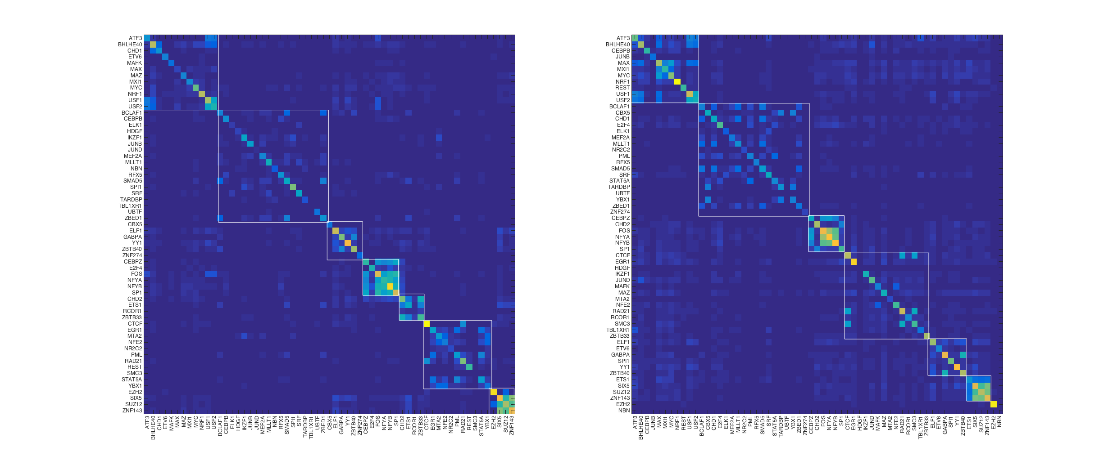
GM

Slide 20
K562

