Slide 1
Bullet point and Figure For E&C

Slide 2
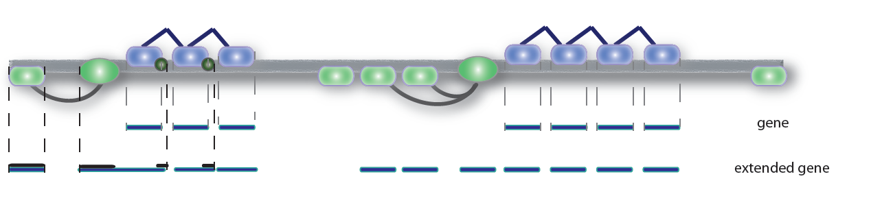
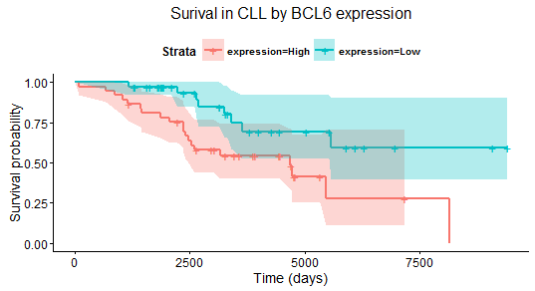
A
B
C
D

Slide 3
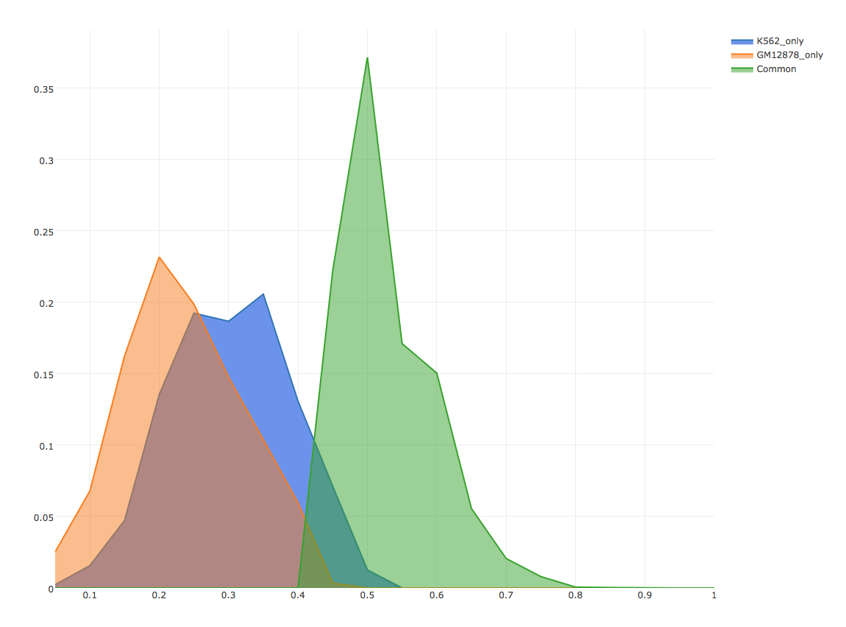
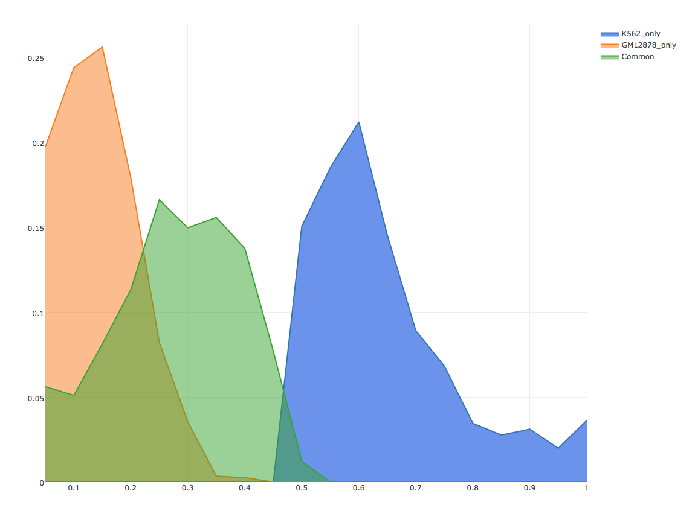
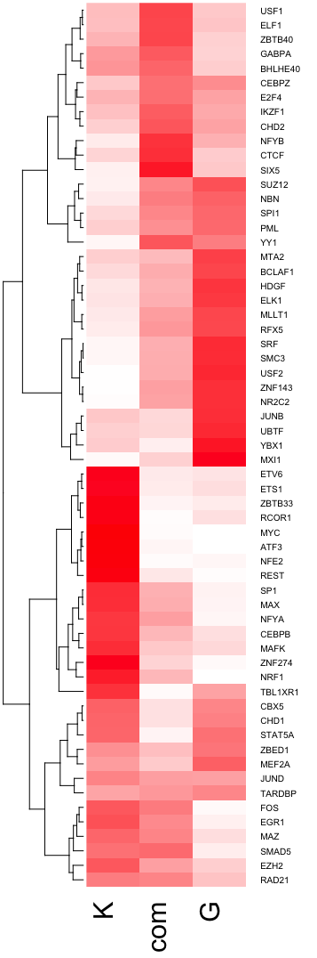
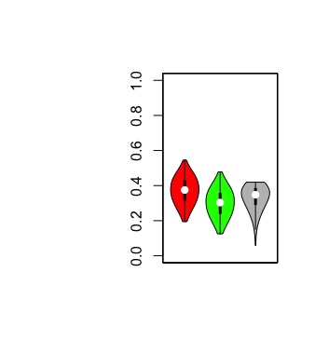
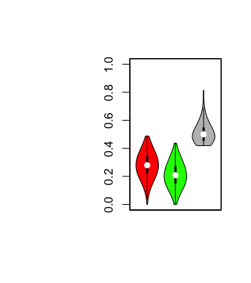
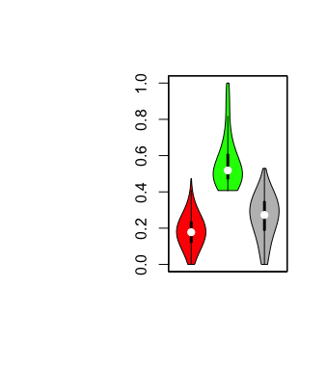
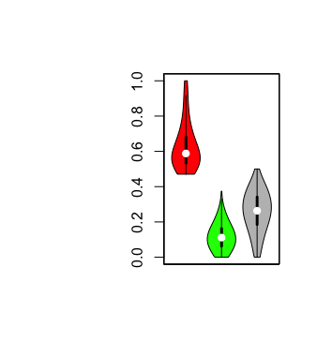
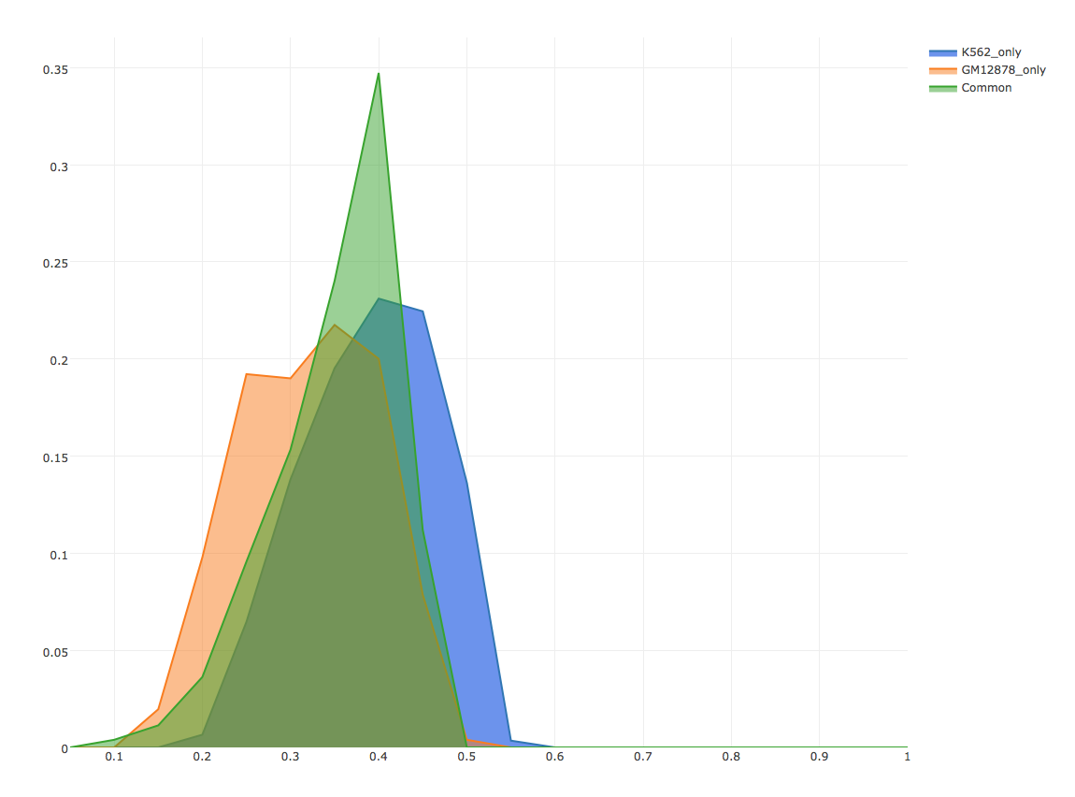
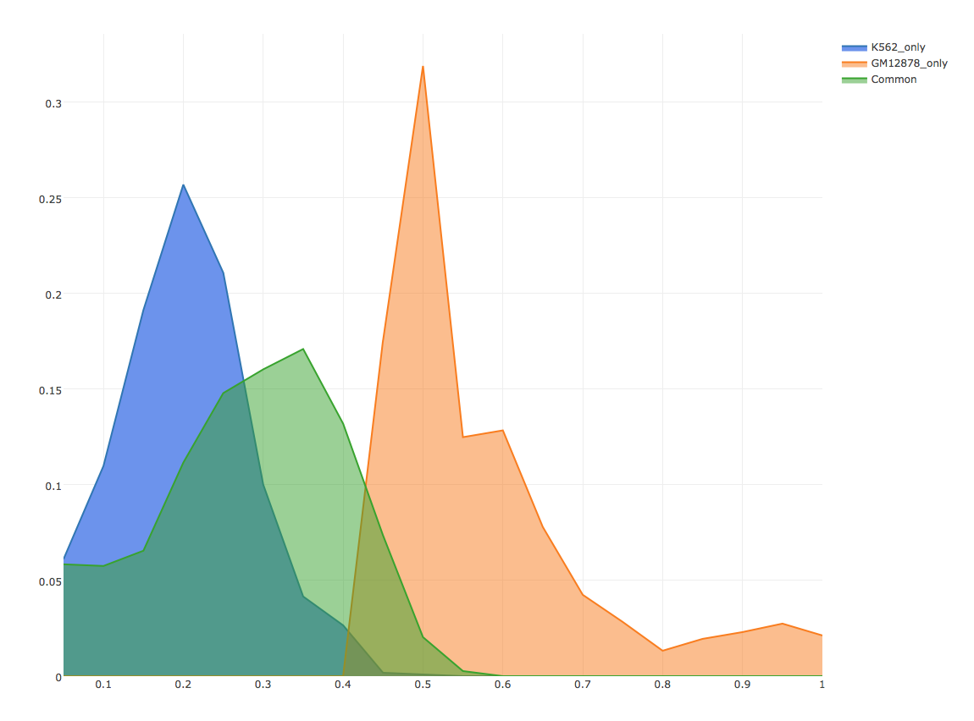
A
B
C
Dynamic
Static
USF1
MLLT1
Suppressed
Enhanced
D
TPM
DHS
MYC
H3K27ac
H3K27me3
JUND

Slide 6
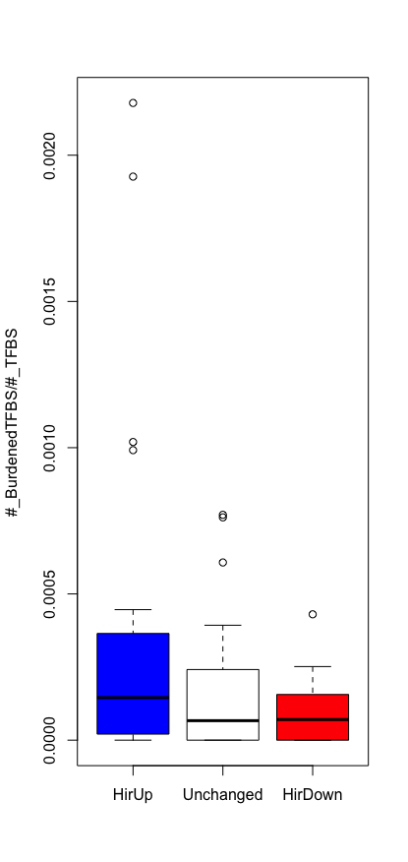
0.272
0.170
0.125

Slide 7
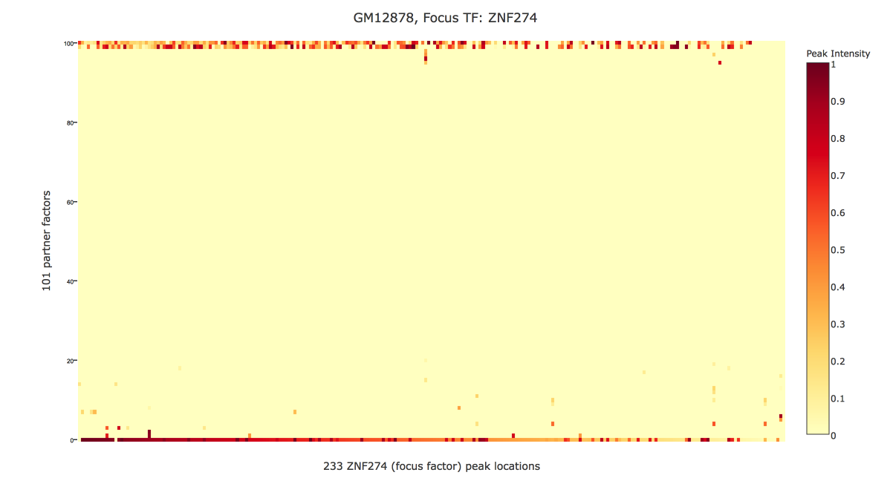
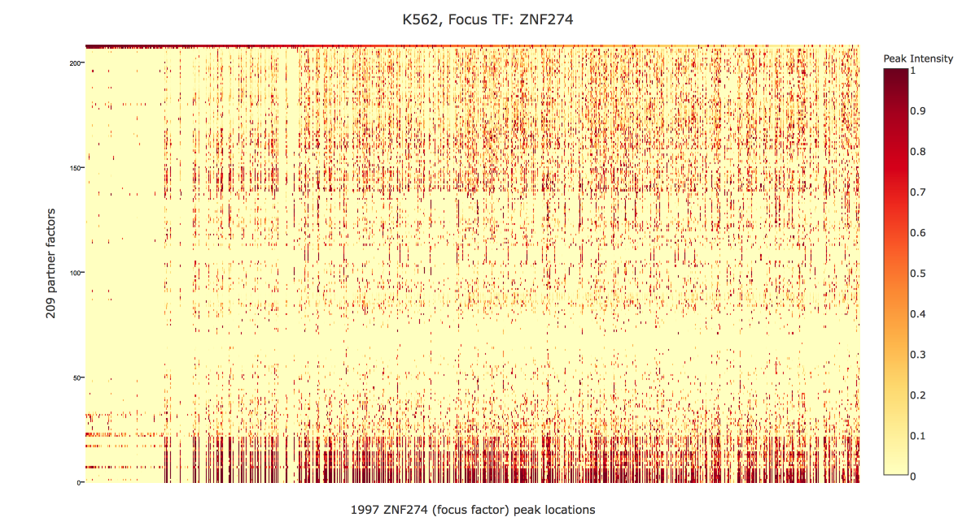

Slide 8
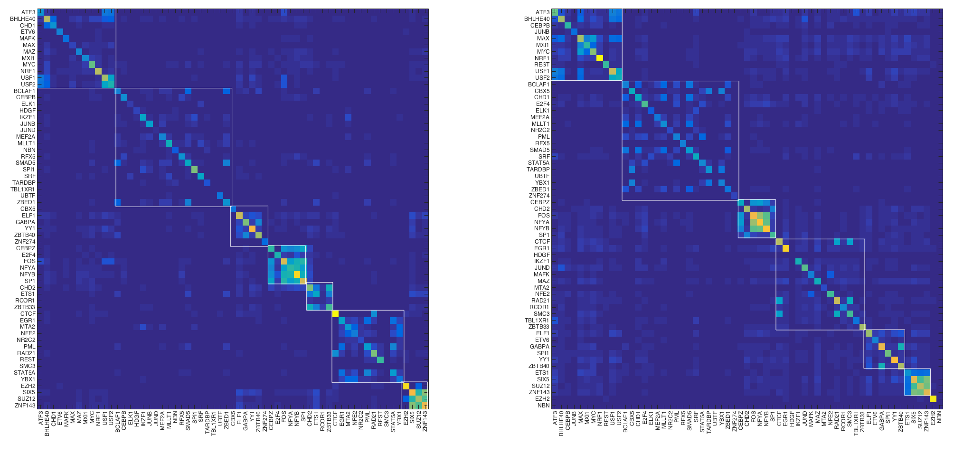
GM12878
K562
Regulation matrix RX,
CHD2, ETS1, ZBTB33 should be co-binding since they share motifs, but in K this is disrupted

Slide 9
Somatic SNVs
Annotated Regions?
Find in 1000 genomes?
Recurrence
Burdened Regions?
Conservation Score?
Highly Rewired TFs?
Other tissue?
Network
Chromatin Change?
Motif breaking?
Expression regulation?
Exact recurrence?
Ranked SNV for small scale validation
Regulatory Element Scoring
Individual SNV Scoring

