Slide 1
P3-VAR
MTG
12/14/2016

Slide 2
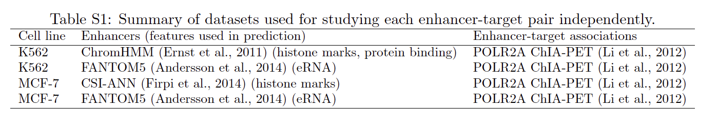
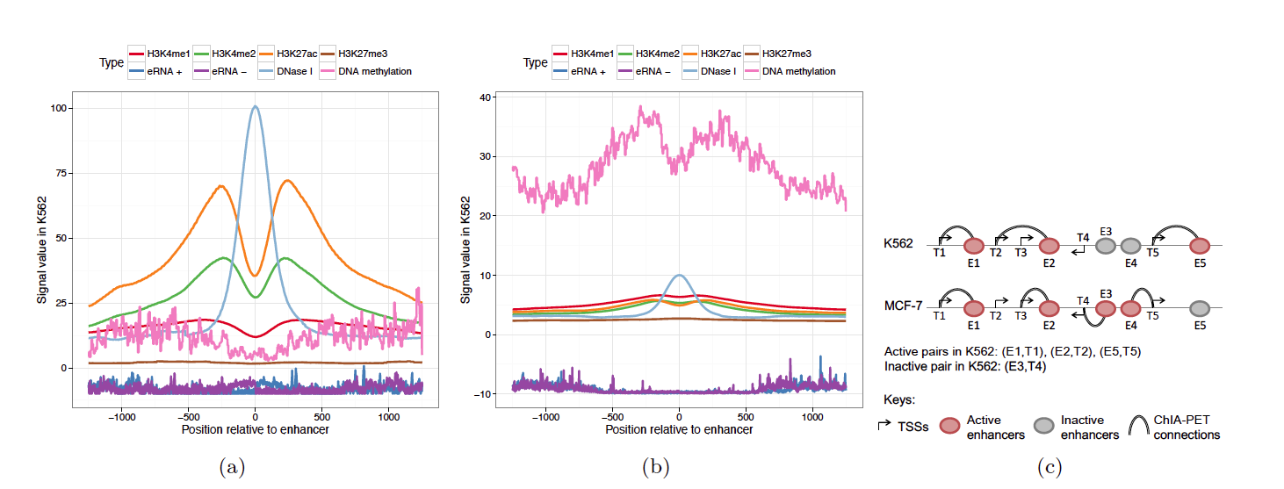
Notes:
Aggregation plot of enhancer features in K562 around FANTOM5 enhancers active in K562
Enhancers inactive in K562 but active in some other cell lines
Inactive pairs must have both the enhancer and the gene not involved in any active pair in K562

Slide 3
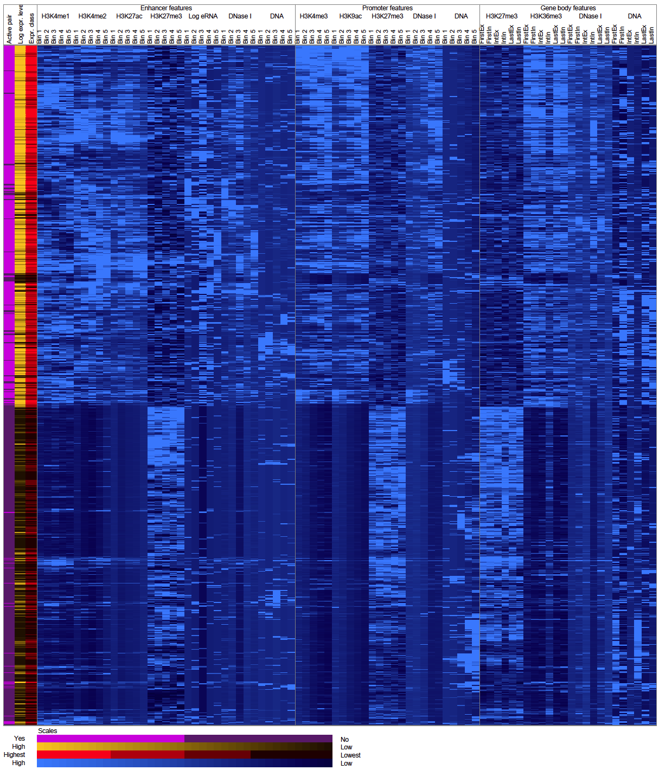
Notes:
Figure 1
Heatmap showing the correlations of enhancer, promoter and gene body features with gene expression
Each row corresponds to an active or inactive enhancer-target pair in K562, based on FANTOM5 enhancers
The second and third columns show the log-transformed expression level of the transcription start site (TSS) of the gene, and its expression class
The remaining columns show the enhancer, promoter and gene body features

Slide 4
However, if a gene is regulated by several enhancers in disjoint cell types, the activity of each enhancer may only correlated weakly with the expression of the gene across the cell types
Collect enhancer features and gene expression levels for 935 human primary cell types, tissue types and cell lines (127 from Roadmap + 808 from FANTOM5)
Consider all enhancers within 1Mbp of each transcription start site (TSS) as potential regulating enhancers
Notes:
Roadmap enhancers: activity defined by histone modifications
FANTOM5 enhancers: activity defined by enhancer RNAs (eRNA)
No Hi-C or ChIA-PET data available for most samples

Slide 5
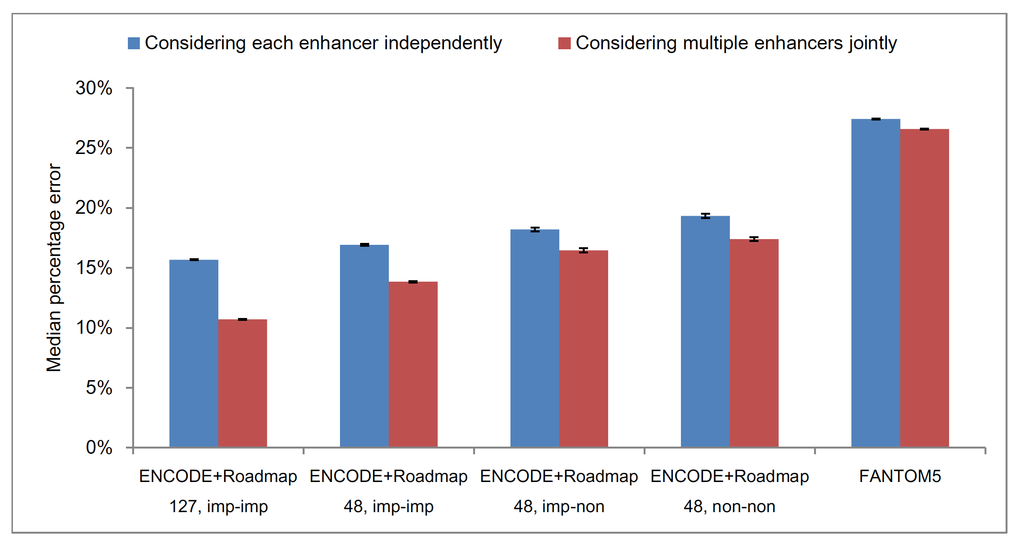
Notes:
Figure 2
Regression errors of the statistical models with and without considering multiple enhancers potentially regulating a TSS at the same time.
Regression model: (linear regression model implemented in Weka
Log-transformed expression values ~
|y_i – y_telta| / y_i, y_i is an actual expression, y_telta is the expected expression
The median of these error values among all genes was recorded
Five-fold cross-validation
Procedure repeated ten times

Slide 6
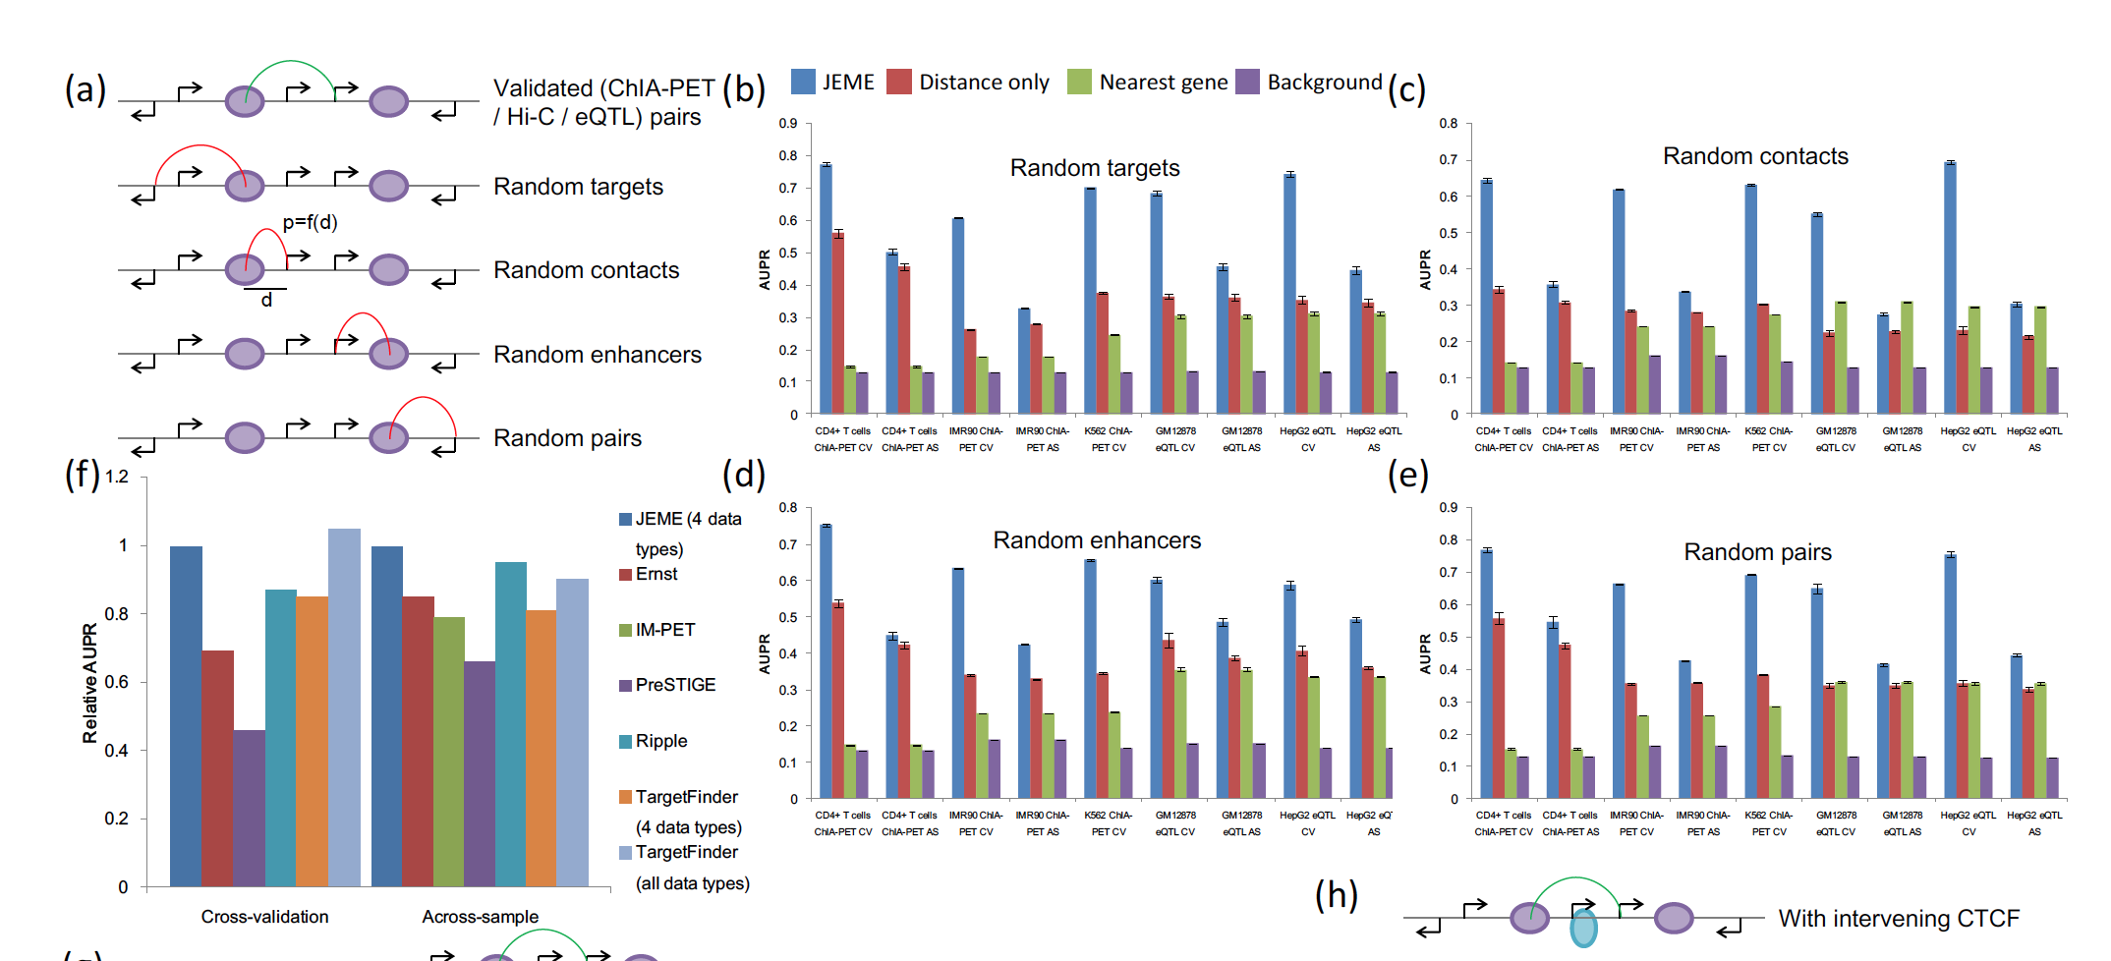
Notes:
Figure 3
######Divide all the included TSS into four equal-sized classes based on their expression levels: highest, medium-high, medium-low, lowest
Select one-fifth of the pairs as a left-out testing set
Remaining four-fifth for training a Random Forest model for each of the four expression classes
Error bars show the standard deviations of 10 repeated runs based on different random training and testing sets.
f) The relative AUPR of JEME was fixed at 1 for computing the values of the other methods.

Slide 7
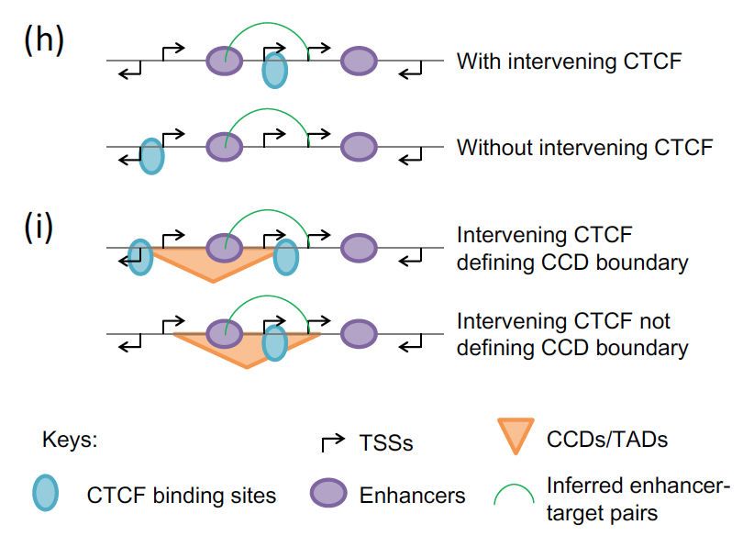
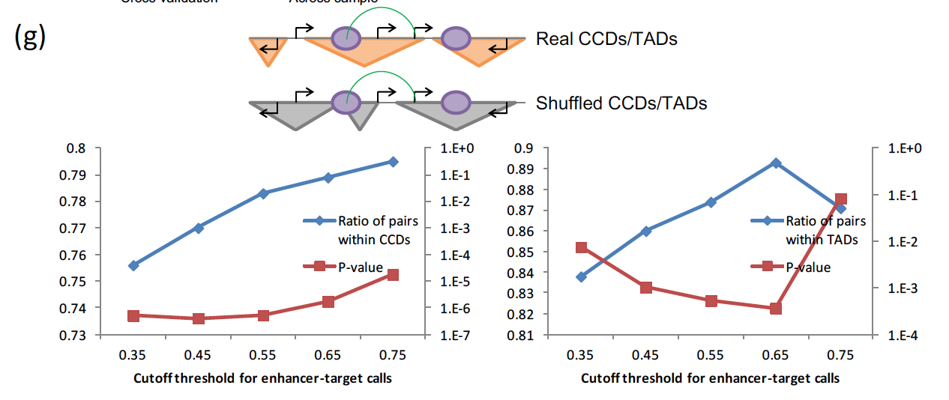
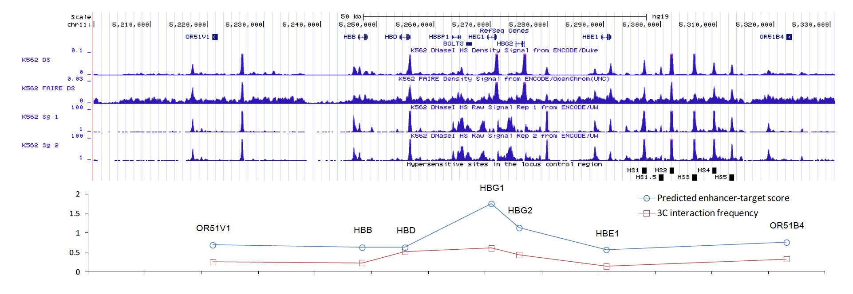
Notes:
Figure 3
(g) Comparing the fractions of inferred enhancer-target pairs within GM12878 CCDs and IMR90 TADs with the fractions within shuffled domains.
(h) An enhancer-target pair that has or do not have intervening CTCF binding.
(i) Intervening CTCF that defines CCD boundary or not. (j) Locus control region (LCR) around the human beta-globin locus in K562.

Slide 8
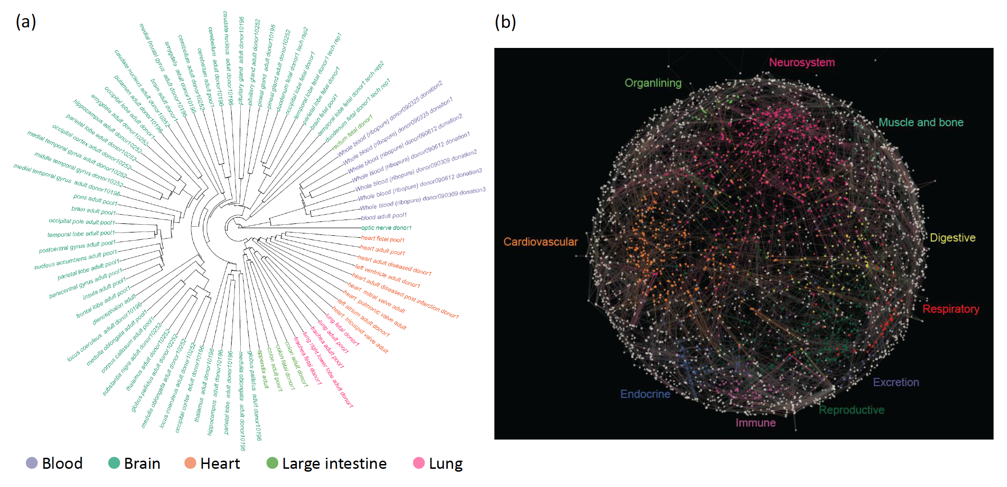
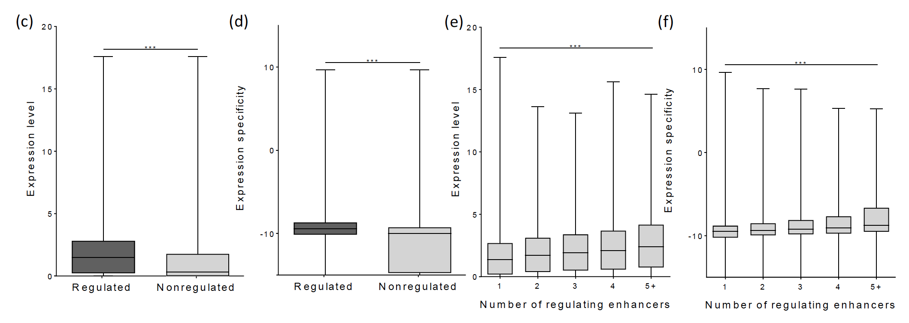
Notes:
Figure 4
a) Clustering of FANTOM5 samples from the largest facets, based on similarities of their enhancer-target networks
b) Subnetworks active in only a single groups of FANTOM5 tissues for the enhancers and TSSs in chromosome 1.

Slide 9
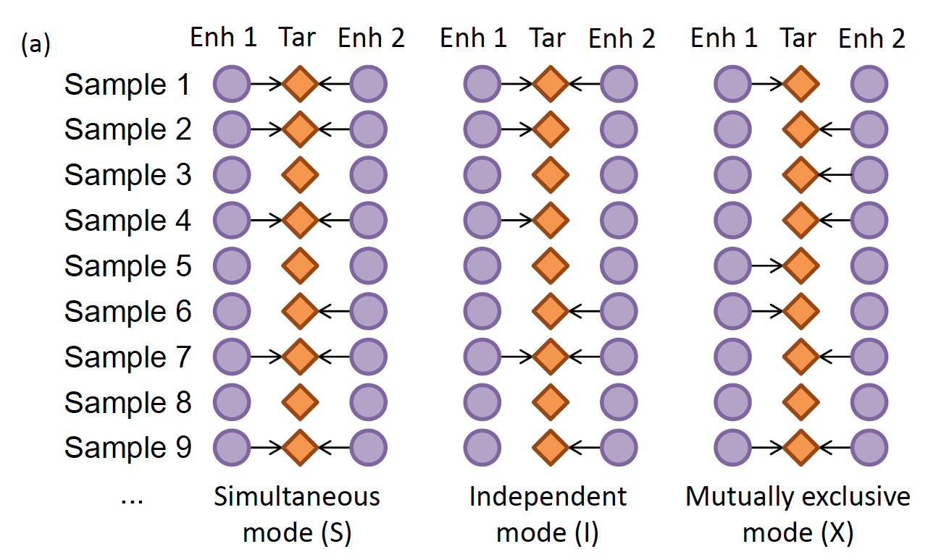
Notes:
Figure 5

Slide 10
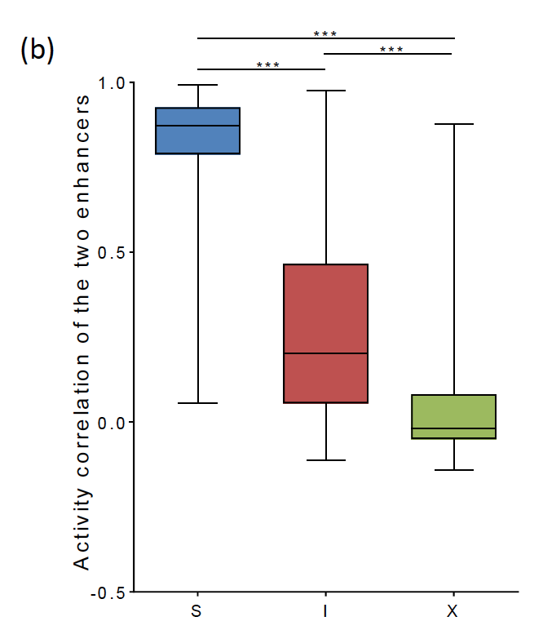
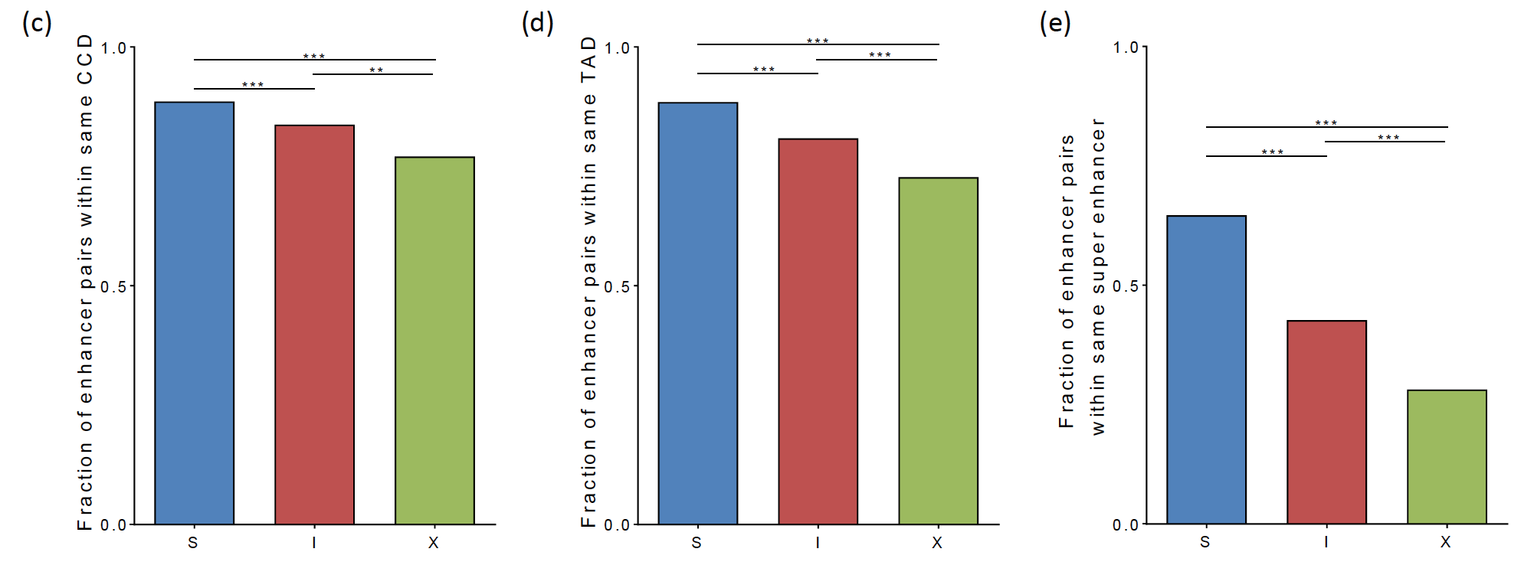
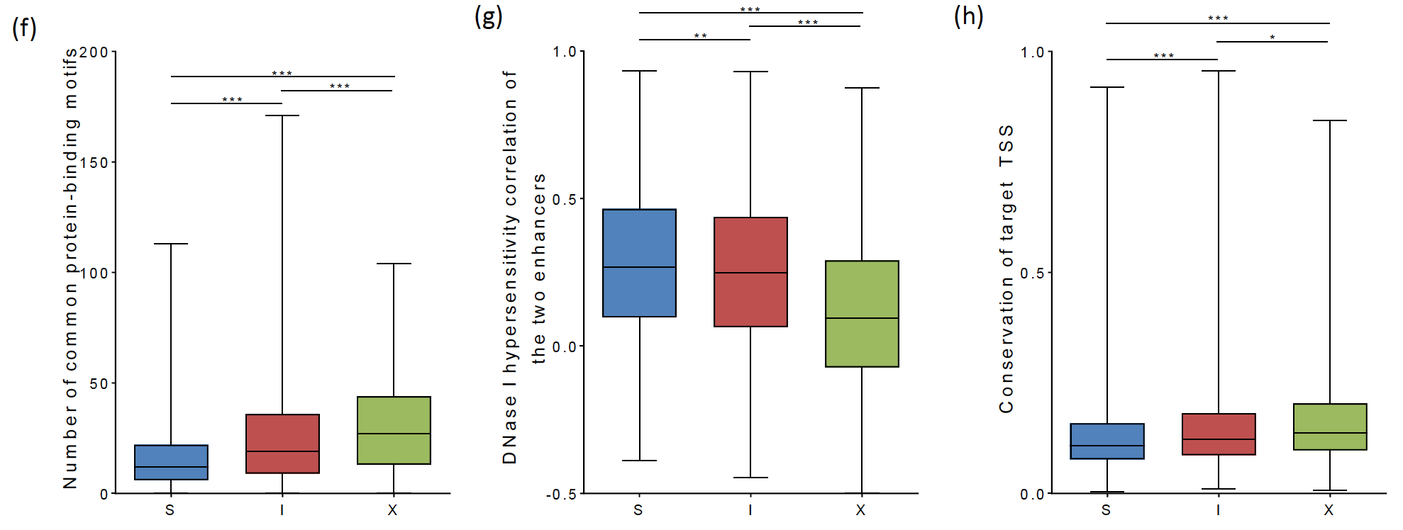
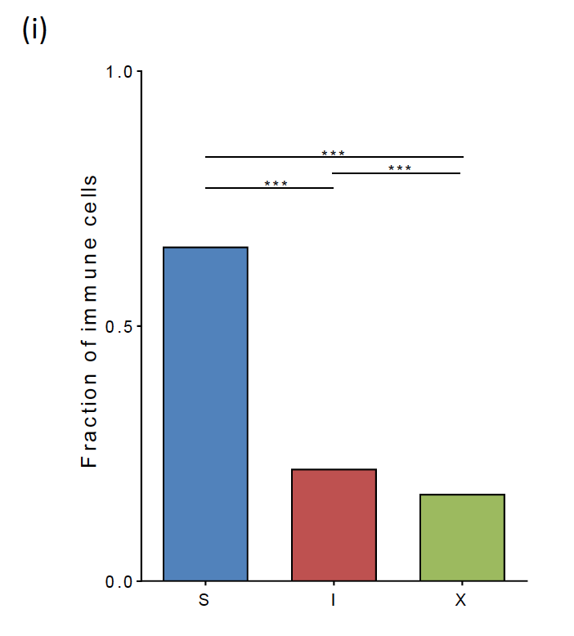
Notes:
Figure 5

Slide 11
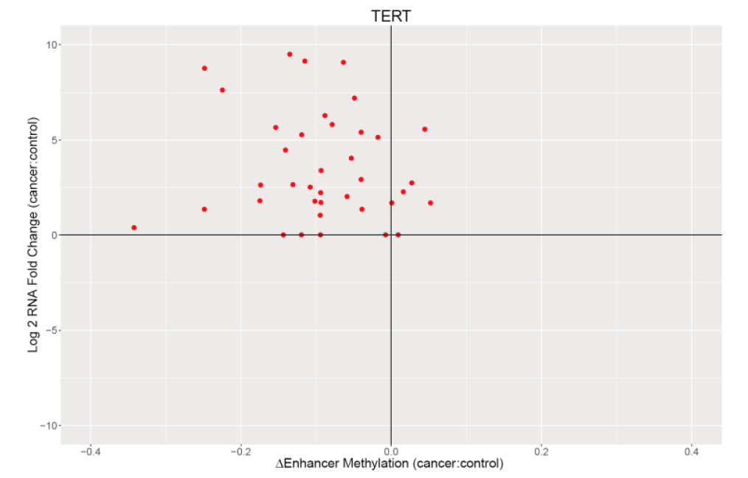
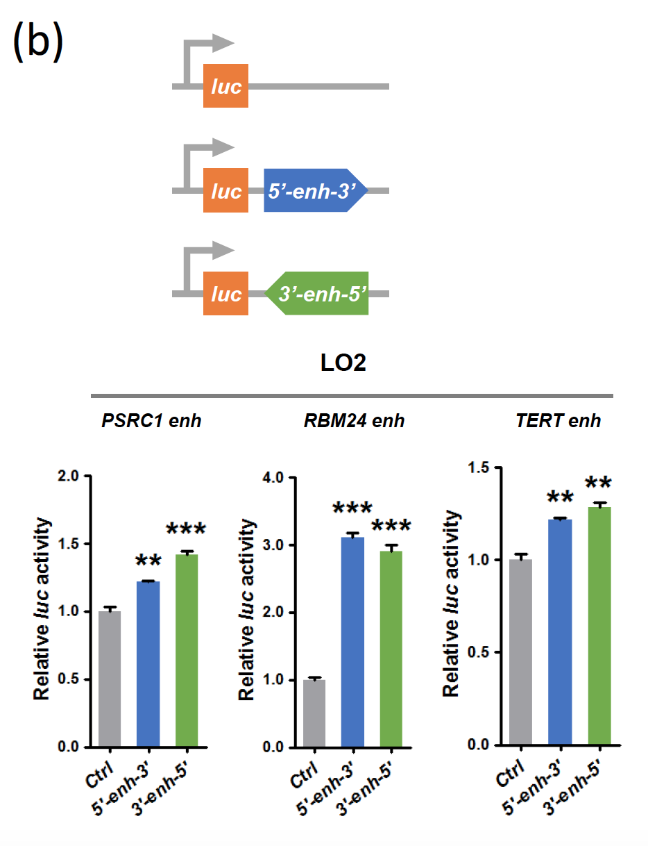
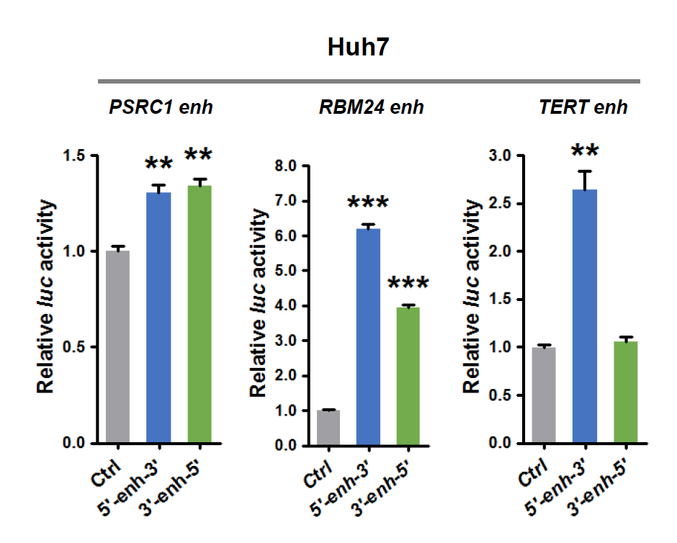
Notes:
Figure 6
HCC cancer genes identified by liver-related enhancer-target networks
PSRC1
RBM24

Slide 12
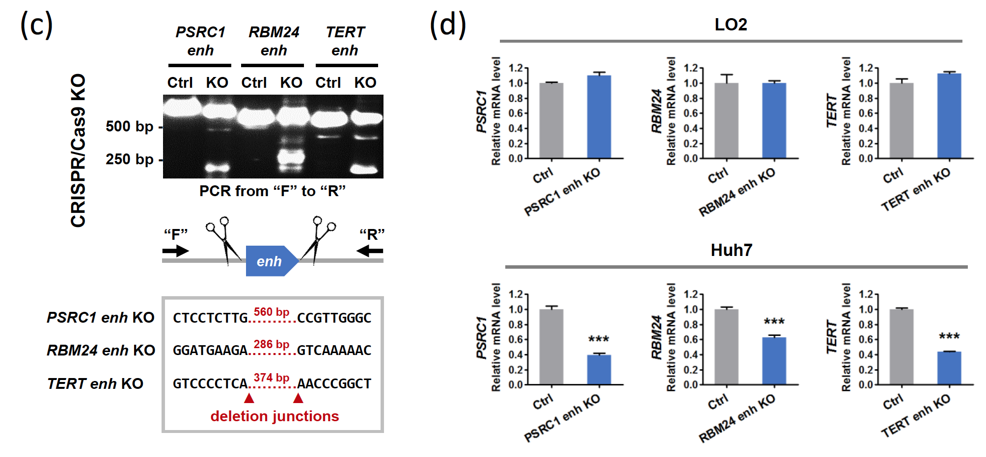
Notes:
Figure 6

