Slide 1
TF network

Slide 2
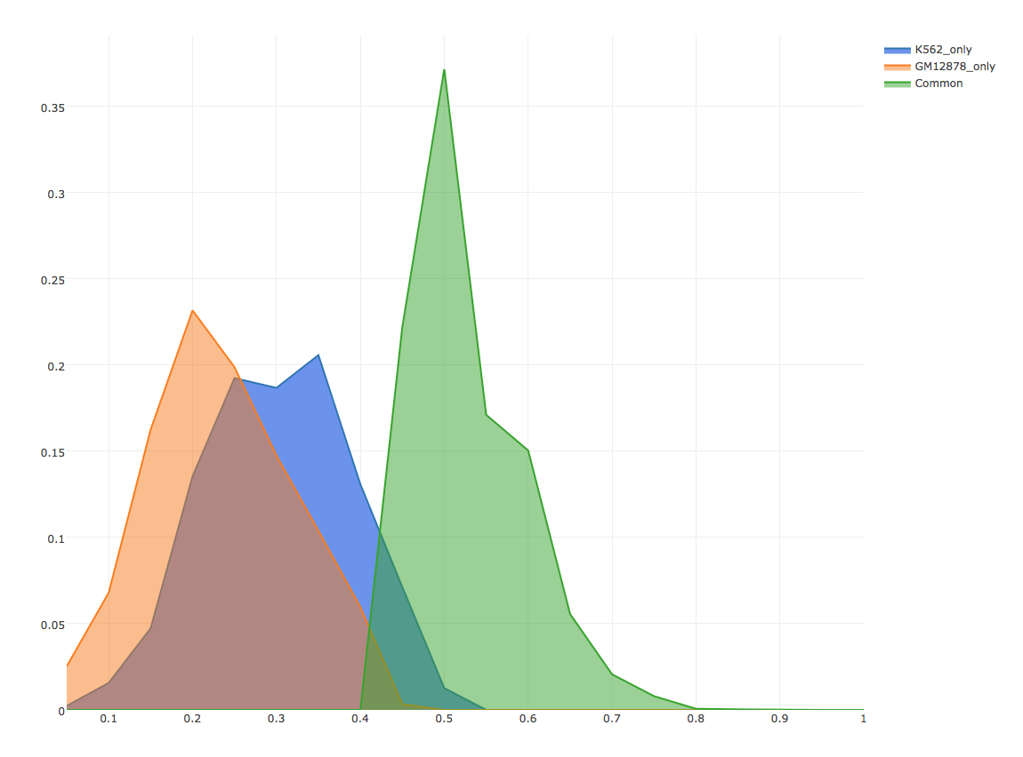
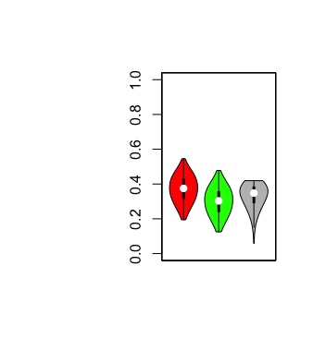
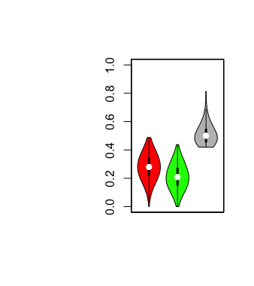
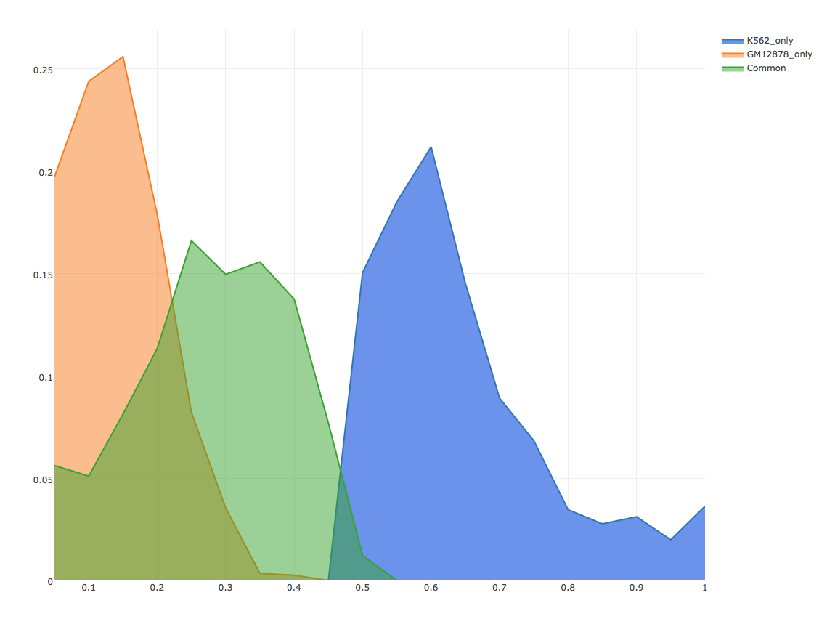
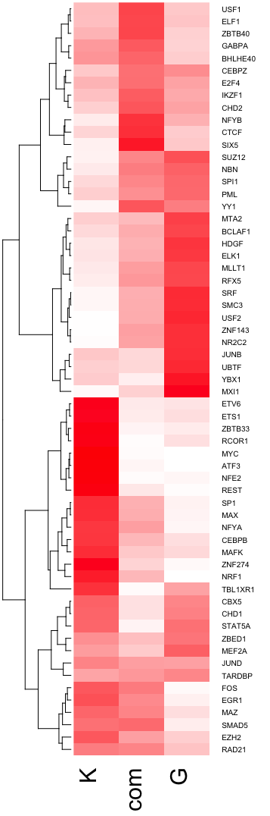
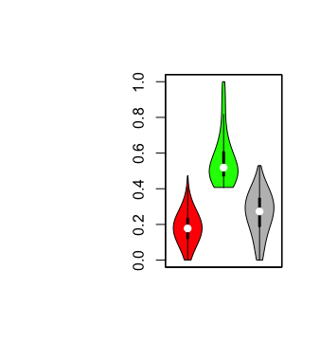
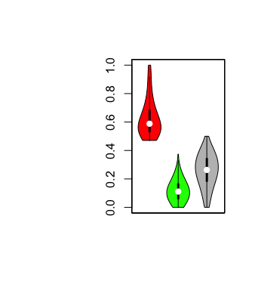
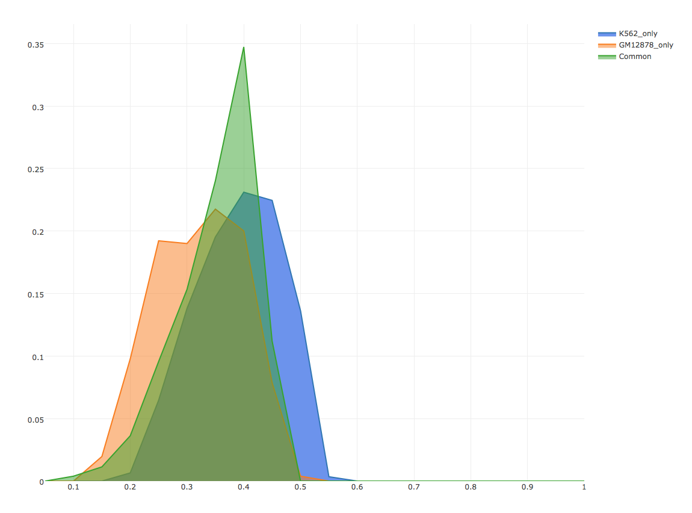
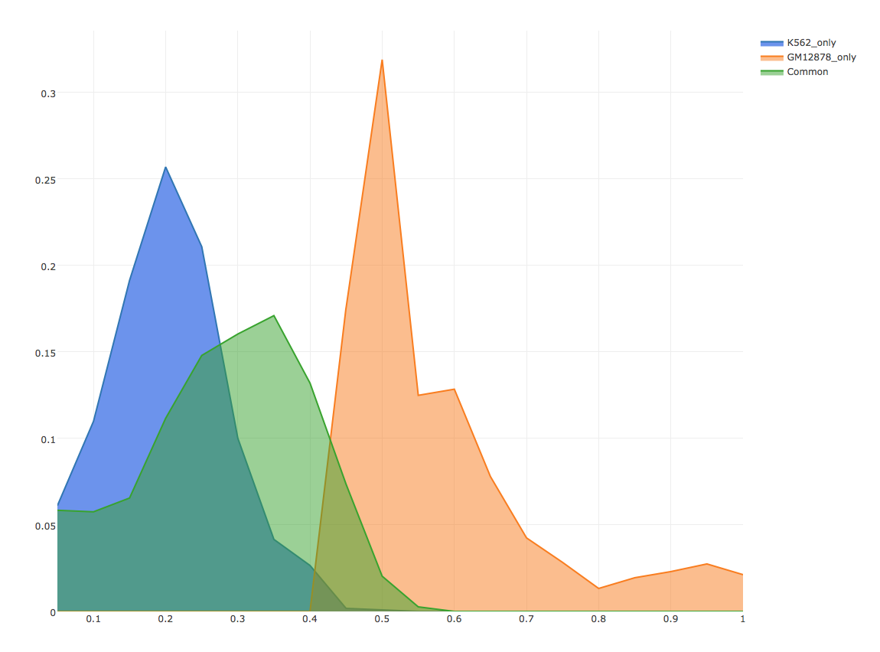
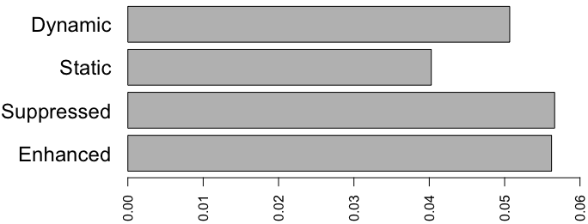

Dynamic
Static
Suppressed
Enhanced
USF1
MLLT1
TPM
DHS
H3K27ac
H3K27me3
MYC
JUND
}
*
}
**
**
Percent of genes with motif gain/loss events

Slide 3
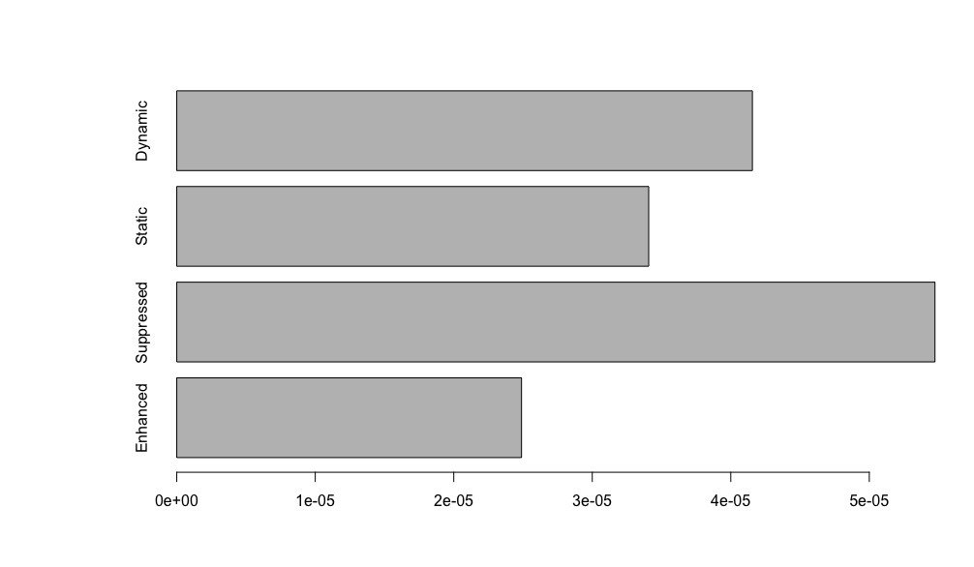
Dynamic
Static
Suppressed
Enhanced
USF1
MLLT1
TPM
DHS
H3K27ac
H3K27me3
MYC
JUND
Observed mutation rate around TSS sites

Slide 4
USF1
MLLT1
}
*
}
**
**
TPM
DHS
MYC
JUND
H3K27ac
H3K27me3

Slide 5
USF1
}
*
MLLT1
}
**
**
TPM
DHS
MYC
JUND
H3K27ac
H3K27me3

Slide 6
USF1
MLLT1
}
*
}
**
**
TPM
DHS
MYC
JUND
H3K27ac
H3K27me3

Slide 7
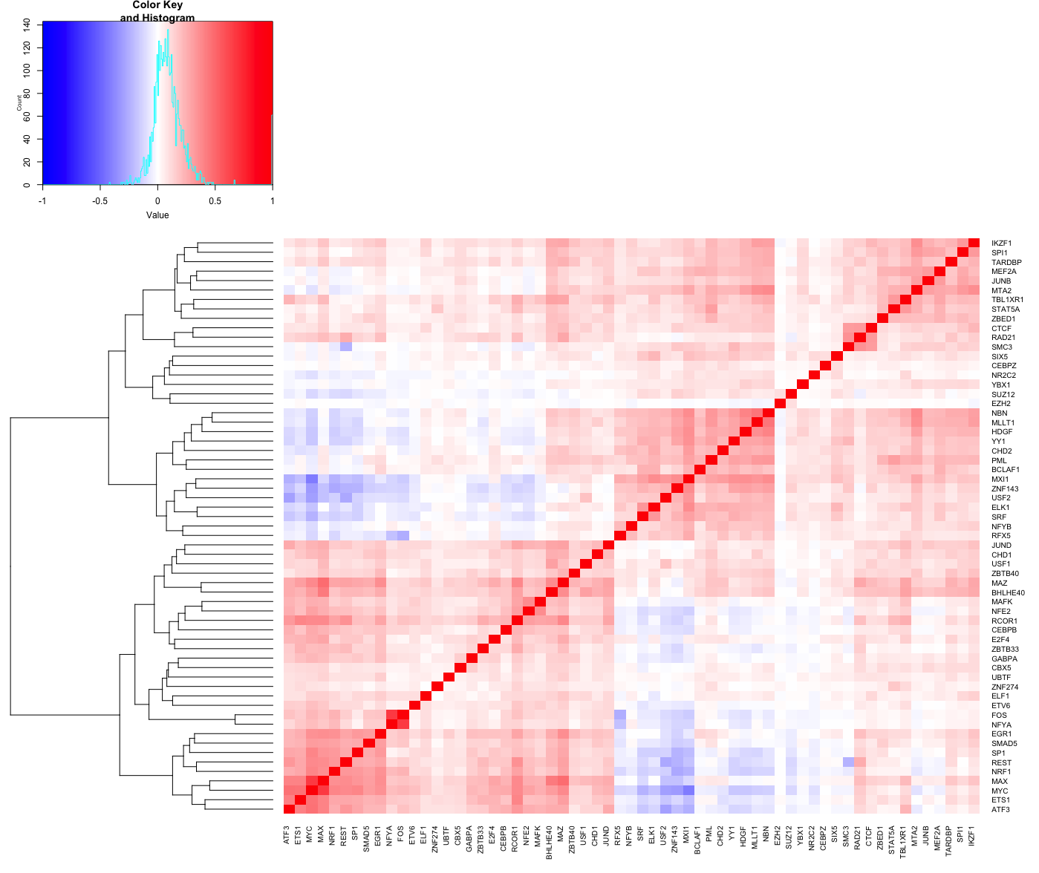

Slide 8
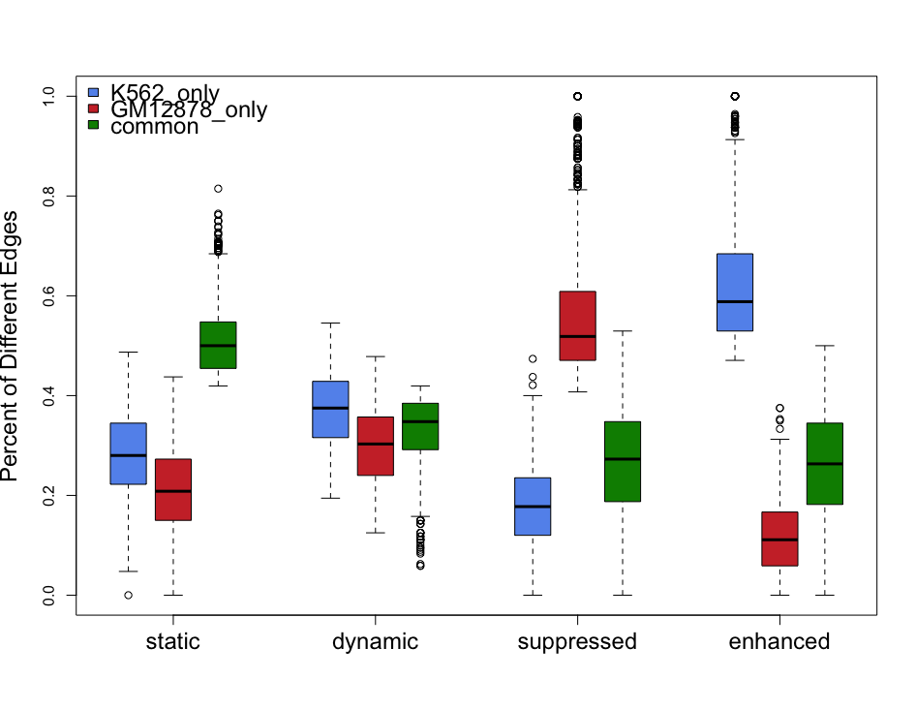

Slide 10
Time line
Dec 18th, full figure pack including supplementary
Dec 22nd, 1st version of draft including supplementary
Refinement every 3~4 days after meetings

