Slide 1
Synergy2
Will Meyerson
Paper E
13 December 2016

Slide 2
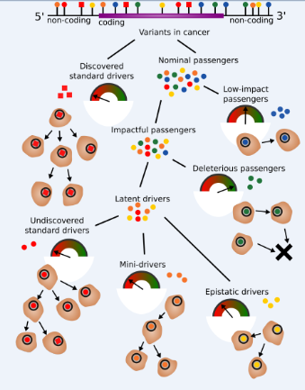
Epistatic aka “synergistic” drivers are a kind of Latent driver

Slide 3
Co-Action Effect Size
For each eligible* pair of genes in a given cancer subtype, define
CoAction_EffectSize = NormalizedCoMutationRateInCancer / NormalizedCoMutationRateInRandomizedSet
Where:
CoMutationRate = the fraction of samples that have both genes mutated
Normalization: divide by the product of the MutationRate of Gene1 and the MutationRate of Gene2
MutationRate = the fraction of samples that have the given gene mutated
Add pseudocount of 1/#pts to MutationRate and to CoMutationRate

Slide 4
Last time
Last time I had negative results for all 37 cancer subtypes
Two issues were I could only test so many gene-pairs, and I could only calculated p-values to two values of precision
Let it run longer
Two innovations this time:
prioritize gene-pairs, rather than individual genes
Group together gene-pairs with the same mean characteristics to compute their p-values all at once

Slide 5
Multiple Hypothesis Testing
19,697 distinct coding genes are mutated in PCAWG
This implies 387,971,809 possible gene pairs to test for synergy
Not possible to compute p-values for each of these pairs
And even if we could, our power would suffer from all the noise
Hence primacy of selecting an intelligent subset of gene pairs

Slide 6
First Filter: Require the genes to participate in the same pathway
Rationale: Genes that participate in the same pathway are more likely to interact mechanistically in the way expected of synergistic drivers
Magnitude: Left with 9,403,745 gene pairs, a 40-fold reduction in number of tests
Cost: We lose a validity test at the end. If we don’t filter on co-pathway pairs, then we can use the fact that our top hits were the same pathway anyway to argue for the fact that our method was tracking reality

Slide 7
Second Filter: In each cancer subtype, select the top 10,000 same-pathway gene pairs based on score
Score = #mutsInGene1 +
#mutsInGene2 +
sumOfMaxFunSeqScoresInEachPatientForGene1 +
sumOfMaxFunSeqScoresInEachPatientForGene2 +
difIn#Gene1MutsInObservedVsRandomized +
difIn#Gene2MutsInObservedVsRandomized +
difInSumofMaxFunSeqScoreObservedVsRandomizedForGene1 +
difInSumofMaxFunSeqScoreObservedVsRandomizedForGene2
Potential later implementation could also include co-expression subscores of gene pairs

Slide 8
P-values as computational bottleneck
The computational bottleneck is computing p-values because they involve doing the synergy calculations many thousands of times to describe the null distribution
The null for each gene-pair depends only on the four mean characteristics of that gene pair:
The mutation rate of Gene 1 in Observed set
The mutation rate of Gene 1 in Randomized set
The mutation rate of Gene 2 in Observed set
The mutation rate of Gene 2 in Randomized set
Would like to reduce the number of null distributions we have to describe
One thought was to pre-compute the null distributions, but this is not possible
Theoretically, in Liver-HCC up to 316^4 ≈ 10 billion unique combinations of mean characteristics
In practice, most genes are sparsely mutated, so the sparsest mean characteristics are redundantly populated

Slide 9
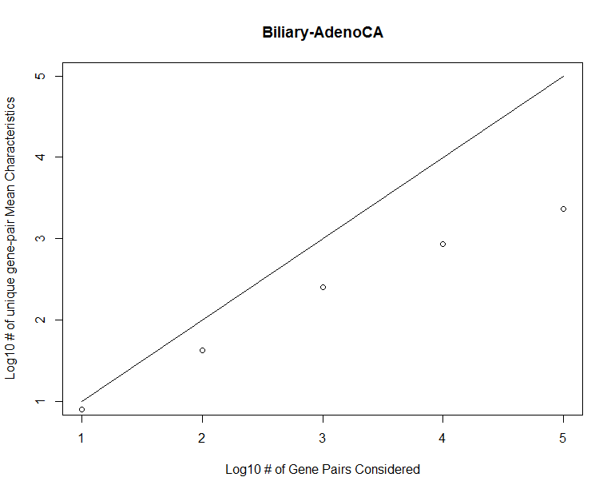
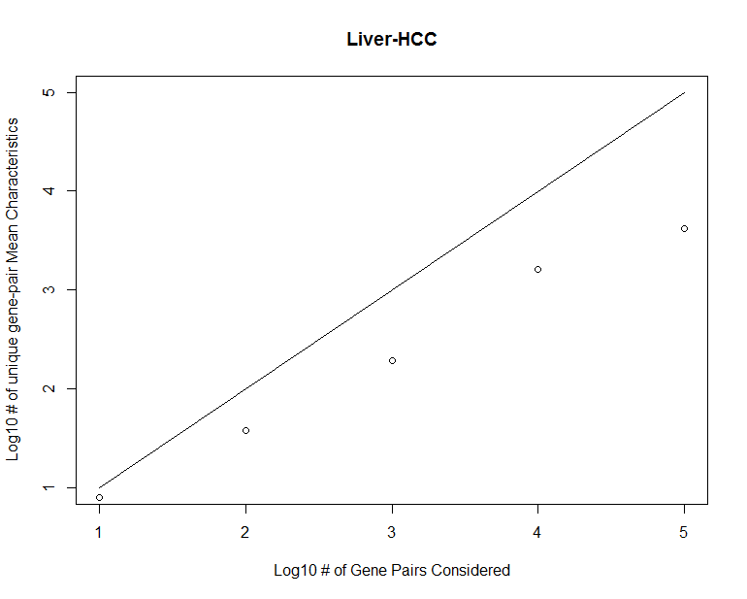
Grouping gene-pairs by Mean Characteristics reduces the required number of simulations by 1-2 orders of magnitude

Slide 10
Run parameters this time
Top 10,000 gene-pairs
Use 10,000 simulations per unique gene characteristics

Slide 11
Positive (but sometimes funky) results in 7/37 subtypes
Cancer Subtype | Number of BH-corrected significantly synergistic gene-pairs of 10,000 tested | Number of BH pairs in which there are any observed co-mutations | Number of instances among pairs of most frequent genes | P-value for “Filter proved useful” Take the mean
Breast-LobularCa | 1728 | 53 | 1728 | 1
Eso-AdenoCa | 10 | 10 | 5,5 | 0.1188
Liver-HCC | 12 | 12 | 4,3 | 2e-04
Lung-AdenoCA | 14 | 14 | 12,2 | < 1e-04
Lymph-BNHL | 2597 | 341 | 1200,455,448 | < 1e-04
Skin-Melanoma | 46 | 46 | 12,5,5,5,5 | 0.7551 (but OK: melanoma scores higher)
Uterus-AdenoCA | 602 | 301 | 264,204,42,40 | < 1e-04

Slide 12
These are the BH-significant gene-pairs with the highest number of co-mutations
Subtype | Gene1 | Gene2 | obs:1/1 | rand:1/1 | ModularityScore | Raw_P | BH_P
Lung-AdenoCA | GNG7 | RASA4 | 3 | 0 | 2 | 1.00E-04 | 0.071429
Lung-AdenoCA | GNRHR | RASA4 | 3 | 0 | 2 | 1.00E-04 | 0.071429
Skin-Melanoma | HIST1H3I | KIAA0391 | 3 | 0 | 2.42962963 | 1.00E-04 | 0.027778
Skin-Melanoma | HIST1H3J | KAT6A | 3 | 0 | 1.376744186 | 1.00E-04 | 0.027778
Skin-Melanoma | CENPP | TLE4 | 3 | 0 | 1.882352941 | 1.00E-04 | 0.027778
Skin-Melanoma | MED8 | PSMB2 | 3 | 0 | 1.25 | 1.00E-04 | 0.027778
Skin-Melanoma | HIST1H3I | KDM2A | 3 | 0 | 2 | 1.00E-04 | 0.027778
Skin-Melanoma | CHCHD4 | TNKS2 | 3 | 0 | 1.494505495 | 1.00E-04 | 0.027778
Skin-Melanoma | HIST1H3I | KCTD7 | 3 | 0 | 2.482758621 | 1.00E-04 | 0.027778
Uterus-AdenoCA | IFNLR1 | IL1A | 3 | 0 | 1.388888889 | 1.00E-04 | 0.030769
Uterus-AdenoCA | ANPEP | INSR | 4 | 0 | 0.974025974 | 5.00E-04 | 0.05
Uterus-AdenoCA | IFNLR1 | ITGA4 | 3 | 0 | 1.25 | 1.00E-04 | 0.030769
Uterus-AdenoCA | IFNLR1 | IL24 | 3 | 0 | 1.875 | 3.00E-04 | 0.038961
Uterus-AdenoCA | ANPEP | IL2RA | 3 | 0 | 1.26984127 | 2.00E-04 | 0.030769
Uterus-AdenoCA | ANPEP | POLR3GL | 3 | 0 | 2.514285714 | 2.00E-04 | 0.030769
Uterus-AdenoCA | IFNLR1 | PRKCSH | 3 | 0 | 2.8125 | 1.00E-04 | 0.030769
Uterus-AdenoCA | IFNLR1 | IMPDH2 | 3 | 0 | 2.083333333 | 1.00E-04 | 0.030769
Uterus-AdenoCA | IFNLR1 | ITGB2 | 3 | 0 | 2.5 | 1.00E-04 | 0.030769

Slide 13
Synergy
Definition
A patient’s mutation status of some gene G1 shares some information with that patient’s cancer status. Same with G2.
Now obviously if you knew both G1 and G2, you would know at least as much about the patient’s cancer status as if you knew only one of G1 or G2 – that’s not a very interesting observation. What would be interesting, however, is if knowing both G1 and G2 told you more information about the patient’s cancer status than the sum of the informations from the two genes alone.
I had been assuming that synergy was related to AND-GATES, but my English language definition of the above equation seems to allow for other kinds of logic gates. Thoughts?

Slide 14
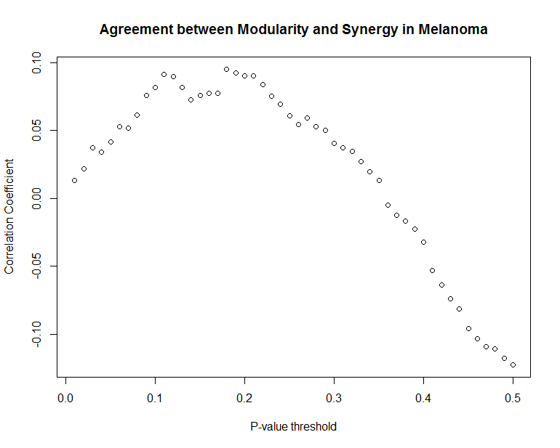
Some (but weak) agreement between synergistic assignment strategies

Slide 15
Still Running
Top 100,000 gene pairs per cancer subtype
The Juggernaut – lump all cancer subtypes together

Slide 16
Questions
What to do with these wacky gene elements with so many pairs?

