Slide 1
Gene expression elucidates functional impact of polygenic risk for schizophrenia
Jclub
Mengting Gu

Slide 2
Generating data
Cohort of schizophrenia samples (N=258) and control subjects (N=279)
Sequenced RNA from dorsolateral prefrontal cortex
About CMC
Largest existing collection of collaborating brain banks (over 1150 samples)
Generate a wide spectrum of data, including regional gene expression, epigenomics (cell-type-specific histone modification and open chromatin), whole genome sequencing and somatic mosaicism

Slide 3
Analysis goal
Identify specific effects on gene expression of genetic variants previously implicated in risk
Identify genes showing a significant difference in expression between subjects with SCZ and control subjects
Identify coordinated expression of genes implicated in SCZ

Slide 4
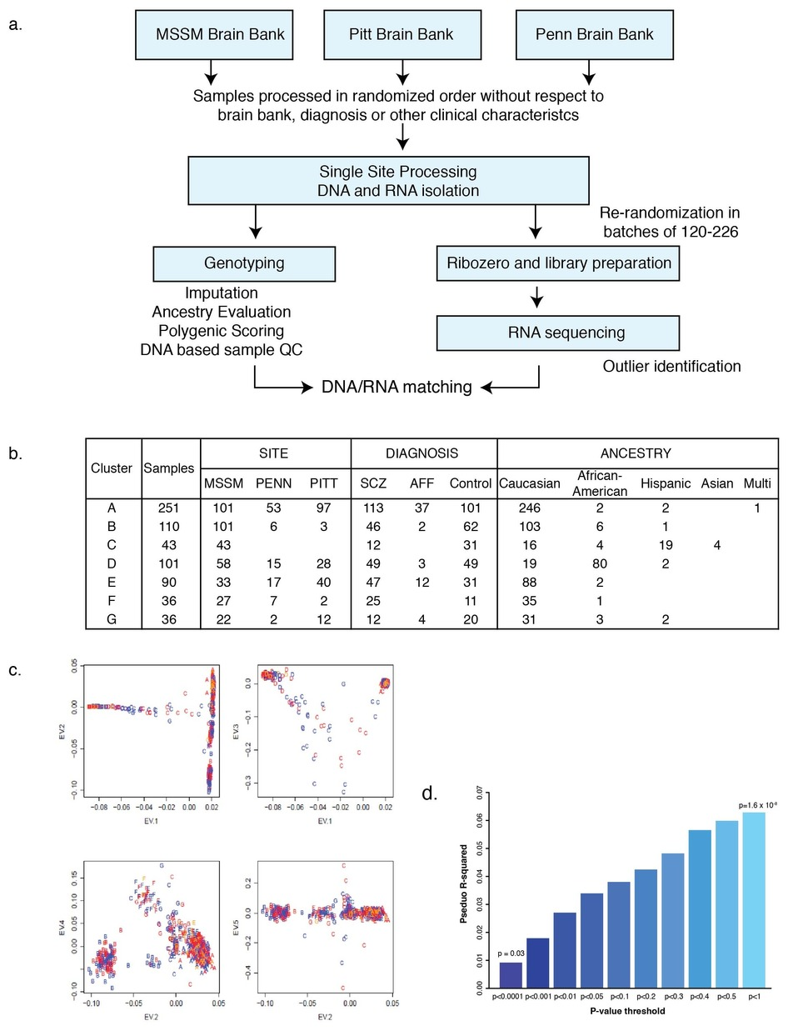
Experimental flow diagram and ancestry characterization
Notes:
Icahn School of Medicine at Mount Sinai
University of Pennsylvania
University of Pittsburgh
All together, there are 258 SCZ and 279 controls. 55 subjects with affective disorder were included to increase the power to detect eQTL
The model identified 2,154,331 significant cis-eQTL, (i.e., SNP–gene pairs within 1 Mb of a gene) at a false discovery rate (FDR) ≤ 5%, for 13,137 (80%) of 16,423 genes.
Many eQTL for the same gene were highly correlated, due to linkage disequilibrium, and 32.8% of eQTL SNPs (eSNPs) predicted expression of more than one gene.

Slide 5
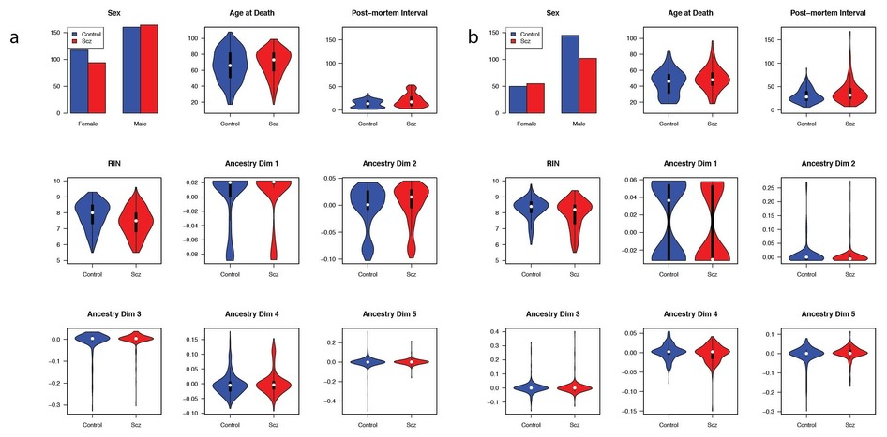
Selecting Biological Covariates
(a) CMC and (b) HBCC
Notes:
Human Brain Collection Core
Gene expression measurement can be influenced by a number of variables; some are well documented (for example, RNA integrity (RIN) and post-mortem interval) but others may be unknown.
Performed standard model-selection procedures to find a good statistical model
Covariates for RIN, library batch, institution (brain bank), diagnosis, age at death, genetic ancestry, post-mortem interval and sex together explained a substantial fraction (0.42) of the average variance of gene expression and were thus employed to adjust the data for all analyses
The model identified 2,154,331 significant cis-eQTL, (i.e., SNP–gene pairs within 1 Mb of a gene) at a false discovery rate (FDR) ≤ 5%, for 13,137 (80%) of 16,423 genes.

Slide 6
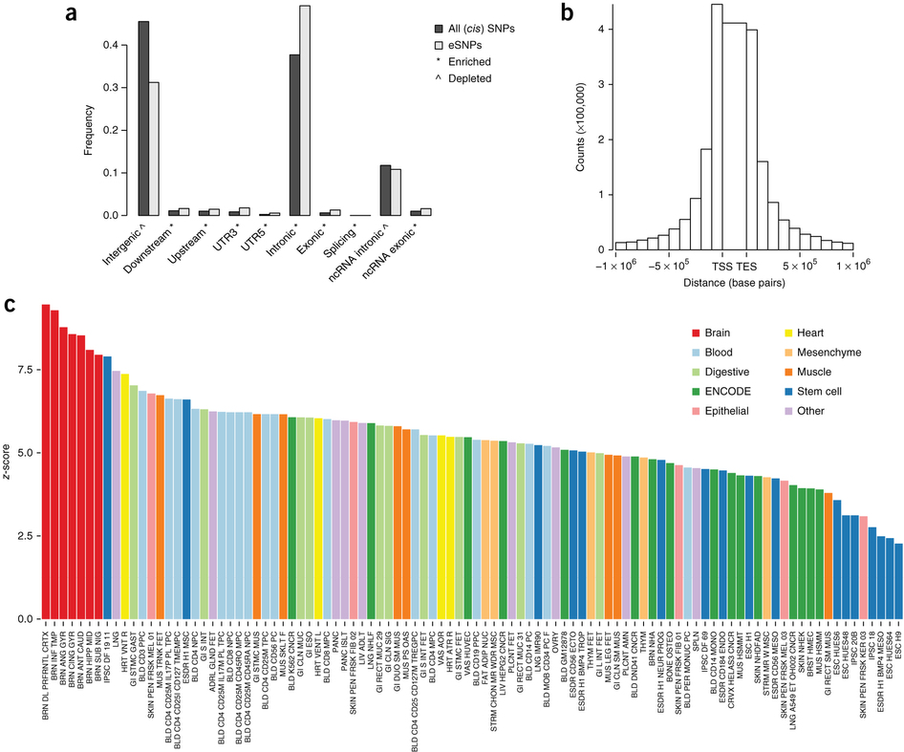
Notes:
Enrichment of cis-eQTL in regulatory and other genomic elements
Significant cis-eQTL (at FDR 5%) compared to all cis SNPs (within 1 MB from expressed genes)
Distribution of cis-eQTL location relative to the gene
Enrichment of max-cis-eQTL (most associated eSNP per gene) within enhancer sequences across 98 human tissues and cell lines

Slide 7
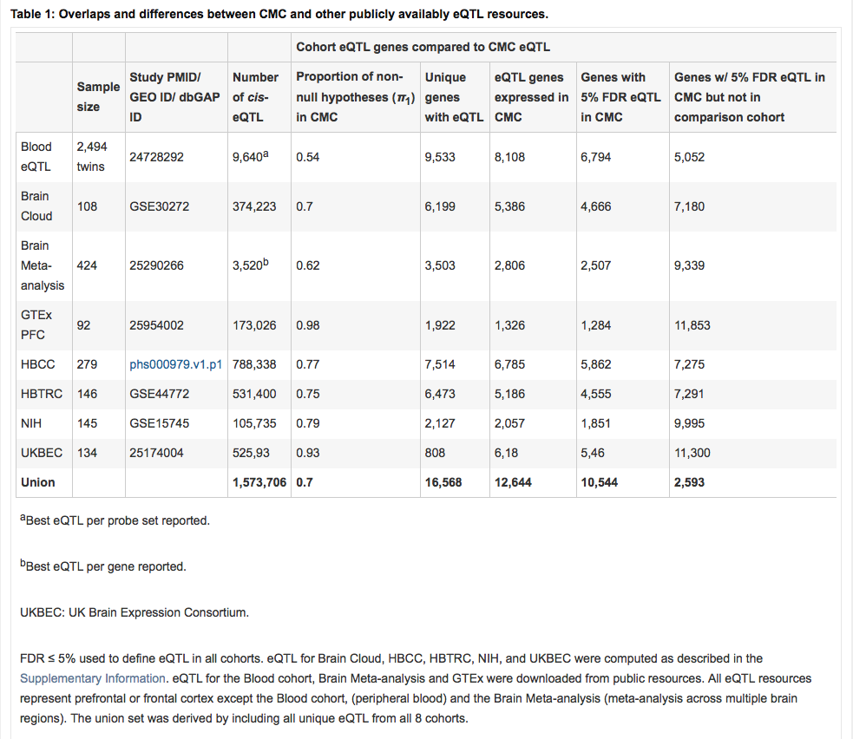
Notes:
“The model identified 2,154,331 significant cis-eQTL, (i.e., SNP–gene pairs within 1 Mb of a gene) at a false discovery rate (FDR) ≤ 5%, for 13,137 (80%) of 16,423 genes.”

Slide 8
Leverage CMC-derived eQTL to SCZ risk variants
108 SCZ loci
(73 harbor cis-eQTL)
30 Loci
84 genes
18 Loci
33 genes
GWAS
Sherlock
Additional evaluation
108 SCZ loci
(73 harbor cis-eQTL)
--
--
8 Loci
9 genes
(3 unidentified)
Gene-level eQTL
Isoform-level eQTL
Notes:
Of the 108 SCZ GWAS loci reported previously³, 73 harbor cis-eQTL SNPs for one or more genes (FDR ≤ 5%)
Additional evaluation: gene level vs isoform-level; genes failing manual inspection
20 out of 108 SNPs selected
Sherlock: a Bayesian approach that prioritizes consistency between disease association and eQTL signatures in GWAS loci, to identify genes likely to contribute to SCZ etiology.

Slide 9
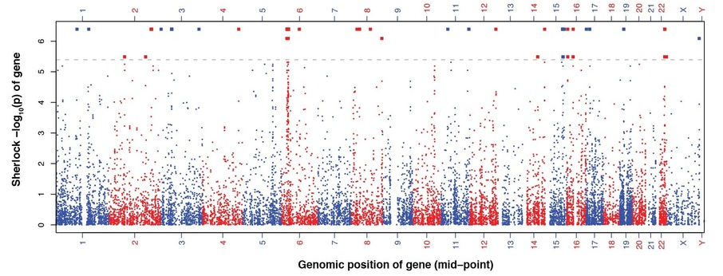
Prioritize consistency between disease association and eQTL in GWAS loci
Notes:
After Sherlock
The results suggested that GWAS risk and eQTL association signals colocalized for 84 genes in 30 of these loci (adjusted P < 0.05)

Slide 10
8 SCZ-associated cis-eQTL involve only a single gene
FURIN, encodes furin, downregulated by risk allele
TSNARE1, t-SNARE domain containing 1, upregulated
CNTN4, contactin 4, upregulated
CLCN3, voltage-sensitive chloride channel 3, upregulated
SNAP91, synaptosomal-associated protein of 91 Kda
ENSG00000259946, upregulated
ENSG00000253553, downregulated
SNX19 isoform, sorting nexin, downregulated
Notes:
CLCN3, SNAP91 and TSNARE1 are direct synaptic components
CNTN4 and FURIN play roles in neurodevelopment

Slide 11
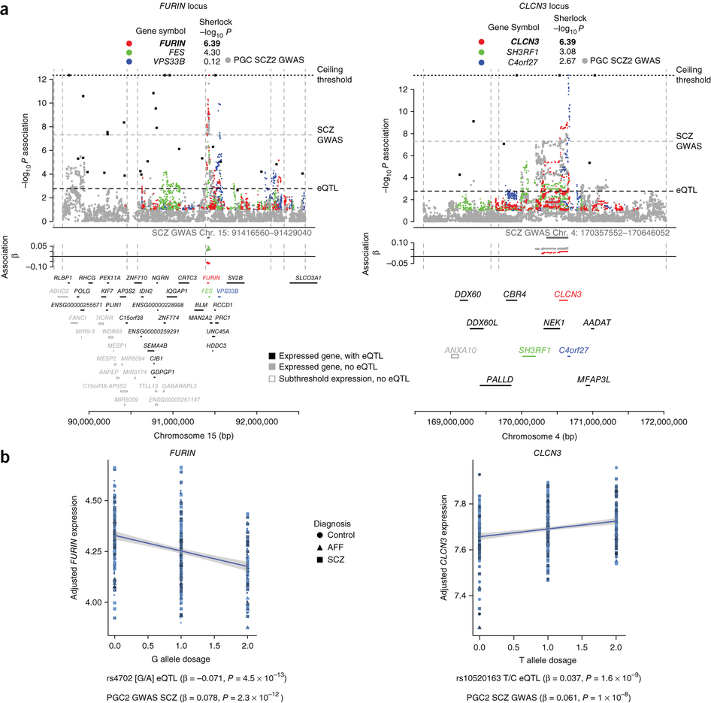
Notes:
SNP-level associations are plotted for the SCZ GWAS (gray)
cis-eQTL association profiles for genes with Sherlock Pcorrected < 0.5 (or regulatory trait concordance score (RTC) > 0.9) are plotted in colors, with colors and Sherlock P values noted on top of the graphic (P = 4.07 × 10⁻⁷ and P = 4.07 × 10⁻⁷ for FURIN and CLCN3, respectively)
For additional genes in the region with significant eQTL, the single eSNP with minimal eQTL P value (max-eQTL) is marked by a black point (corresponding genes names are located above the chromosome marker bar)

Slide 12
Experimental Validation
Experimental Assay to follow-up :
  Rapid and amenable to over -and underexpression of target genes
Manipulate zebrafish embryos:
  Evaluate anatomical phenotypes of early development, eg. head/brain size
Neurosphere outgrowth:
  Neurosphere outgrowth is a well-established neural migration assay measuring the distance NPCs migrate away from the neurosphere.
Notes:
Reduce cell proliferation
Increase apoptosis

Slide 13
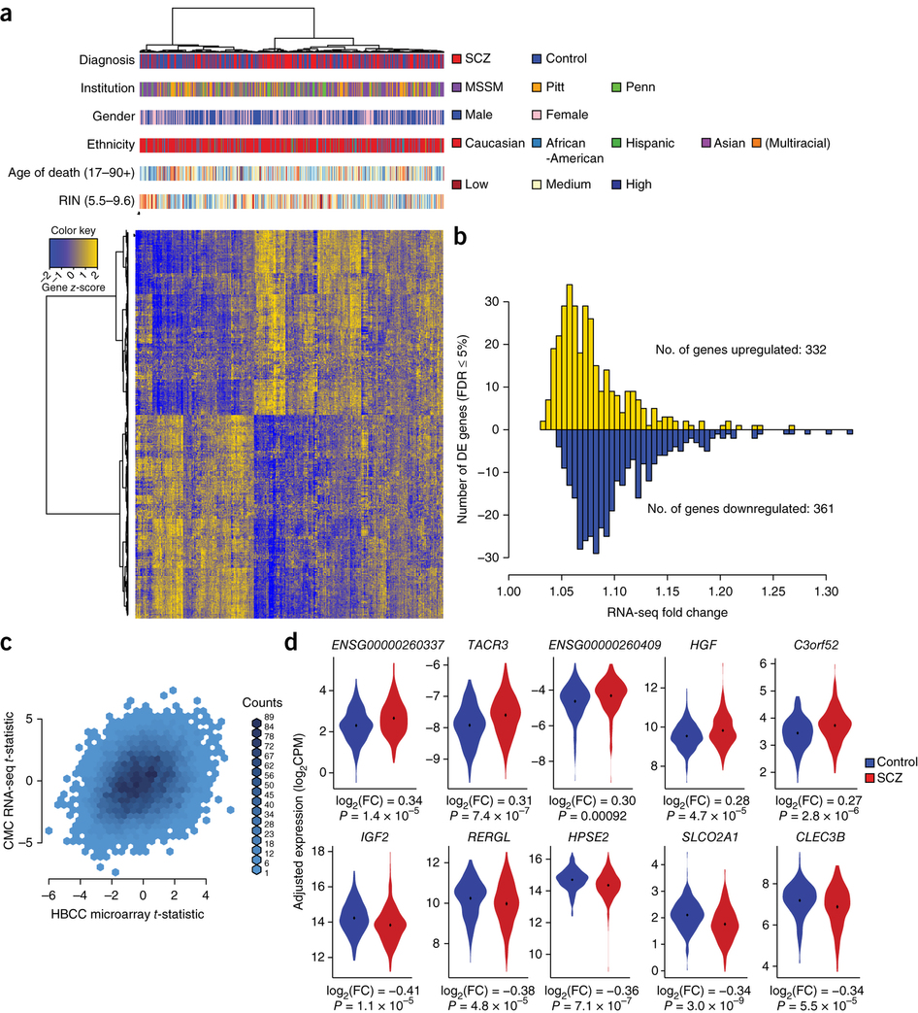
Gene expression is subtly disrupted in schizophrenia
Notes:
They found 693 genes to be differentially expressed after correction for multiple testing (FDR<=5%)
332 upregulated and 361 downregulated
Modest fold change: mean of 1.09 and range 1.03-1.33
hierarchical clustering of the differentially expressed genes showed case–control distinctions but were independent of institution, sex, age at death, ethnicity and RIN

Slide 14
Significantly differentially expressed genes
Notes:
Binned density scatter plot comparing the t-statistics for case versus control differential expression between the independent HBCC replication cohort assayed on microarrays and the CMC RNA-seq data; correlation between the statistics is 0.28 (P < 10⁻¹⁶).
For the 10 significantly differentially expressed genes with the largest fold changes (5 upregulated and 5 downregulated), the normalized and adjusted gene expression in 25 subjects with SCZ (red) versus 25 controls (blue).

Slide 15
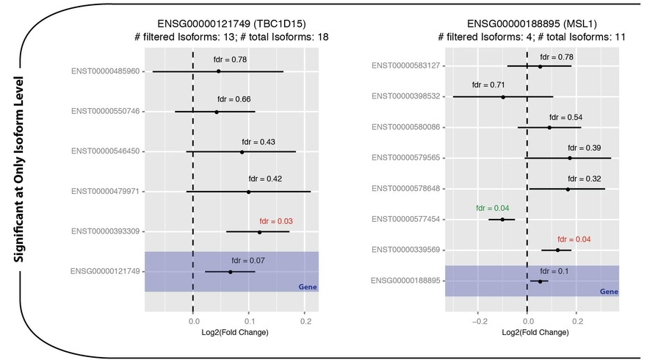
Differentially expressed isoforms
Notes:
The mean log2 fold change, 95% confidence interval, and FDR value is plotted for each isoform. The top two genes (TBC1D15 and MSL1) each have at least one isoform differentially down-regulated in SCZ cases, but in aggregate (across all isoforms), the gene is not differentially expressed; for MSL1, this is likely due to the presence of 2 differential isoforms moving in opposite directions.

Slide 16
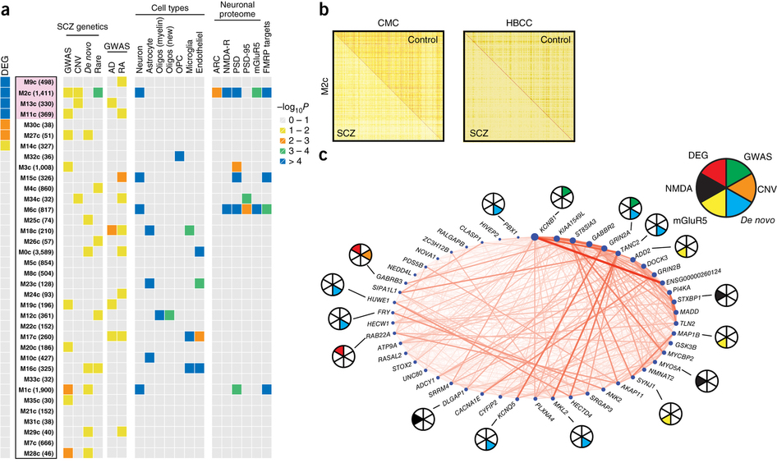
Co-expression network
Notes:
Apply Weighted Gene Co-expression Network Analysis (WGCNA)
Construct gene co-expression networks separately from control individuals and subjects with SCZ.
Control: 35 modules. Four modules stand out in harboring an excess of differentially expressed genes
One of the modules (M2c) shows association with differential expression and multiple prior genetic association with SCZ
multiple prior genetic association with SCZ: genes in GWAS loci, rare nonsynonymous variants
M2c module exhibits a loss of density in subjects with SCZ, which is replicated in HBCC cohort
Circle plot showing connection strengths for the top 50 hub genes of the M2c module, where node size corresponds to intramodular connectivity and nodes are ordered clockwise based on connectivity. Pie charts show SCZ susceptibility genes based on GWAS PGC2-SCZ (green), CNV (orange) or de novo (cyan) studies; genes that belong in the NMDA (black) or mGluR5 (yellow) signaling pathway; and genes that are differentially expressed in subjects with SCZ vs. controls at FDR ≤ 5% (red).

Slide 17
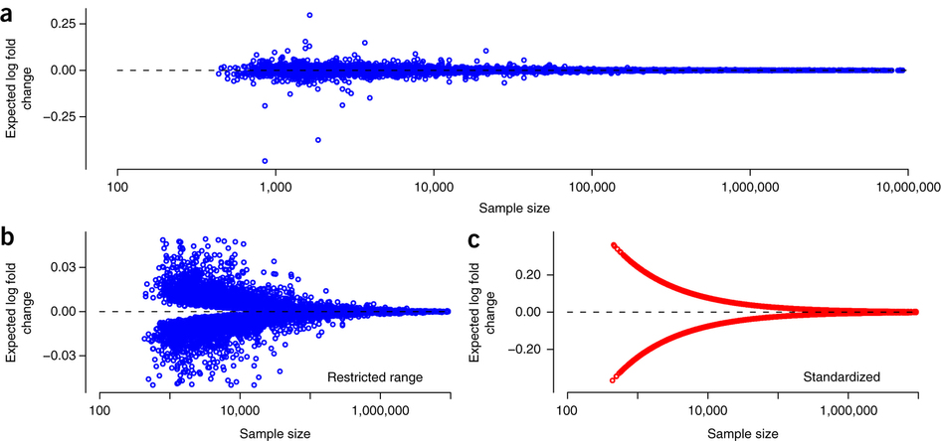
Power to detect differential expression
Notes:
a): each gene is a dot
Expected differential expression to achieve 80% power was computed for 10,094 gene-cis-eQTL association pairs

Slide 18
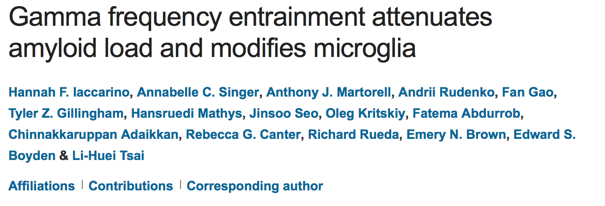
Notes:
Alzheimer’s disease

Slide 19


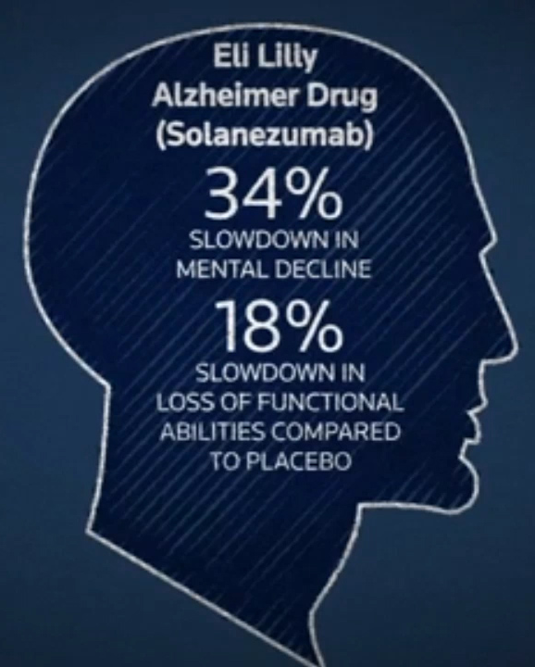


Slide 20



Slide 21
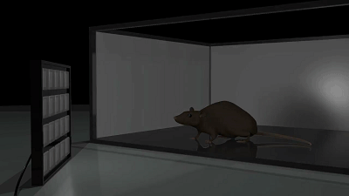
Notes:
Alzheimer’s disease

Slide 22
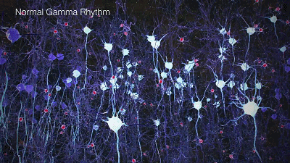
Activation of local circuits of excitatory and fast-spiking inhibitory neurons that resonate at 20-50 Hz gives rise to oscillations in the local field potential (LFP), called gamma oscillation.

Slide 23
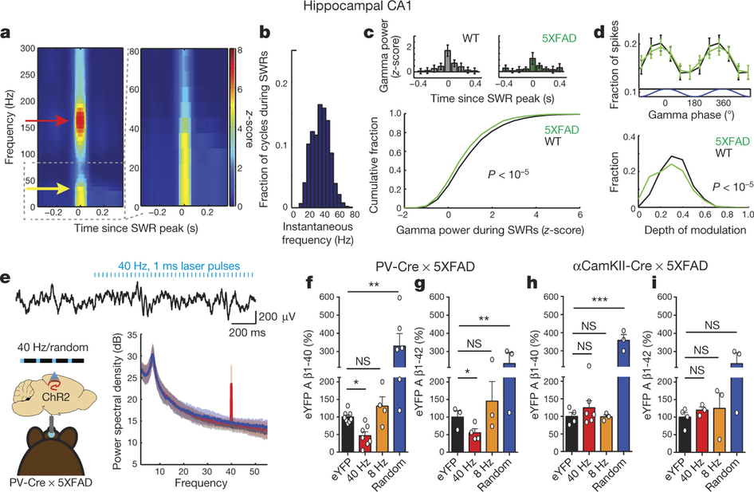
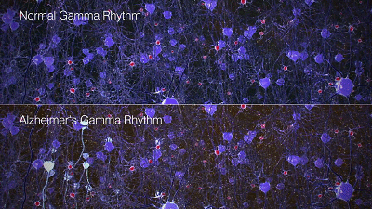
Studies has demonstrated disrupted gamma in various neurological disease
Observe reduced hippocampal gamma in 5XFAD mice

Slide 24
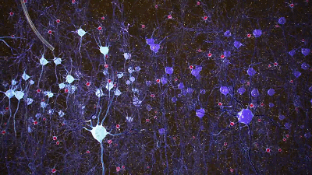
Induce gamma optogenetically in 5XFAD/PV-Cre mice
Notes:
Optogenetics
Induce gamma optogenetically
DPSS laser was connected to a patch cord with a fibre channel/physical contact connector at each end

Slide 25
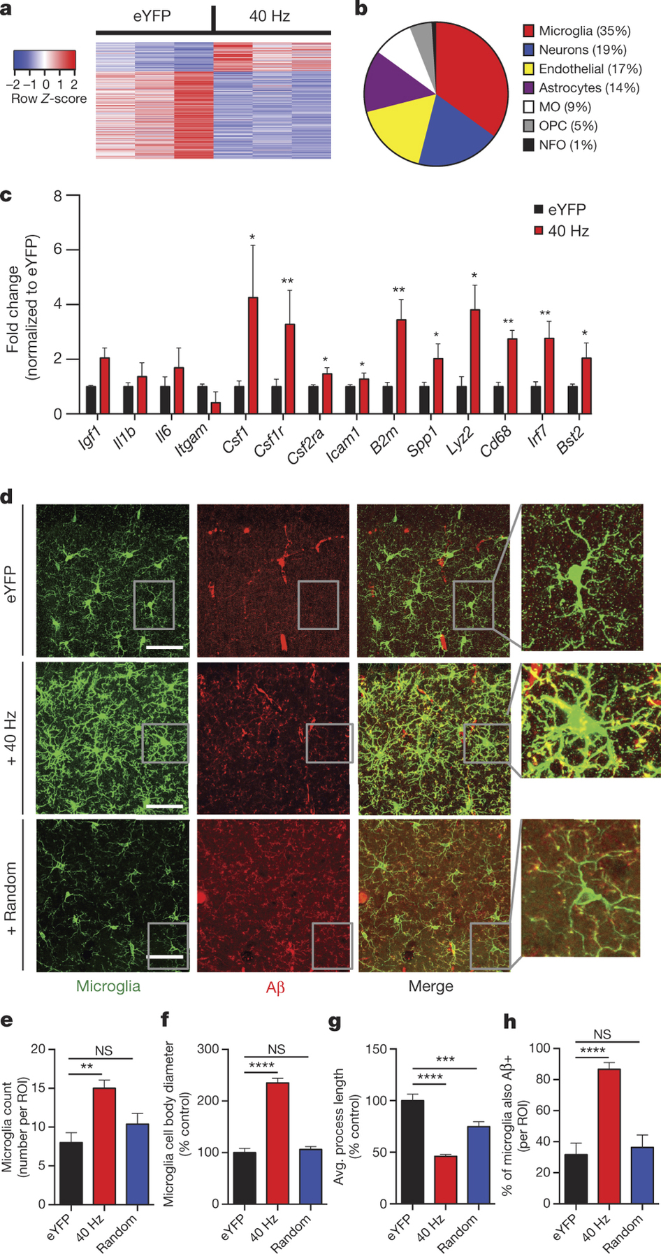

Slide 26

Light flicker entrains gamma in VC
Many studies have shown that visual stimulation can drive oscillations in the gamma range.
Flickering lights at a specific frequency can induce that frequency in primary visual cortex (VC).

Slide 27
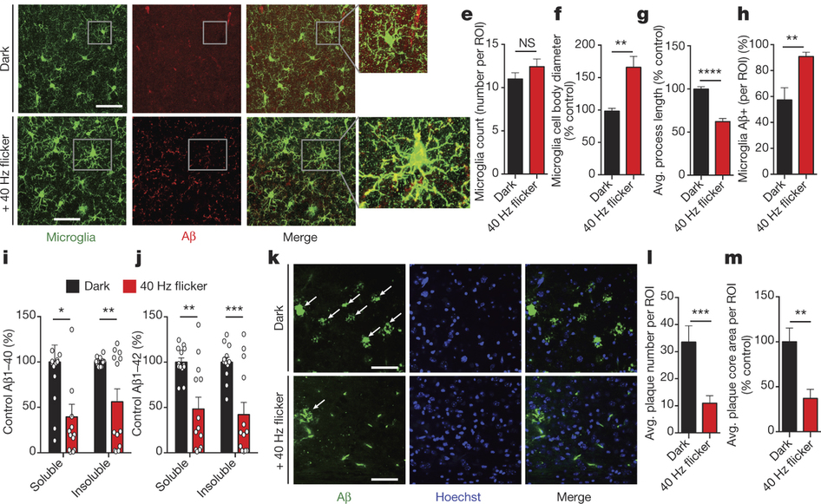
Notes:
While microglia number was unchanged (fig 4d,e), microglia cell body diameter increased by 165.8% after 40 Hz flicker compared with dark controls.
Microglia primary process lengths were reduced by 37.7% after 40 Hz flicker compared with dark controls

Slide 28



