Slide 1
Modifying ExceRpt for Paired End Reads
Calvin Rhodes
Notes:
Hi!
My name is Calvin Rhodes, senior majoring in MB&B and Applied Math
Background: wanted to do research in bioinformatics this semester, talked to Dan and he had a cool project that fit my interests, here we are

Slide 2
Background / Motivation
Internal Medicine Data on asthma endotyping: Professor Chupp
  250 sputum samples of bulkcellRNAseq reads
    40% that don’t map to well characterized databases – not being used!
Paired end reads: more information = more accurate?
  Less ambiguous alignments - indicates to alignment program how much it would expect to overlap with the genome
Notes:
This specific project was part of a lofty, overarching set of goals which I laid out in my project proposal at the beginning of the semester (which I quickly realized were a little too lofty for a semester long research project):
After reading papers, getting up to speed on how the lab works → quickly realized that definitely too lofty!
The overarching goal of this project was to take those 40% that don’t map and extract some sort of valuable analysis about asthma endotypes
Already multiple versions of exceRpt out – including longRNA / shortRNA, what is the motivation here?
In our case, this is directly motivated by an undertaking with Professor Geoff Chupp, at the medical school
Idea: Paired end reads provide more information – more information = more accurate!

Slide 3
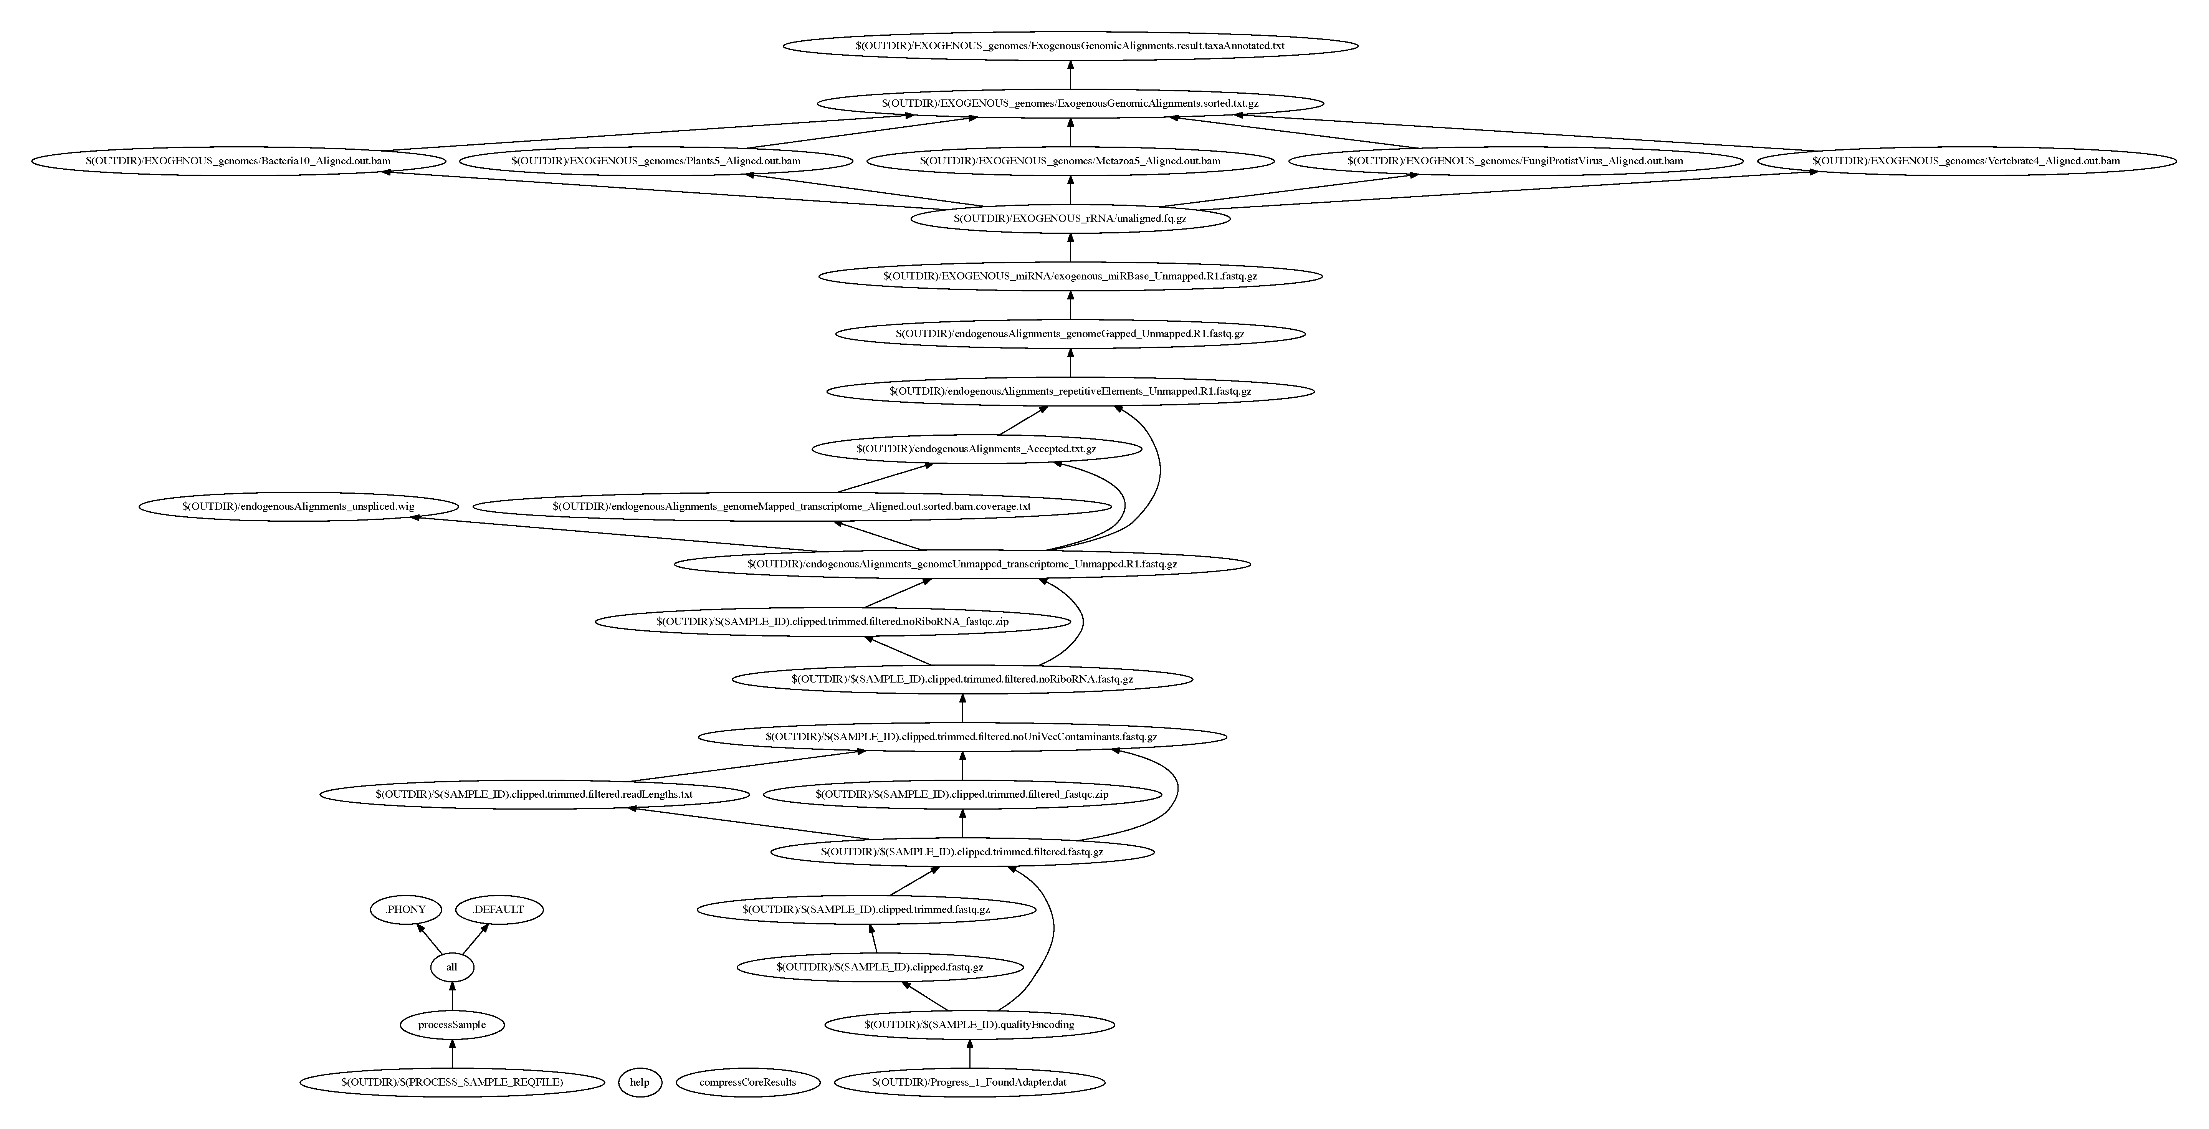
Initial Challenges
Bash, Unix, HPC
Tenets of Bioinformatics
Diving into exceRpt
  understanding makefiles, documentation
Notes:
Only coded in R and a little bit of python – relatively steep learning curve working in terminal with the bash shell
Bash, unix, hpc
Received a personal bootcamp over thanksgiving break that helped a ton
Tenets of bioinformatics – had been a summer since I had studied any of this stuff, had to remember things like:
Basic tenets of sequence alignment, what fastQC is
exceRpt
Layers upon layers of makefiles
Target, dependencies are

Slide 4
Modifications
Removing adapters + primers, preprocessing: read 1 + read 2
  Makefile tree: 4 levels deep with both read 1, read 2 processed simultaneously
STAR aligner (Alex Dobin) – paired end read capability!
  Output is same with single end or paired end
Delete extra files created by simultaneous processing
Notes:
Makefile tree:
Will see on the next slide, this includes
Writing adapter sequence
Guessing fastq quality encoding
Clipping adapter sequence
Trimming reads
Filtering reads with poor overall base quality, removing homopolymer repeats
Performing FastQC after adapter removal
STAR aligner – maps to UniVec contaminant sequences

Slide 5
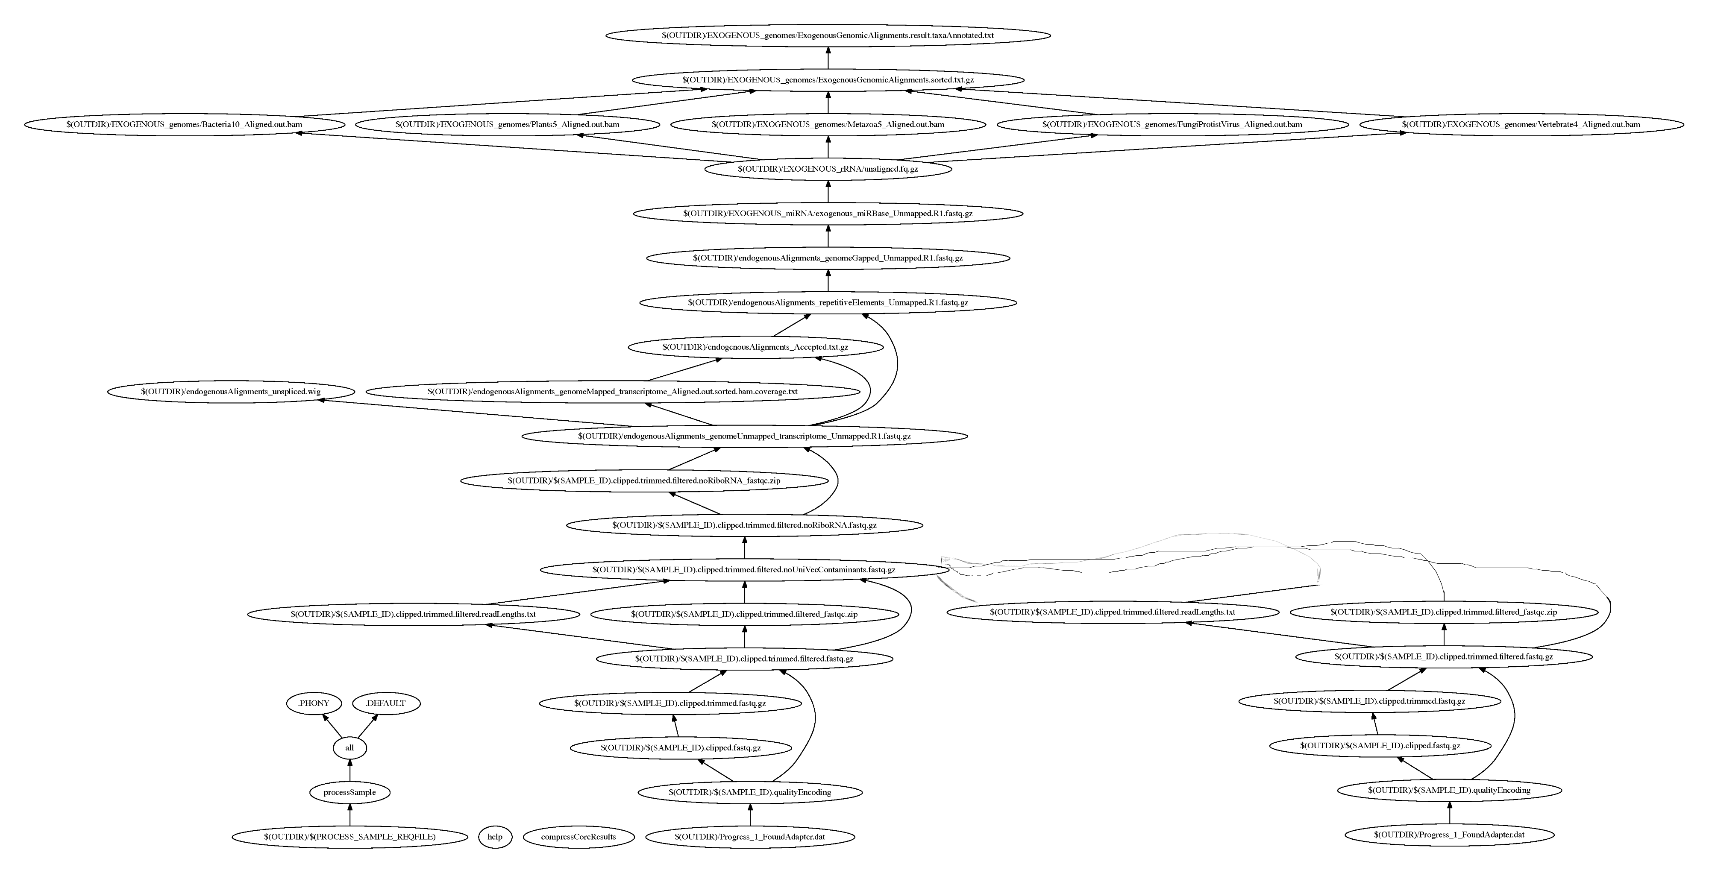
Modifications (cont.)

Slide 6
Data and Analysis
As of Tuesday @1am, 1 successful run of exceRpt_longRNA_PE!
Runtime:
  longRNA - pipeline == 4:25.95
  longRNA_PE – pipeline == 4:29.09
Ran on M.globosa test set… so no aligned reads
  Next steps: run on 250 bulkCellRNAseq samples
(edit: 12/14) Broke script by trying to scrap adapterSequence makefile→ look into nitty gritty
Notes:
Successfully compiled and ran exceRpt_longRNA_PE on Malasezzia globosa test run → so no reads were aligned at all…
Runtime analysis – only took about 4 minutes longer, Univec contaminant step is when both reads are read which is the bulk of the extended time

Slide 7
Discussion, Moving Forward
Polish final exceRpt script
  (edit 12/14) No more broken executables!
  rRNA output tables
Run for 250 bulkCellRNASeq samples
Build custom database for microbiota alignment, perform relative abundance calculation – exogenous alignment
Identity best algorithm for calculating relative abundance among closely related species
  RDP’s naïve bayesian clasifier
  MetaPhlAn
Notes:
Microbiota alignment:
From pilot data, that includes
Strep
Malassezia
Lactobacillus rhamnosus
Test best algorithm
Unique problem of how to assign relative abundances to species that are close to each other on the phylogenetic tree (therefore have similar genomes)
Multiple algorithms have been tried
This would likely involve using some well-characterized test data set, testing multiple algorithms on it, then applying the best algorithm to our output from exceRpt

Slide 8
Thank You!
Dan
Timur + Gerstein lab
Modern day technology!
Notes:
Thank you!
Dan
Always being available by phone / email / skype when I have dumb questions
Also taking me on when I probably just added more work to your day – thanks!
Timur+Gerstein lab – providing ecosystem necessary to do this project
Code help! Very helpful and definitely expedited the amount of things I need to do
Everyone very kind and very receptive to email when I had questions
Also forgiving when I didn’t know what I was doing in grace and overloaded home storage quota with 220 GB!
Hope to stay on next semester, continue working on this project for my thesis!

