Slide 1
Elucidating mechanisms that govern miRNA-eQTLs
Q: To what extent do predicted enhancers help to drive the strength (as measured using different metrics) of miRNA-eQTLs?
Use ENCODE-annotated enhancers
Restrict analysis to “Strong Enhancers” (count = 904)

Slide 2
eQTL SNVs in ENCODE-annotated regulatory regions
All Cis eQTLs
6977
2635
215
Cis eQTLs that do not fall
in annotated reg. regions
Cis eQTLs within
regulatory regions (promoters,
enhancers, etc)
Trans eQTLs in annotated reg. regions

Slide 3
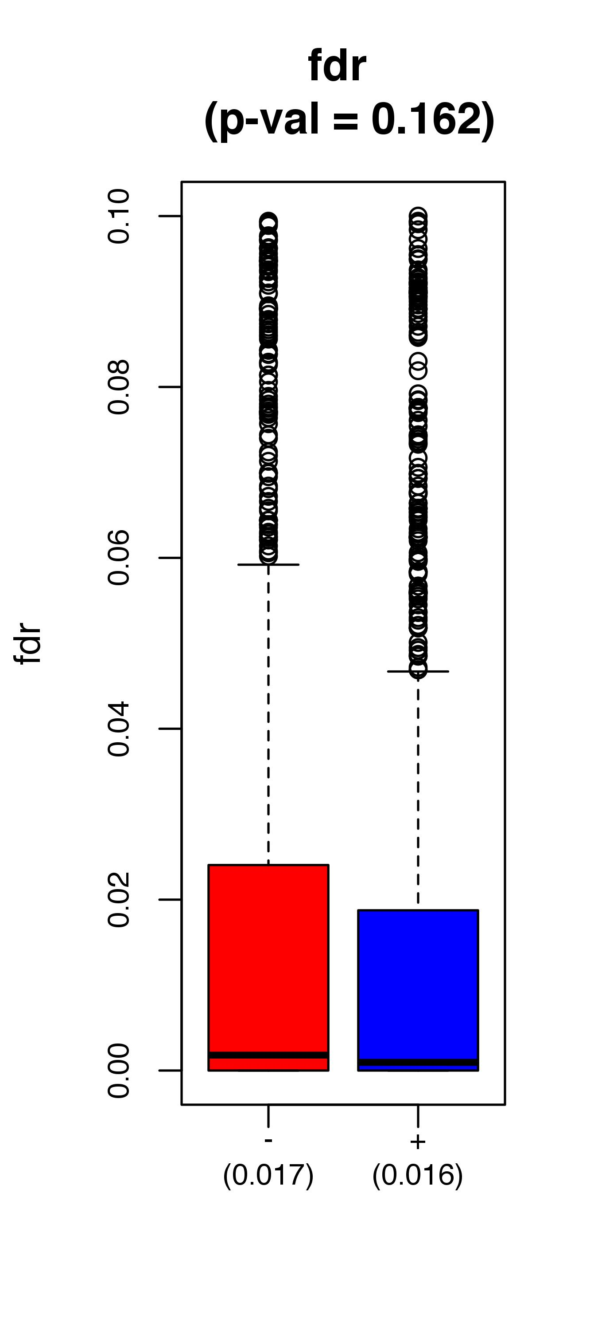
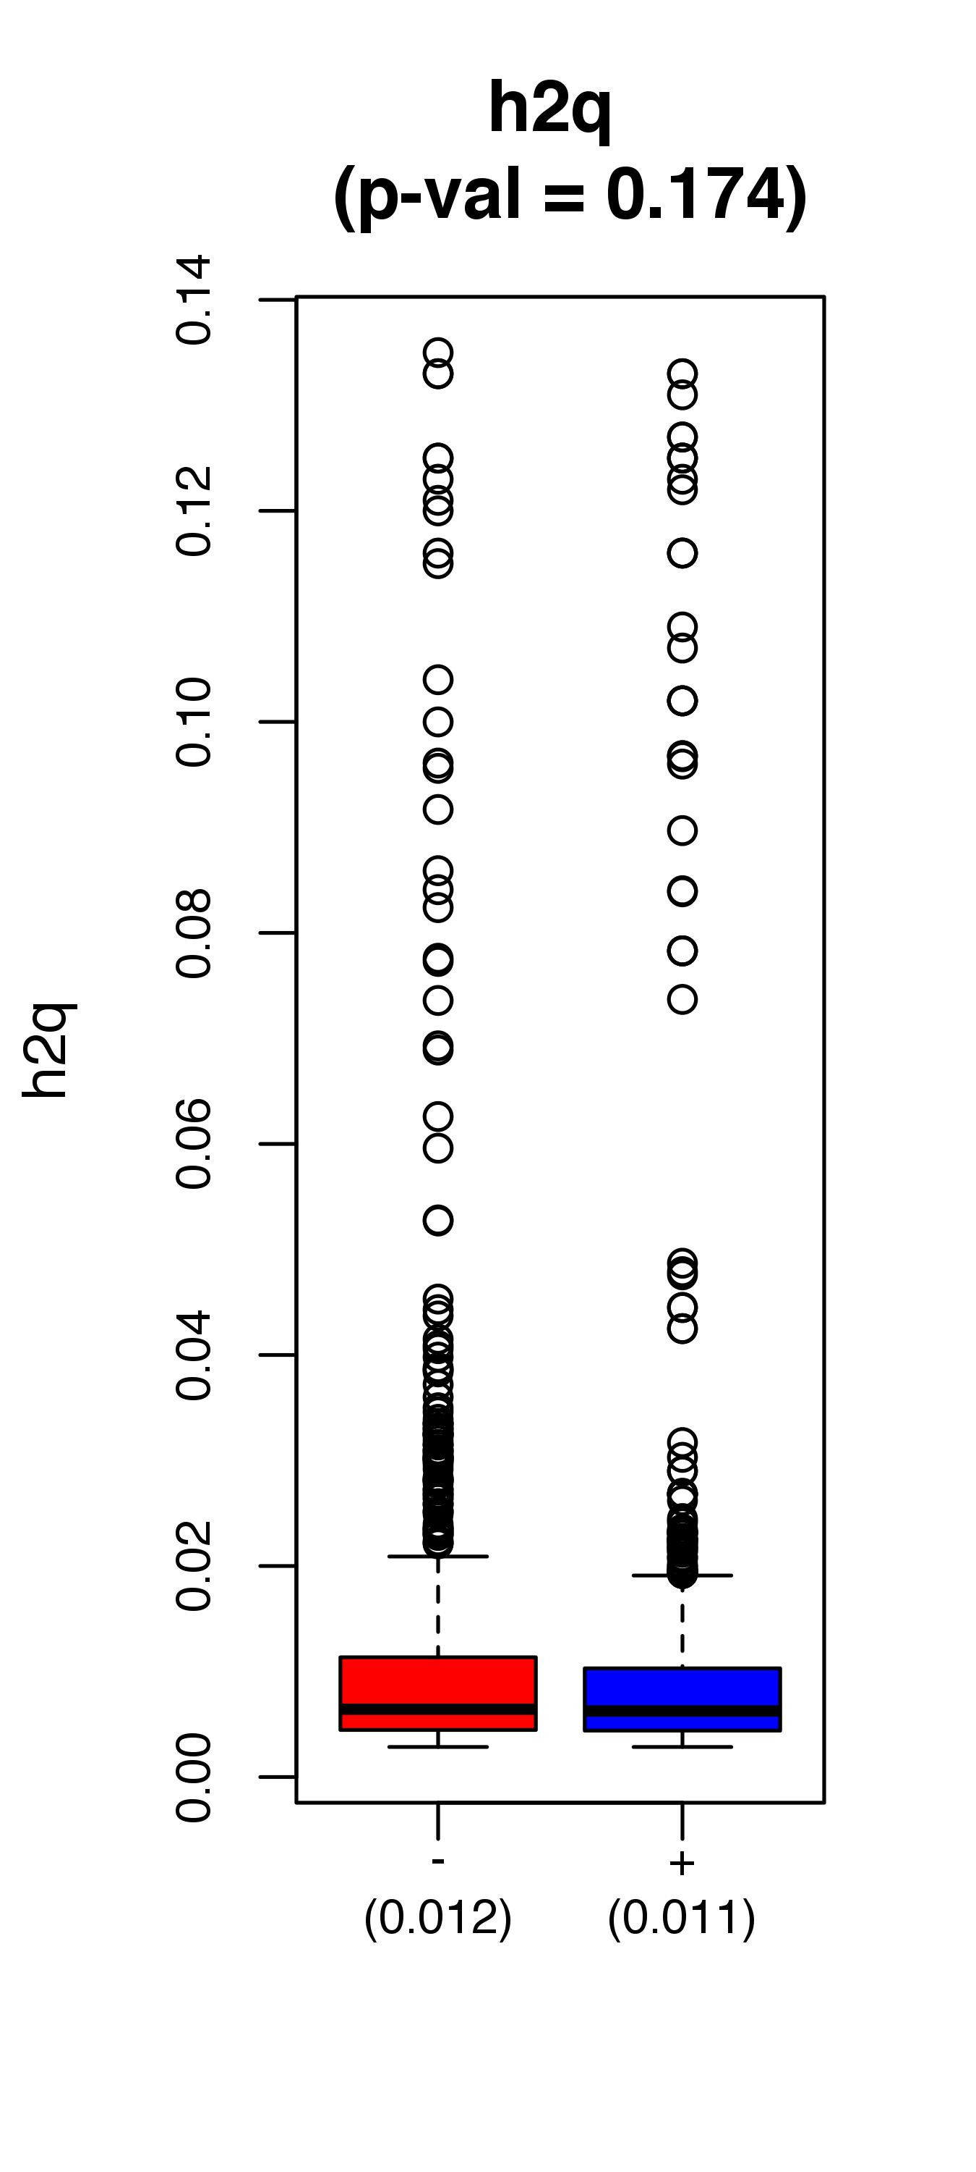
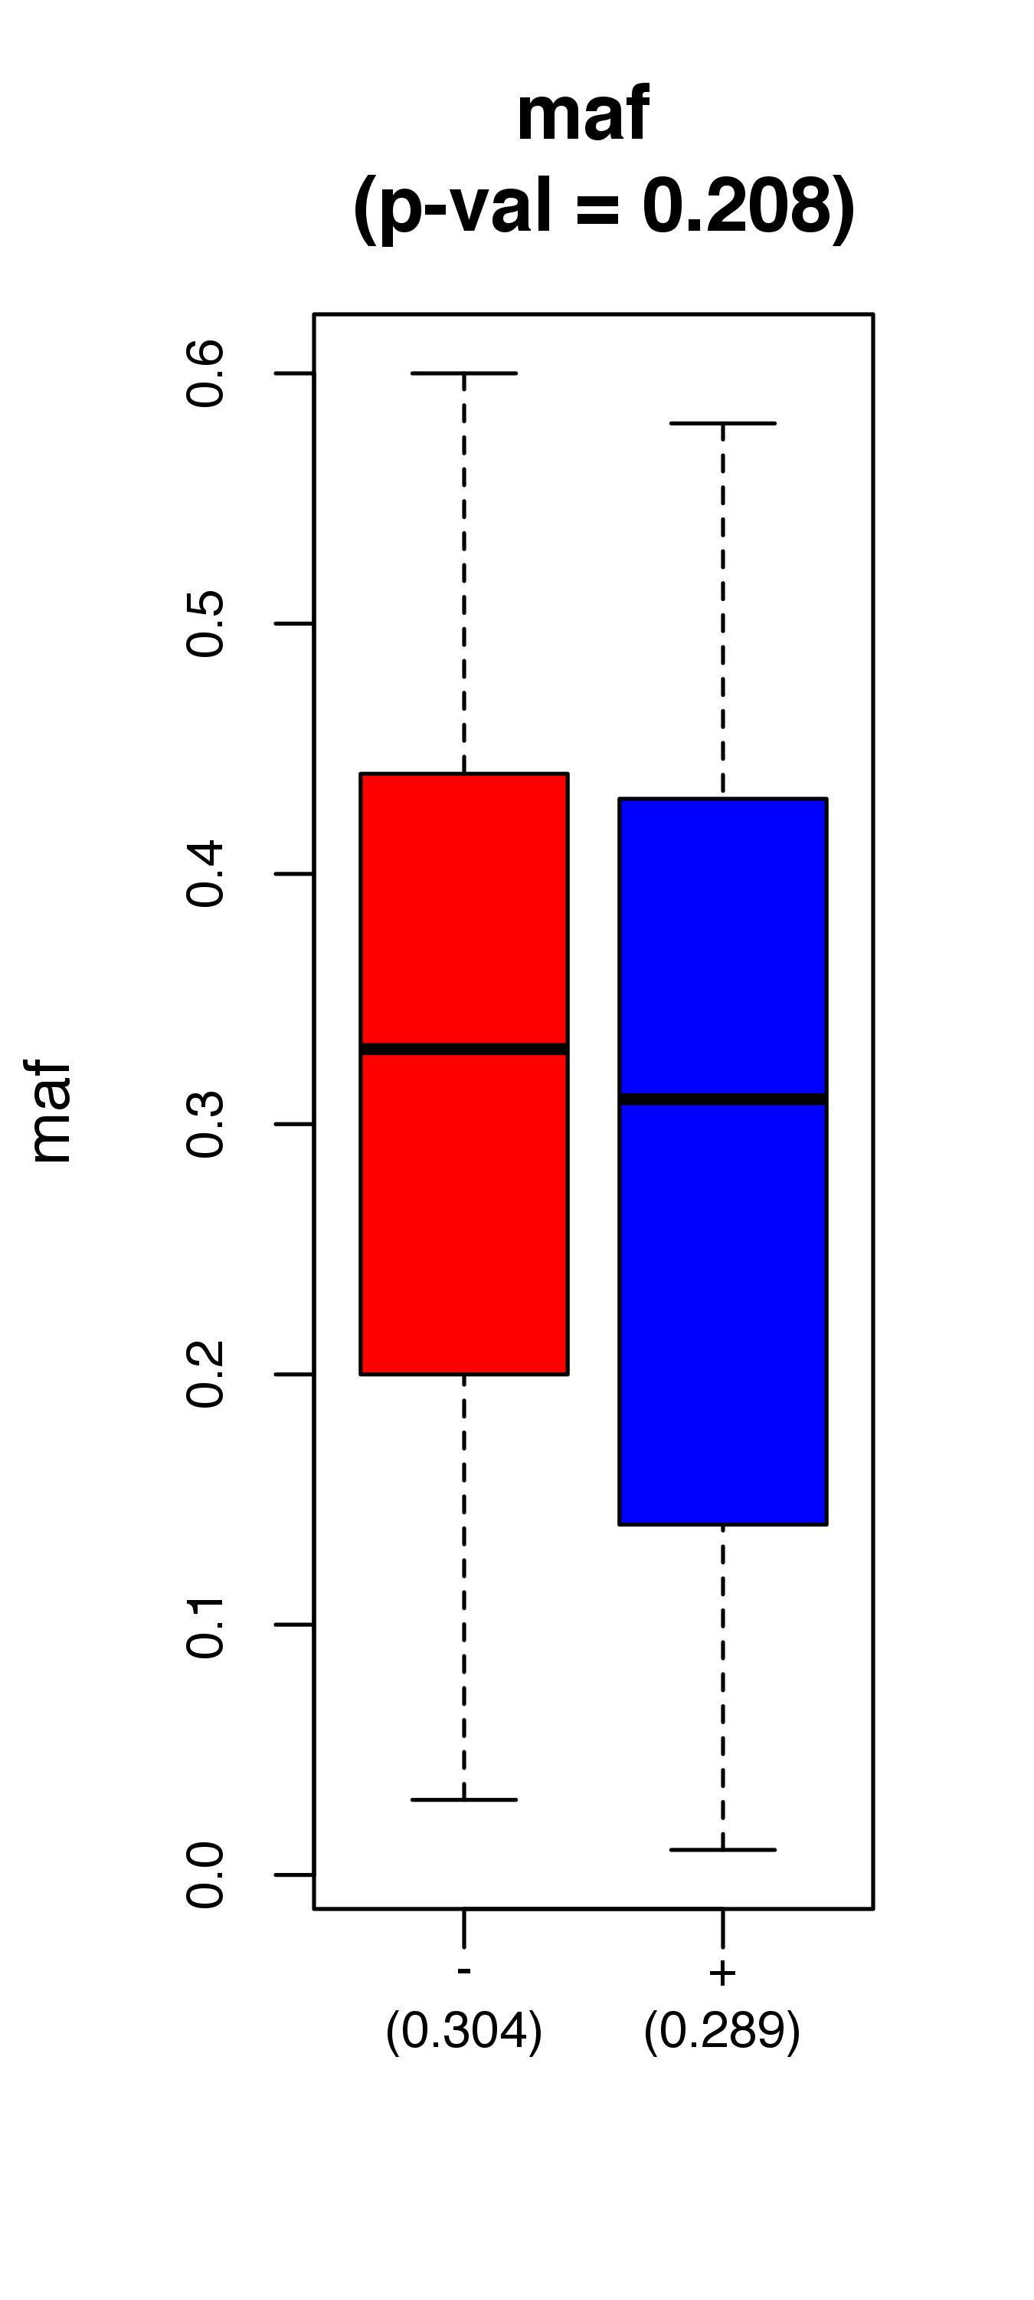
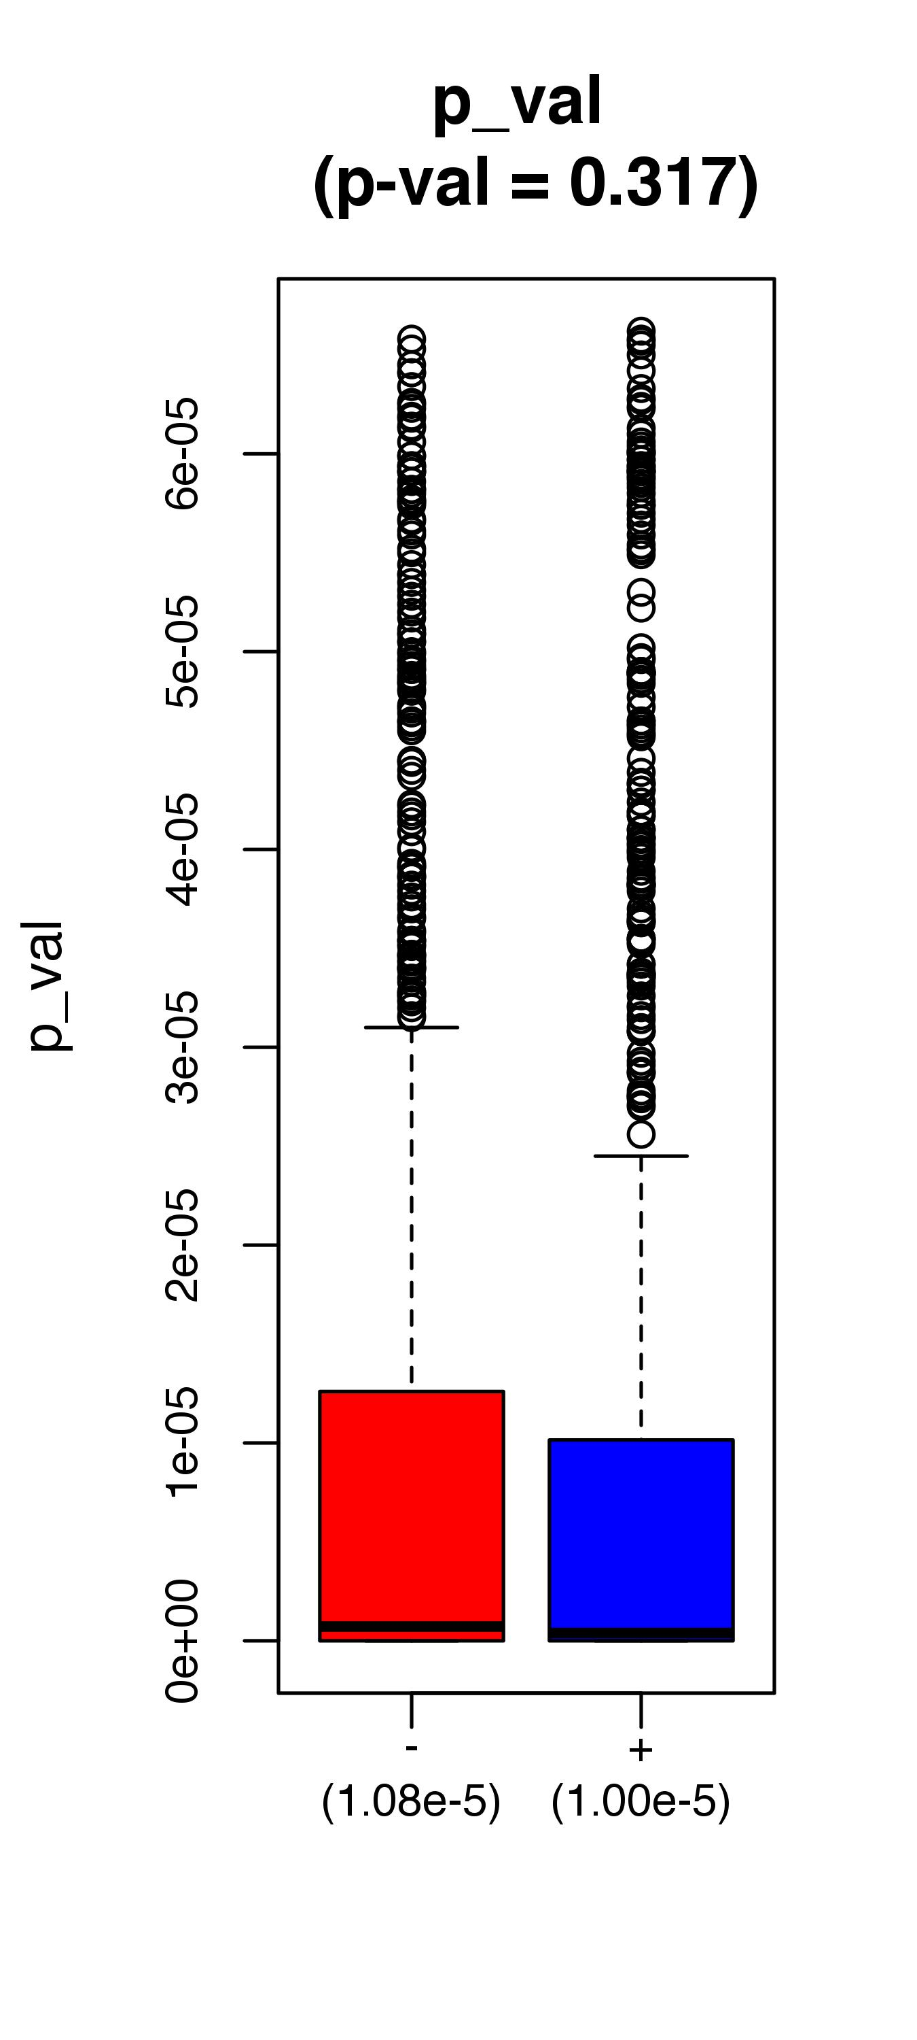
*
eQTLs for which the SNV does not lie in an enhancer
eQTLs for which the SNV does lie in an enhancer
* Heritability in miRNA expression levels

Slide 4
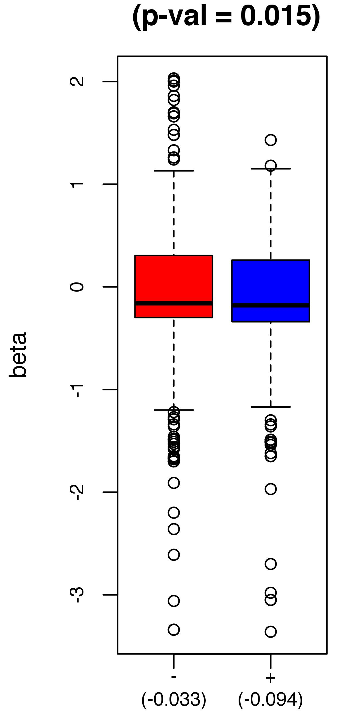
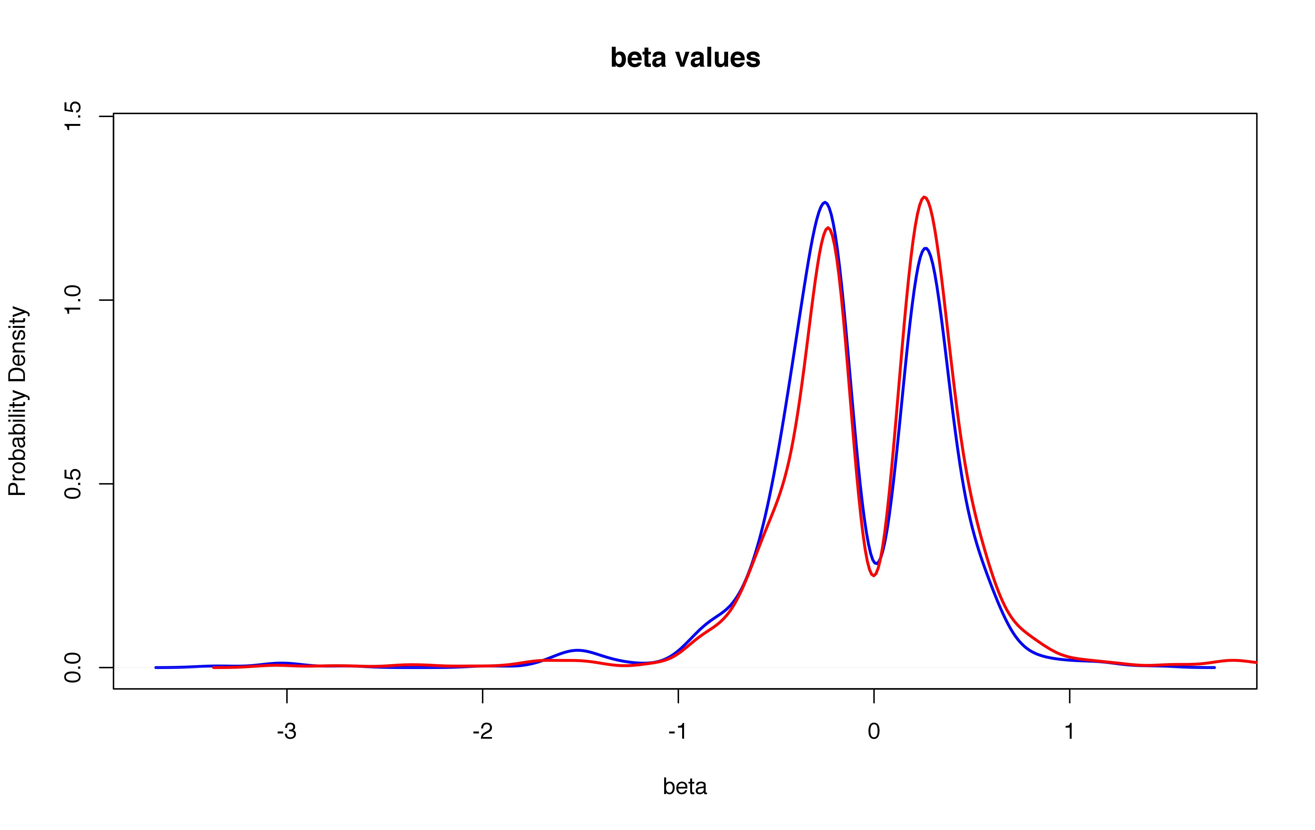
eQTLs for which the SNV does not lie in an enhancer
eQTLs for which the SNV does lie in an enhancer

Slide 5
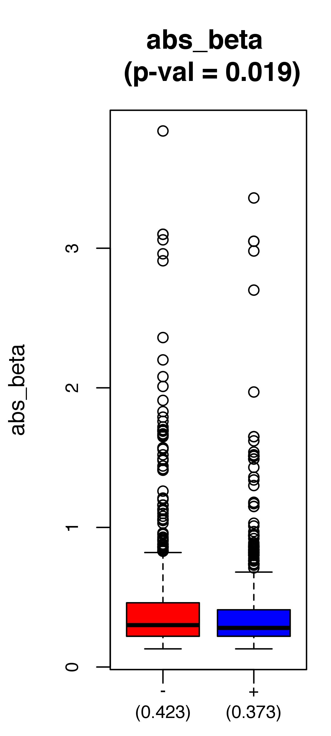
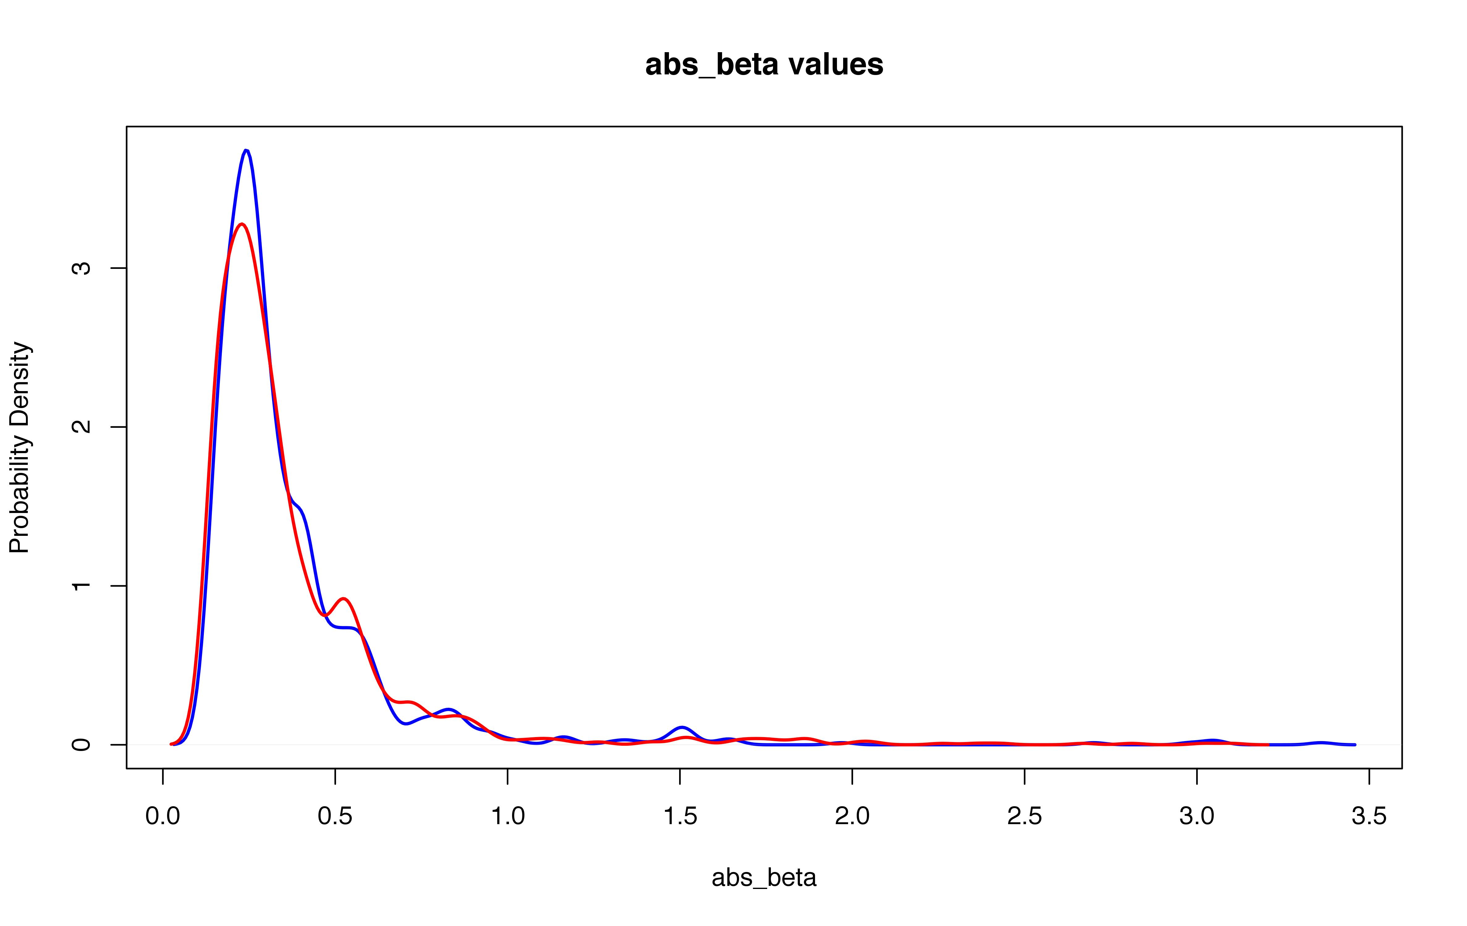
eQTLs for which the SNV does not lie in an enhancer
eQTLs for which the SNV does lie in an enhancer

Slide 6
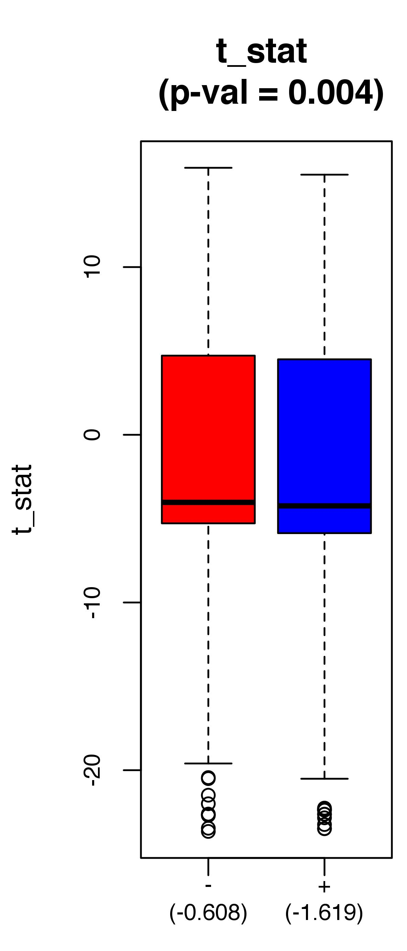
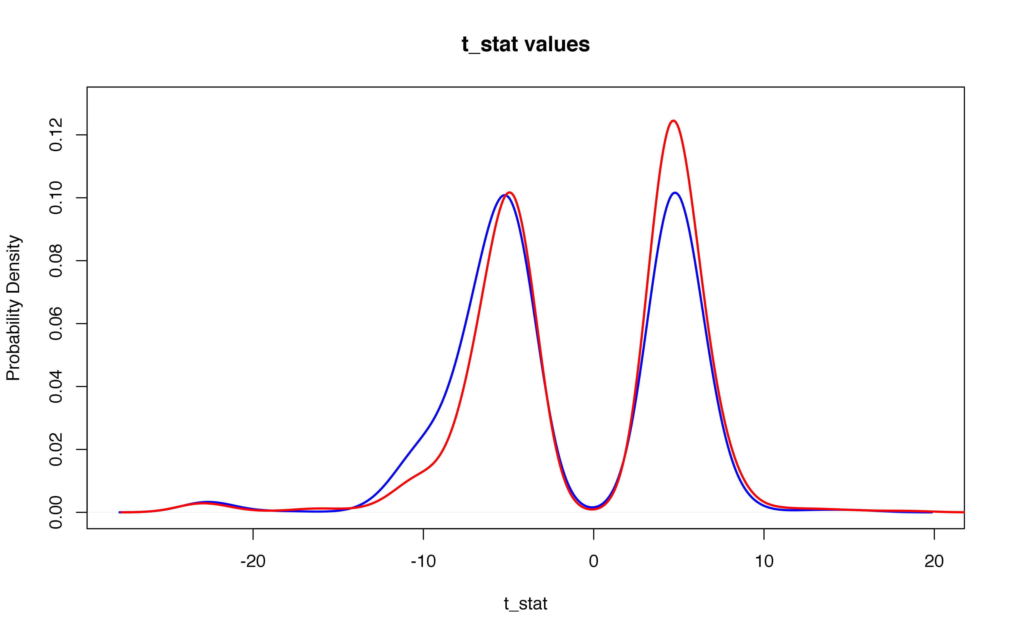
eQTLs for which the SNV does not lie in an enhancer
eQTLs for which the SNV does lie in an enhancer

Slide 7
Can also use enhancer data from epigenome roadmap: specific to blood types (need a systematic and justifiable way to merge enhancer data for different blood cell sub-types) – some of this carried out by undergrad (Holly Zhou)
Primary monocytes from peripheral blood
Primary neutrophils from peripheral blood
Primary B cells from cord blood
Primary B cells from peripheral blood
Primary T cells from cord blood
Primary T cells from peripheral blood
Primary mononuclear cells from peripheral blood
& a battery of T cell sub-types
Enh
Enh
Blood sub-cell type 1
Blood sub-cell type 2
Blood sub-cell type 3
Enh
Enh
Enh
Enhancer list:
E₁ ∪ E₂ ∪ E₃
“Enh” “Enh” “Enh”

Slide 8
Important consideration: the regulatory regions may not correspond to the target miRNAs
Raw data considerations (IRB, etc)?
+ new info beyond processed data
+ expedite process w/consultation from collaborators at
med school?
Investigating links to GTEx eQTLs. -- ie, are there detectable eQTLs in GTEx Whole Blood samples that actually arise from miRNA-eQTLs, wherein the GTEx gene is the target of the associated miRNA?
2660 Framingham-GTEx eQTL matches
(out of 9612 Framingham mirQTLs)
miRNA
Protein-coding gene
SNV
GTEx eQTL

