Slide 1
Genomics:
Comparing Diverse Transcriptomes to Determine Deeply Conserved Aspects of Gene Expression
Mark Gerstein
Yale
Slides freely downloadable from
Lectures.GersteinLab.org
& “tweetable”
(via @markgerstein).
See last slide for more info.

Slide 2
How might we annotate a human text?
Color is Function
Lines are Similarity
[B Hayes,
Am. Sci.
(Jul.- Aug. '06)]

Slide 3
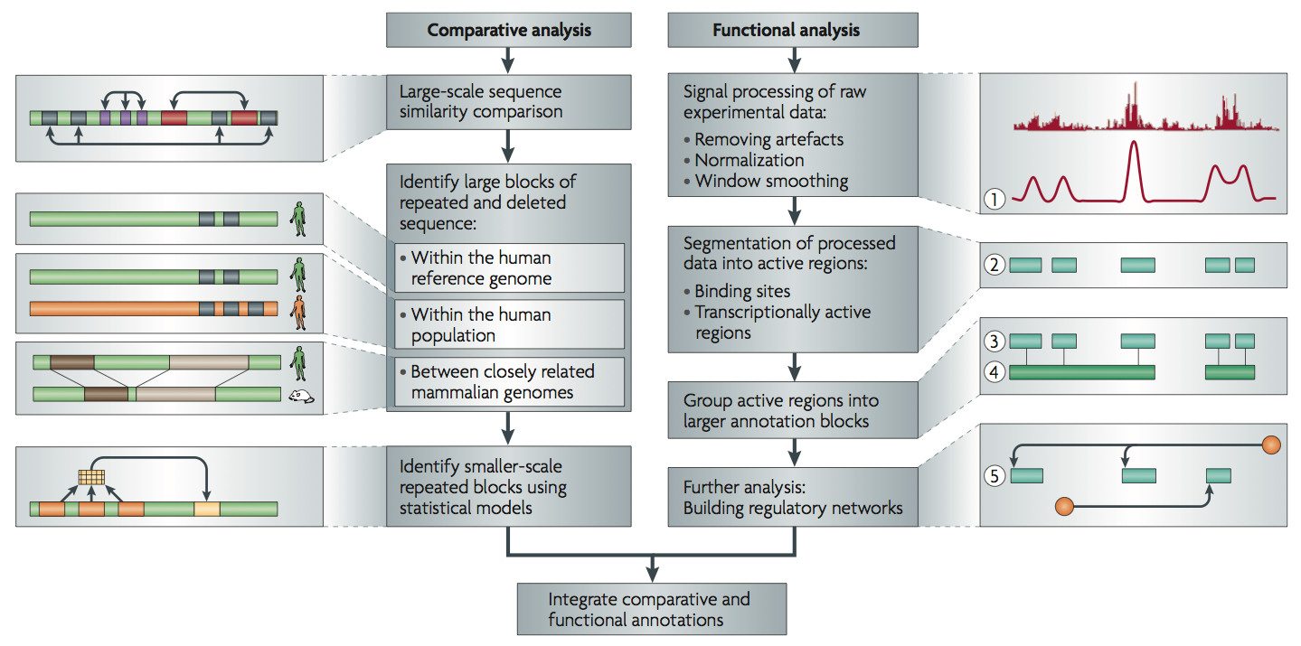
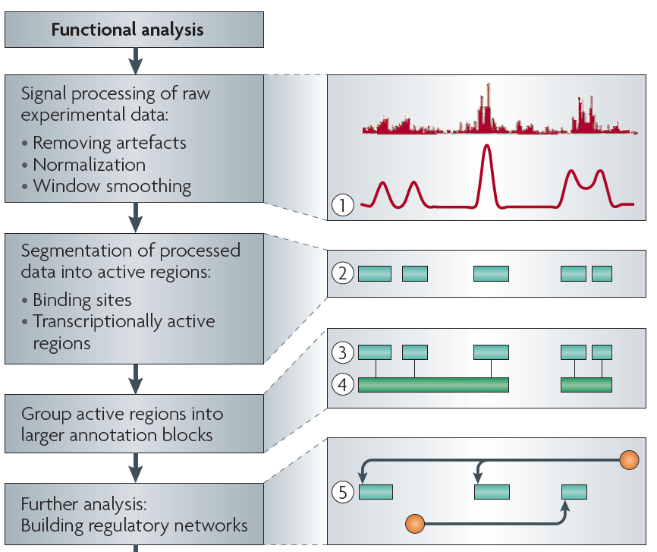
Non-coding Annotations: Overview
There are several collections of information "tracks" related to non-coding features
Sequence features, incl. Conservation
Functional Genomics
ChIP-seq (Epigenome & seq. specific TF) and ncRNA & un-annotated transcription
[Nat. Rev. Genet. (2010) 11: 559]

Slide 4
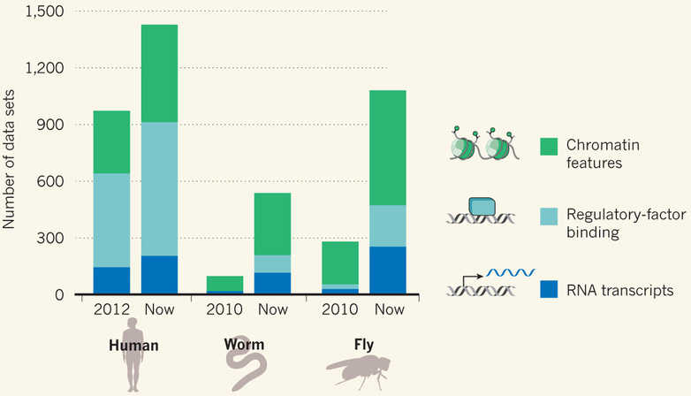
Comparative ENCODE Functional Genomics Resource
(EncodeProject.org/comparative)
Broad sampling of conditions across transcriptomes & regulomes for human, worm & fly
  embryo & ES cells
  developmental time course (worm-fly)
In total: ~3000 datasets (~130B reads)

Slide 5
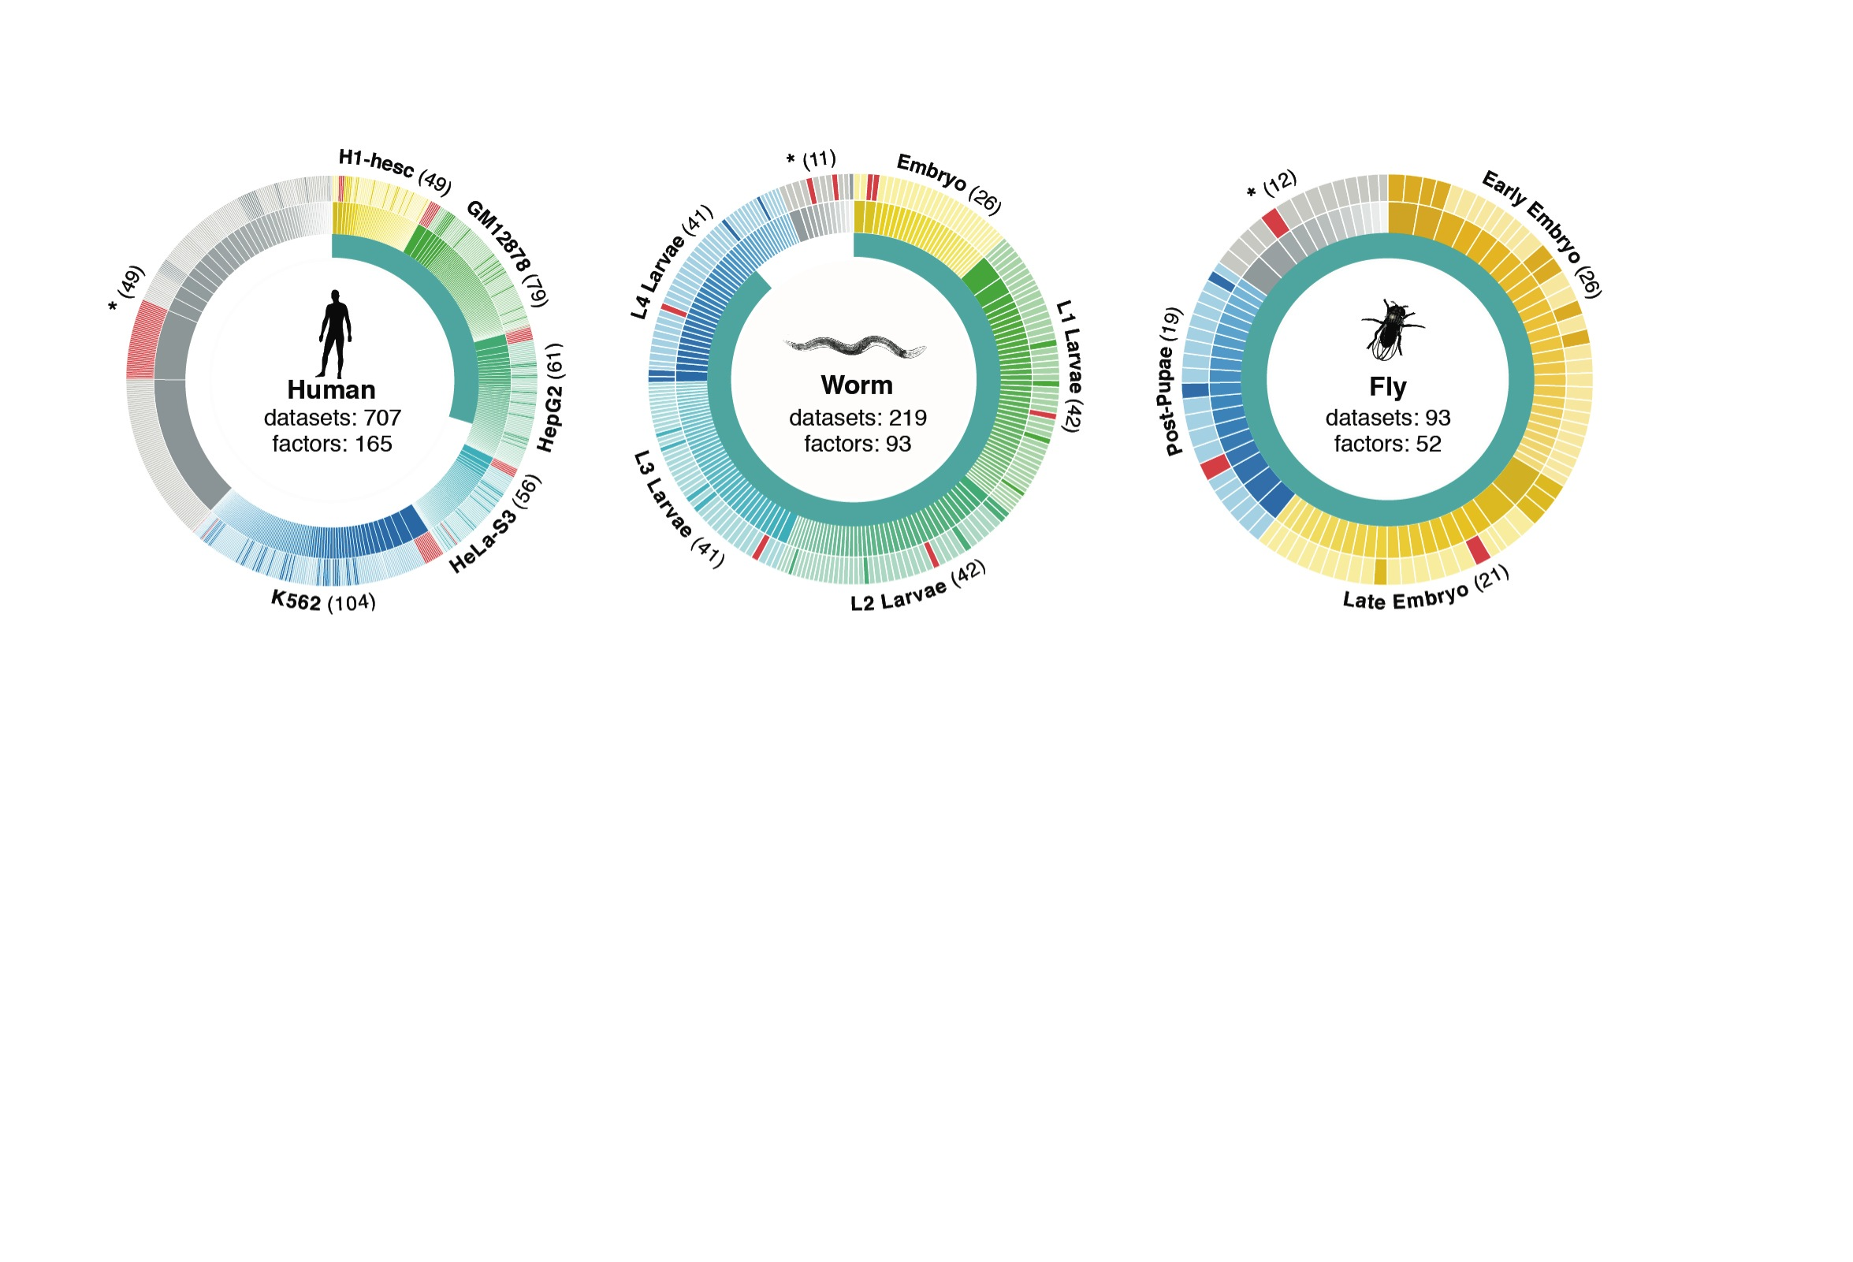
Time-course gene expression data of worm & fly development
[Nature 512:445 ('14); doi: 10.1038/nature13424]
Organism | Major developmental stages
worm (C. elegans) | 33 stages: 0, 0.5, 1, …, 12 hours, L1, L2, L3, L4, …, Young Adults, Adults
fly (D. mel.) | 30 stages: 0, 2, 4, 6, 8,…, 20, 22 hours, L1-L4, Pupaes, Adults

Slide 6
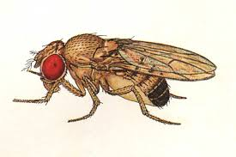

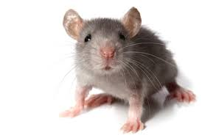
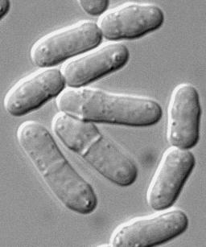
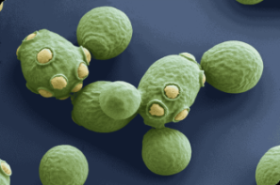

Comparative ENCODE
Previous studies have compared RNA transcription between closely related organisms (e.g. RNA-seq within mammals, Brawand et al. '11) …
EUKARYOTES
ANIMALS
MAMMALS
YEAST
500 MYO
75 MYO
Fly
Worm
Human
Mouse
Fission Yeast
Budding Yeast
RNA

Slide 7
Comparative ENCODE
Previous studies have compared RNA transcription between closely related organisms (e.g. RNA-seq within mammals, Brawand et al. '11) …
… or integrated diverse –omic information within each of several species (eg modencode '10)
EUKARYOTES
ANIMALS
MAMMALS
YEAST
500 MYO
75 MYO
Fly
Worm
Human
Mouse
Fission Yeast
Budding Yeast
RNA
TF
chromatin

Slide 8
Comparative ENCODE
Previous studies have compared RNA transcription between closely related organisms (e.g. RNA-seq within mammals, Brawand et al. '11) …
… or integrated diverse –omic information within each of several species (eg modencode '10)
EUKARYOTES
ANIMALS
A first effort to
comprehensively integrate diverse data across distantly related species
MAMMALS
YEAST
500 MYO
75 MYO
Fly
Worm
Human
Mouse
Fission Yeast
Budding Yeast
RNA
TF
chromatin

Slide 9
Comparing Diverse Transcriptomes to Determine Deeply Conserved Aspects of Gene Expression
Intro to Comparative ENCODE
  Lots of Matched Data for Comparative Analysis
Expression Clustering, Cross-species
  Potts-model optimization gives 16 conserved co-expression modules (which can potentially annotate ncRNAs/TARs)
  Developmental 'hourglass' genes in 12 of these. They also exhibit intra-organism hourglass behavior.
  Stage alignment of worm & fly development, strongest with hourglass genes
State Space Models of Gene Expression
  Using dimensionality reduction to help determine internal & external drivers
  Decoupling expression changes into those driven by worm-fly conserved genes vs species-specific ones. Also, Conserved genes have similar canonical patterns (iPDPs) in contrast to species specific ones (Ex of ribosomal v signaling genes)
Characterizing ncRNAs & TARs
  Not much news in canonical gene models
  Simple contig search (TARs) finds uniform density of non-canonical transcription
  ML model shows few TARs similar to existing ones, but some enrichment for eRNAs
Pseudogenes
  Fundamentally repetitive elements
  Collaborative assignment in results in ~14K
  Impact of lineage-specific retro-transpositional burst – ie human v other metazoans is dominated (~80%) by retro-duplication ~40 MYA (Ribo. Proteins).
  Many Pseudogenes with Low Levels of Biochemical Activity
    ~15% transcribed & 80% w/ some activity
Value of publication patterns generated by the consortium
  Co-authorship network statistics relate to publication rollouts & show gradual adoption by a diverse community
  Key role of brokers in data dissemination

Slide 10
Comparing Diverse Transcriptomes to Determine Deeply Conserved Aspects of Gene Expression
Intro to Comparative ENCODE
  Lots of Matched Data for Comparative Analysis
Expression Clustering, Cross-species
  Potts-model optimization gives 16 conserved co-expression modules (which can potentially annotate ncRNAs/TARs)
  Developmental 'hourglass' genes in 12 of these. They also exhibit intra-organism hourglass behavior.
  Stage alignment of worm & fly development, strongest with hourglass genes
State Space Models of Gene Expression
  Using dimensionality reduction to help determine internal & external drivers
  Decoupling expression changes into those driven by worm-fly conserved genes vs species-specific ones. Also, Conserved genes have similar canonical patterns (iPDPs) in contrast to species specific ones (Ex of ribosomal v signaling genes)
Characterizing ncRNAs & TARs
  Not much news in canonical gene models
  Simple contig search (TARs) finds uniform density of non-canonical transcription
  ML model shows few TARs similar to existing ones, but some enrichment for eRNAs
Pseudogenes
  Fundamentally repetitive elements
  Collaborative assignment in results in ~14K
  Impact of lineage-specific retro-transpositional burst – ie human v other metazoans is dominated (~80%) by retro-duplication ~40 MYA (Ribo. Proteins).
  Many Pseudogenes with Low Levels of Biochemical Activity
    ~15% transcribed & 80% w/ some activity
Value of publication patterns generated by the consortium
  Co-authorship network statistics relate to publication rollouts & show gradual adoption by a diverse community
  Key role of brokers in data dissemination

Slide 11
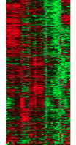
Expression clustering:
revisiting an ancient problem
Species A
Species B
Clustering
algorithm
Clustering
algorithm
co-expressed genes
responsible for the same
function in a species
co-expressed genes
responsible for the same
function in a species
Eisen MB et al. PNAS 1998
Langfelder P et al. BMC Bioinfo. 2008
Tamayo P et al. PNAS 1999
Kluger Y et al. Genome Res. 2003
two independent sets
of modules
Cross species
co-expression modules

Slide 12
Expression clustering:
revisiting an ancient problem
Species A
Orthologous pairs
between species
Species B
A novel unified framework to integrate co-expression data across species
OrthoClust
cross species modules
Yan et al. Genome Biol. 2014
Cross species
co-expression modules

Slide 13
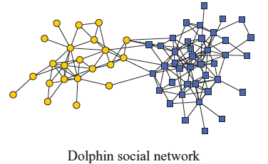
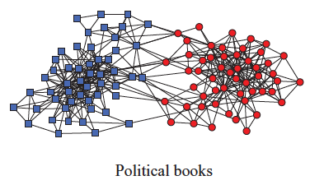
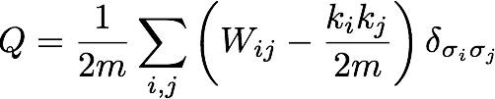
Network modularity
degree of node i
Newman Phy. Rev. E 2013
adjacency matrix
whether or not
i, j are in the
same module
number of edges
expected number of
edges between i and j

Slide 14

Network modularity
degree of node i
adjacency matrix
whether or not
i, j are in the
same module
number of edges
expected number of
edges between i and j

Slide 15

Network modularity
Optimization problem
degree of node i
adjacency matrix
whether or not
i, j are in the
same module
number of edges
expected number of
edges between i and j

Slide 16
A toy example [orthoclust]
[Yan et al. GenomeBiol 15:R100 ('14)]
2
Every node i is assigned with a spin value σ_{i} (labels of modules: 1,2,…q).
4
4
co-expressed
1
1
2
2
orthologs
Species A
3
3
Species B
reward an orthologous pair
with the same value
4
4
4
1
2
1
3
1
reward a co-expressed
pair with the same value
punish a non co-expressed
pair with the same value
Favorableness = "Modularity" in species A + "Modularity" in species B + consistency betw. A & B

Slide 17
A toy example [orthoclust]
[Yan et al. GenomeBiol 15:R100 ('14)]
2
2
4
co-expressed
2
4
2
4
orthologs
Species A
2
4
Species B
4
1
4
1
4
4
1
1
species A specific
conserved modules
species B specific
Use Potts model (generalized Ising model) to simultaneously cluster co-expressed genes within an organism as well as orthologs shared between organisms. Here, the ground state configuration correspond to three modules: 1, 2, 4.

Slide 18
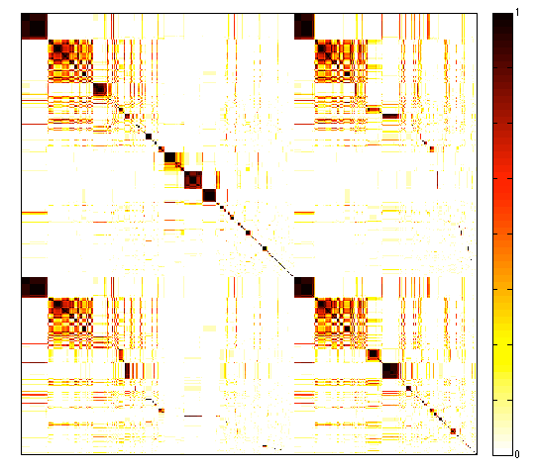
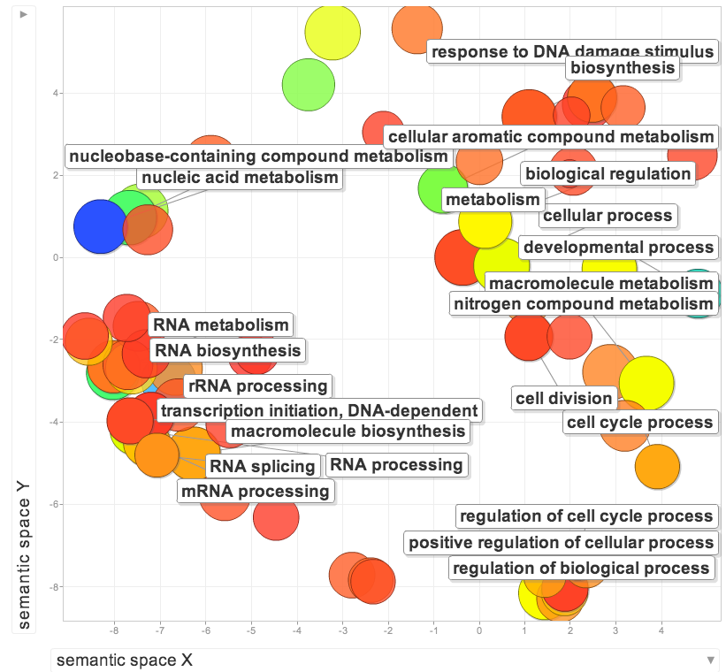
Cross-species clusters for worm and fly
GO terms of conserved modules
Worm genes (20377)
Fly genes (13623)
GO terms of specific modules
worm specific | dauer entry
fly specific | chitin activities
co-association
frequency
Yan KK et al. Genome Biology. 2014

Slide 19
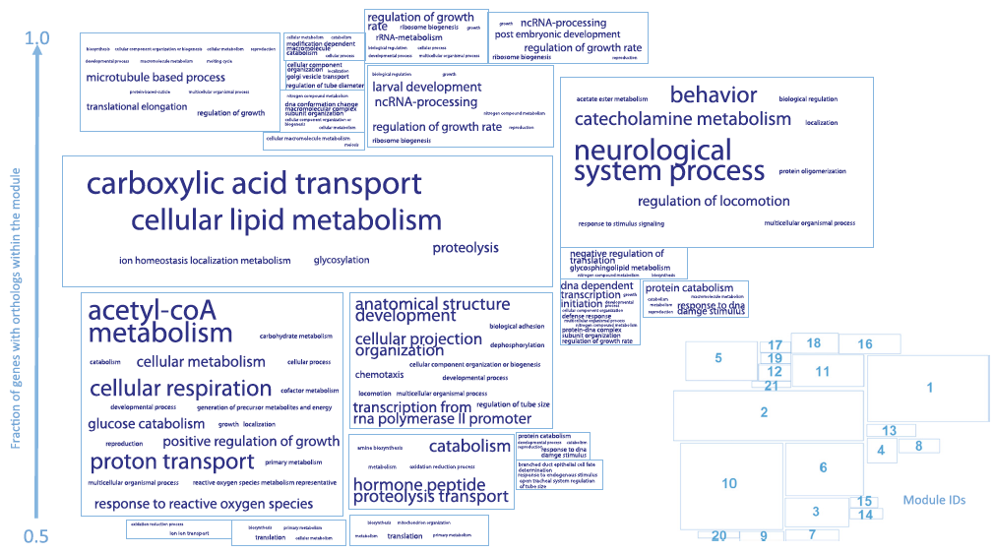
More conserved modules
Yan KK et al. Genome Biology. 2014

Slide 20
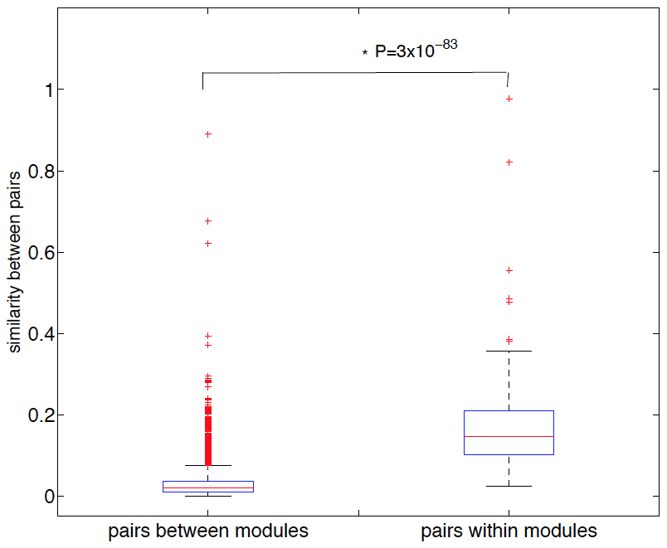
Separation of modules in terms of GO
Yan KK et al. Genome Biology. 2014

Slide 21
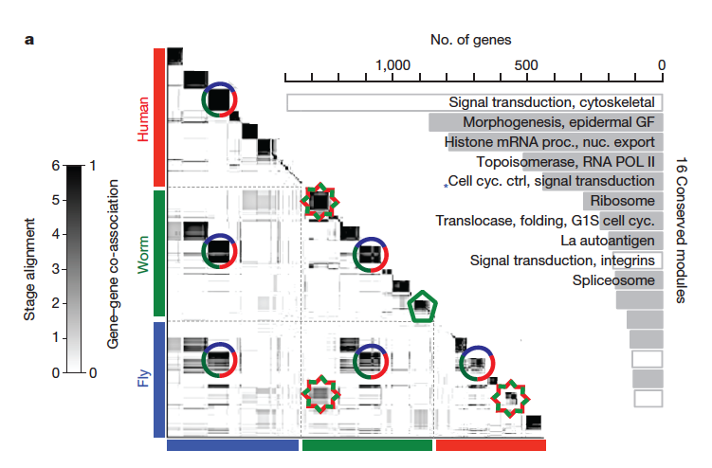
Application for more than 2 species
~55000 genes
[Nature 512:445 ('14); doi: 10.1038/nature13424]

Slide 22
ncRNAs associated with modules
Non-canonical transcription (TARs):
Identify TARs that are significantly correlated and anti-correlated with genes in the 16 modules.
Human, Worm & Fly
[Nature 512:445 ('14); doi: 10.1038/nature13424]

Slide 23
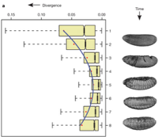
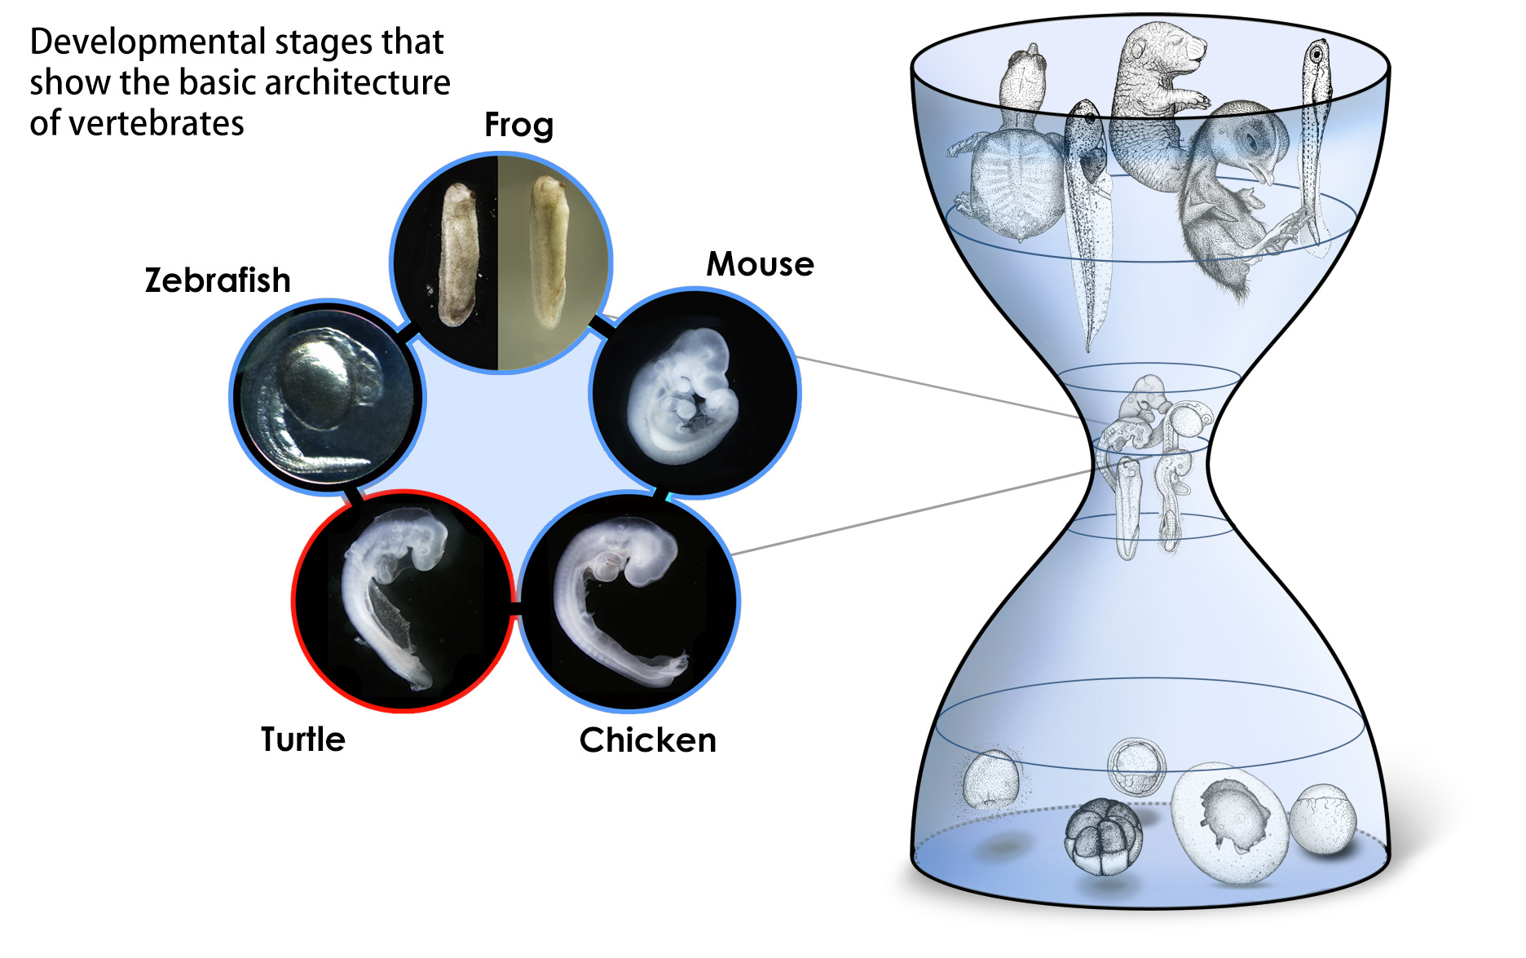
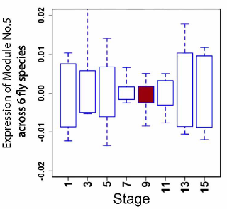
Conserved modules exhibit canonical hourglass behavior
Phylotypic stage
Expression divergence across species is minimized during phylotypic stage (Kalinka et al. Nature 2010)
Illustrations courtesy Naoki Irie
Canonical Inter-organism Behavior
“Hourglass hypothesis”: all organisms go through a particular stage in embryonic development ("phylotypic" stage) where
inter-organism expression differences of orthologous genes are smallest.
We identify modules (12 out of 16) which have this behavior at the phylotypic stage.
phylotypic stage
[Nature 512:445 ('14); doi: 10.1038/nature13424]

Slide 24
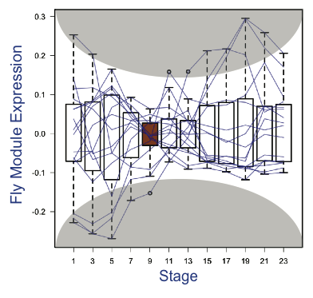
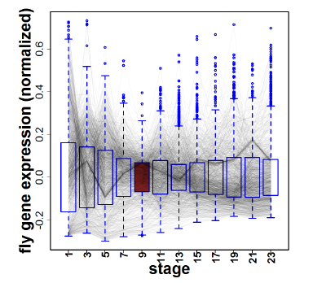
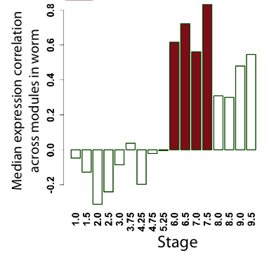
Hourglass Behavior
phylotypic stage
Intra-organism Behavior also Present
We observe that the expression of genes across 12 modules are the most tightly coordinated at the phylotypic stage (fly).
Strongly correlated correlation at phylotypic stage (worm).
[Nature 512:445 ('14); doi: 10.1038/nature13424]

Slide 25
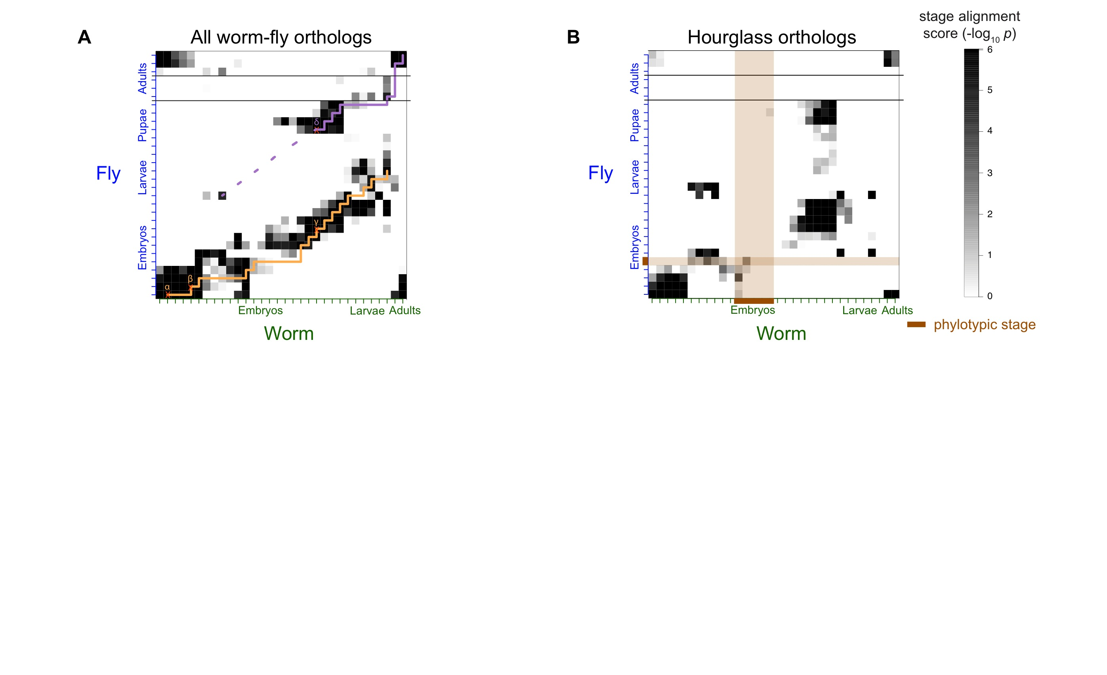
Alignment of Developmental Time-Course
For worm & fly find stage-specific genes
We can align developmental stages using fraction of shared orthologs between worm and fly amongst these
Reuse of genes from LE in worm in fly pupa
Fly
Align developmental stages using shared orthologs between worm and fly
  Reuse of genes from LE in worm in fly pupa
Using only orthologs in hourglass modules we find similar behavior except for absence of genes at the phylotypic stage
primary alignment
secondary alignment
Worm
[Nature 512:445 ('14); doi: 10.1038/nature13424]

Slide 26
Alignment of Developmental Time-Course
Using only orthologs in 12 "hourglass" modules show stronger alignment except for absence of genes at the phylotypic stage
  By definition genes in hourglass modules are not phylotypic stage specific, hence the gap
[Nature 512:445 ('14); doi: 10.1038/nature13424]

Slide 27
Conserved gene regulatory networks between worm and fly?
Orthologous genes between worm and fly
Many co-expressed orthologous genes during embryonic development, especially at phylotypic stage;e.g., hourglass and alignment gap
Co-expression implies co-regulation
Do there exist internally conserved gene regulatory networks in orthologous genes driving orthologous gene co-expression?
  No sure, because orthologous genes can be also externally regulated by species-specific genes
Notes:
Transition from alignment gap, hourglass to dreiss

Slide 28
Comparing Diverse Transcriptomes to Determine Deeply Conserved Aspects of Gene Expression
Intro to Comparative ENCODE
  Lots of Matched Data for Comparative Analysis
Expression Clustering, Cross-species
  Potts-model optimization gives 16 conserved co-expression modules (which can potentially annotate ncRNAs/TARs)
  Developmental 'hourglass' genes in 12 of these. They also exhibit intra-organism hourglass behavior.
  Stage alignment of worm & fly development, strongest with hourglass genes
State Space Models of Gene Expression
  Using dimensionality reduction to help determine internal & external drivers
  Decoupling expression changes into those driven by worm-fly conserved genes vs species-specific ones. Also, Conserved genes have similar canonical patterns (iPDPs) in contrast to species specific ones (Ex of ribosomal v signaling genes)
Characterizing ncRNAs & TARs
  Not much news in canonical gene models
  Simple contig search (TARs) finds uniform density of non-canonical transcription
  ML model shows few TARs similar to existing ones, but some enrichment for eRNAs
Pseudogenes
  Fundamentally repetitive elements
  Collaborative assignment in results in ~14K
  Impact of lineage-specific retro-transpositional burst – ie human v other metazoans is dominated (~80%) by retro-duplication ~40 MYA (Ribo. Proteins).
  Many Pseudogenes with Low Levels of Biochemical Activity
    ~15% transcribed & 80% w/ some activity
Value of publication patterns generated by the consortium
  Co-authorship network statistics relate to publication rollouts & show gradual adoption by a diverse community
  Key role of brokers in data dissemination

Slide 29
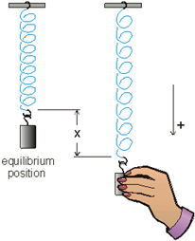
Internal & external gene regulatory networks
Internal Group
External Group
How to identify gene expression dynamics driven by internal/external regulation?
Internal regulation
External regulation
Interested system | Internal regulatory network | External regulatory network
Cross-species conserved genes | Conserved transcriptional factors (TFs) | Non-conserved TFs
Protein-coding genes | TFs | micro-RNAs
Individual’s protein coding genes | Wild-type TFs | Somatic mutated TFs
Protein-coding genes in brain | Commonly expressed TFs | Brain-specific expressed TFs
Protein-coding genes in development | House-keeping TFs | Developmental TFs
External force
[Wang et al. PLOS CB (in revision, ‘15)]
Notes:
connect loregic to here too! to see regulatory mechanisms similar too

Slide 30
State-space model for internal and external gene regulatory networks
Internal Group
External Group
How to identify gene expression dynamics driven by internal/external regulation?
Internal regulation
External regulation
Control: Gene expression vector of external factors at time t
State space model
X_{t+1}
A
X_{t}
B
U_{t}
B_{kl} captures temporal casual influence from external factor k to Gene l in internal group
State: Gene expression vector of Group X at time t+1
A_{ij} captures temporal casual influence from Gene i to Gene j in internal group
State: Gene expression vector of internal group at time t
[Wang et al. PLOS CB, ‘16]
Notes:
connect loregic to here too! to see regulatory mechanisms similar too

Slide 31
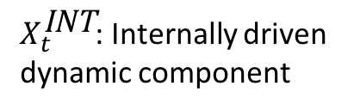
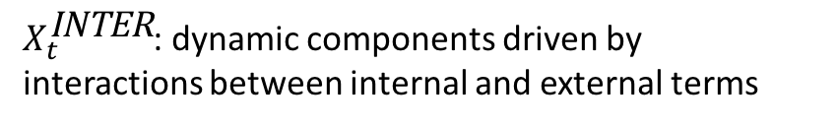
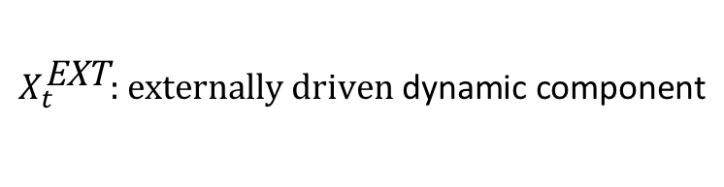
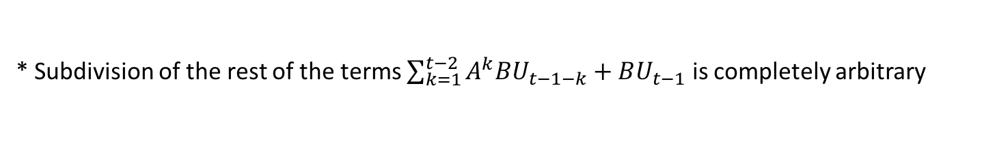
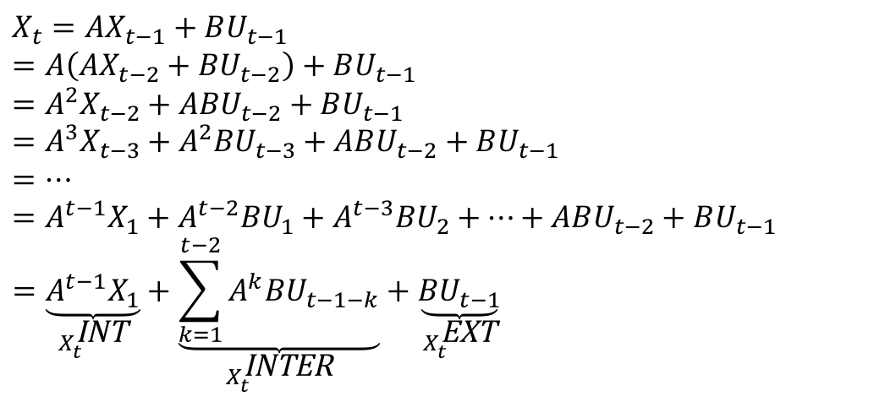
Decomposition of internal and external-related dynamic components
$$X_{t}=AX_{t−1}+BU_{t−1}$$
$$=A\left(AX_{t−2}+BU_{t−2}\right)+BU_{t−1}$$
$$=A^{2}X_{t−2}+ABU_{t−2}+BU_{t−1}=A^{3}X_{t−3}+A^{2}{BU}_{t−3}+ABU_{t−2}+BU_{t−1}$$
$$=…$$
$$=A^{t−1}X_{1}+A^{t−2}{BU}_{1}+A^{t−3}{BU}_{2}+…+ABU_{t−2}+BU_{t−1}=\underset{X_{t}^{\text{INT}}}{\underbrace{A^{t−1}X_{1}}}+\underset{X_{t}^{\text{INTER}}}{\underbrace{\sum_{k=1}^{t−2}{A^{k}BU_{t−1−k}}}}+\underset{X_{t}^{\text{EXT}}}{\underbrace{BU_{t−1}}}$$
$$X_{t}^{\text{EXT}}\text{: }\text{externally} \text{driven} \text{dynamic} \text{component}$$
$X_{t}^{\text{INTER}}$: dynamic components driven by interactions between internal and external terms
$X_{t}^{\text{INT}}$: Internally driven dynamic component
* Subdivision of the rest of the terms $\sum_{k=1}^{t−2}{A^{k}BU_{t−1−k}}+BU_{t−1}$ is completely arbitrary
[Wang et al. PLOS CB, ‘16]

Slide 32
Effective state space model for meta-genes
Not enough data to estimate state space model for genes
(e.g., 25 time points per gene to estimate 4 million elements of A or B for 2000 genes)
Dimensionality reduction from genes to meta-genes (e.g., SVD)
Effective state space model for meta-genes
(e.g., 250 time points to estimate 50 matrix elements if 5 meta-genes)
[Wang et al. PLOS CB, ‘16]

Slide 33
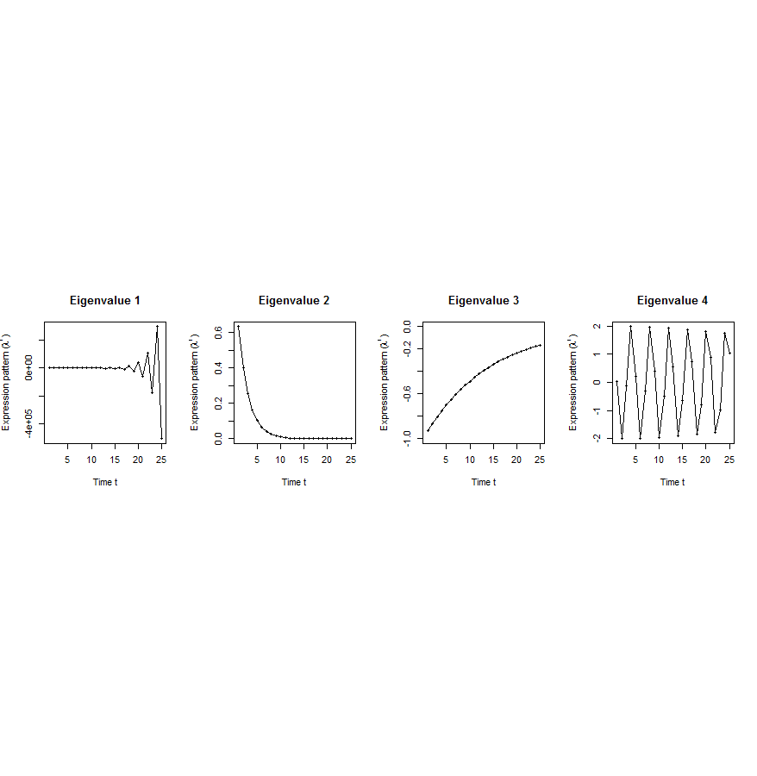
Canonical temporal expression trajectories from effective state space model
Internal driven dynamics
p^{th} internal principal dynamic pattern (iPDP): [λ_{p}¹, λ_{p}², …, λ_{p}^{T}],
where λ_{p} is p^{th} eigenvalue of Ã.
Canonical temporal expression trajectories
(e.g., degradation, growth, damped oscillation, etc.)
iPDP expression
time
[Wang et al. PLOS CB, ‘16]
Notes:
if we look at A tilde, it controls the dynamic trajectory of expression part internally driven by meta-genes of X. according to the analytic solution, the internally driven expression part Xtilde I can be linear combinations of A tilde’s eigenvalue’s exponentials across time, which are defined by us as internal principal dynamic pattern (iPDP). B tilde controls the dynamic trajectory of X’s metagene expression part externally driven by U. similarly, we can find external principal dynamic pattern (ePDP) based on B tilde’s eigenvalue exponentials across time. Actually, those patterns are canonical temporal expression trajectories, which are as simple as degradation, growth, damped oscillation temporal processes). In short, from metagene effective model, we are able to identify internal and external driven canonical temporal expression trajectories.

Slide 34
Are gene regulations among orthologs conserved across species?
Are gene regulatory networks among orthologs conserved across species?
Species A
Species B
orthologs
co-expressed
Regulation among orthologs (internal)
Regulation from species-specific factors (external)
Orthologous genes (orthologs)
Species-specific transcription factors
To what degree can’t ortholog expression levels be predicted due to species-specific regulation
[Wang et al. PLOS CB, ‘16]
Notes:
connect loregic to here too! to see regulatory mechanisms similar too

Slide 35
Are there any conserved regulatory networks between worm and fly during embryonic development?
Not enough time samples!
Dataset | Internal Group | External Group | Developmental stages | # of unknown parameters in A and B | # of available time samples
worm (C. elegans) | N₁=3147 worm-fly orthologs (incl. ortholog TFs) | N₂=509 worm-specific transcription factors | T=25 time points: 0, 0.5, 1, …, 12 hours | 3147*3147+3147*509=11.5M | 3147*25+509*25=91400
fly (D. mel.) |  | N₂=442 fly-specific transcription factors | T=12 time points: 0, 2, 4, 6, 8,…, 20, 22 hours | 3147*3147+3147*442=11.3M | 3147*25+442*25=89725
A_{w}
B_{w}
A_{f}
B_{f}
worm
fly
If A_{w} and A_{f} have similarities, cross-species conserved regulatory networks in embryonic development
Embryonic stem cells (ESCs)
Notes:
we apply this method to time-series gene expression data in embryonic development of worm and fly in modENCODE, and identified internal principal dynamic patterns of ortholog gene expressions driven by orthologous TFs, and external patterns driven by species-specific TFs.

Slide 36
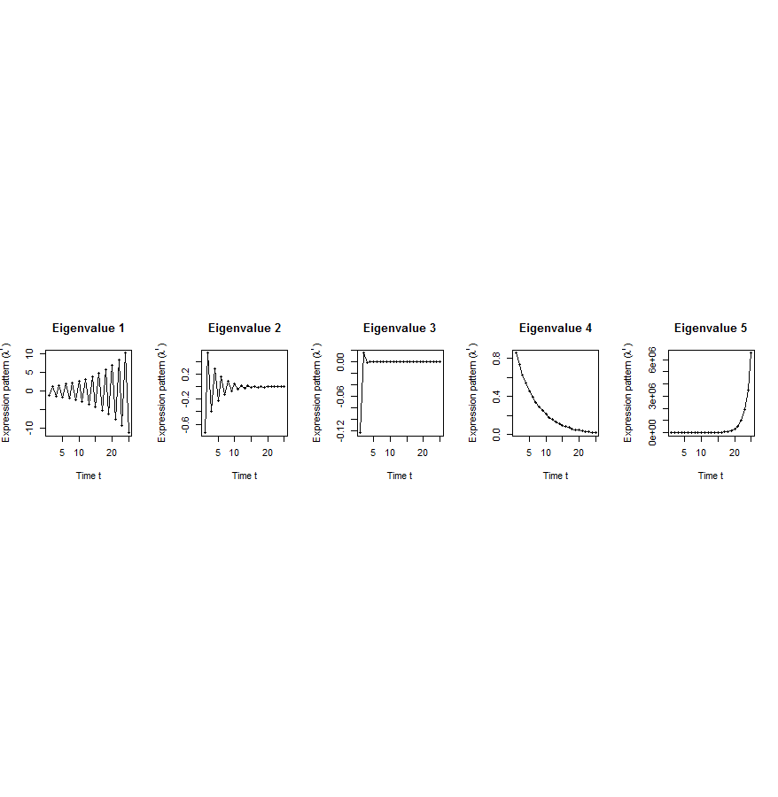
Flowchart
[Wang et al. PLOS CB, ‘16]
A. Gene state-space model
C. Meta-gene state-space model
B. Dimensionality Reduction
X_{t+1}=AX_{t}+BU_{t}
Genes of X
Meta-genes of X
time
E. Gene’s internal (INT) and external (EXT) driven expression dynamics composed of PDPs
time
D. Internal/External Principal Dynamic Patterns (PDPs)
x^{INT} = c₁ +c₂
+c₃ +c₄
[λ_{p}¹, λ_{p}², …, λ_{p}^{T}]
Genes of U
Meta-genes of U
time
time
x^{EXT} = d₁ +d₂
+d₃ +d₄
/
Internal regulation among internal genes/meta-genes by A/Ã
/
External regulation from external genes/meta-genes to internal genes/meta-genes in Group X by B/
/
/
External genes/meta-genes
Internal genes/meta-genes

Slide 37
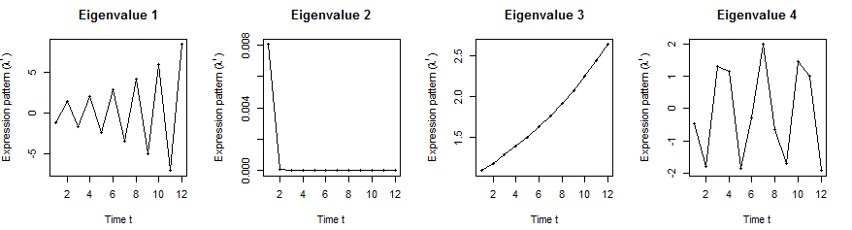
Orthologs have similar internal but different external dynamic patterns during embryonic development
Worm’s effective state space model
A
B
iPDPs: time exponentials of Ã eigenvalues in worm
ePDPs: in worm
1st iPDP
2nd iPDP
3rd iPDP
4th iPDP
1st ePDP
2nd ePDP
3rd ePDP
4th ePDP
5th ePDP
Expression
Expression
Similar iPDPs
Different ePDPs
1st iPDP
2nd iPDP
3rd iPDP
4th iPDP
1st ePDP
2nd ePDP
3rd ePDP
4th ePDP
5th ePDP
Expression
Expression
iPDPs: time exponentials of Ã eigenvalues in fly
ePDPs: in fly
Fly’s effective state space model
[Wang et al. PLOS CB, ‘16]

Slide 38
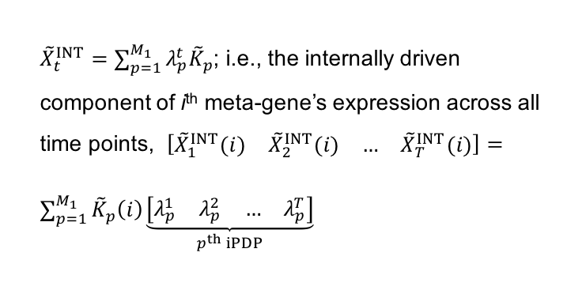

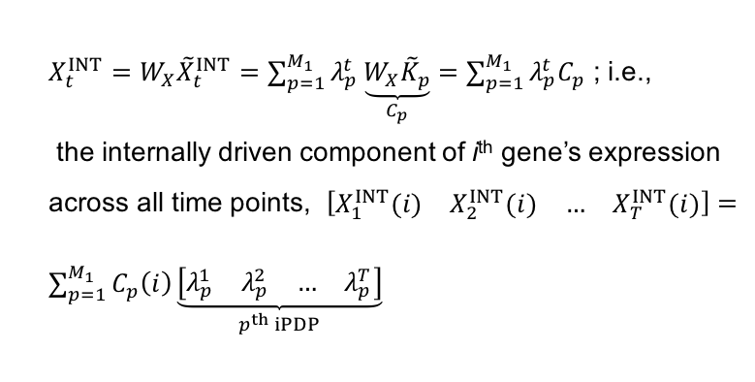
Projection back to gene space to get gene coefficients on iPDPs
X_{t}
Internal component of meta-genes: ${\tilde{X}}_{t+1}^{INT}=\tilde{A}{\tilde{X}}_{t}^{INT}$
=>
${\tilde{X}}_{t}^{INT}=\sum_{p=1}^{M_{1}}{λ_{p}^{t}{\tilde{K}}_{p}}$; i.e., the internally driven component of i^{th} meta-gene’s expression across all time points, $\left[\begin{matrix}\begin{matrix}{\tilde{X}}_{1}^{INT}(i) & {\tilde{X}}_{2}^{INT}(i)\end{matrix} & \begin{matrix}… & {\tilde{X}}_{T}^{INT}(i)\end{matrix}\end{matrix}\right]=\sum_{p=1}^{M_{1}}{{\tilde{K}}_{p}\left(i\right)\underset{p^{th} iPDP}{\underbrace{\left[\begin{matrix}\begin{matrix}λ_{p}^{1} & λ_{p}^{2}\end{matrix} & \begin{matrix}… & λ_{p}^{T}\end{matrix}\end{matrix}\right]}}}$
Linear transformation between genes and meta-genes
${{X_{t}^{INT}=W}_{X}\tilde{X}}_{t}^{INT}=\sum_{p=1}^{M_{1}}{λ_{p}^{t}\underset{C_{p}}{\underbrace{W_{X}{\tilde{K}}_{p}}}}=\sum_{p=1}^{M_{1}}{λ_{p}^{t}C_{p}}$ ; i.e.,
the internally driven component of i^{th} gene’s expression across all time points, $\left[\begin{matrix}\begin{matrix}X_{1}^{INT}(i) & X_{2}^{INT}(i)\end{matrix} & \begin{matrix}… & X_{T}^{INT}(i)\end{matrix}\end{matrix}\right]=\sum_{p=1}^{M_{1}}{C_{p}\left(i\right)\underset{p^{th} iPDP}{\underbrace{\left[\begin{matrix}\begin{matrix}λ_{p}^{1} & λ_{p}^{2}\end{matrix} & \begin{matrix}… & λ_{p}^{T}\end{matrix}\end{matrix}\right]}}}$
…
XINT（i）=c1 +c₂ +c₃ +c₄
* V(i) represents i^{th} element of vector V
Individual gene x’s coefficients on iPDPs

Slide 39
Orthologs have correlated iPDP coefficients
1st iPDP
2nd iPDP
r=+0.33
r=+0.66
Coefficients of orthologs on fly iPDPs
3rd iPDP
4th iPDP
r=+0.67
r=+0.73
Coefficients of orthologs on worm iPDPs
[Wang et al. PLOS CB, ‘16]

Slide 40
Evolutionarily conserved and younger genes exhibit the opposite internal and external PDP coefficients
p<2.2e-16
p<2.6e-13
p<5.6e-11
p<8.3e-4
Worm
Fly
Ribosomal genes have significantly larger coefficients for the internal than external PDPs, but signaling genes exhibit the opposite trend
[Wang et al. PLOS CB, ‘16]

Slide 41
Breast cancer cell cycle under hormonal stimulation
Dataset | Group X (internal) | Group U (external) | Time samples of a full cell cycle
Human breast cancer cell cycle under hormonal stimulation | 1132 metazoan conserved genes incl. 150 orthologous TFs | 1870 non-conserved metazoan transcription factors | T=12 time points: 0, 4, 6, 8, 12, …, 28, 32 hours
Oscillated iPDP by conserved TFs
a full cell cycle
Oscillated ePDP by non-conserved TFs
faster cycle due to hormone
[Wang et al. PLOS CB, ‘16]

Slide 42
Comparing Diverse Transcriptomes to Determine Deeply Conserved Aspects of Gene Expression
Intro to Comparative ENCODE
  Lots of Matched Data for Comparative Analysis
Expression Clustering, Cross-species
  Potts-model optimization gives 16 conserved co-expression modules (which can potentially annotate ncRNAs/TARs)
  Developmental 'hourglass' genes in 12 of these. They also exhibit intra-organism hourglass behavior.
  Stage alignment of worm & fly development, strongest with hourglass genes
State Space Models of Gene Expression
  Using dimensionality reduction to help determine internal & external drivers
  Decoupling expression changes into those driven by worm-fly conserved genes vs species-specific ones. Also, Conserved genes have similar canonical patterns (iPDPs) in contrast to species specific ones (Ex of ribosomal v signaling genes)
Characterizing ncRNAs & TARs
  Not much news in canonical gene models
  Simple contig search (TARs) finds uniform density of non-canonical transcription
  ML model shows few TARs similar to existing ones, but some enrichment for eRNAs
Pseudogenes
  Fundamentally repetitive elements
  Collaborative assignment in results in ~14K
  Impact of lineage-specific retro-transpositional burst – ie human v other metazoans is dominated (~80%) by retro-duplication ~40 MYA (Ribo. Proteins).
  Many Pseudogenes with Low Levels of Biochemical Activity
    ~15% transcribed & 80% w/ some activity
Value of publication patterns generated by the consortium
  Co-authorship network statistics relate to publication rollouts & show gradual adoption by a diverse community
  Key role of brokers in data dissemination

Slide 43
Protein-coding gene counts in worm, fly & human have stabilized & have remained fairly constant
[Nature 512:445 ('14);
doi: 10.1038/nature13424]

Slide 44
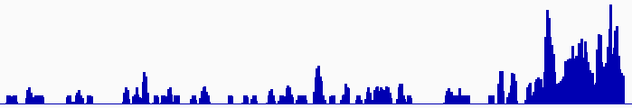
Discovering Transcriptionally Active Regions (novel RNA contigs)
Cluster reads setting minimum-run and maximum gap parameters for newly identified transcribed regions (TARs)
Assess exon discovery rates for known genes and noncoding RNAs
Known exon
Known exon
TAR
TAR
TAR
novel TAR
correct identification
possible exon extension
ENCODE RNA-Seq Data

Slide 45
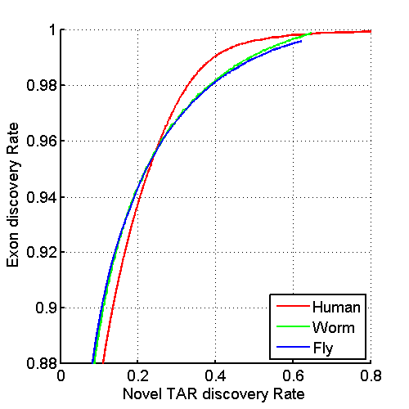
Uniform Annotation of non-coding Elements
Uniformly processed the RNA-seq expression compendium and for identification of pervasively transcribed regions
[Nature 512:445 ('14); doi: 10.1038/nature13424]

Slide 46
Annotated ncRNAs
 |  |  | Human |  |  | Worm |  |  | Fly
 |  |  | Elements | Genome Coverage |  | Elements | Genome Coverage |  | Elements | Genome Coverage
 |  |  |  | Kb | % |  | Kb | % |  | Kb | %
mRNAs (exons) |  |  | 20,007 | 86,560 | 3.0 | 21,192 | 34,437 | 34.3 | 13,940 | 35,970 | 28.0
Pseudogenes |  |  | 11,216 | 27,089 | 0.95 | 881 | 1,343 | 1.3 | 145 | 155 | 0.12
Annotated ncRNAs | Comparable ncRNAs | pri-miRNA | 58 | 1,158 | 0.04 | 44 | 16 | 0.02 | 43 | 300 | 0.23
 |  | pre-miRNAs | 1,756 | 162 | 0.006 | 221 | 20 | 0.02 | 236 | 22 | 0.02
 |  | tRNAs | 624 | 47 | 0.002 | 609 | 45 | 0.04 | 314 | 22 | 0.02
 |  | snoRNAs | 1,521 | 168 | 0.006 | 141 | 16 | 0.02 | 287 | 34 | 0.03
 |  | snRNAs | 1,944 | 210 | 0.007 | 114 | 14 | 0.01 | 47 | 7 | 0.006
 |  | lncRNAs | 10,840 | 10,581 | 0.37 | 233 | 184 | 0.18 | 852 | 868 | 0.68
 | Other ncRNAs |  | 5,411 | 3,268 | 0.11 | 40,104 | 2,329 | 2.3 | 376 | 2,103 | 1.6
 |  | nc-piRNA loci | 88 | 1,272 | 0.04 | 35,329 | 449 | 0.45 | 27 | 1,473 | 1.1
Total |  |  | 22,154 | 17,770 | 0.62 | 41,466 | 2,611 | 2.6 | 2,155 | 3,279 | 2.6
Identify non-canonical transcription in regions of the genome excluding mRNA exons, pseudogenes or annotated ncRNAs.
[Nature 512:445 ('14); doi: 10.1038/nature13424]

Slide 47
& Non-Canonical Transcription
 |  |  | Human |  |  | Worm |  |  | Fly
 |  |  | Elements | Genome Coverage |  | Elements | Genome Coverage |  | Elements | Genome Coverage
 |  |  |  | Kb | % |  | Kb | % |  | Kb | %
Total ncRNAs |  |  | 22,154 | 17,770 | 0.62 | 41,466 | 2,611 | 2.6 | 2,155 | 3,279 | 2.6
Regions Excluding mRNAs, Pseudogenes or Annotated ncRNAs |  |  | 283,816 | 2,731,811 | 95.5 | 143,372 | 63,520 | 63.3 | 60,108 | 89,445 | 69.6
 | Transcription Detected (TARs) |  | 708,253 | 916,401 | 32.0 | 232,150 | 37,029 | 36.9 | 83,618 | 44,256 | 34.5
 |  | Supervised Predictions | 104,016 | 13,835 | 0.48 | 2,525 | 392 | 0.39 | 599 | 164 | 0.13
Similar fraction of non-canonical transcription of non-canonical transcription in human, worm and fly
  32-37% of each genome
[Nature 512:445 ('14); doi: 10.1038/nature13424]

Slide 48
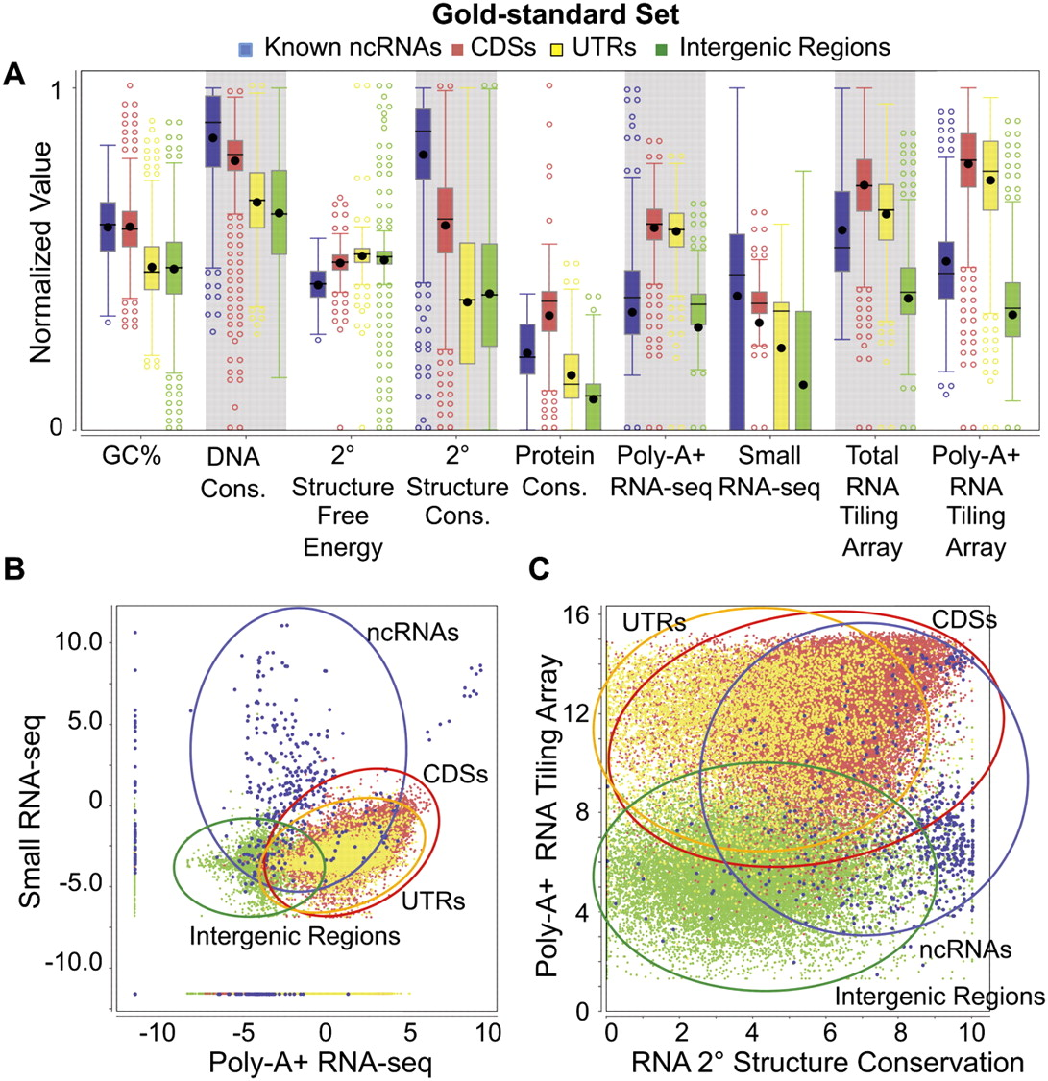
IncRNA:
Machine-learning Identification of many candidate ncRNAs through evidence integration
No single feature (e.g. expr. expts., conservation, or sec. struc.) finds all known ncRNAs => combine features in stat. model
90% PPV, 13 of 15 tested validate
[Lu et al. Genome Res. 2011;21:276-285]
Notes:
Distributions of nine genomic feature values. The distributions of values of the nine features are shown for the gold-standard set (for the definition of the gold-standard set, see Supplemental Methods) of the four types of genomic elements: known ncRNAs, coding sequences (CDSs), untranslated regions (UTRs), and intergenic regions. The values of each expression feature are the maximum of the corresponding values from all the expression data sets of the same type. (A) Box plots of individual features (normalized values). (B) Two-dimensional scatter-plot of the maximum small RNA-seq signal against the maximum poly-A+ RNA-seq signal. (C) Two-dimensional scatter-plot of the maximum poly-A+ RNA tiling array signal against the predicted secondary structure conservation. Expression values in B and C are the log-transformed normalized read counts (DCPM, depth of coverage per million reads).

Slide 49
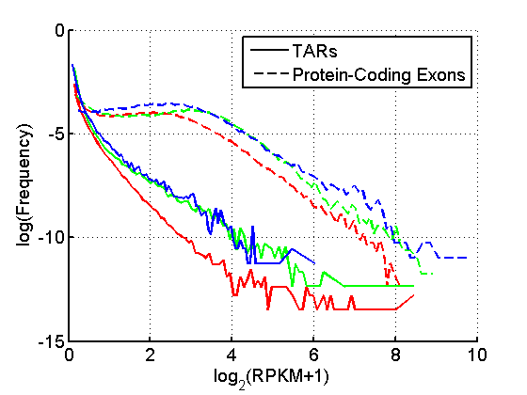
TAR Characterization
Non-canonical transcription (TARs):
Mostly transcribed at lower levels than protein-coding genes.
Enrichment for overlap of TARs with ENCODE enhancers and distal HOT regions -> potential enhancer RNAs (eRNAs).
Human, Worm & Fly
[ENCODE-modencode Transcriptome paper, Nature (in press), doi: 10.1038/nature13424]
HOT Regions = High TF Co-occupancy

Slide 50
Comparing Diverse Transcriptomes to Determine Deeply Conserved Aspects of Gene Expression
Intro to Comparative ENCODE
  Lots of Matched Data for Comparative Analysis
Expression Clustering, Cross-species
  Potts-model optimization gives 16 conserved co-expression modules (which can potentially annotate ncRNAs/TARs)
  Developmental 'hourglass' genes in 12 of these. They also exhibit intra-organism hourglass behavior.
  Stage alignment of worm & fly development, strongest with hourglass genes
State Space Models of Gene Expression
  Using dimensionality reduction to help determine internal & external drivers
  Decoupling expression changes into those driven by worm-fly conserved genes vs species-specific ones. Also, Conserved genes have similar canonical patterns (iPDPs) in contrast to species specific ones (Ex of ribosomal v signaling genes)
Characterizing ncRNAs & TARs
  Not much news in canonical gene models
  Simple contig search (TARs) finds uniform density of non-canonical transcription
  ML model shows few TARs similar to existing ones, but some enrichment for eRNAs
Pseudogenes
  Fundamentally repetitive elements
  Collaborative assignment in results in ~14K
  Impact of lineage-specific retro-transpositional burst – ie human v other metazoans is dominated (~80%) by retro-duplication ~40 MYA (Ribo. Proteins).
  Many Pseudogenes with Low Levels of Biochemical Activity
    ~15% transcribed & 80% w/ some activity
Value of publication patterns generated by the consortium
  Co-authorship network statistics relate to publication rollouts & show gradual adoption by a diverse community
  Key role of brokers in data dissemination

Slide 51
Pseudogenes are among the most interesting intergenic elements
Formal Properties of Pseudogenes (ΨG)
  Inheritable
  Homologous to a functioning element – ergo a repeat!
  Non-functional
    No selection pressure so free to accumulate mutations
      Frameshifts & stops
      Small Indels
      Inserted repeats (LINE/Alu)
    What does this mean? no transcription, no translation?…
[Mighell et al. FEBS Letts, 2000]

Slide 52
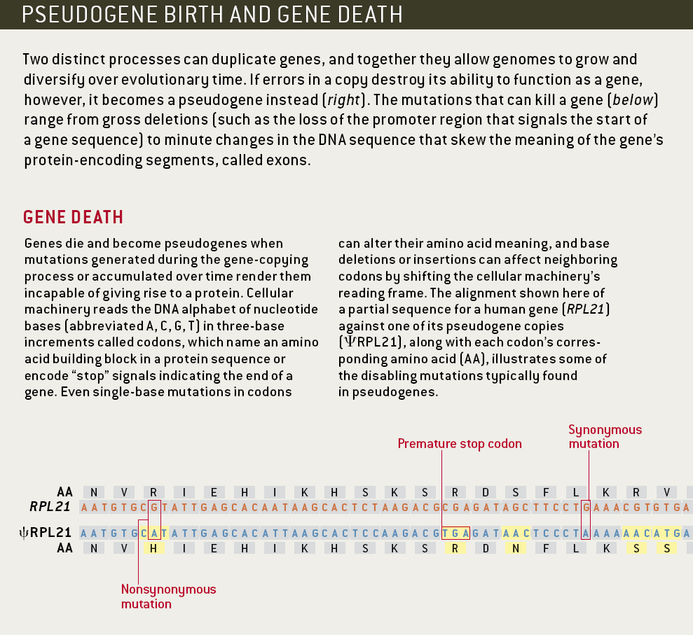
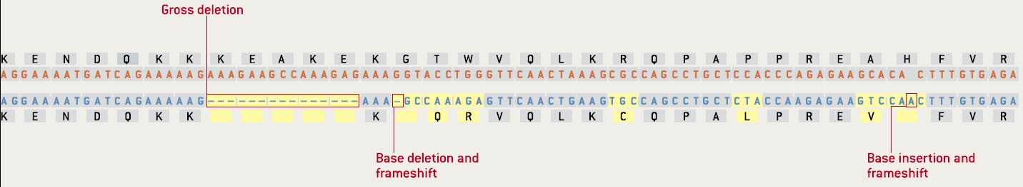
Identifiable Features of a Pseudogene (ψRPL21)
[Gerstein & Zheng. Sci Am 295: 48 (2006).]

Slide 53
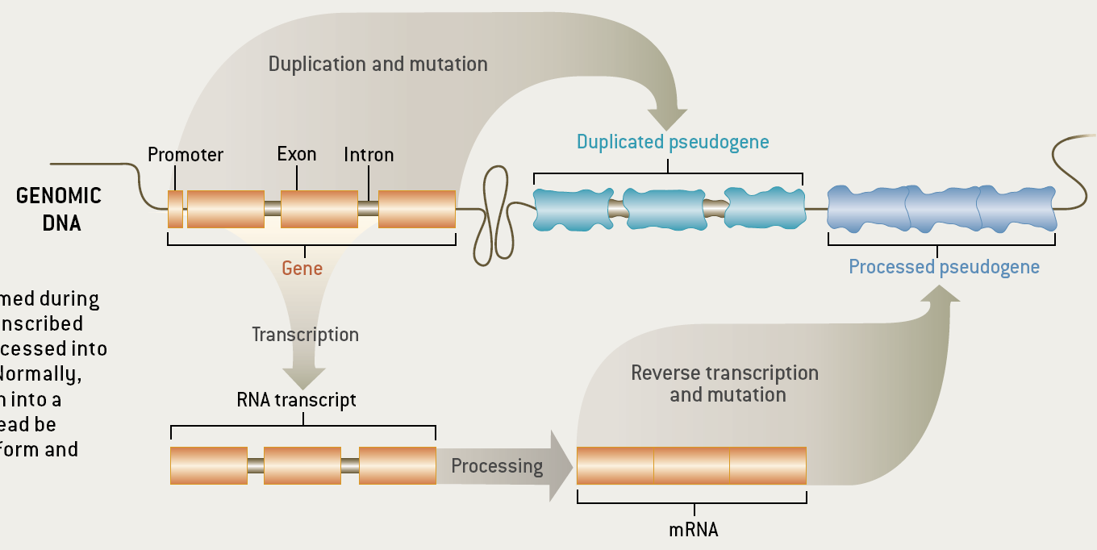
Two Major Genomic Remodeling Processes Give Rise to Distinct Types of Pseudogenes
[Gerstein & Zheng. Sci Am 295: 48 (2006).]

Slide 54
Genome-wide Annotation of Pseudogenes
Pseudogene Information Pool
PseudoPipe
16,653
14,520
14,206
PseudoPipe
RetroFinder
HAVANA
Protein
Sequence
Reference
Genome
2-way consensus
Six-frame blast
9,772
Feedback Loop
Eliminate redundant hits
Remove hits overlapping exon
````````
1000G
ENCODE
Δ2-way
Level 1
Level 2&3
Merge hits and identify parents
913
8,859
5,347
FASTA re-alignment
Polymorphic
Pseudogenes
45
````````
14,161
8,814 level 1
5,347 level 2&3
Processed
Pseudogenes
Duplicated
Pseudogenes
Pseudogene Decoration
Resource
12,358
[Pei et al., GenomeBiology (2012, 13:R51)]

Slide 55
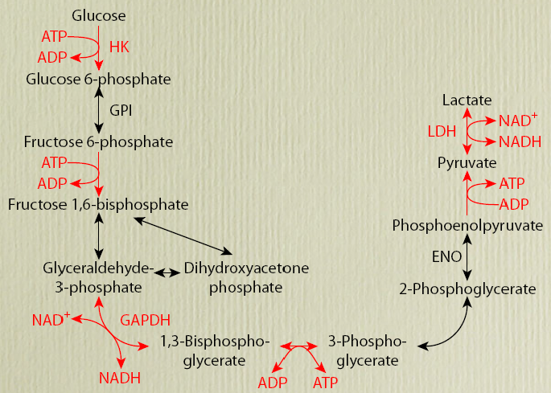
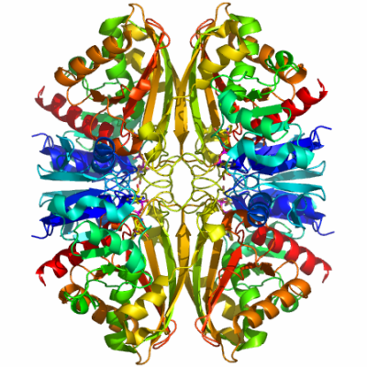
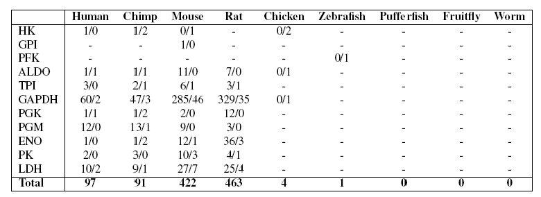
EX: Number of pseudogenes for each glycolytic enzyme
[Liu et al. BMC Genomics ('09)]
Large numbers of processed GAPDH pseudogenes in mammals comprise one of the biggest families but numbers not obviously correlated with mRNA abundance.
GAPDH
Processed/Duplicated
GAPDH

Slide 56
EX: Number of pseudogenes for each glycolytic enzyme
[Liu et al. BMC Genomics ('09)]
Large numbers of processed GAPDH pseudogenes in mammals comprise one of the biggest families but numbers not obviously correlated with mRNA abundance.
GAPDH
Processed/Duplicated
GAPDH
60 Proc/2 Dup

Slide 57
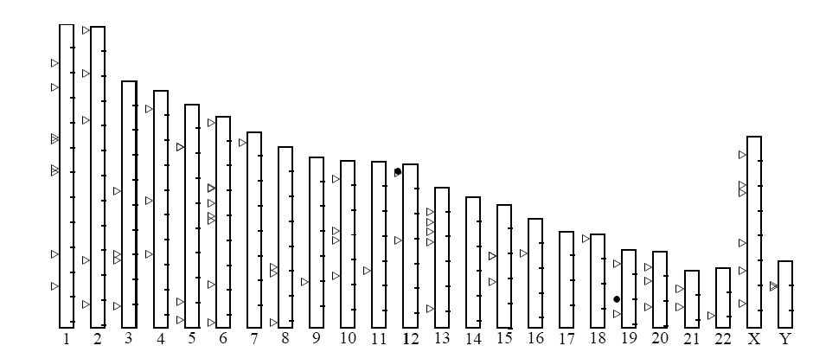
Distribution of human GAPDH pseudogenes
Large numbers of processed GAPDH pseudogenes in mammals comprise one of the biggest families but numbers not obviously correlated with mRNA abundance.
60 Proc/2 Dup
[Liu et al. BMC Genomics ('09, in press)]
Notes:
57

Slide 58
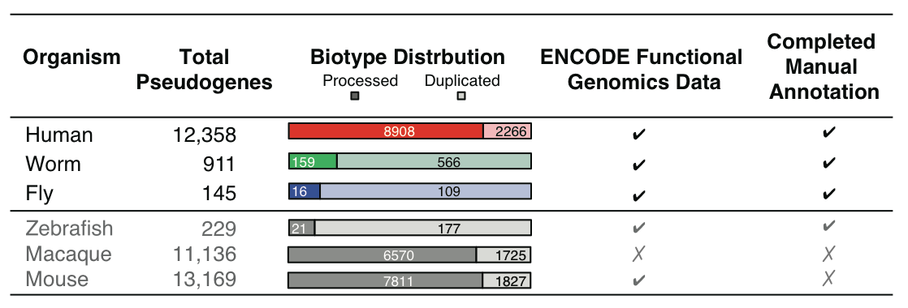
Annotation of Human Pseudogenes in Comparison to those in other Model Organisms
[Sisu et al. PNAS ('14); doi: 10.1073/pnas.1407293111 ]

Slide 59
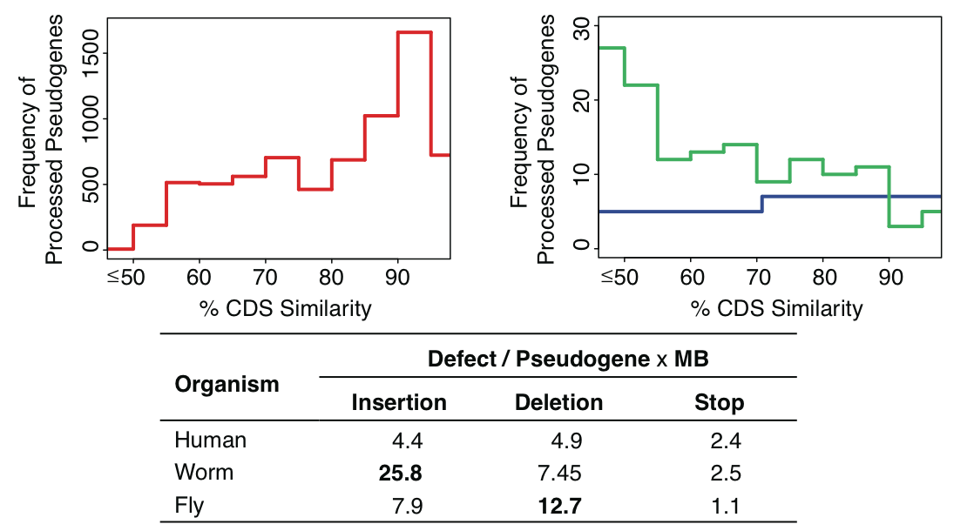
Evolution
Human
Worm
Fly
[Sisu et al. PNAS ('14); doi: 10.1073/pnas.1407293111 ]

Slide 60
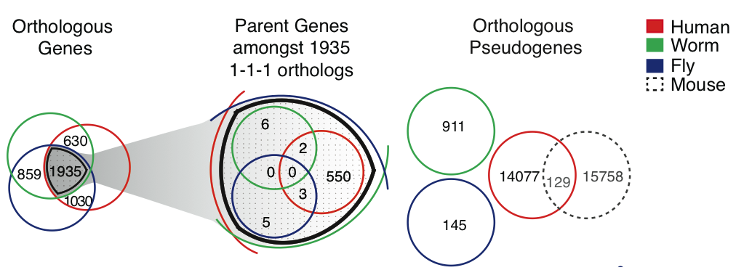
Great divergence in pseudogenes in terms of Orthologs & Paralogs
[Sisu et al. PNAS ('14); doi: 10.1073/pnas.1407293111 ]

Slide 61
Divergence but
More interpretable Patterns in terms of Families
[Sisu et al. PNAS ('14); doi: 10.1073/pnas.1407293111 ]

Slide 62
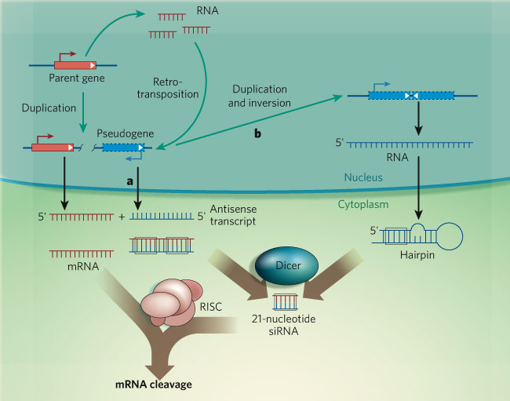
Examples & speculation on the function of pseudogene ncRNAs:
Regulating their parents
via acting as endo-siRNAs
[ex. in fly & mouse, ‘08 refs.]
via acting as miRNA decoys
[PTEN]
via inhibiting degradation of parent’s mRNA [makorin]
Functional candidates:
  SLIT-ROBO Rho GTPase activating protein 2B pseudogene
  PRKY-004, Y-linked protein kinase pseudogene
  Fer-1-like 4 (C. elegans), pseudogene
[Sasidharan & Gerstein, Nature ('08)]
Alternatively, just last gasps of a dying gene
Czech et al. Nature 453: 798 (‘08).
Ghildiyal et al. Science 320: 1077 (‘08).
Kawamur et al. Nature 453: 793 (‘08).
Okamura et al. Nature 453: 803 (‘08).
Tam et al. Nature 453: 534 (‘08).
Watanabe et al. Nature 453: 539 (‘08).
Poliseno et al. Nature 465:1033 (’10).

Slide 63

Pseudogene Transcription: interesting but tricky to ascertain
Difficulty in ascertainment because of mis-mapping v parent
One approach to this confound is look across mult. samples
[Science 330:6012]

Slide 64
Pseudogene Activity
H Highly-Active
P Partially-Active
D Dead
Yes
No
Human
Worm
Fly
[Sisu et al. PNAS ('14); doi: 10.1073/pnas.1407293111 ]
2381
1%
78%
21%
15% of pseudogenes are transcribed in each organism
4%
66%
30%
5%
63%
32%

Slide 65
Comparing Diverse Transcriptomes to Determine Deeply Conserved Aspects of Gene Expression
Intro to Comparative ENCODE
  Lots of Matched Data for Comparative Analysis
Expression Clustering, Cross-species
  Potts-model optimization gives 16 conserved co-expression modules (which can potentially annotate ncRNAs/TARs)
  Developmental 'hourglass' genes in 12 of these. They also exhibit intra-organism hourglass behavior.
  Stage alignment of worm & fly development, strongest with hourglass genes
State Space Models of Gene Expression
  Using dimensionality reduction to help determine internal & external drivers
  Decoupling expression changes into those driven by worm-fly conserved genes vs species-specific ones. Also, Conserved genes have similar canonical patterns (iPDPs) in contrast to species specific ones (Ex of ribosomal v signaling genes)
Characterizing ncRNAs & TARs
  Not much news in canonical gene models
  Simple contig search (TARs) finds uniform density of non-canonical transcription
  ML model shows few TARs similar to existing ones, but some enrichment for eRNAs
Pseudogenes
  Fundamentally repetitive elements
  Collaborative assignment in results in ~14K
  Impact of lineage-specific retro-transpositional burst – ie human v other metazoans is dominated (~80%) by retro-duplication ~40 MYA (Ribo. Proteins).
  Many Pseudogenes with Low Levels of Biochemical Activity
    ~15% transcribed & 80% w/ some activity
Value of publication patterns generated by the consortium
  Co-authorship network statistics relate to publication rollouts & show gradual adoption by a diverse community
  Key role of brokers in data dissemination

Slide 66



The Human
Genome Project
2000
2005
2010
2015
Worm
Genome

Slide 67



The Human
Genome Project
ENCODE
Pilot
ENCODE
Production
2000
2005
2010
Worm
Genome
modENCODE

Slide 68


The Human
Genome Project
ENCODE
Pilot
ENCODE
Production
Comparative
ENCODE
2000
2005
2010
2015
Worm
Genome
modENCODE

Slide 69


The Human
Genome Project
ENCODE
Pilot
ENCODE
Production
Comparative
ENCODE
2000
2005
2010
2015
Worm
Genome
modENCODE
1000 Genomes
Pilot
1000 Genomes
Production

Slide 70


The Human
Genome Project
ENCODE
Pilot
ENCODE
Production
Comparative
ENCODE
Epigenome
Roadmap
2000
2005
2010
2015
Worm
Genome
modENCODE
1000 Genomes
Pilot
1000 Genomes
Production
GTEx

Slide 71
With help of M Pazin at NHGRI, identified: 702 community papers that used ENCODE data but were not supported by ENCODE funding &
558 consortium papers supported by ENCODE funding
(https://www.encodeproject.org/search/?type=Publication for up-to-date query)
Then identified 1,786 ENCODE members & 8,263 non-members .
<= # Papers
# Authors Yr. (‘04 to ‘15)
[Wang et al., TIG (’16)]
Notes:
1 slides from dw encode authors

Slide 72


Co-authorship Network of ENCODE members
& Data Users
co-authorship
2014
[Wang et al., TIG (’16)]

Slide 73

Co-authorship Network of ENCODE members
& Data Users
# neighbors: non-ENCODE ==>
co-authorship
# neighbors: ENCODE ==>
2014
[Wang et al., TIG (’16)]

Slide 74
Co-authorship Network of ENCODE members
& Data Users
co-authorship
2014
[Wang et al., TIG (’16)]

Slide 75
Dynamics of co-authorship network
2014
co-authorship
[Wang et al., TIG (’16)]

Slide 76










Dynamics of co-authorship network
2009
2010
2011
2008
2007
2012
2006
2005
2013
2004
2014
co-authorship
[Wang et al., TIG (’16)]

Slide 77
Dynamics of co-authorship network
2009
2010
2011
2008
2007
2012
“Modularity”
2006
2005
2013
2004
2014
co-authorship
[Wang et al., TIG (’16)]

Slide 78









Similar findings in terms of slow growth trends & broker scientists in the modENCODE consortium as for ENCODE
2014
2013
2012
2011
2010
2009
2008
2007
Number of member neighbors
modENCODE
Number of non-member neighbors
[Wang et al., TIG (‘16)]

Slide 79
Comparing Diverse Transcriptomes to Determine Deeply Conserved Aspects of Gene Expression
Intro to Comparative ENCODE
  Lots of Matched Data for Comparative Analysis
Expression Clustering, Cross-species
  Potts-model optimization gives 16 conserved co-expression modules (which can potentially annotate ncRNAs/TARs)
  Developmental 'hourglass' genes in 12 of these. They also exhibit intra-organism hourglass behavior.
  Stage alignment of worm & fly development, strongest with hourglass genes
State Space Models of Gene Expression
  Using dimensionality reduction to help determine internal & external drivers
  Decoupling expression changes into those driven by worm-fly conserved genes vs species-specific ones. Also, Conserved genes have similar canonical patterns (iPDPs) in contrast to species specific ones (Ex of ribosomal v signaling genes)
Characterizing ncRNAs & TARs
  Not much news in canonical gene models
  Simple contig search (TARs) finds uniform density of non-canonical transcription
  ML model shows few TARs similar to existing ones, but some enrichment for eRNAs
Pseudogenes
  Fundamentally repetitive elements
  Collaborative assignment in results in ~14K
  Impact of lineage-specific retro-transpositional burst – ie human v other metazoans is dominated (~80%) by retro-duplication ~40 MYA (Ribo. Proteins).
  Many Pseudogenes with Low Levels of Biochemical Activity
    ~15% transcribed & 80% w/ some activity
Value of publication patterns generated by the consortium
  Co-authorship network statistics relate to publication rollouts & show gradual adoption by a diverse community
  Key role of brokers in data dissemination

Slide 80
Comparing Diverse Transcriptomes to Determine Deeply Conserved Aspects of Gene Expression
Intro to Comparative ENCODE
  Lots of Matched Data for Comparative Analysis
Expression Clustering, Cross-species
  Potts-model optimization gives 16 conserved co-expression modules (which can potentially annotate ncRNAs/TARs)
  Developmental 'hourglass' genes in 12 of these. They also exhibit intra-organism hourglass behavior.
  Stage alignment of worm & fly development, strongest with hourglass genes
State Space Models of Gene Expression
  Using dimensionality reduction to help determine internal & external drivers
  Decoupling expression changes into those driven by worm-fly conserved genes vs species-specific ones. Also, Conserved genes have similar canonical patterns (iPDPs) in contrast to species specific ones (Ex of ribosomal v signaling genes)
Characterizing ncRNAs & TARs
  Not much news in canonical gene models
  Simple contig search (TARs) finds uniform density of non-canonical transcription
  ML model shows few TARs similar to existing ones, but some enrichment for eRNAs
Pseudogenes
  Fundamentally repetitive elements
  Collaborative assignment in results in ~14K
  Impact of lineage-specific retro-transpositional burst – ie human v other metazoans is dominated (~80%) by retro-duplication ~40 MYA (Ribo. Proteins).
  Many Pseudogenes with Low Levels of Biochemical Activity
    ~15% transcribed & 80% w/ some activity
Value of publication patterns generated by the consortium
  Co-authorship network statistics relate to publication rollouts & show gradual adoption by a diverse community
  Key role of brokers in data dissemination

Slide 81



Acknowledgements
Joel Rozowsky, Koon-Kiu Yan, Daifeng Wang,
Chao Cheng, James B. Brown, Carrie A. Davis, LaDeana Hillier, Cristina Sisu, Jingyi Jessica Li, Baikang Pei, Arif O. Harmanci, Michael O. Duff, Sarah Djebali, Roger P. Alexander, Burak H. Alver, Raymond K. Auerbach, Kimberly Bell, Peter J. Bickel, Max E. Boeck, Nathan P. Boley, Benjamin W. Booth, Lucy Cherbas, Peter Cherbas, Chao Di, Alex Dobin, Jorg Drenkow, Brent Ewing, Gang Fang, Megan Fastuca, Elise A. Feingold, Adam Frankish, Guanjun Gao, Peter J. Good, Phil Green, Roderic Guigó, Ann Hammonds, Jen Harrow, Roger A. Hoskins, Cédric Howald, Long Hu, Haiyan Huang, Tim J. P. Hubbard, Chau Huynh, Sonali Jha, Dionna Kasper, Masaomi Kato, Thomas C. Kaufman, Rob Kitchen, Erik Ladewig, Julien Lagarde, Eric Lai, Jing Leng, Zhi Lu, Michael MacCoss, Gemma May, Rebecca McWhirter, Gennifer Merrihew, David M. Miller, Ali Mortazavi, Rabi Murad, Brian Oliver, Sara Olson, Peter Park, Michael J. Pazin, Norbert Perrimon, Dmitri Pervouchine, Valerie Reinke, Alexandre Reymond, Garrett Robinson, Anastasia Samsonova, Gary I. Saunders, Felix Schlesinger, Anurag Sethi, Frank J. Slack, William C. Spencer, Marcus H. Stoiber, Pnina Strasbourger, Andrea Tanzer, Owen A. Thompson, Kenneth H. Wan, Guilin Wang, Huaien Wang, Kathie L. Watkins, Jiayu Wen, Kejia Wen, Chenghai Xue, Li Yang, Kevin Yip, Chris Zaleski, Yan Zhang, Henry Zheng, Steven E. Brenner, Brenton R. Graveley, Susan E. Celniker, Thomas R Gingeras, Robert Waterston
Hiring Postdocs. See gersteinlab.org/jobs !
EncodeProject.org/comparative/transcriptome

Slide 82
DREISS.gersteinlab.org
D Wang, F He, S Maslov
Pseudogene.org/psicube
C Sisu, B Pei, Jing Leng, A Frankish, Yan Zhang, Suganthi Balasubramanian, Rachel Harte, Daifeng Wang, Michael Rutenberg-Schoenberg, Wyatt Clark, Mark Diekhans, Joel Rozowsky,
Tim Hubbard, J Harrow
Publication patterns [“encode authors”]
D Wang
KK Yan, J Rozowsky, E Pan
github.com/gersteinlab/OrthoClust
KK Yan, D Wang,
J Rozowsky, H Zheng, C Cheng
Models
Acknowledgements
Hiring Postdocs. See gersteinlab.org/jobs !
Hiring Postdocs. See gersteinlab.org/jobs !

Slide 83

Extra

Slide 84
Info about content in this slide pack
General PERMISSIONS
  This Presentation is copyright Mark Gerstein,
  Yale University, 2016.
  Please read permissions statement at
  www.gersteinlab.org/misc/permissions.html .
  Feel free to use slides & images in the talk with PROPER acknowledgement
  (via citation to relevant papers or link to gersteinlab.org).
  Paper references in the talk were mostly from Papers.GersteinLab.org.
PHOTOS & IMAGES. For thoughts on the source and permissions of many of the photos and clipped images in this presentation see http://streams.gerstein.info .
  In particular, many of the images have particular EXIF tags, such as kwpotppt , that can be easily queried from flickr, viz: http://www.flickr.com/photos/mbgmbg/tags/kwpotppt

