Slide 1
Genomics: Comparing Diverse Transcriptomes to Determine Deeply Conserved Aspects of Gene Expression
Mark Gerstein
Yale
Slides freely downloadable from Lectures.GersteinLab.org
& “tweetable”
(via @markgerstein).
See last slide for more info.

Slide 2
How might we annotate a human text?
Color is Function
Lines are Similarity
[B Hayes, Am. Sci. (Jul.- Aug. '06)]

Slide 3
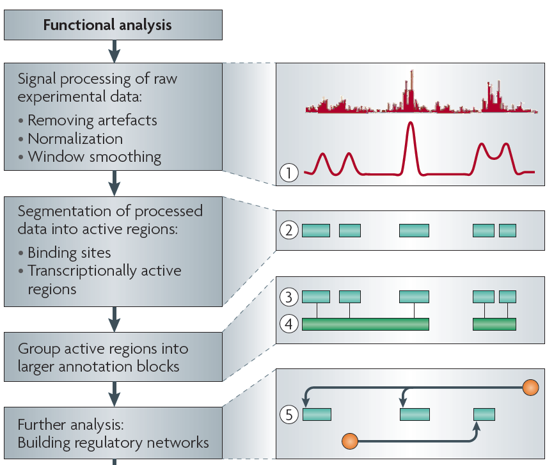
Non-coding Annotations: Overview
There are several collections of information "tracks" related to non-coding features
Sequence features, incl. Conservation
Functional Genomics
ChIP-seq (Epigenome & seq. specific TF) and ncRNA & un-annotated transcription
[Nat. Rev. Genet. (2010) 11: 559]

Slide 4
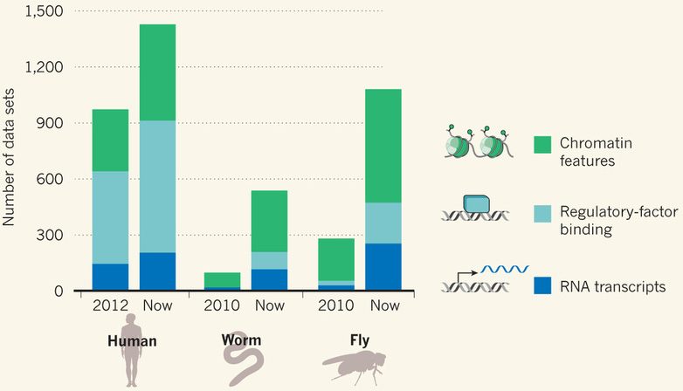
Comparative ENCODE Functional Genomics Resource (EncodeProject.org/comparative)
Broad sampling of conditions across transcriptomes & regulomes for human, worm & fly
embryo & ES cells
developmental time course (worm-fly)
In total: ~3000 datasets (~130B reads)

Slide 5
Time-course gene expression data of worm & fly development
[Nature 512:445 ('14); doi: 10.1038/nature13424]
Organism | Major developmental stages
worm (C. elegans) | 33 stages: 0, 0.5, 1, …, 12 hours, L1, L2, L3, L4, …, Young Adults, Adults
fly (D. mel.) | 30 stages: 0, 2, 4, 6, 8,…, 20, 22 hours, L1-L4, Pupaes, Adults

Slide 6
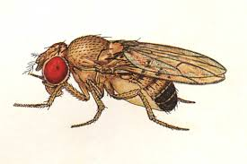
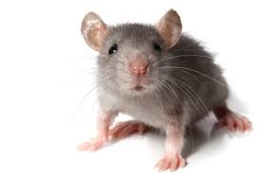
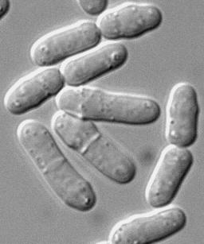
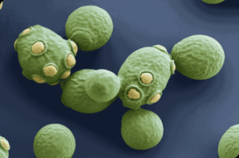
Comparative ENCODE
Previous studies have compared RNA transcription between closely related organisms (e.g. RNA-seq within mammals, Brawand et al. '11) …
EUKARYOTES
ANIMALS
MAMMALS
YEAST
500 MYO
75 MYO
Fly
Worm
Human
Mouse
Fission Yeast
Budding Yeast
RNA

Slide 7
Comparative ENCODE
Previous studies have compared RNA transcription between closely related organisms (e.g. RNA-seq within mammals, Brawand et al. '11) …
… or integrated diverse –omic information within each of several species (eg modencode '10)
EUKARYOTES
ANIMALS
MAMMALS
YEAST
500 MYO
75 MYO
Fly
Worm
Human
Mouse
Fission Yeast
Budding Yeast
RNA
TF
chromatin

Slide 8
Comparative ENCODE
Previous studies have compared RNA transcription between closely related organisms (e.g. RNA-seq within mammals, Brawand et al. '11) …
… or integrated diverse –omic information within each of several species (eg modencode '10)
EUKARYOTES
ANIMALS
A first effort to comprehensively integrate diverse data across distantly related species
MAMMALS
YEAST
500 MYO
75 MYO
Fly
Worm
Human
Mouse
Fission Yeast
Budding Yeast
RNA
TF
chromatin

Slide 9
Comparing Diverse Transcriptomes to Determine Deeply Conserved Aspects of Gene Expression
Intro to Comparative ENCODE
Lots of Matched Data for Comparative Analysis
Expression Clustering, Cross-species
Potts-model optimization gives 16 conserved co-expression modules (which can potentially annotate ncRNAs/TARs)
Developmental 'hourglass' genes in 12 of these. They also exhibit intra-organism hourglass behavior.
Stage alignment of worm & fly development, strongest with hourglass genes
State Space Models of Gene Expression
Using dimensionality reduction to help determine internal & external drivers
Decoupling expression changes into those driven by worm-fly conserved genes vs species-specific ones. Also, Conserved genes have similar canonical patterns (iPDPs) in contrast to species specific ones (Ex of ribosomal v signaling genes)
Characterizing ncRNAs & TARs
Not much news in canonical gene models
Simple contig search (TARs) finds uniform density of non-canonical transcription
ML model shows few TARs similar to existing ones, but some enrichment for eRNAs
Pseudogenes
Fundamentally repetitive elements
Collaborative assignment in results in ~14K
Impact of lineage-specific retro-transpositional burst – ie human v other metazoans is dominated (~80%) by retro-duplication ~40 MYA (Ribo. Proteins).
Many Pseudogenes with Low Levels of Biochemical Activity
~15% transcribed & 80% w/ some activity
Value of publication patterns generated by the consortium
Co-authorship network statistics relate to publication rollouts & show gradual adoption by a diverse community
Key role of brokers in data dissemination

