Slide 1
The Hunt for Co-acting Driver Genes
By Will Meyerson

Slide 2
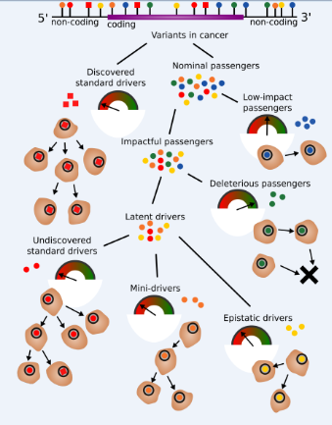
Epistatic aka “synergistic” drivers are a kind of Latent driver

Slide 3
The “synergistic” part of synergistic drivers has something to do with co-mutation
One kind of latent driver is the Synergistic Driver
Are there genes that work together to produce cancer?
The evidence for a synergistic driver would be a sets of genes (let’s start with pairs of genes) that are more frequently co-mutated in cancer than in normal
“Co-mutation rate” - The fraction of

Slide 4
Co-Mutation Rate Definition
What fraction of samples in cancer

Slide 5
More and Less Interesting Reasons a Set of Genes Might Be Co-Mutated in Cancer
Interesting
Less Interesting
Synergistic driver: The mutant genes work together mechanistically to confer a selective advantage to the cells they inhabit above and beyond the “sum” of the selective advantages of each gene alone
(Mini-driver: Each gene confers a selective advantage, and their effects combine additively or only partially redundantly, BUT at least one of the genes was one we hadn’t previously appreciated to be a driver if just measured on its own merits) (?)
Each gene confers a known selective advantage, and their effects combine additively or only partially redundantly (?)
The genes have similar trinucleotide compositions and therefore co-mutate even under neutral evolution
Multiple samples from same patient
Sheer luck

Slide 6
How to make sure that identified co-mutated genes are most likely interesting:
2-3. To differentiate synergistic drivers from mini-drivers: normalize co-mutation rate by expectations assuming additive effects
4. To address similar trinucleotide context: use Randomized set as control
5. To avoid multiple samples per patient: select only one (best) sample per patient with PCAWG release key
6. To identify sheer luck: Compute P-values (with simulations, described later) and perform multiple hypothesis testing correction

Slide 7
Two approaches pursued in parallel
“Synergy” as defined in Computational analysis of the synergy among multiple interacting genes
“Co-action” which I build from the ground up
PRO: peer-reviewed
PRO: existing packages (sort of) handle some of the machinery
CON: I don’t fully understand this approach, can’t personally confirm that it is exactly the right measure for the job. Not helped by confusing notation (e.g. commas and semi-colons with distinct, unexplained, ungoogleable meanings) and information-theoretic language that doesn’t directly relate to cancer
PRO: I (almost) understand what’s going on and why each move is justified
CON: Not expressly peer-reviewed
(WONDER: I wonder if mine is essentially the same thing as theirs)

Slide 8
Co-Action Effect Size
For each eligible* pair of genes in a given cancer subtype, define
CoAction_EffectSize = NormalizedCoMutationRateInCancer / NormalizedCoMutationRateInRandomizedSet
Where:
CoMutationRate = the fraction of samples that have both genes mutated
Normalization: divide by the product of the MutationRate of Gene1 and the MutationRate of Gene2
MutationRate = the fraction of samples that have the given gene mutated
Add pseudocount of 1/#pts to MutationRate and of (1/#pts)^2 to CoMutationRate
*Eligible: initially only 300 most frequently mutated genes per cancer so far

Slide 9
Synergy

Slide 10
P-values
Determine P-values by comparing observed Effect Size to the range of Effect Sizes resulting from tailored null simulations
Create (100, 1000, 10000) random genes with similar mutation frequencies as actual genes
Determine p-value by
Perform Benjamini-Hochberg correction

Slide 11
Raw Results

