Slide 1
MOAT Germline Analysis Update
Lucas Lochovsky
Cancer subgroup, Misc sub-subgroup
2016-12-08

Slide 2
Overview
Variants
ExAC TCGA variants
Annotations
Exons merged into genes
Wrote custom code to split gene with exon block annotations into block intervals for intersection step, then aggregate into genes for p-value calculation
Algorithm
Make a new genome out of the exome

Slide 3
Introns
Intergenic regions
Exons in the human genome
Exons in the exome-genome
And so on…
Each exon’s bp is mapped into coordinates for a new ”genome”
Variants are permuted with this “exome-genome”
Excludes introns and intergenic regions

Slide 4
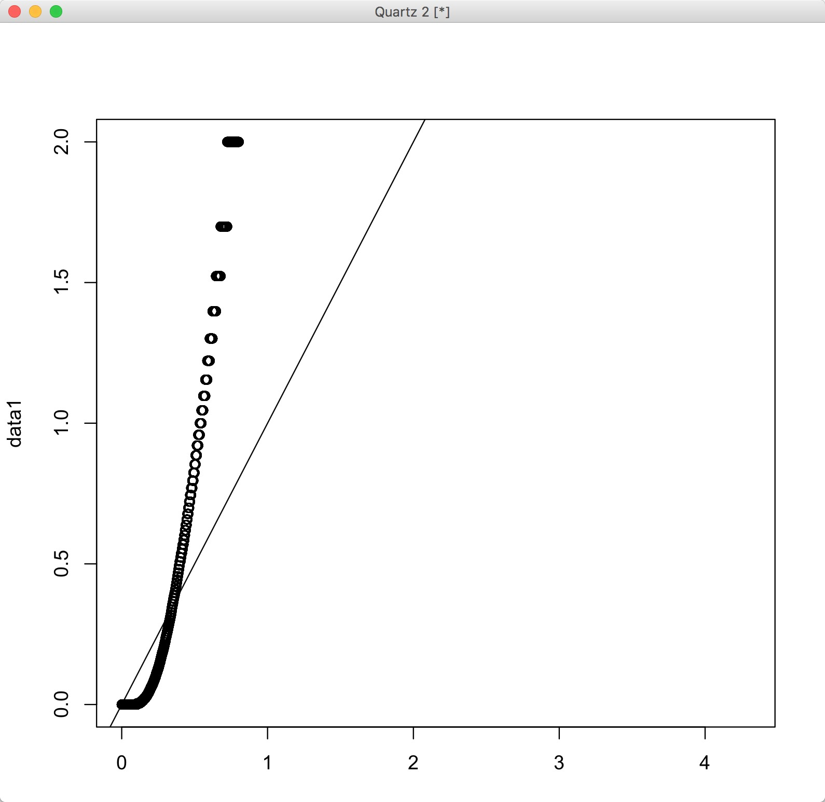
QQ-plot vs uniform
3193 genes come back significant
after BH p-value adjustment
~15% of the exome is
significant?
DAVID gene clusters:
Group 1: Olfactory genes
Group 2: Hormones
Group 3: Metabolic enzymes
Group 4: Collagen and related
Group 5: ATP binding
Group 6: Leucine rich repeat domains

