Slide 1
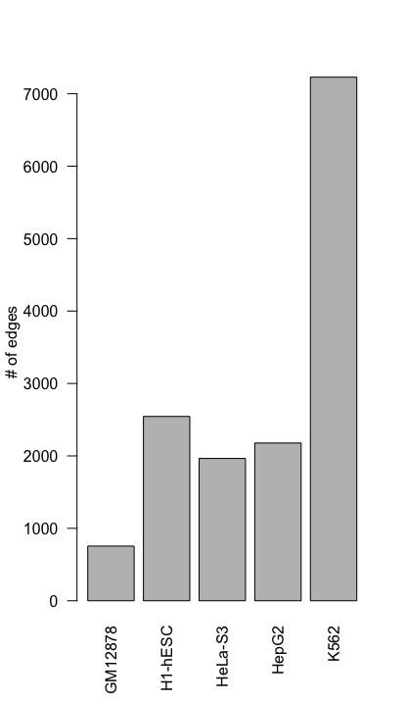
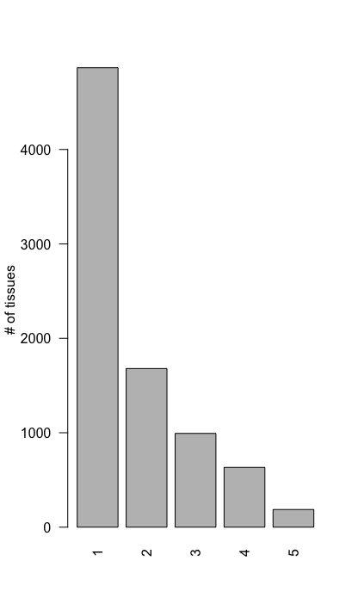

Slide 2
DHS peak intersect within 5KB around any coding TSS
Tissue Compare | Tissue Baseline | Edge Gain | DHS common Peak | DHS Baseline | DHS Compare
K562 | GM12878 | 6567 | 6455 | 2 | 99
GM12878 | K562 | 93 | 85 | 0 | 6
K562 | HepG2 | 5521 | 5443 | 2 | 68
K562 | HeLa-S3 | 5679 | 5568 | 4 | 102
K562 | H1-hESC | 5101 | 5017 | 3 | 74
DHS peak intersect within 1KB around any coding TSS
Tissue Compare | Tissue Baseline | Edge Gain | DHS common Peak | DHS Baseline | DHS Compare
K562 | GM12878 | 6567 | 6369 | 3 | 177
GM12878 | K562 | 93 | 79 | 0 | 12
K562 | HepG2 | 5521 | 5383 | 4 | 120
K562 | HeLa-S3 | 5679 | 5474 | 6 | 190
K562 | H1-hESC | 5101 | 4972 | 5 | 111

Slide 3
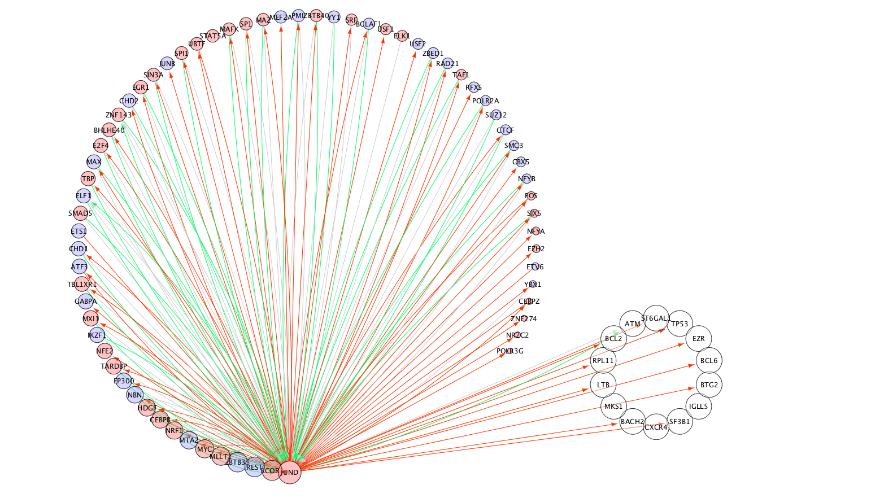

Slide 4
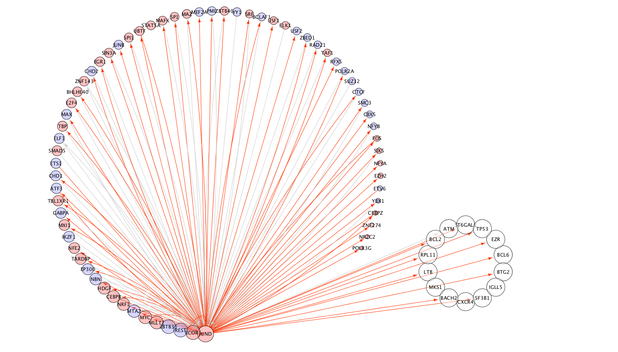
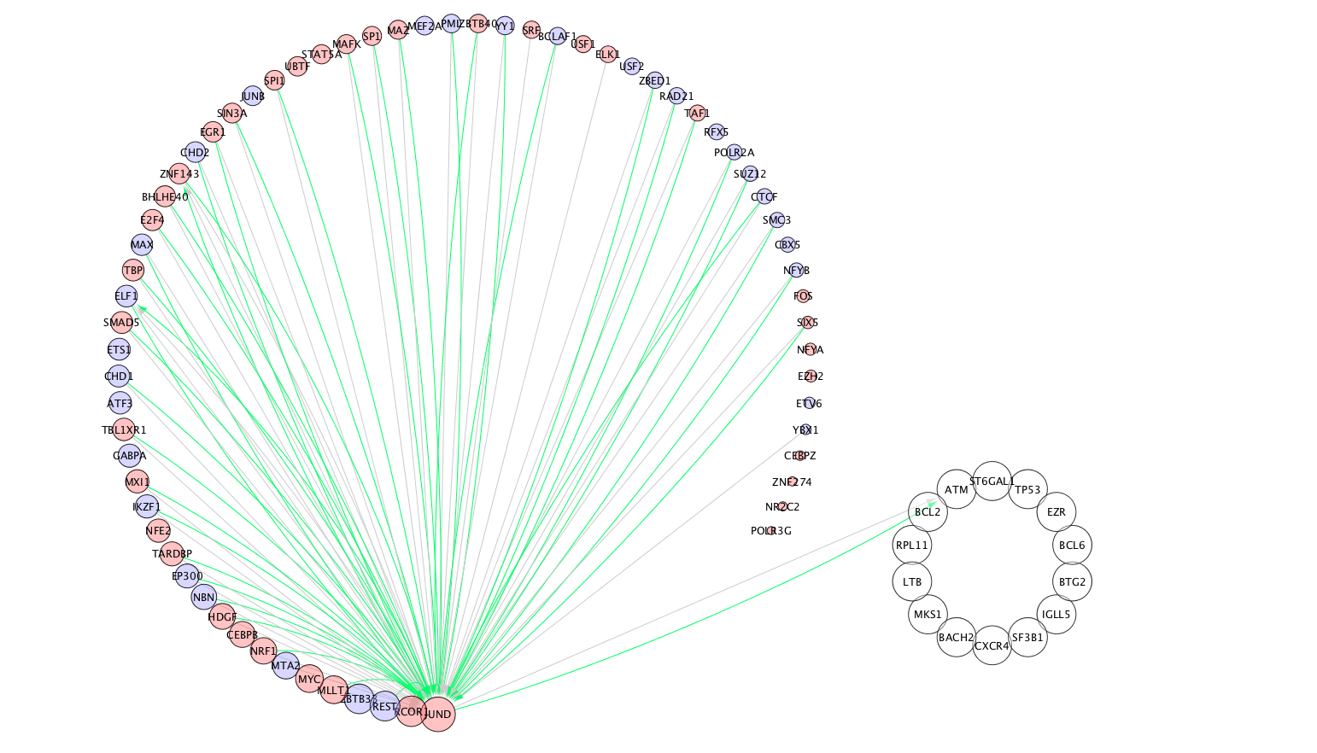

Slide 5
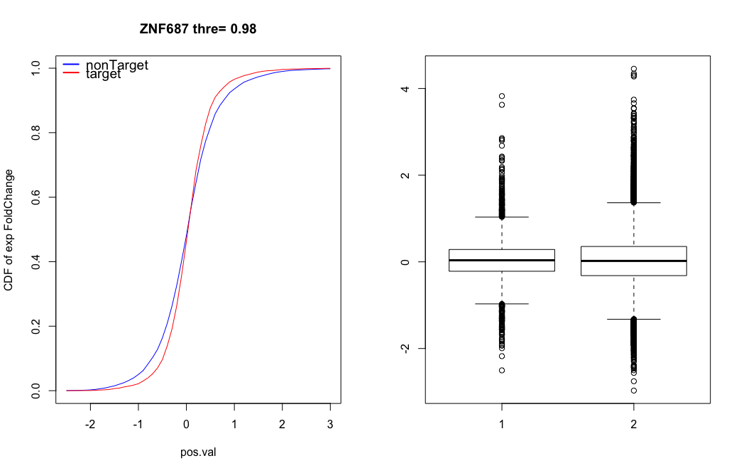
ESR1: foldchange=0.6279199, log(fc)=-0.6713477
ZNF687: foldchange=0.3612065, log(fc)=-1.469104

Slide 6
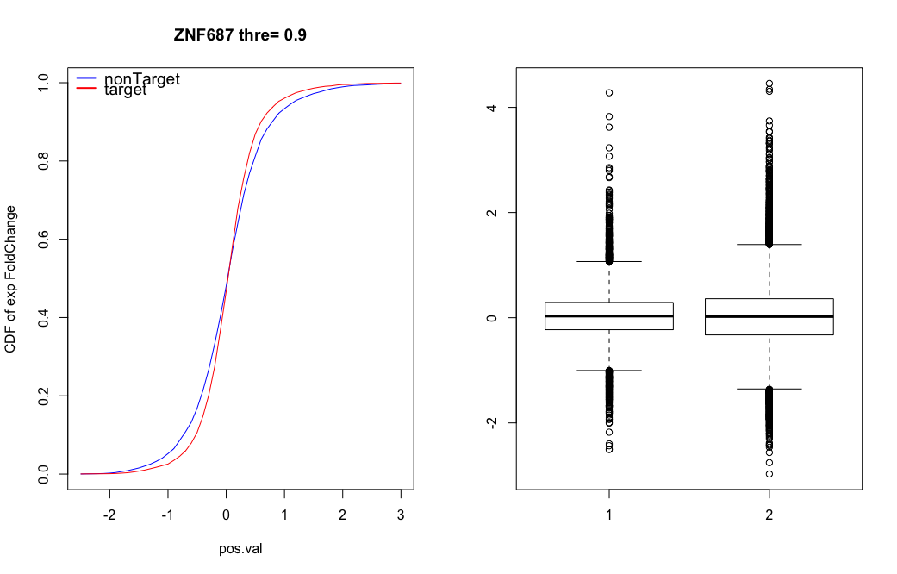

Slide 8
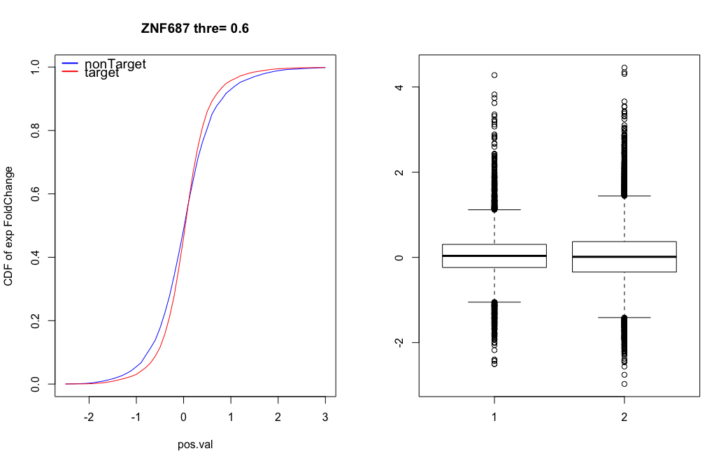

Slide 10
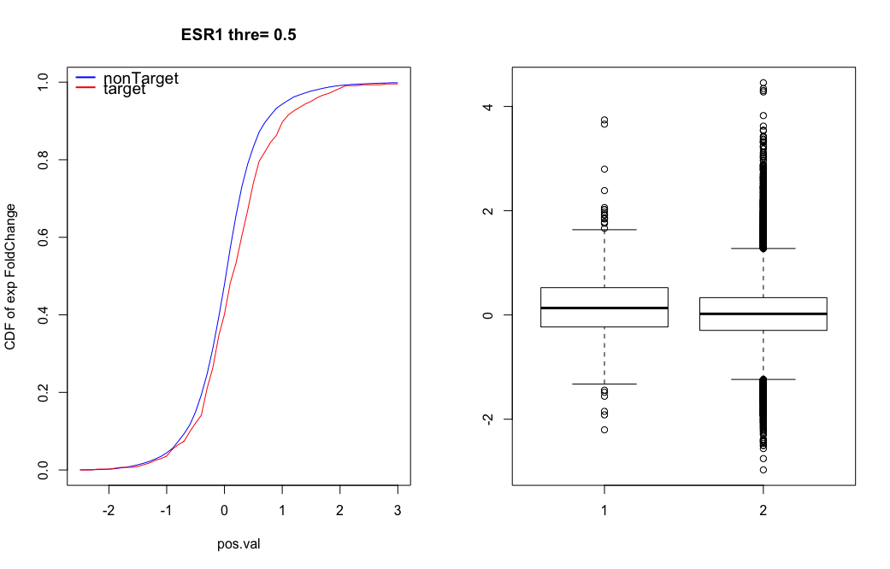

Slide 11
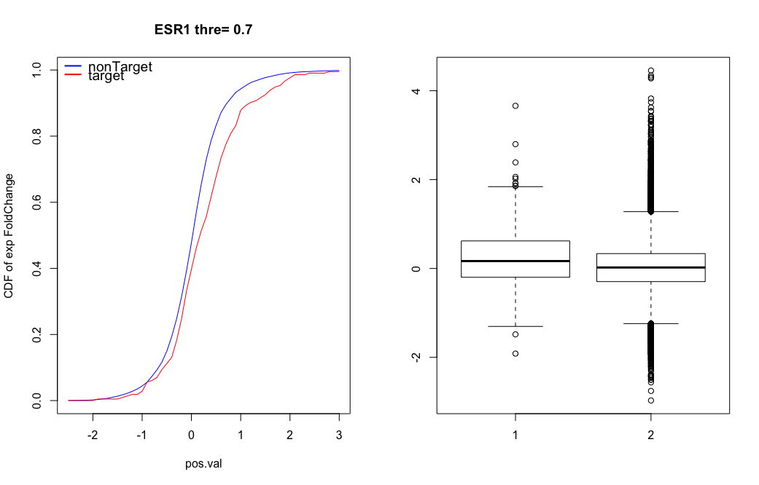

Slide 12
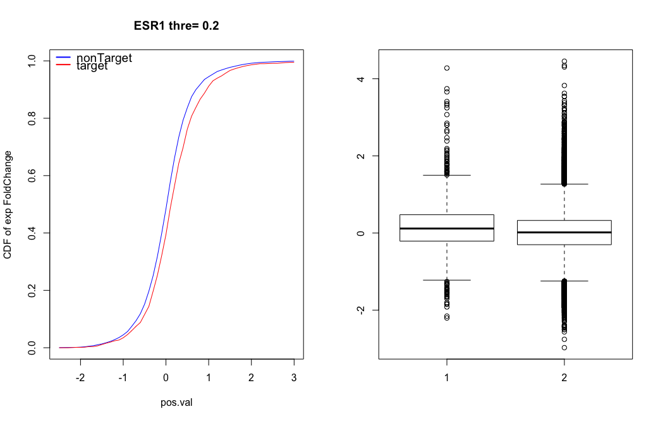

Slide 13
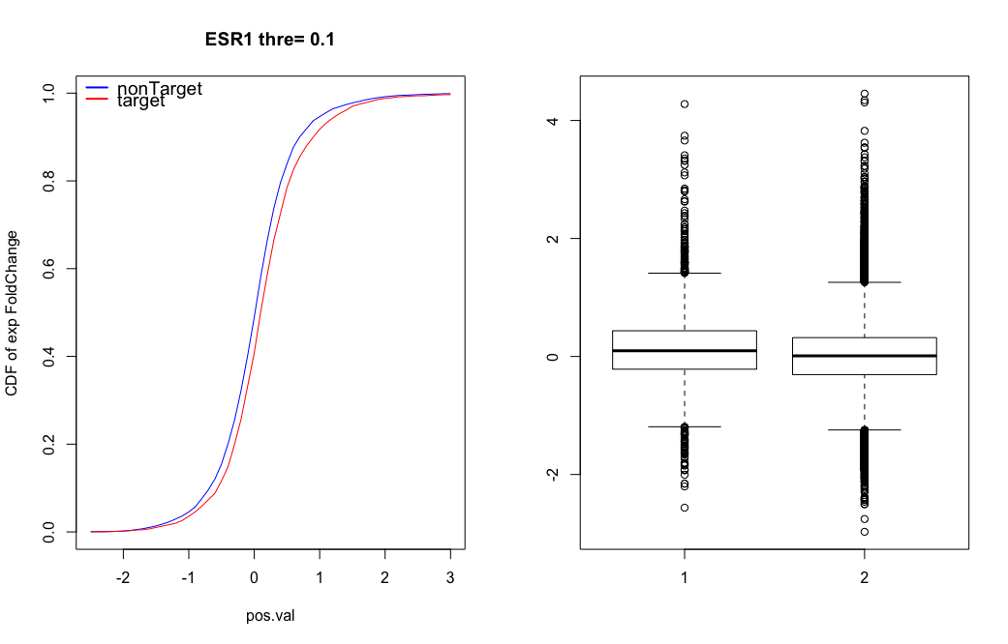

Slide 14
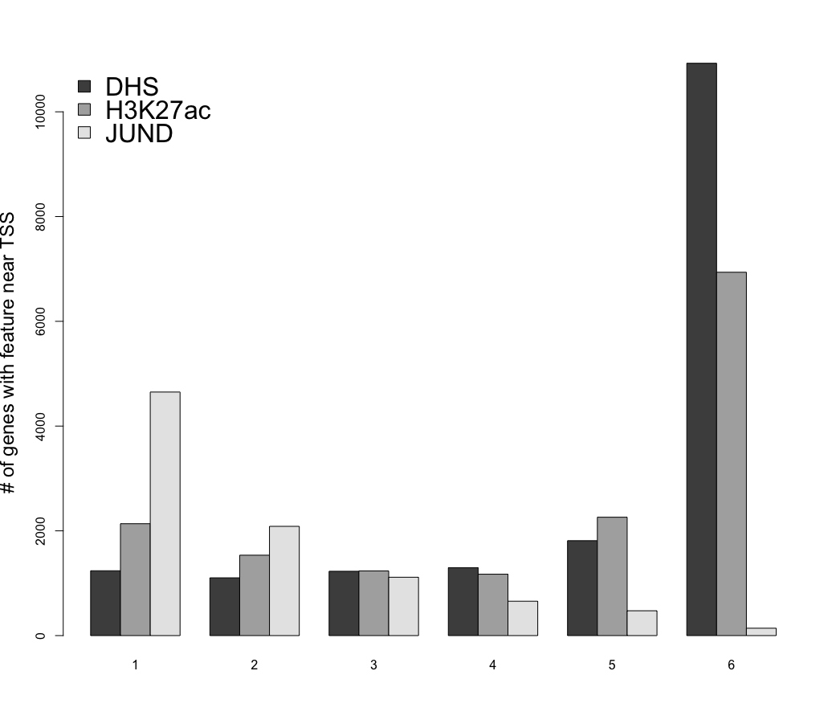

Slide 15
 | Cell1 |  | Cell2 |  | Cell1 |  | Cell2
 | K562 |  | GM |  | HepG2 |  | Liver
EdgeG | 6567 |  | 93 |  | 996 |  | 2150
 | DHSG | DHSL | DHSG | DHSL | DHSG | DHSL | DHSG | DHSL
DHS | 215 | 10 | 3 | 12 | 49 | 25 | 100 | 49
 | HG | HL | HG | HL | HG | HL | HG | HL
H3K27ac | 549 | 138 | 4 | 30 | 79 | 51 | 111 | 129

Slide 16
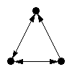
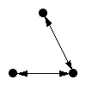
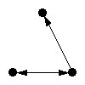
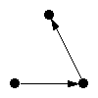
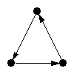
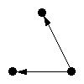
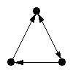
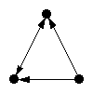
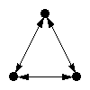
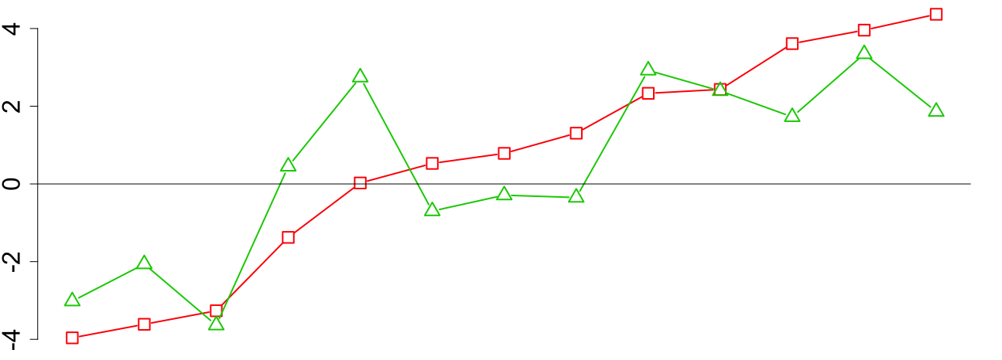
Network motif analysis using TF-TF only
Need to replot using the FULL network

Slide 17
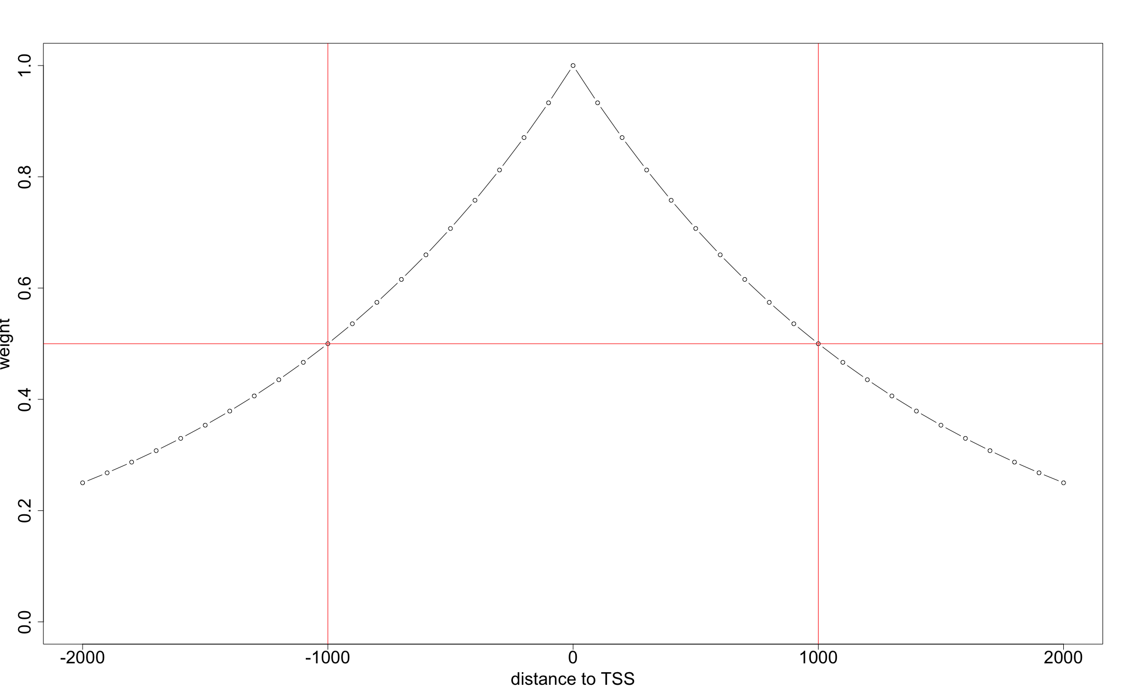

Slide 18
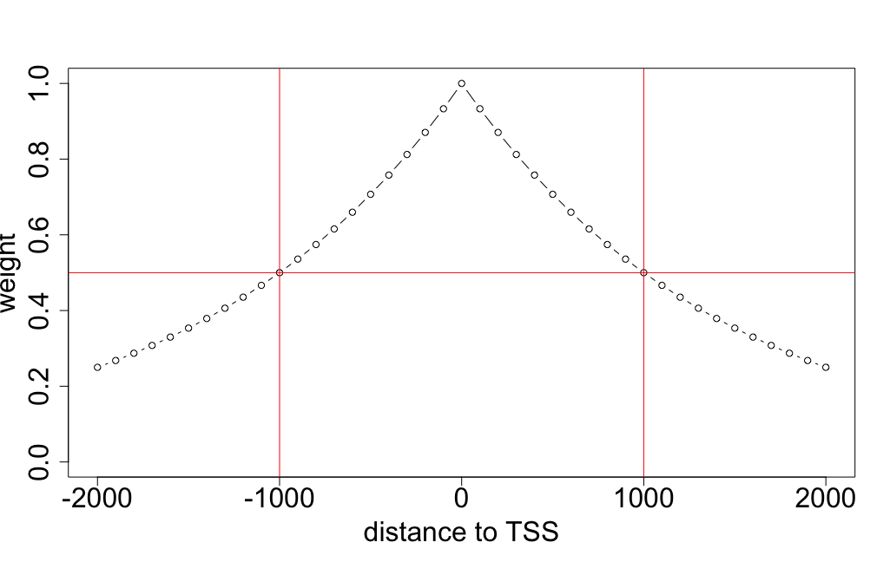
peak1
peak2
peak3
S = s1*w1+s2*w2+s3*w3
Regulation potential between TF i and gene k

Slide 19
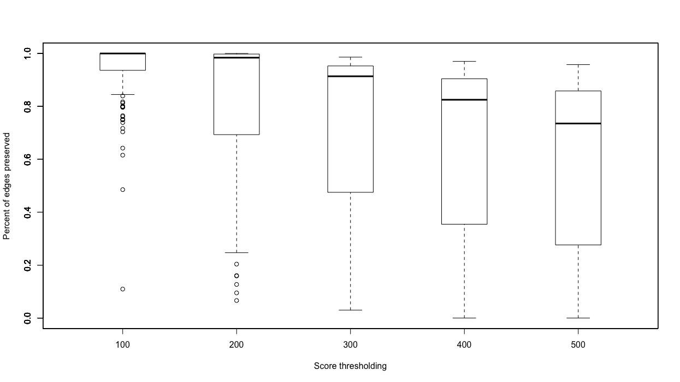
Pruning network by regulation scoring

Slide 20
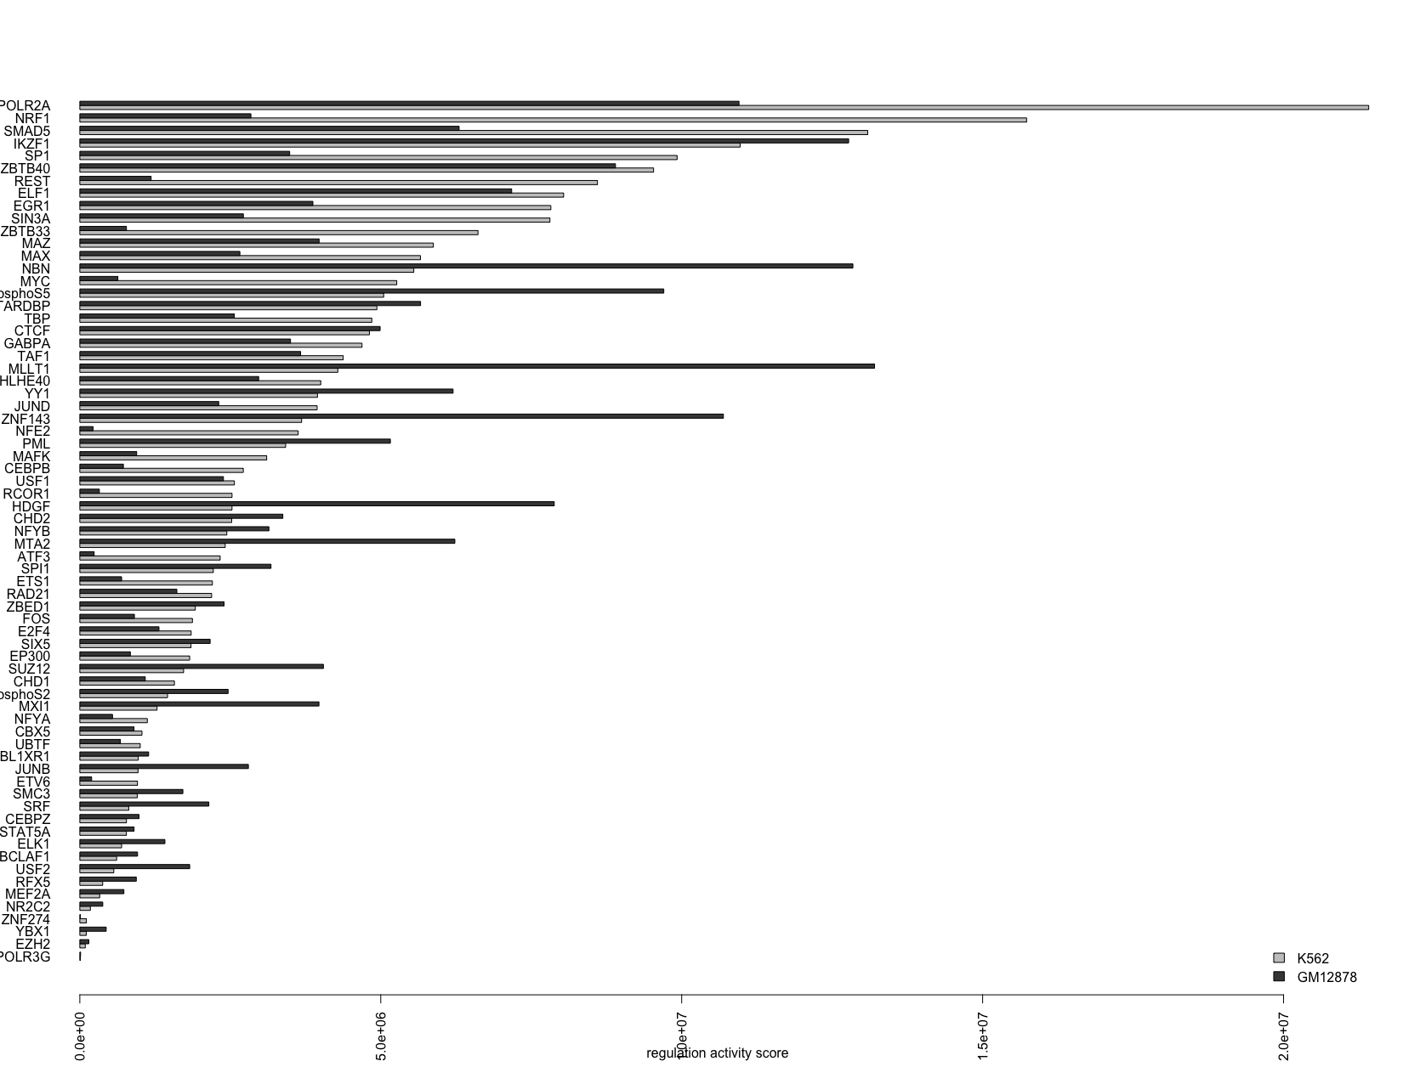
Regulation Activity score for each TF in a cell line

Slide 21
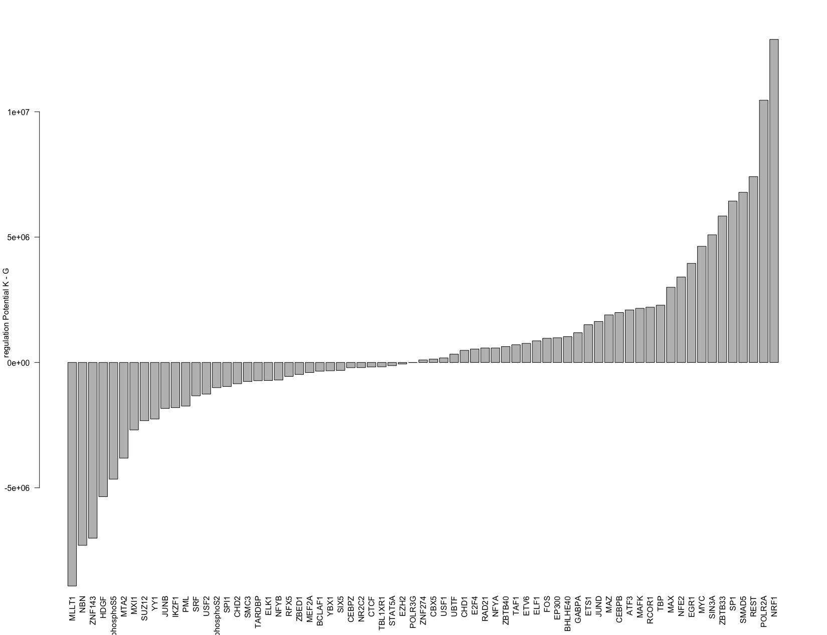

Slide 22
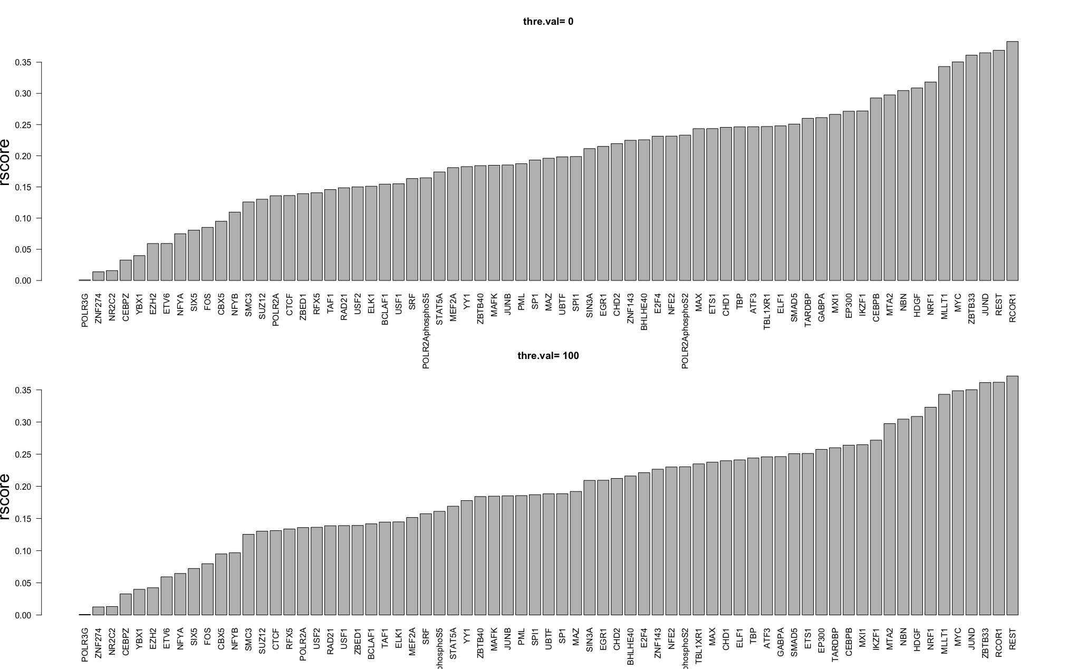

Slide 23
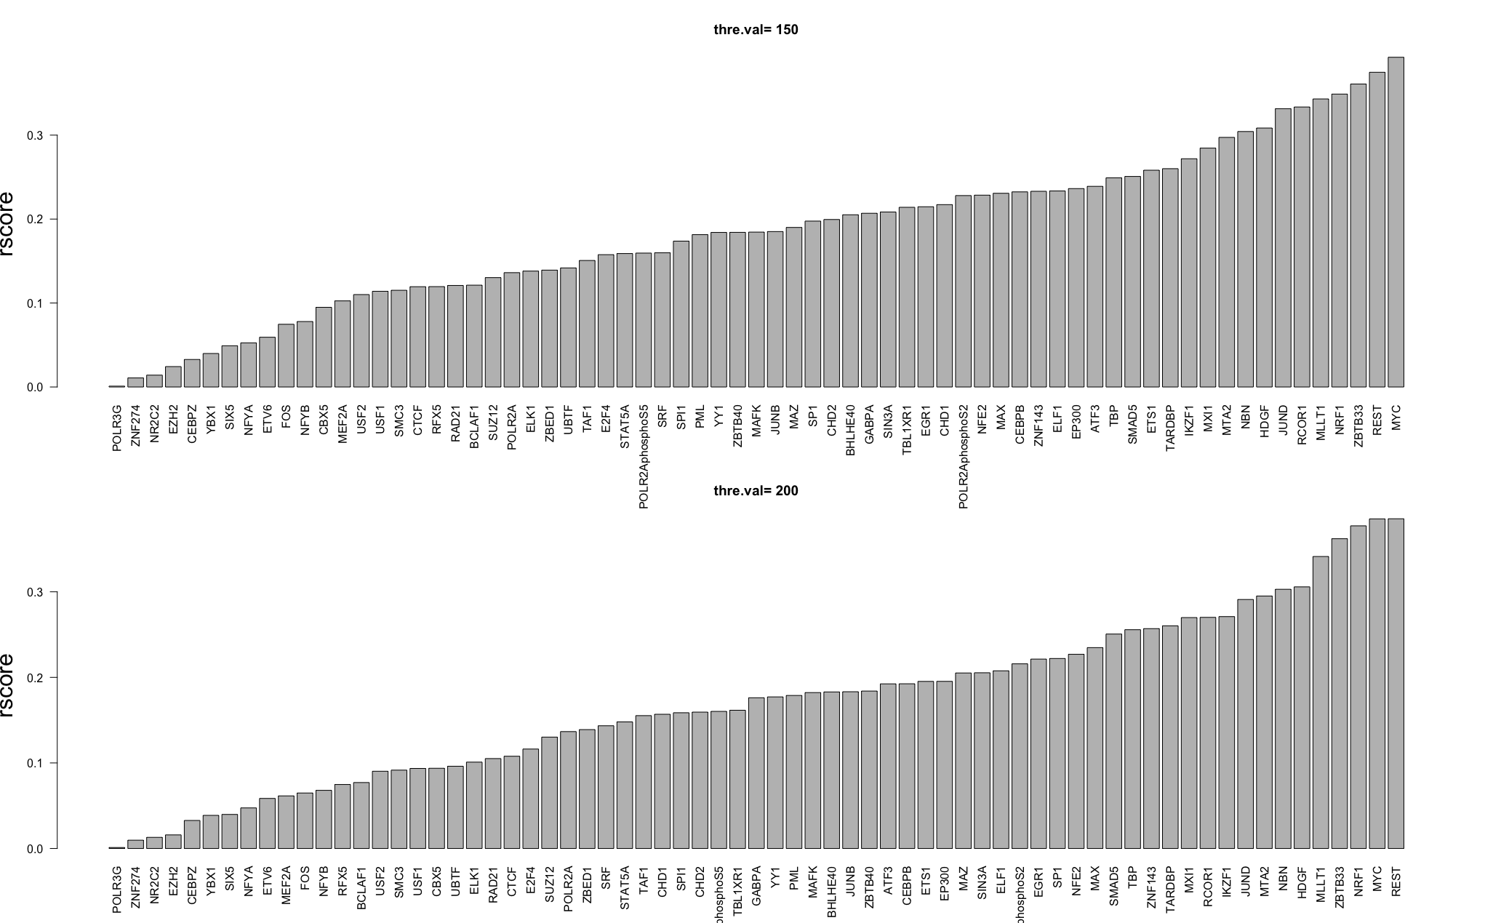

Slide 24
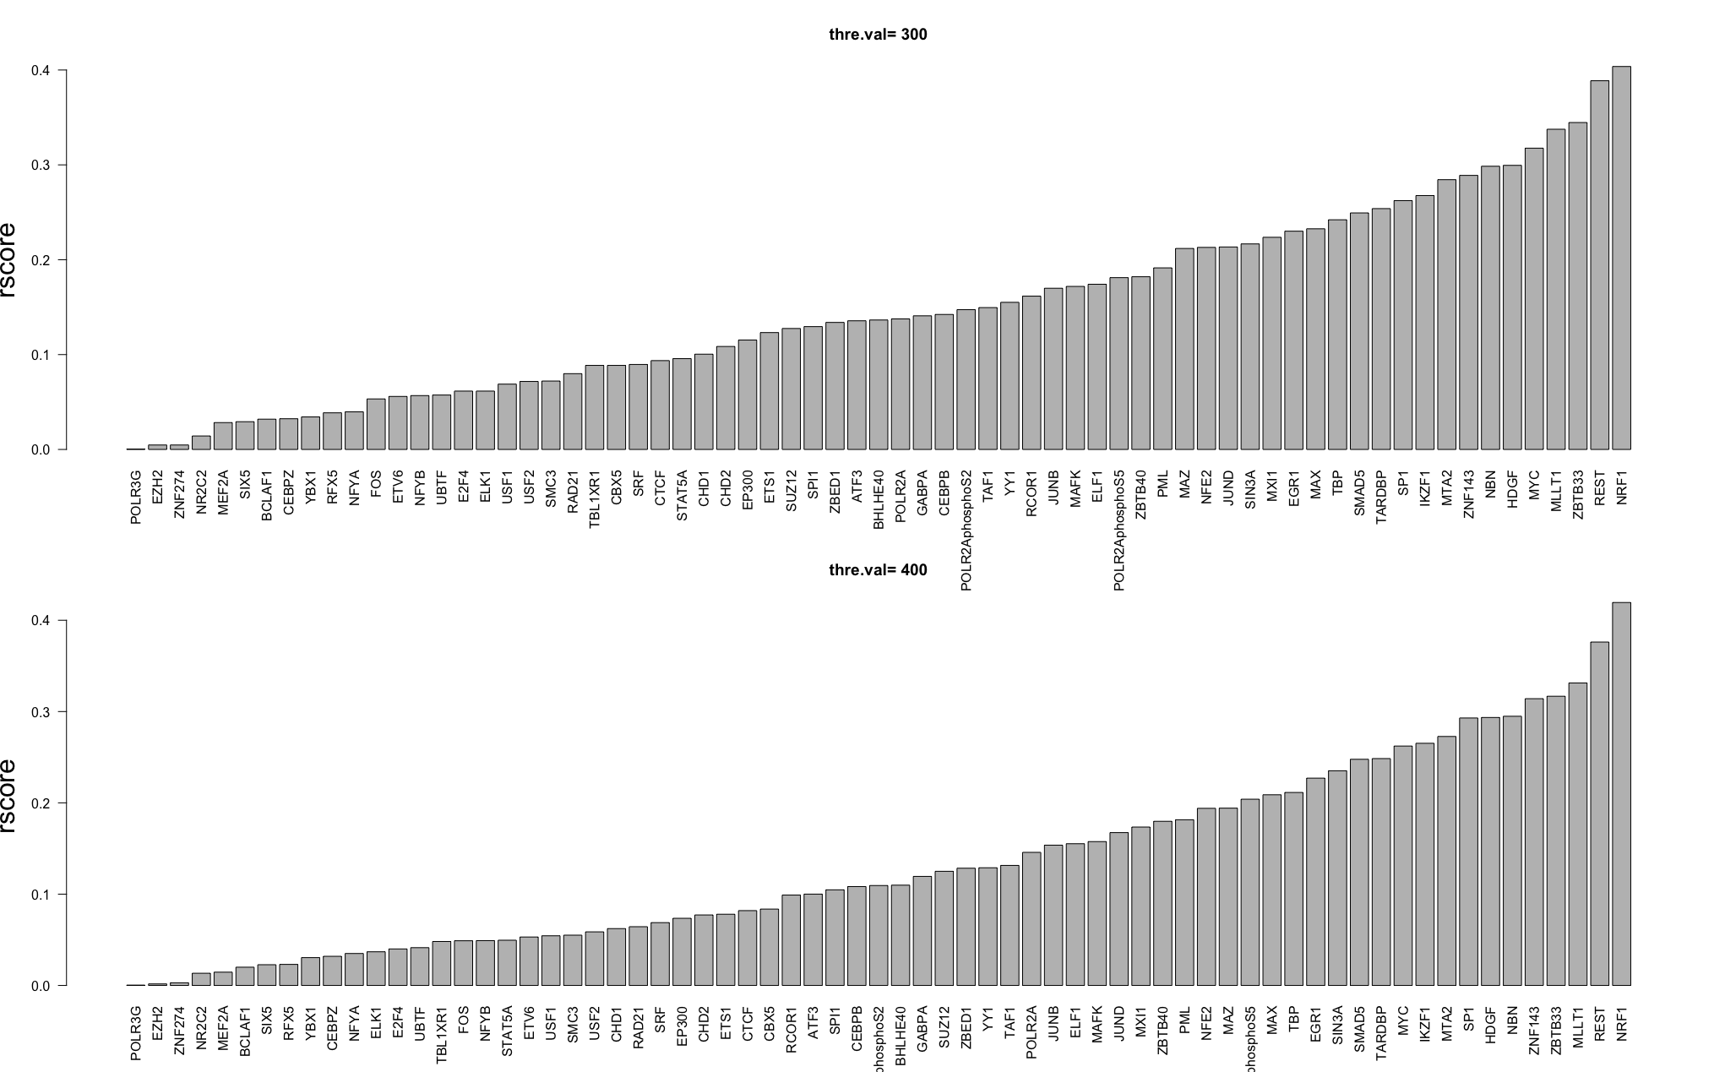

Slide 25
Regulation potential matrix in K562
Regulation potential matrix in GM12878

Slide 26
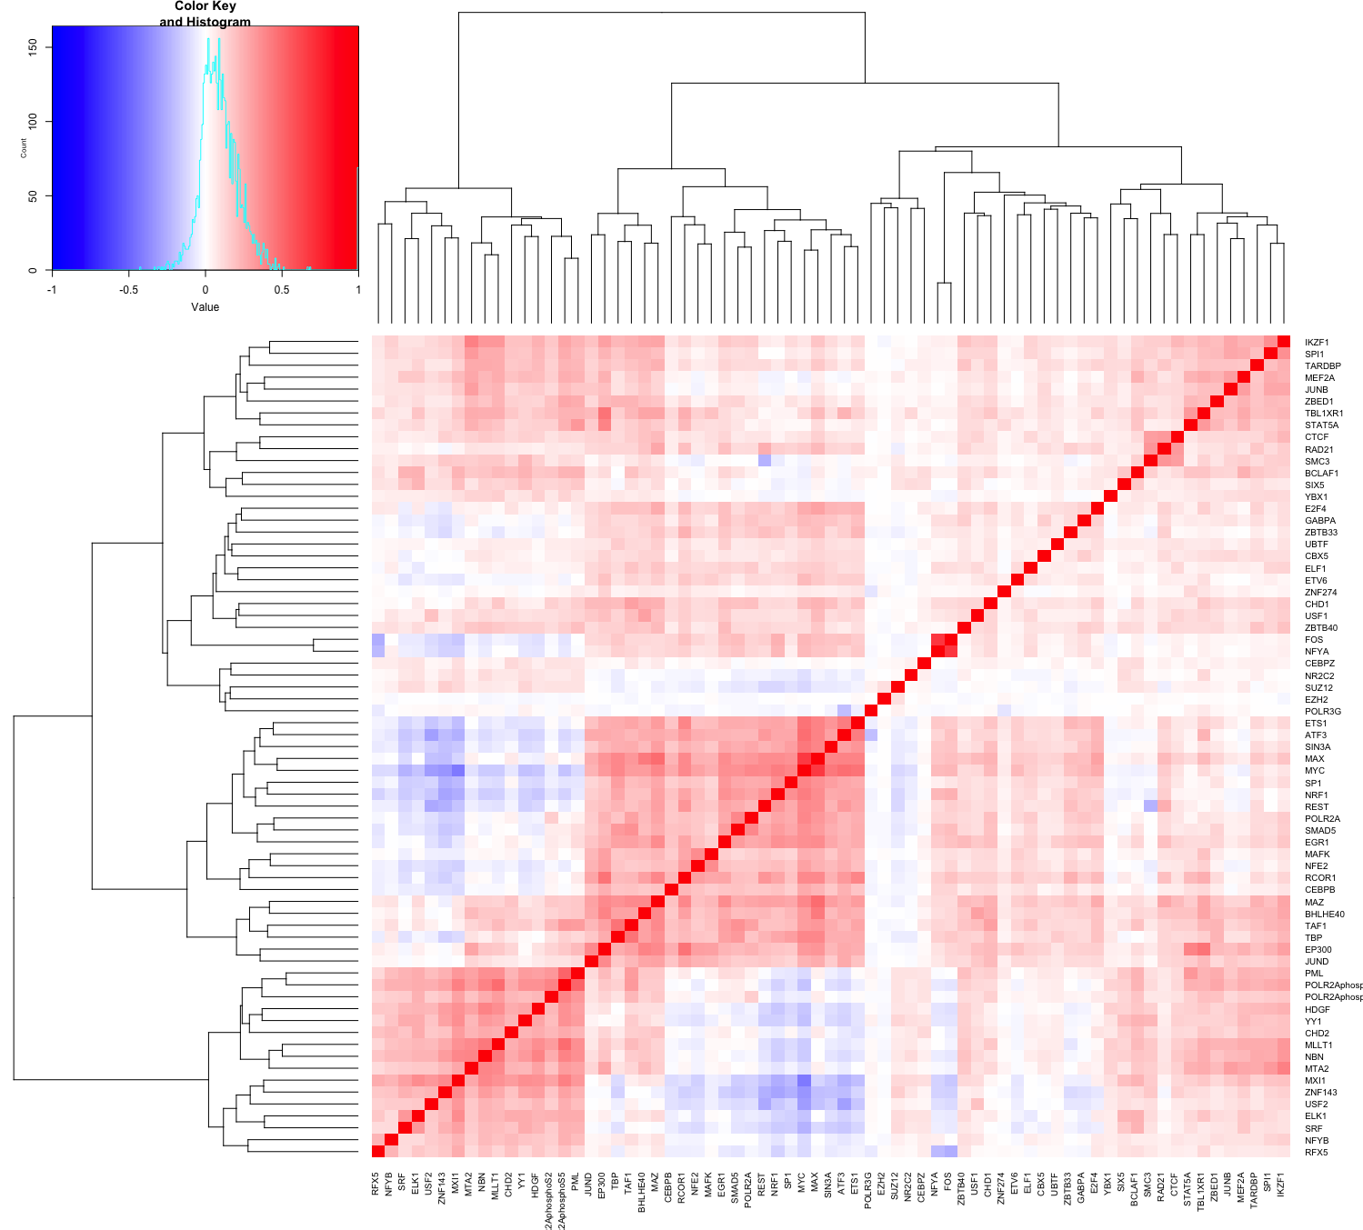

Slide 27
Mostly less “regulative” in K
Mostly more “regulative” in K

Slide 28
Breast Cancer
TP53, apoptotic
Multiple cancers
MYC pair, lung cancer
oncogene
proliferation & tumors metastasis
Breast & prostate cancer
Tumor suppressor
Co-deleted with TP53
Breast cancer
Multiple tumor
AML
? Fusion in Lung cancer
DLBCL
oncogene
Breast cancer
suppress tumor invasion
apoptosis regulator
Cervical&Ovarian
Tumor suppressor
Proto-oncogene

