Slide 1
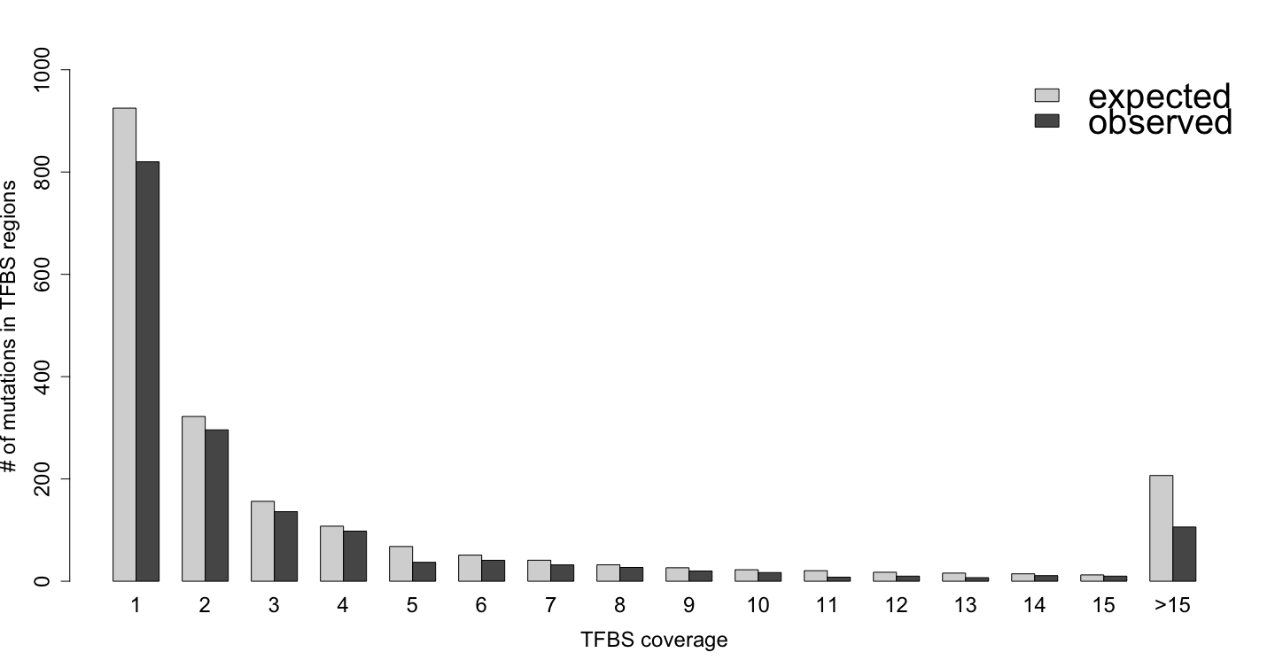
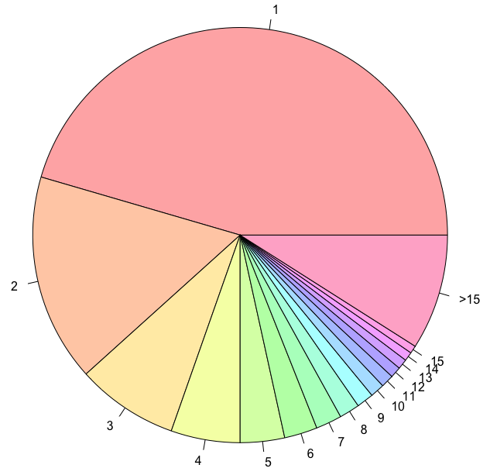
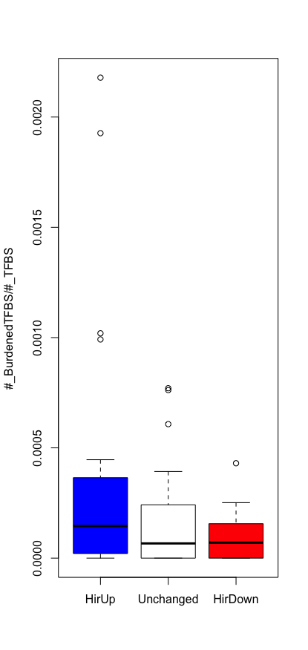
A
A
K562
GM12878
Non
Both
C
0.272
0.170
0.125

Slide 2
1
2
3
2
1
2
1
To get
The kth bin during training
AGTACCGATCCGGGTAGC
1
2
3

