Slide 1
GTEx-reported eQTLs vs. in-house calculations
Existing Protocol (disregards cis/trans effects
& enforces stringent FDR cutoffs)
Filter SNVs from GTEx (remove SNVs w/ MAF<5%, imputation score < 0.4, etc)
GTEx reports ~7 million SNVs (the deviation from our SNV dataset is ~ 1.5%)
Select a random sample of 100000 SNVs from each of the tissue lists
Use matrix-eQTL to identify eQTLs within each tissue using a linear regression model
Remove all eQTLs with and FDR exceeding 5% (per GTEx pilot Supp)
Determine which fraction of in-house identified eQTLs match eQTLs provided by GTEx

Slide 2
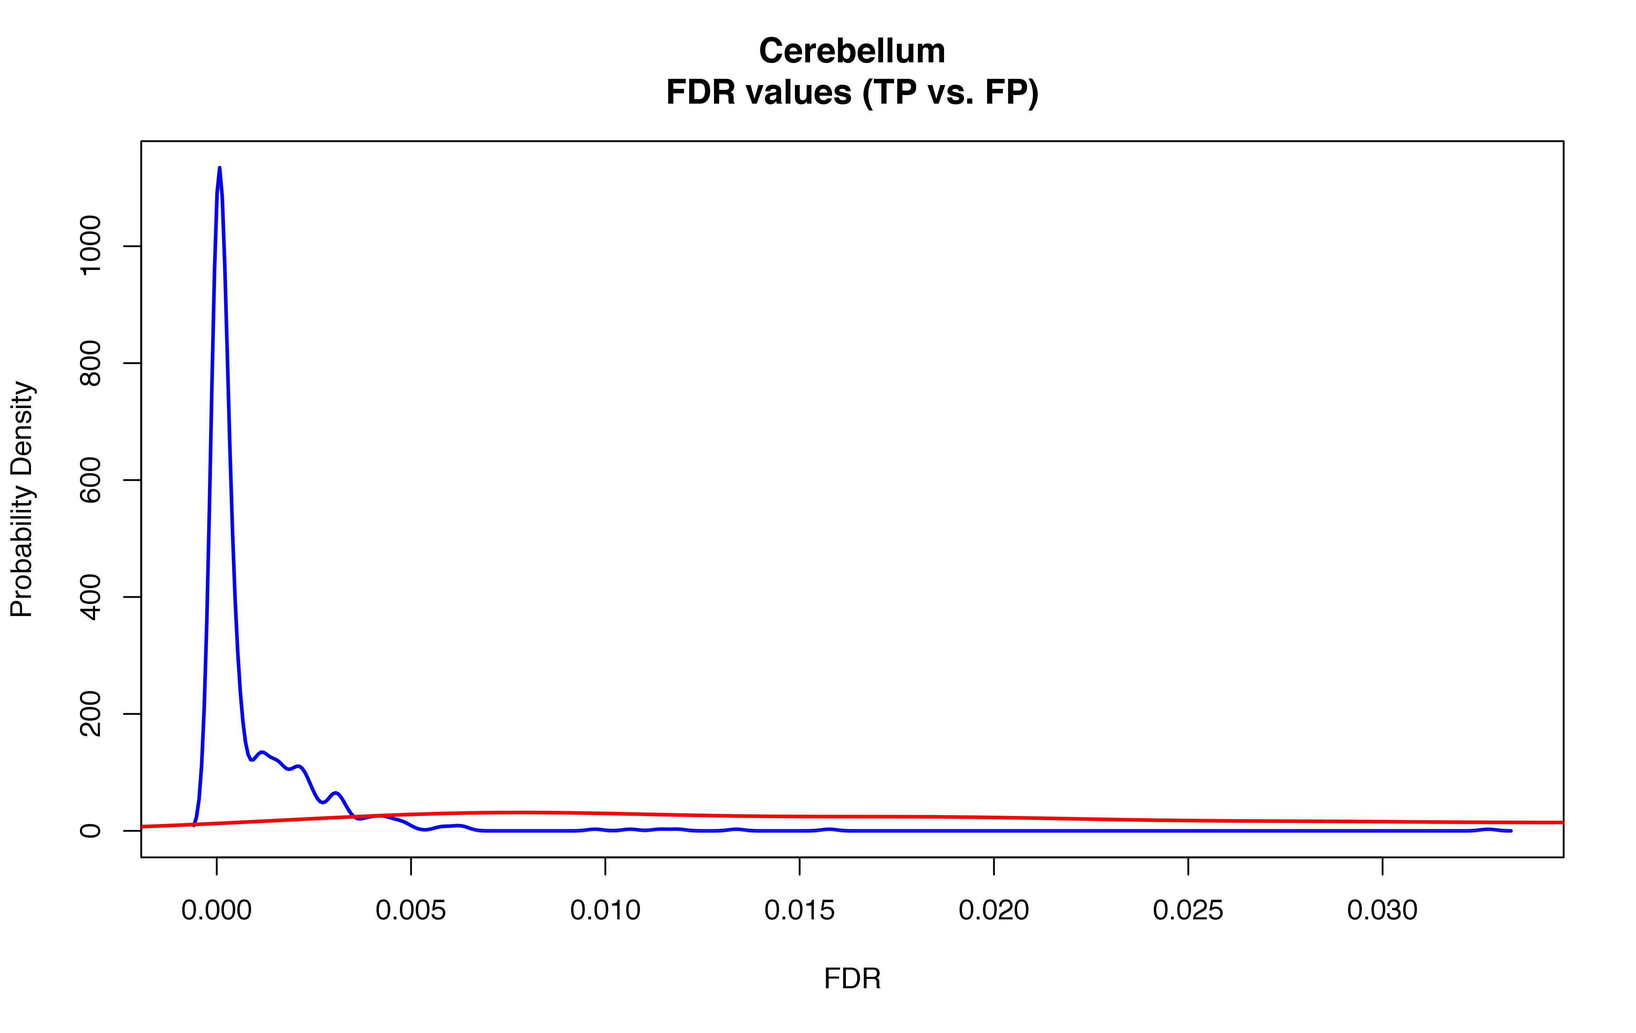
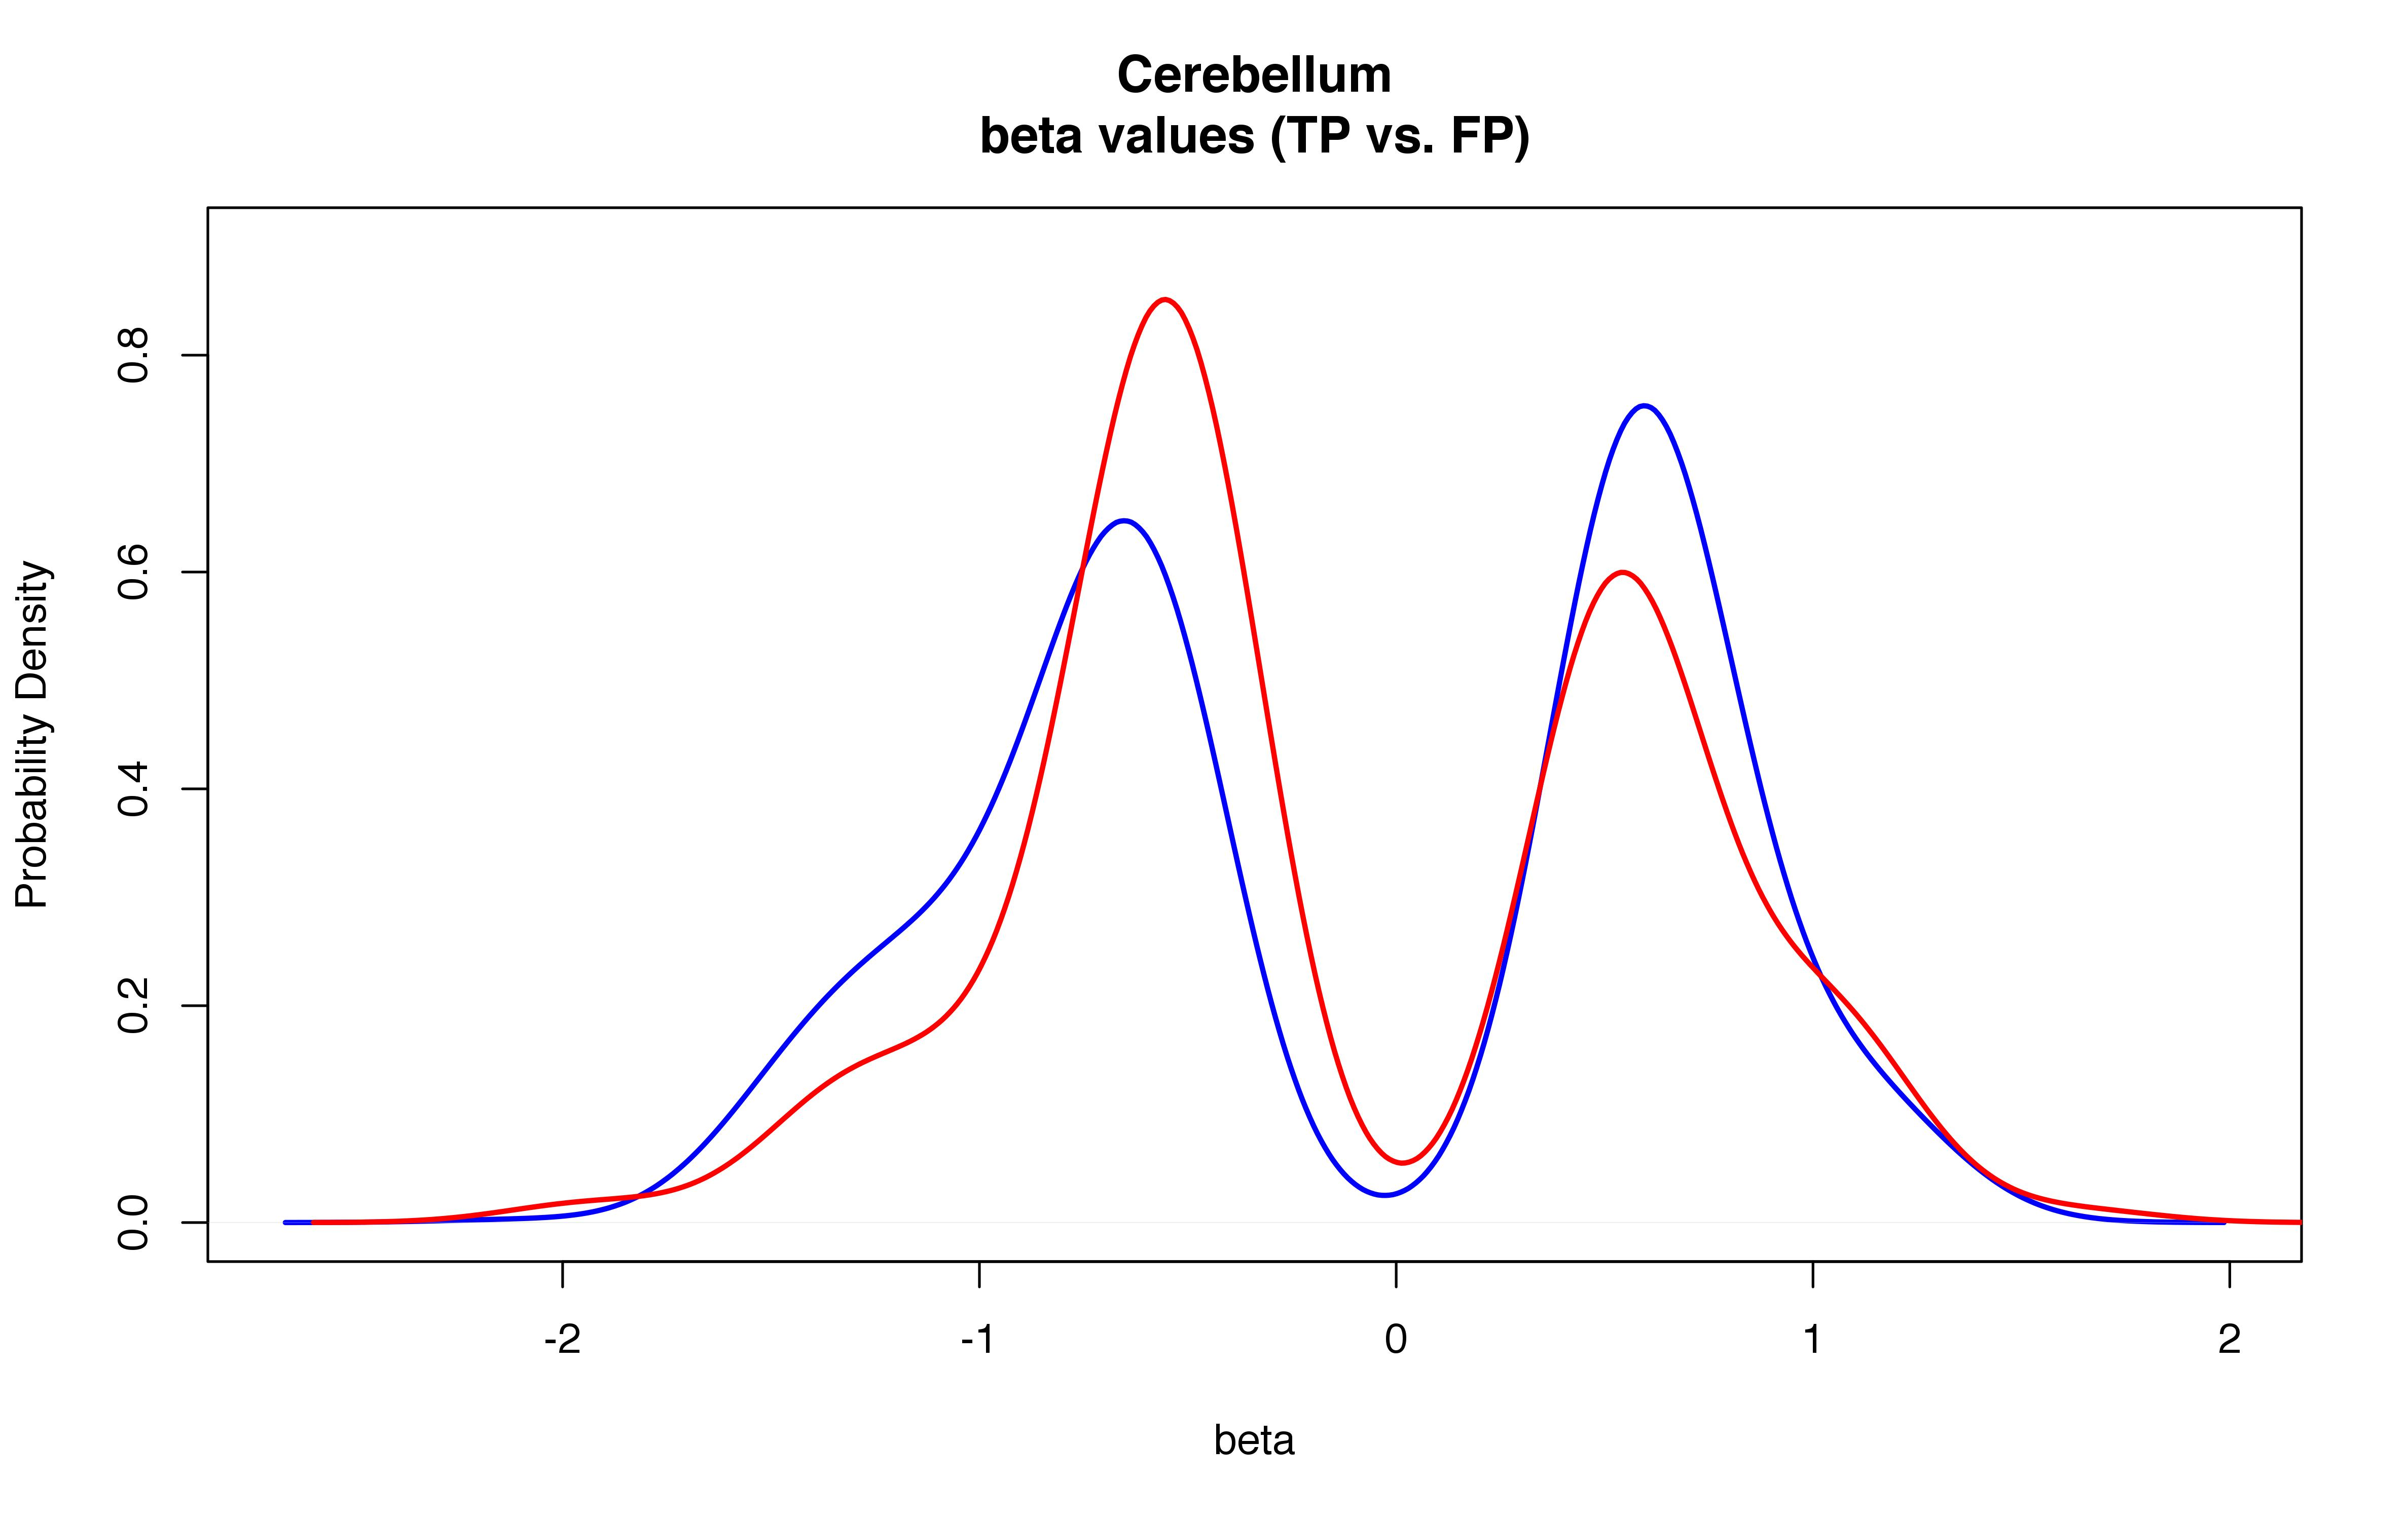
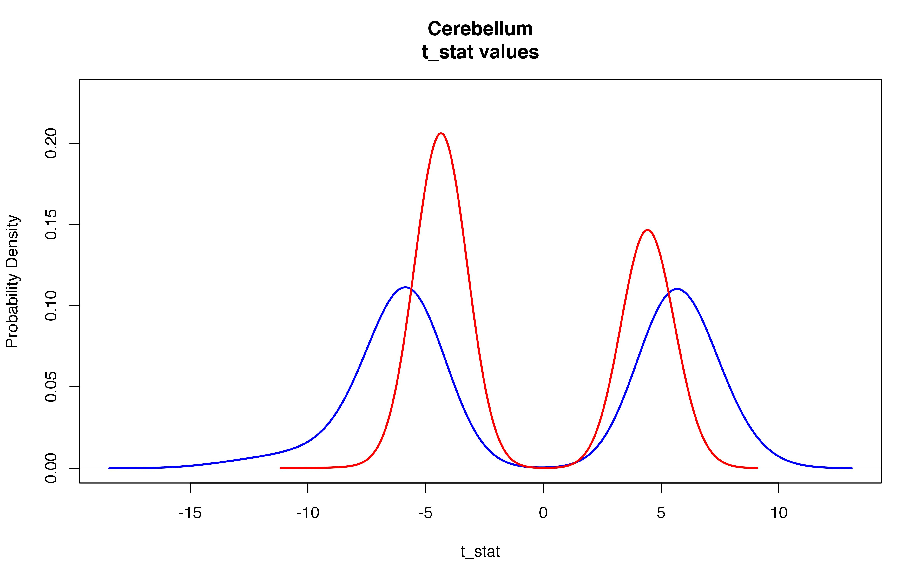
cis effects, with FDR < 5% (more consistent w/GTEx-reported approach)
TP / [TP + FP]: ~55% (depending on tissue)
TP: eQTLs calculated Matrix-eQTL that match GTEx-reported eQTLs
FP: eQTLs calculated with Matrix-eQTL that do not appear in GTEx
(matrix-eQTL value distributions)
Prob. Density of TP values
Prob. Density of FP values

Slide 3
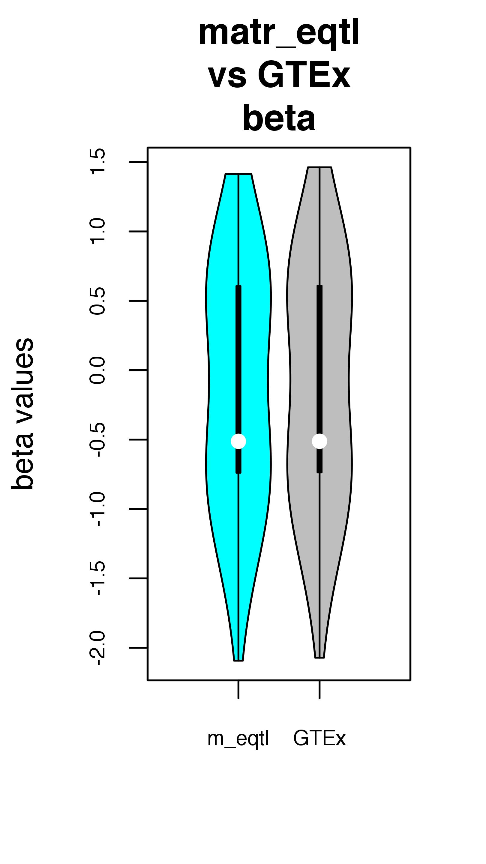
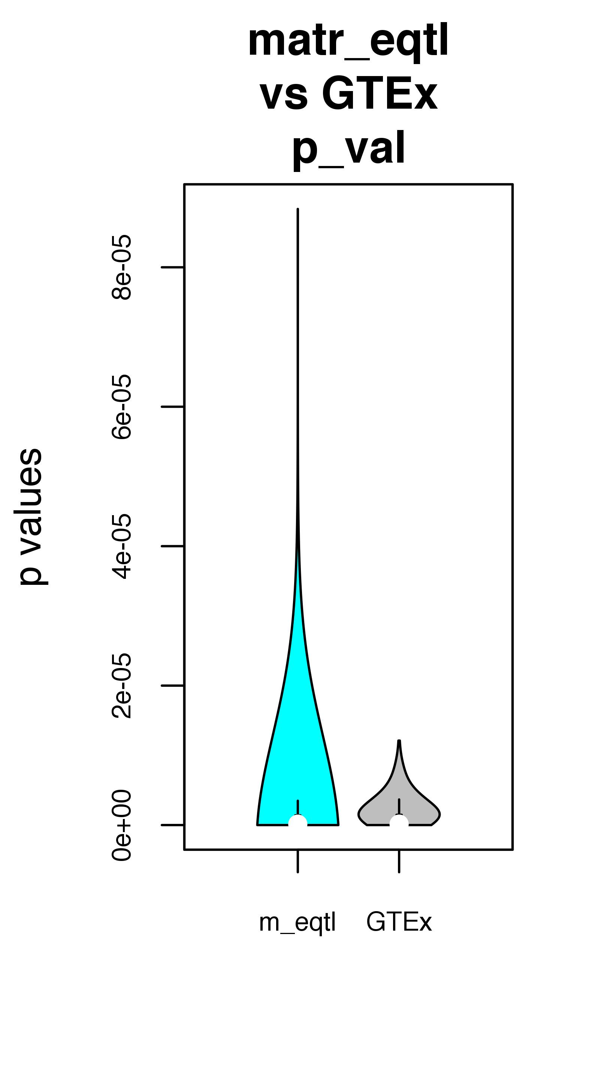
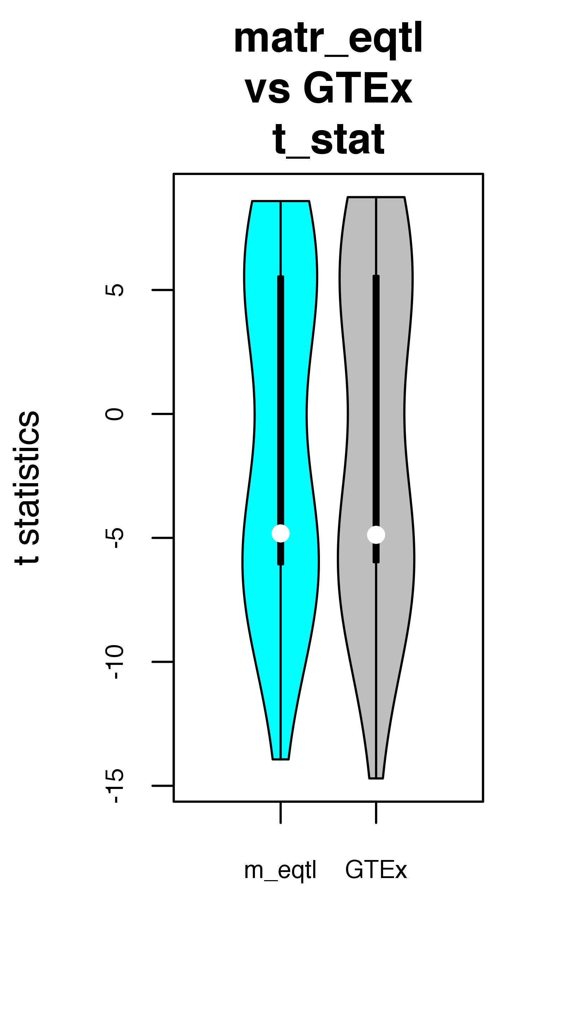
Among TP set -- Differences between values reported by matrix-eQTL & GTEx
(FDR values not provided in GTEx files)

Slide 4
What to trust? – Numerous inconsistencies found in GTEx processing pipeline (ie, comparing Method details in Supp to portal README files)
–> among a few of them:
Include platform platform? (missing in Supp methods, but included in portal data files)?
RPKM and gene counts: "For a given tissue, genes having at least 0.1 RPKM in 2 or more individuals were retained..." (README files: “Genes must have at least 10 samples with RPKM > 0.1 and raw read counts greater than 6”
"Nine tissues all having greater than 80 samples were chosen for eQTL analysis: adipose, artery, blood, heart, lung, muscle, nerve, skin and thyroid."
FDR values not reported in GTEx eQTL (“snpgenes”) files
version of matrix-eQTL not available in paper

Slide 5
Attempted ‘fixes’
  Matrix-eQTL variable changes (ex: slice size for matrices, window size, p-value cutoffs)
  Tried with and w/o platform covariates
  change gene naming: "ENSG00000272004.12" --> "ENSG00000272004
  Multiple tissues (ie, no one tissue is an anomaly)
  Performed calculations only for cases in which biomart coordinates avail and roughly match gtex coordinates
  modelLINEAR_CROSS
  Manual checks on intermediary files and matrices (discussion w/SL last Tues/Wed)
Next:
> contact gtex ppl?
> continue w/eqtls we have?
> implement further possible fixes? (list)

