Slide 1
5th Year Fall Committee Meeting
Michael Rutenberg-Schoenberg
Matt Simon & Mark Gerstein labs
5 December 2016

Slide 2
Two Projects
Correcting for biological variation in RNA chemical probing experiments
d
D
D
Building a sequence-predictive model of RNA polyadenylation from library experiments

Slide 3
Two Projects
Correcting for biological variation in RNA chemical probing experiments
New project
Have built analysis pipeline
Currently refining approach, considering path to publication
Building a sequence-predictive model of RNA polyadenylation from library experiments
Close to key experiments to test efficacy of my approach

Slide 4
Outline
Chemical probing is useful for RNA structure secondary structure determination
Summary of current methodology for inference of modified nucleotides
Chemical probing data do not follow Poisson statistics
Fitting a negative binomial distribution to chemical probing data enables better identification of modified nucleotides in some cases

Slide 5
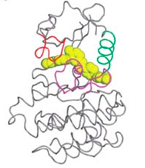
Molecular structure aids mechanistic understanding
Group II Intron
Active Site
BCR-Abl Kinase in complex with Imatinib
(leukemia drug)
Weisberg et al. Nat Rev Cancer 2007
Nagar et al. Cancer Research 2002
Toor et al. Science 2008, Anna Pyle Ann. Rev. Biophys. 2016

Slide 6
long noncoding RNAs
10s of thousands in the human genome
Defined as ncRNAs >200 nt (often several kb) with no apparent protein-coding function
Often spliced and polyadenylated
Xist: A prototypical functional example
Master regulator of X inactivation
Coats the X-chromosome
17 kb in humans
Ulitsky and Bartel Cell 2013
Simon et al. Nature 2013
Notes:
----- Meeting Notes (10/27/16 15:24) -----
Xist on X vs. genome

Slide 7
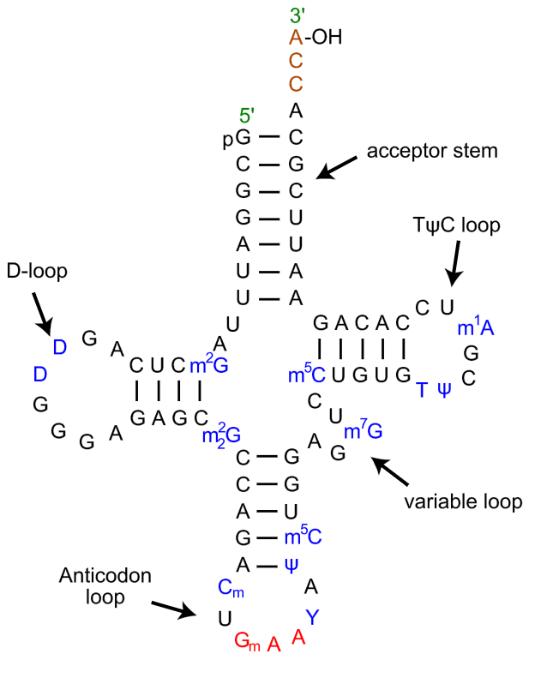
RNA secondary structure
S. cerevisiae tRNA^{Phe}
Maps of base pairing interactions of RNA
https://en.wikipedia.org/wiki/Transfer_RNA; reviewed in Kevin Weeks Curr Opin Struct Biol 2010

Slide 8
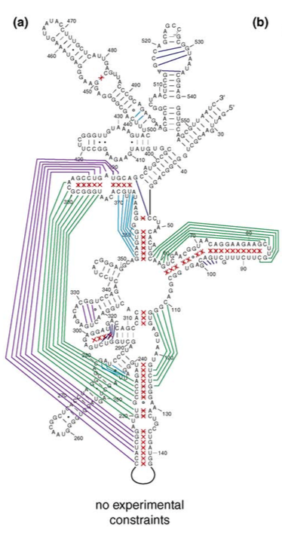
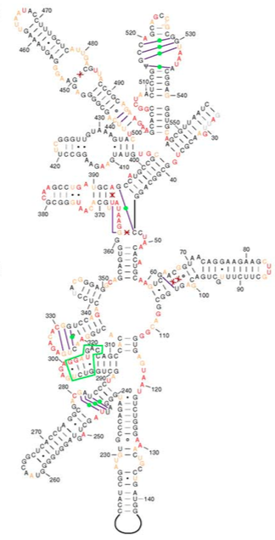
Constraints can improve RNA secondary structure prediction
E. coli 16S rRNA
naïve prediction
constrained prediction
Green and purple indicate mistakes in structure prediction
Prior knowledge of which nucleotides are single- or double-stranded aids prediction.
Deigan et al. PNAS 2009; Kevin Weeks Curr Opin Struct Biol 2010

Slide 9
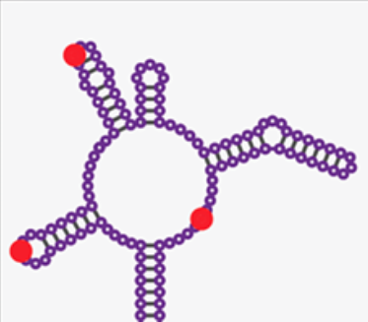
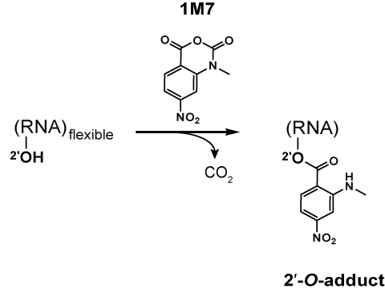
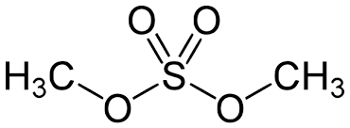
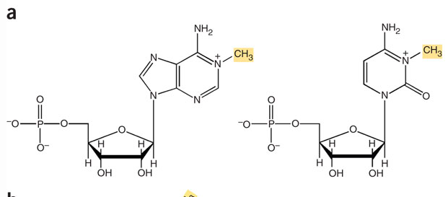
Chemical probing of RNA
Chemically modify RNA
Usually unstructured nucleotides are modifiable
Read out with reverse transcriptase
Stops & Mutations
Chemically modify RNA
(mainly unstructured regions)
SHAPE
(Selective 2’-hydroxyl acylation & primer extension)
Dimethyl Sulfate (DMS)
A
C
Reviewed in Kubota et al Nat Chem Biol 2016; https://en.wikipedia.org/wiki/Nucleic_acid_structure_determination, Tijerna et al. Nat Protocols 2007
Notes:
DMS – methylates the Watson-Crick face of A,C
1M7 (SHAPE reagent) – acylate flexible 2’ OH in the ribose sugar

Slide 10
Chemical probing of RNA
Chemically modify RNA
Usually unstructured nucleotides are modifiable
Read out with reverse transcriptase
Stops & Mutations
Chemically modify RNA
(mainly unstructured regions)
Read out with Reverse Transcriptase
Stops
Mutations
(SHAPE-MaP)
mutation
Reviewed in Kubota et al Nat Chem Biol 2016
Siegfried et al. Nat Methods 2014
Notes:
DMS – methylates the Watson-Crick face of A,C
1M7 (SHAPE reagent) – acylate flexible 2’ OH in the ribose sugar

Slide 11
Outline
Chemical probing is useful for RNA structure secondary structure determination
Summary of current methodology for inference of modified nucleotides
Chemical probing data do not follow Poisson statistics
Fitting a negative binomial distribution to chemic al probing data enables better identification of modified nucleotides, especially for long RNAs

Slide 12
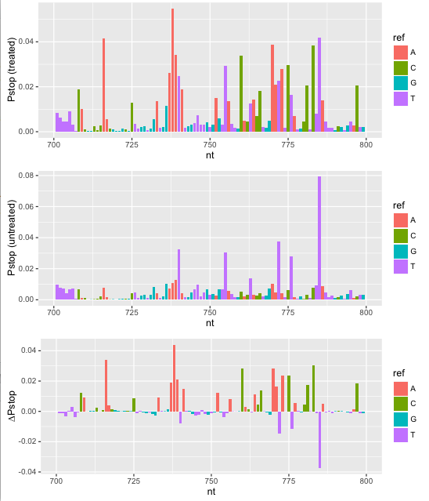
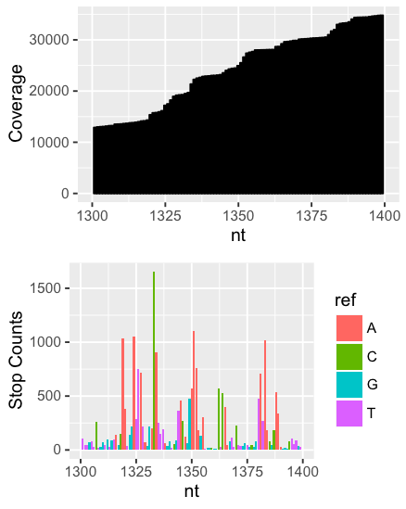
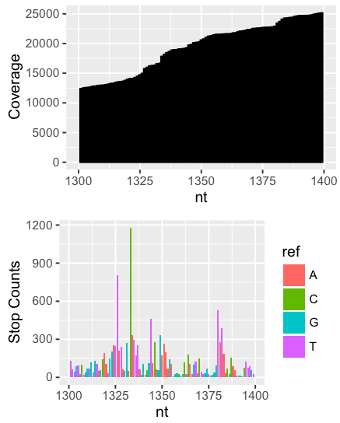
Basic analysis of chemical probing data
i∈nucleotides; N total
P_{stop}(i) = stops(i)/coverage(i)
∆P_{stop}(i) = P_{stop}(treated) - P_{stop}(control)
DMS-Seq data for Xist RNA
A and C should be modified
Treated
Control
Combined
Fang, Moss et al. PLoS Genet. 2015
Notes:
Fang, Moss et al. PLoS Genet. 2015

Slide 13
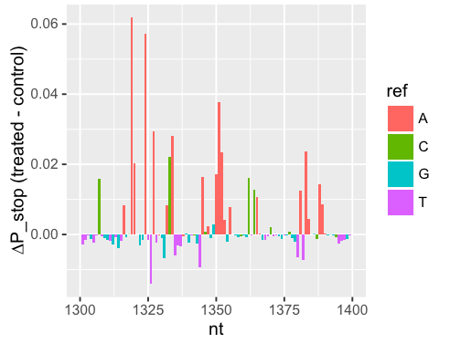
How do we statistically identify modified nucleotides?
Typical work in the field: Poisson statistics
Reverse transcription stops are counts, compare between treated & untreated samples
Extensively used in the chemical probing field to describe variation of data
Aviran et al. PNAS 2011
Choudhary et al. Bioinformatics 2016
Smola et al. Biochemistry 2015
Smola et al. PNAS 2016
Siegfried et al. Nat Methods 2014

Slide 14
Why have people been using Poisson statistics?
Chemical probing has been traditionally done in vitro → good experiments should behave like technical replicates
Only more recently has in vivo analysis become widespread
Rouskin et al. Nature 2014 – DMS-Seq genome-wide
Spitale et al. Nature 2015 – icSHAPE genome-wide
Fang, Moss et al. PLoS Genet 2015 – DMS-Seq Xist
Smola et al. Biochemistry 2015 – ∆SHAPE
Smola et al. PNAS 2016 – ∆SHAPE Xist
(several others)

Slide 15
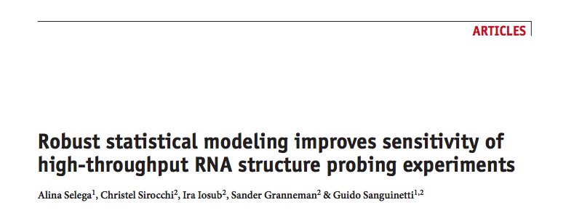
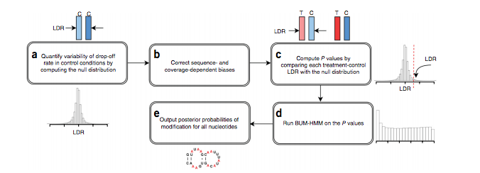
Selega et al. Nat Meth 2016

Slide 16
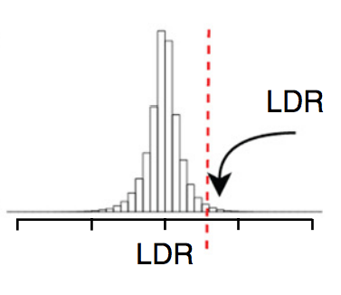
Method outline
Construct empirical distribution of log ratios of P_{stop} between replicates of control samples.
Calculate empirical p-values of log P_{stop} ratios of treated samples to untreated samples
Calculate posterior probabilities of modification using HMM
(next slide)
Selega et al. Nat Meth 2016

Slide 17
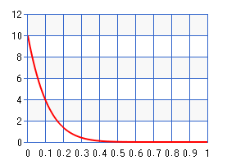
Beta-Uniform Mixture HMM (BUM-HMM)
Assumptions
P-values for modified nucleotides follow a ß distribution with alpha = 1, beta = 10
P-values for unmodified nucleotides follow a uniform distribution
Transition probabilities between paired & unpaired bases are:
Selega et al. Nat Meth 2016
Starting
 | Paired | Unpaired
Paired | 0.95 | 0.8
Unpaired | 0.05 | 0.2
Ending

Slide 18
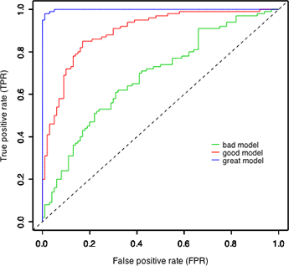
BUM-HMM Results
Idealized ROC curves
AUC for 18s rRNA secondary structure
(ROC curve not shown):
BUM-HMM: 0.73
∆TCR (very similar to ∆P_{stop}): 0.74
Structure-Seq: 0.68
Mod-Seq: 0.64
Selega et al. Nat Meth 2016 https://www.unc.edu/courses/2010fall/ecol/563/001/docs/lectures/lecture22.htm

Slide 19
Outline
Chemical probing is useful for RNA structure secondary structure determination
Summary of current methodology for inference of modified nucleotides
Chemical probing data do not follow Poisson statistics
Fitting a negative binomial distribution to chemical probing data enables better identification of modified nucleotides in some cases

Slide 20
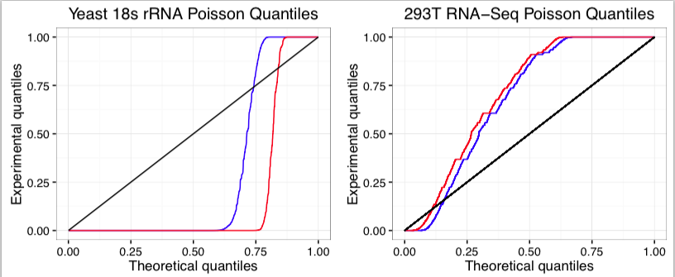
Chemical probing data, like RNA-Seq, do not fit Poisson distribution
Note: these are uniform quantiles, not normally distributed quantiles
KS test: p is approximately 0
Most values are > µ^.5 away from each other

Slide 21
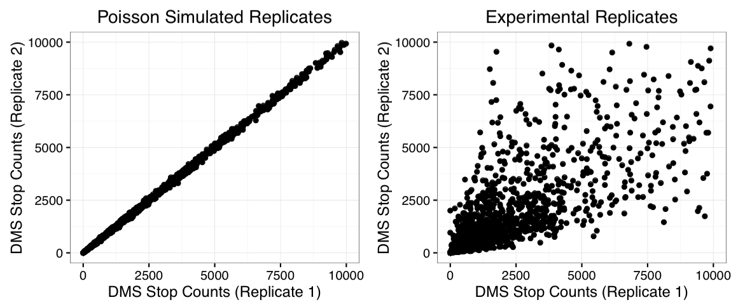
Chemical probing data, like RNA-Seq, do not fit Poisson distribution

Slide 22
Pseudocounts for Poisson-family distributions
Chemical probing
RNA-Seq
Samples
Samples
Nucleotide
1
2
3
…
10000
Gene
1
2
3
…
10000
Normalize all rows to same coverage
Normalize all columns to same coverage
Notes:
----- Meeting Notes (10/27/16 15:24) -----
RNA-Seq on left
Make things correspond as clearly as possible

Slide 23
Pseudocounts for Poisson-family distributions
Chemical probing
i∈nucleotides; N total
j∈samples; M total
Y_{ij} = stop counts for nucleotide i in sample j
Coverage for nucleotide i in sample j
C_{ij} =
S_{ij} = relative coverage for nucleotide i in sample j
S_{ij} =
Pseudocounts
P_{ij} = Y_{ij}/S_{ij}
RNA-Seq
i∈genes; N total
j∈samples; M total
Y_{ij} = gene
C_{j} = total coverage for sample j
S_{j} = relative library size
P_{ij} = Y_{ij}/S_{j}
Notes:
----- Meeting Notes (10/27/16 15:24) -----
RNA-Seq on left
Make things correspond as clearly as possible

Slide 24
Negative-Binomial Distribution
Distribution
Mean-Variance relationship
σ² = µ + αµ²
α = 0 → Poisson
Larger alpha → higher variance
Challenge:
Fit dispersion parameter with small number of replicates
Notes:
----- Meeting Notes (10/27/16 15:24) -----
Estimate variance
DESeq/edgeR

Slide 25
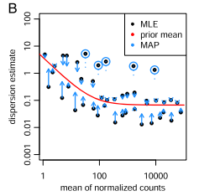
DESeq2 procedure
Fit individual gene (nucleotide) dispersion using Cox-Reid adjusted profile likelihood
Fit a curve of the form y = a1 + 1/a2 to Cox-Reid dispersions
Use empirical Bayes procedure to squeeze dispersions toward fitted value, assuming that dispersion follows a log-normal distribution

Slide 26
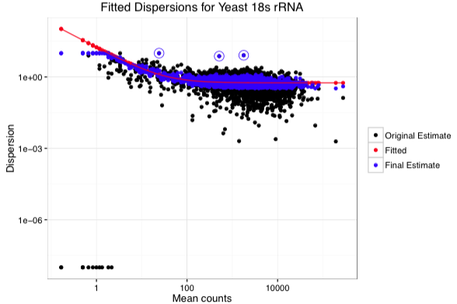
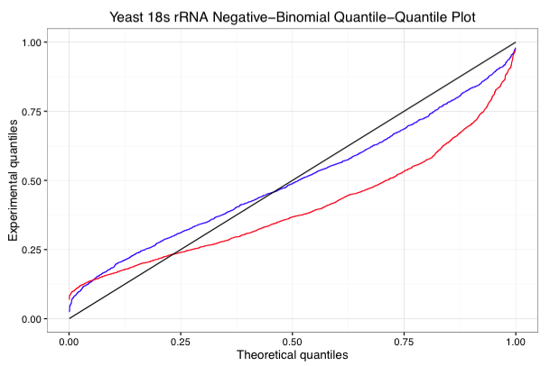
Fitting negative-binomial dispersion
Fit to Negative-Binomial distribution is very conservative.

Slide 27
NB-based p-values vs. emprical p-values
-log10 scale
-log10 scale
Negative-binomial p–values much more clearly identify modified bases, whereas after Benjamini-Hochberg correction, no bases are directly seen as significant in BUM-HMM method.
This is because there are a small number of total bases (1800) in this RNA, so the minimum possible p-value is 1/1800
The HMM in BUM-HMM helps compensate for the low power of the empirical dist.

Slide 28
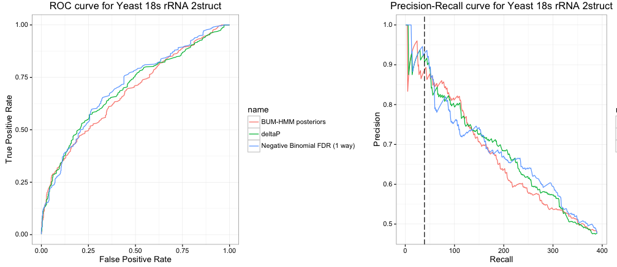
Performance for yeast 18s secondary structure
 | ∆P_{stop} | Negative-Binomial | BUM-HMM
AUC | 0.679 | 0.689 | 0.663
AUPR | 0.685 | 0.685 | 0.666

Slide 29
Performance for yeast 18s secondary structure
How many nucleotides are statistically significantly modified?
 | ∆P_{stop} | Negative-Binomial | BUM-HMM
AUC | 0.679 | 0.689 | 0.663
AUPR | 0.685 | 0.685 | 0.666

Slide 30
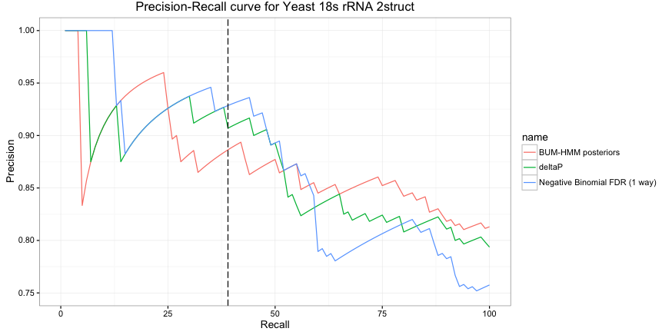
Performance for yeast 18s secondary structure
5% False discovery rate
 | ∆P_{stop} | Negative-Binomial | BUM-HMM
AUPR | 0.926 | 0.946 | 0.916

Slide 31
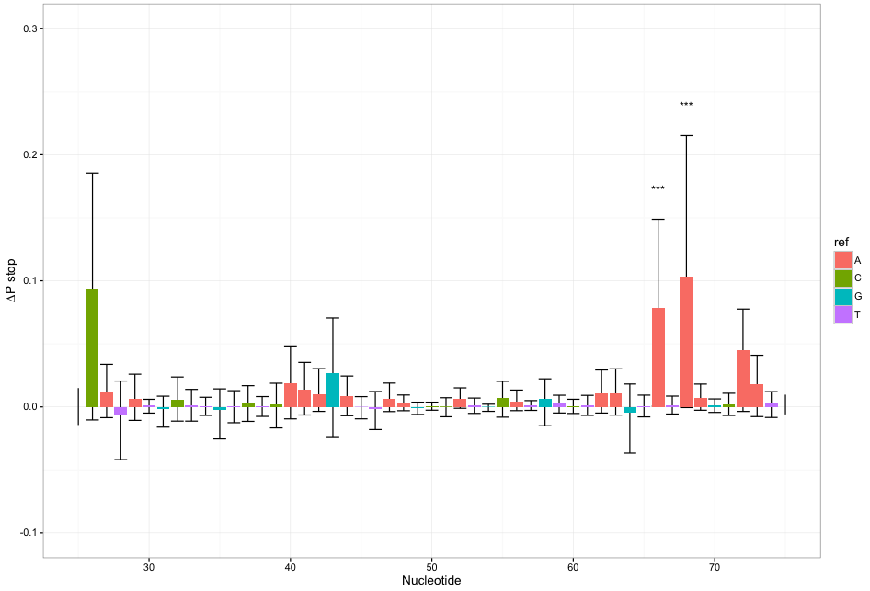
A sample false positive
Not many positives overall: noisy experiment or conservative statistical model?

Slide 32
Xist RNA
Experimental design
1 control, 2 DMS treatments (slightly different)
3 primer cocktails tiling Xist, with some overlap
No gold standard structure, but only* A & C nucleotides should be modified by DMS.
Data from Fang, Moss et al. PLoS Genet 2015

Slide 33
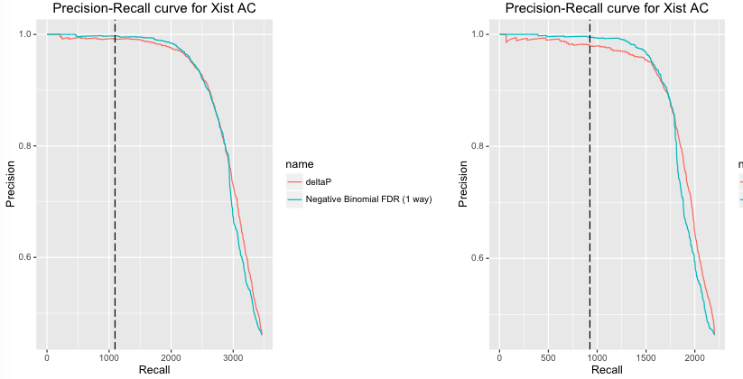
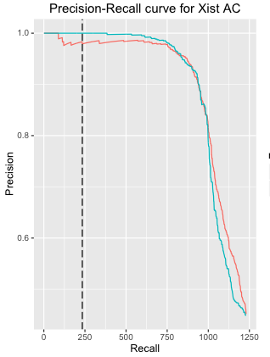
Individual primer cocktails
mix 1
mix 2
mix 3
BUM-HMM requires 2 controls → only ∆Pstop and negative-binomial method used
Data from Fang, Moss et al. PLoS Genet 2015

Slide 34
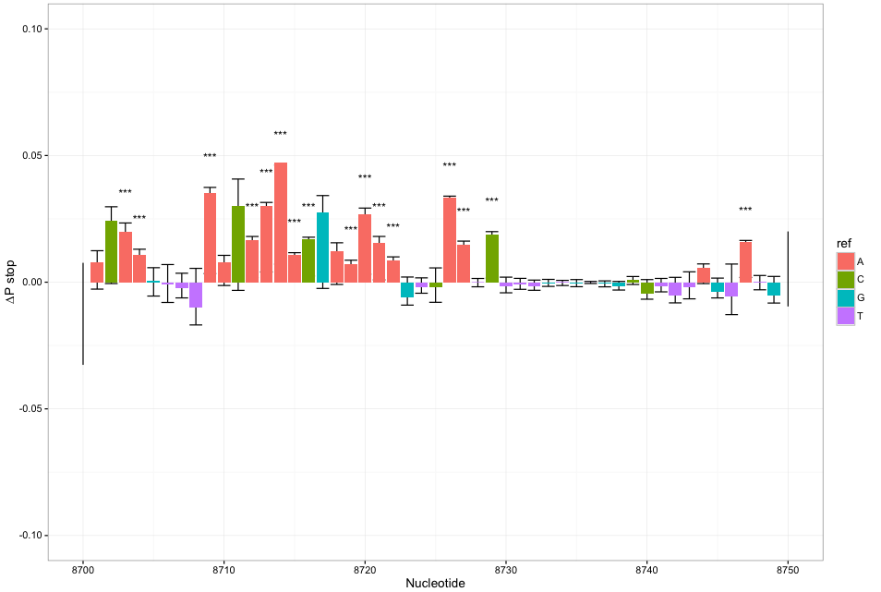
Sample region of Xist

Slide 35
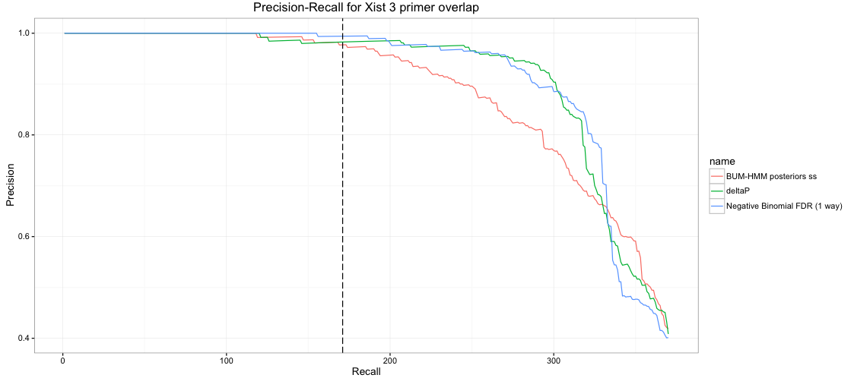
Combined Xist primer cocktails
922 nucleotides with > 1000 coverage in each sample and > 5000 average coverage/sample.
 | ∆P_{stop} | Negative-Binomial | BUM-HMM
AUPR | 0.995 | 0.999 | 0.996
Data from Fang, Moss et al. PLoS Genet 2015

Slide 36
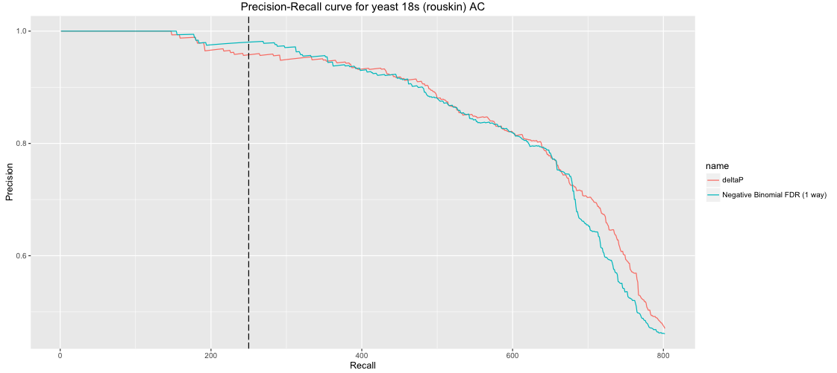
Human 18s rRNA
DMS-MaPSeq – only 1 control → can’t compare to BUM-HMM
Zubradt et al. Nat Meth 2016

Slide 37
What happens with shorter RNAs?
Expect BUM-HMM to struggle, because of low power with empirical distribution
-log10 scale
-log10 scale

Slide 38
What happens with shorter RNAs?
Negative-binomial method may also struggle, because fewer data points are available to fit dispersion trend

Slide 39
Naïve calculation (∆Pstop) stays the same
What happens with shorter RNAs?
DMS-Seq data for Xist RNA
A and C should be modified
i∈nucleotides; N total
P_{stop}(i) = stops(i)/coverage(i)
∆P_{stop}(i) = P_{stop}(treated) - P_{stop}(control)
Fang, Moss et al. PLoS Genet. 2015
Notes:
Fang, Moss et al. PLoS Genet. 2015

Slide 40
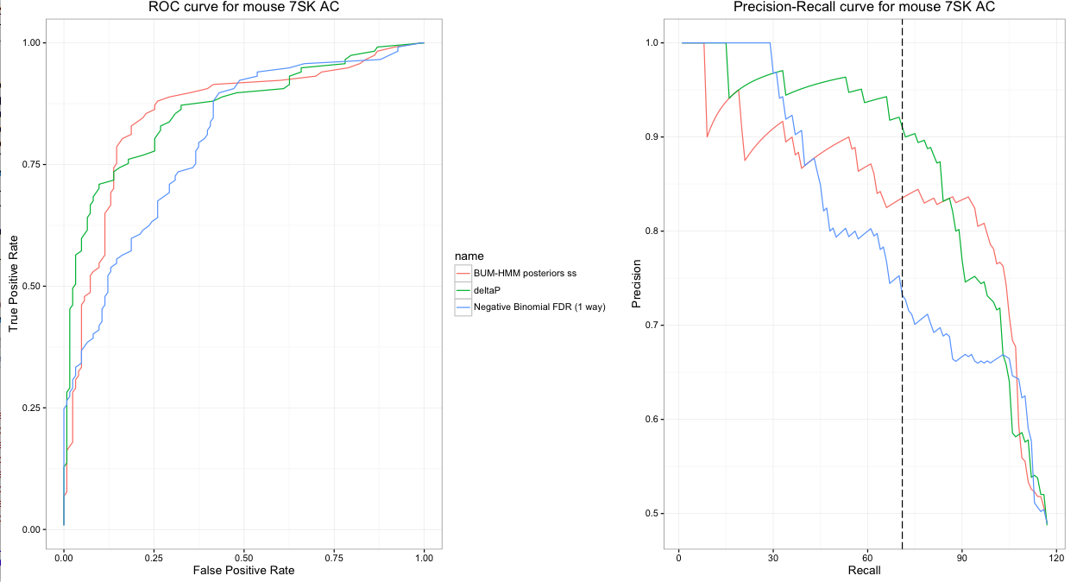
Mouse 7SK A&C performance
332 nt
Negative-Binomial has a lower AUC/AUPR, but identifies many more bases perfectly
5% FDR cutoff not meaningful
Alec Sexton

Slide 41
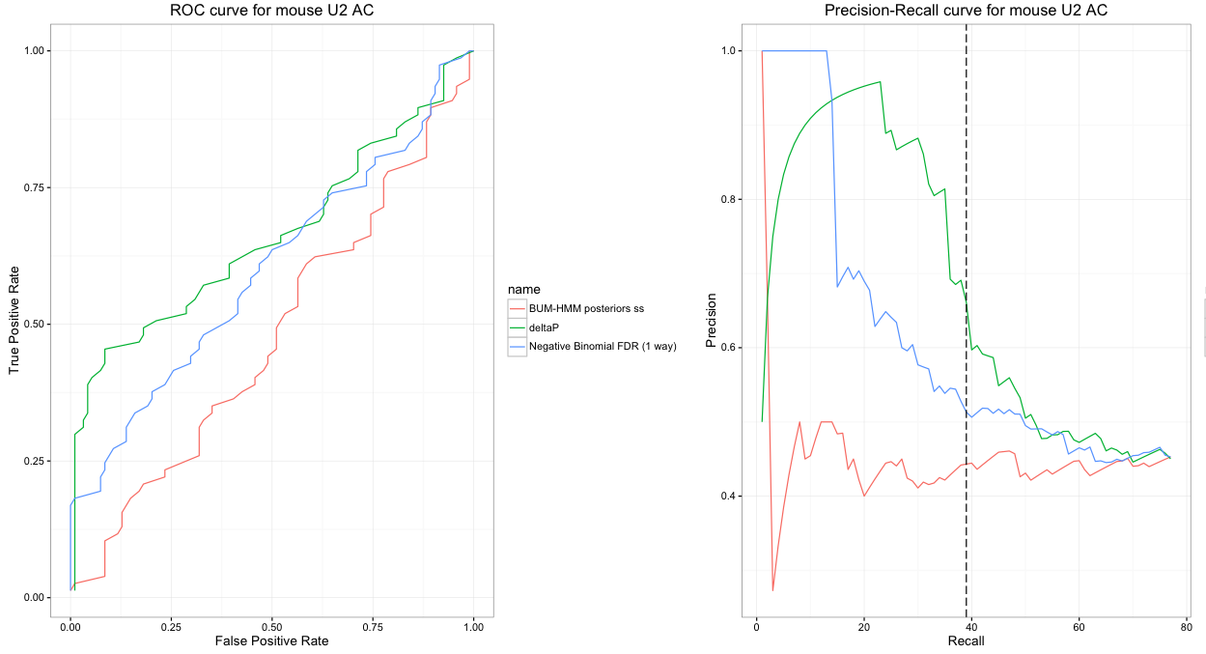
U2 A&C performance
BUM-HMM probably performs poorly, because its empirical distribution prevents extreme p-values when the number of nucleotides is small
Alec Sexton

Slide 42
Conclusions
In all long RNAs tested, the negative-binomial method performed better (though often very slightly) than ∆Pstop for nucleotides that had FDR < 5%.
This implies good control of false positives, though the negative binomial fits seem to conservative, which may compromise sensitivity
Need to analyze more data to get a good sense of comparative performance of negative-binomial & BUM-HMM methods on long RNAs.
In small RNAs, the negative-binomial method still identifies a set of modified bases correctly, but then starts to make more mistakes.
BUM-HMM does not perform well for short RNAs.

Slide 43
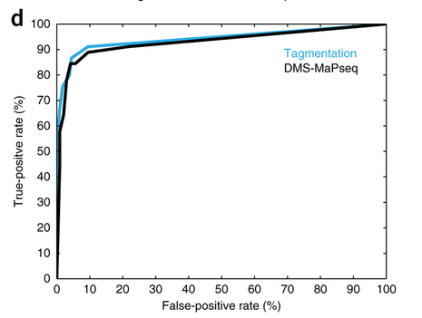
Future directions
Evaluation with better gold standard
Reports that analyze DMS data relative to solvent accessibility in solved crystal structures show better agreement between DMS and gold standard
Zubradt et al. Nat Meth 2016

Slide 44
Future directions
Evaluation/improvement of short RNA performance
Does simulating analysis with fewer bases (by randomly subsampling longer RNAs) damage performance of negative-binomial or BUM-HMM methods?
Does analysis of a short RNA along with a longer RNA (a calibration experiment) improve analysis?

Slide 45
Future directions
Simulation/evaluation of fitting method
Simulate data from negative-binomial distribution
Assess efficacy of recovering parameters using current fitting methods
Improve fitting methods?
Does local sequence bias the dispersion parameter?

Slide 46
Future directions
Application to genome-wide datasets
Might need tricks to avoid being too computationally intensive
Simulation of depth needed to achieve correct inference of modified bases
Use statistically inferred constraints to predict structures!

Slide 47
Building a sequence-predictive model of RNA polyadenylation from library experiments

Slide 48
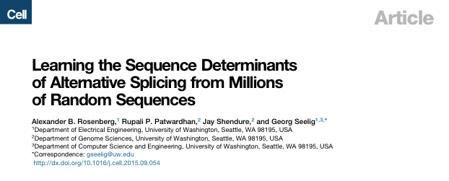
Background thoughts
SD1
Minor splice site
SD2
Major splice site
3’ barcode
25 nt random sequence
200,000 random sequences (~10⁶ for 3’ splice site).
Transfect plasmids into 293T cells
RNA-Seq with targeted primers to observe splicing patterns
Predict RNA splicing (of construct and endogenous genes)

Slide 49
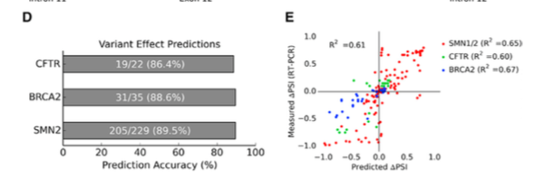
Model can also predict effects of disease-causing splicing variants
These are exon-skipping events, instead of just alternative 5’ and 3’ splice junctions
Allegedly, this is much better than the “Splicing code” from Brendan Frey et al., but hard to compare, because Frey et al. don’t share their code.

Slide 50
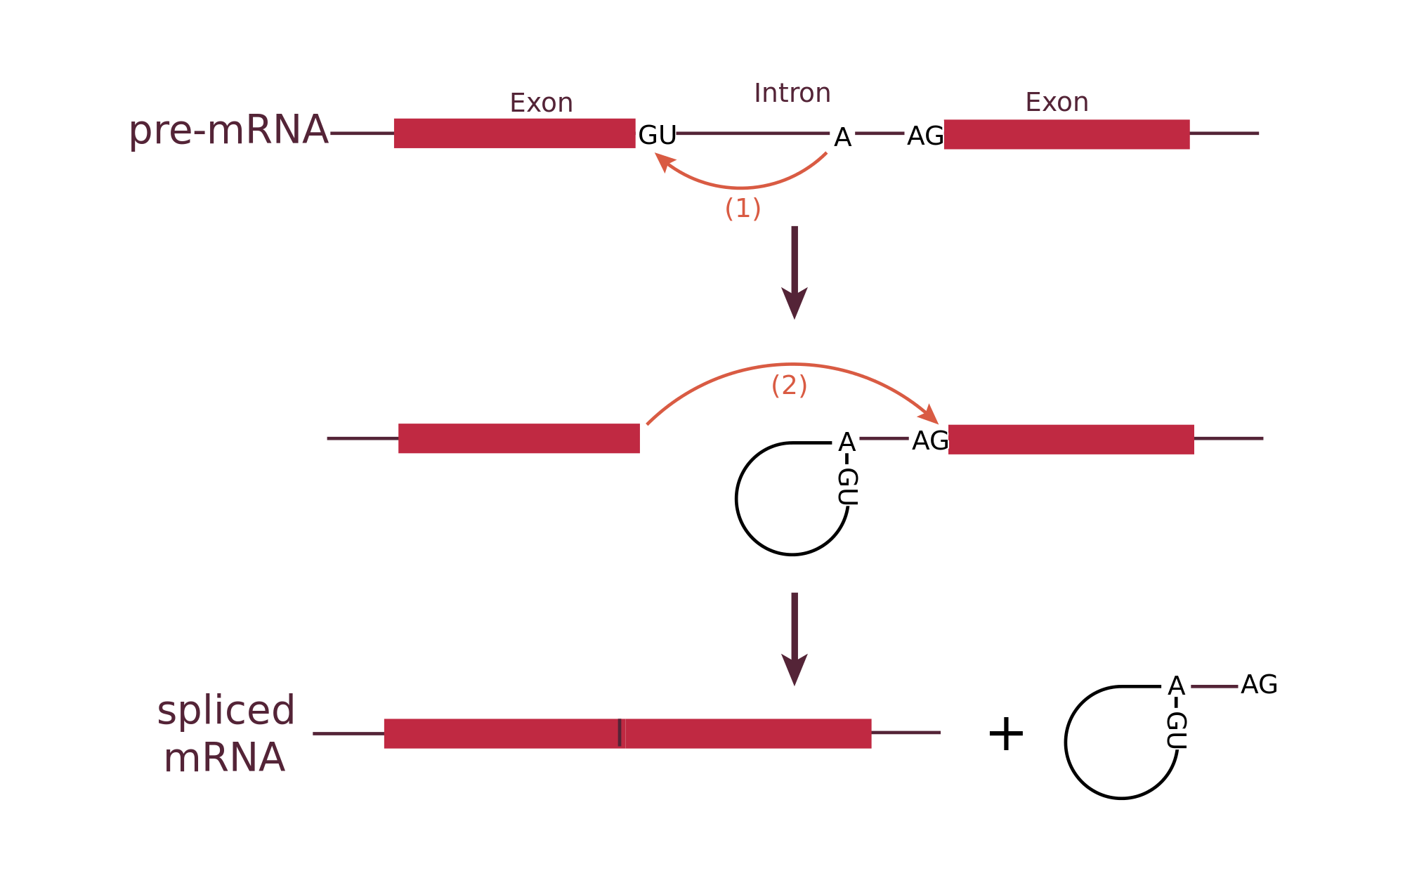
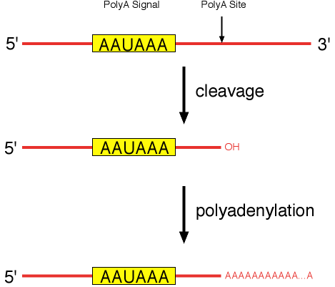
RNA processing
RNA splicing
Polyadenylation
https://en.wikipedia.org/wiki/RNA_splicing#/media/File:RNA_splicing_reaction.svg; http://oregonstate.edu/instruct/bb331/lecture10/FigpolyA.html

Slide 51
Polyadenylation and disease
Human gene mutation database, overlapped with GENCODE v19 polyadenylation annotation

Slide 52
Local sequences regulate RNA polyadenylation
Similar to splicing (not so similar to RNA stability, which is a property of the entire RNA sequence)
Tian and Graber 2012

Slide 53
Construct design
Endogenous cleavage site
(slightly after end of randomized
flanking sequence)
AAUAAA
AAUAAA
25 nt random sequence
Non-endogenous
sequence for primer
>100 nt
intervening
sequence
Second endogenous cleavage site

Slide 54
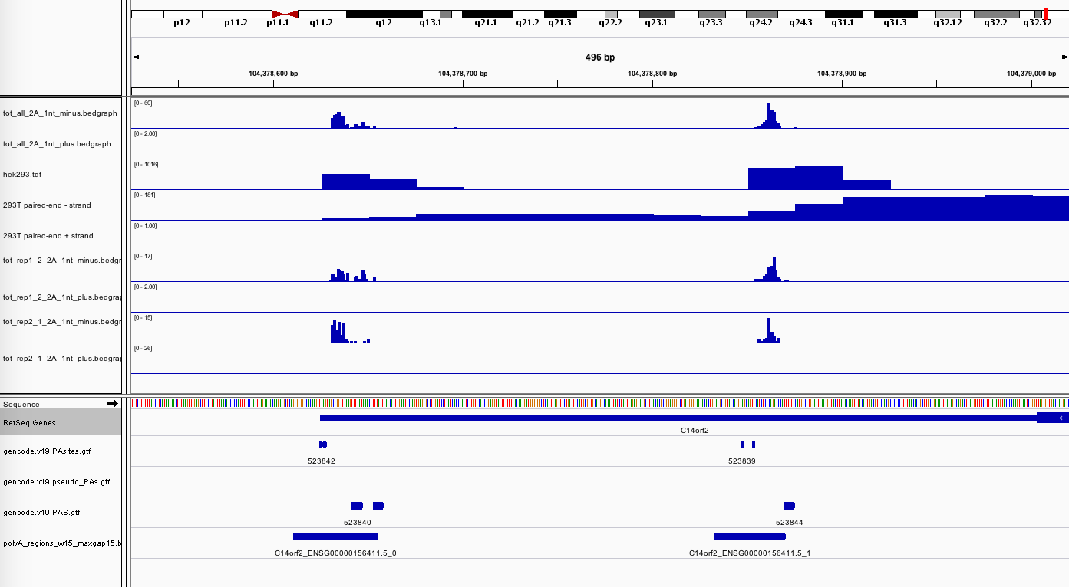
C14orf2 3’UTR
Two approximately equally expressed polyA isoforms in 293/293T cells.
The upstream isoform has a single polyadenylation signal sequence (PAS)
Full UTR is < 500 nt

Slide 55
Next steps
Clone in new gene block with
Use Gibson assembly to build large (!) libraries of construct sequences with randomized nucleotides close to the polyA site
Assay with “3’ RACE - Seq”
Build machine learning model!

Slide 56
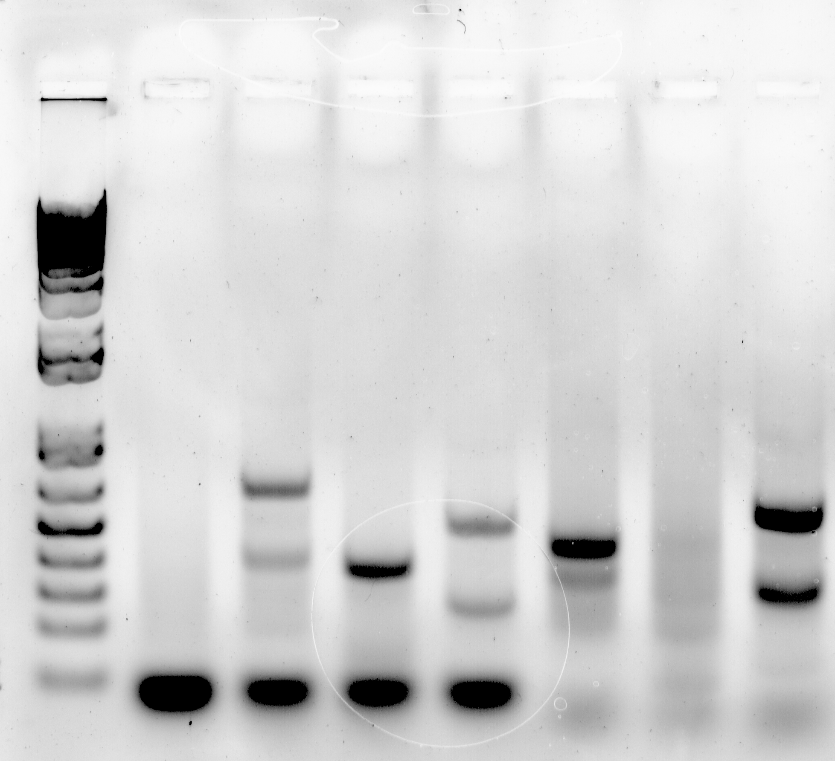
3’ RACE
delPAS1 (EcoRI-BamHI)
C14orf2 (from WT construct sample)
delPAS1 (EcoRI-AgeI)
No transfection
Full construct
ACTB
TMEM59
WT construct uses the second polyA site in C14orf2, as well as another site that is part of the plasmid, but not PAS1.
Deleting PAS1 leaves clean 2 site polyA pattern!

Slide 57
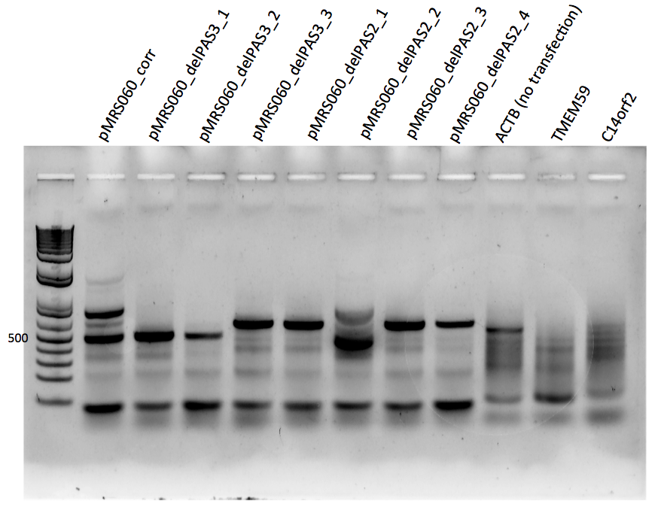
3’ RACE
3 polyA sites, not 2!
First polyA site disfavored

Slide 58
New construct
Deleted polyA site 1, now using sites 2/3

Slide 59
ROC curves
red – naïve analysis
green – Negative-binomial
blue – BUM-HMM
 | ∆P_{stop} | Negative-Binomial | BUM-HMM
AUC | 0.679 | 0.689 | 0.663
AUPR | 0.685 | 0.685 | 0.666

Slide 60
PR curves
red – naïve analysis
green – Negative-binomial
blue – BUM-HMM
 | ∆P_{stop} | Negative-Binomial | BUM-HMM
AC | 0.765 | 0.762 | 0.760
Secondary struct | 0.752 | 0.772 | 0.757
Both statistical methods are much better at identifying A/C bases as modified without making any mistakes

Slide 61
# of perfectly called A/C’s
 | ∆P_{stop} | Negative-Binomial | BUM-HMM
Yeast 18s rRNA | 7 | 58 | 52
Mouse 7SK | 8 | 29 | 18
Mouse U2 snRNA | 17 | 21 | 1

Slide 62
Need better gold standard
Identification of accessible bases by solvent accessible surface area from crystal structure leads to much better identification of DMS-modifiable bases.
Zubradt et al Nat Meth 2016, Rouskin et al. Nature 2014

Slide 63
Conclusions
Statistical methods are needed to identify modified bases in chemical probing experiments for use in structure predictions
Chemical probing data do not follow a Poisson distribution, as had been assumed by several previous reports
Tentative: Negative-binomial based identification of modified bases is more sensitive than naïve analysis and the one recently published replicate-aware analysis method when not allowing any false-positives
Tentative: Negative-binomial modeling is better than the empirical distribution used in BUM-HMM for short RNAs

Slide 64
Future directions
Better gold standard
Test more RNAs
Test for differential modification
What are the best available gold-standard data?
Do negative binomial constraints improve structure prediction?

