Slide 1
Peak calling using different controls
Jinrui Xu
12/01/2016
P2 tech

Slide 2
modERN ChIP-Seq: TF is fused with a GFP
a: reads from IP (GFP-Antibody)
a’: reads from DNA input
Control experiments
Experiment 1: wt-fly (no GFP)
b’’: reads from IP (GFP-Antibody)
b’: reads from DNA input
Experiment 2: mt-fly with nls-GFP expressed
c’’: reads from IP (GFP-Antibody)
c’: reads from DNA input

Slide 3
Principle steps of the new method
Use SPP to detect peaks from a/a’
Use b’’ and b’ information to refine the SPP peaks

Slide 4
Peak refinement
Step1: normalizing sequencing depth, so that a and a’, b’’ and b’ comparable, respectively
Take a and a’ as an example,
Remove the reads at SPP peak regions from a and a’
Remained reads of a divided by that of a’ is the scaling factor for a and a’, f_{a/a’}

Slide 5
For each peak, count the number of reads (e.g. n.a, n.a’) at the peak region in a and in a’
Down normalize between n.a and n.a’ using the scaling factor f_{a/a’}
i.e. if f_{a/a’} < 1, then n.a’*f_{a/a’}
Down normalize between n.b’’ and n.b’

Slide 6
Step2, significance of the peak
Build the contingency table of a peak with normalized read counts
n.a vs n.a’
n.b’’ vs n.b’ (normalized read counts)
Use fisher exact test to calculate the p-value of the table
Calculate p-values for all SPP peaks
Use qvalue to get peaks with FDR = 0.01

Slide 7
Down normalization reduces statistical power significantly
Bayesian method to avoid losing power
Bayesian version of the fisher exact test

Slide 8
Comparison of peak callings
a/a’
a/b’’
Fisher exact test (FDR=0.01)
Bayesian method (FDR=0.01)
Bayesian method (FDR=0.05)

Slide 9
Validation
Correlation btw TF expression (RPKM) and number of its peaks
a/a’
rho 0.058, p =0.25
a/b’’
rho 0.25, p =0.0019
Fisher exact test (FDR=0.01)
rho 0.32, p =8.9e-5
Bayesian method for the test (FDR=0.01)
rho 0.31, p =0.0001
Bayesian method for the test (FDR=0.05)
rho 0.29, p =0.0003

Slide 10
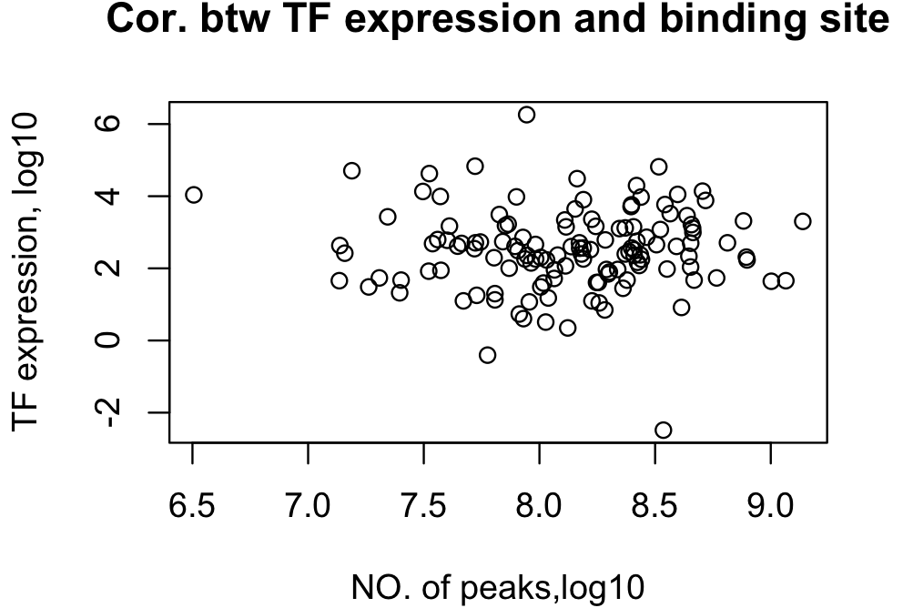
a/a’

Slide 11
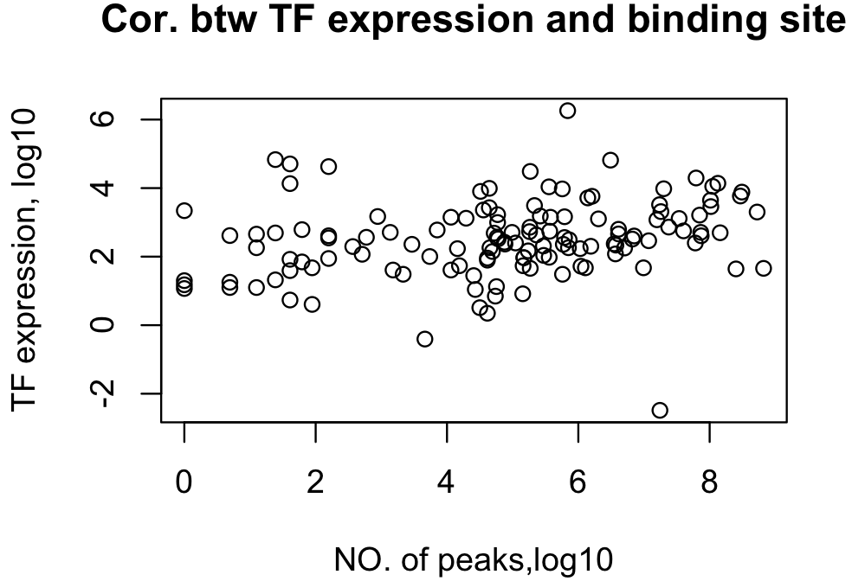
Fisher (FDR=0.01)

Slide 12
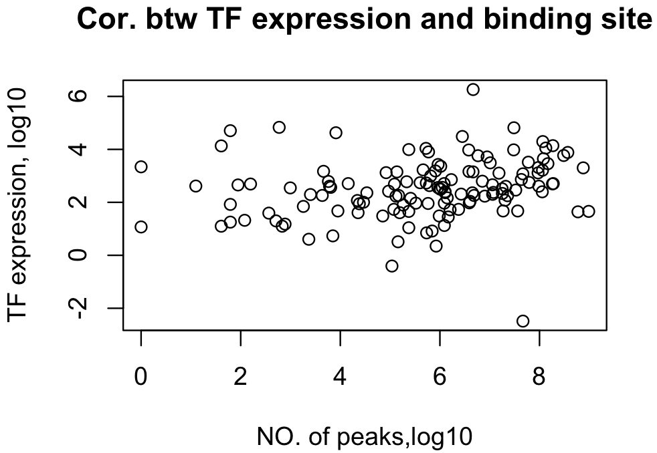
Bayes (FDR=0.05)

