Slide 1
Temporal dynamics of collaborative networks in large scientific consortia
Daifeng Wang, Ph.D.
Associate Research Scientist, Gerstein Lab
Computational Biology and Bioinformatics
Yale University

Slide 2
Increase in Consortium Science
Notes:
Figure 1. I[2_TD$DFF]Numbers of Consortium-Related Papers. (A) Numbers of PubMed indexed papers from 2004 to 2015. Blue circles represent the number of consortia papers indexed by PubMed (i.e., the author names on the paper appear as ‘consortium’ or ‘consortia’) per year from 2004 to 2015. The red squares represent the total number of papers indexed by PubMed per year from 2004 to 2015. (B) Paper distribution over author numbers driven by the ENCyclopedia Of DNA Elements (ENCODE) consortium until 2015. The x-axis represents the ranges in terms of numbers of authors per paper and the y-axis displays the numbers of ENCODE (blue) and non- ENCODE (red) papers. (C) Number of papers driven by ENCODE consortium from 2004 to 2015. The y-axis displays the numbers of ENCODE (blue) and non-ENCODE (red) papers in each year from 2004 to 2015. The non-ENCODE papers were those that were not directly funded by ENCODE but used ENCODE data.

Slide 3




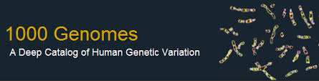
Big Genomic Data from large scientific consortia
Human | Consortium
hundreds of cell types
dozens of tissues
> 100 cancer types
various life stages
7.3 billion people
ENCODE (Encyclopedia of DNA Elements) Consortium
(> 300 cell types)
Genotype-Tissue Expression (GTEx)
(> 40 tissues)
The Cancer Genome Atlas (TCGA)
(> 30 cancer types)
(13 developmental stages,
8-16 brain regions)
The 1000 Genomes Project
( 1092 individuals)
Animals, Plants, Microbes, …
Notes:
tons of public available genomic data from large scientific consortia make us develop independent research programs
https://followthedata.wordpress.com/2014/06/24/data-size-estimates/

Slide 4
Genomic data sizes from large scientific consortia
Notes:
TCGA is the largest single project in the visible sequence universe to date.
TCGA is depicted at the center of the solar system because it integrates DNA, RNA-Seq, miRNA, epigenomic, and clinical data.
Currently there is over a Petabyte of TCGA data deposited in the CGHub cancer genomics repository (https://cghub.ucsc.edu/summary_stats.html).
This scale dwarfs its closest competitors which are shown as planets in orbit:
1000G 222 TB http://www.ncbi.nlm.nih.gov/bioproject/28889
ADSP 68 TB http://www.ncbi.nlm.nih.gov/bioproject/202226
NHGRI LSSP 40 TB http://www.ncbi.nlm.nih.gov/bioproject?term=NHGRI%20Large%20Scale%20Sequencing%20Program%5BTitle%5D
GTeX 34 TB http://www.ncbi.nlm.nih.gov/bioproject/75899
NHLBI ESP 32 TB http://www.ncbi.nlm.nih.gov/bioproject/165957
HMP 29 TB http://www.ncbi.nlm.nih.gov/bioproject/43021
ARRA Autism 24 TB http://www.ncbi.nlm.nih.gov/bioproject/74861
ENCODE 9 TB http://www.ncbi.nlm.nih.gov/bioproject/63441
Projects just starting now, like 100K Genomes England, may eventually overtake TCGA.

Slide 5
Genome-related consortia

Slide 6
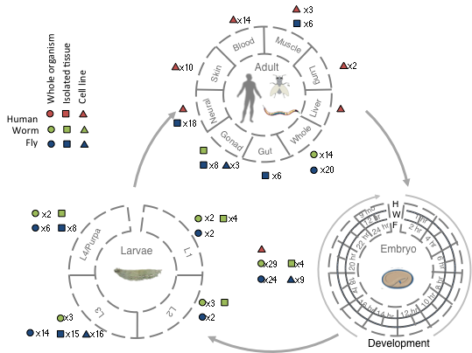
modENCODE/ENCODE data resource
Broad sampling of conditions across transcriptomes of human, worm and fly
  >67 billion reads (575 datasets)
Comparisons
  Poly(A)+ RNA
  embryo & embryonic stem cells
  developmental time course (worm-fly)
Gerstein*, Rozowsky* et al. Nature (‘14)
Notes:
Here, we used modENCODE/ENCODE, two consortia as case study and try to find the collaborative patterns

Slide 7
ENCODE related publications
https://www.encodeproject.org/publications/

Slide 8
With help of Dr. Mike Pazin at NHGRI, identified: 702 community papers that used ENCODE data but were not supported by ENCODE funding &
558 consortium papers supported by ENCODE funding
Then identified 1,786 ENCODE members & 8,263 non-members .
Number of papers relating to ENCODE
<= # Papers
# Authors Year (2004 to 2015)
[Wang et al., TIG (’16)]
Notes:
1 slides from dw encode authors

Slide 9
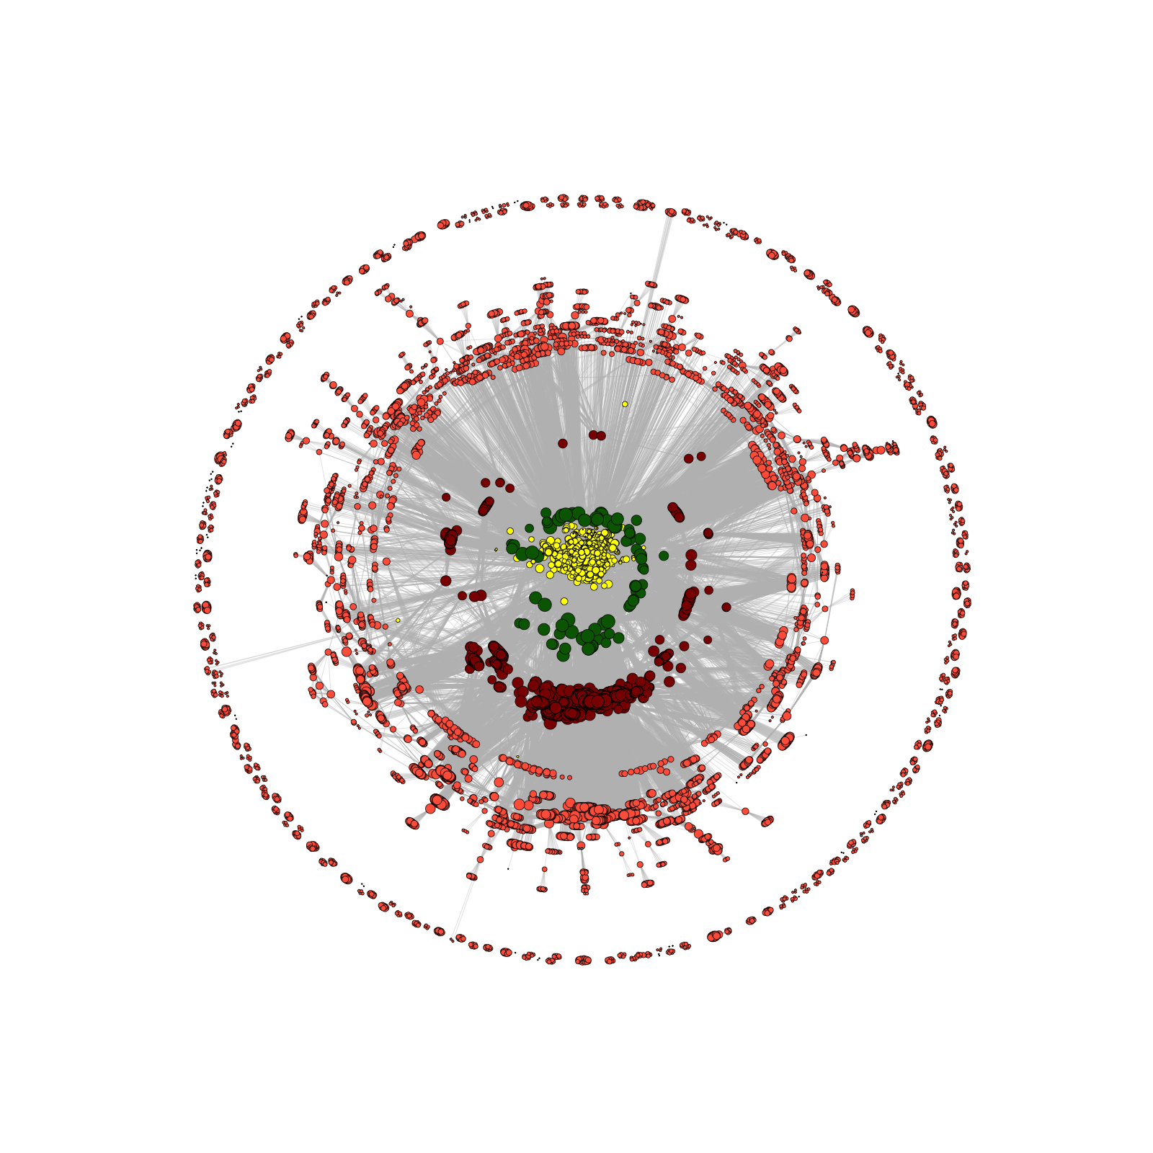
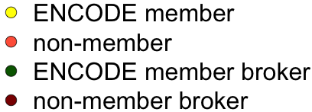
Co-authorship Network of ENCODE members
& Data Users
co-authorship
Researcher B
# of co-authored papers
Researcher A
2014
[Wang et al., TIG (’16)]

Slide 10
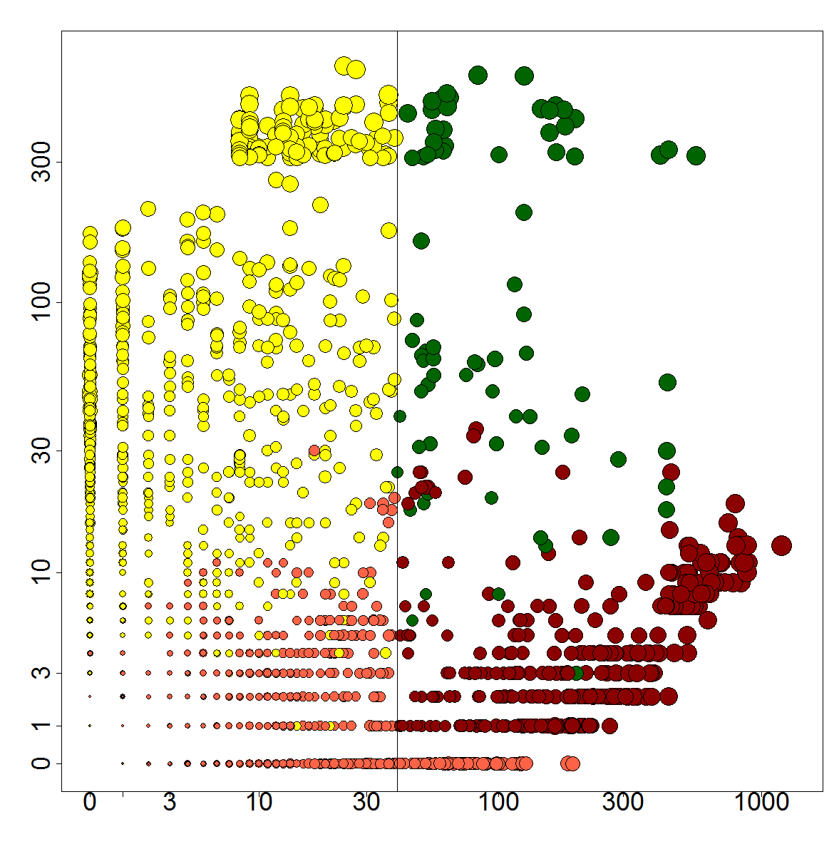
“Brokers” in co-authorship network
Number of member neighbors
2014
Number of non-member neighbors
co-authorship
[Wang et al., TIG (’16)]

Slide 11
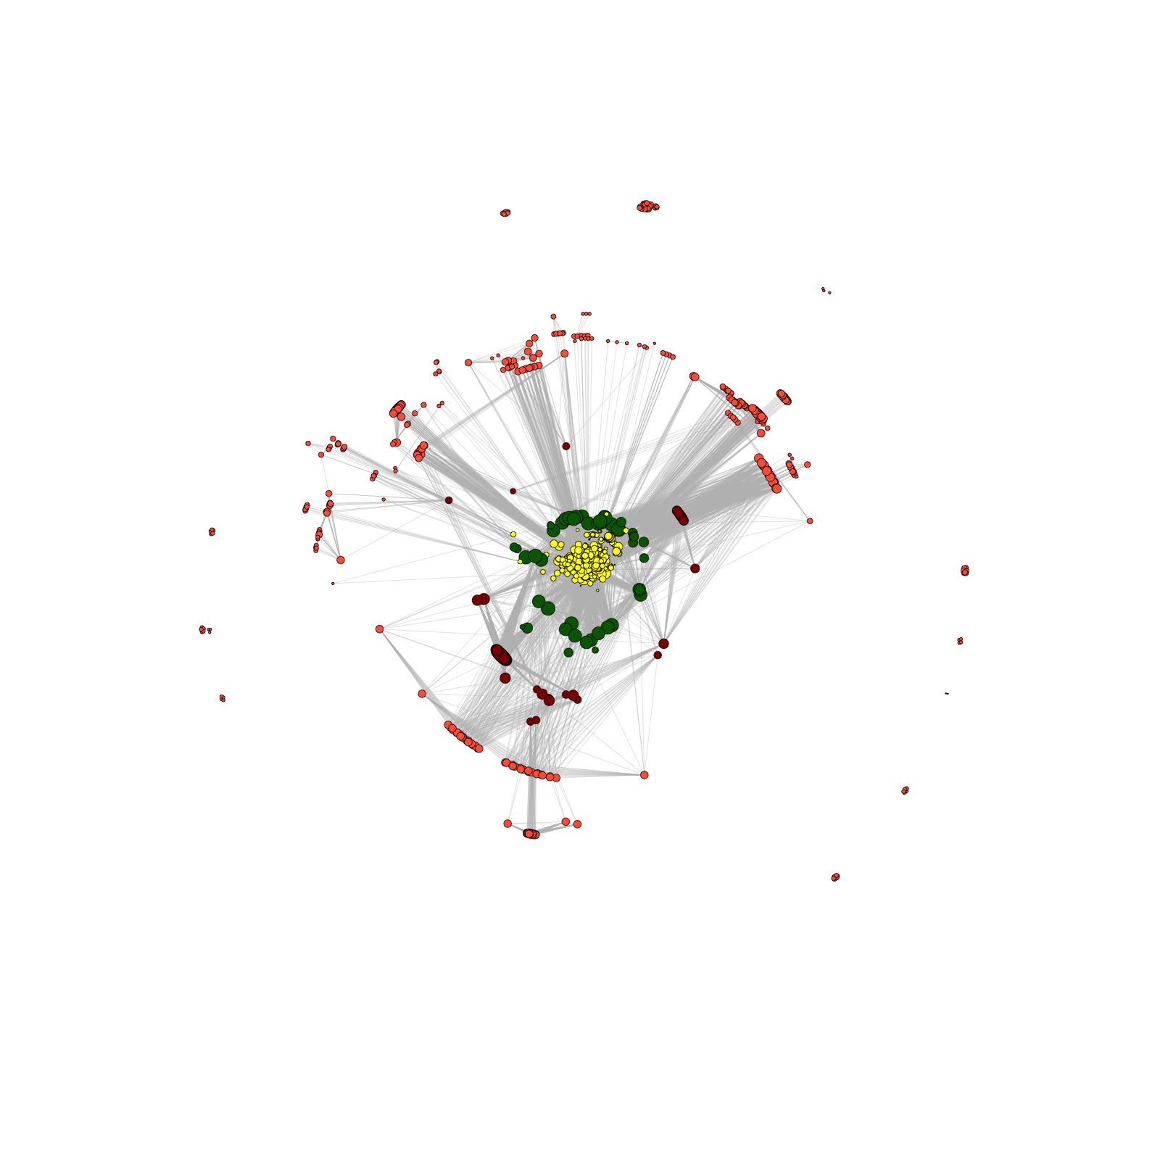
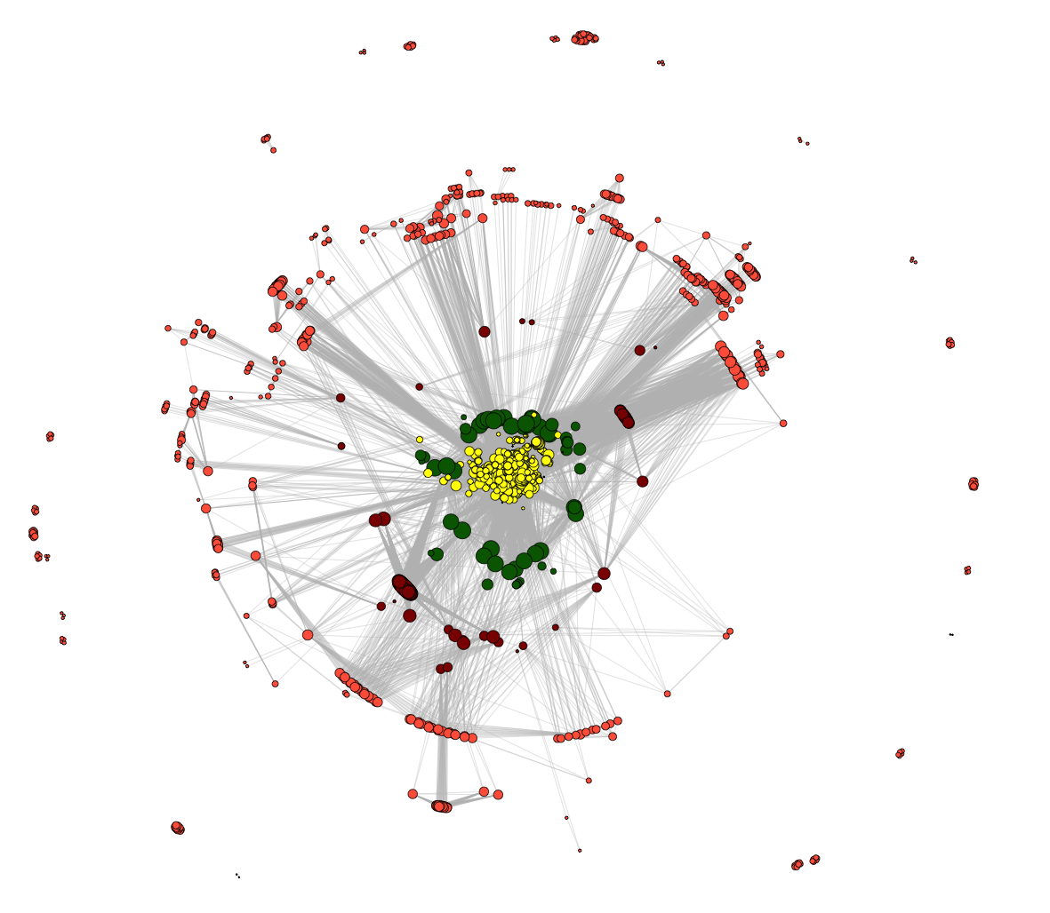
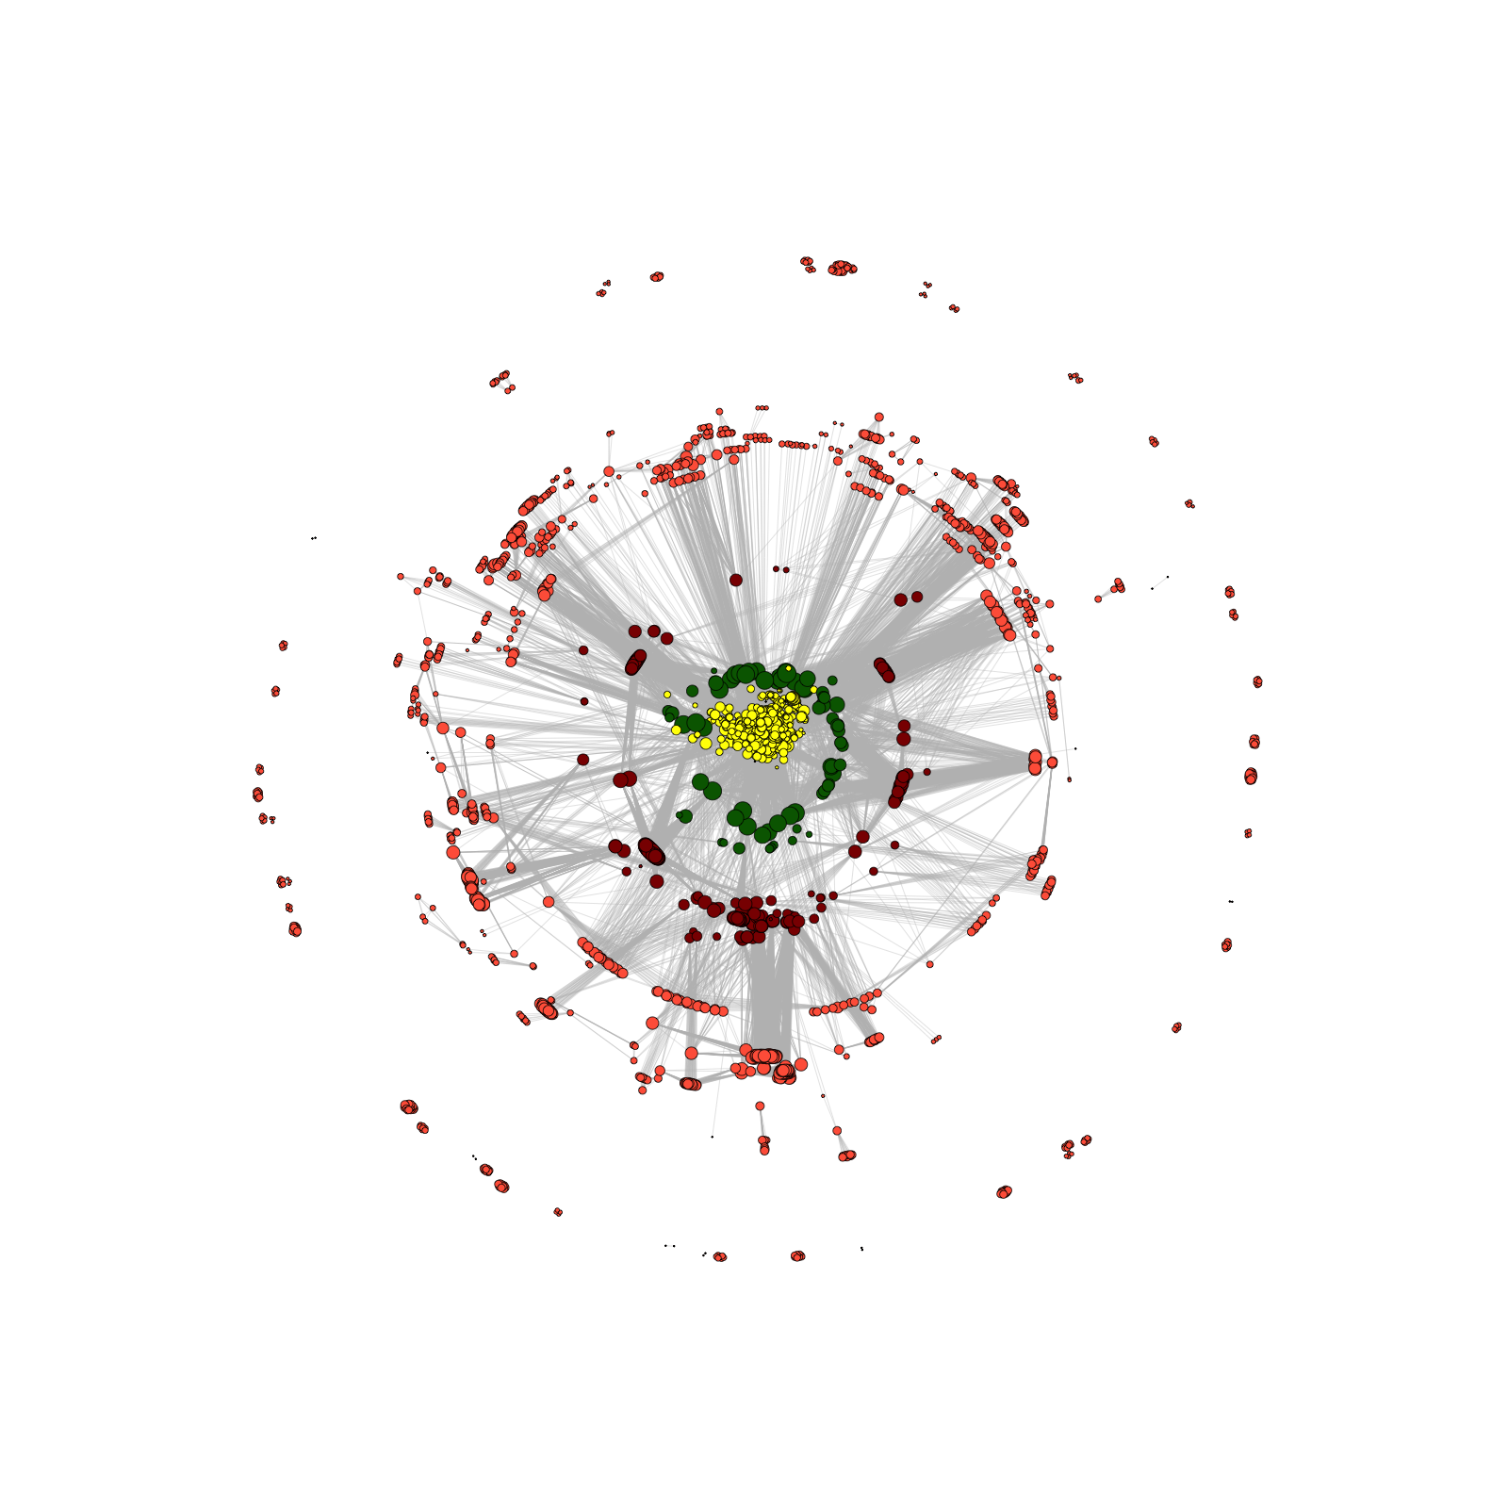
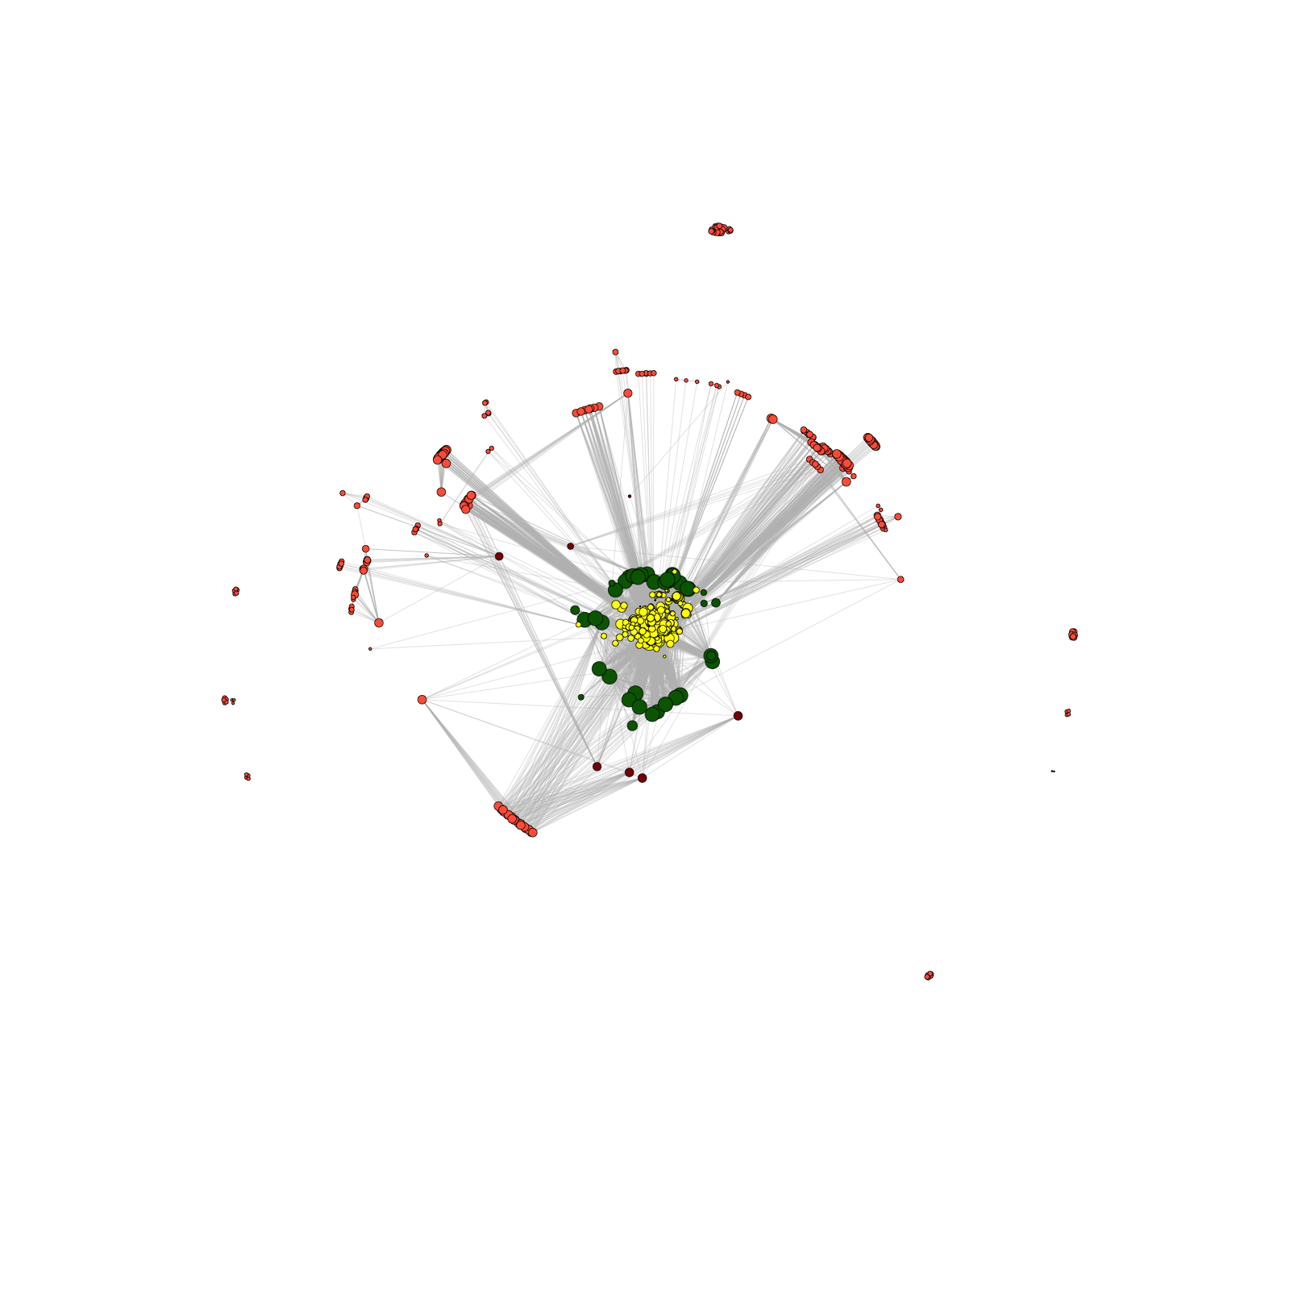
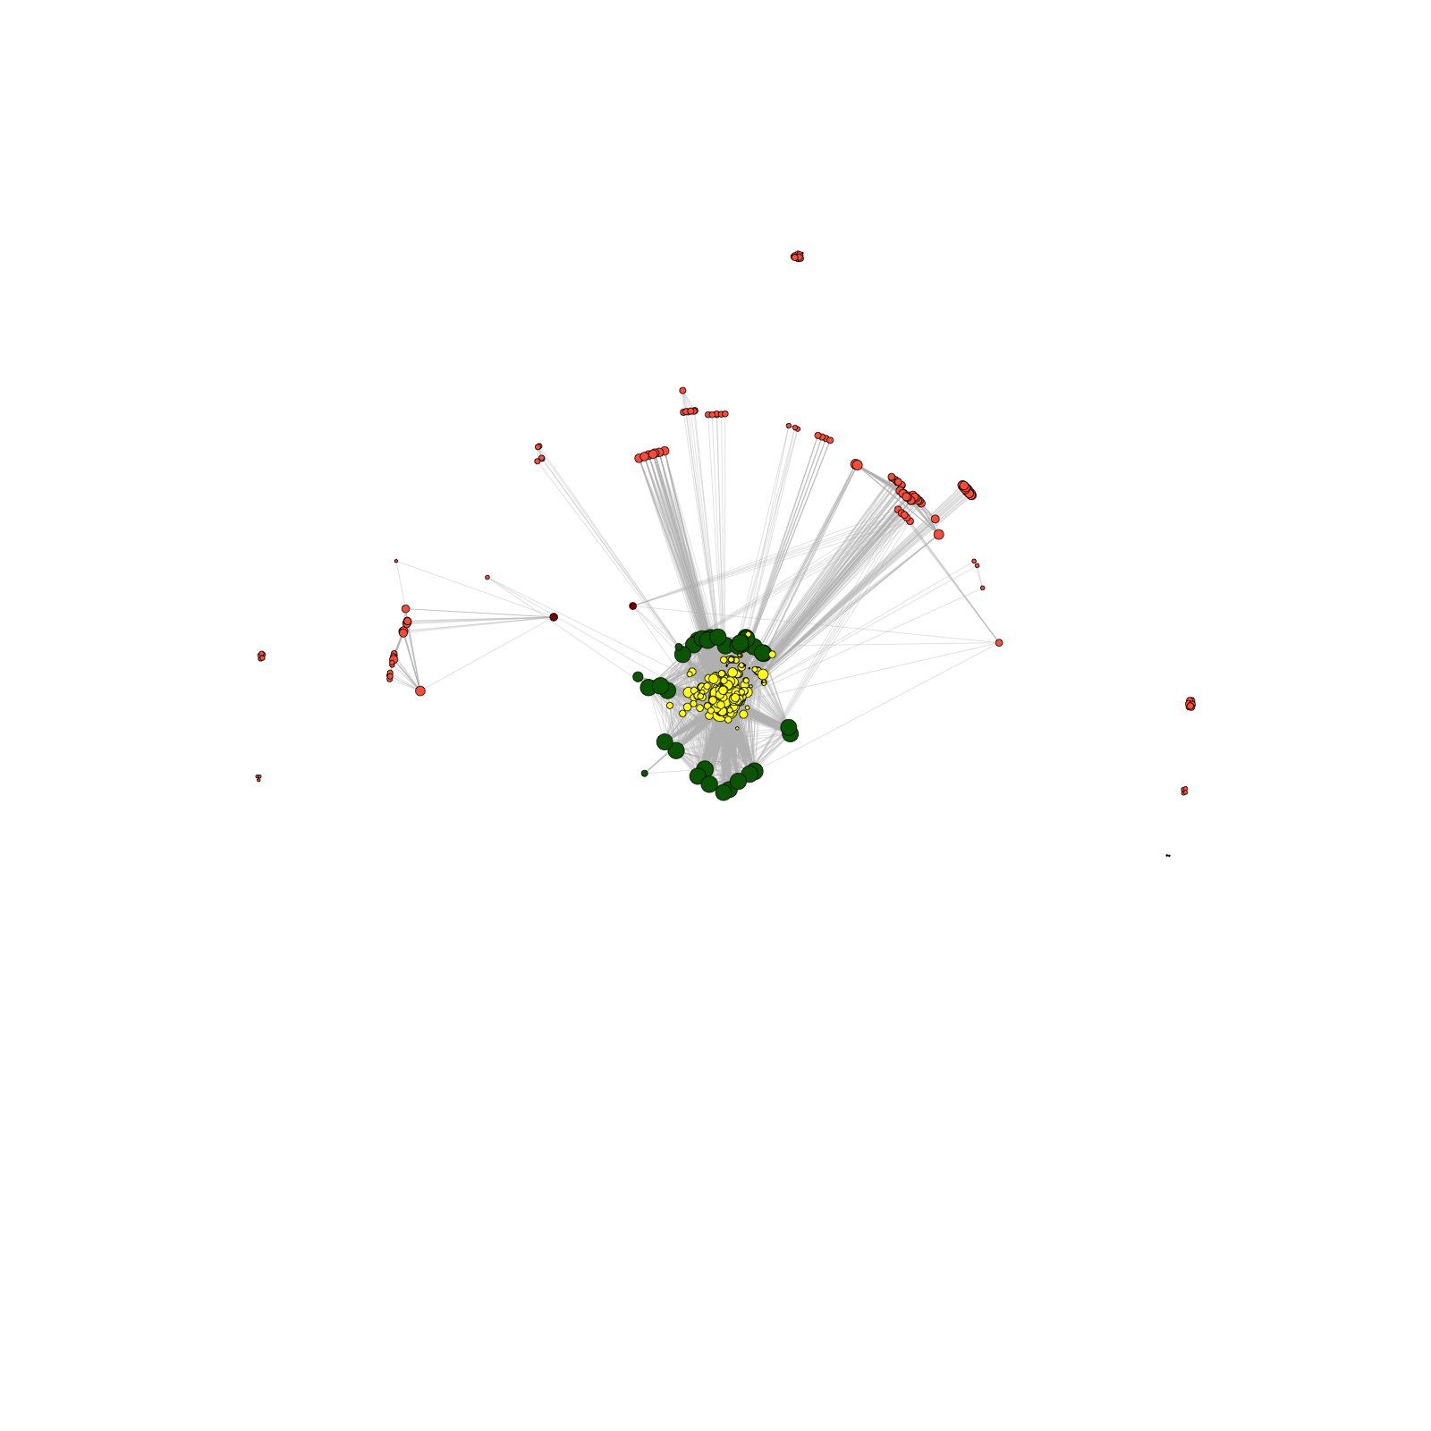
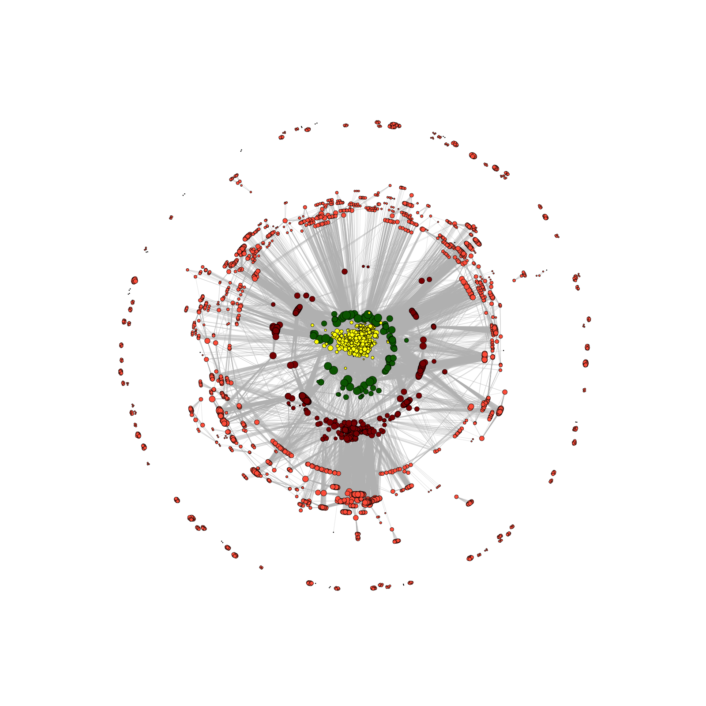
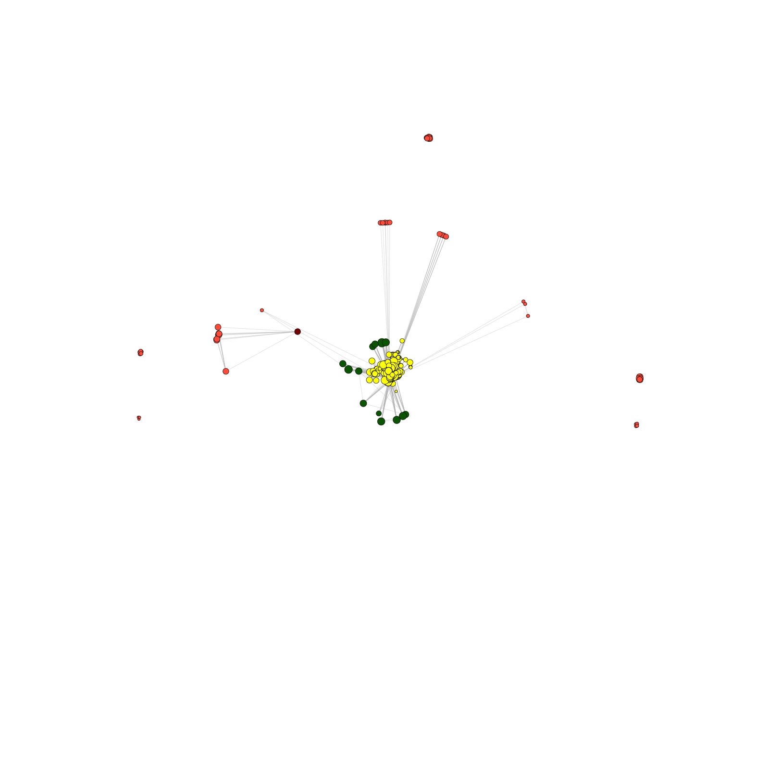
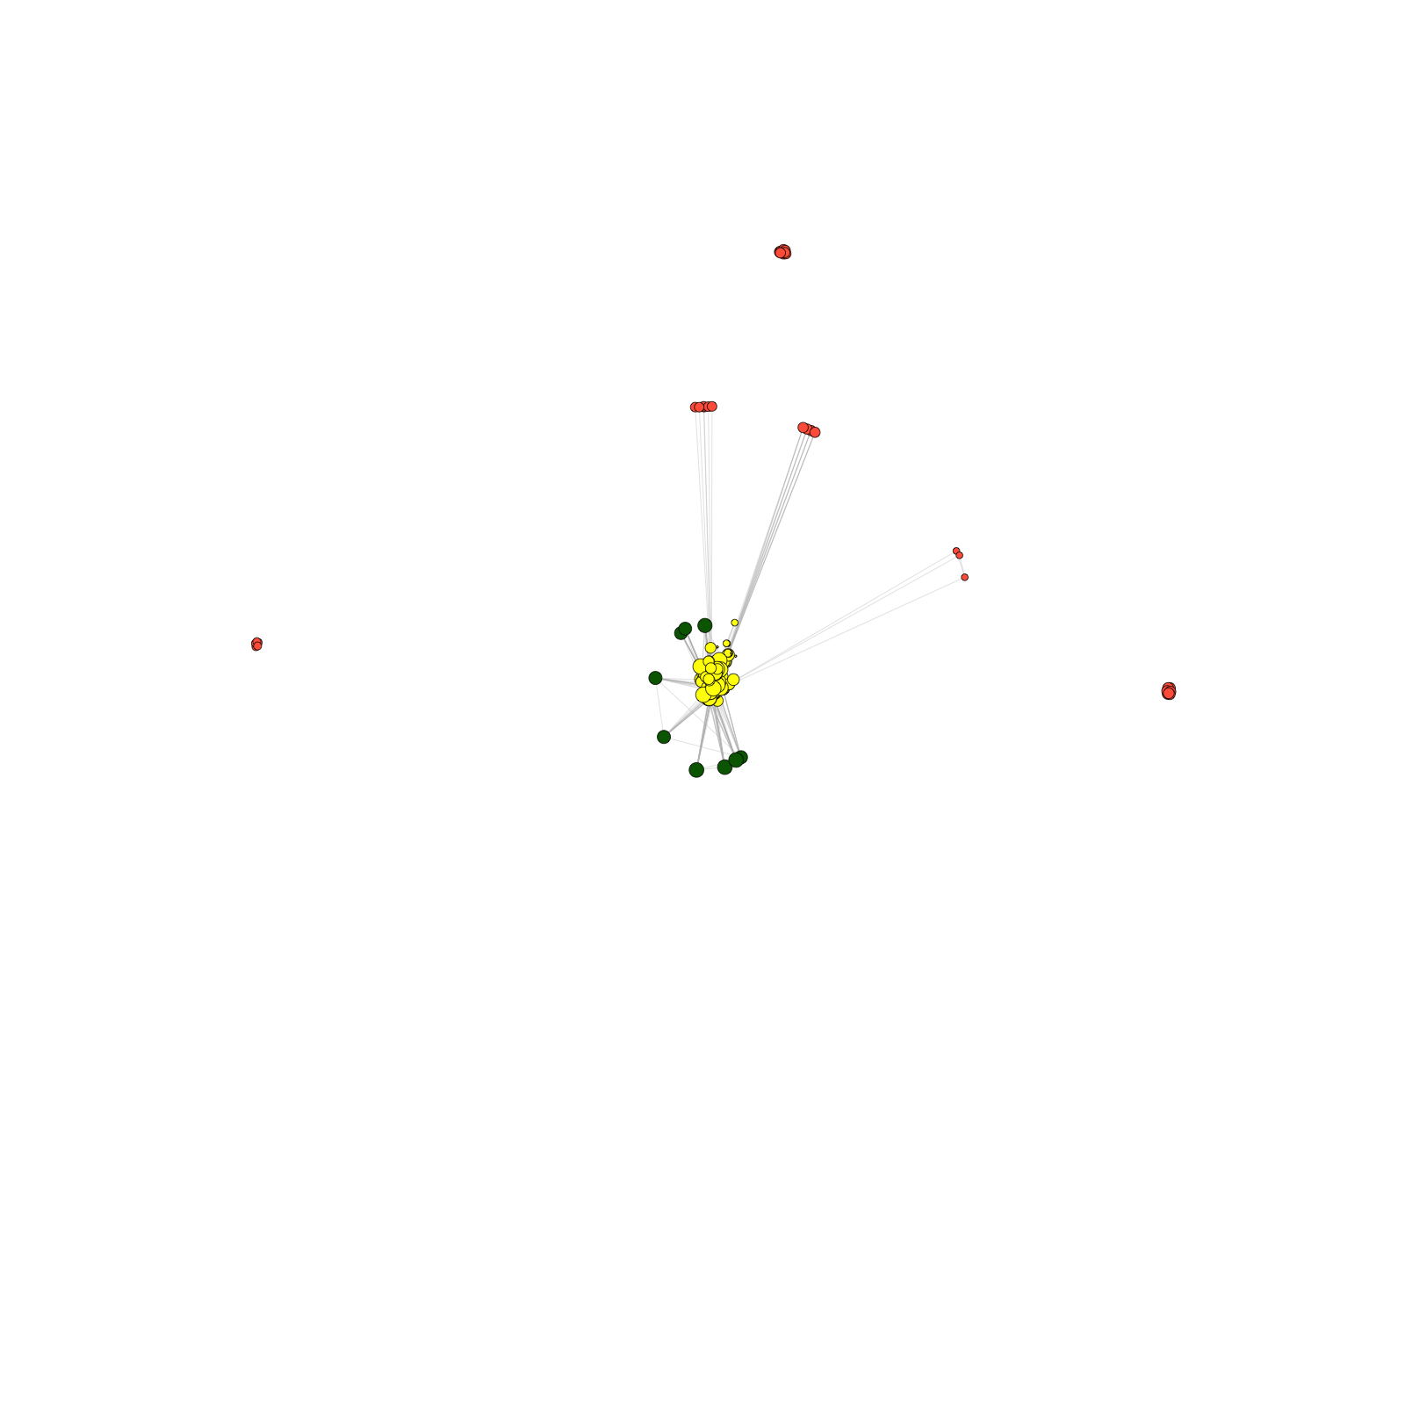
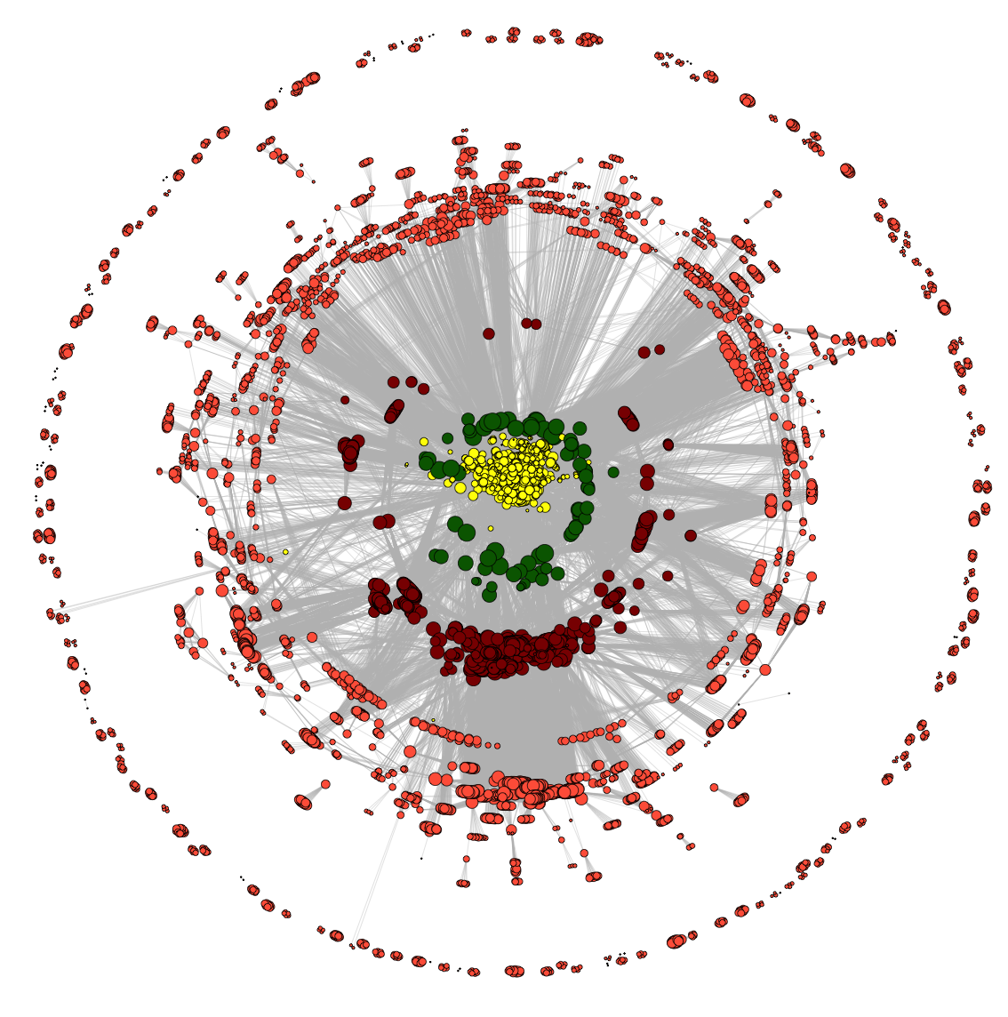
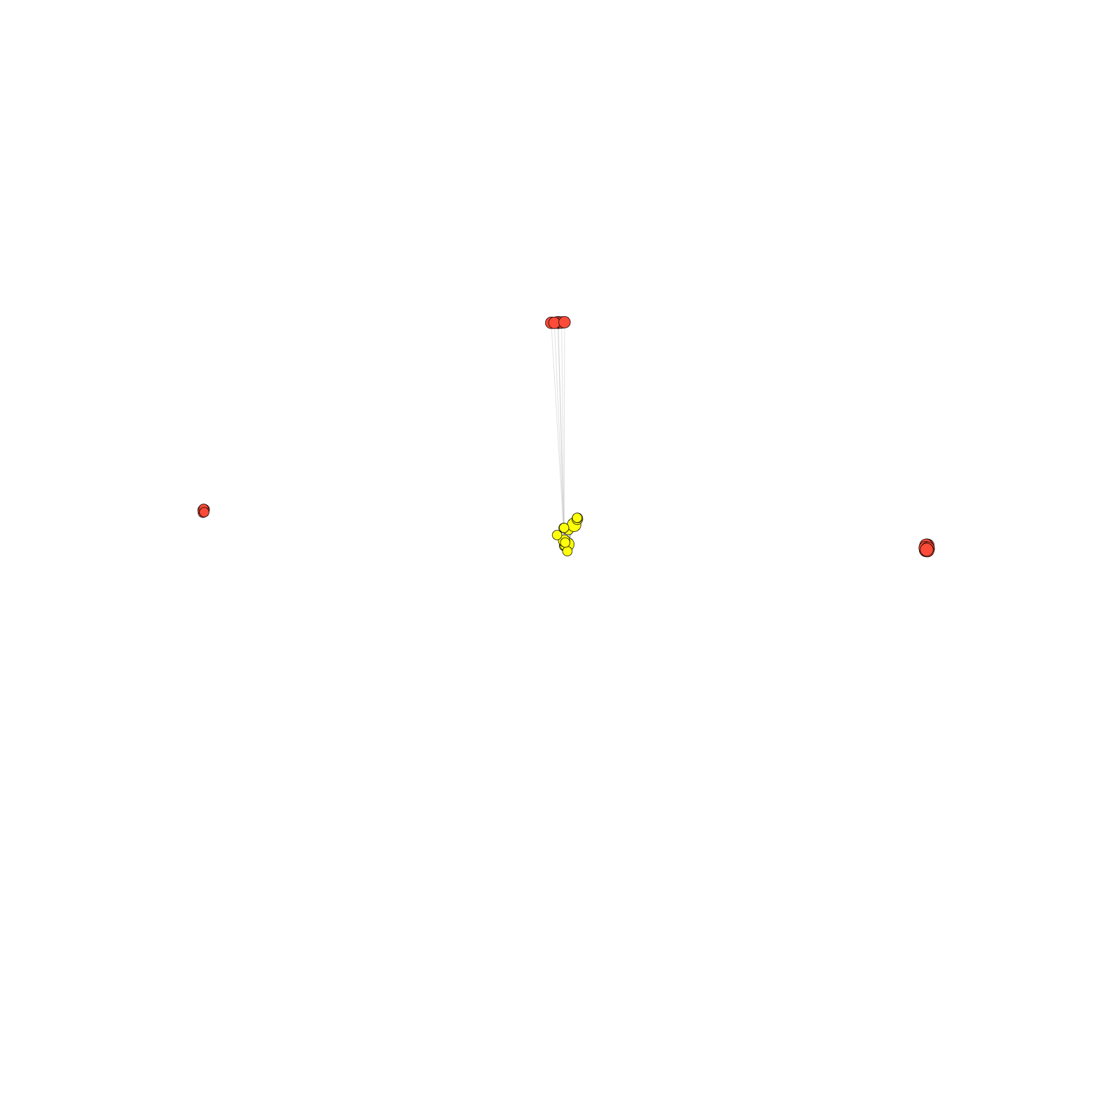
Dynamics of co-authorship network
2009
2010
2008
2011
2007
2012
2006
2005
2013
2004
co-authorship
2014
[Wang et al., TIG (’16)]
Notes:
Add animation

Slide 12
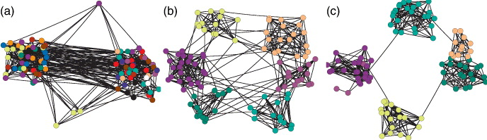
“Modularity” for measuring network division
low
high
Brede, Europhysics Letters, 2010.
Modularity Q: measurement on strength of network division
sum over nodes within a group (module)
normalization
m: total number of edges
edge weight between nodes i and j
=expected edge weight that would go between i and j
Newman, PNAS, 2006.
Notes:
for a single network clustering, we always try to divide nodes into groups / modules such that connections within groups are relatively dense while those between groups are sparse.
then, the modularity has been proposed to measure strength of division using your clustering method. e.g., right clustering is good because modularity is high. Thus, a common clustering strategy is that we can use modularity as objective function, and find the modules that maximize modularity from all possible divisions of a network.
http://www.cs.cmu.edu/~ckingsf/bioinfo-lectures/modularity.pdf

Slide 13
Dynamics of co-authorship network
2009
2010
2008
2011
2007
“Modularity”
2007
2012
2006
2006
2005
2005
2004
2013
2004
2014
co-authorship
2014
co-authorship
[Wang et al., TIG (’16)]
Notes:
Add animation

Slide 14
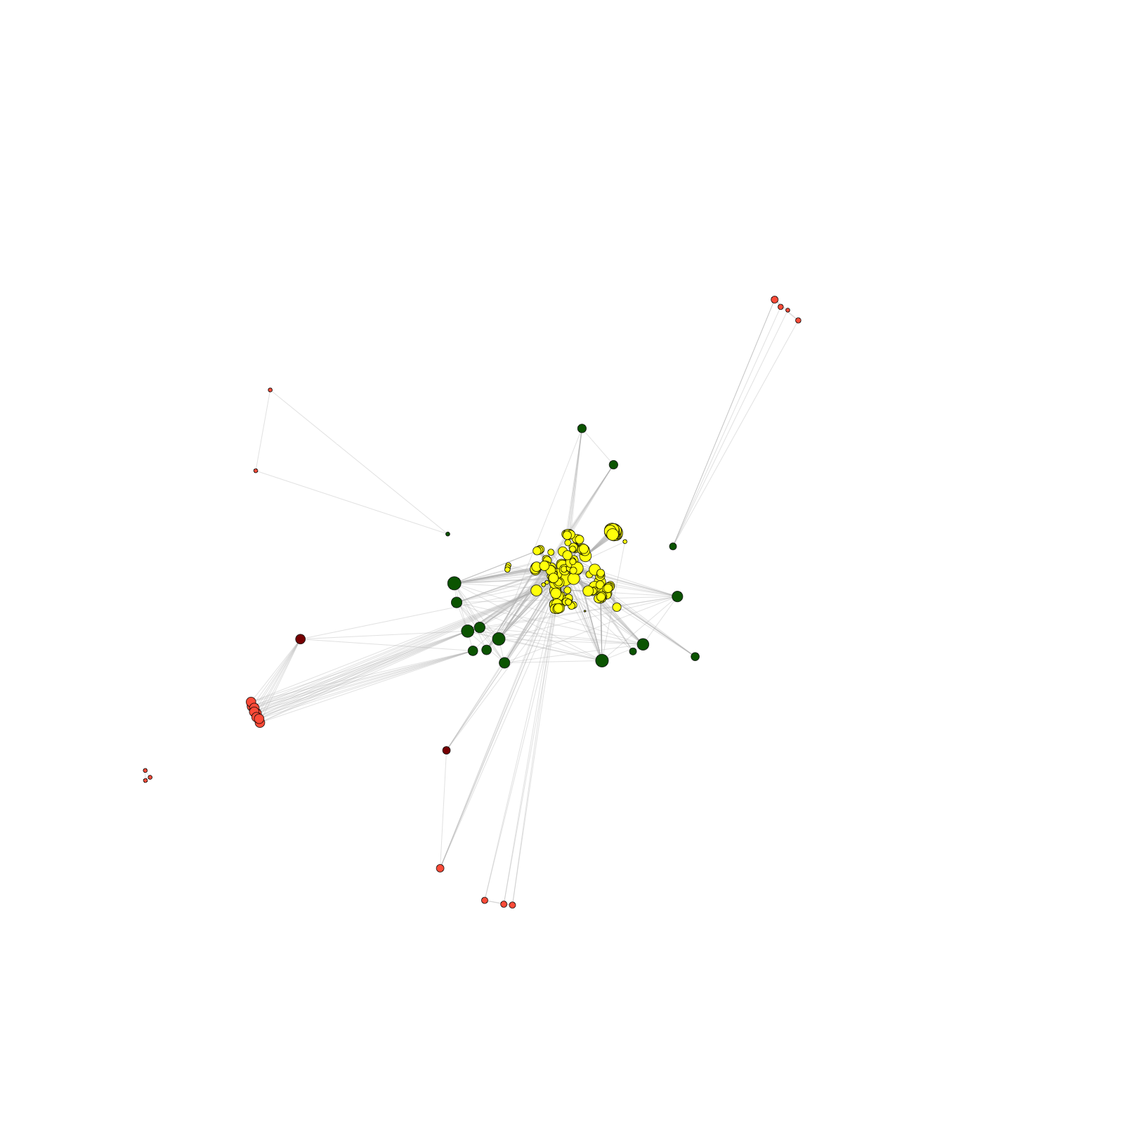
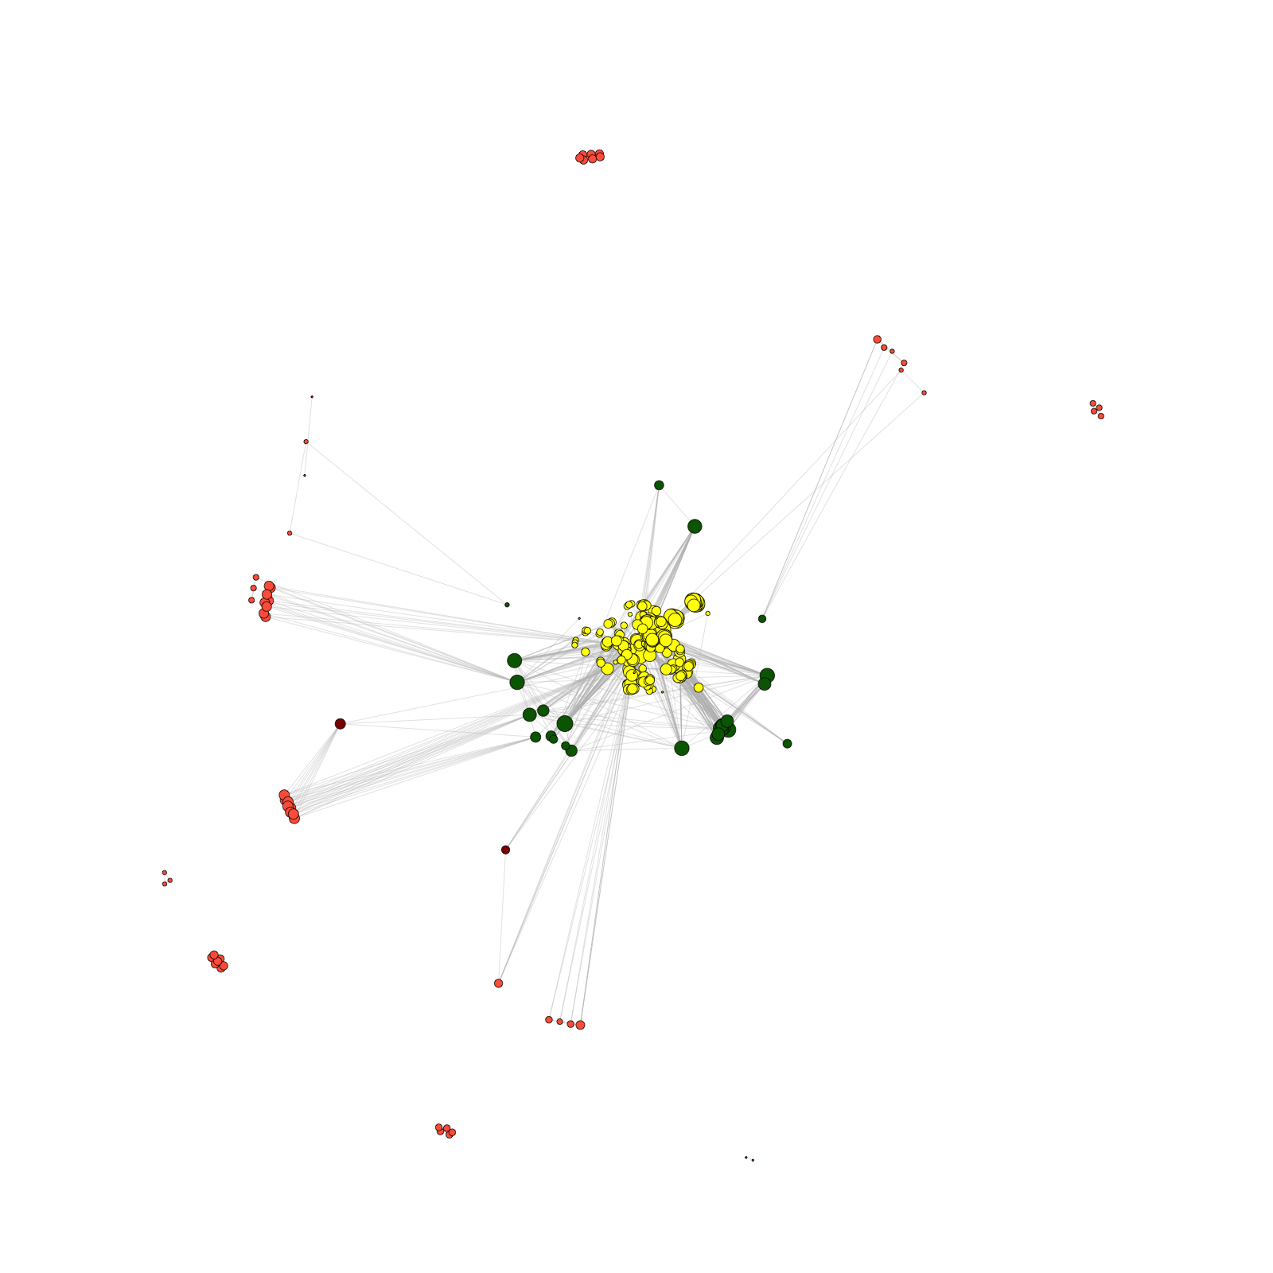
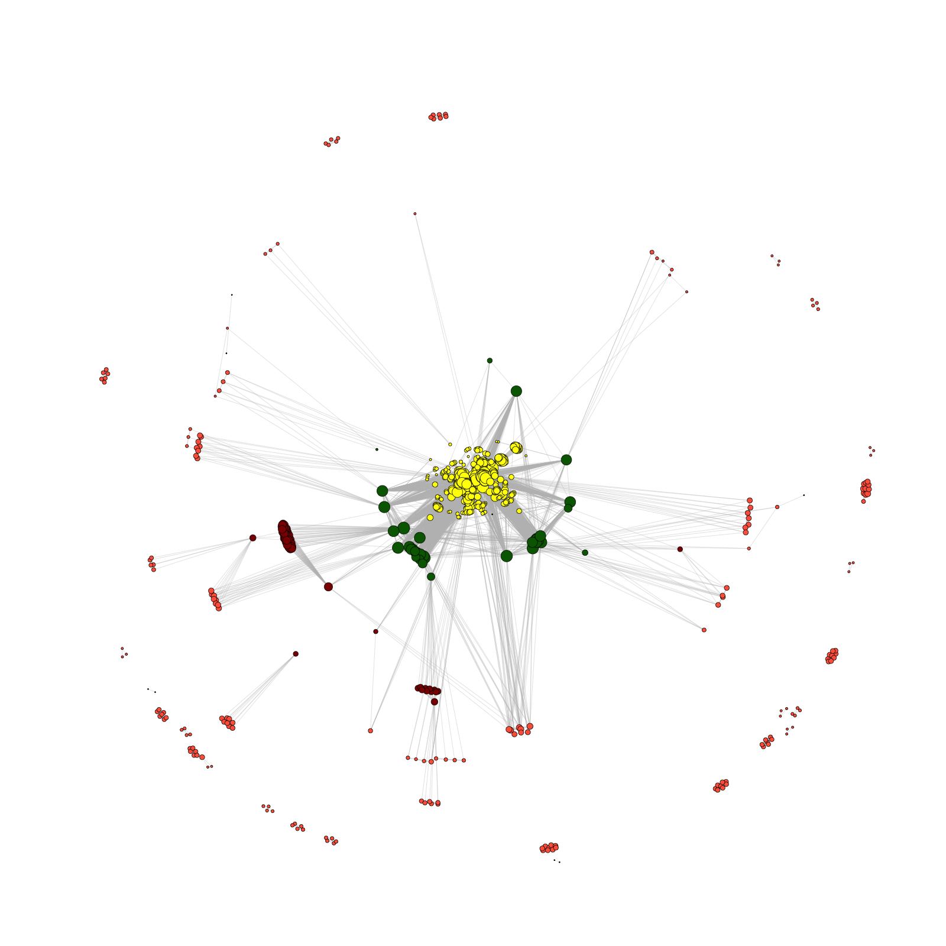
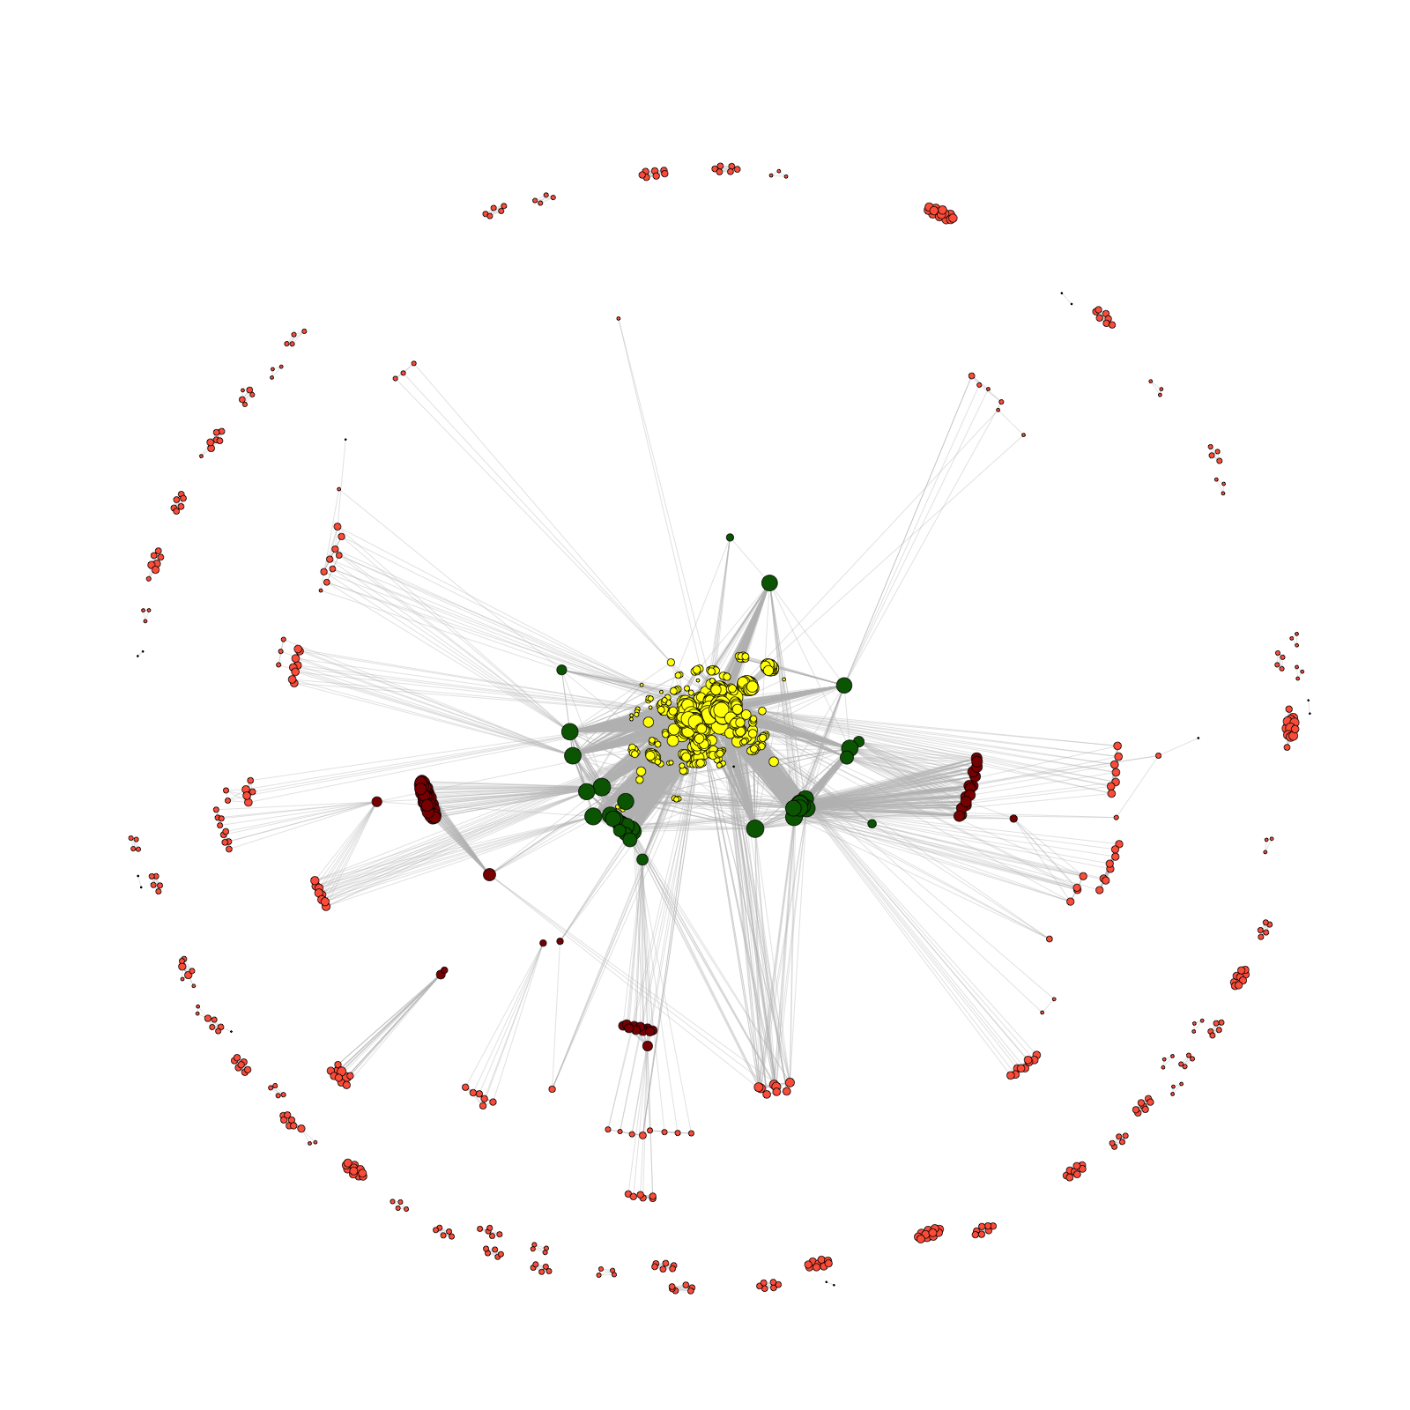
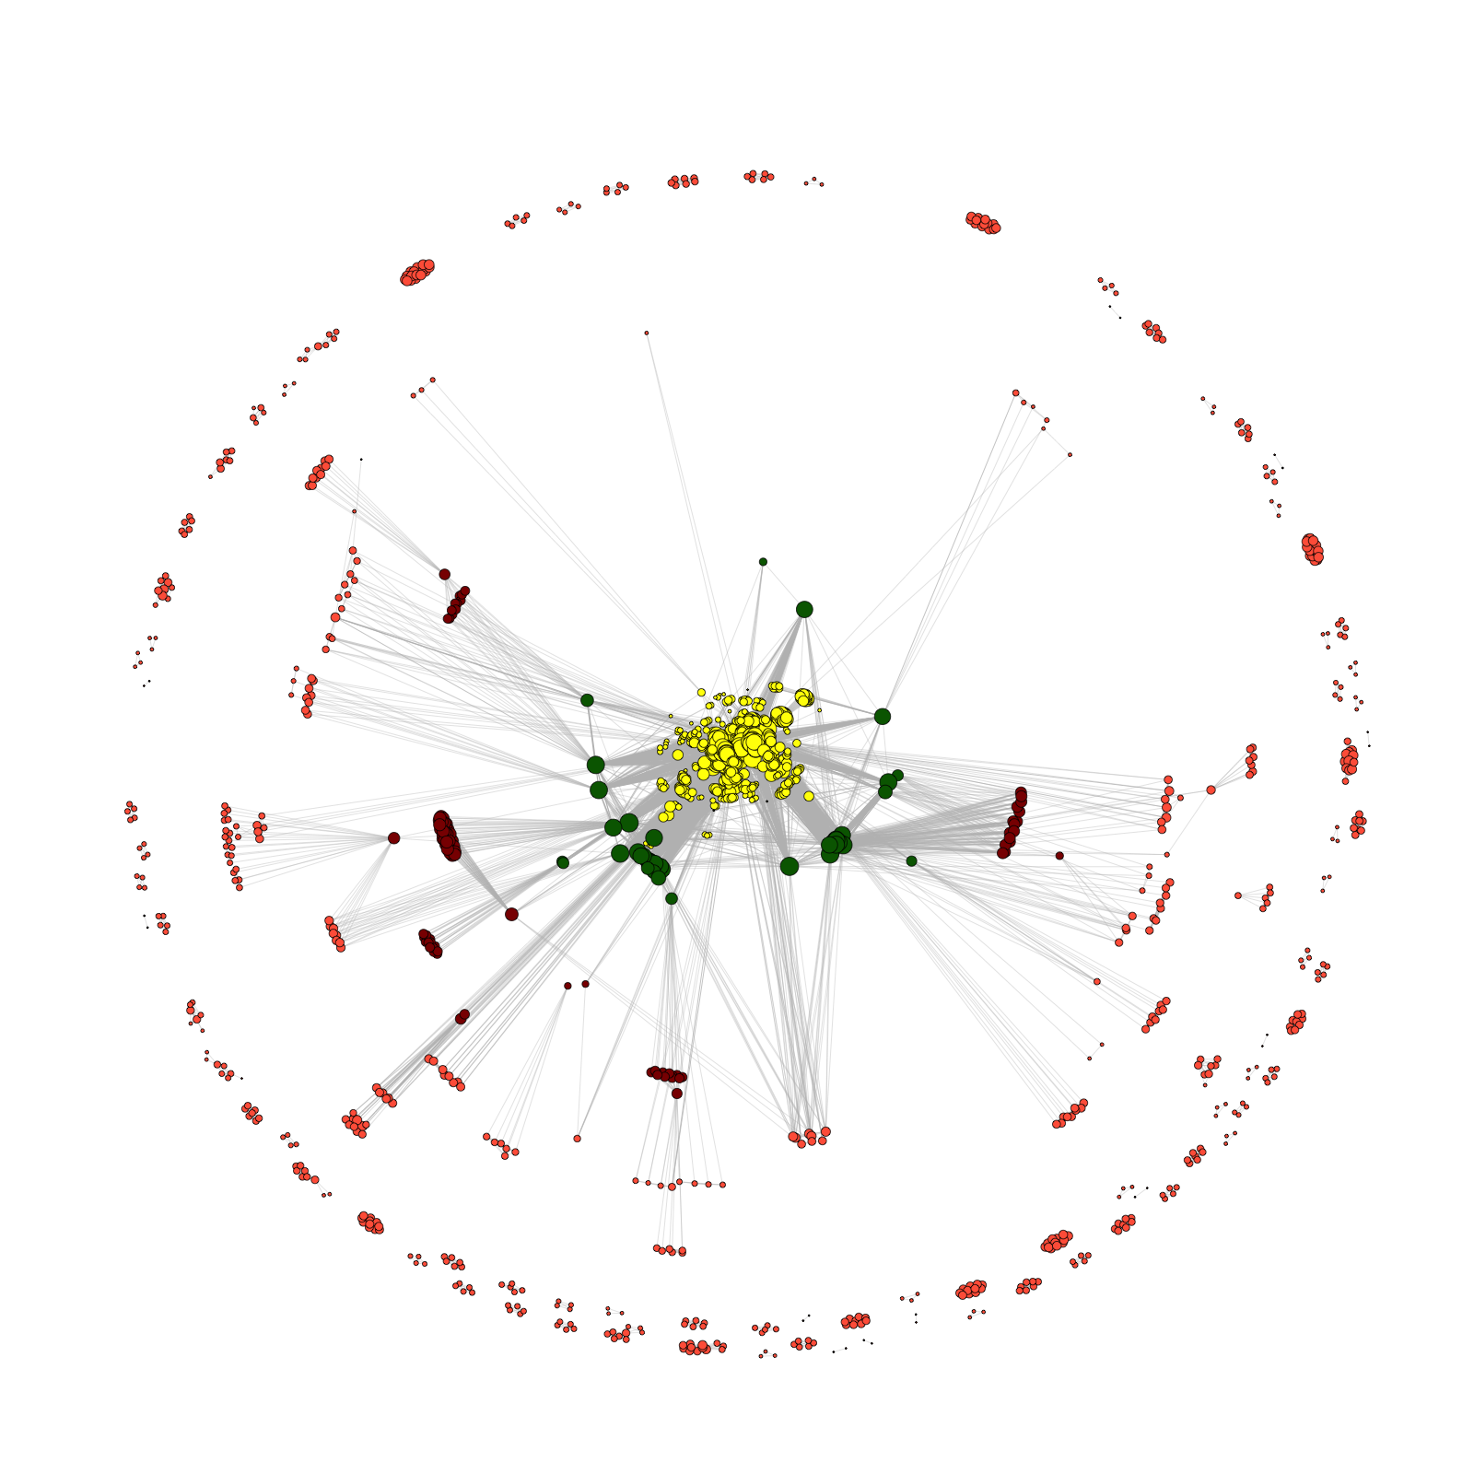
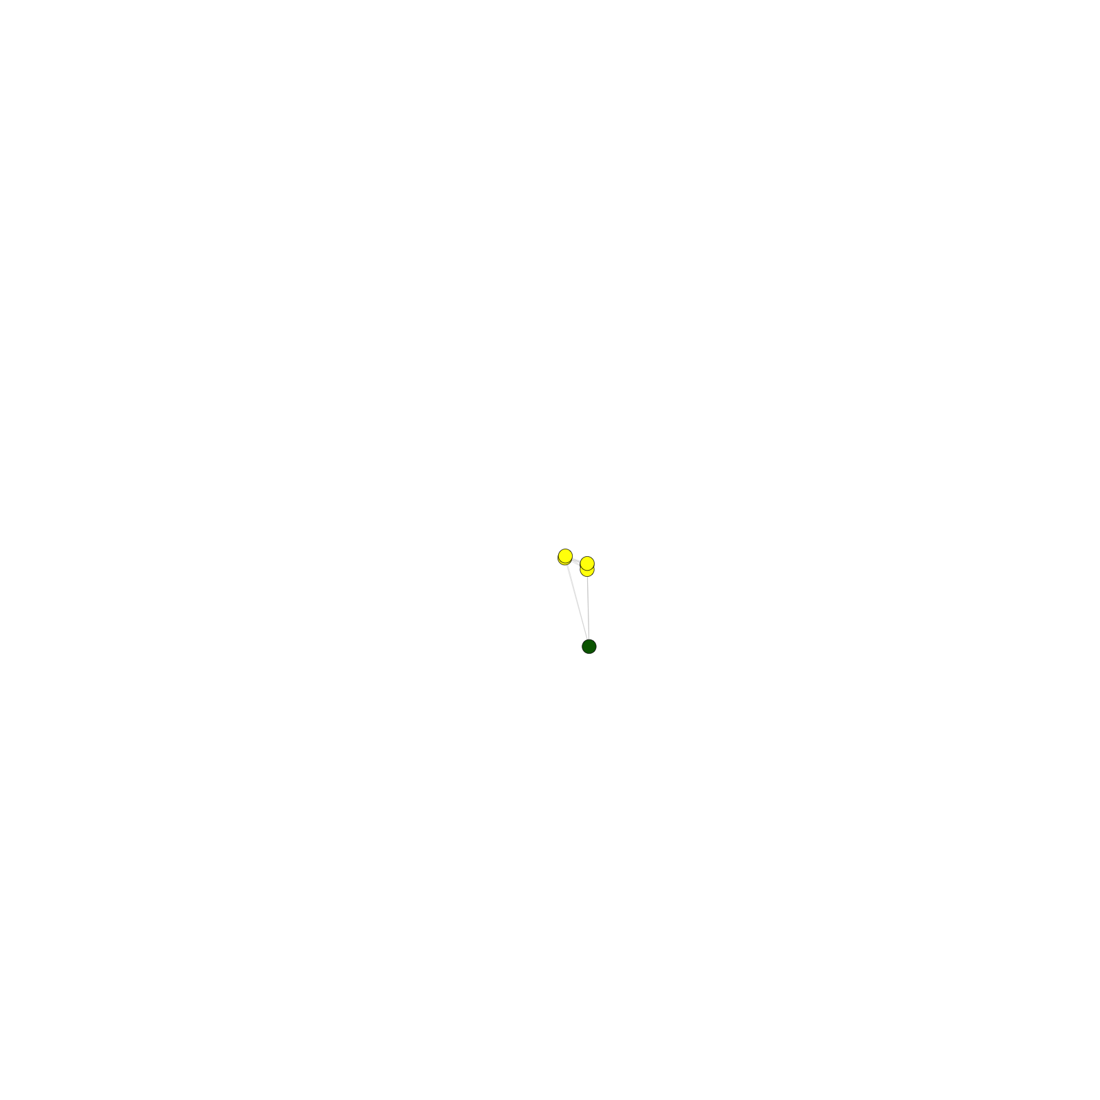
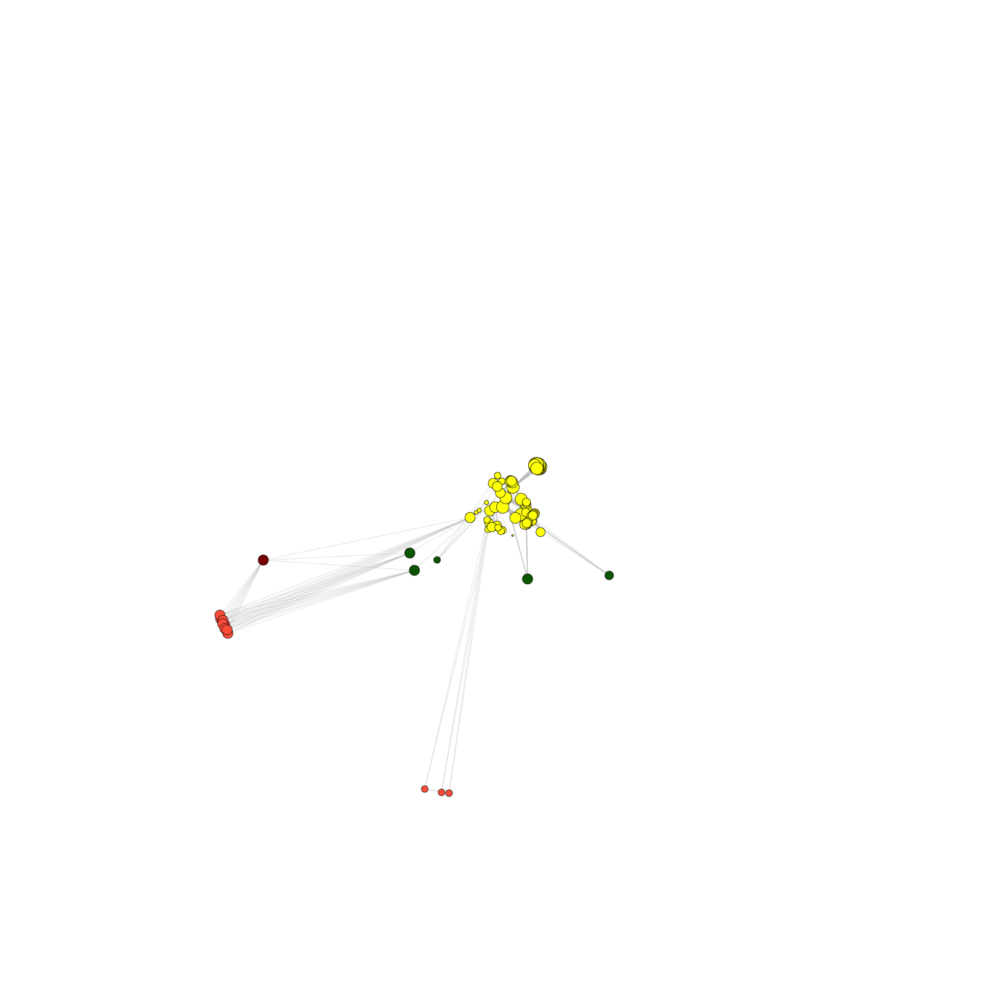
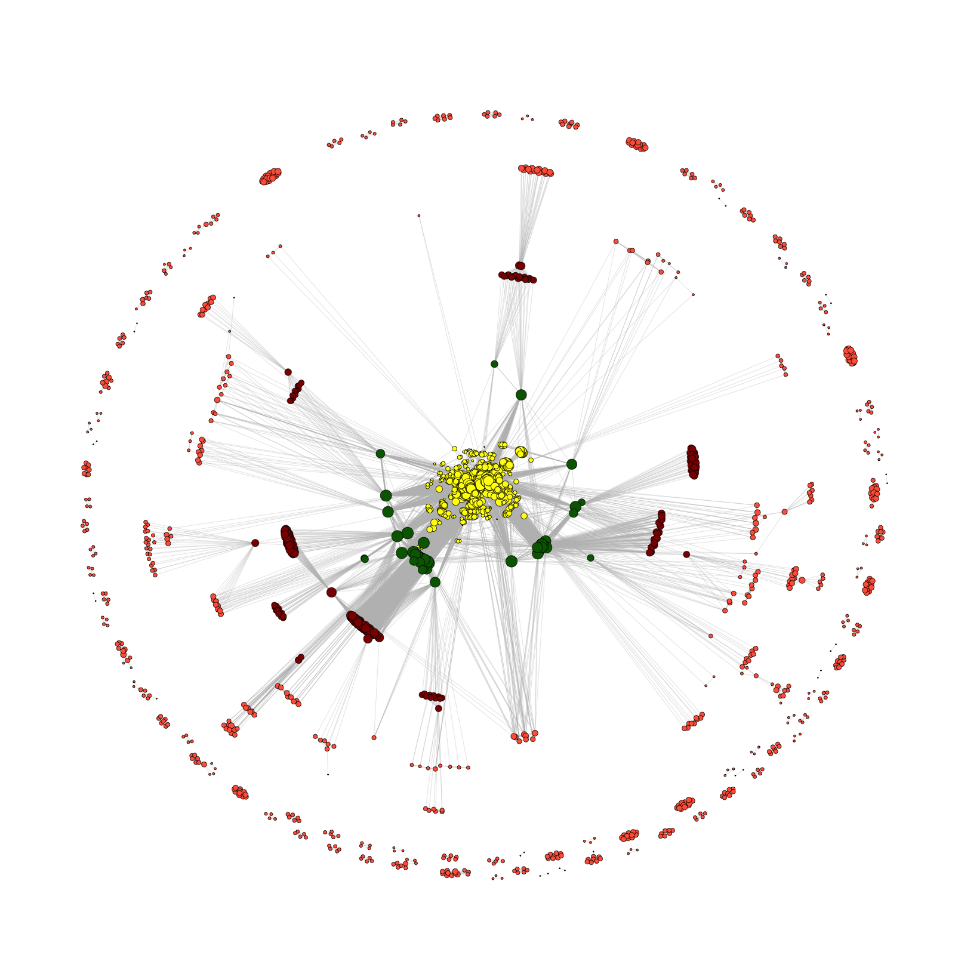
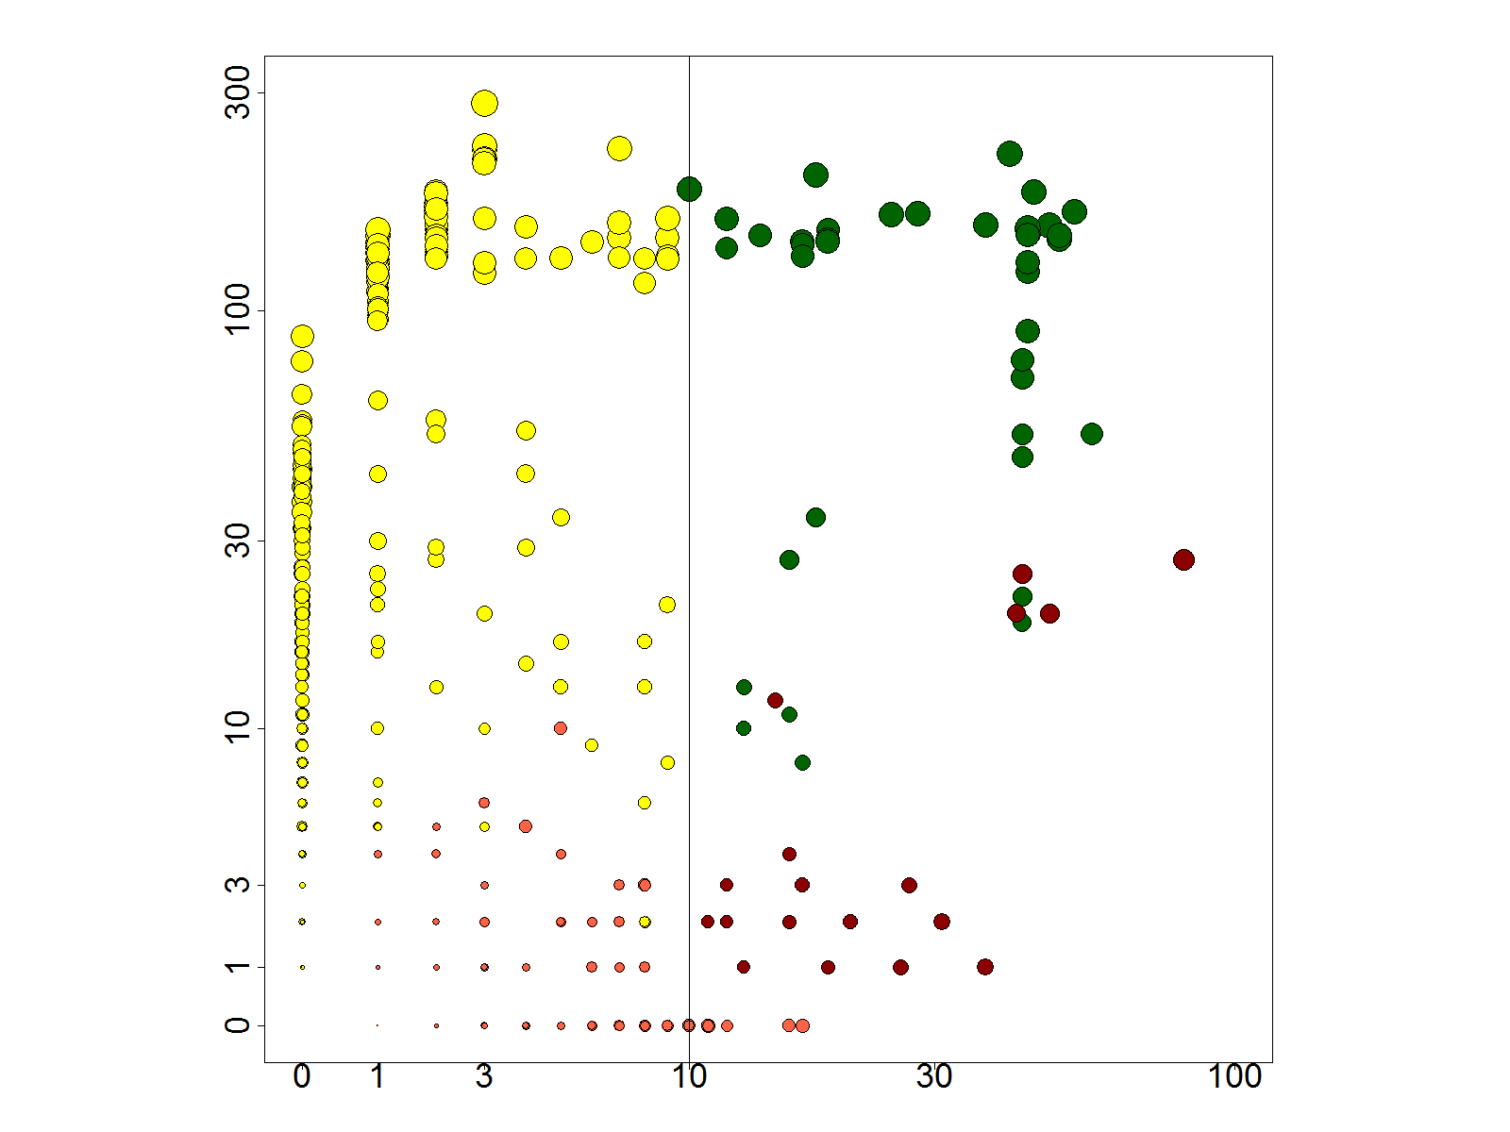
Similar findings in terms of slow growth trends & broker scientists in the modENCODE consortium as for ENCODE
2014
2013
2012
2011
2010
2009
2008
2007
Number of member neighbors
modENCODE
Number of non-member neighbors
Conclusions
  Value of publication patterns generated by the consortium
  Co-authorship network statistics relate to publication rollouts & show gradual adoption by a diverse community
  Key role of brokers in data dissemination
[Wang et al., TIG (‘16)]

Slide 15
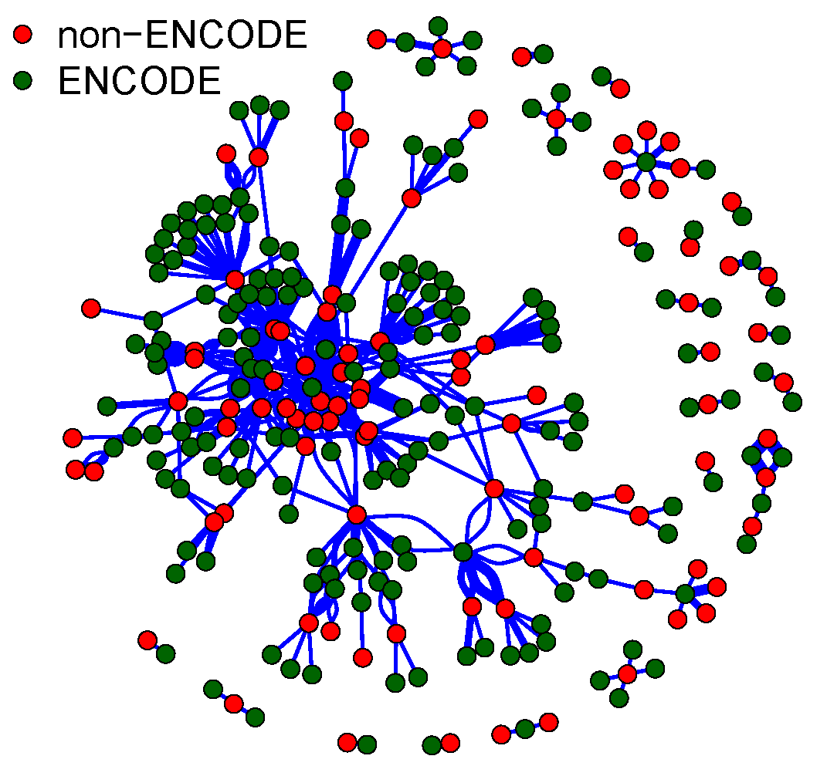
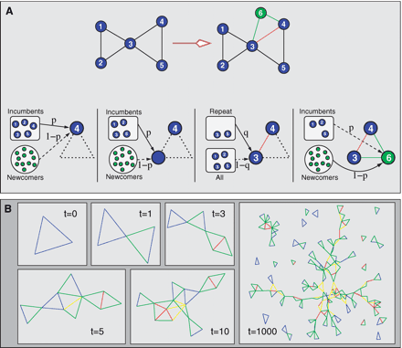
Future work
Publication network
Citation network (directed)
Network structures for more collaboration patterns
Team Assembly Mechanisms Determine Collaboration Network Structure and Team Performance
Roger Guimerà, Brian Uzzi, Jarrett Spiro, and Luís A. Nunes Amaral
Science 29 April 2005: 308 (5722), 697-702.
95 out of 291 non-ENCODE papers have co-authors with ENCODE papers

Slide 16
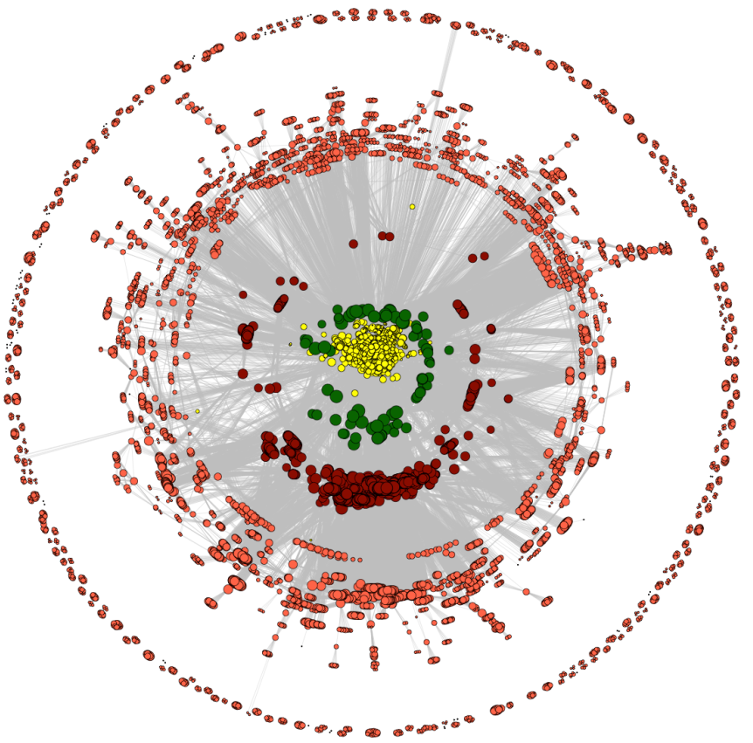


Acknowledgment
Prof. Mark Gerstein (Yale University)
Koon-Kiu Yan, Joel Rozowsky, Eric Pan
Dr. Mike Pazin (National Human Genome Research Institute)
Daifeng Wang, Koon-Kiu Yan, Joel Rozowsky, Eric Pan, Mark Gerstein, Temporal dynamics of collaborative networks driven by large scientific consortia, Trends in Genetics, 32(5):251-3, 2016
Thank you!
Notes:
add grants

Slide 17
Backup
A
B
C
Notes:
Figure 1. I[2_TD$DFF]Numbers of Consortium-Related Papers. (A) Numbers of PubMed indexed papers from 2004 to 2015. Blue circles represent the number of consortia papers indexed by PubMed (i.e., the author names on the paper appear as ‘consortium’ or ‘consortia’) per year from 2004 to 2015. The red squares represent the total number of papers indexed by PubMed per year from 2004 to 2015. (B) Paper distribution over author numbers driven by the ENCyclopedia Of DNA Elements (ENCODE) consortium until 2015. The x-axis represents the ranges in terms of numbers of authors per paper and the y-axis displays the numbers of ENCODE (blue) and non- ENCODE (red) papers. (C) Number of papers driven by ENCODE consortium from 2004 to 2015. The y-axis displays the numbers of ENCODE (blue) and non-ENCODE (red) papers in each year from 2004 to 2015. The non-ENCODE papers were those that were not directly funded by ENCODE but used ENCODE data.

Slide 18
2014
2013
2012
2011
2010
2009
2008
2007
Number of member neighbors
modENCODE
Number of non-member neighbors

Slide 19
ENCODE
B
C
2004
2005
Number of member neighbors
2006
Number of non-member neighbors
A
2014
2013
2012
2011
2010
2009
2008
2007
D
E
F
Number of member neighbors
modENCODE
Number of non-member neighbors

Slide 20
modENCODE member
2010
modENCODE member broker
2011
co-authorship
2009
2008
2012
2013
2007
modENCODE
2014

Slide 21
modENCODE stats
Modularity
Number of modules

Slide 22
ENCODE
B
C
2004
2005
Number of member neighbors
2006
Number of non-member neighbors
A
2014
2013
2012
2011
2010
2009
2008
2007
D
E
F
Number of member neighbors
modENCODE
Number of non-member neighbors

