Slide 1
Correcting for biological variation in RNA structure probing experiments
Michael Rutenberg-Schoenberg
Matt Simon & Mark Gerstein labs
1 December 2016

Slide 2
Outline
Quick reminder: Chemical probing are useful for RNA structure determination and don’t follow Poisson stats
New method tries to improve inference of modified bases using empirical distribution & HMM
Selega et al. Nat Meth 2016
My method (fit negative binomial distribution, similar to RNA-Seq analysis) performs similarly to other method and has some advantages (?)

Slide 3
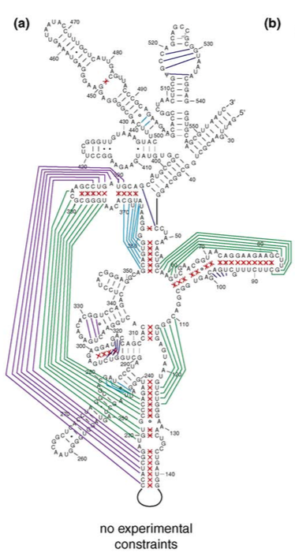
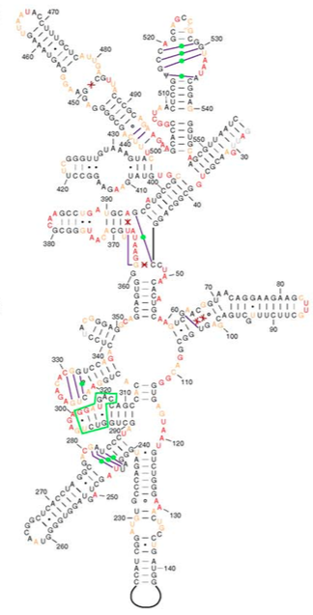
Constraints can improve RNA secondary structure prediction
E. coli 16S rRNA
naïve prediction
constrained prediction
Green and purple indicate mistakes in structure prediction
Prior knowledge of which nucleotides are single- or double-stranded aids prediction.
Deigan et al. PNAS 2009; Kevin Weeks Curr Opin Struct Biol 2010

Slide 4
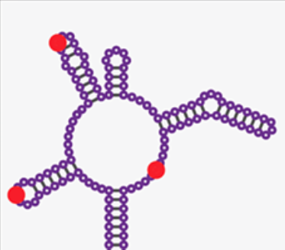
Chemical probing of RNA
Chemically modify RNA
Usually unstructured nucleotides are modifiable
Read out with reverse transcriptase
Stops & Mutations
Chemically modify RNA
(mainly unstructured regions)
Read out with Reverse Transcriptase
Stops
Mutations
(SHAPE-MaP)
mutation
Reviewed in Kubota et al Nat Chem Biol 2016
Siegfried et al. Nat Methods 2014
Notes:
DMS – methylates the Watson-Crick face of A,C
1M7 (SHAPE reagent) – acylate flexible 2’ OH in the ribose sugar

Slide 5
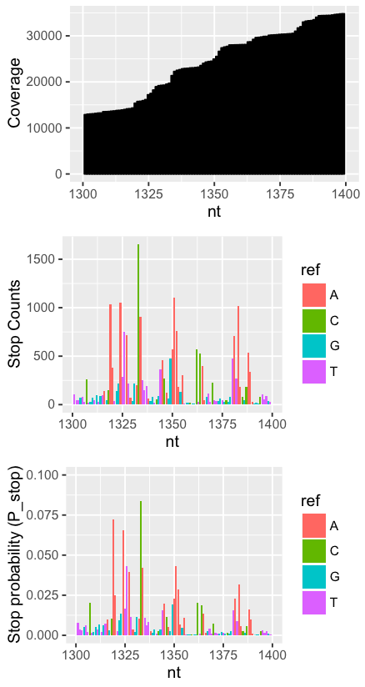
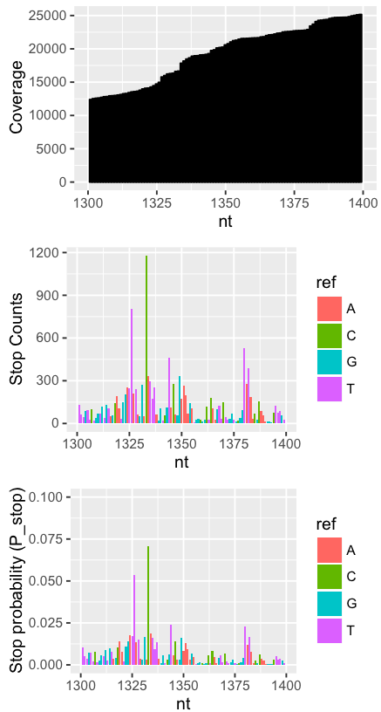
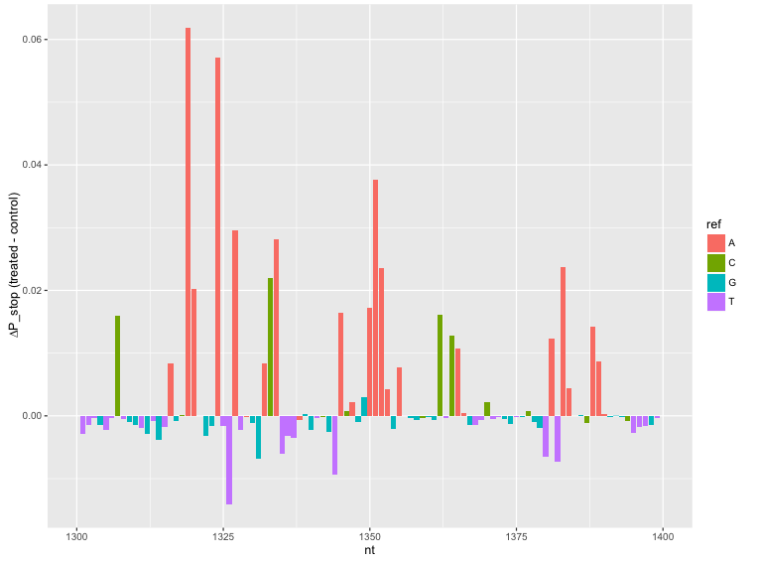
Basic analysis of chemical probing data
Treated
Control
i∈nucleotides; N total
P_{stop}(i) = stops(i)/coverage(i)
∆P_{stop}(i) = P_{stop}(treated) - P_{stop}(control)
DMS-Seq data for Xist RNA
A and C should be modified
Combined
Fang, Moss et al. PLoS Genet. 2015
Notes:
Fang, Moss et al. PLoS Genet. 2015

Slide 6
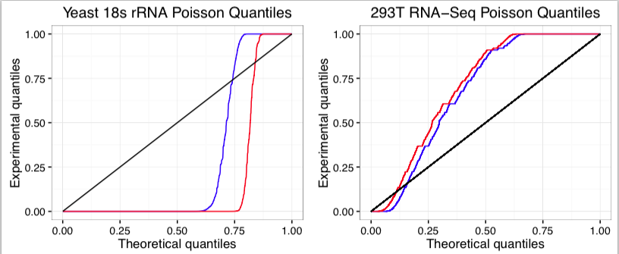
Chemical probing data, like RNA-Seq, do not fit Poisson distribution
Note: these are uniform quantiles, not normally distributed quantiles
KS test: p is approximately 0
Most values are > µ^.5 away from each other

Slide 7
Pseudocounts for Poisson-family distributions
Chemical probing
i∈nucleotides; N total
j∈samples; M total
Y_{ij} = stop counts for nucleotide i in sample j
Coverage for nucleotide i in sample j
C_{ij} =
S_{ij} = relative coverage for nucleotide i in sample j
S_{ij} =
Pseudocounts
P_{ij} = Y_{ij}/S_{ij}
RNA-Seq
i∈genes; N total
j∈samples; M total
Y_{ij} = gene
C_{j} = total coverage for sample j
S_{j} = relative library size
P_{ij} = Y_{ij}/S_{ij}
Notes:
----- Meeting Notes (10/27/16 15:24) -----
RNA-Seq on left
Make things correspond as clearly as possible

Slide 8
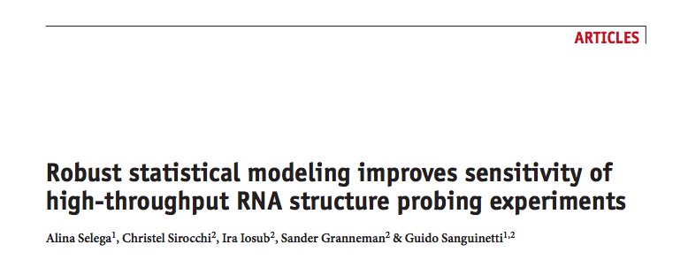
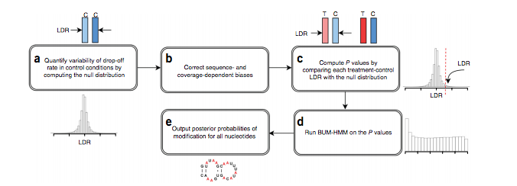

Slide 9
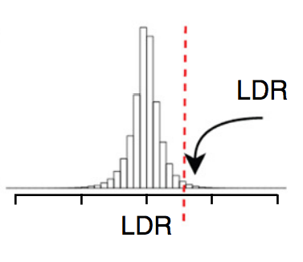
Method outline
Construct empirical distribution of log ratios of P_{stop} between replicates of control samples.
Calculate empirical p-values of log P_{stop} ratios of treated samples to untreated samples
Calculate posterior probabilities of modification using HMM
(next slide)

Slide 10
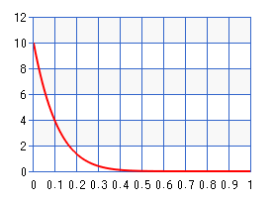
Beta-Uniform Mixture HMM (BUM-HMM)
Assumptions
P-values for modified nucleotides follow a ß distribution with alpha = 1, beta = 10
P-values for unmodified nucleotides follow a uniform distribution
Transition probabilities between paired & unpaired bases are:
Starting
 | Paired | Unpaired
Paired | 0.95 | 0.8
Unpaired | 0.05 | 0.2
Ending

Slide 11
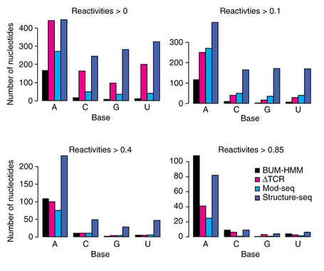
Results
AUC for 18s rRNA secondary structure
(ROC curve not shown):
BUM-HMM: 0.73
∆TCR (very similar to ∆P_{stop}): 0.74
Structure-Seq: 0.68
Mod-Seq: 0.64

Slide 12
Negative-Binomial Distribution
Distribution
Mean-Variance relationship
σ² = µ + αµ²
α = 0 → Poisson
Larger alpha → higher variance
Challenge:
Fit dispersion parameter with small number of replicates
Notes:
----- Meeting Notes (10/27/16 15:24) -----
Estimate variance
DESeq/edgeR

Slide 13
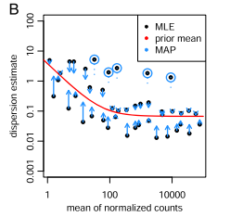
DESeq2 procedure
Fit individual gene (nucleotide) dispersion using Cox-Reid adjusted profile likelihood
Fit a curve of the form y = a1 + 1/a2 to Cox-Reid dispersions
Use empirical Bayes procedure to squeeze dispersions toward fitted value, assuming that dispersion follows a log-normal distribution

Slide 14
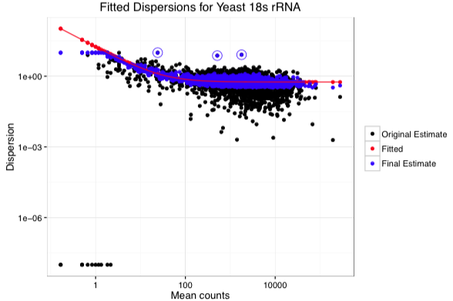
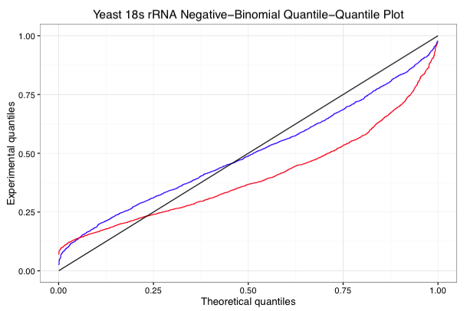
Fitting negative-binomial dispersion
Fit to Negative-Binomial distribution is very conservative.

Slide 15
NB-based p-values vs. emprical p-values
-log10 scale
-log10 scale
Negative-binomial p–values much more clearly identify modified bases, whereas after Benjamini-Hochberg correction, no bases are directly seen as significant in BUM-HMM method.
This is because there are a small number of total bases (1800) in this RNA, so the minimum possible p-value is 1/1800
The HMM in BUM-HMM helps compensate for the low power of the empirical dist.

Slide 16
ROC curves
red – naïve analysis
green – Negative-binomial
blue – BUM-HMM
 | ∆P_{stop} | Negative-Binomial | BUM-HMM
AUC | 0.679 | 0.689 | 0.663
AUPR | 0.685 | 0.685 | 0.666

Slide 17
PR curves
red – naïve analysis
green – Negative-binomial
blue – BUM-HMM
 | ∆P_{stop} | Negative-Binomial | BUM-HMM
AC | 0.765 | 0.762 | 0.760
Secondary struct | 0.752 | 0.772 | 0.757
Both statistical methods are much better at identifying A/C bases as modified without making any mistakes

Slide 18
Conclusions
Negative-binomial based method is only very slightly better than naïve analysis at identifying modified bases
Probably because fitted dispersions are over-conservative
Negative-binomial method works as well or better than Selega et al. Nat Meth 2016
P-values are more directly interpretable/fewer underlying assumptions
Still working on test for differences in modification under different experimental conditions (need better data)

