Slide 1
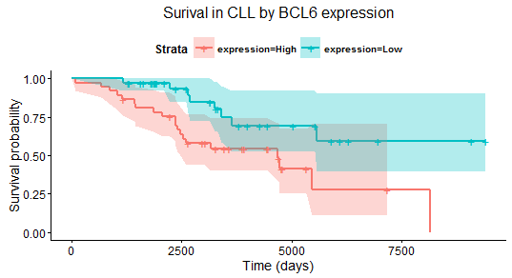
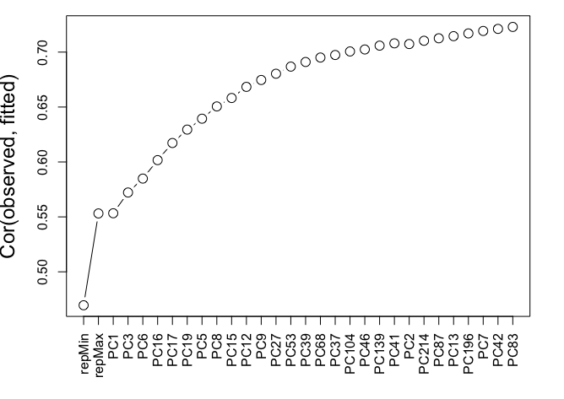
A
Enhancer
TFBS
Coding Exon
Noncoding Coding exon
Extended Gene
B
D
C

