Slide 1
Controls, Logic & Struggles in Pathway Survival
Will Meyerson
Paper E
30 Nov 2016

Slide 2
Outline
Three Controls
Analysis Plan
Results/Next Steps

Slide 3
Negative control emphasizes the importance of multiple testing correction
1848 pathways * 9 (eligible) tumor subtypes = 16,632 possible tests
Negative control:
Create 1848 uniformly random values for each patient in each subtype to serve as their dummy “pathway burden scores”
Perform survival analysis with Cox proportional hazard model and real patient survival data
If no multiple hypothesis testing correction, uniformly random values report 856 tests with p < 0.05 and 8 with p < 0.001
With BH correction, 0 adjusted p-values < 0.1

Slide 4
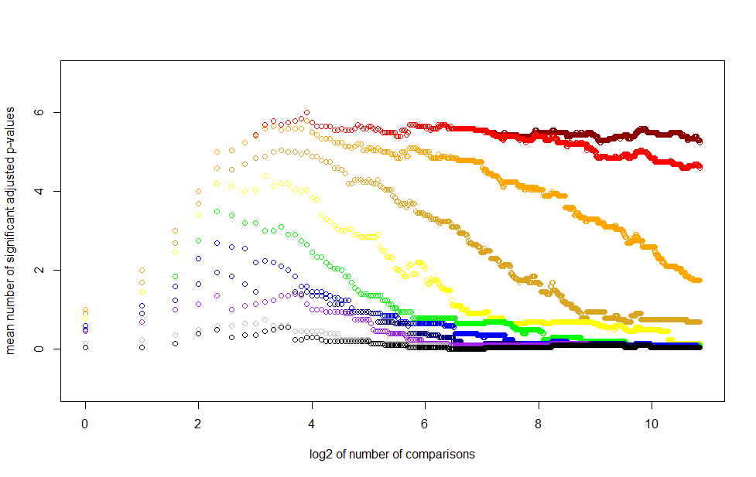
Positive control emphasizes the importance of filtering
PROCEDURE: Survival Analysis using
-Real survival data from 98 patients with Esophageal Adenocarcinoma.
-5 Positive control “pathway burden scores” derived from patient vital status indicator plus noise
-1,843 Negative control “pathway burden scores” of pure noise.
OBSERVATIONS:
If you have powerful enough predictor variables (warm colors), you can easily find them even among 1,848 mostly noisy pathways.
It is hard to find weak predictor variables (cooler colors), but you might find some if you have a superb filtering strategy. You might be able to replicate some key literature findings, but you likely won’t find anything new.
For predictor variables of intermediate strength (Goldilocks colors), you can find maybe 1 of 5 without any filtering, and but you stand to do much better with 4-fold or 8-fold smart filtering (so long as you don’t filter out the true positives too, which is mostly not modeled here).

Slide 5
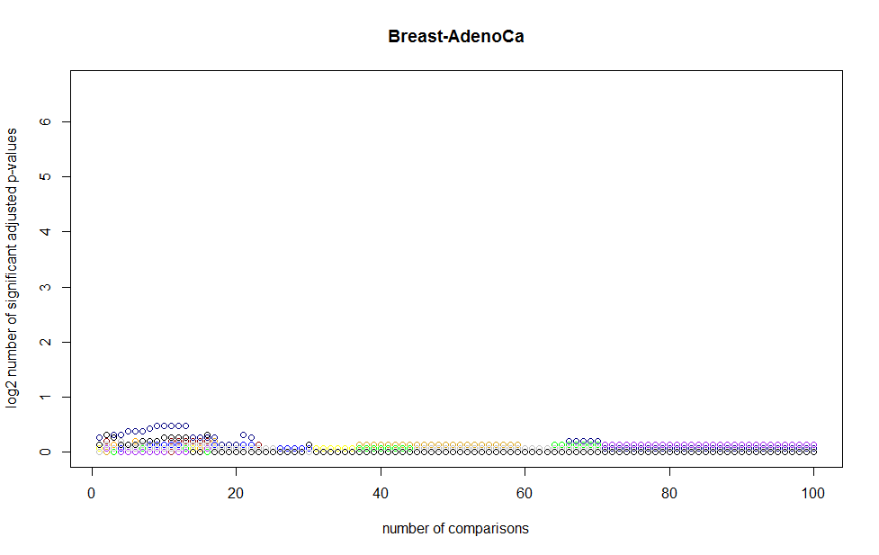
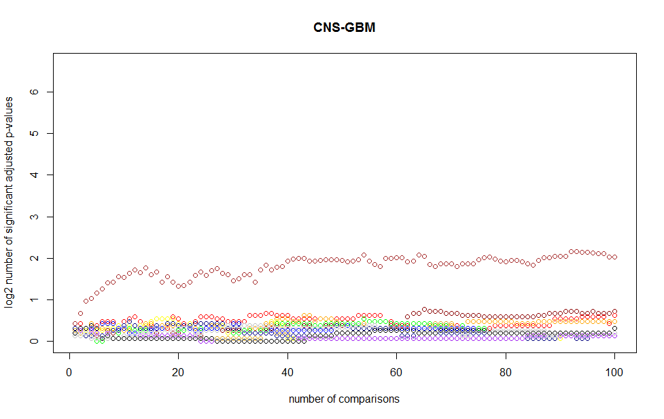
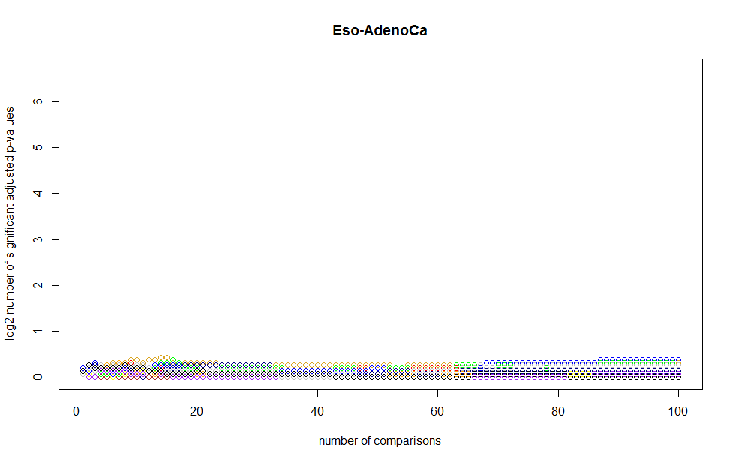
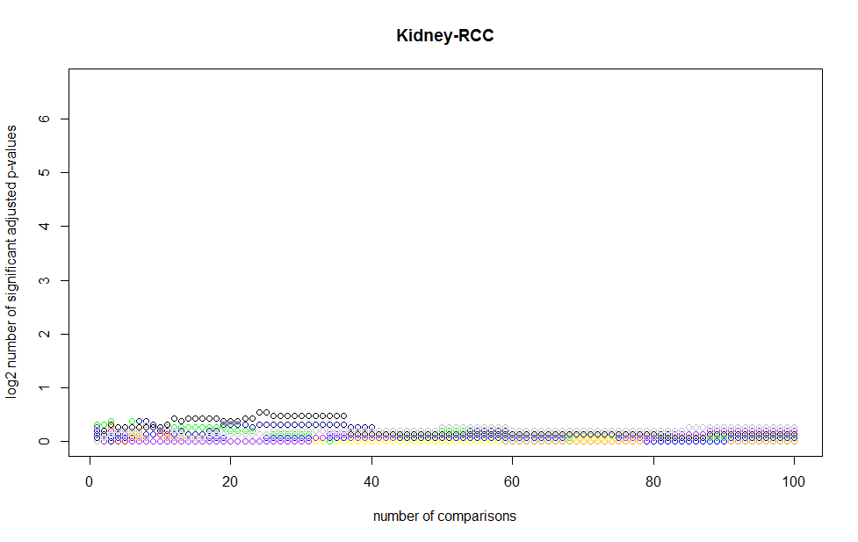
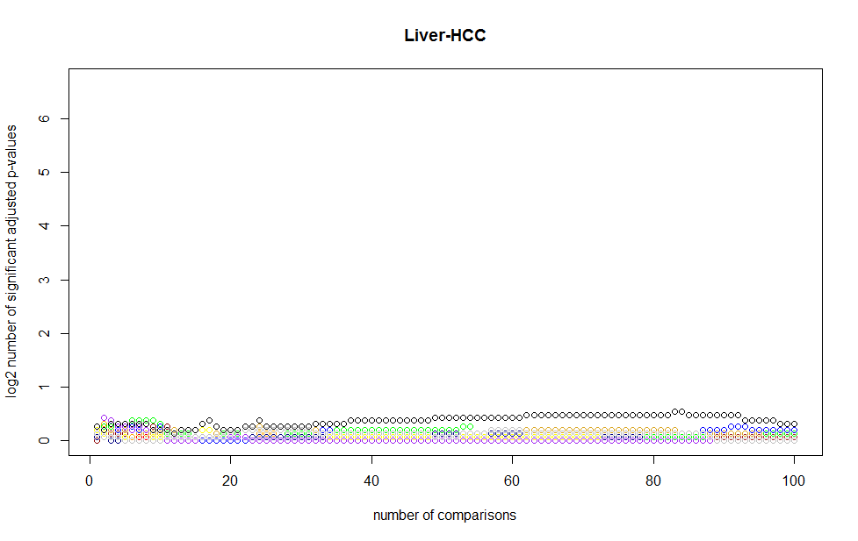
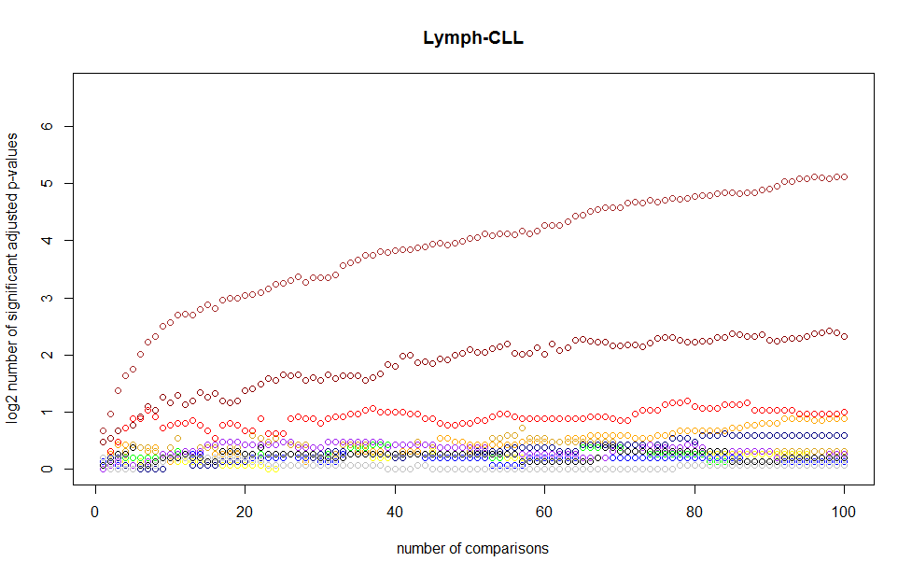
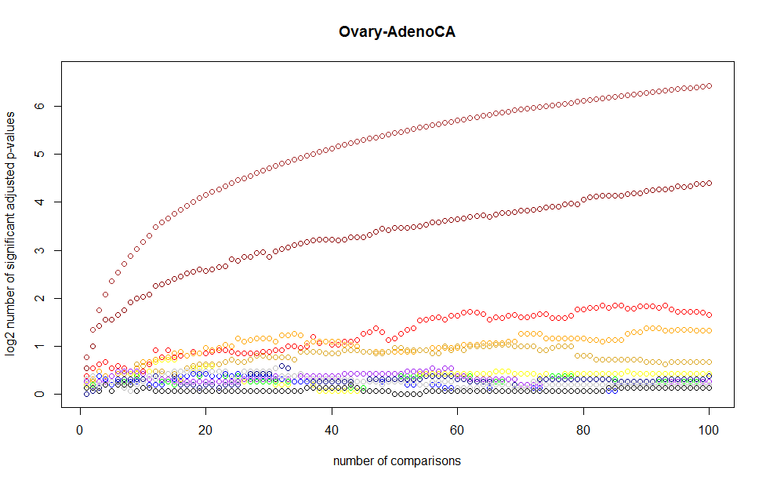
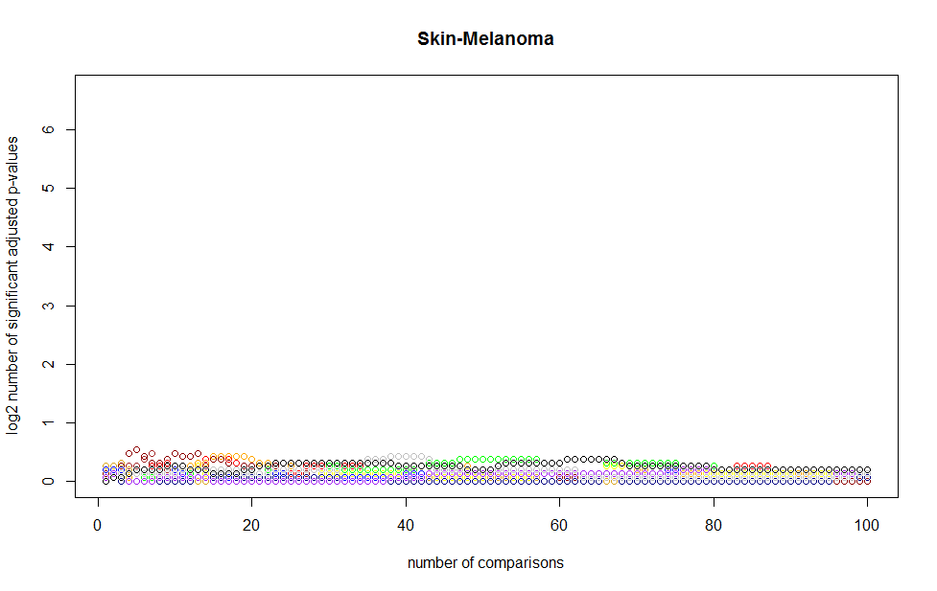
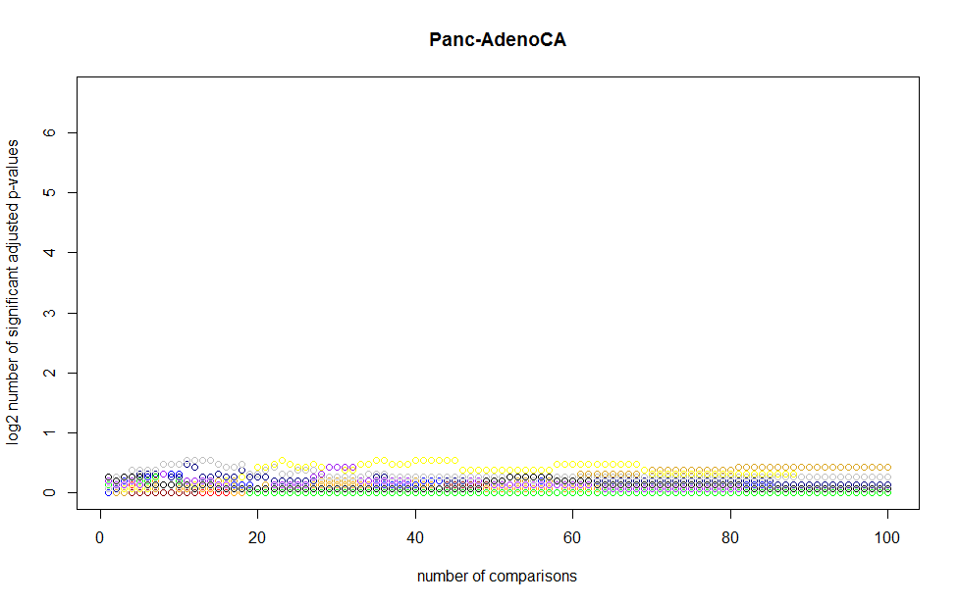
Confounded negative control emphasizes the need for proper normalization, especially in select subtypes
Created random “pathway burden scores” biased to be larger in patients with more low-impact mutations.
Then performed survival analysis with real patient survival data.
If no confounding, should see flat line around 0.
If confounding present, should see logarithmically growing curve, especially with warmer colors.
Breast OK
GBM BAD
Eso OK
RCC OK
Liver OK
CLL Very BAD
Ovary Very BAD
PancAdeno OK
Melanoma OK

Slide 6
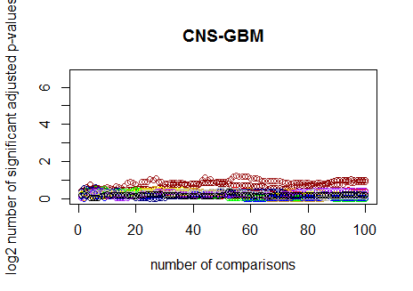
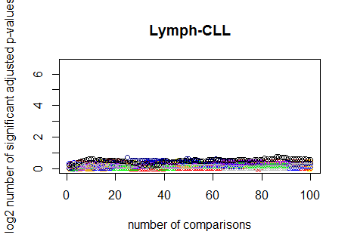
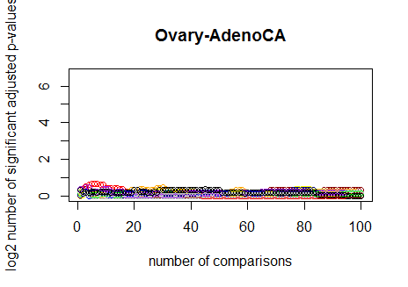
Including the number of low-impact mutations as a covariate appears to correct this type of confounding
There are other types of confounding, and we may not be able to foresee them all.

Slide 7
Key Strategy #1: Enrich the signal through principled filtering.
Which pathways do we think matter in cancer by subtype (for reasons other than their observed impact on survival in this data set)?
For those pathways, compute the per-patient, per-pathway normalized burdening but don’t relate to survival yet
In each tumor subtype eligible for survival analysis (>=20 patient deaths), which of those pathways have enough heterogeneity in normalized burdening among patients to have a chance of relating to patient survival?
Then perform survival analysis on those pathway-subtype combinations

Slide 8
Which pathways matter in cancer by subtype?
I took the coding whitelist PCAWG validated and predicted driver genes by subtype and plugged them into Reactome’s pathway enrichment tool
Filter the pathways for analysis down from 1,848 total to just those ~300 or so pathways per subtype with an enrichment with FDR < 0.1

Slide 9
For those pathways, compute the per-patient, per-pathway normalized burdening. This relates to Key Strategy #2. Address confounding through proper normalization.
For each patient, for each pathway, compute
Normalized burden = (OBS_hits+2)/(OBS_hits+RAND_hits+4)
Take the observed high-impact coding muts that hit that pathway in that patient and divide by the sum of the observed hits
OBS_hits = number of high-impact coding mutations observed in that patient in that pathway
RAND_hits = number of high-impact coding mutations observed in that patient’s associated random file in that pathway
Add 2 to the numerator and 4 to the denominator to solve two technical issues
Gives the right solution to 0 hits in patient, 0 hits in random
Helps reduce a technical artifact of OBS_hits=1, RAND_hits=0 leading to very high scores (as compared with adding 1 to the numerator and 2 to the denominator)
Theoretically, this eliminates confounding due to number of mutations and mutational signatures

Slide 10
Which of those pathways have enough heterogeneity in normalized burdening among patients to have a chance of relating to patient survival?
Pathways with at least 20% of patients with a score < 0.4 and at least 20% of patients with a score > 0.6
Left with 0 – ~100 pathways per cancer subtype

Slide 11
The problem is, even after I take all this into account, I don’t find anything of interest
I get one BH-corrected hit in this method in Melanoma, and 0 in all other subtypes
Pathways are only weak predictors?
Even more strict filtering, just using pathways enriched in Vogelstein drivers?
Is one random set per patient too noisy?
Are random sets too locally generated?
Use alternative normalization scheme? E.g.# of low-impact muts as a covariate. (But still there’s confounding from mutational signatures)
Give up?
Can transfer this level of rigor to the other parts of my survival analyses. (But this might negate my positive findings in these other analyses)

