Slide 1
Clonal Fitness

Slide 2
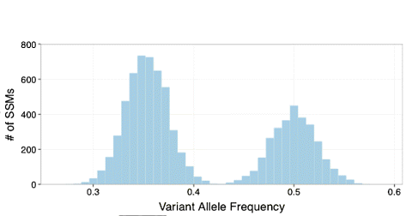
Calling Subclones

Slide 3
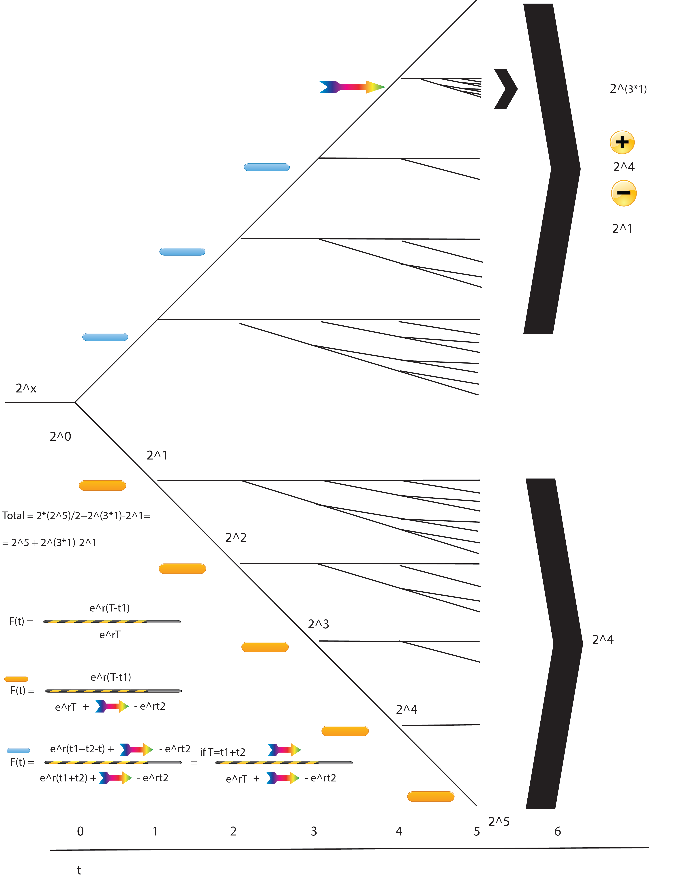

Slide 4
T=t1+t2, t1 the moment of driver mutation

Slide 5
Green mutations with lower Freq

Slide 6
Hitchhiked mutations with higher Freq

Slide 7
Calling Subclones
Early Hitchhiked Mutations with Fitness r
New Fitness Mutations (NFM)
with fitness K*r
Mutations with fitness r
Subclone With Higher Fitness

Slide 8
Sampling ‘r’ from hitchhiking freqs

Slide 9
Identifying the fitness mutation
Out of 1987 simulations
TPs:1983
FPs:850
TPrate(Sensitivity):0.998
FPrate(per sim):0.572

Slide 10
3 ways of estimating fitness effect k
By calculating ‘r’ from hitchhike mutations
By optimizing the algorithm statistically to stop at best k
(So far the most stable to errors)
C) By sampling k from well optimized ‘r’s
(Bayesian approach, obtain ‘k’ probability)

Slide 11
Estimating K from simulations
By calculating ‘r’ from hitchhike mutations
By optimizing the algorithm statistically to stop at best k
(So far the most stable to errors)
C) By sampling k that for well optimized ‘r’s
(Bayesian approach, obtain ‘k’ probability)

Slide 12
Estimating K In PAWG data

Slide 13
Estimating K In PAWG data

Slide 14
Finding Fitness
To do
- Refine the model (eg add stats)
- Run on Will’s simulation data
- Run on Prostate Cancer VCFs

