Slide 1
Functional burdening analysis of cancer genomes
PCAWG-2,5,9,14 presentation
November 28, 2016

Slide 2
Aim and deliverables for the functional impact paper
Decipher overall functional burdening in cancer genomes in the PCAWG project.
Avg cancer has ~5 drivers & ~5000 mutations. What is the overall burdening of the many passengers in different cancers ?
Look at Overall variation burden observed in various genomic elements (coding & noncoding) in different PCAWG cohorts.
Comparison between real and simulated data to highlight genomic elements with significant burden from passengers in different cohorts
This work will provide comprehensive functional annotations across all of pcawg (FunSeq & aloft score)
Coding and noncoding functional impact score distribution across pan-cancer cohorts.
Enrichment/depletion of high impact passengers (other than drivers) in gene block/neighborhood
Correlation of passenger burdening with downstream gene expression changes
Framework to evaluate structural variation impact score
Comparison between somatic and germline variation burdening
Investigate influence of germline mutational burden on the somatic genome variation profile
Decipher the the differential passenger burdening in various cohorts (how it relates to mechanism)
Relate to different Signature, Ageing, sub-clonality & other clinical information

Slide 3
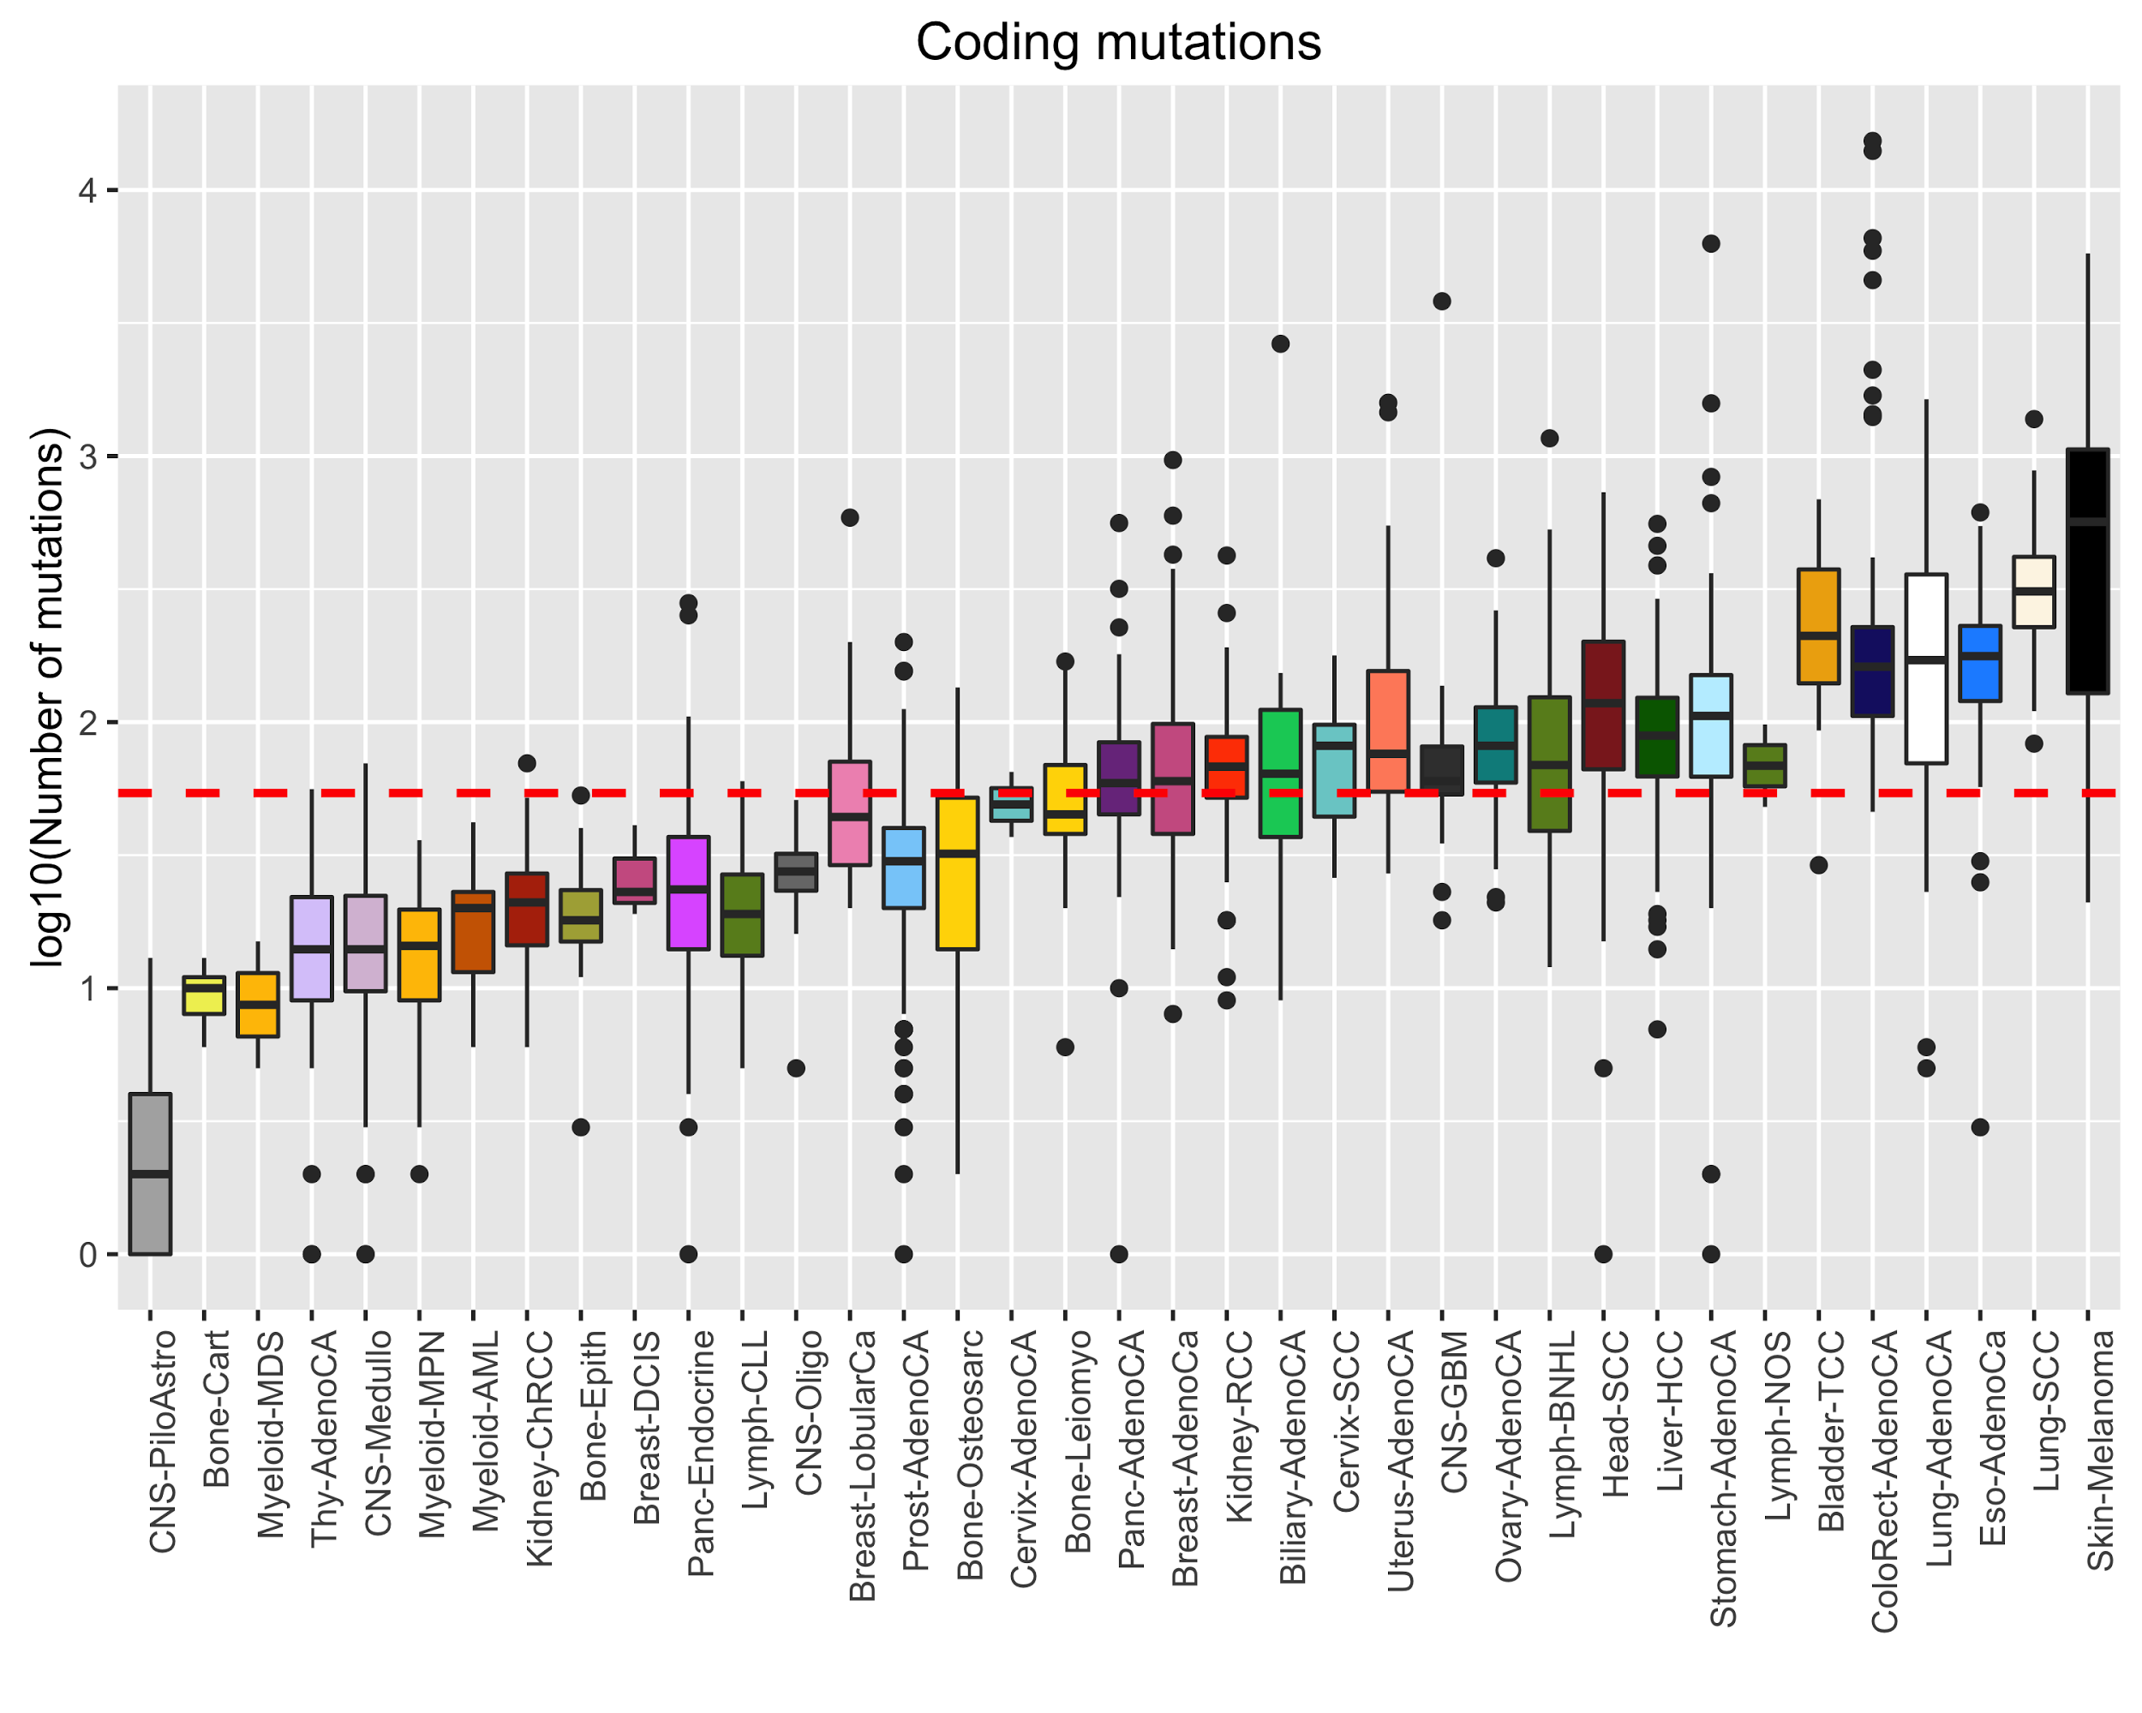
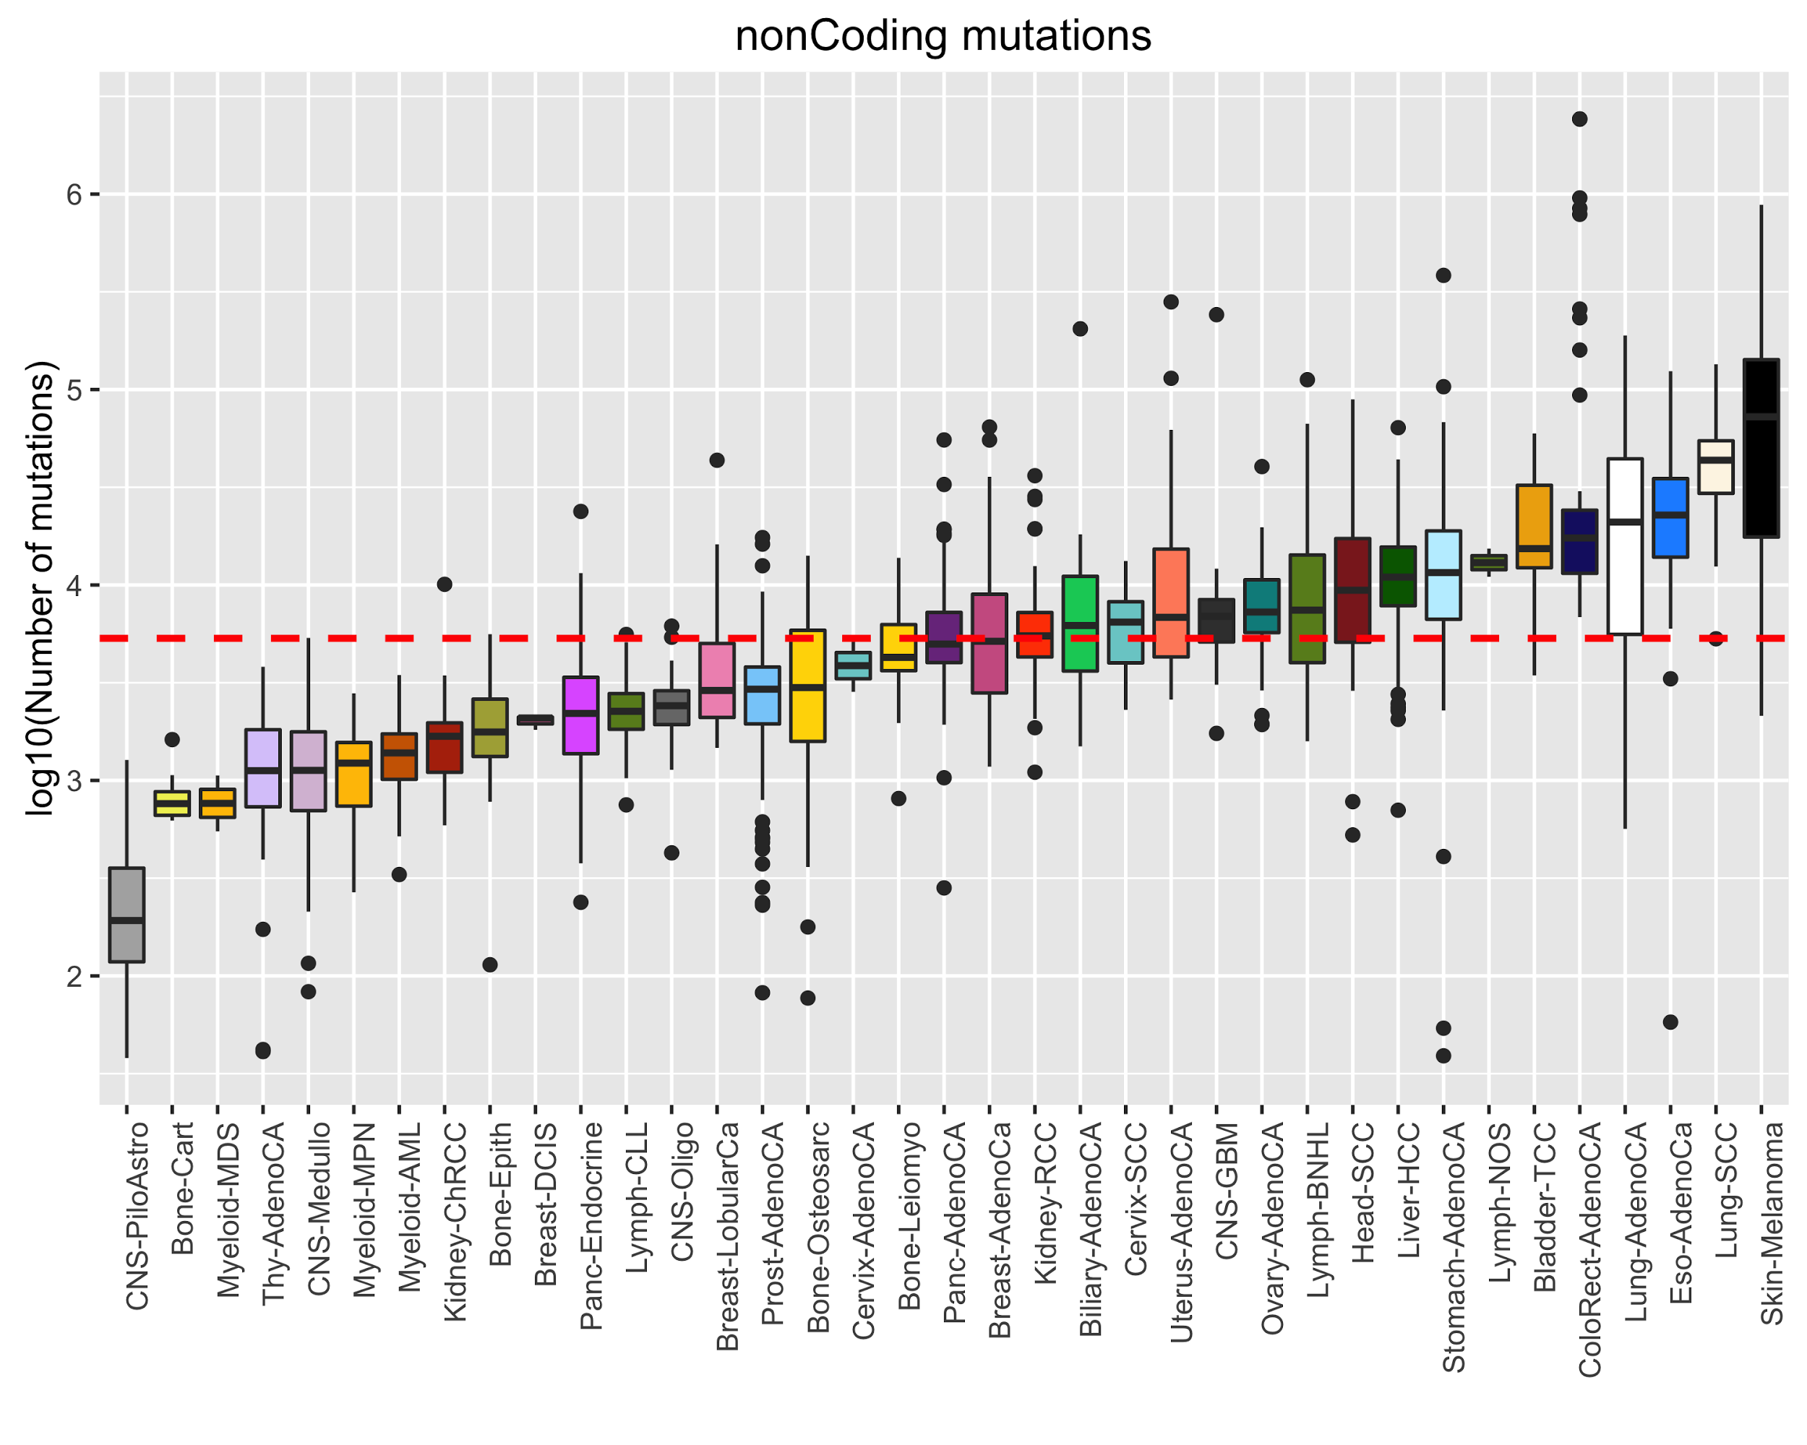
Deciphering overall functional burdening in cancer genomes

Slide 4
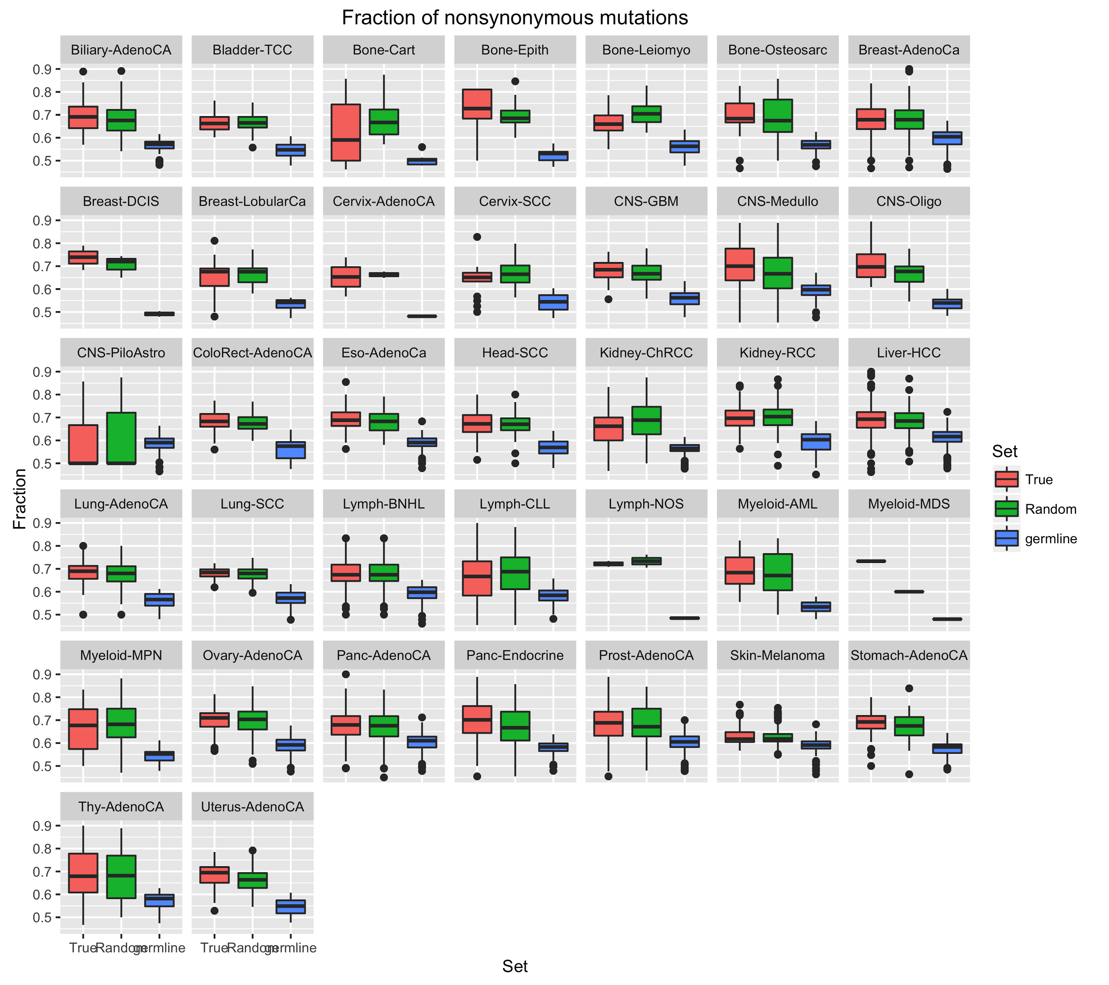
Fraction of nonsynonymous SNVs in different cohorts

Slide 5
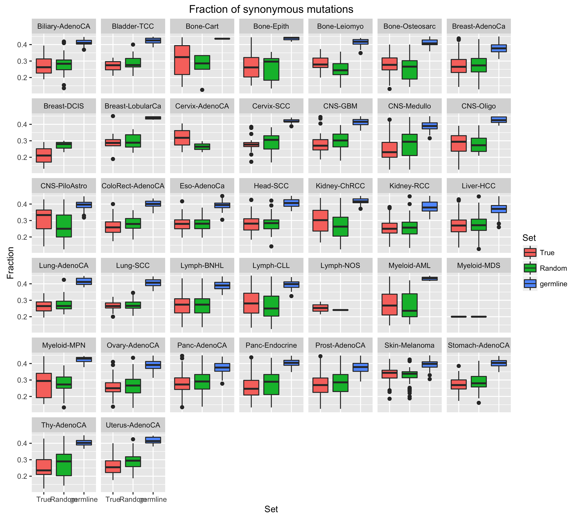
Fraction of synonymous SNVs in different cohorts

Slide 6
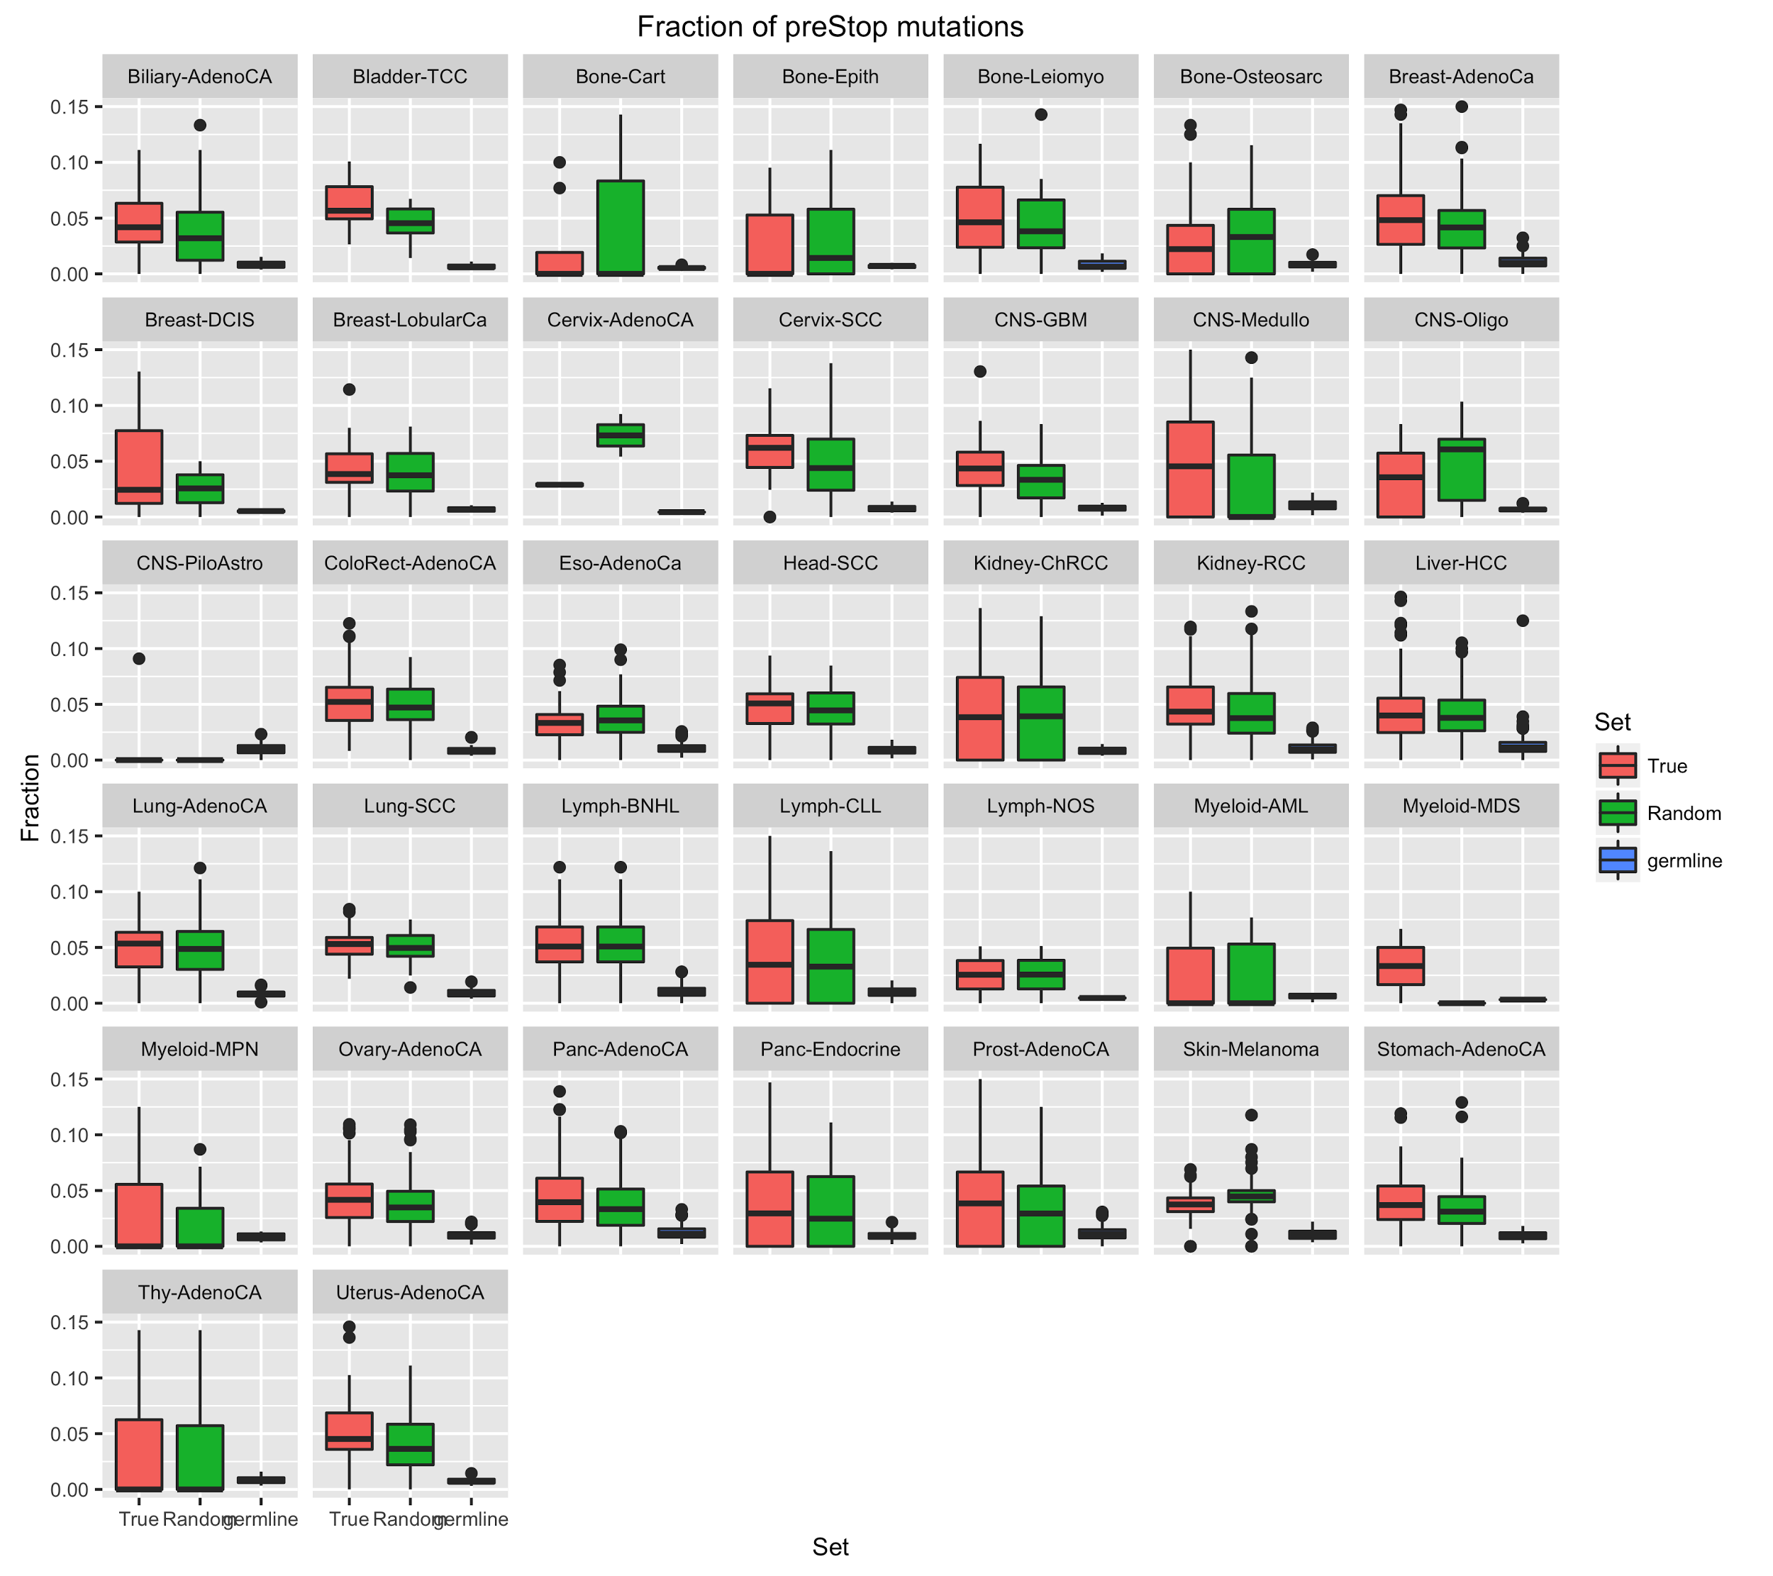
Fraction of premature stop SNVs in different cohorts

Slide 7
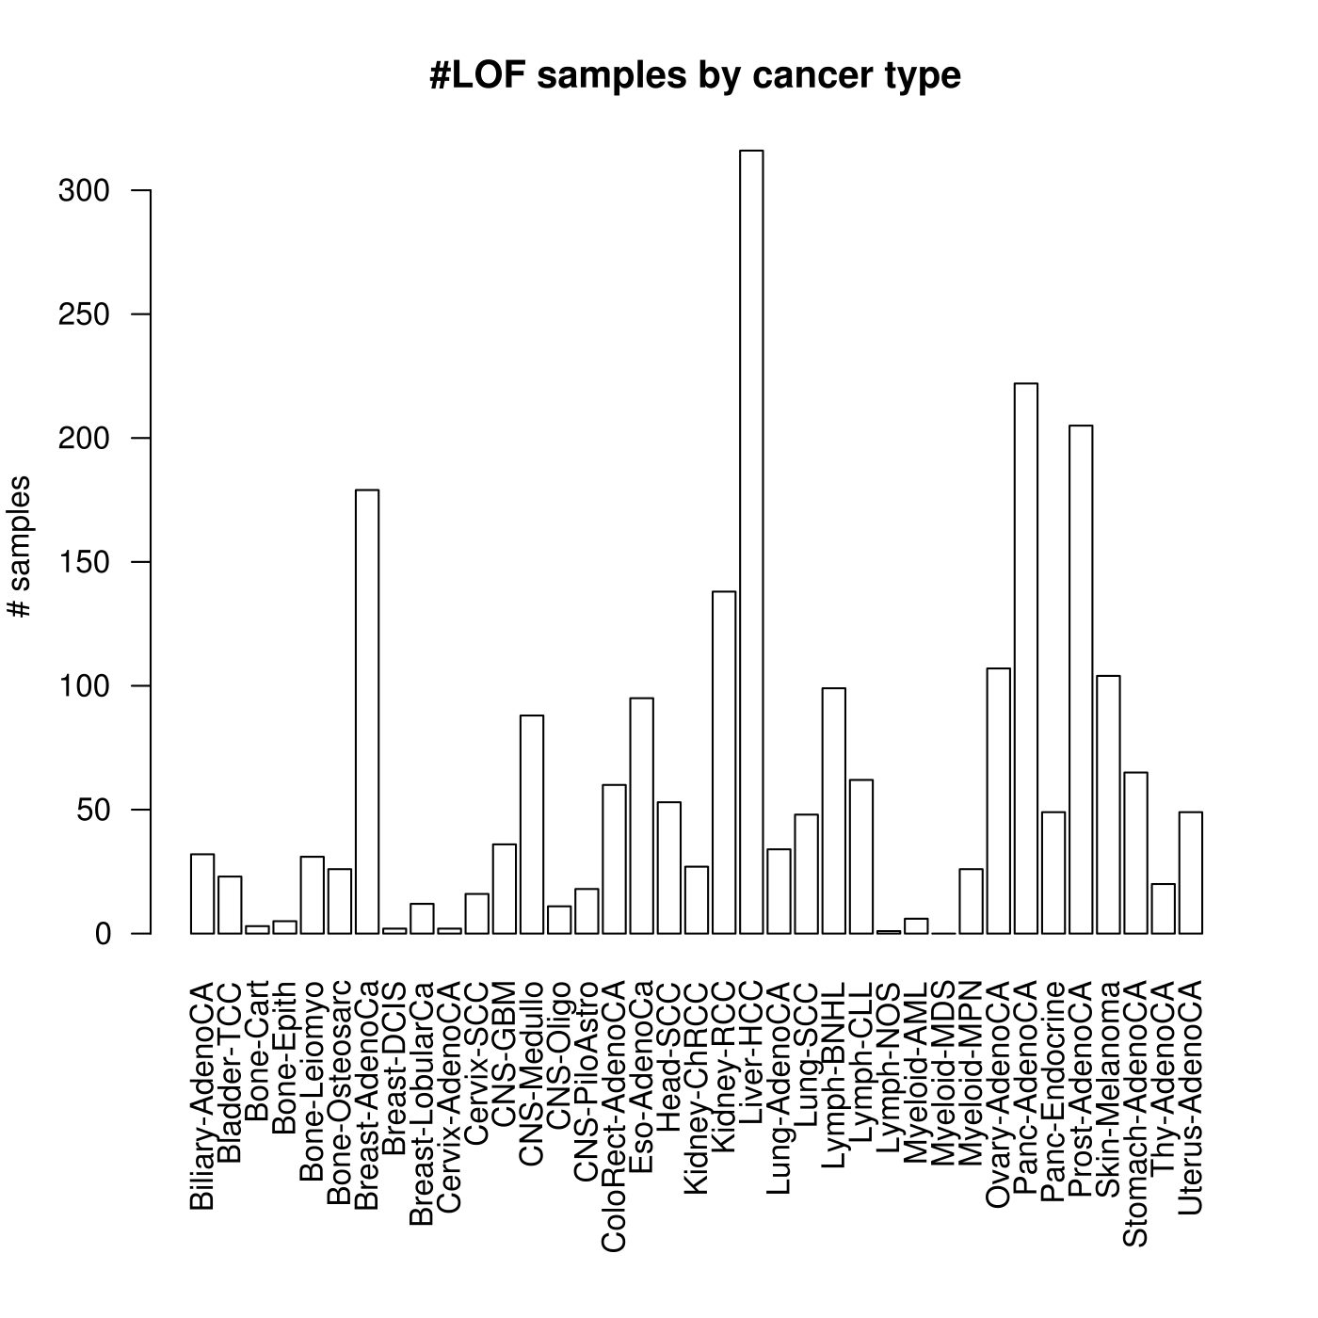
predicted loss of function (pLOF) mutation
Total LOF events : 28426
PCAWG pLOF mutations: 15435
#samples with at least 1 pLOF event =2270

Slide 8
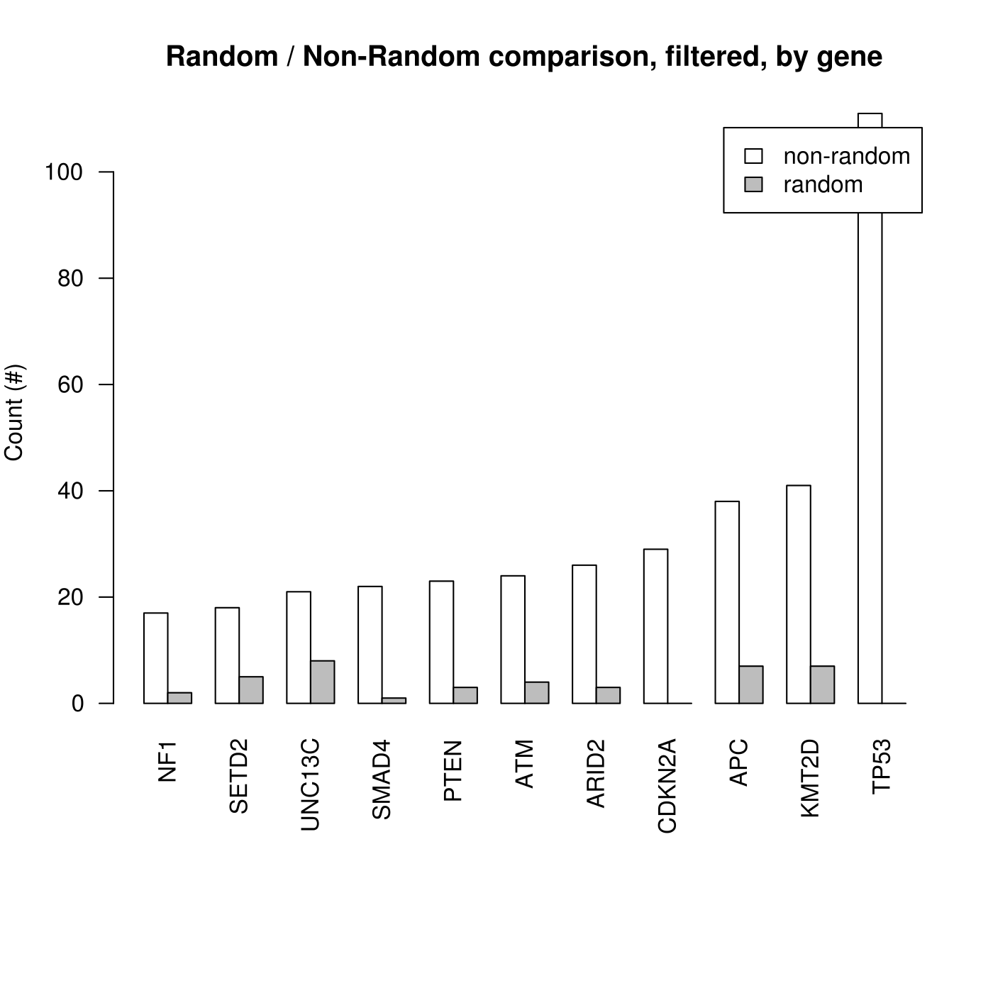
Enrichment of LOFs in the pan-cancer cohort

Slide 9
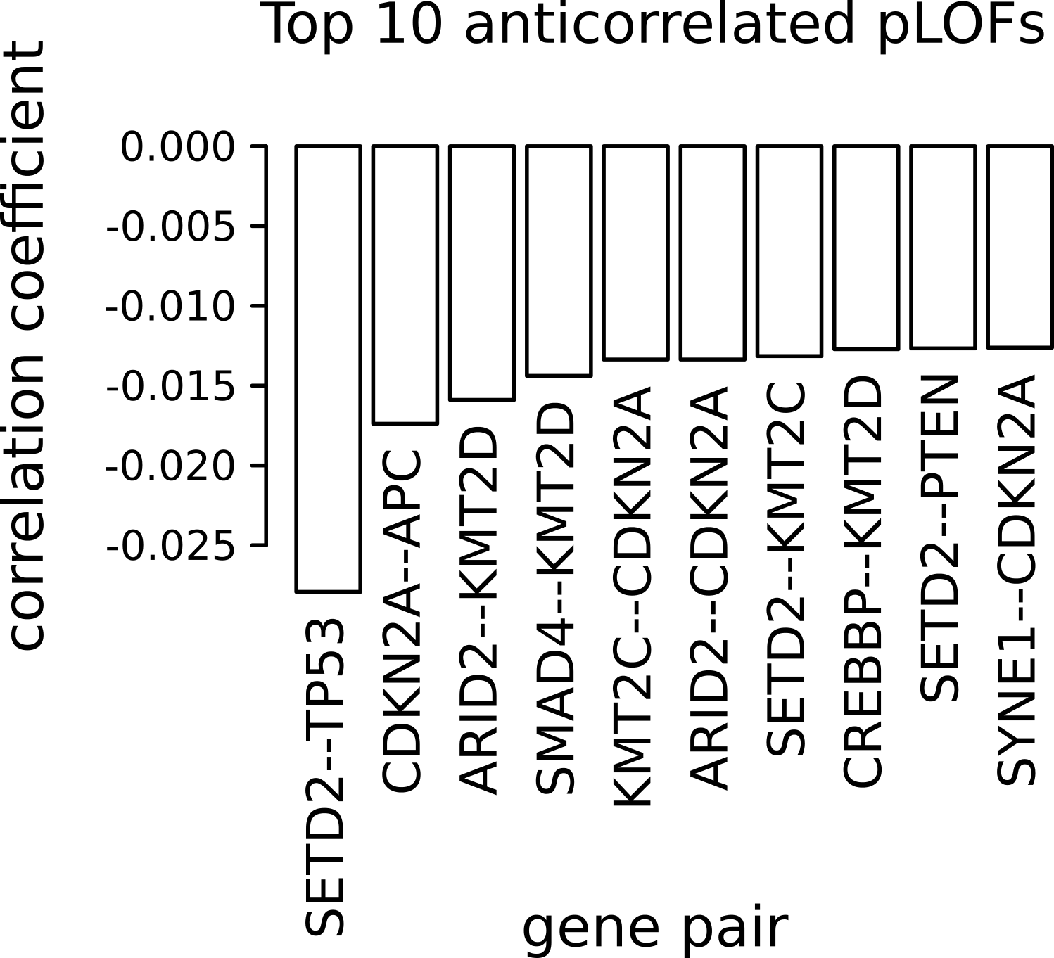

Slide 10
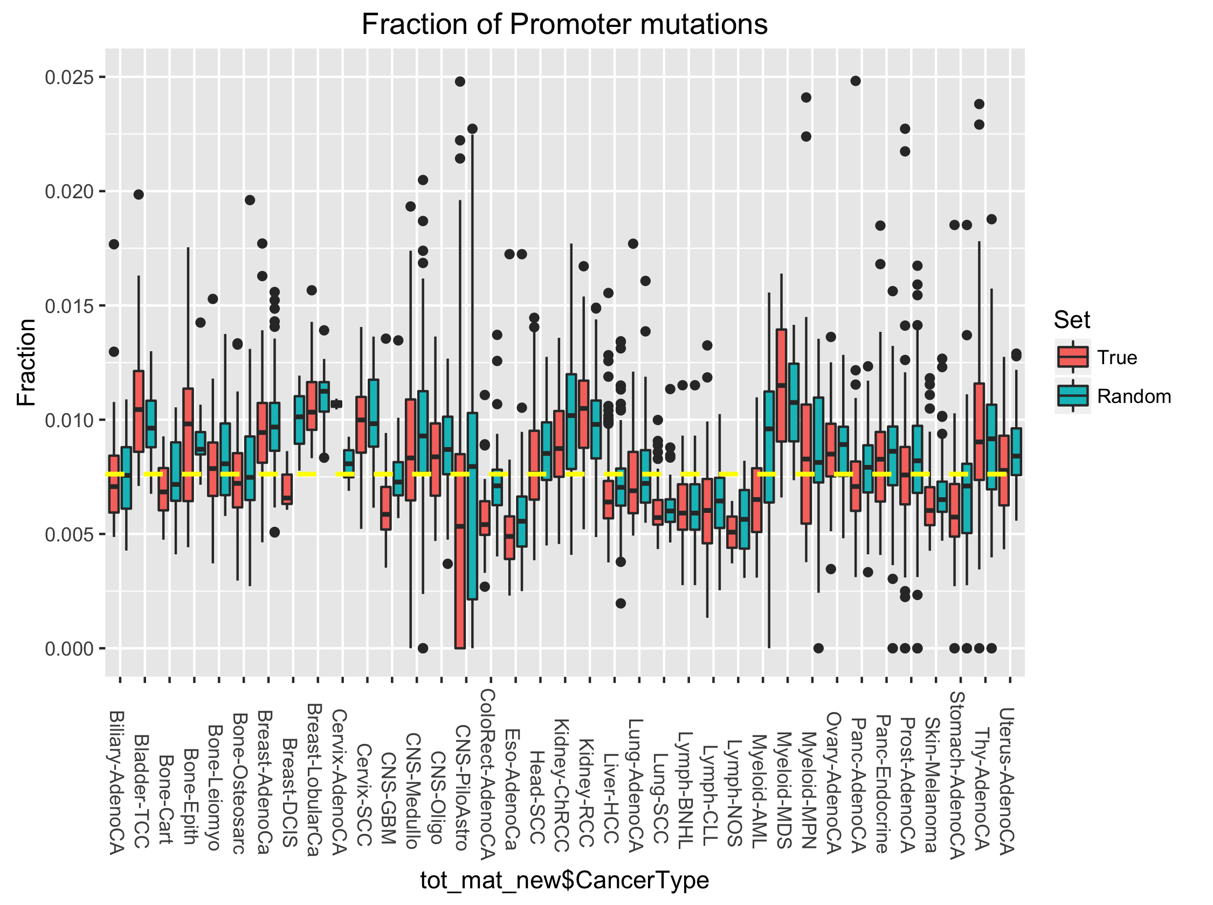

Slide 11
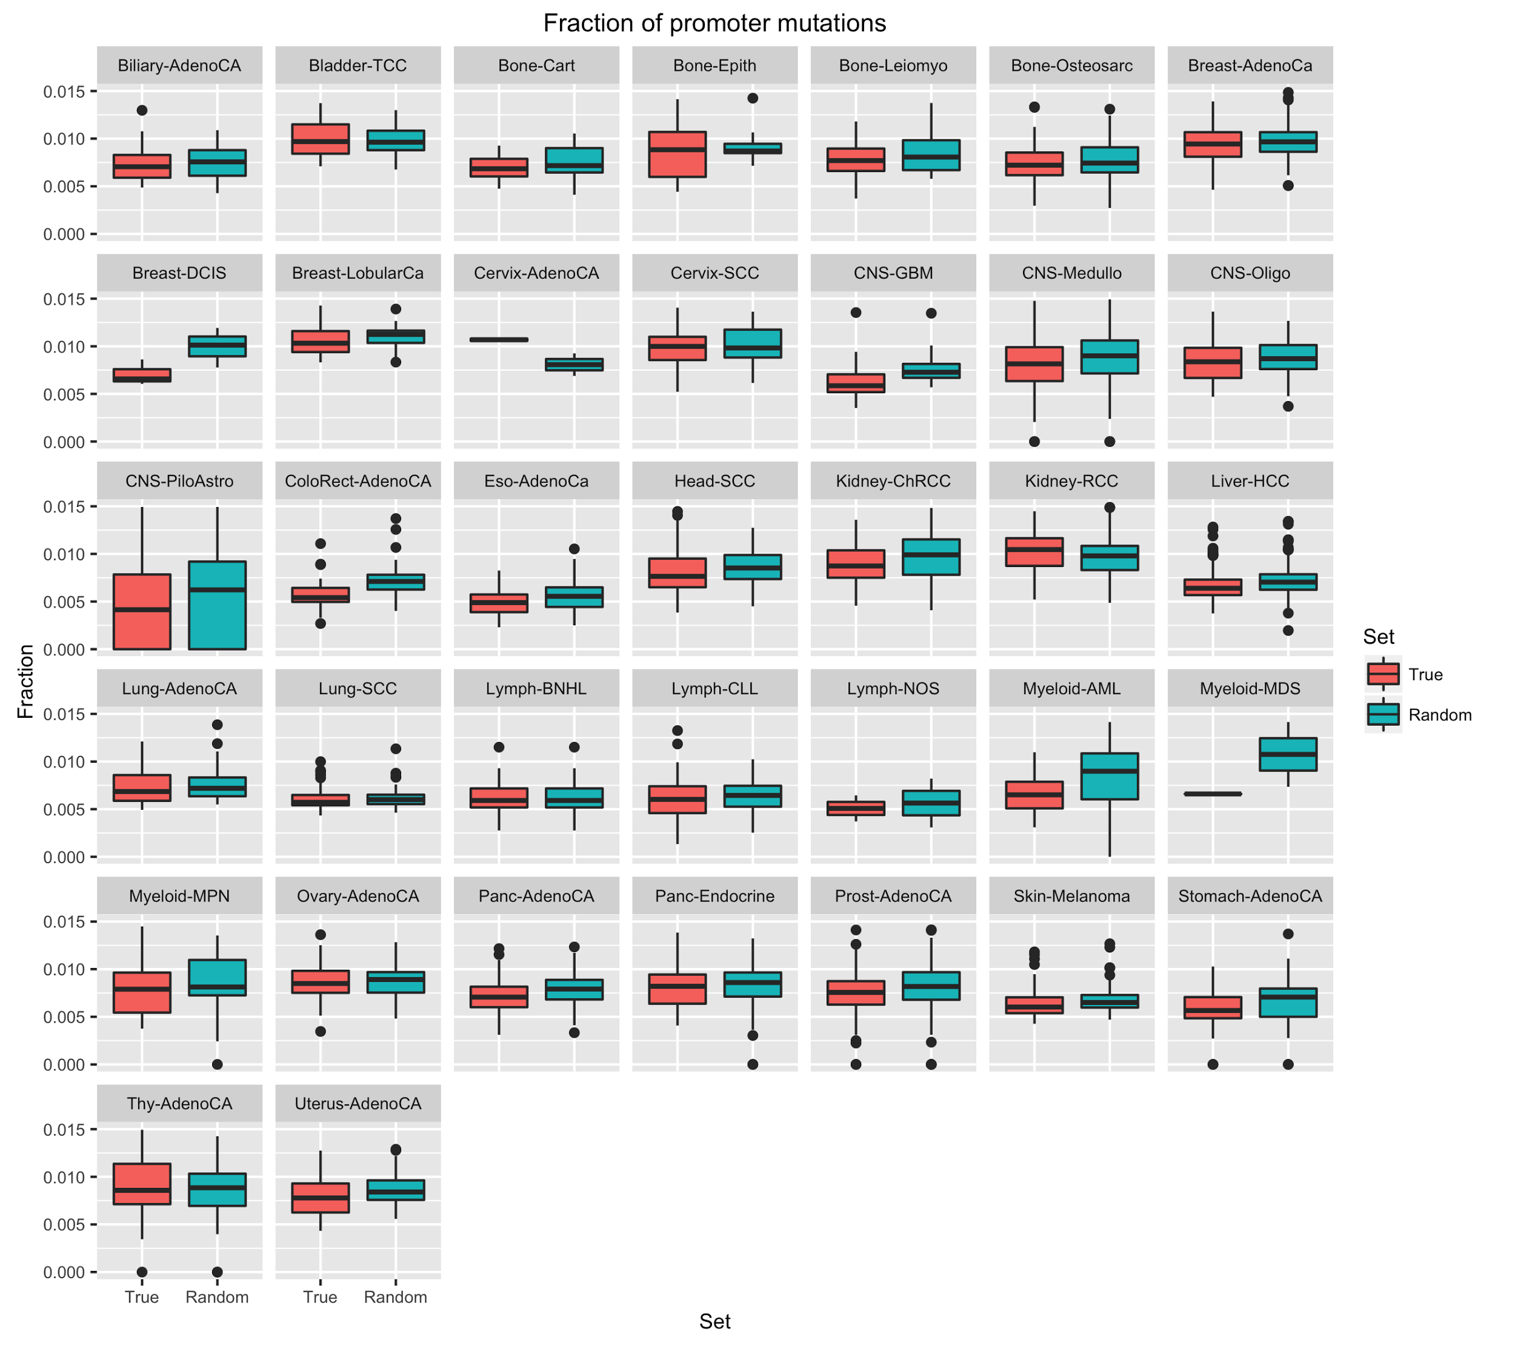

Slide 12
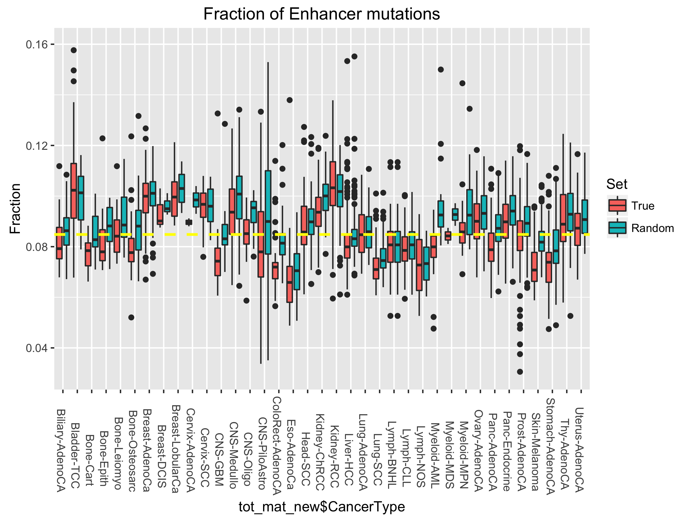

Slide 13
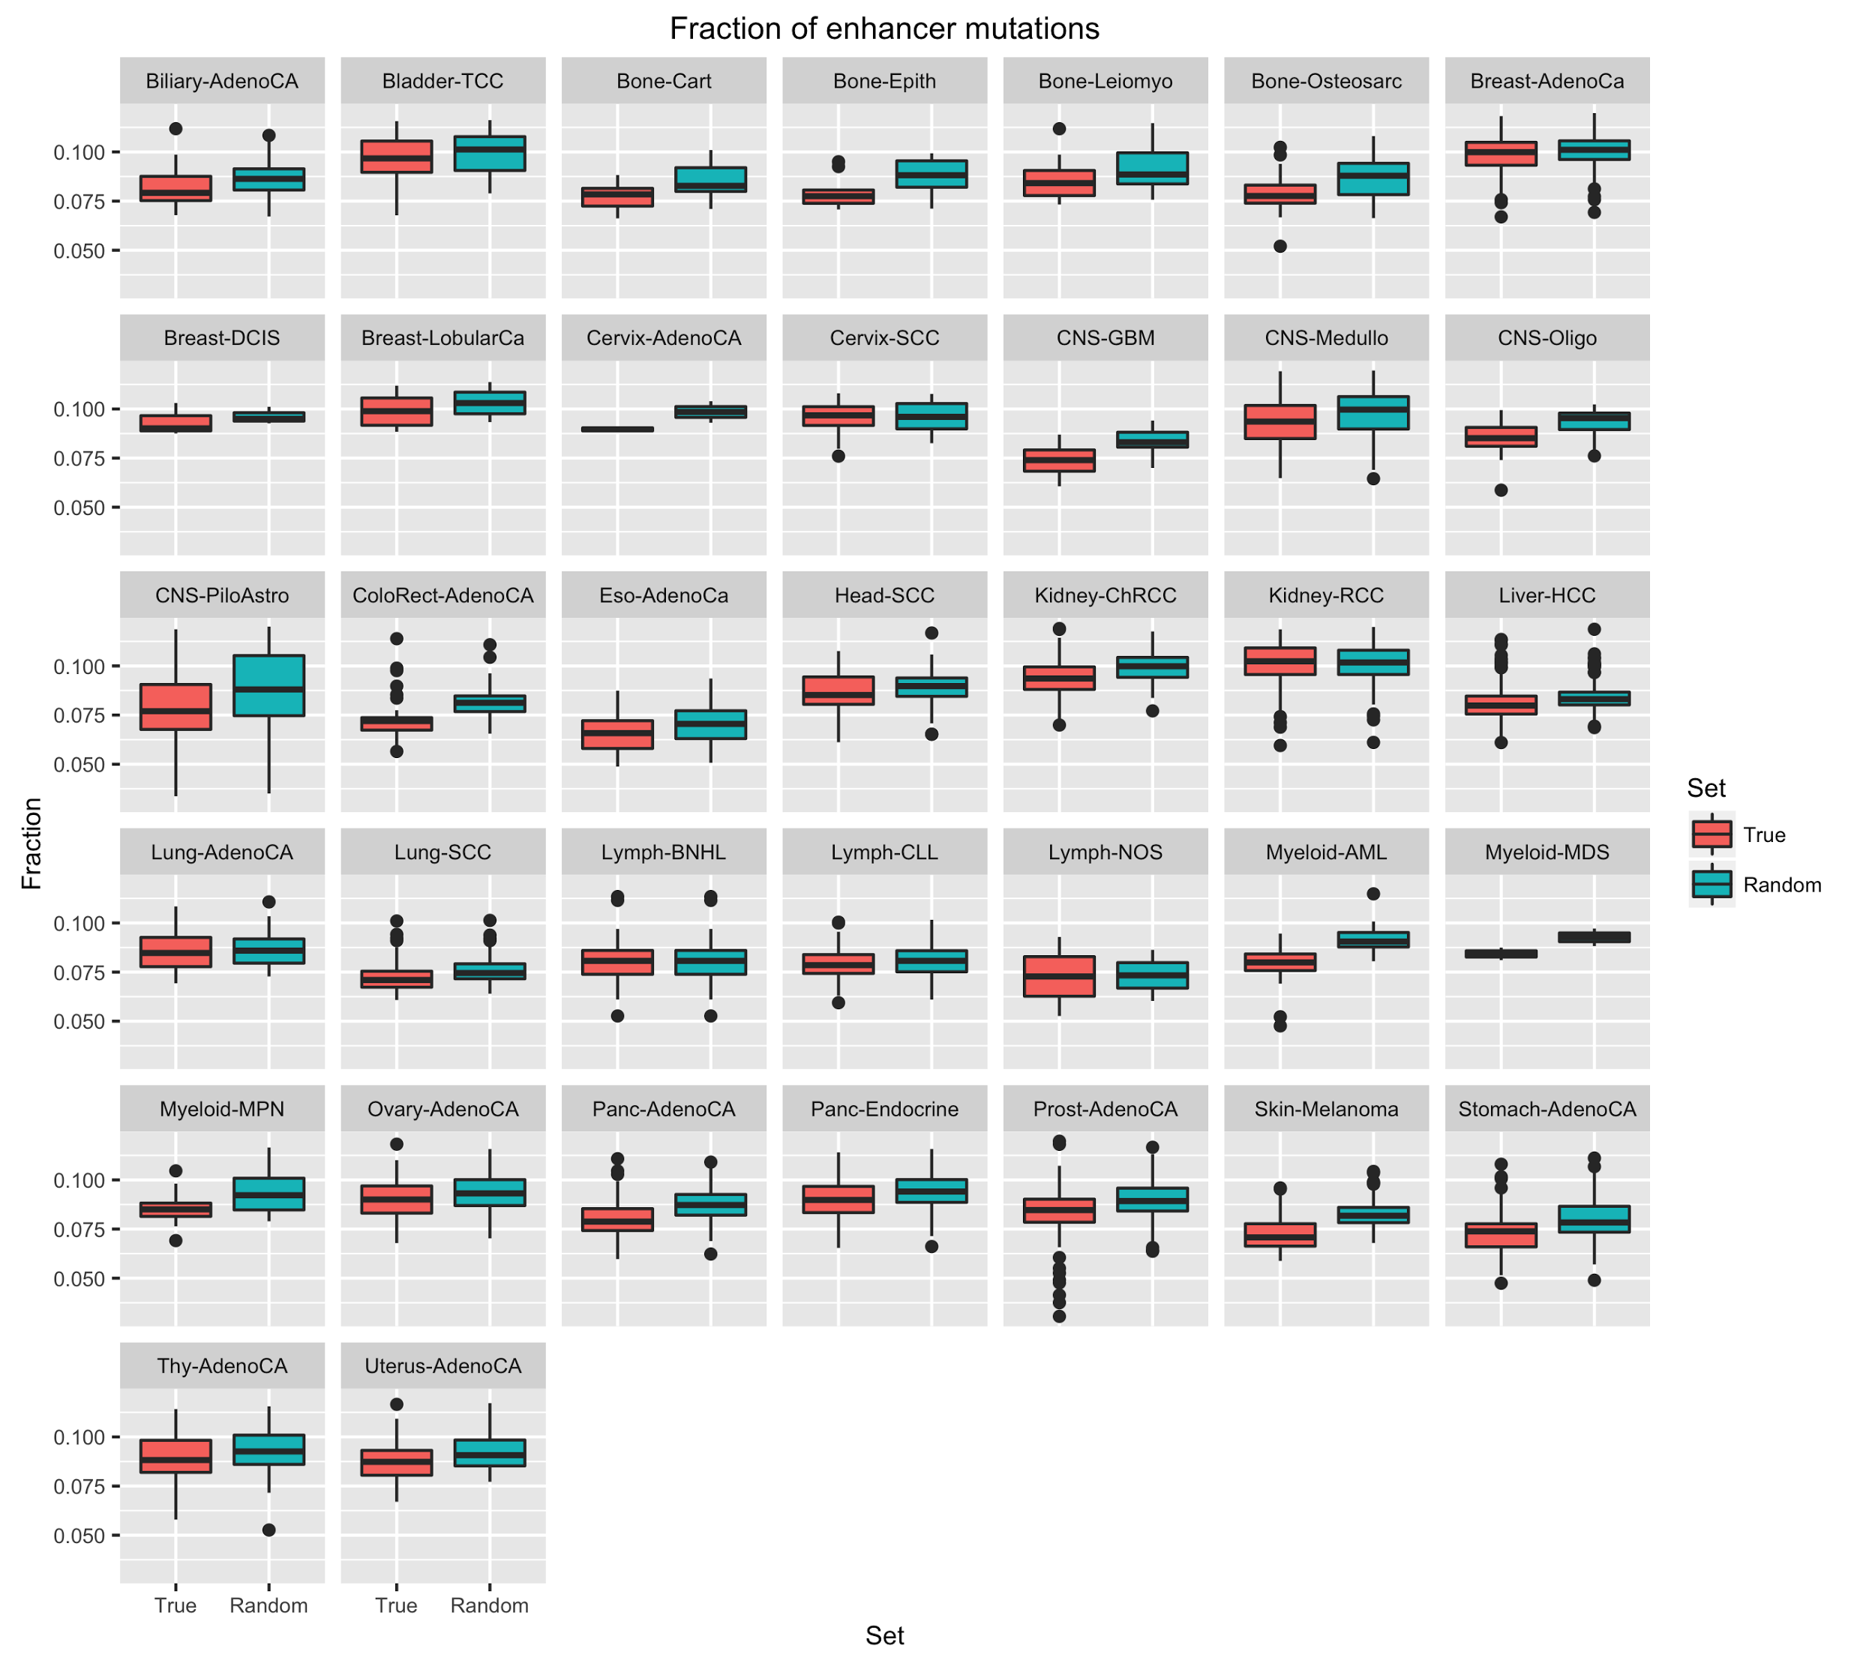

Slide 14
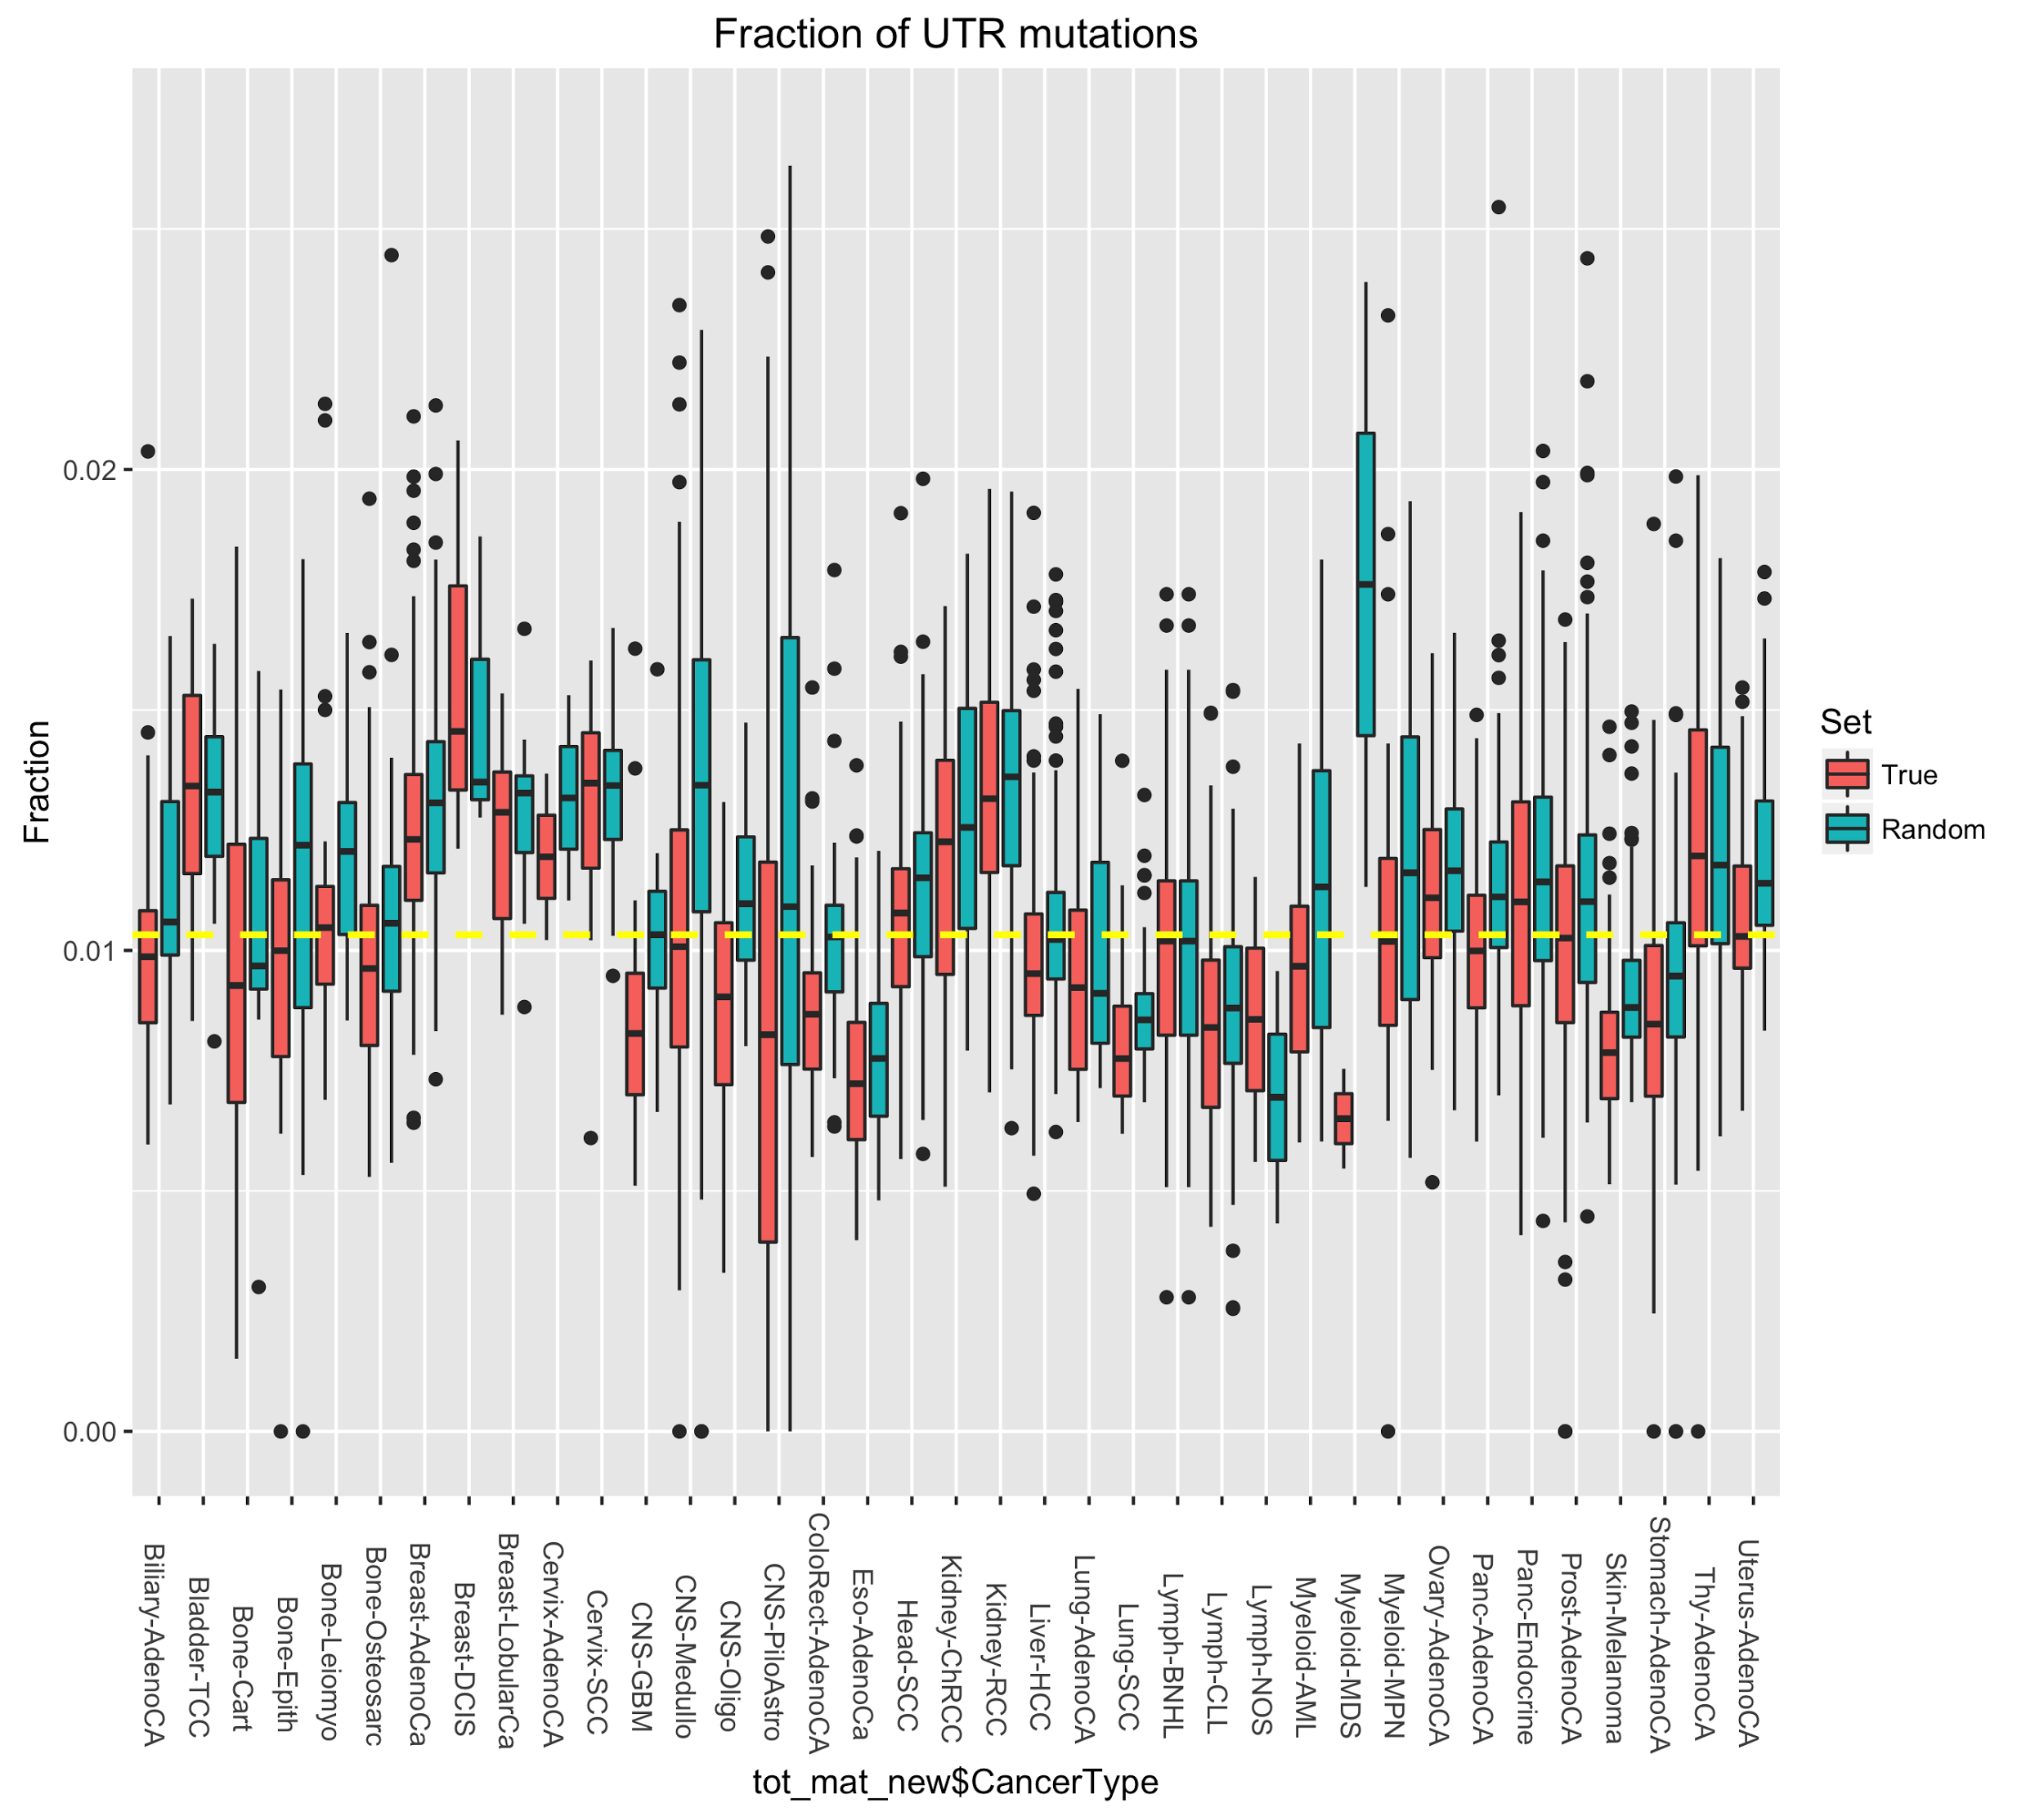

Slide 15
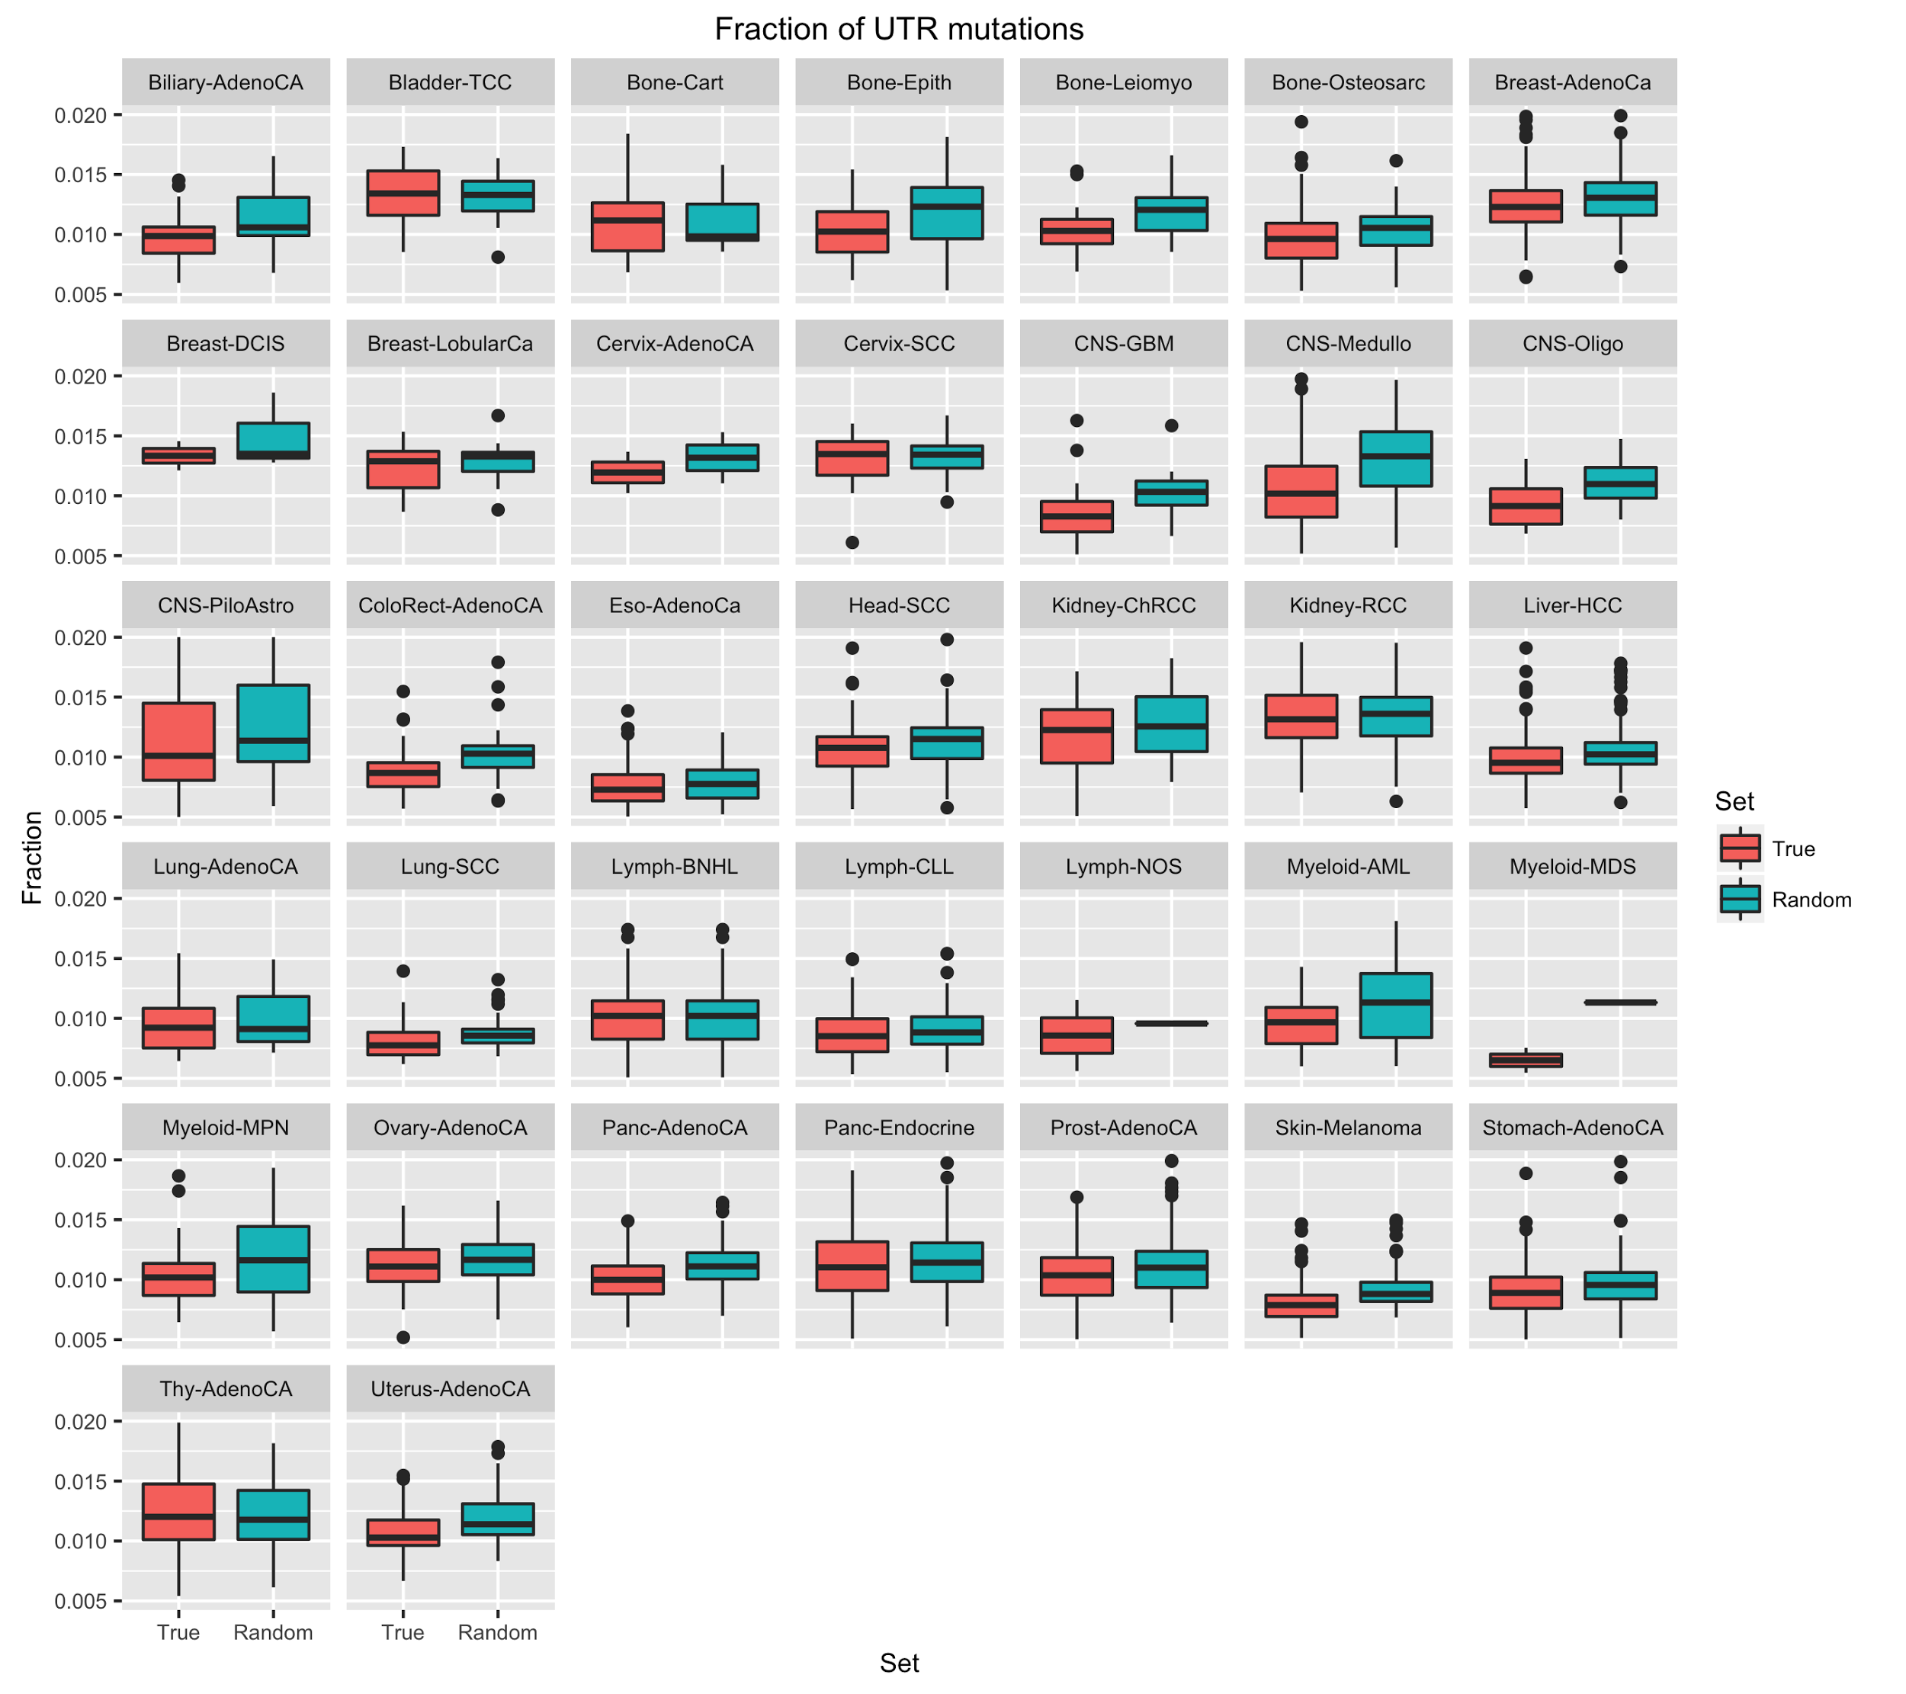

Slide 16
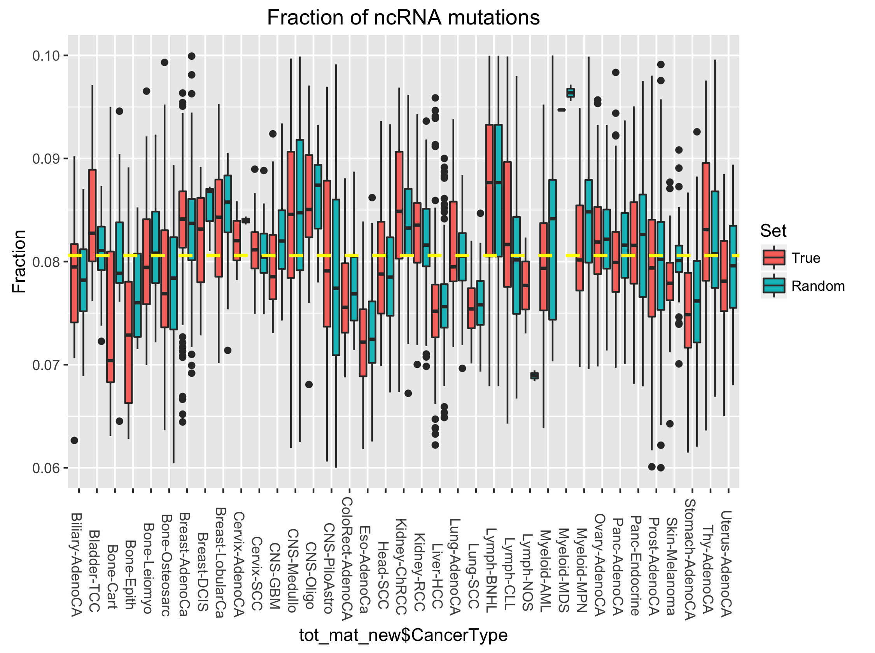

Slide 17
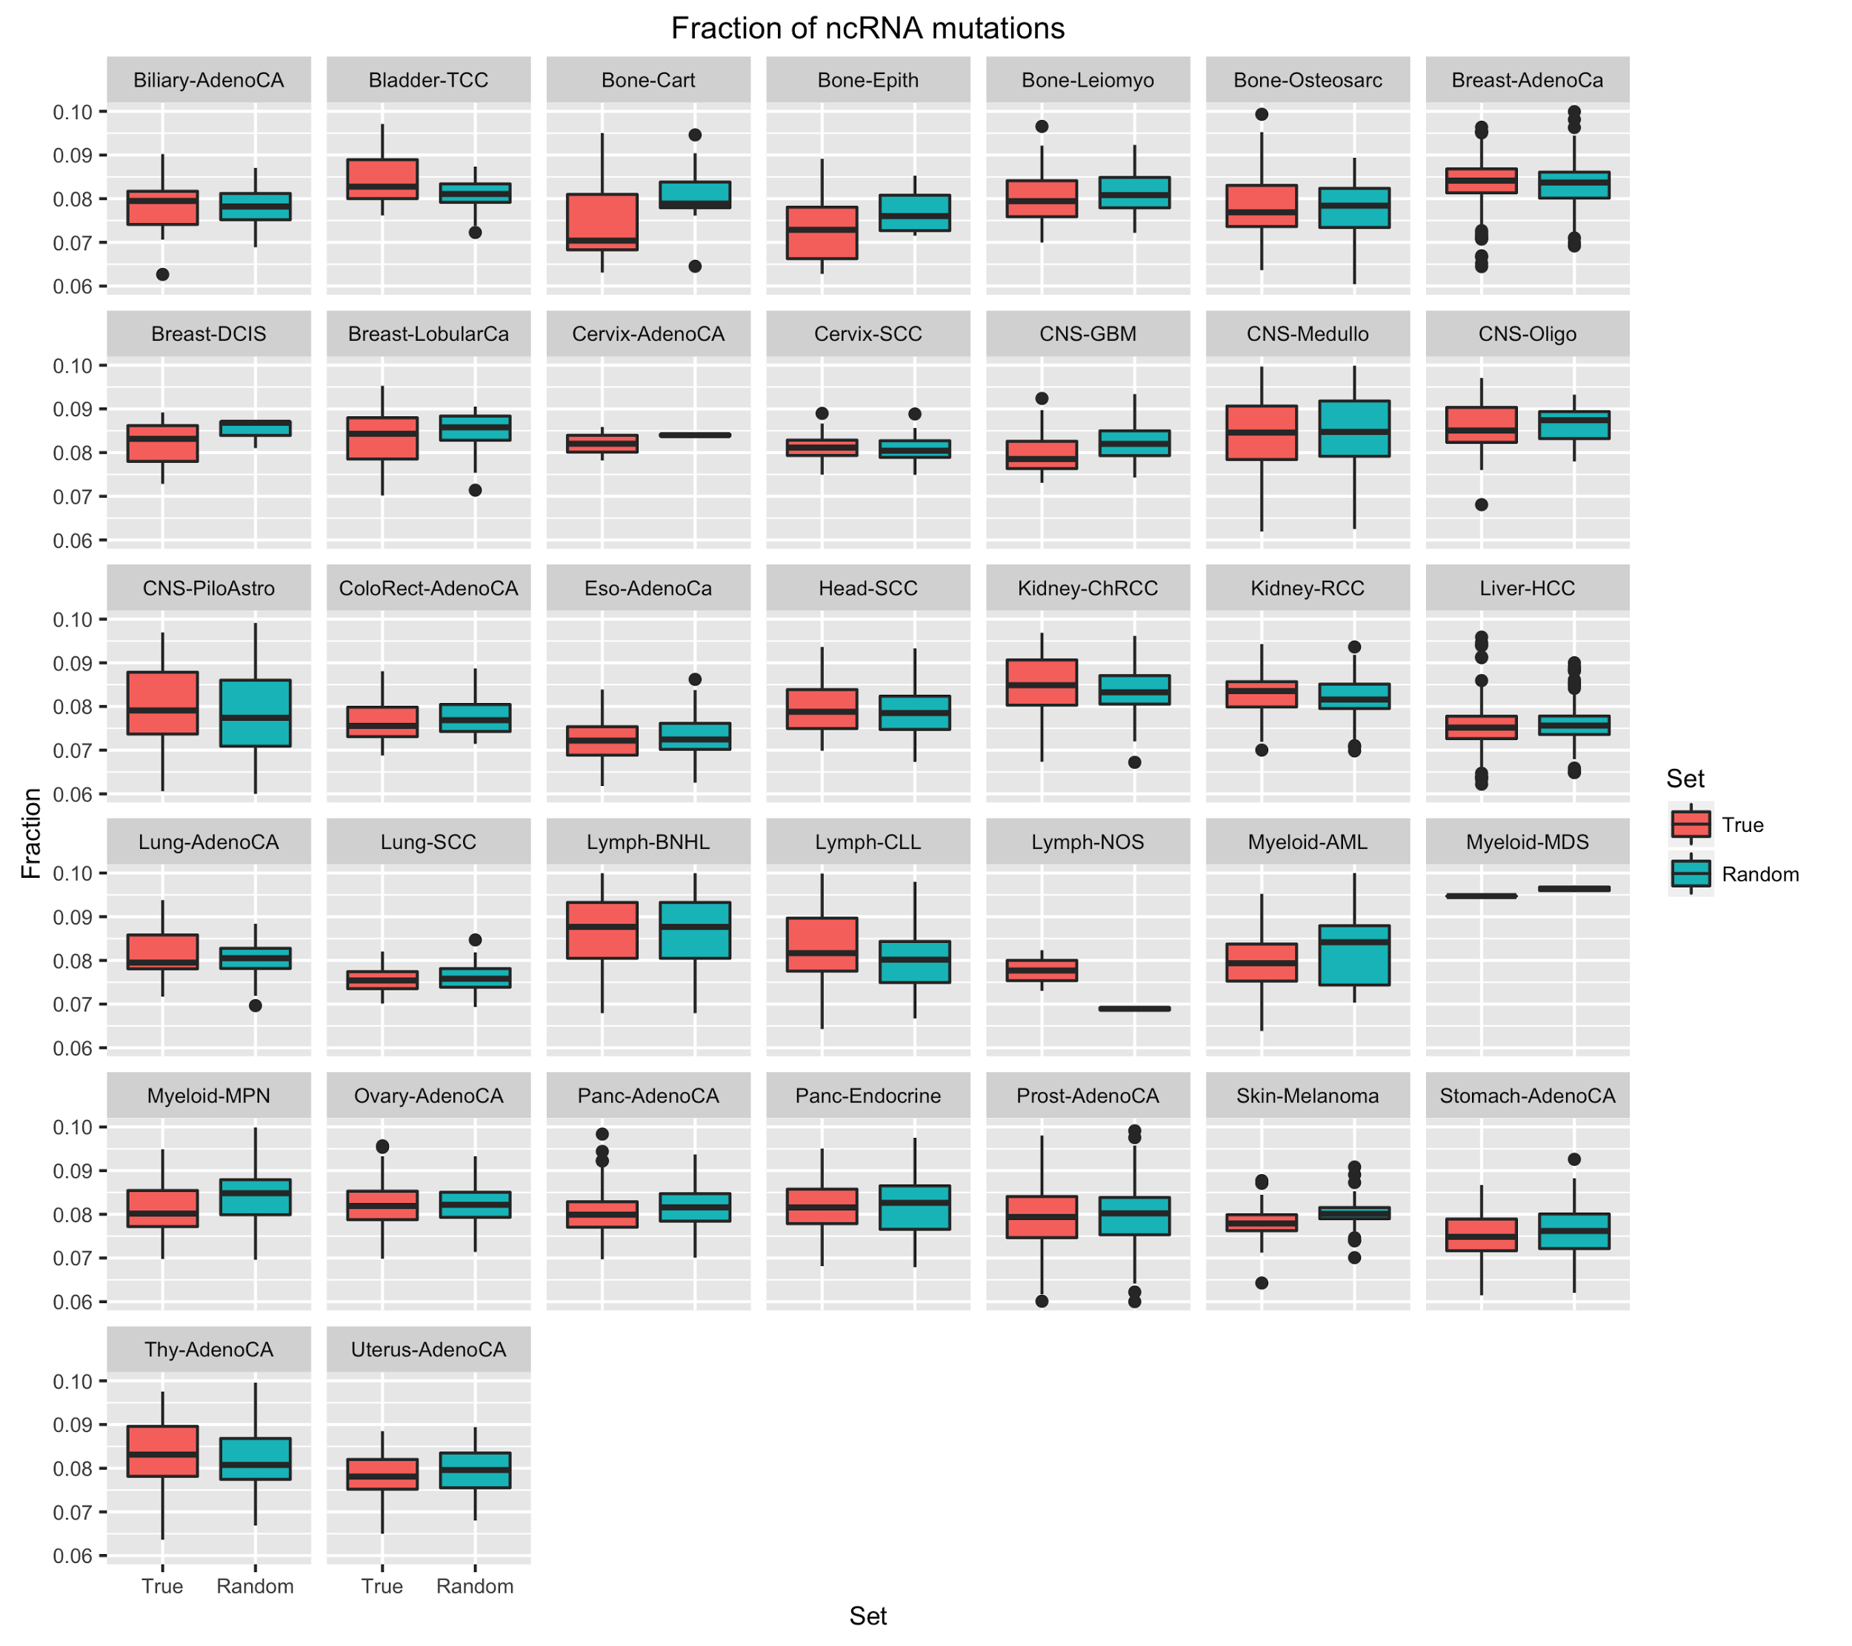

Slide 18
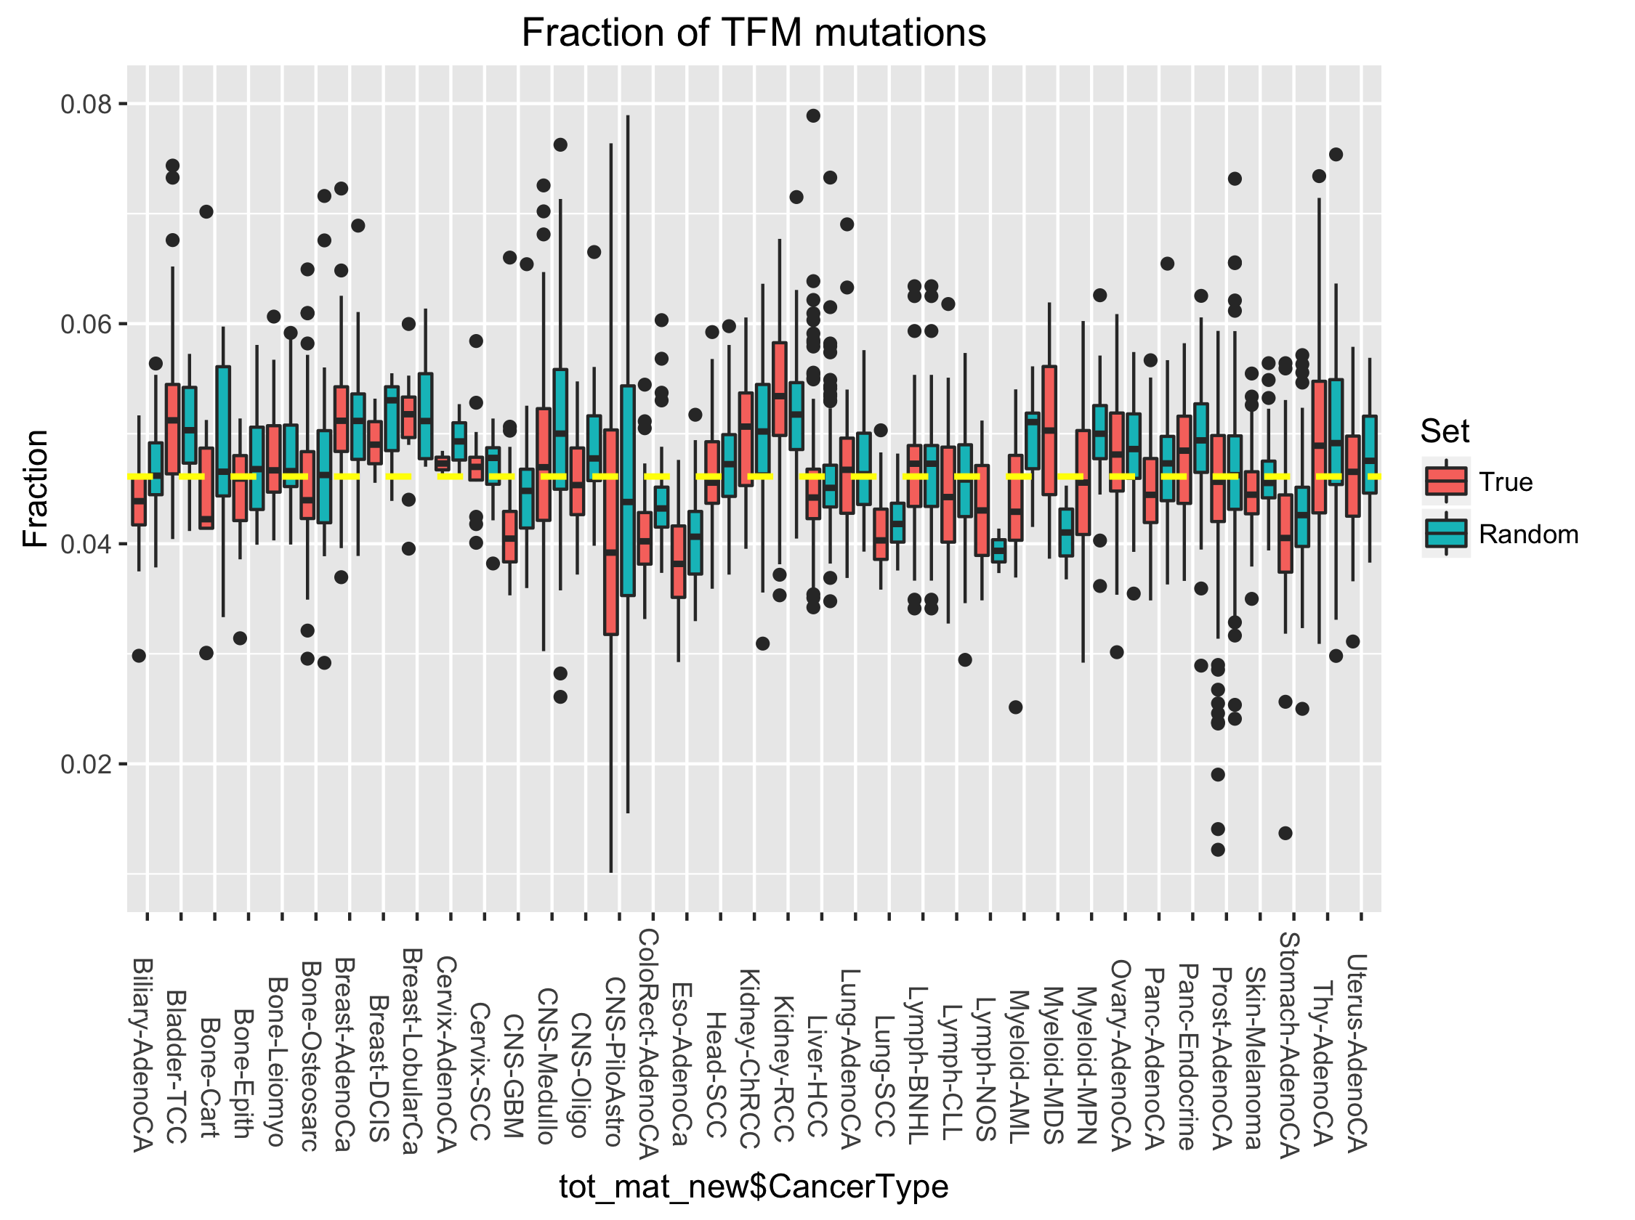

Slide 19
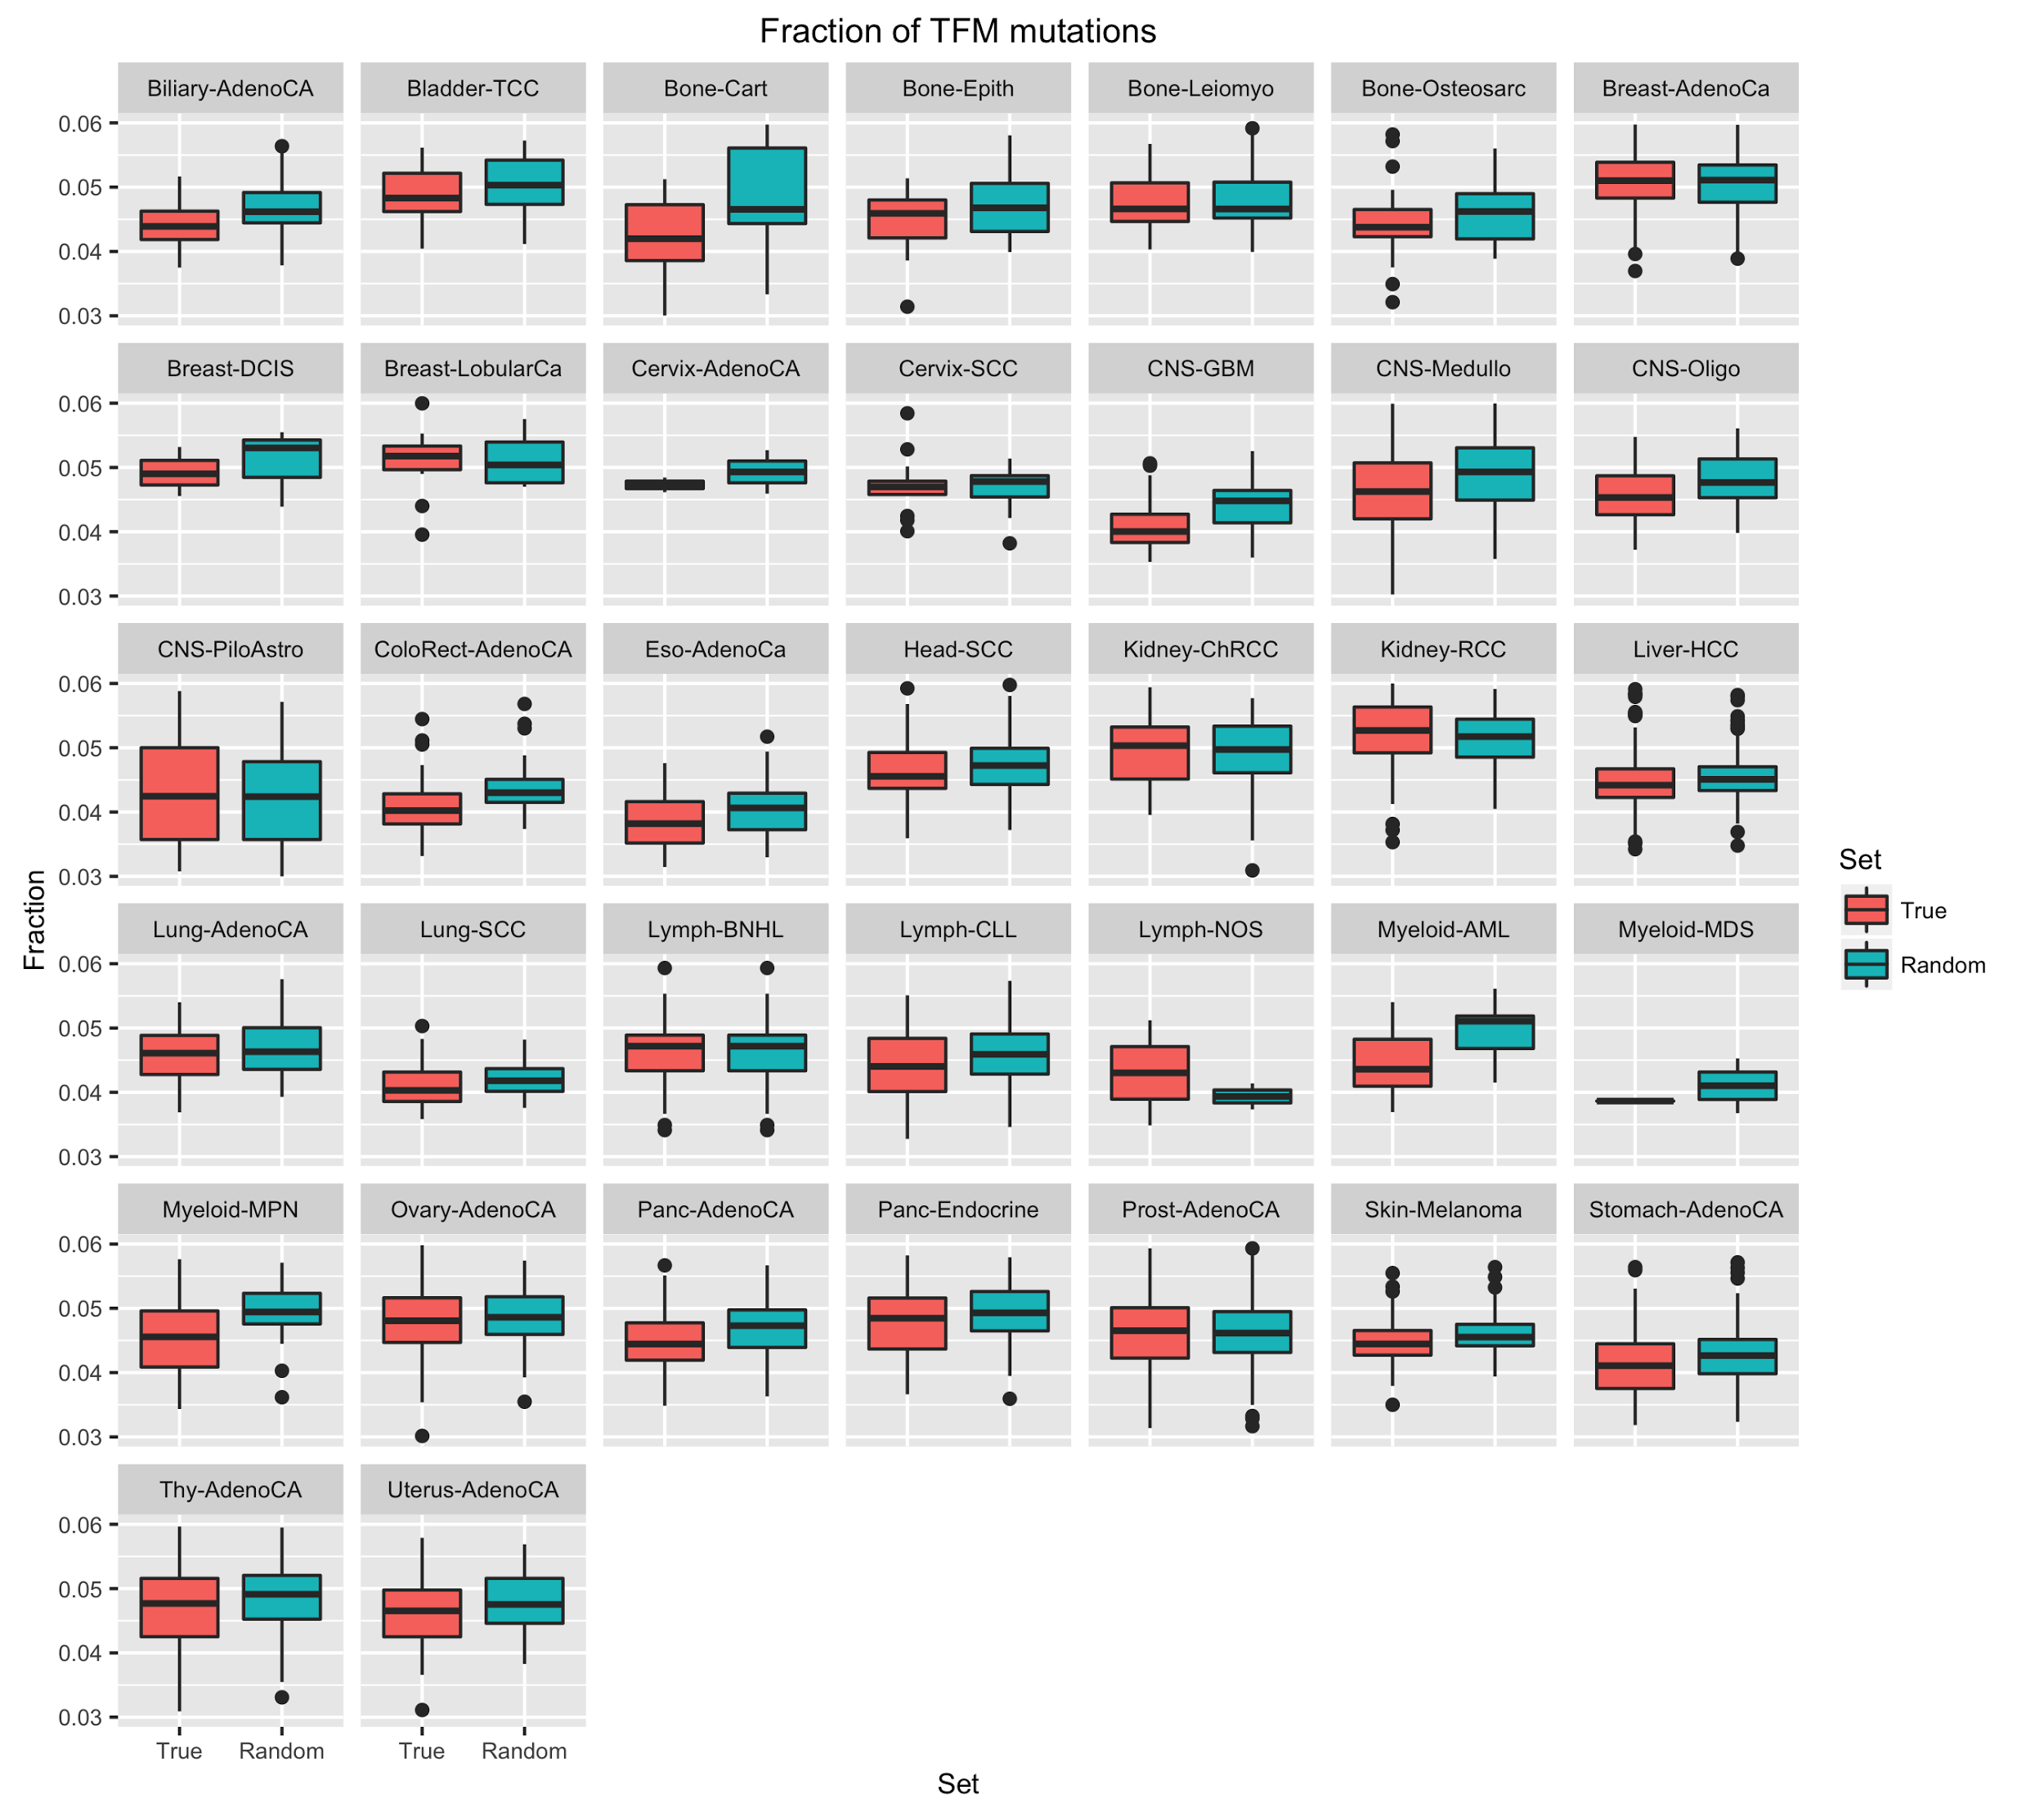

Slide 20
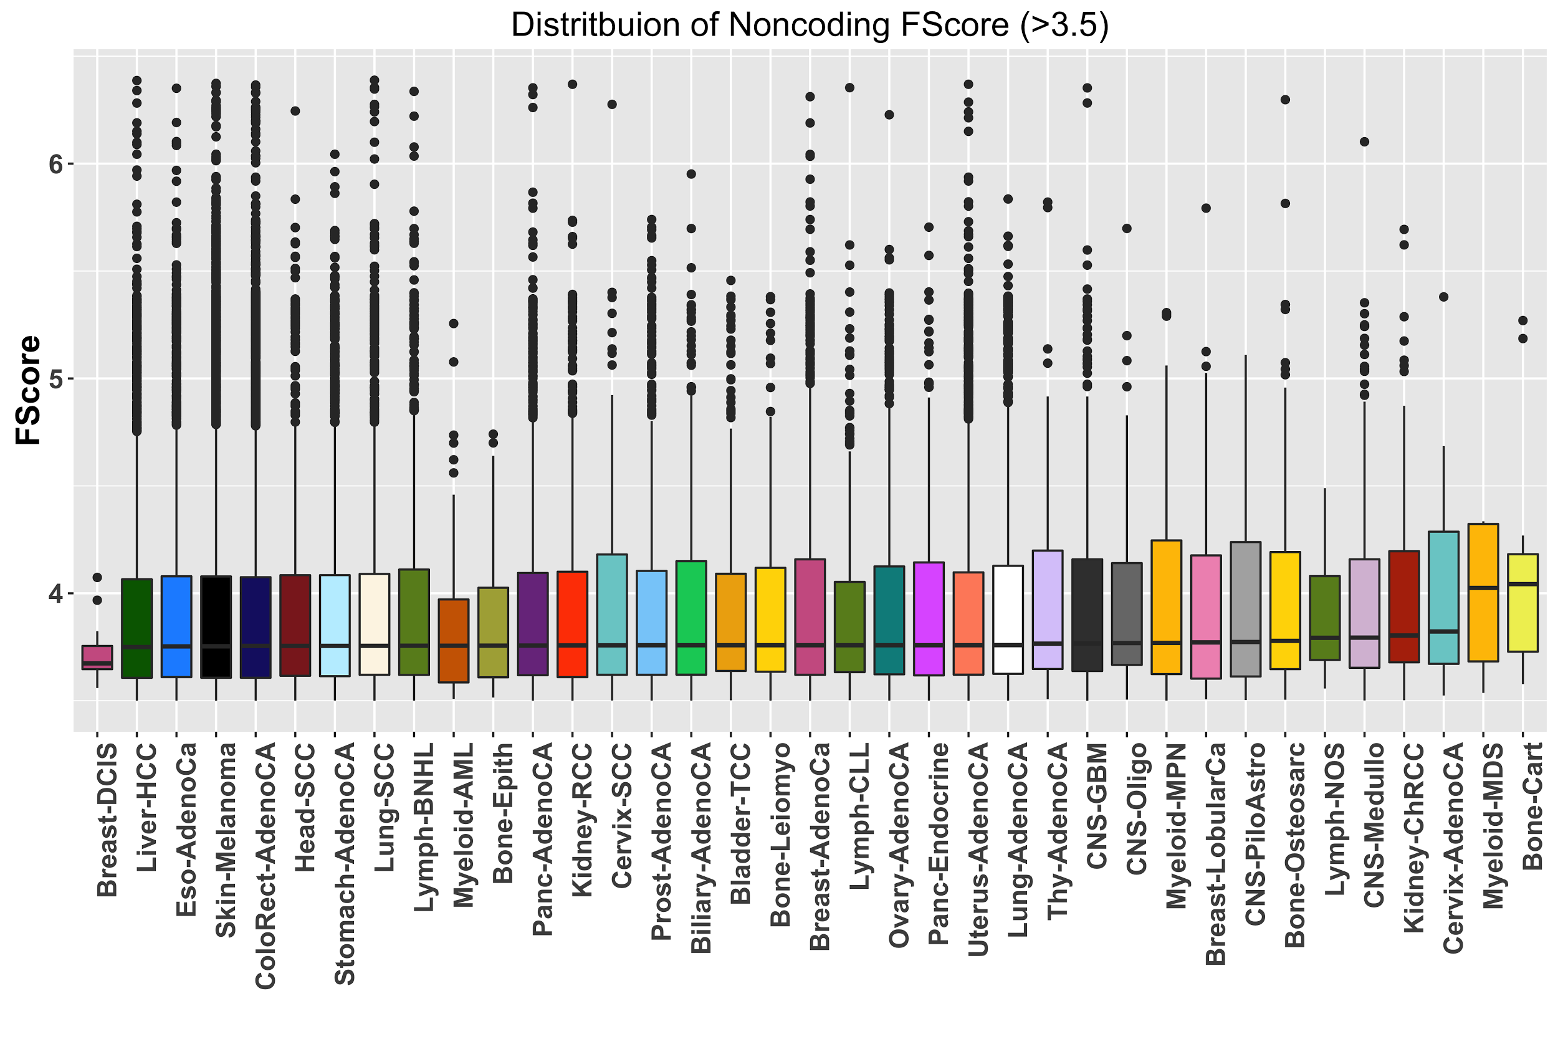
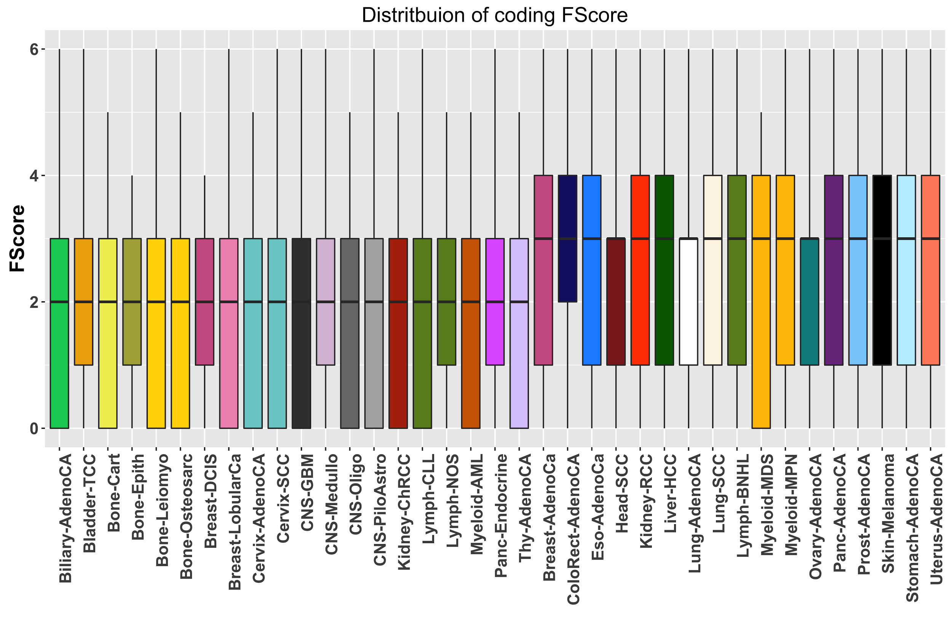
Functional impact score distribution of noncoding and coding SNVs

Slide 21
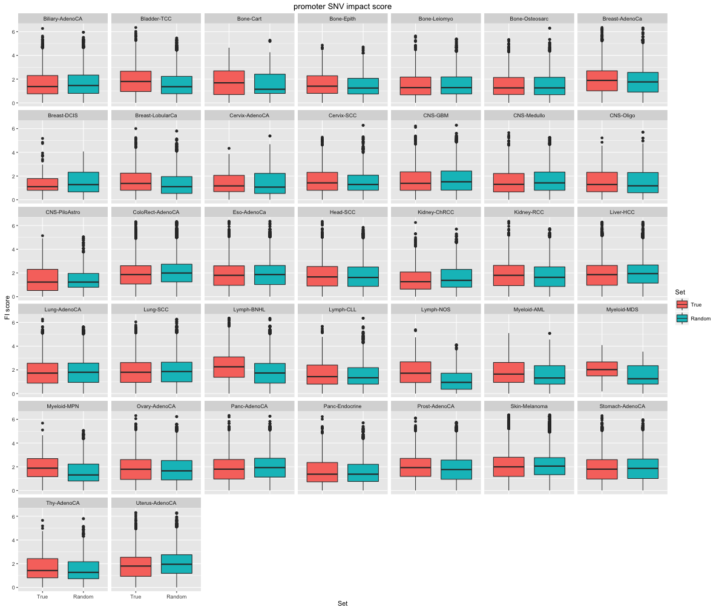
Functional impact score distribution of promoter SNVs :
Broad randomization

Slide 22
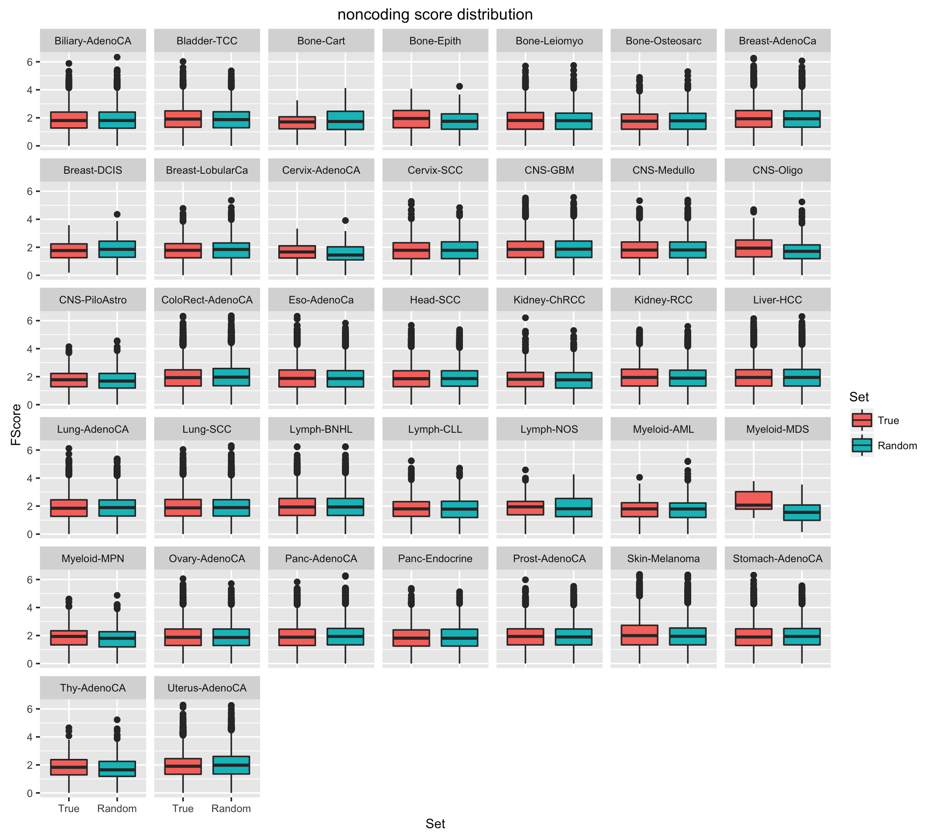
Functional impact score distribution of promoter SNVs:
Sanger randomization

Slide 23
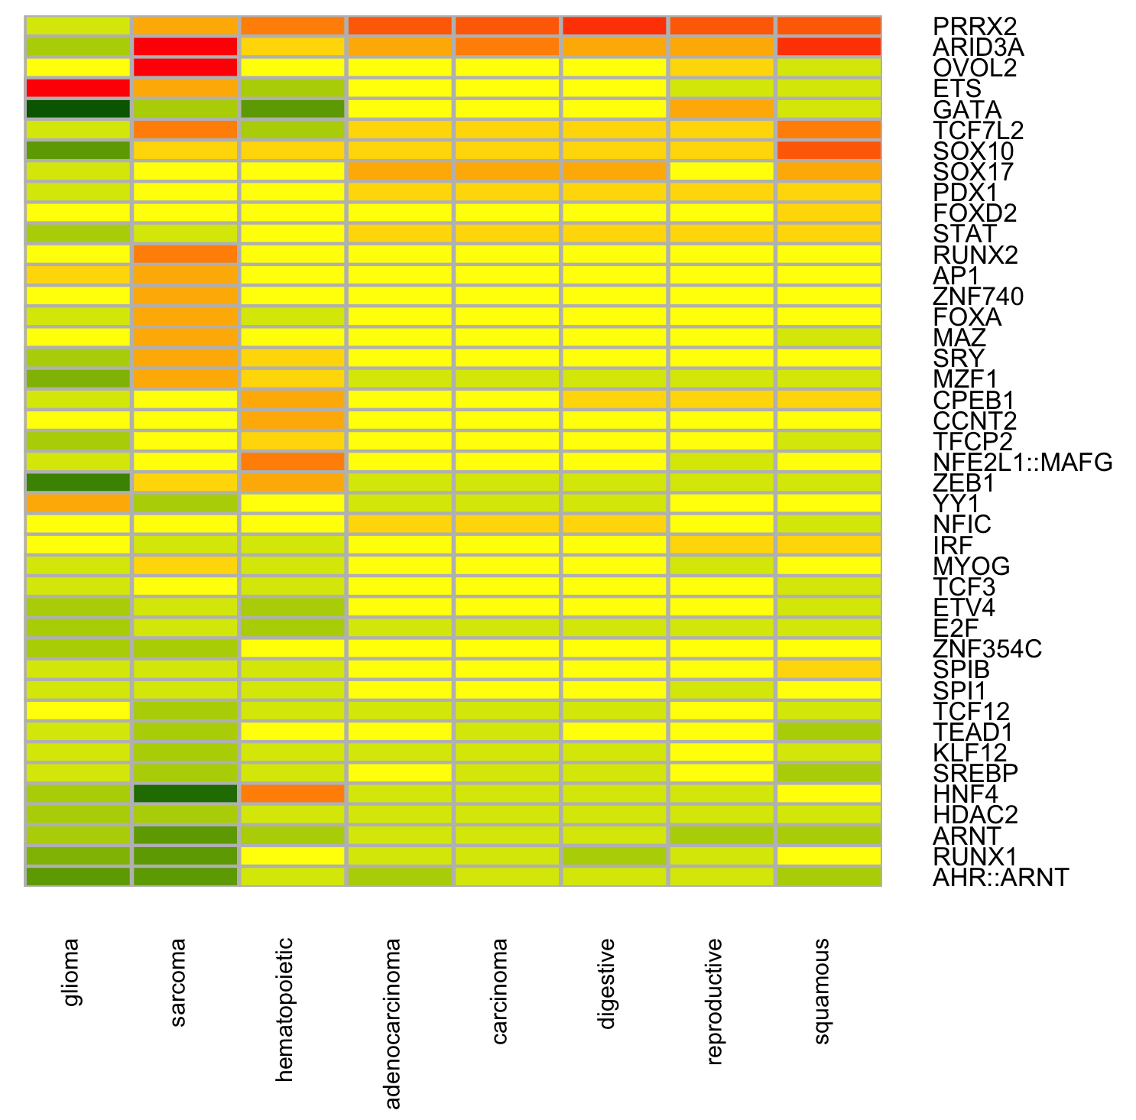
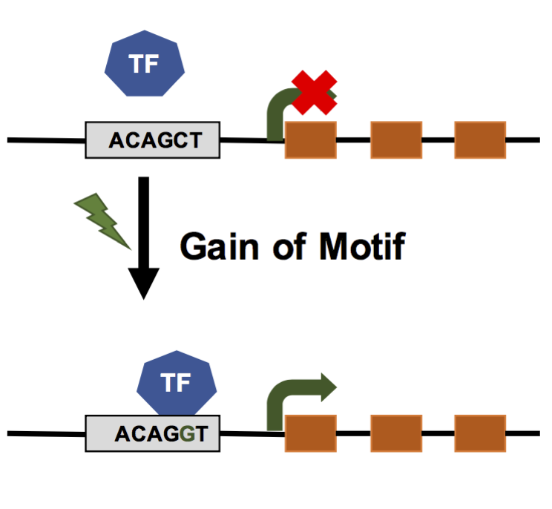
Functional burden of SNVs influencing TF motifs

Slide 24
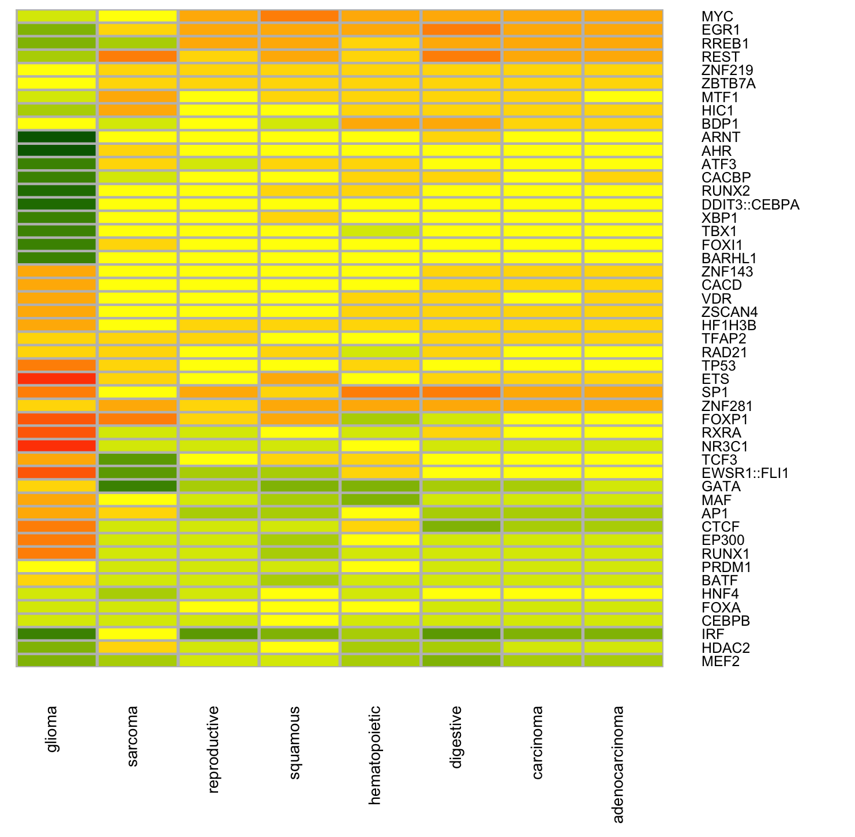
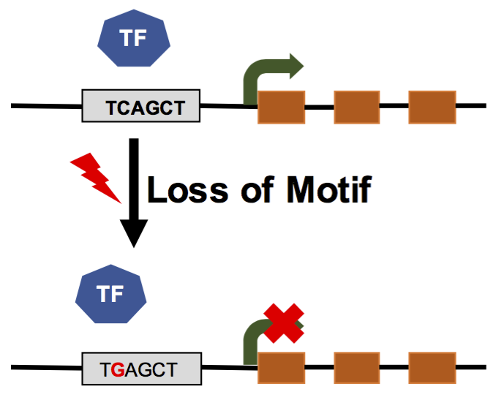
Functional burden of SNVs influencing TF motifs

Slide 25
Ongoing work
SV enrichment and impact score calculations
Closer inspection of deleterious passenger variants
Correlating functional burdening with clinical data, clonality and signature data

