Slide 1
Peak calling using difference controls
Jinrui Xu
11/21/2016
P2

Slide 2
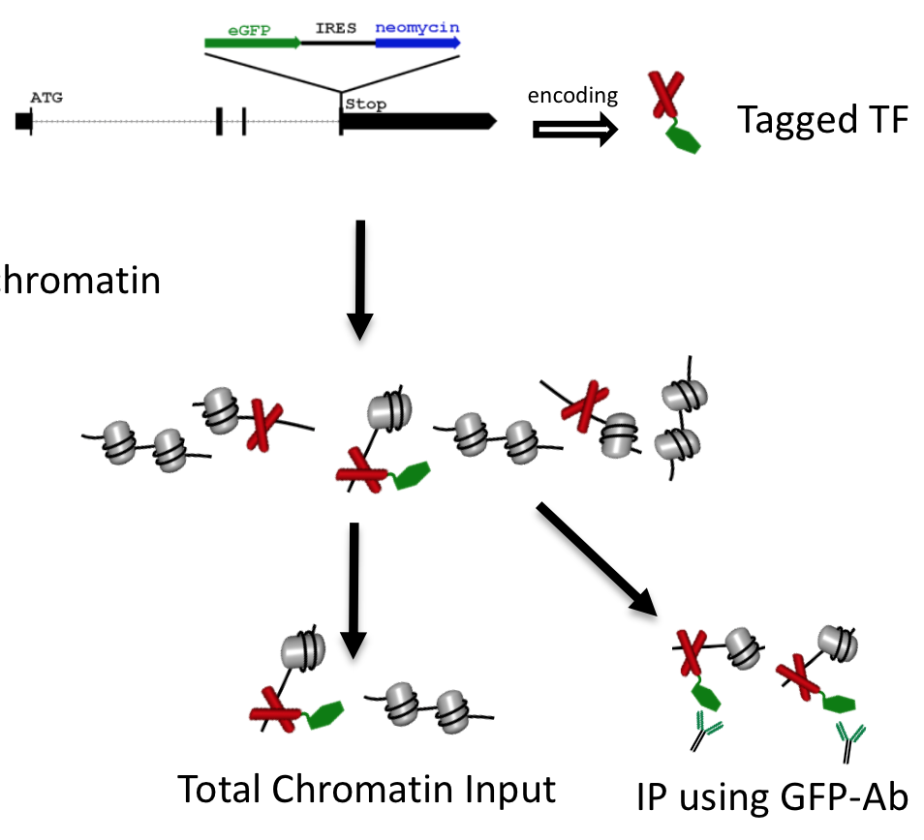
modERN ChIP-Seq experiment
Read profiles
a’
a

Slide 3
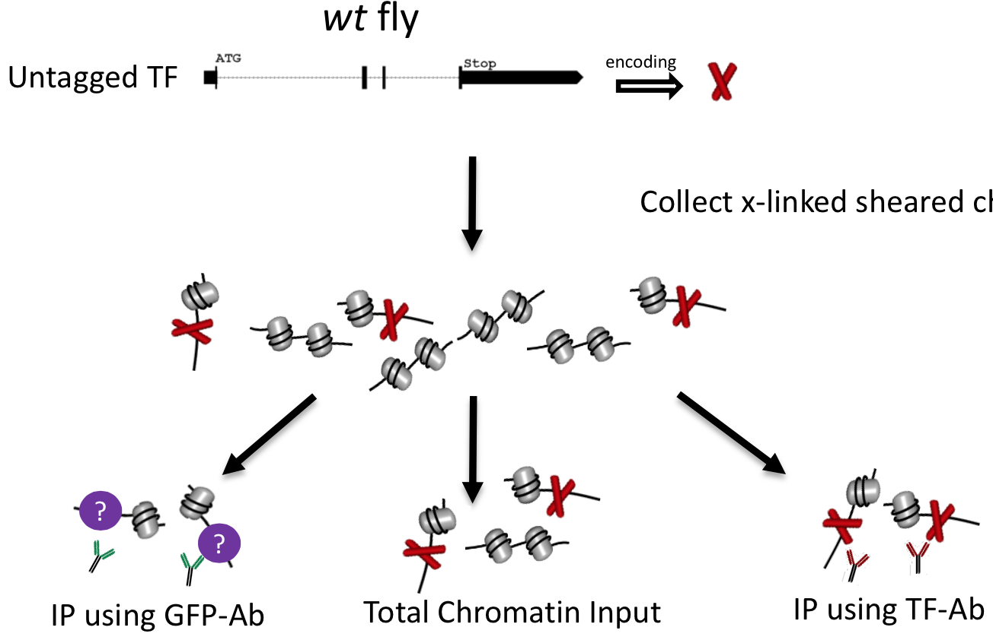
Control experiment 1
b’’
b’

Slide 4
Control experiment 2
Mutant fly expressing nls-GFP
c’’
c’

Slide 5
modERN ChIP-Seq: TF is fused with a GFP
a: reads of IP (GFP-Antibody)
a’: reads of DNA input
Control experiments
Experiment 1: wt-fly (no GFP)
b’: reads of DNA input
b’’: reads of IP (GFP-Antibody)
Experiment 2: mt-fly with nls-GFP expressed
c’: reads of DNA input
c’’: reads of IP (GFP-Antibody)
‘ is for control

Slide 6
X/Y: call peaks from X using Y as control; e.g. a/a’, current modERN peaks
To check effect of b’’ or c’’ on peak calling:
Relative frequency, e.g., NO. of sig. peaks from a/b’’ over that from a/a’

Slide 7
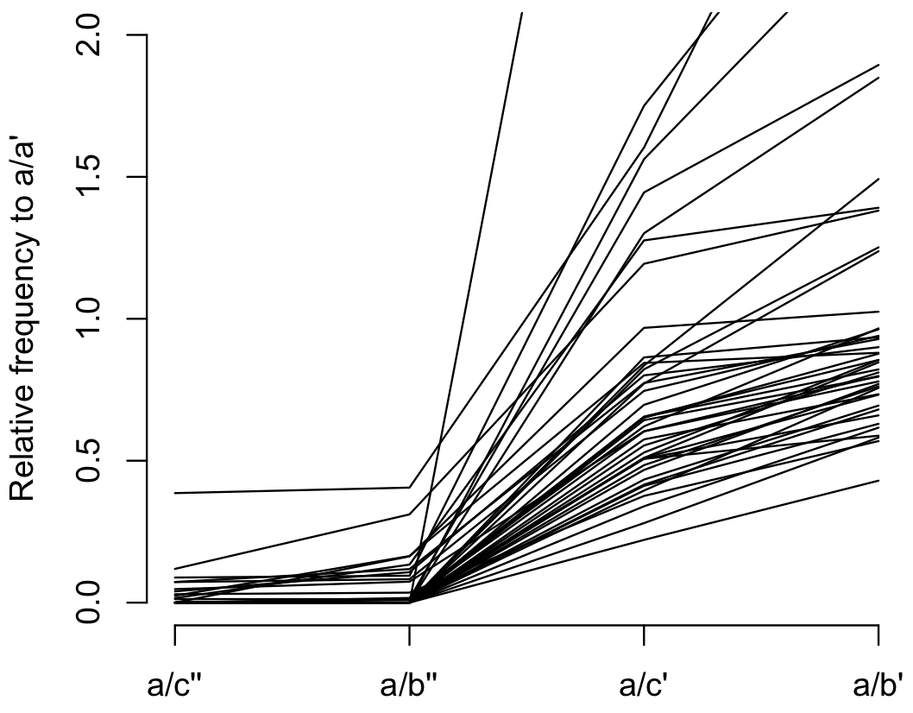
Each line represents a TF
Median/Ave
0/0.02
0/0.04
0.64/0.82
0.85/1.2
b’’ and c’’ substantially reduce NO. of peaks
a/c’’ and a/b’’ are similarly small, suggesting GFP-Antibody is the key factor

Slide 8
A substantial fraction of peaks in a/b’’ fails to pass FDR cutoff 0.01, compared to a/a’
b’’ also has many high peaks (much more than a’)
Genomic location problem

Slide 9
Another problem
Each line represents a TF
Median/Ave
0/0.02
0/0.04
0.64/0.82
0.85/1.2
c’ and b’ also significantly reduce peaks
It is not fair to compare across experiments. e.g. a/b’

Slide 10
b’’ is influenced by b’
Not fair to do a/b’’: a and b’’ from different experiments
If b’’ = b’f(..), the f may render a small change in b’ causes large change in b’’,which influence a/b’’ substantially.
Cross-experiment comparison

Slide 11
Subtract b’ influence on b’’ using “enrichment test”
i.e. compare a/a’ and b’’/b’ to call peaks
One example
TF: CG30403,
a/a’ peaks: 8225
a/b’’ peaks: 82

Slide 12
a/a’ => 8225 candidate peaks
For each of the peak regions, calculate
nr.a: NO. of reads mapped to the peak region in a
nr.a’: NO. of reads mapped to the peak region in a’
nr.b’’: NO. of reads mapped to the peak region in b’’
nr.b’: NO. of reads mapped to the peak region in b’
Note that the NO. of reads has been normalized by the tot sequencing reads

Slide 13
A contingency table:
nr.a vs nr.a’
nr.b’’ vs nr.b’
p-value of this table using fisher test
Totally, 8225 p-values => q-values (by qvaule)
481 significant peaks at FDR = 0.01 (r package: qvalue, ref. Storey 2008)

Slide 15
