Slide 2
(A)
(B)
(C)
(D)
TP53
HIST1H2AH
PIK3CA
HIST1H3D
HIST1H3G
CBFB
TBC1D31
PURA
AKT1
H2AFJ
PTEN
PLXNA3
CDH9
HIST1H2BO

Slide 4
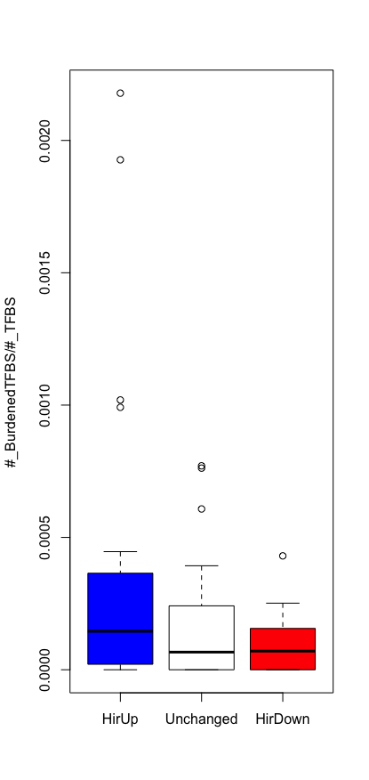
Active in K562
Active in G
Stay Less Active in Both
Stay More Active in Both
0.272
0.170
0.125

Slide 5
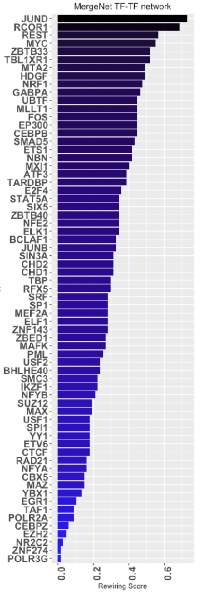
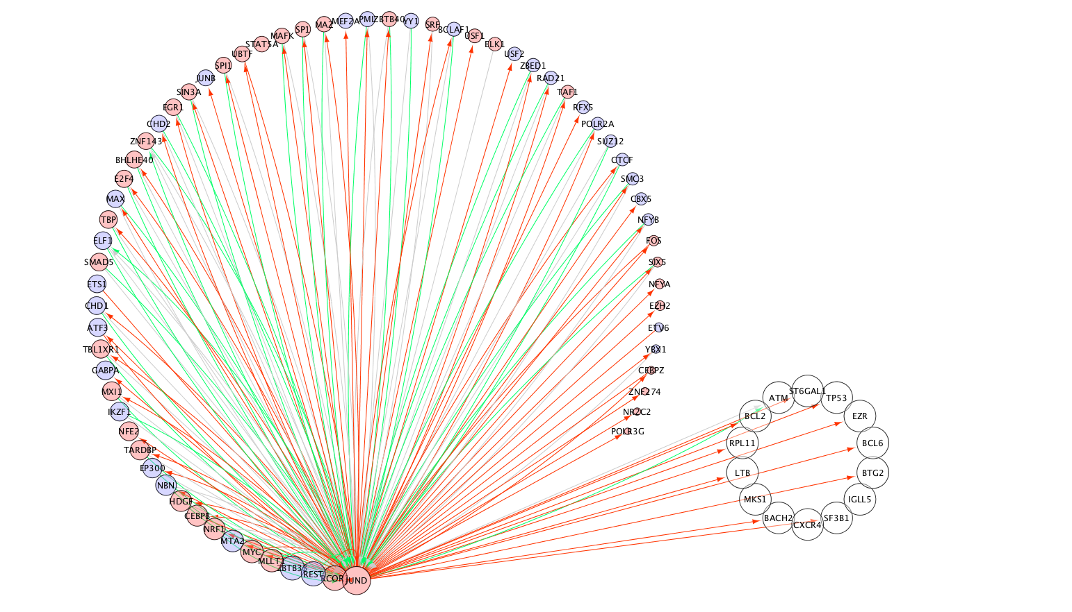

Slide 6
