Slide 1
Burden in Blood Cancer
JZ, DL, AH, KKY, KY,

Slide 2
 | K562 |  |  |  | GM12878
Match Filter | distal |  |  | proximal | distal | proximal
Internal Removal | 45802 |  |  |  | 45203
 | 34071 |  |  |  | 33943
Merge | 22001 |  |  |  | 21603
xEnhancerSeq | 12869 |  |  |  | 6293
 | 5069 | 7800 |  |  | 1892 | 4401
With KY target prediction | 8672 |  |  |  | 4449
 | 2855 |  | 5817 |  | 1140 | 3309
HiC q= 0.1 | 1051 |  |  | 2861 | 768 | 2602
HiC q=0.05 | 951 |  |  | 2617 | 758 | 2561
Length of enhancers:
Min. 1st Qu. Median Mean 3rd Qu. Max.
389 941 1219 1647 2030 9452

Slide 3
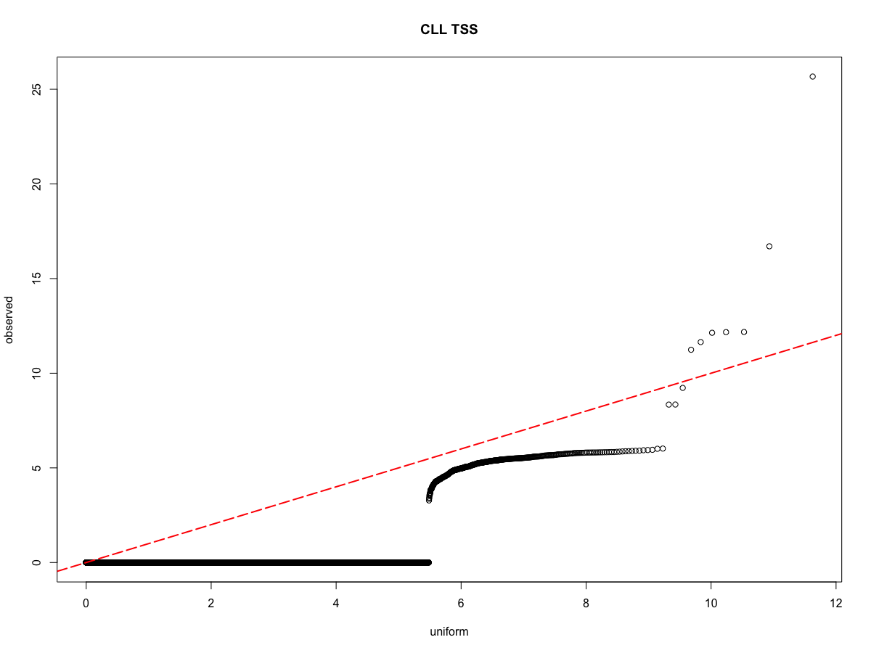
CXCR4 overexpression contributes to tumor growth, invasion, angiogenesis, metastasis, relapse, and therapeutic resistance (PMC4322894 )
CXCR4
BCL2
simultaneous over-expression of Bcl-2 and the proto-oncogene myc may produce aggressive B-cell malignancies including lymphoma

Slide 4
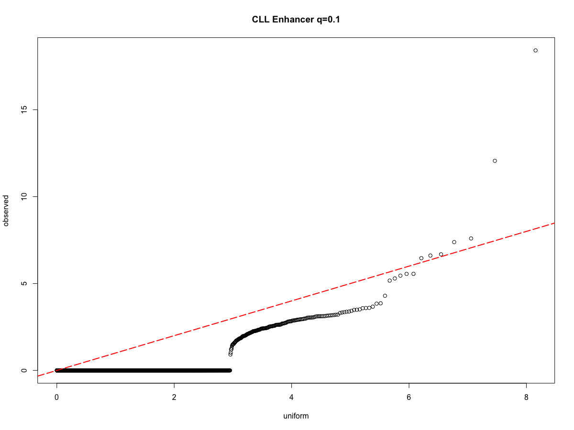
chr17:56408460:56411127
chr3:186714547:186715378

Slide 5
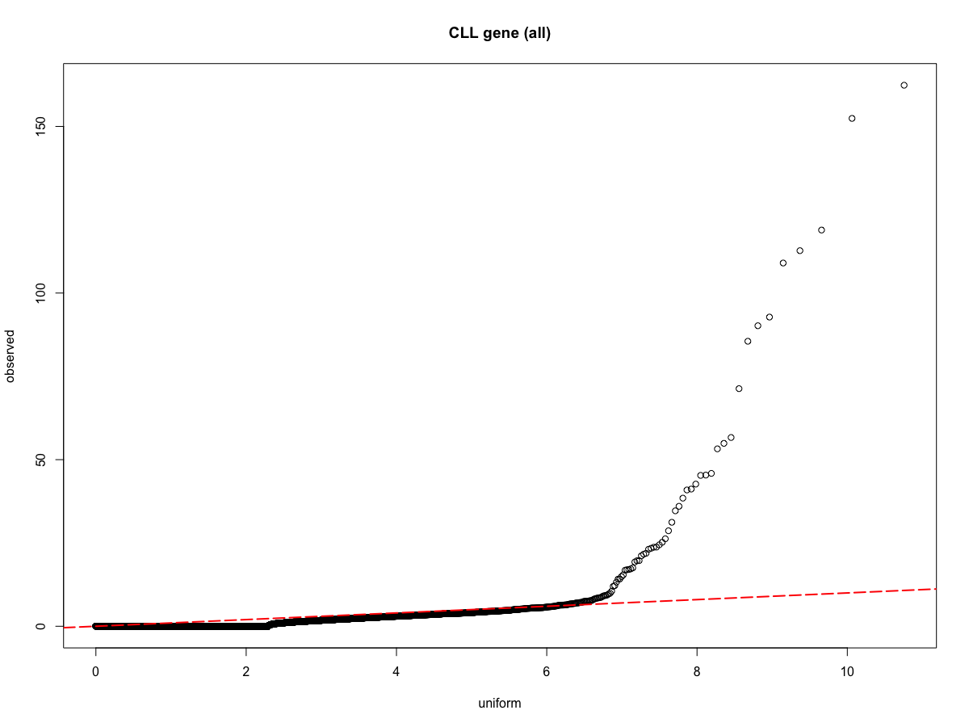
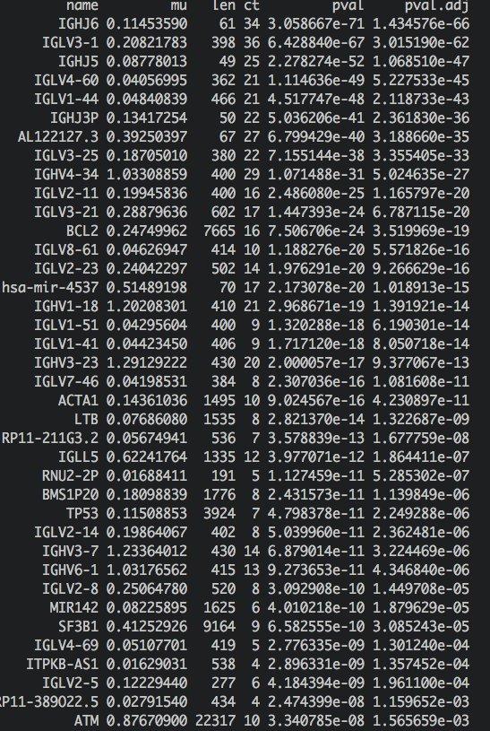
IGHV: mmunoglobulin variable heavy chain
IGLV: Immunoglobulin Lambda Variable
SF3B1: reported in CLL, splicing factor, has eCLIP data & shRNA-seq
BCL2 expression and to be asso ciated with adverse prognostic features in CLL
ATM : predict CLL progression

Slide 6
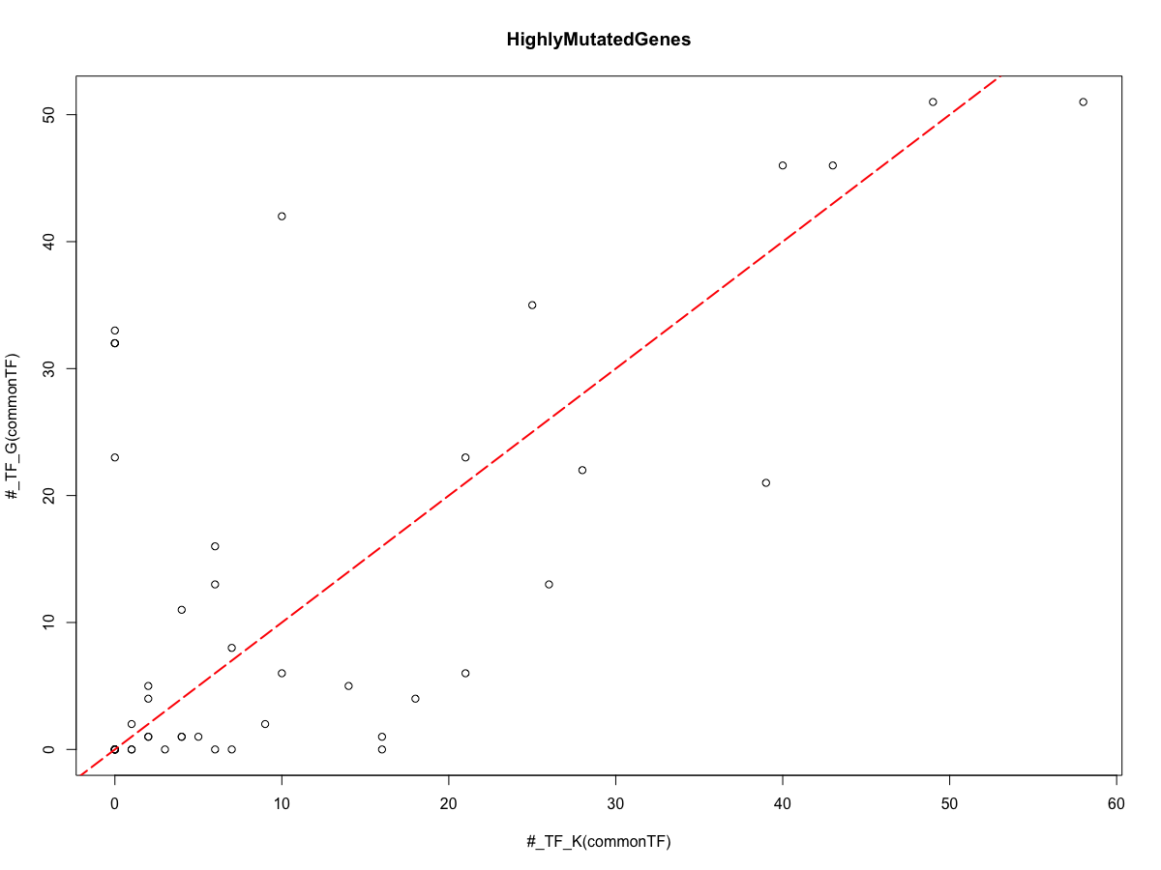

Slide 7
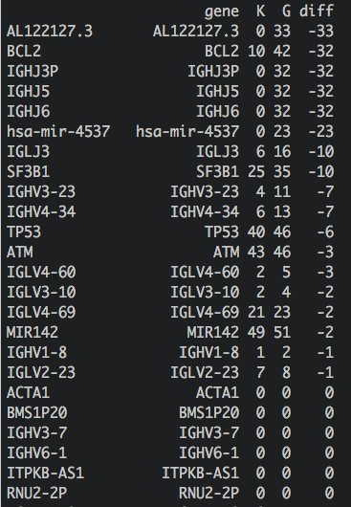
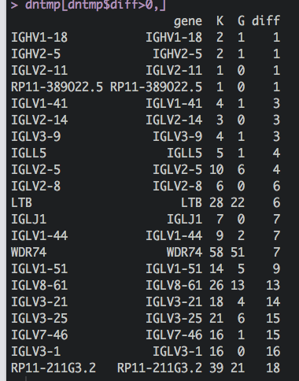

Slide 8
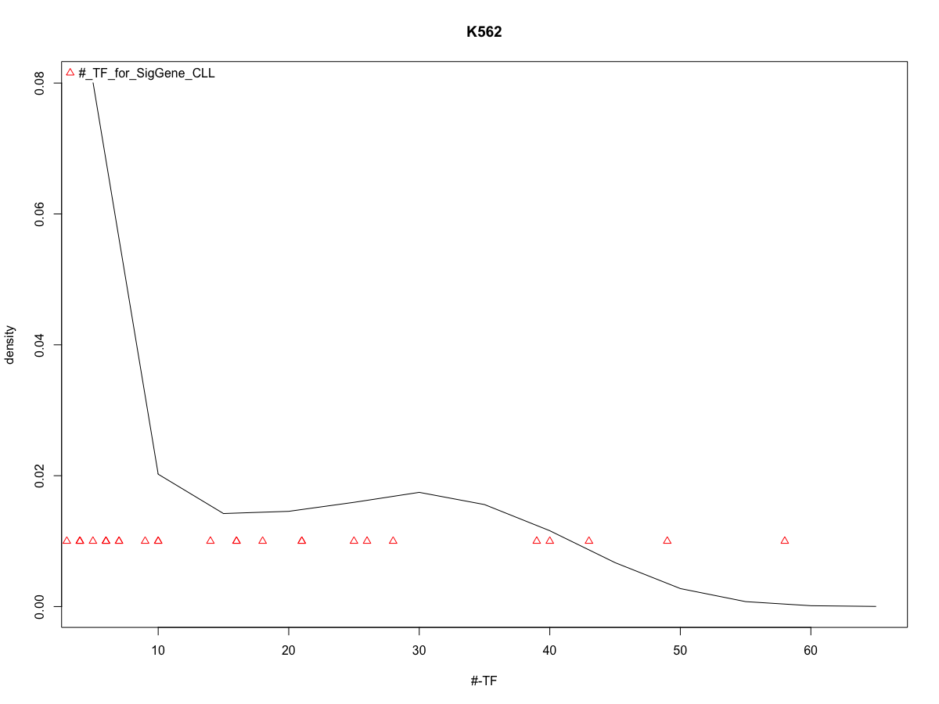

Slide 9
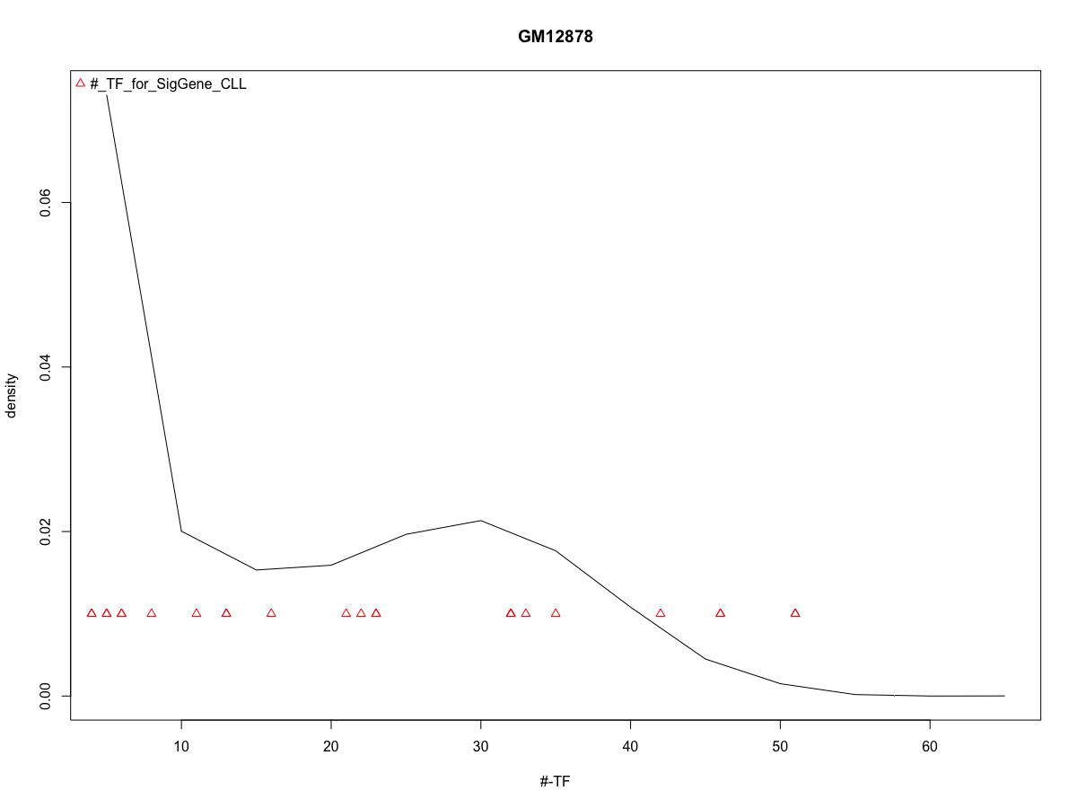

Slide 10

Extended Gene P value: gene+enhancers
45 genes are significant, 1 is new
Extended gene
Two enhancers linked to it:
Nearby to other genes, but remotely regulate MKS1

Slide 11
Exons of Coding Transcripts
Step 1: Coding transcript merging (EXONs + UTR)
Exons of non Coding Transcripts
Merging result
Step 2: Coding TSS merging (EXONs + TSS)
TSS of coding transcripts

Slide 12
±2.5K around coding TSS
Step 3: Key TFBS binding regions
TFBS
Step 4: Link enhancers
Enhancers

Slide 13
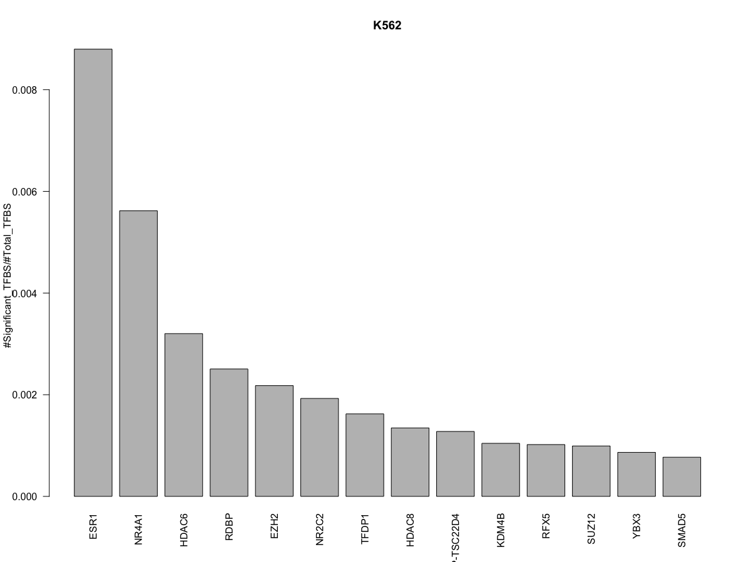

Slide 14
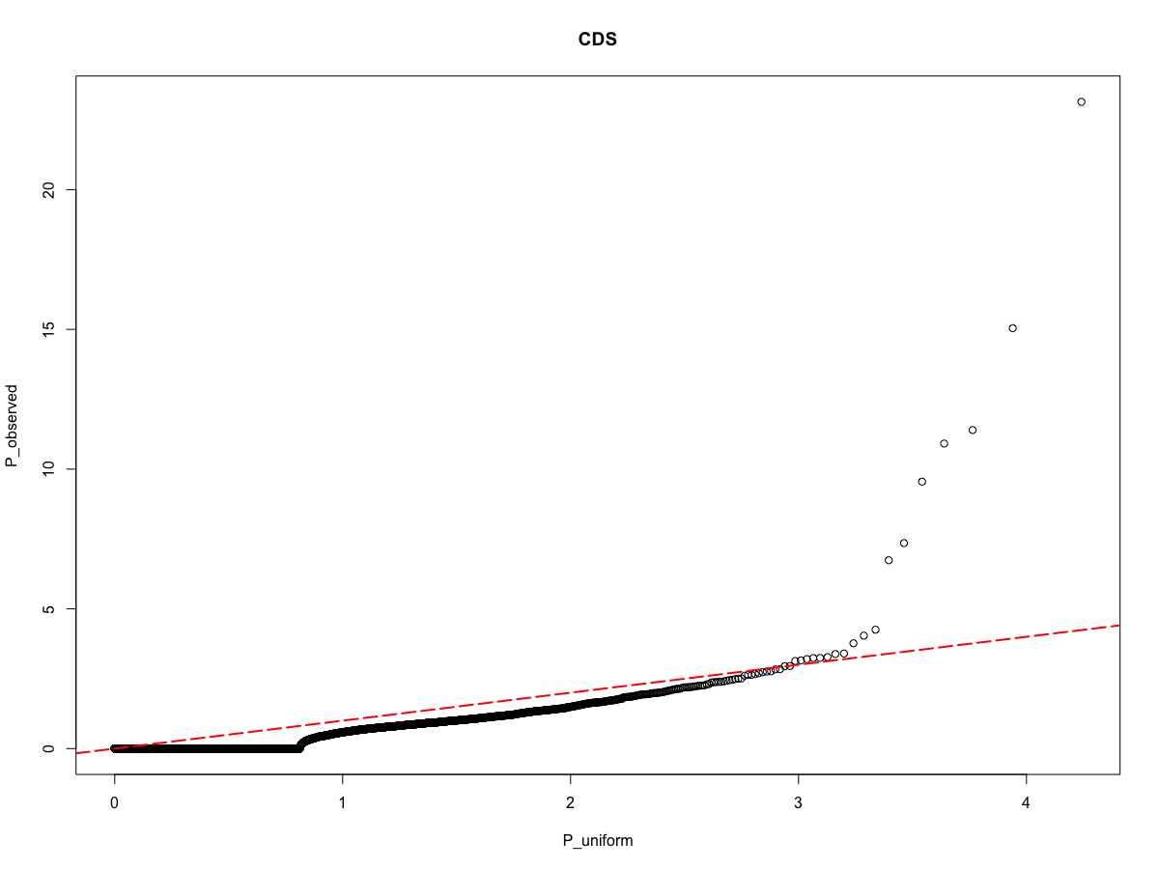
BCL2
ACTA1
IGLL5
TP53
SF3B1
WDR74
ATM

Slide 15
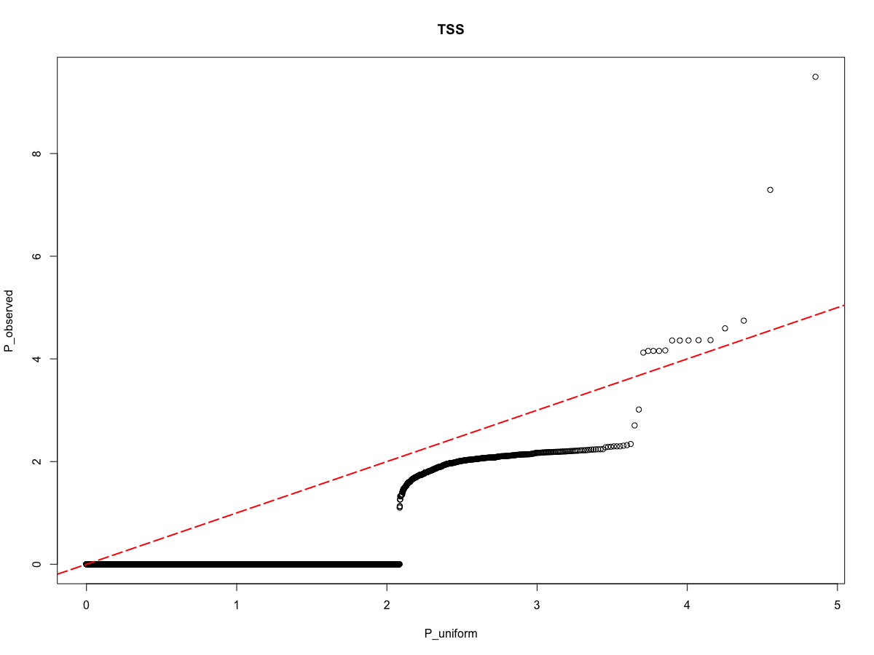
BCL2
BCL2

Slide 16

chr17:56408460:56411127
chr3:186714547:186715378

Slide 17
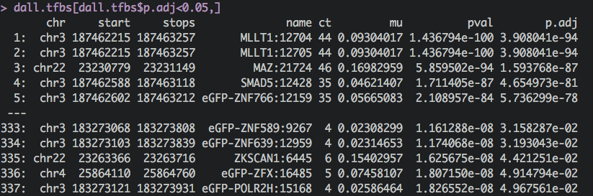

Slide 19
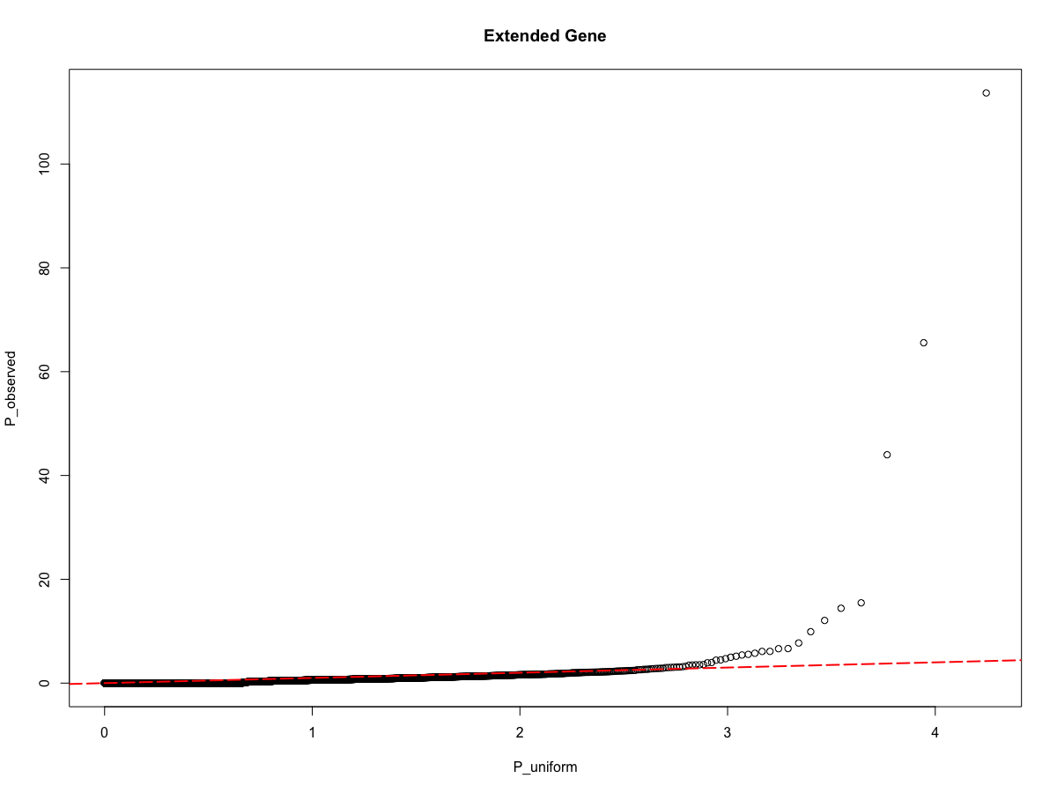

Slide 20
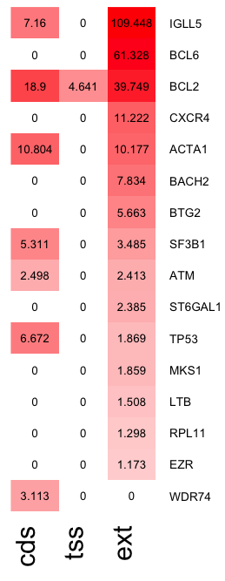
activation-induced cytidine deaminase (AID) activity, PMID: 27336789
Biomarker of Large B-Cell Lymphoma and Intravascular Large B-Cell Lymphoma
Related with apoptosis, potential CLL therapy target
CXCR4 expression is associated with survival in familial chronic lymphocytic leukemia, PMID: 12150154
key component of the molecular program of tumor immunosuppression
Putative Tumor suppressor
CLL poor prognosis
Well-known CLL driver
colorectal cancer metastasis
Well-known CLL driver
tumor suppressors, play an essential role in normal cell proliferation, PMID: 24061479
a key component in tumor metastasis, PMID: 15121044
Frequently mutated in promoter regions, reported by chris sander paper

Slide 21
What is next?
To be added into the extended gene regions
  eCLIP: add binding sites near ± 100/50 bp of coding exons
  RAMPAGE: extend/remove active promoters
  RNA-bind-n-Seq: branch point regions of coding transcripts
  miRNA-seq: active miRNAs -> target sites in 3UTR
Claim: most comprehensive DNA/RNA regulatory elements

Slide 22
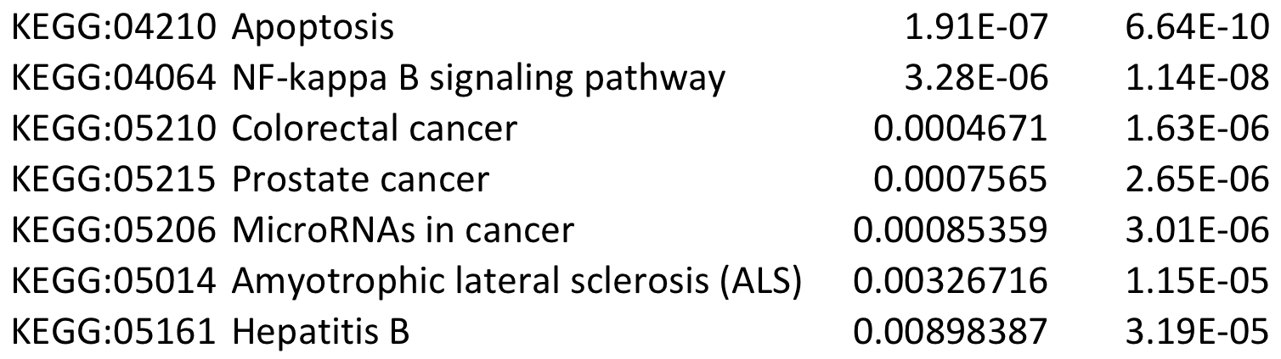
KEGG pathway analysis (CDS)

Slide 23
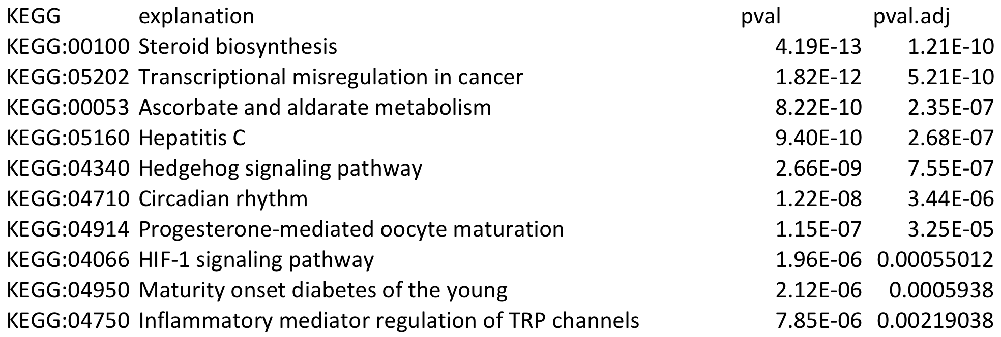
KEGG pathway analysis (extended gene)
Steroids help to control the leukaemic cells
BCL family
Significantly altered in liver cancer
HepC Infection Increases Risk of Lymphoma and Multiple Myeloma
Inhibition for the treatment of CLL
Deregulated expression of circadian clock and clock-controlled cell cycle genes in CLL
Regulation of CLL survival
promising targets for hematologic cancer therapy

Slide 24
Evaluate the mutation effect through network propagation
A: adjacency matrix, aij=1, if i<-> j is connected
A’: degree normalized adjacency matrix
A’=A%*%diag(1/degree)
F0: -log10(extended gene)
Ft+1: the mutation effect at time point t+1
Transferred from old effect
Effect from new effect

Slide 25
Rank | gene | New? | support
1 | BCL6
2 | BCL2
3 | BCOR | Yes | BCOR is detected as a mutational cancer driver in CLL in other reports
4 | CXCR4
5 | ACTA1
6 | BTG2
7 | NLRP1 | Yes | BCL2/6 binds to NLRP1 to kill immunity
8 | SF3B1
9 | TFAP2A | Yes | nasopharyngeal carcinoma tumorigenesis, Breast Ovarian Cancer,
10 | ATM

Slide 26
Rank | gene | New? | support
11 | TP53
12 | ST6GAL1
13 | MKS1
14 | LTB
15 | RPL11 | No | T-cell acute lymphoblastic leukemia
6 | EZR
7 | RNF43 | Yes | interacted closely with BCL6 and others, highly burdened colorectal cancer
8 | BOK |  | BCL2 family, Apoptosis in Cancer Development
9 | BZRAP1 | Yes | breast cancer
10 | SYVN1 | Yes | Breast & renal cancer

Slide 27
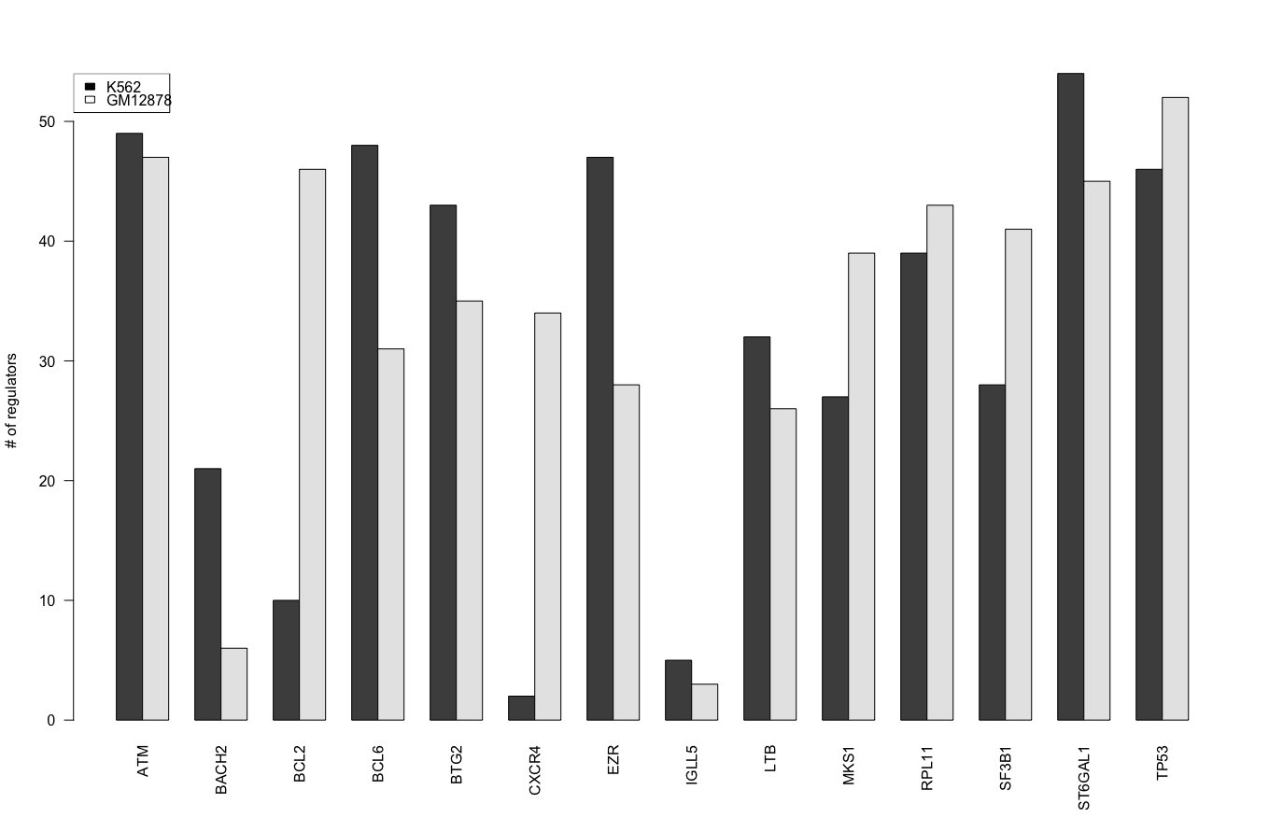

Slide 28
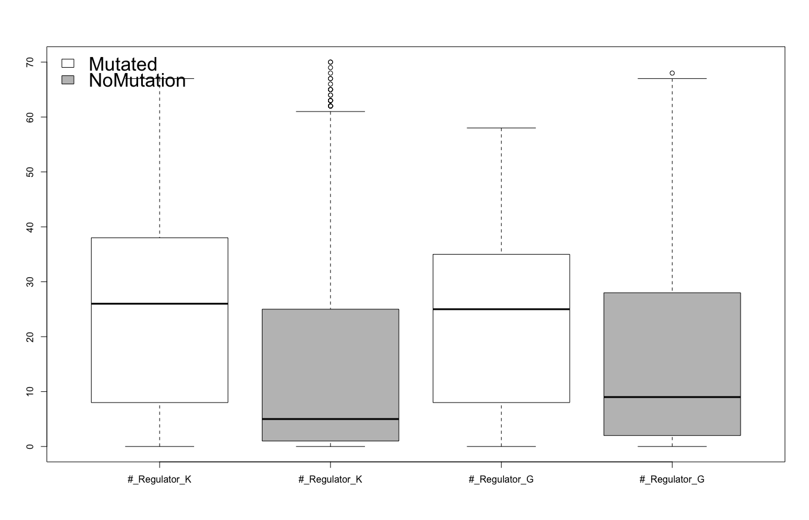

Slide 29
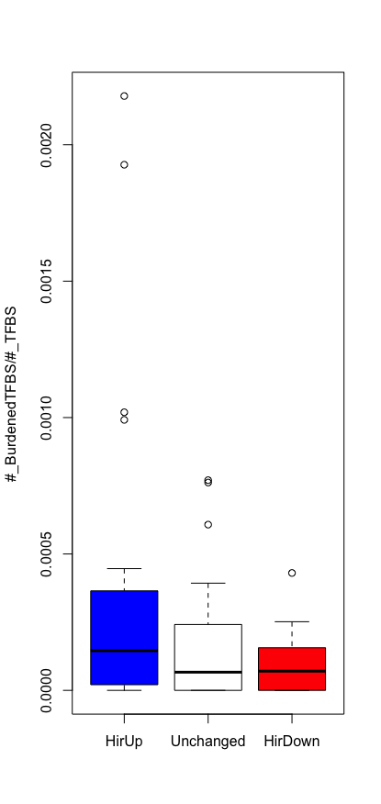
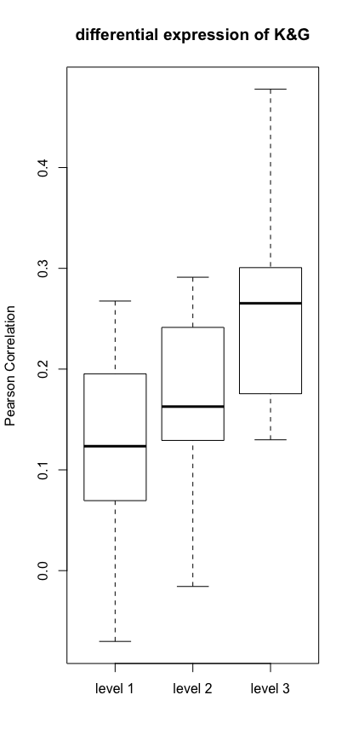
K562:
Blue : hierarchy going down from G->K
Red: hierarchy going up from G->K
Size: percent of TFBS disruption

Slide 30
K562:
Blue : hierarchy going down from G->K
Red: hierarchy going up from G->K
Size: percent of TFBS disruption

Slide 31
Active in K562
Active in G
Stay Less Active in Both
Stay More Active in Both

Slide 32
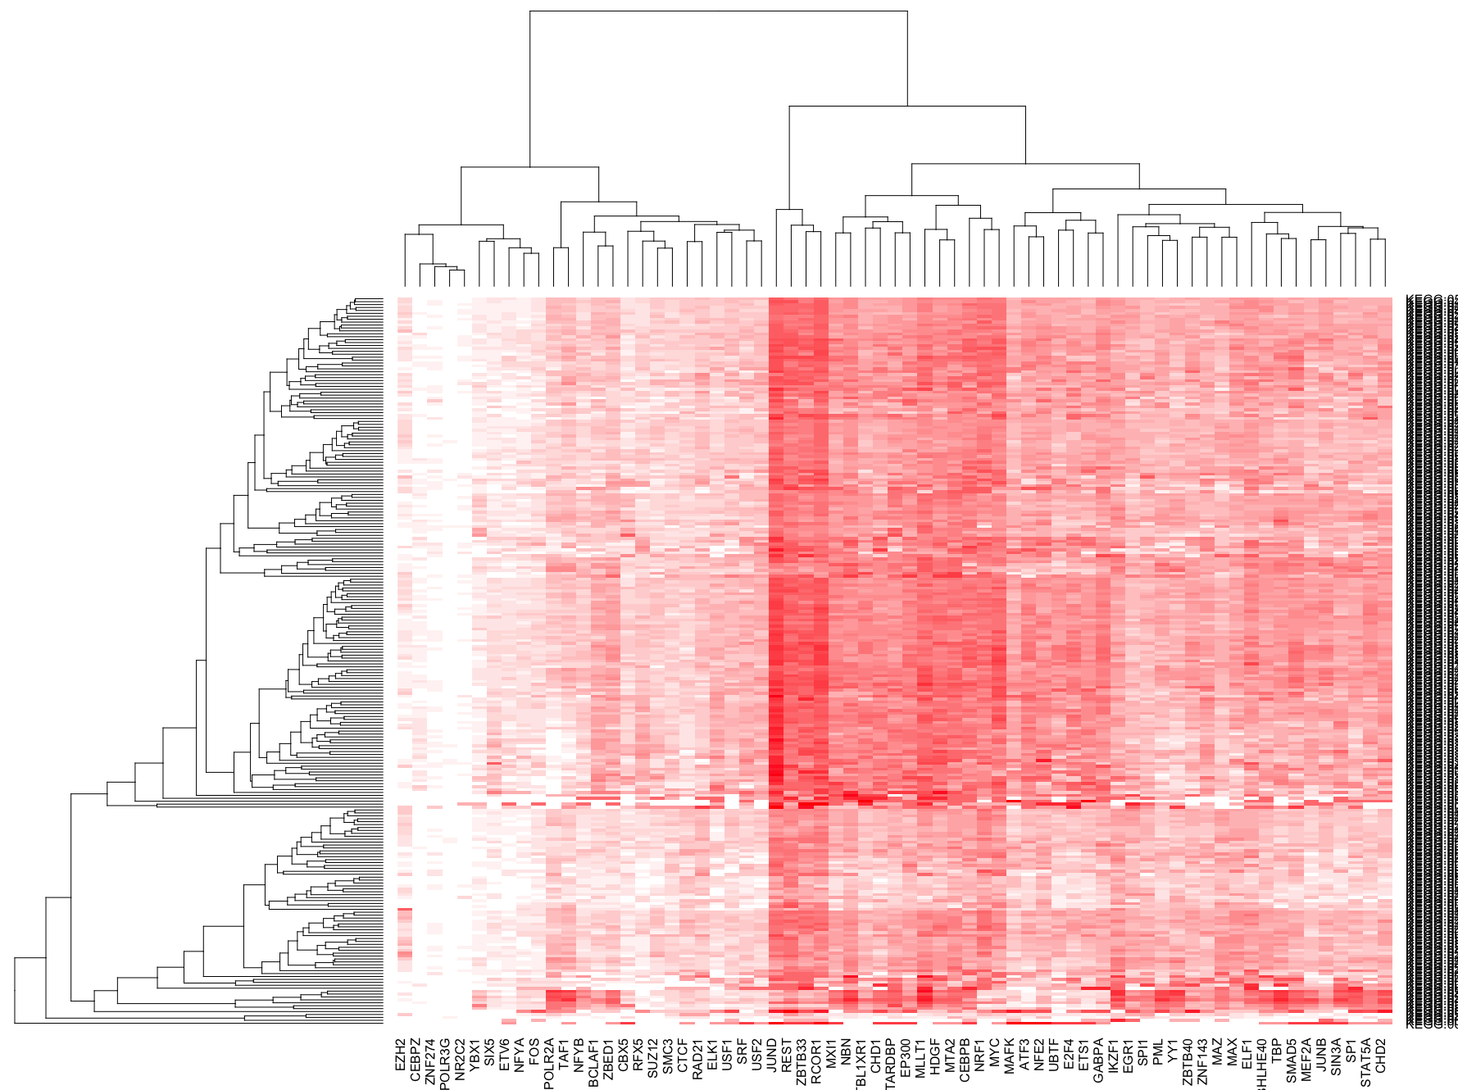

Slide 33
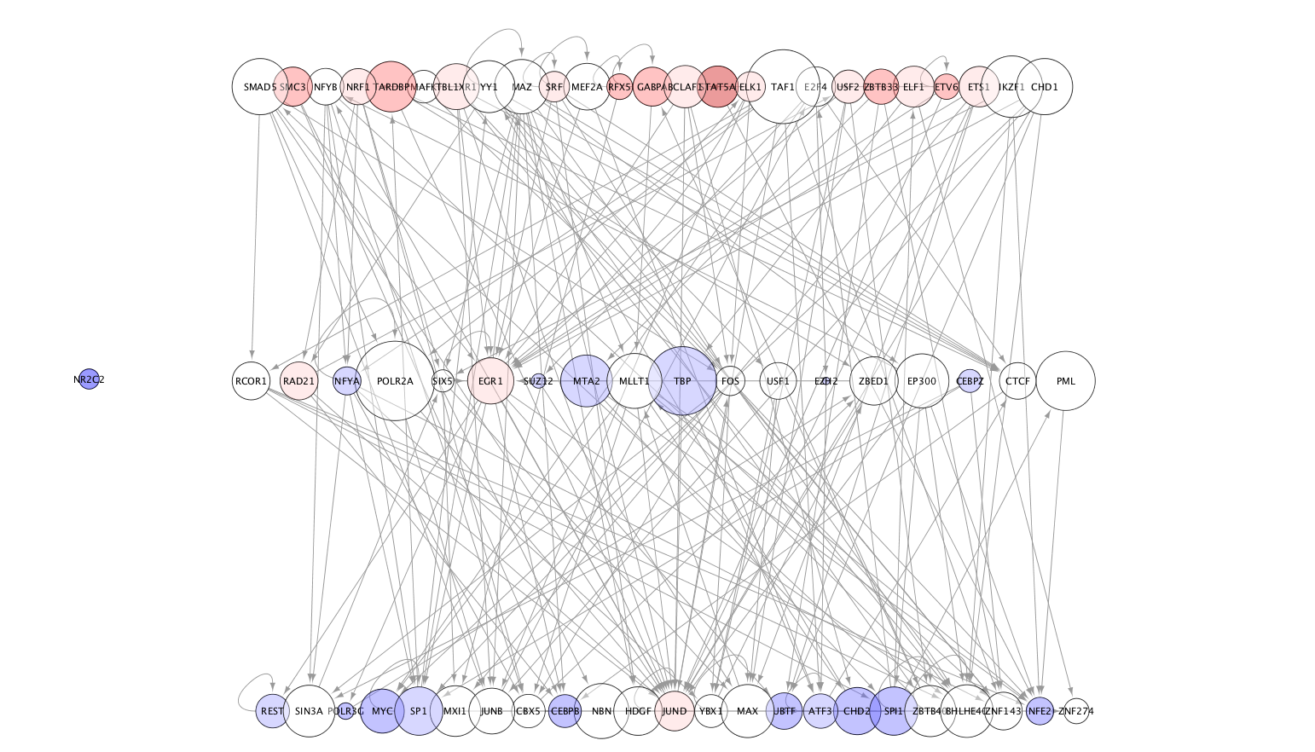
K562 TIP hierarchy, size=correlation

Slide 34
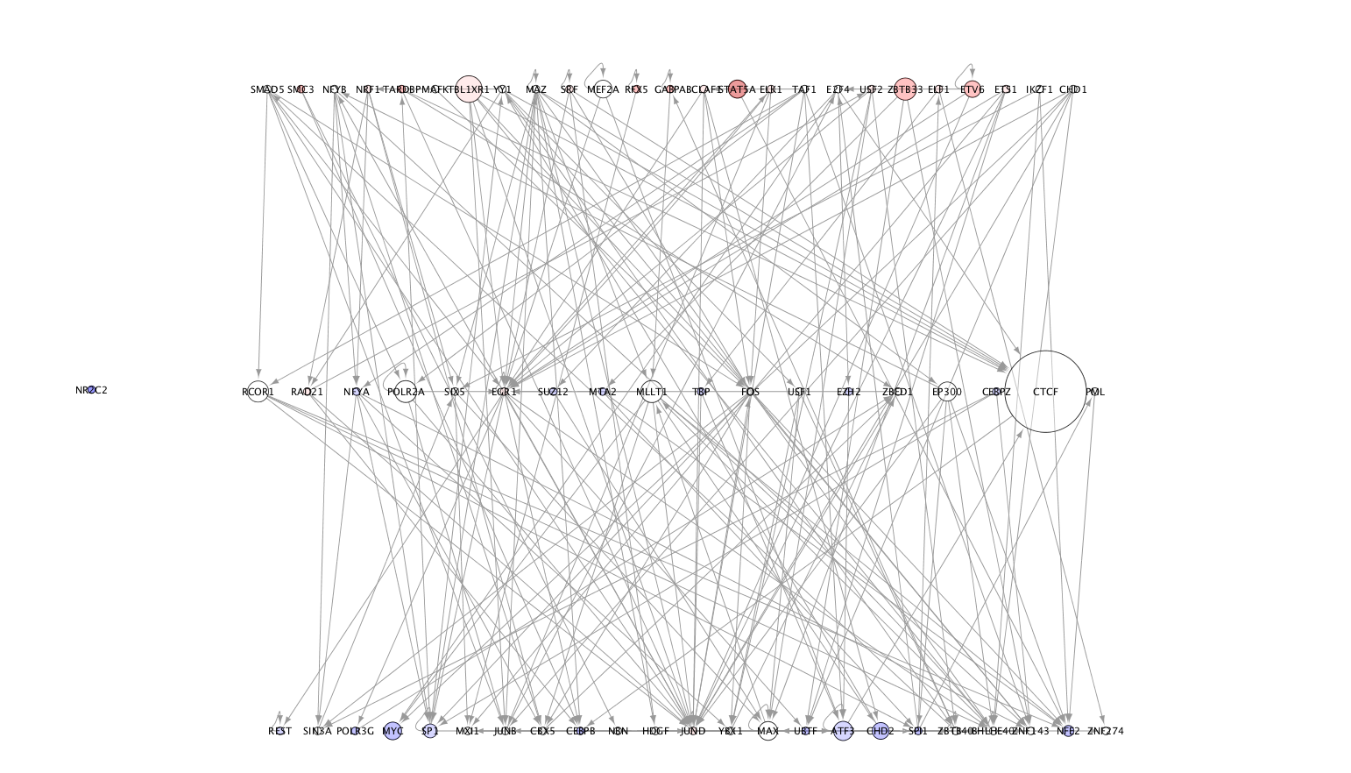
K562 TIP hierarchy, size=logPval, ExtendGene

Slide 35
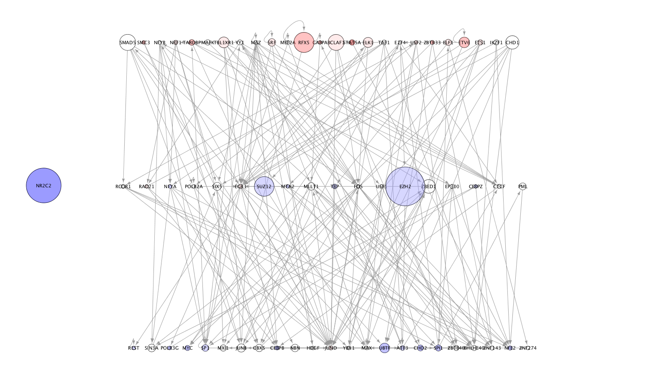
K562 TIP hierarchy, size=TFBS burdenedPercent

Slide 36
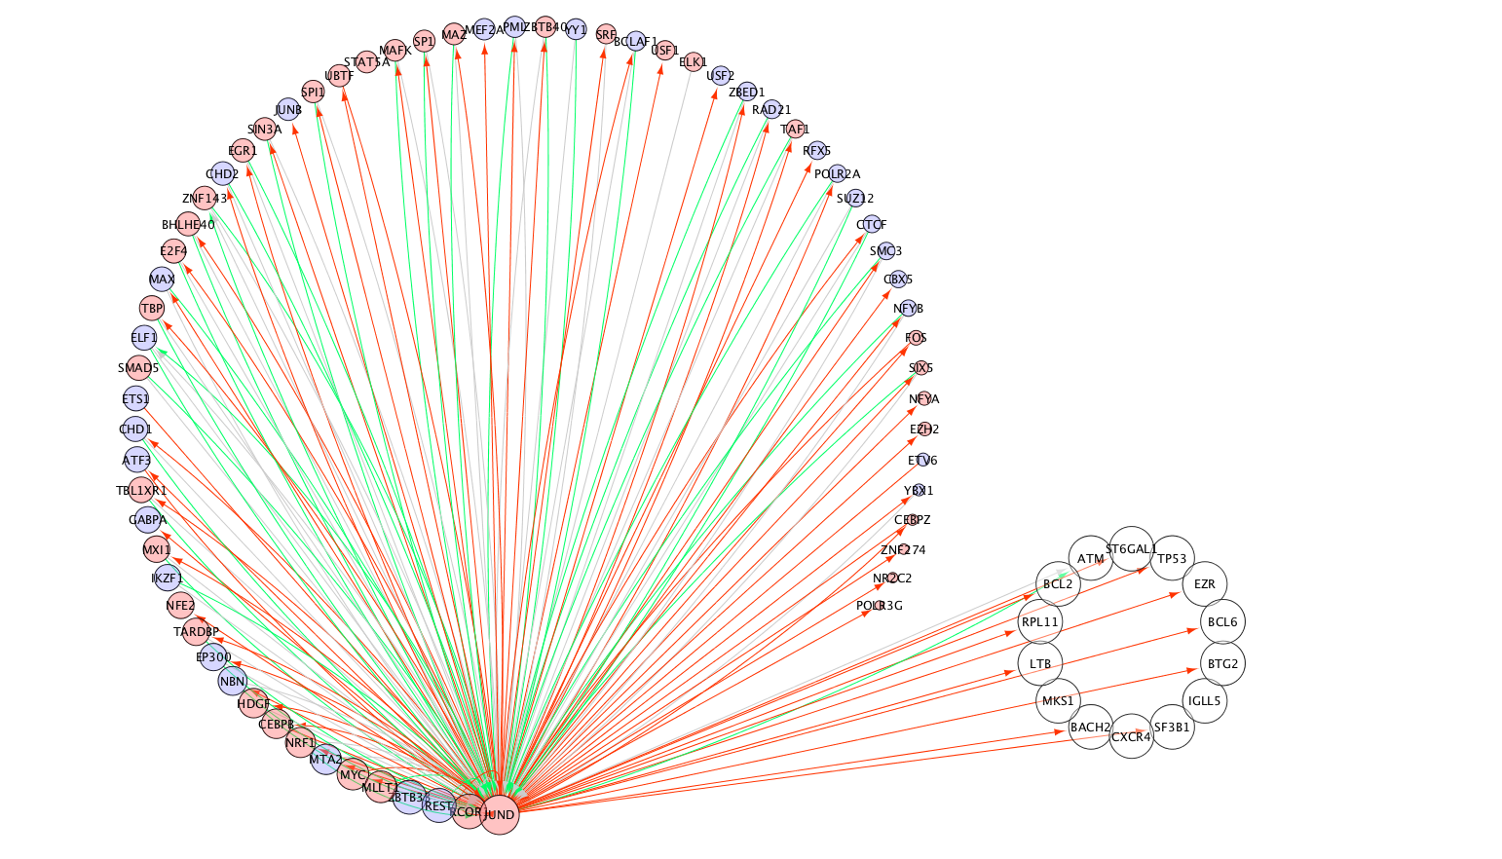
JUND, red gain edge, blue loss edge, gray remain edge

Slide 37
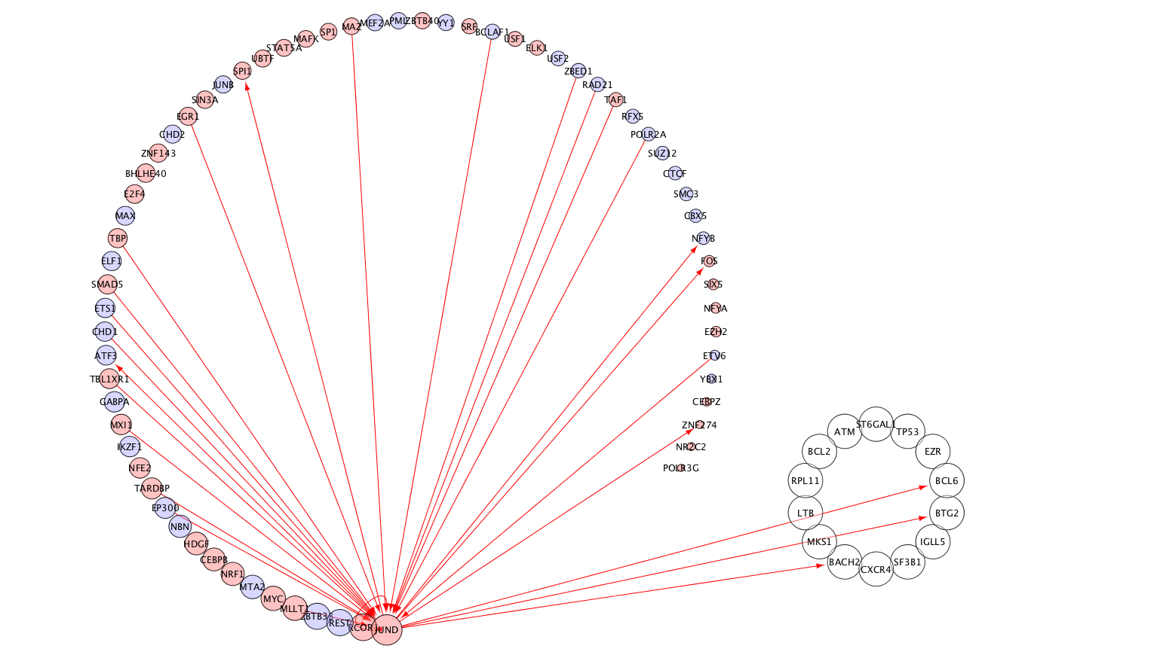
JUND, red gain edge, blue loss edge, gray remain edge
TIP only

Slide 38
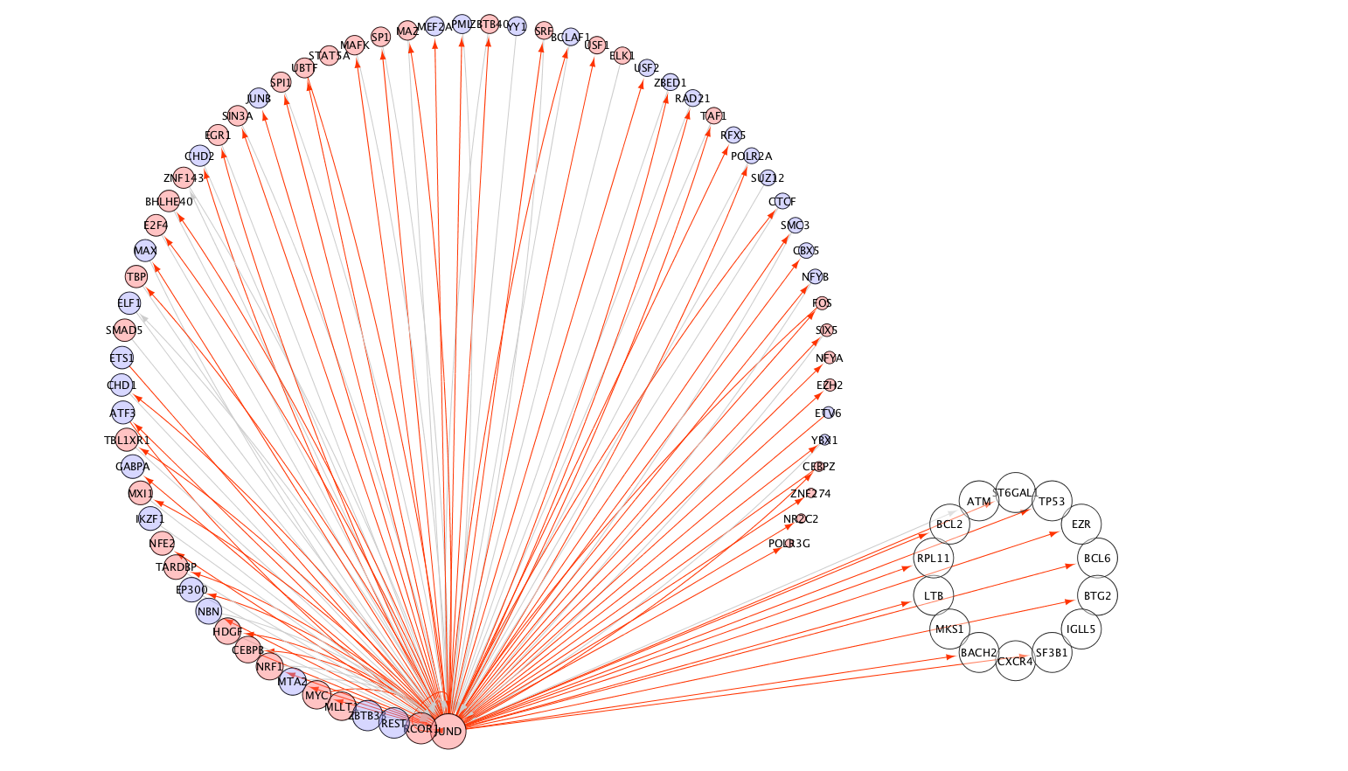
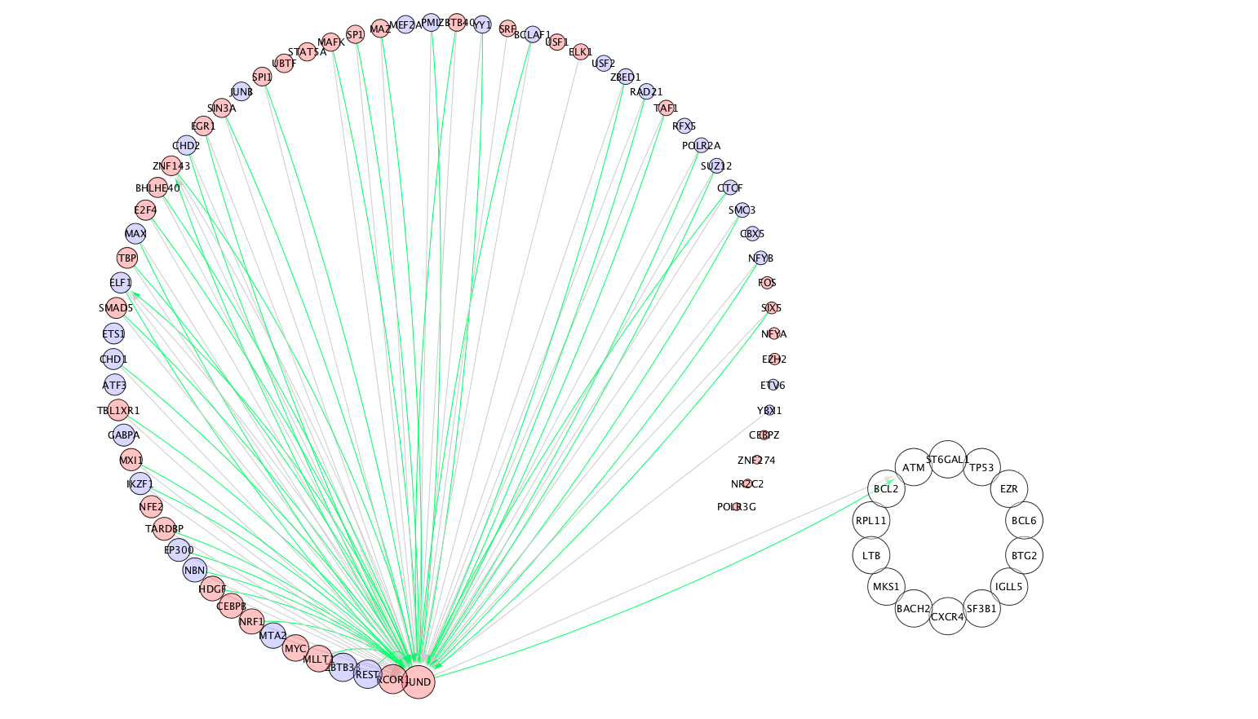
JUND, red gain edge, blue loss edge, gray remain edge, all edges
K562
GM12878

Slide 39
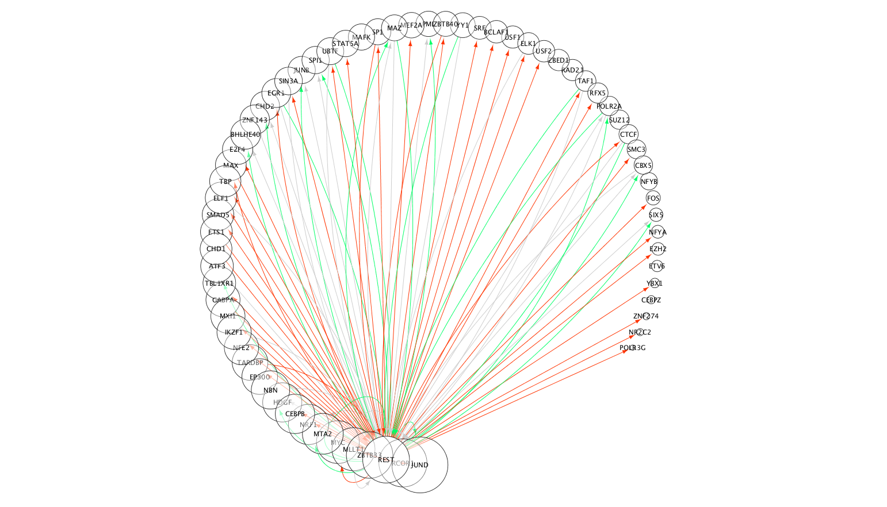
Rest, red gain edge, blue loss edge, gray remain edge

Slide 40
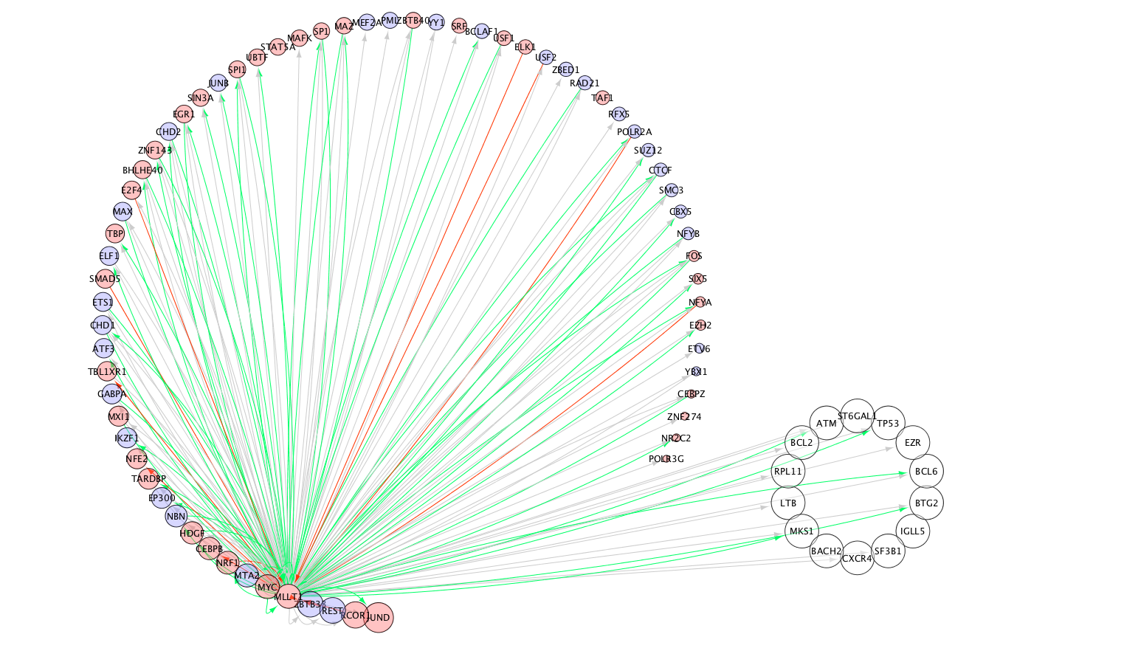
MLLT: mainly lost edges

Slide 41
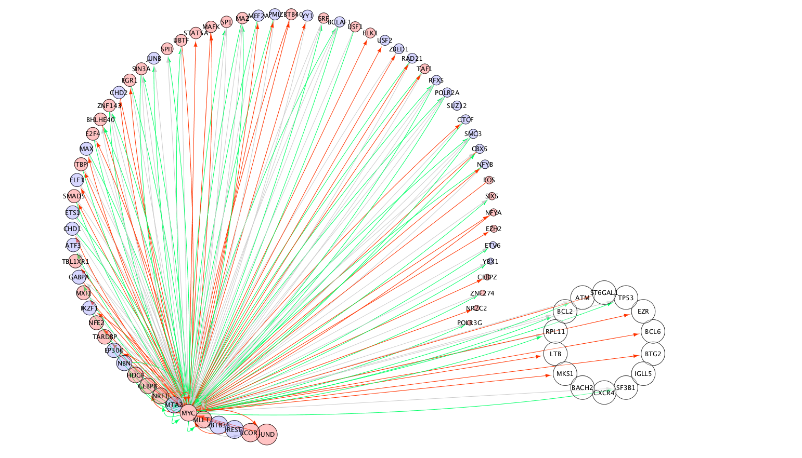

Slide 42
