Slide 1
Matched filter figures

Slide 2
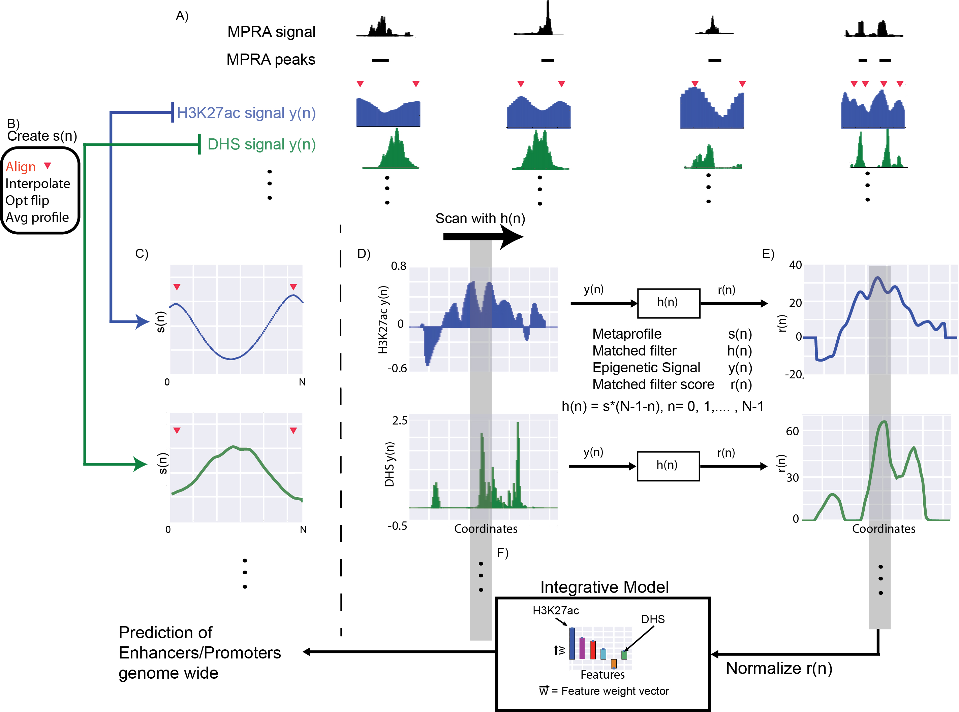
Figure 1 – the workflow

Slide 3
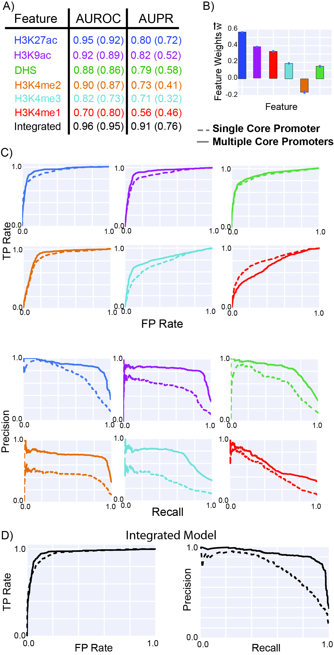
Figure 2 – Single vs Multiple CP and performance of models

Slide 4
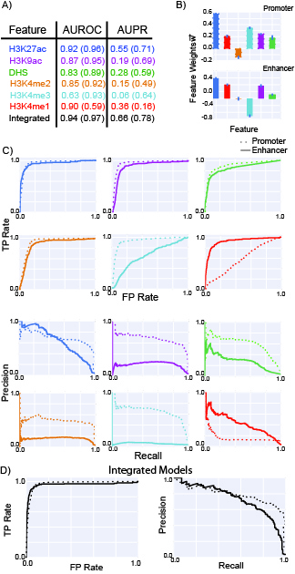
Figure 3 –Promoter and Enhancer
- performance of models

Slide 5
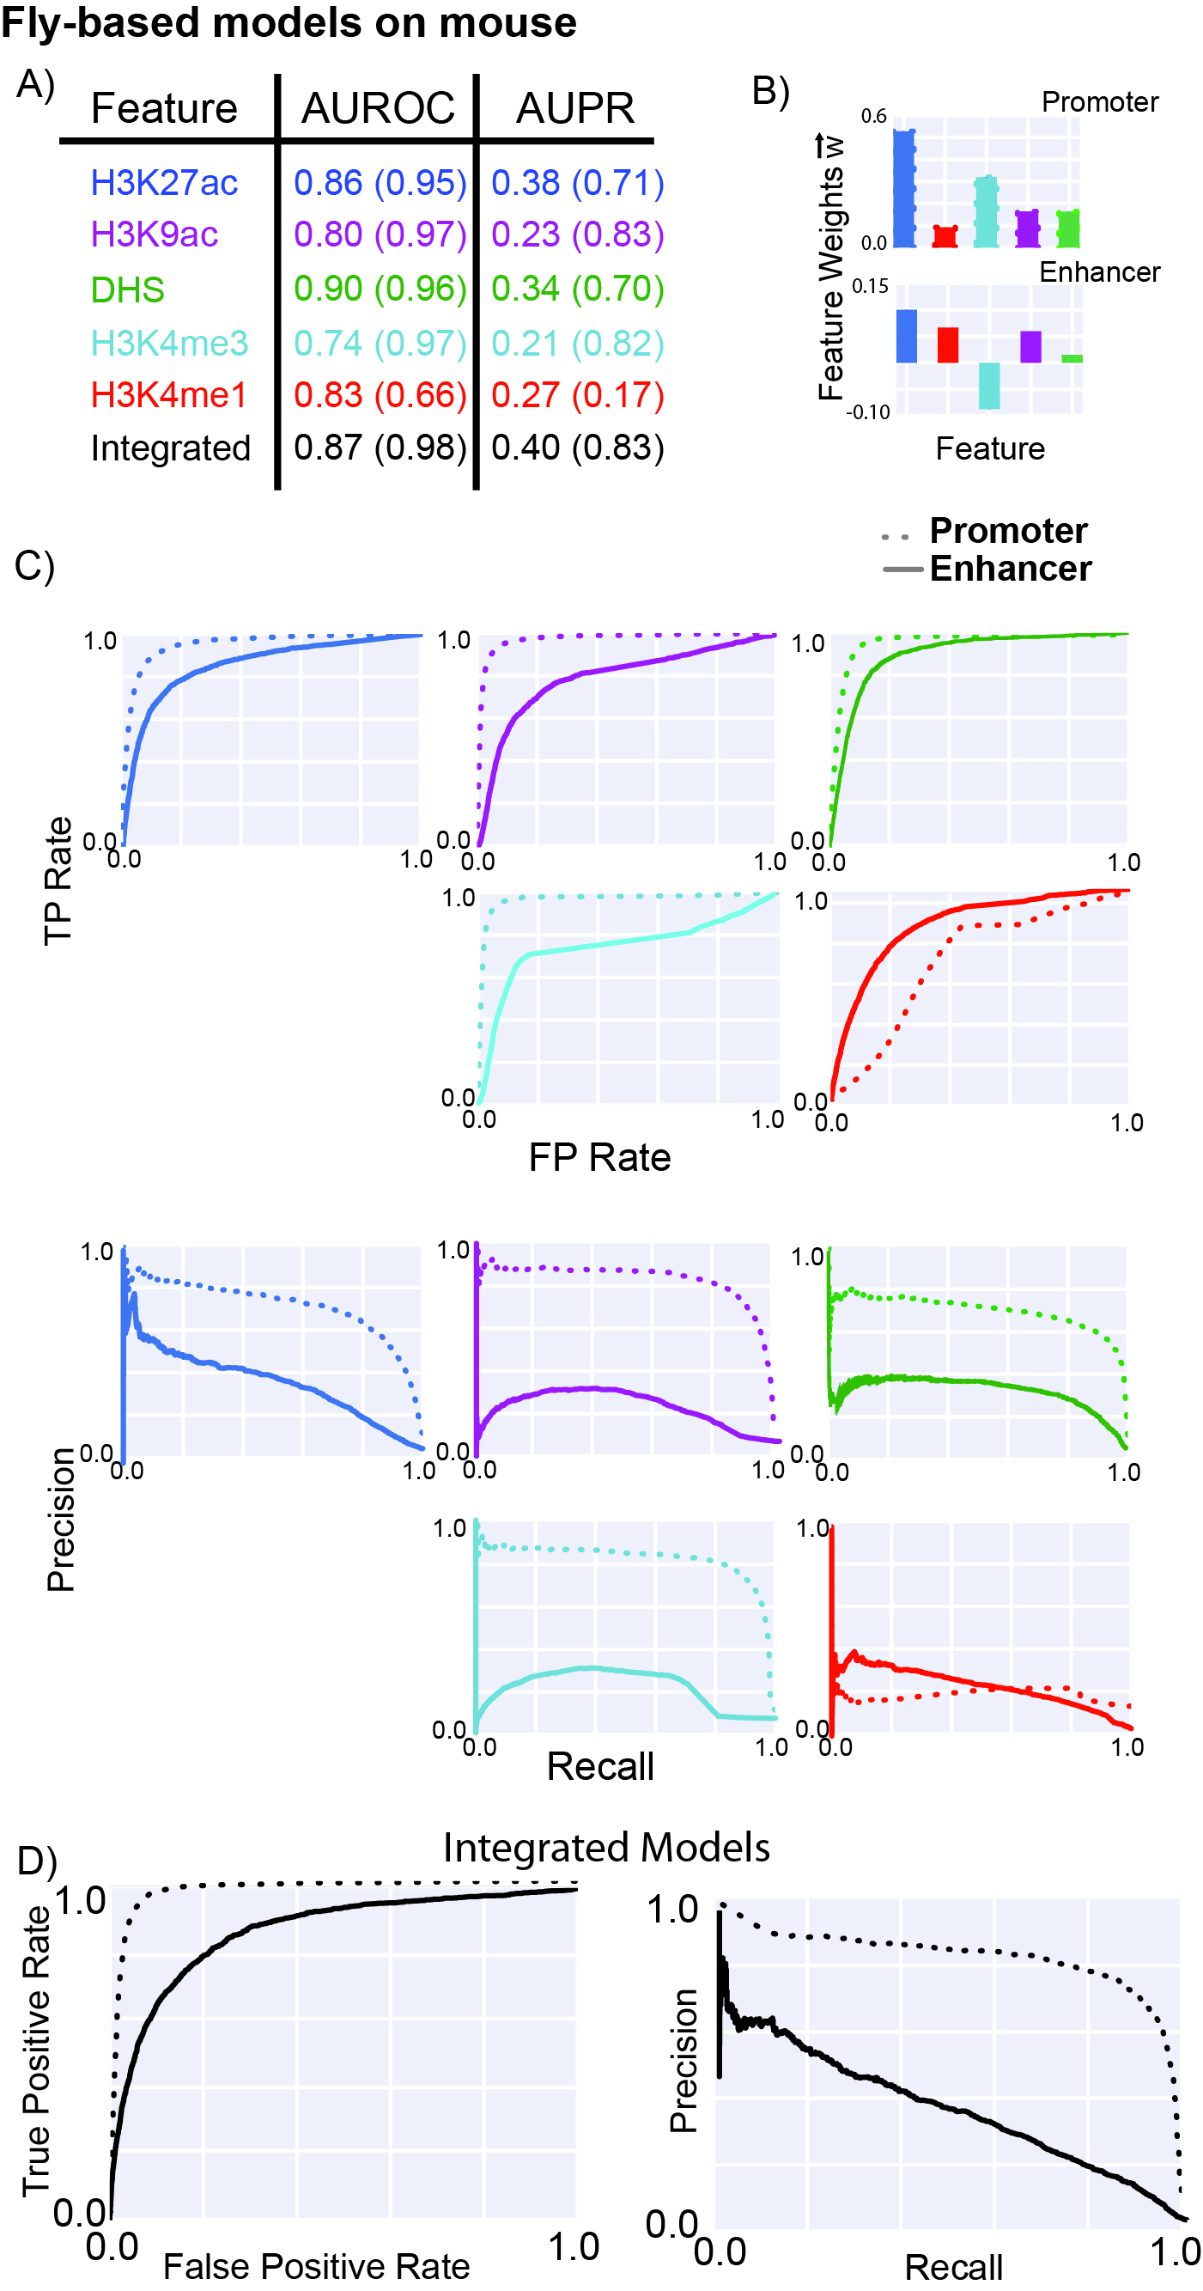
Figure 4 –Across Species

Slide 6
Figure 5 – Enhancer Validation

Slide 7
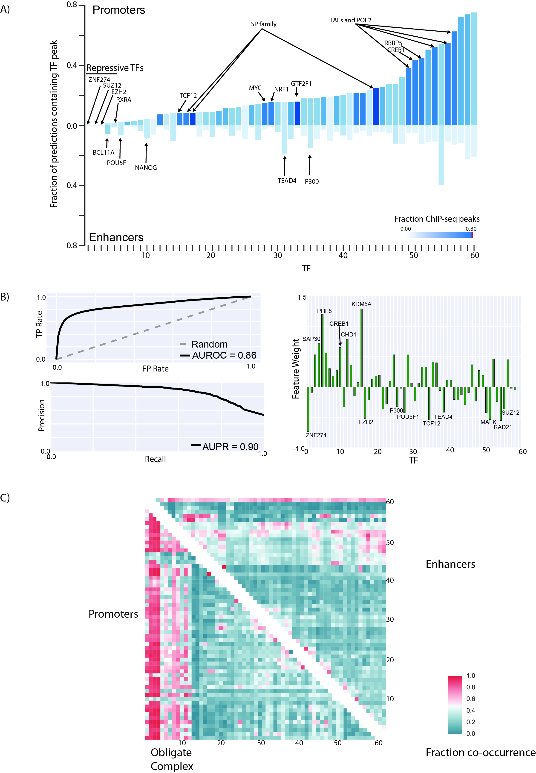
Figure 6 – TF peaks on promoters/enhancers

Slide 8
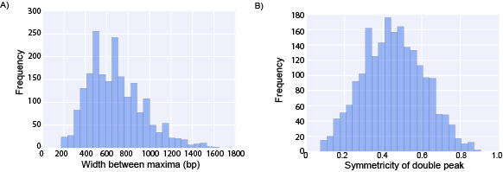
Figure S1 – variability in profile

Slide 9
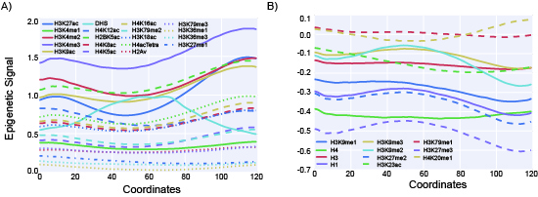
Figure S2 – all the 30 metaprofiles

Slide 10
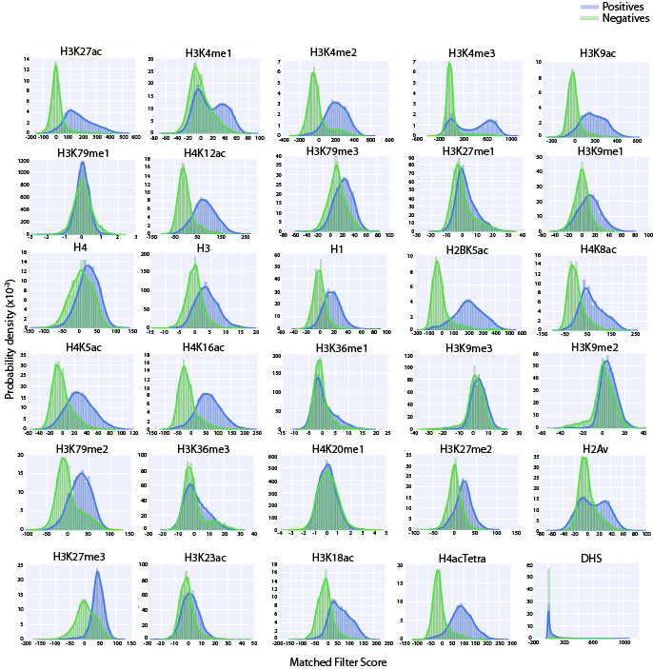
Figure S3 – all the 30 matched filter score histograms

Slide 11
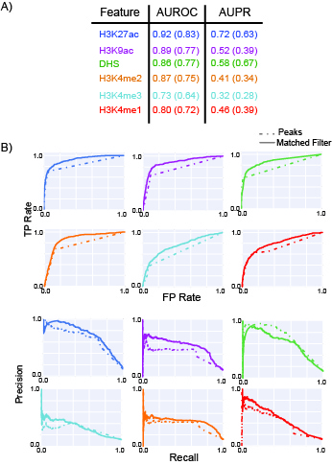
Figure S4 – comparing performance to peaks

Slide 12
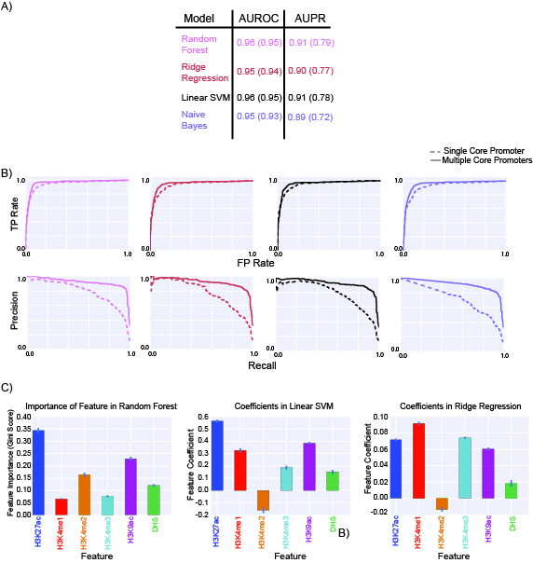
Figure S5 – comparing different statistical models for integrating marks

Slide 13
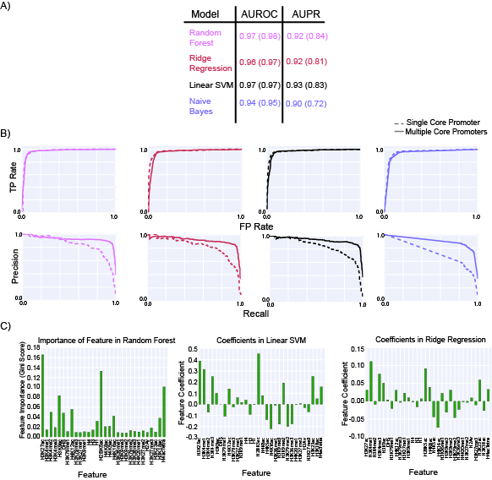
Figure S6 – comparing statistical models for 30 mark model

Slide 14
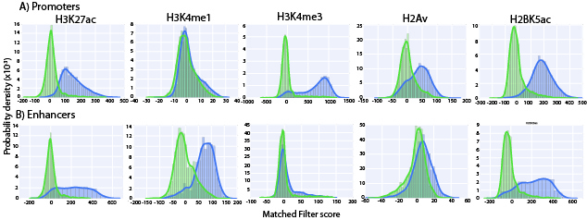
Figure S7 – comparing histograms of MF scores for key marks

Slide 15
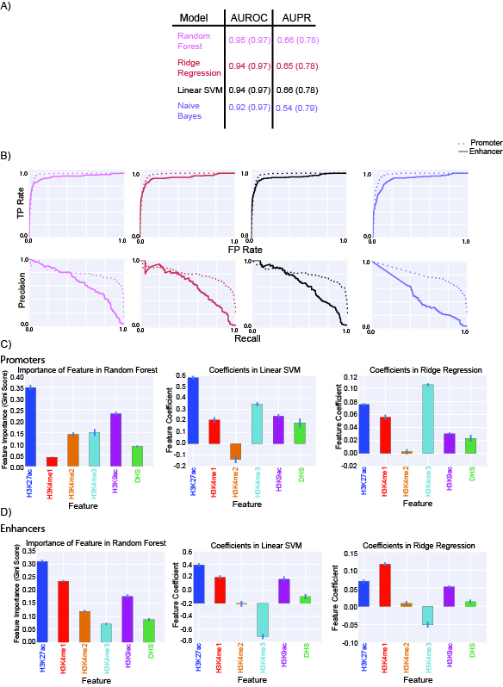
Figure S8 – comparing statistical models for enhancer/promoter models

Slide 16
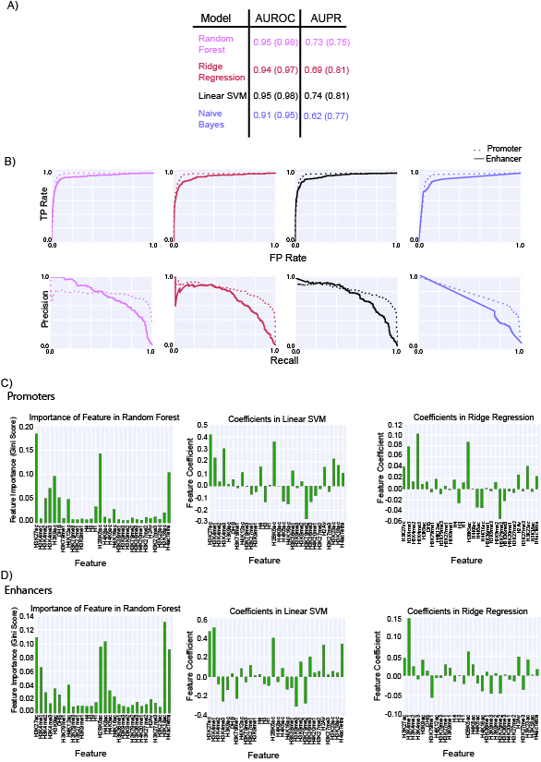
Figure S9 – 30 mark models for enhancer/promoter

Slide 17
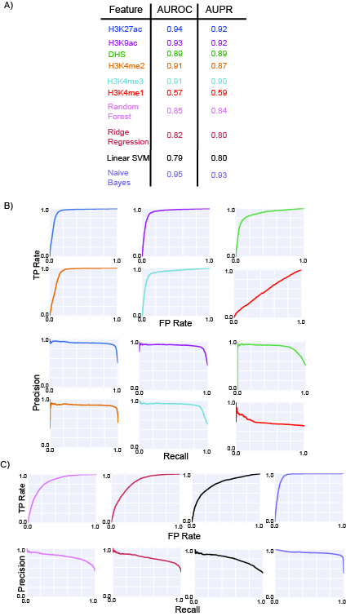
Figure S10 – enhancer model on promoter- profiles conserved but ML model not so good.

Slide 18
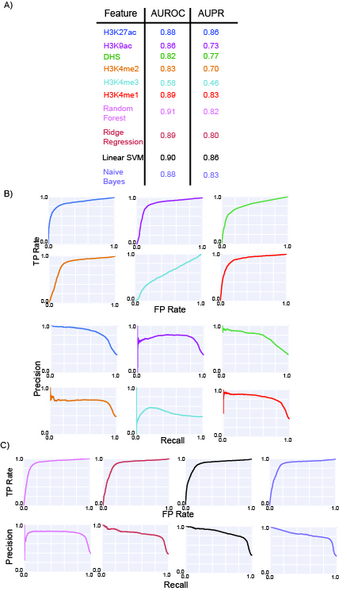
Figure S11 – promoter model on enhancer
- profiles conserved but ML model not so good.

Slide 19
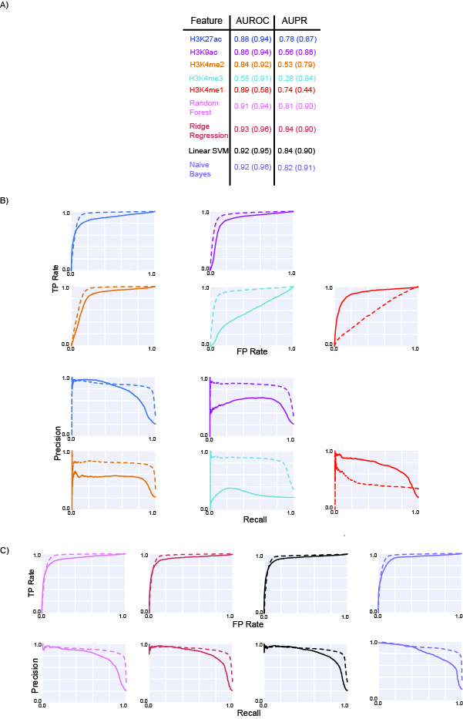
Figure S12 – transferability of models between different cell-lines

Slide 20
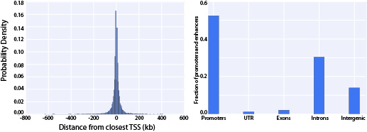
Figure S13 – location of H1-hESC predictions

Slide 21
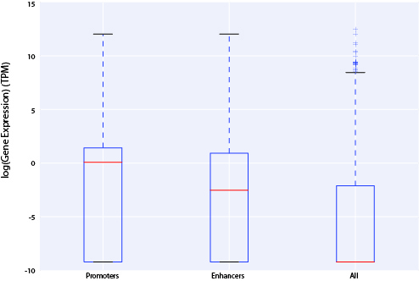
Figure S14 – predictions near active genes

Slide 22
Figure S15 – Comparison of MF promoters with chromHMM chromatin states

Slide 23
Figure S15 – Comparison of MF enhancers with chromHMM chromatin states

Slide 24
Figure S17 – Comparison of MF promoters with SegWay chromatin states

Slide 25
Figure S18 – Comparison of MF enhancers with SegWay chromatin states

Slide 26
Figure S19 – Enhancer Validation in three other cell-lines
A549B)

Slide 27
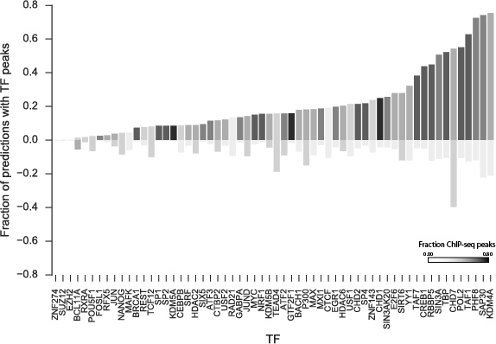
Figure S19 – overlap of TFBS with predicted promoters/enhancers

Slide 28
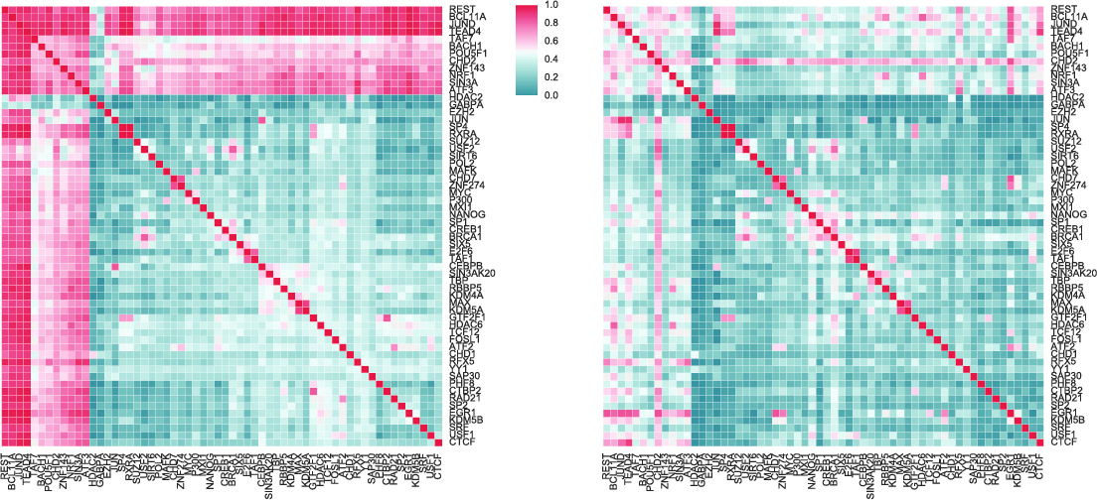
Figure S20 - Patterns of co-TF binding at promoters and enhancers

