Slide 1
Encode & Cancer & TF-Expression & Survival & Zombies

Slide 2
Methods
Take the 24 TFs that both differ between G and K and that XL, LR, and WM consider CML-related
Individually correlate their expression in CLL with patient survival using a Cox proportional hazards model

Slide 3
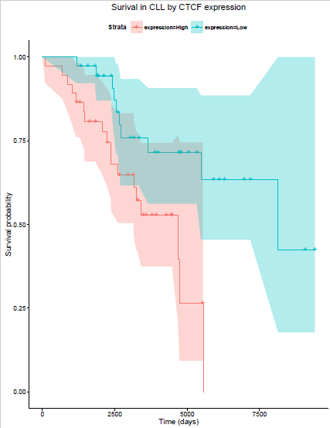
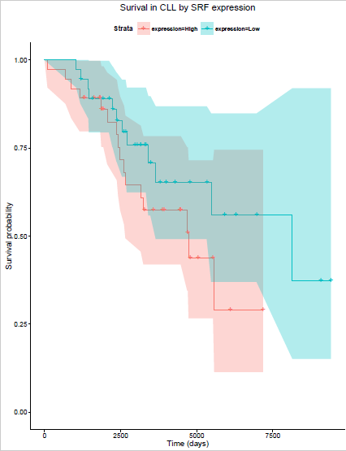
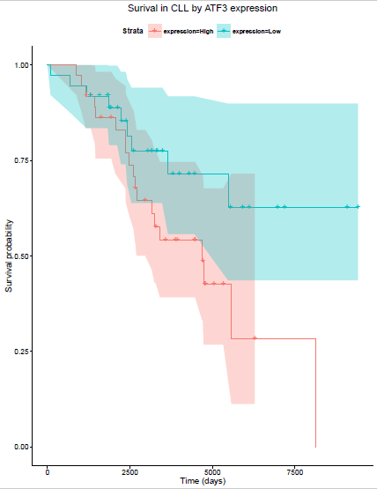
3 of 24 CML-related TFs appear hazardous in CLL
P=0.002
P=0.031
P=0.019

Slide 4
Method 2: Aggregation
Compute the signed, weighted aggregate expression of the 24 TFs
+ for TFs that are overexpressed in K relative to G
- for TFs that are underexpressed in K relative to G
Weight by magnitude of log(K_TPM/G_TPM)
Correlate aggregate expression in CLL with patient survival

