Slide 1
A vision for the future…
What does genomics hold for molecularly pathology?.....

Slide 2
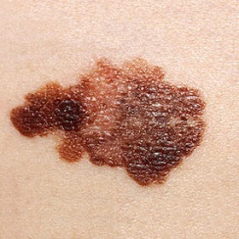
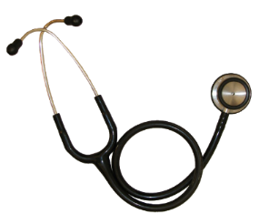
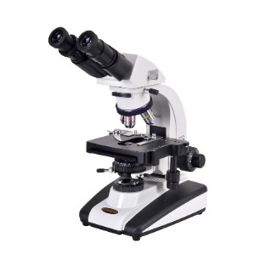
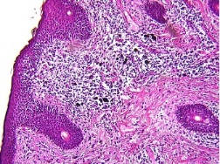
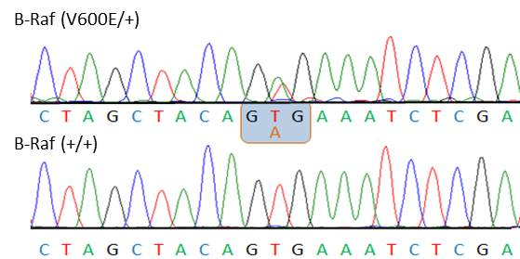
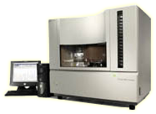
Molecular pathology extends the diagnostic precision gains of surgical pathology by probing even more fundamental elements of biology
Biological Causation
Diagnostic Precision
http://wrightstatephysicians.org/whatsnew/melanoma.html
http://pathology.osu.edu/residents/InternalGate/Area51/ResidentSlideCollection/images/A100.jpg
https://rikengenesis.jp/ori/50279/etc_img/BRAFV600E.jpg
https://upload.wikimedia.org/wikipedia/commons/d/d2/Stethoscope-2.png
http://www.microscope.com/student-microscopes/university-student-microscopes/omano-om139-infinity-corrected-plan-optics.html#gref
http://sequetech.com/

Slide 3
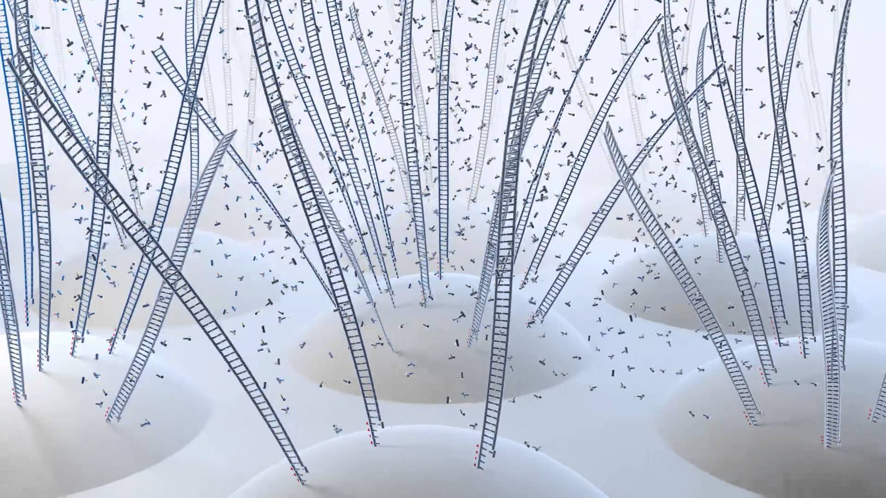
Next generation sequencing is an exciting addition to the molecular pathology suite
Miniaturization and massive parallelization has sparked a genomics revolution
Image credit: http://perception7.com/

Slide 4
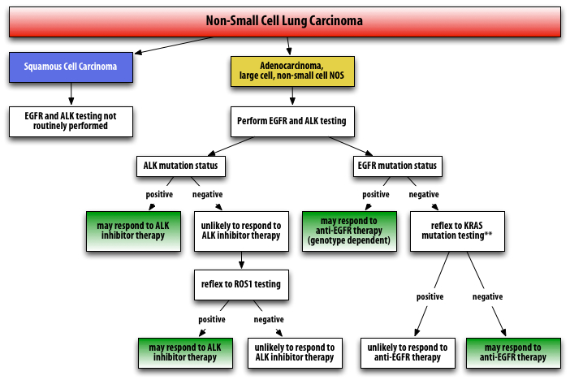
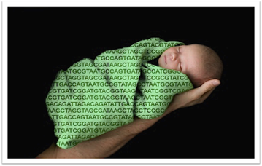
The high stakes and clear genetic etiology of two classes of disease make them suitable for clinical sequencing even at today’s prices
Precision Oncology
Neonatal screening for Mendelian disease
http://www.apmggroup.net/innovation/molecular_testing/Lung_Pathways/lung.html
http://www.ngsleaders.org/blogs.aspx

Slide 5
Genomic technologies will find widespread clinical adoption when their clinical utility justifies their cost across disease domains
+
$
$
$
+
$
+
+
Now
10(?) Years

Slide 6
What will drive this increase in the value of clinical genomics?
Falling costs of sequencing and analysis lowers the threshold for obtaining clinical samples
Greater power to discover complex but clinically meaningful genotype-phenotype relations
  More research samples due to falling costs
  Consortia-based research for larger sample sizes
  New statistical and bioinformatics techniques to identify and prioritize variants
  Better understanding of the non-coding genome, which harbors 80% of disease-associated SNPs but is poorly understood (Hindorff 2009 Proc Natl Acad Sci USA)
  Integration of multiple SNPs
  Integration across multiple experimental strategies
    DNA sequencing to inform baseline risk
    RNA sequencing to identify early signs of disease

Slide 7
In the future, all stages of clinical care will depend on bioinformatics and genomics
Prevention – molecular well-visits for early cancer screening
Risk-prediction – large genomic and transcriptomic data-sets
Diagnosis – identify the molecular subtype of a patient’s condition
Personalized treatments
  Targeted therapy – treat a patient’s underlying molecular pathology
  Smarter experiential learning – treat patients based on what worked for patients who were most molecularly similar

Slide 8
Plummeting costs of sequencing and analysis

Slide 9
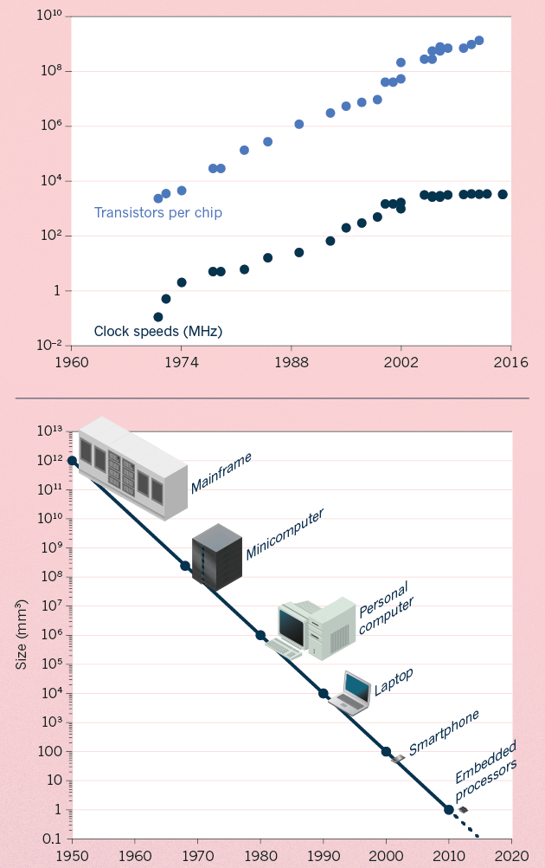
Moore’s Law:
Exponential Scaling of Computer Technology
Exponential increase in the number of transistors per chip.
Led to improvements in speed and miniaturization.
Drove widespread adoption and novel applications of computer technology.
[Waldrop (‘15) Nature]

Slide 10
Kryder’s Law and S-curves underlying exponential growth
Moore’s & Kryder’s Laws
  As important as the increase in computer speed has been, the ability to store large amounts of information on computers is even more crucial
Exponential increase seen in Kryder’s law is a superposition of
S-curves for different technologies
[Muir et al. (‘15) GenomeBiol.]

Slide 11
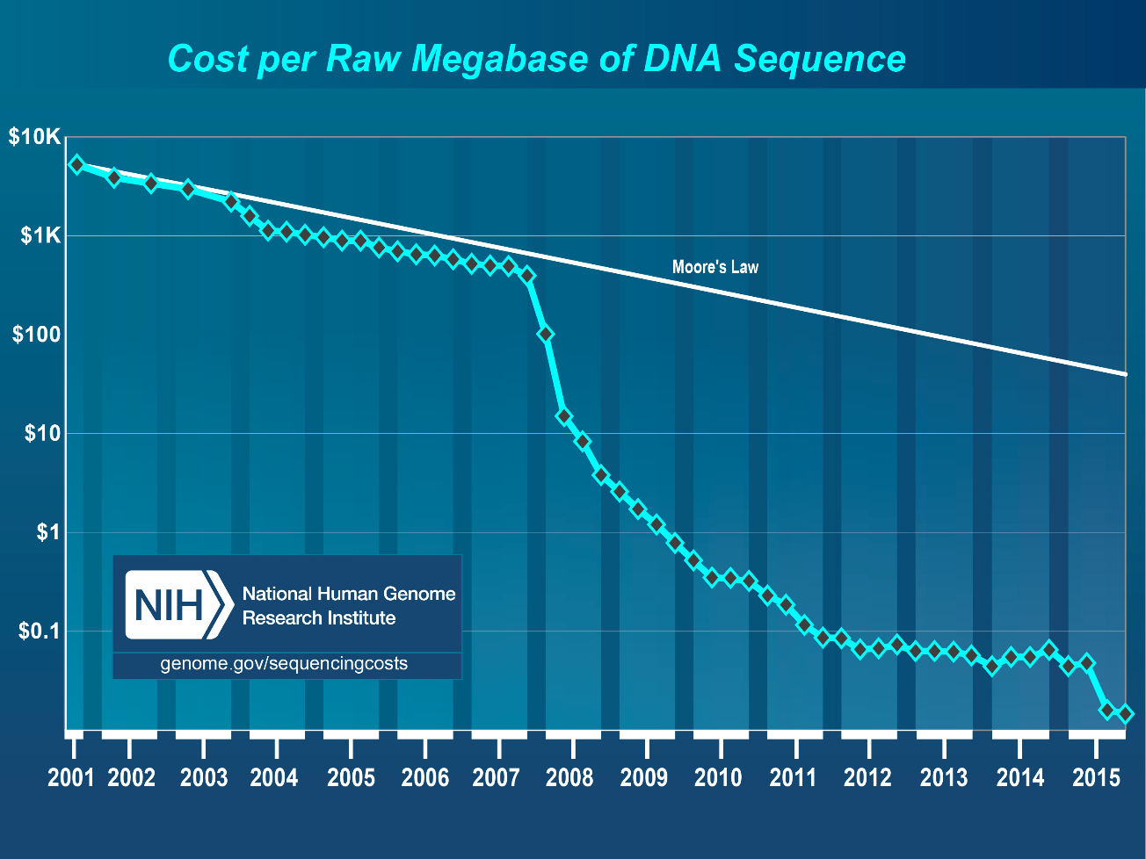
Sequencing Data Explosion:
Faster than Moore’s Law for a Time (or a S-curve)
DNA sequencing has gone through technological S-curves
  In the early 2000’s, improvements in Sanger sequencing produced a scaling pattern similar to Moore’s law.
  The advent of NGS was a shift to a new technology with dramatic decrease in cost).

Slide 12
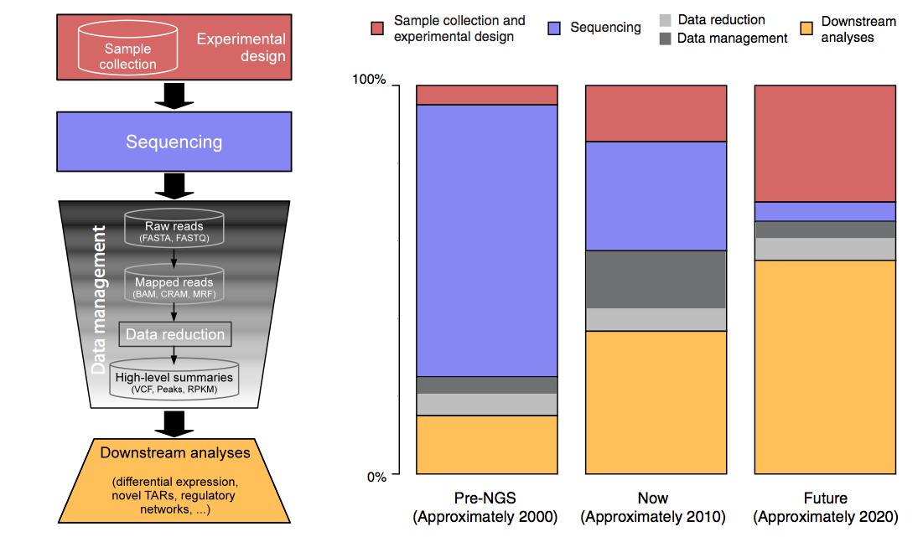
The changing costs of a sequencing pipeline
From ‘00 to ~’20,
cost of DNA sequencing expt. shifts from the actual seq. to sample
collection & analysis
[Sboner et al. (‘11), Muir et al. (‘15) Genome Biology]

Slide 13
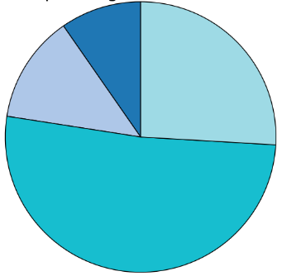
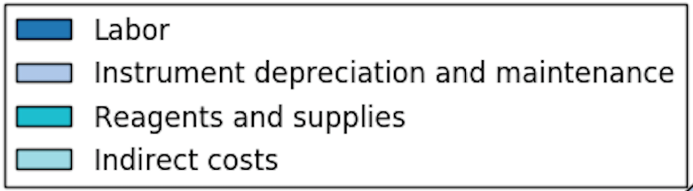
The changing costs of a sequencing pipeline
From ‘00 to ~’20,
cost of DNA sequencing expt. shifts from the actual seq. to sample
collection & analysis
[Sboner et al. (‘11), Muir et al. (‘15) Genome Biology]

Slide 14
The changing costs of a sequencing pipeline
From ‘00 to ~’20,
cost of DNA sequencing expt. shifts from the actual seq. to sample
collection & analysis
Alignment algorithms scaling to keep pace with data generation
[Sboner et al. (‘11), Muir et al. (‘15) Genome Biology]

Slide 15
The changing costs of a sequencing pipeline
From ‘00 to ~’20,
cost of DNA sequencing expt. shifts from the actual seq. to sample
collection & analysis
Alignment algorithms scaling to keep pace with data generation
[Sboner et al. (‘11), Muir et al. (‘15) Genome Biology]

Slide 16
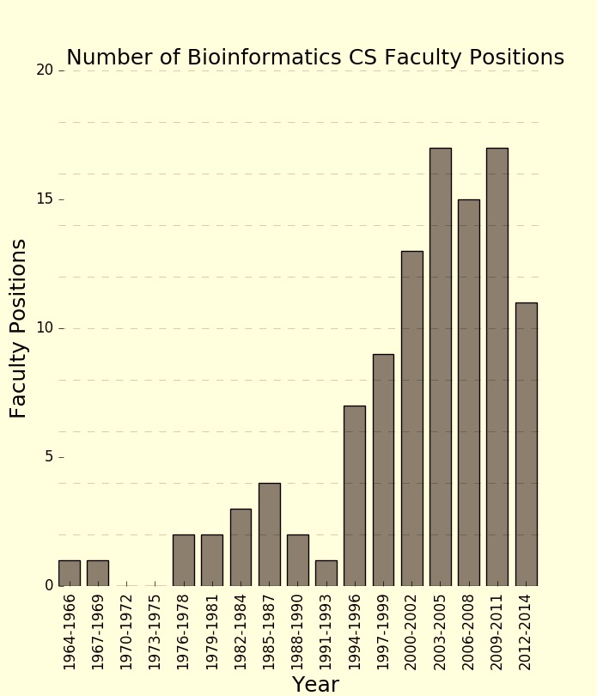
The changing costs of a sequencing pipeline
From ‘00 to ~’20,
cost of DNA sequencing expt. shifts from the actual seq. to sample
collection & analysis
[Sboner et al. (‘11), Muir et al. (‘15) Genome Biology]

Slide 17
Population & power

Slide 18
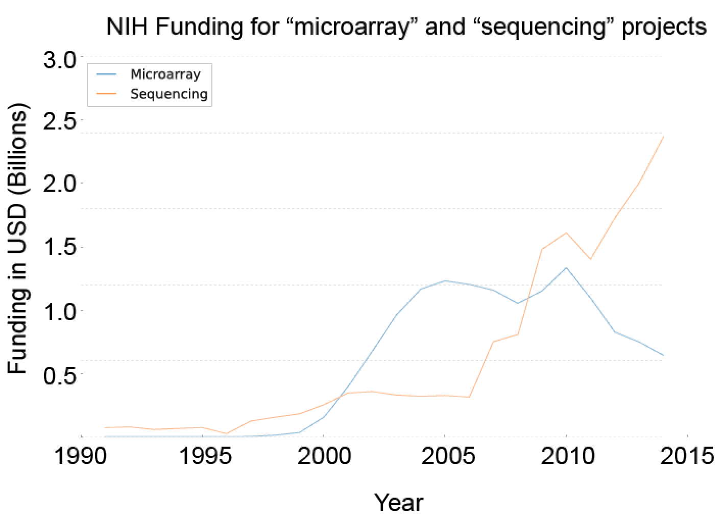
Sequencing cost reductions have resulted in an explosion of data
The type of sequence data deposited has changed as well.
  Protected data represents an increasing fraction of all submitted sequences.
  Data from techniques utilizing NGS machines has replaced that generated via microarray.
[Muir et al. (‘15) GenomeBiol.]

Slide 19






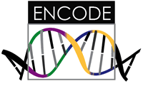





Sequence Universe
SRA ~1 petabyte
TCGA endpoint: ~2.5 Petabytes
~1.5 PB exome
~1 PB whole genome
TCGA 2.3 Petabytes
in CGHub
Clinical
RNASeq
Epigenome
222
TB
miRNA
ARRA
Autism
29
TB
32 TB
34 TB
NHLBI ESP
68 TB
40
TB
GTeX
ADSP
NHGRI LSSP
Star formation
100K Genomes England
Heidi Sofia, 7-16-15
Notes:
TCGA is the largest single project in the visible sequence universe to date.
TCGA is depicted at the center of the solar system because it integrates DNA, RNA-Seq, miRNA, epigenomic, and clinical data.
Currently there is over a Petabyte of TCGA data deposited in the CGHub cancer genomics repository (https://cghub.ucsc.edu/summary_stats.html).
This scale dwarfs its closest competitors which are shown as planets in orbit:
1000G 222 TB http://www.ncbi.nlm.nih.gov/bioproject/28889
ADSP 68 TB http://www.ncbi.nlm.nih.gov/bioproject/202226
NHGRI LSSP 40 TB http://www.ncbi.nlm.nih.gov/bioproject?term=NHGRI%20Large%20Scale%20Sequencing%20Program%5BTitle%5D
GTeX 34 TB http://www.ncbi.nlm.nih.gov/bioproject/75899
NHLBI ESP 32 TB http://www.ncbi.nlm.nih.gov/bioproject/165957
HMP 29 TB http://www.ncbi.nlm.nih.gov/bioproject/43021
ARRA Autism 24 TB http://www.ncbi.nlm.nih.gov/bioproject/74861
ENCODE 9 TB http://www.ncbi.nlm.nih.gov/bioproject/63441
Projects just starting now, like 100K Genomes England, may eventually overtake TCGA.

Slide 20
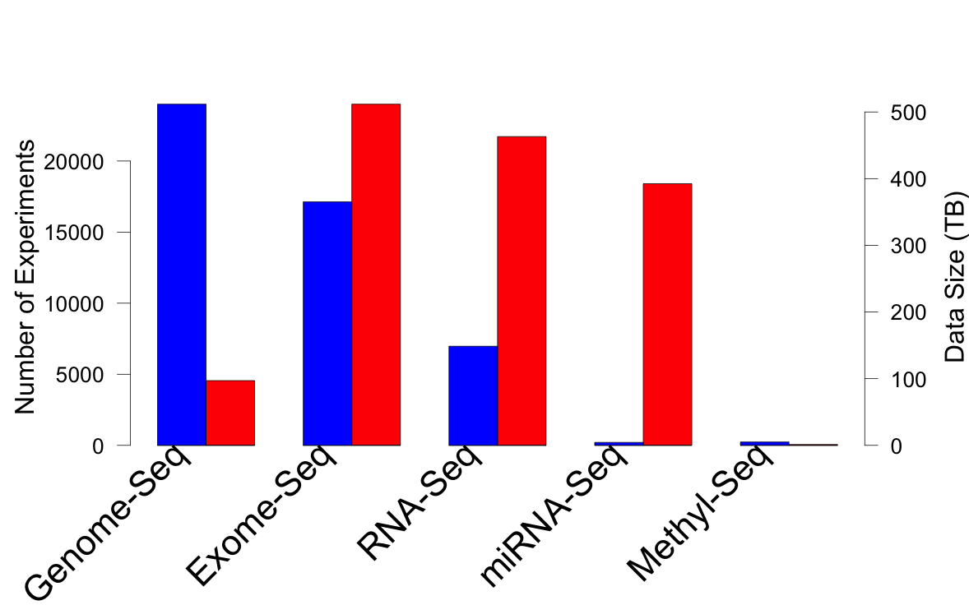
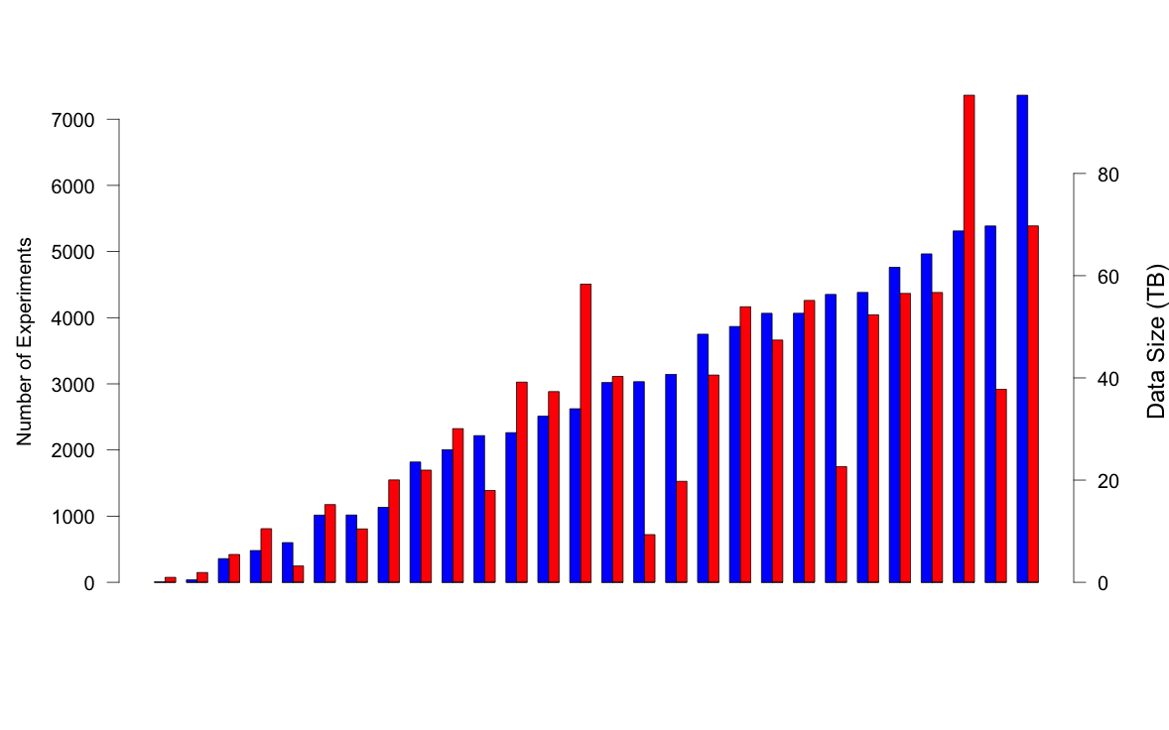
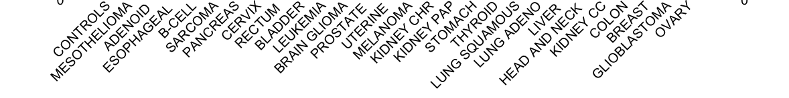
TCGA: What’s in a petabyte?
Breast Cancer
>30 TCGA Cancer Types
>73K Experiments
>11K Patients
https://cghub.ucsc.edu/

Slide 21
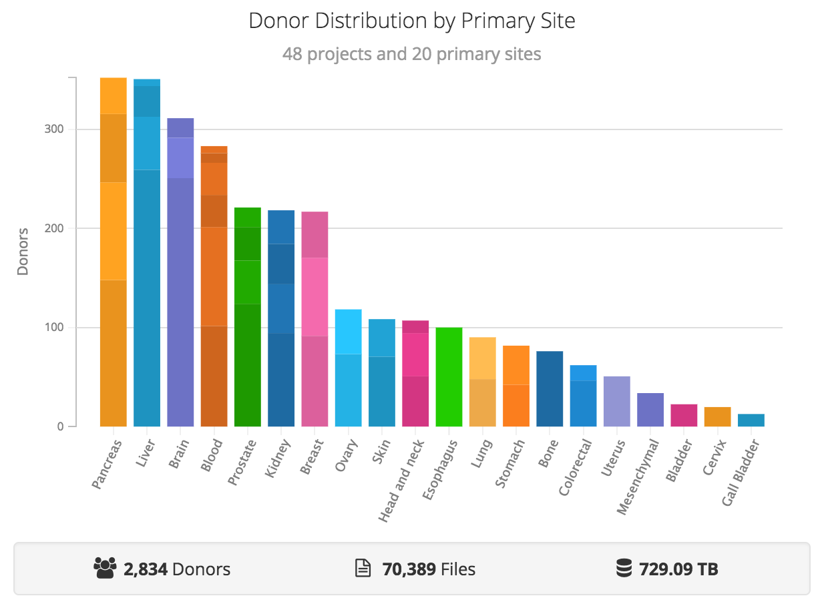
PCAWG: PANCANCER ANALYSIS OF WHOLE GENOMES
https://dcc.icgc.org/pcawg

Slide 22
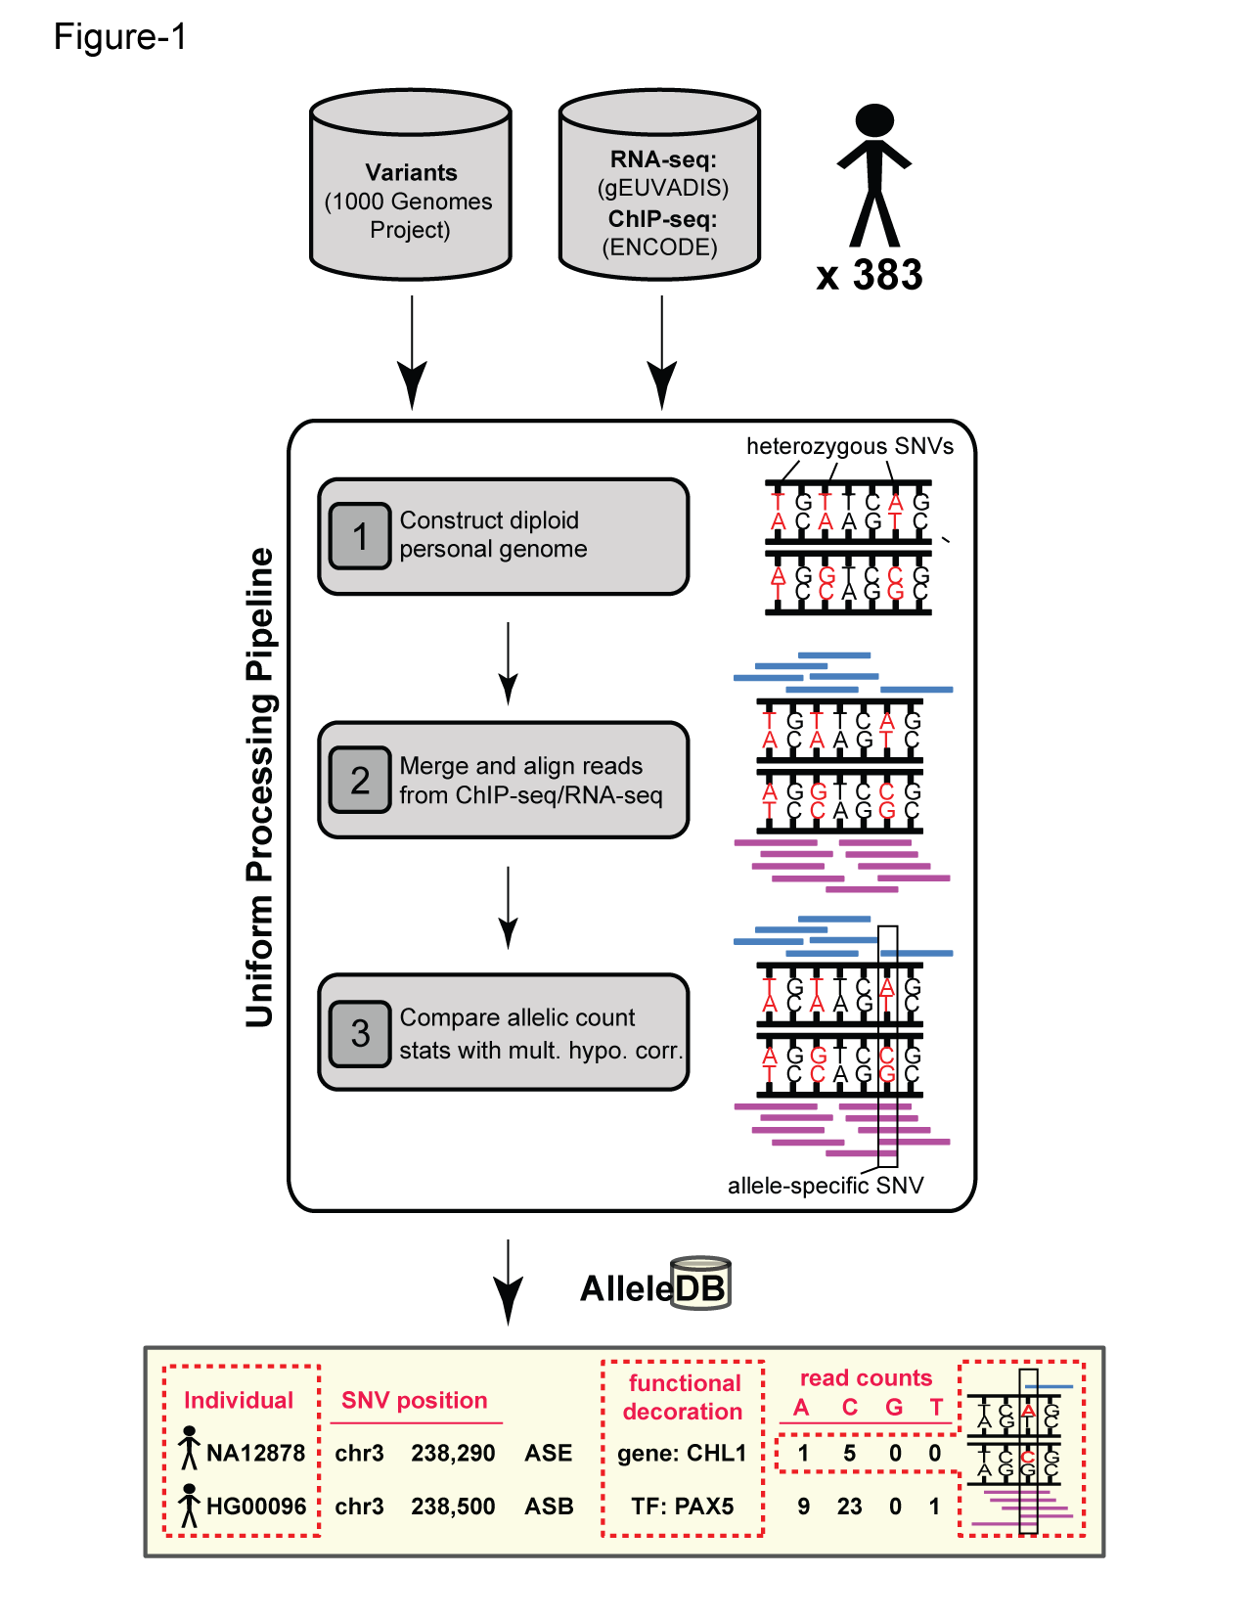
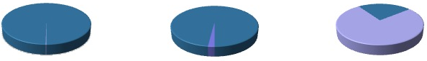
Human Genetic Variation
Population of
2,504 peoples
A Cancer Genome
A Typical Genome
Origin of Variants
Class of Variants
 | Coding | Non-coding
Germ-line | 22K | 4.1 – 5M
Somatic | ~50 | 5K
SNP | 3.5 – 4.3M
Indel | 550 – 625K
SV | 2.1 – 2.5K (20Mb)
Total | 4.1 – 5M
SNP | 84.7M
Indel | 3.6M
SV | 60K
Total | 88.3M
Prevalence of Variants
Common
Common
Passenger
Driver (~0.1%)
Rare* (1-4%)
Rare (~75%)
* Variants with allele frequency < 0.5% are considered as rare variants in 1000 genomes project.
The 1000 Genomes Project Consortium, Nature. 2015. 526:68-74
Khurana E. et al. Nat. Rev. Genet. 2016. 17:93-108

Slide 23
Prioritizing variants

Slide 24
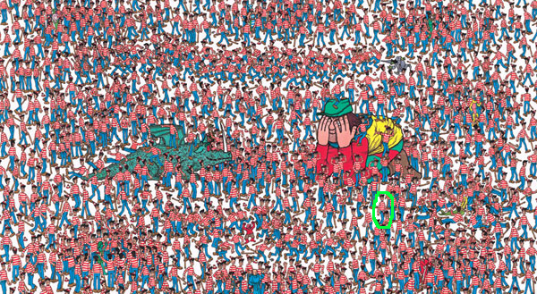
Where is Waldo?
(Finding the key mutations in ~3M Germline variants &
~5K Somatic Variants in a Tumor Sample)

Slide 25
Association of Variants with Diseases
Common
Variants
Healthy
Rare or
Somatic
Variants
Pooled
Variants
High
Function
Impact
Diseased
Burden Test
GWAS Positive

Slide 26
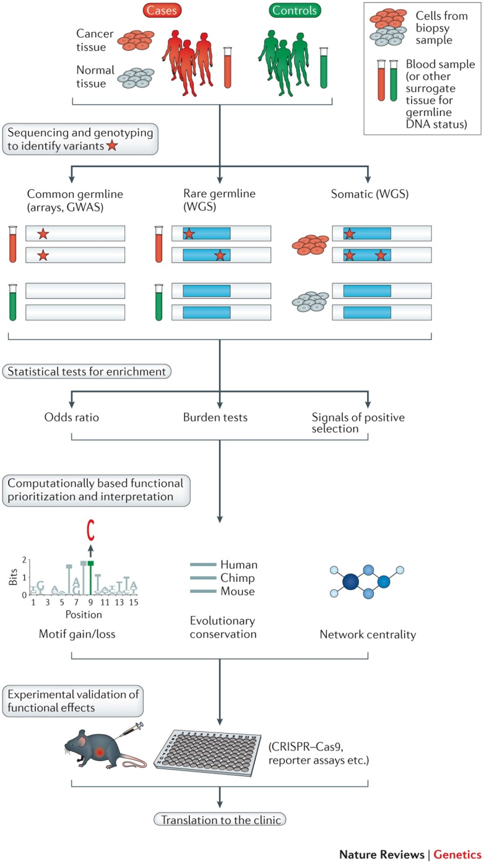
Khurana, Ekta, et al. Nature Reviews Genetics (2016)

Slide 27
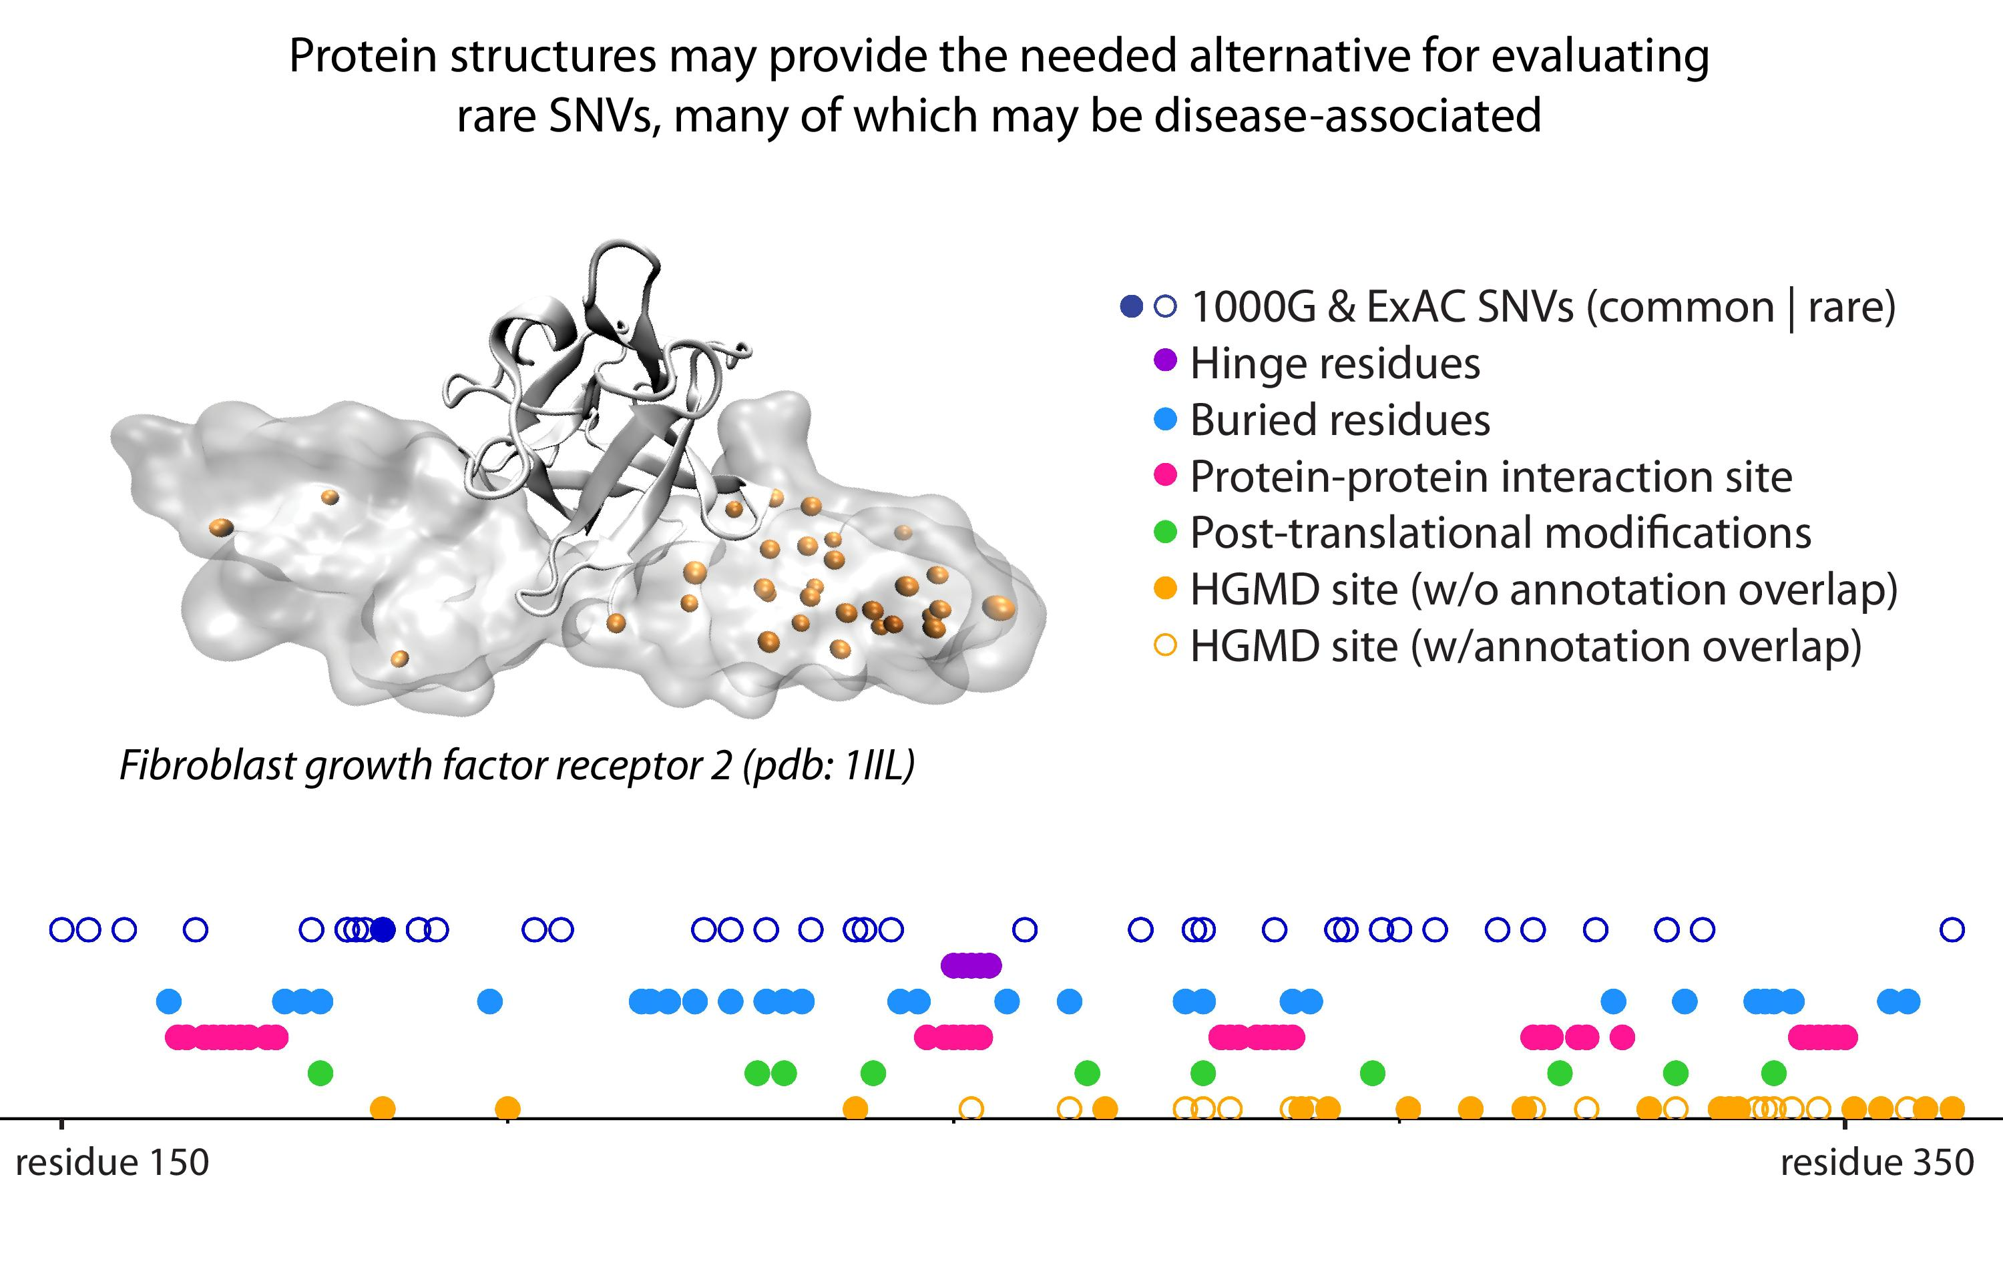
[Sethi et al. COSB (’15)]

Slide 28
Understanding the non-coding genome

Slide 29
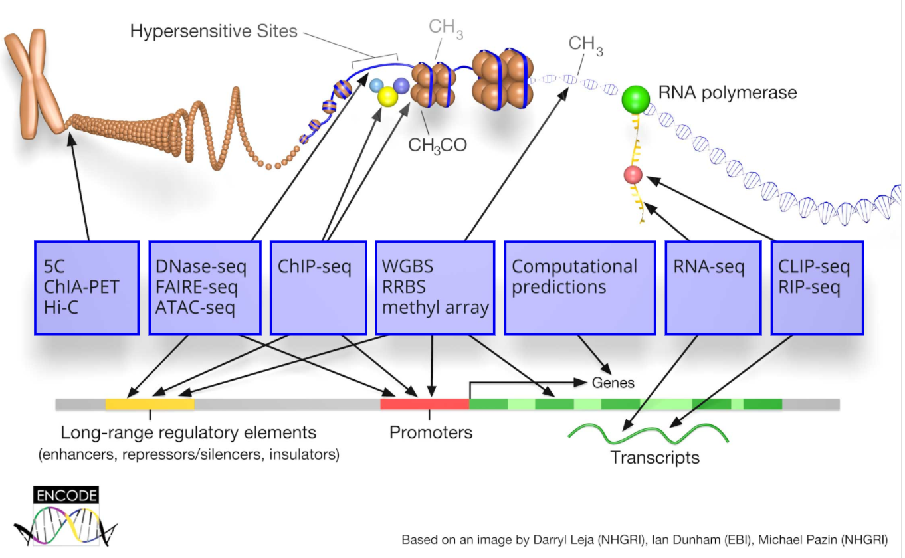
ENCODE: Encyclopedia of DNA Elements

Slide 30
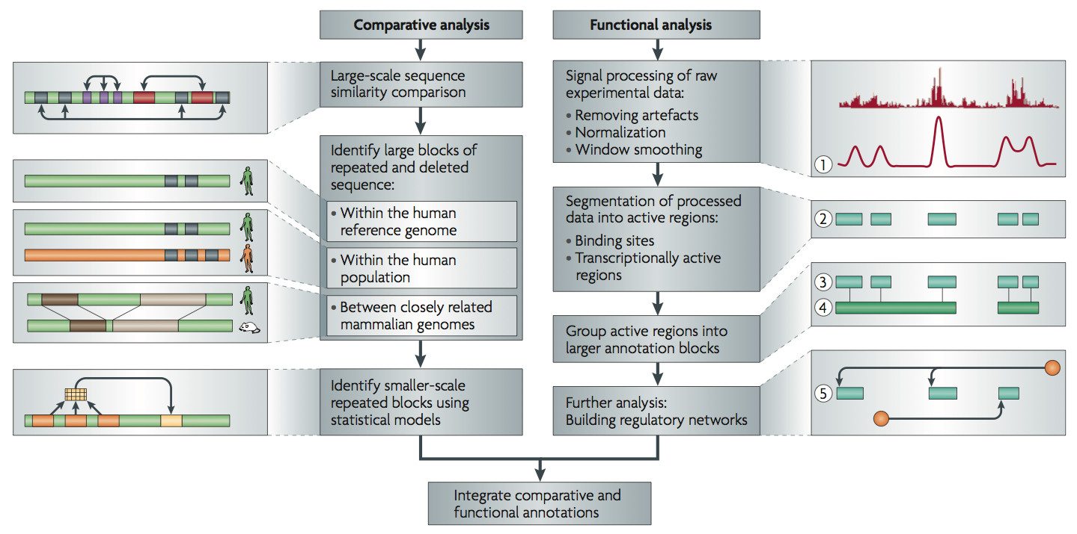
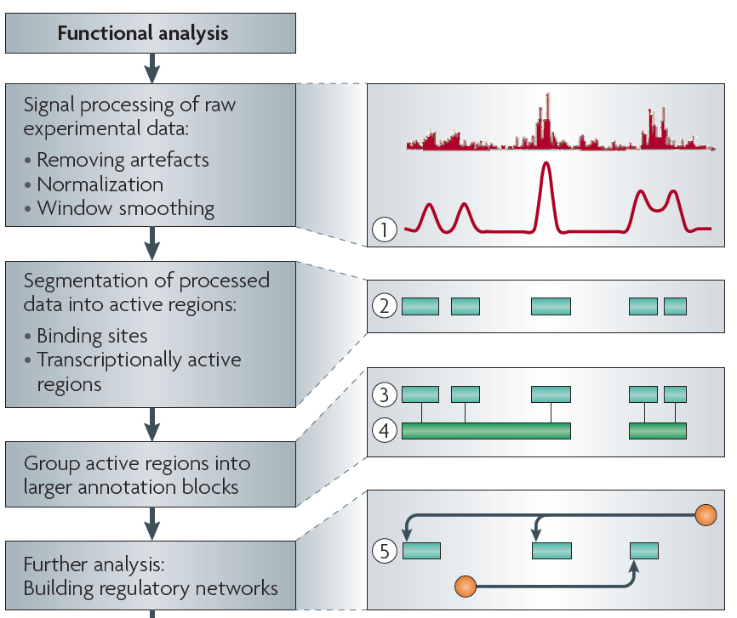
Non-coding Annotations:
Overview
Sequence features, incl. Conservation
Functional Genomics
Chip-seq (Epigenome & seq. specific TF) and ncRNA & un-annotated transcription
[Alexander et al., Nat. Rev. Genet. (’10)]

Slide 31
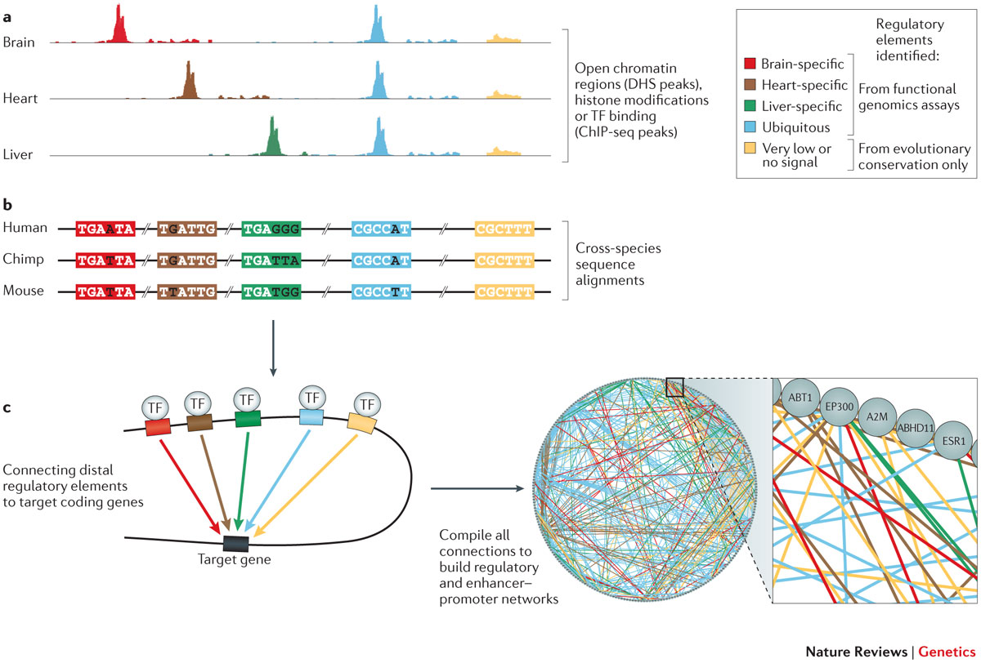
Khurana, Ekta, et al. Nature Reviews Genetics (2016)

Slide 32
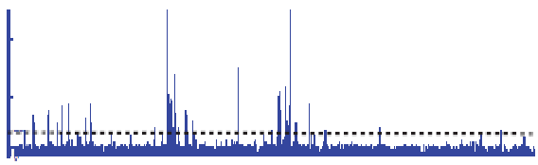

Summarizing the Signal:
"Traditional" ChipSeq Peak Calling
ChIP
Generate & threshold the signal profile to identify candidate target regions
  Simulation (PeakSeq),
  Local window based Poisson (MACS),
  Fold change statistics (SPP)
Threshold
Potential Targets
Normalized Control
Score against the control
Significantly Enriched targets
Now an update: "PeakSeq 2" => MUSIC
[Rozowsky et al. ('09) Nat Biotech]

Slide 33
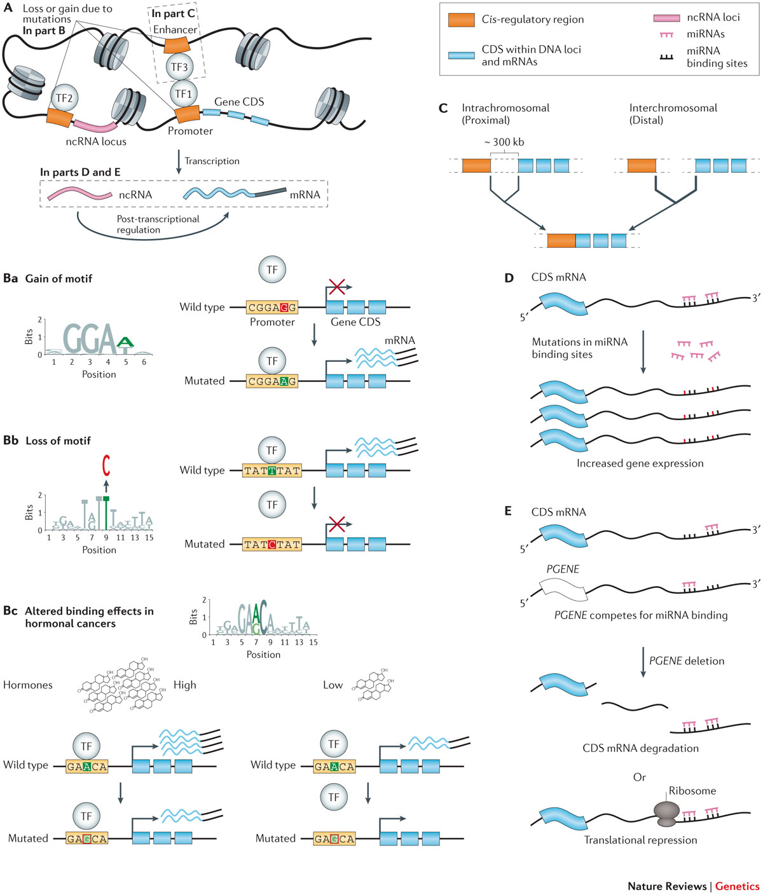
Khurana, Ekta, et al. Nature Reviews Genetics (2016)

Slide 34
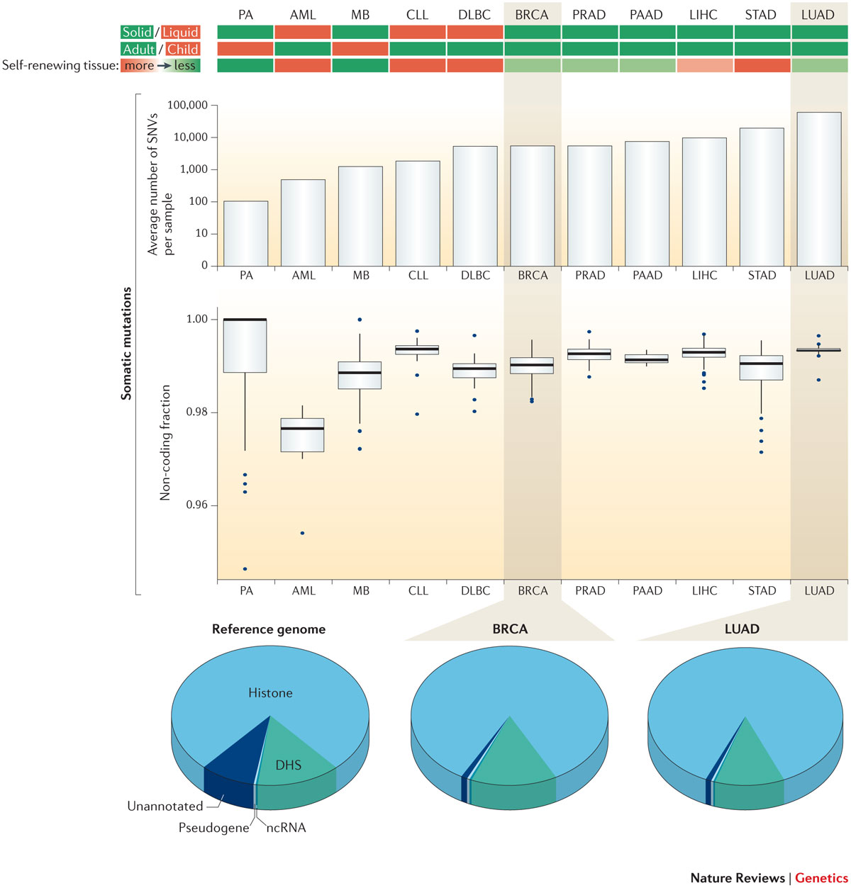
Khurana, Ekta, et al. Nature Reviews Genetics (2016)

Slide 35
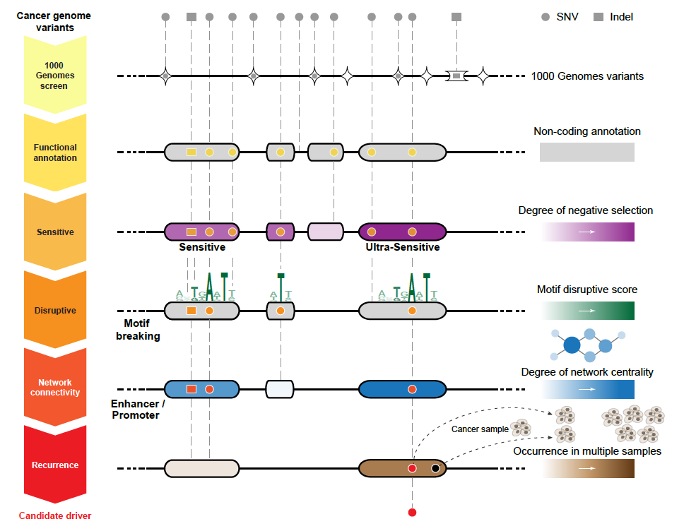
Identification of non-coding candidate drivers amongst somatic variants: Scheme
[Khurana et al., Science (‘13)]

Slide 36
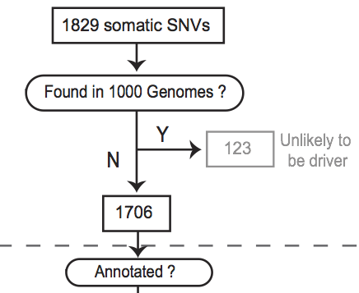
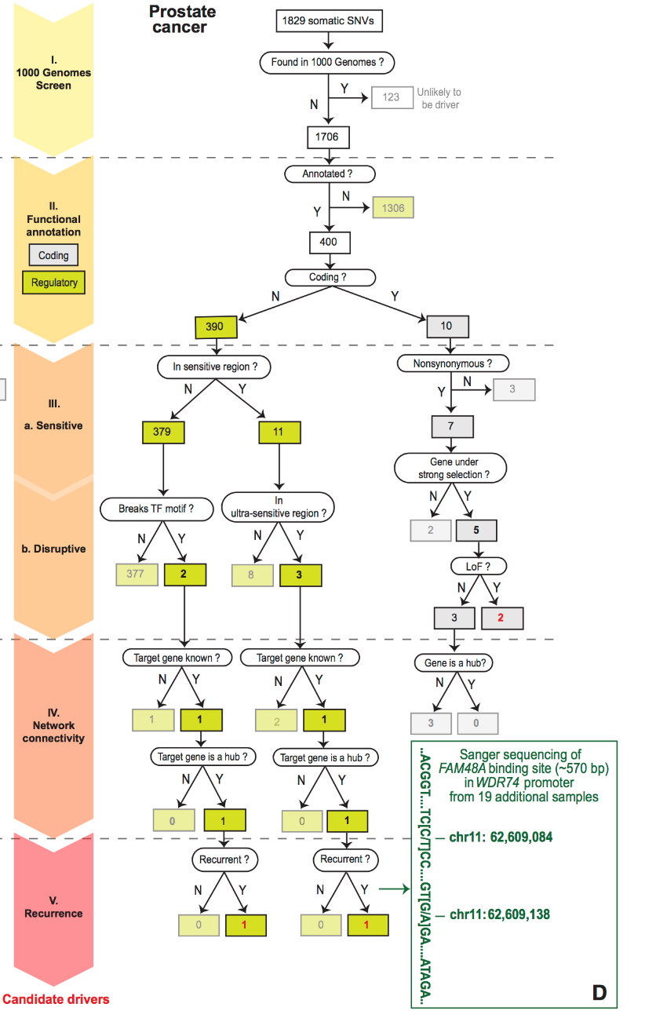
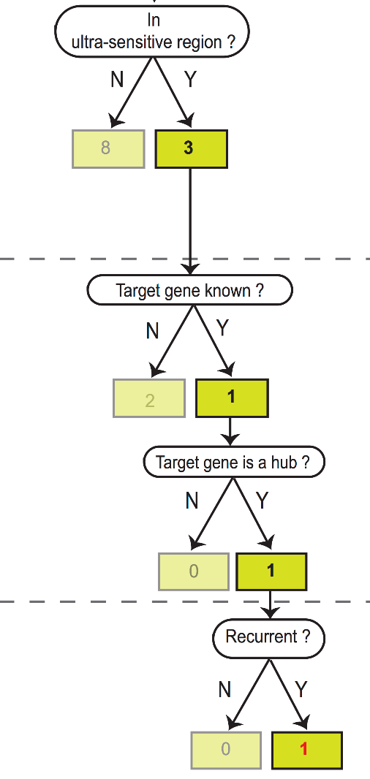
Flowchart for 1 Prostate Cancer Genome (from Berger et al. '11)
[Khurana et al., Science (‘13)]
Notes:
Just have one path

Slide 37
Personal genomes

Slide 38
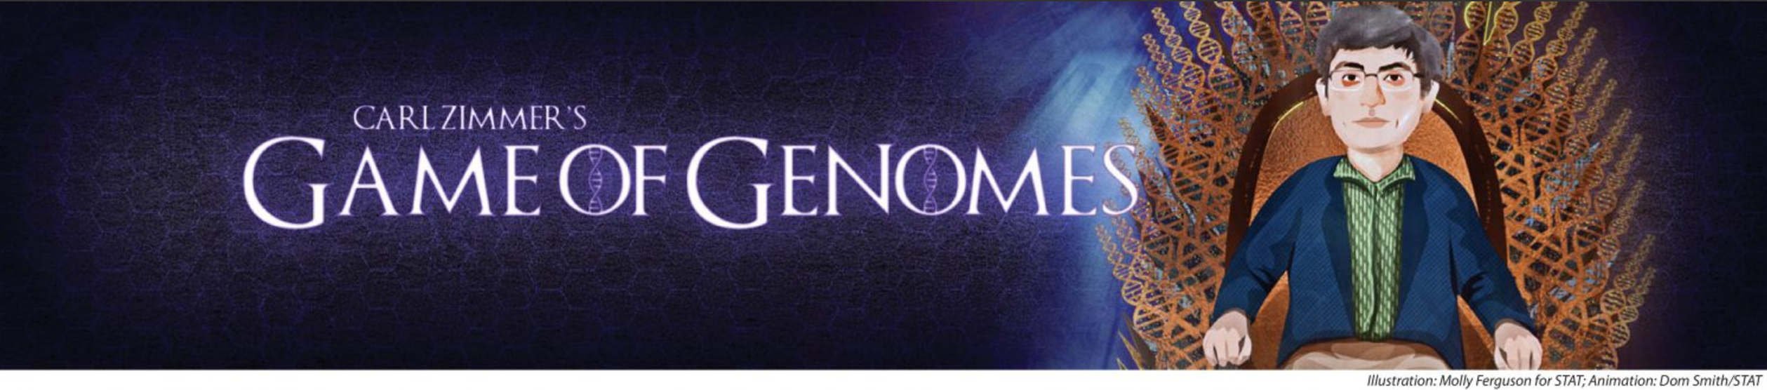
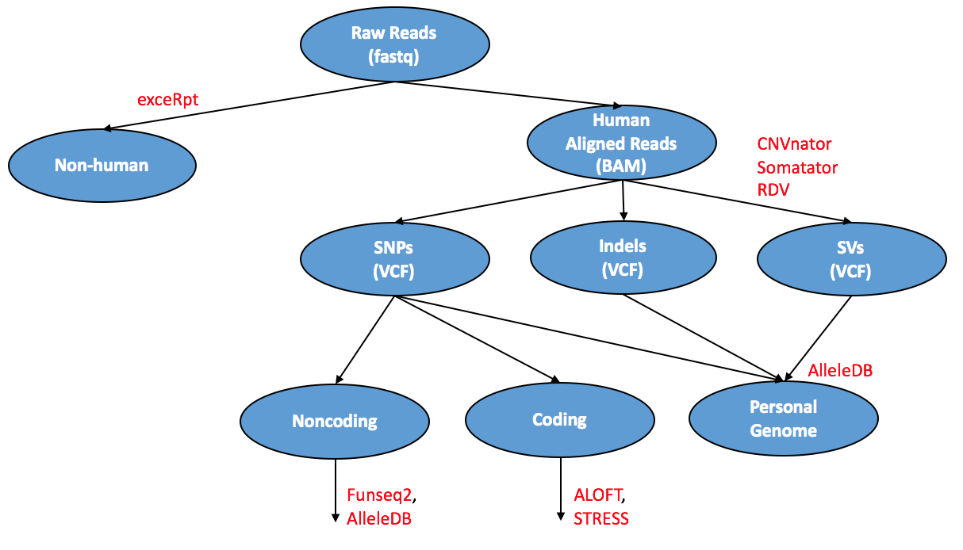

Slide 39
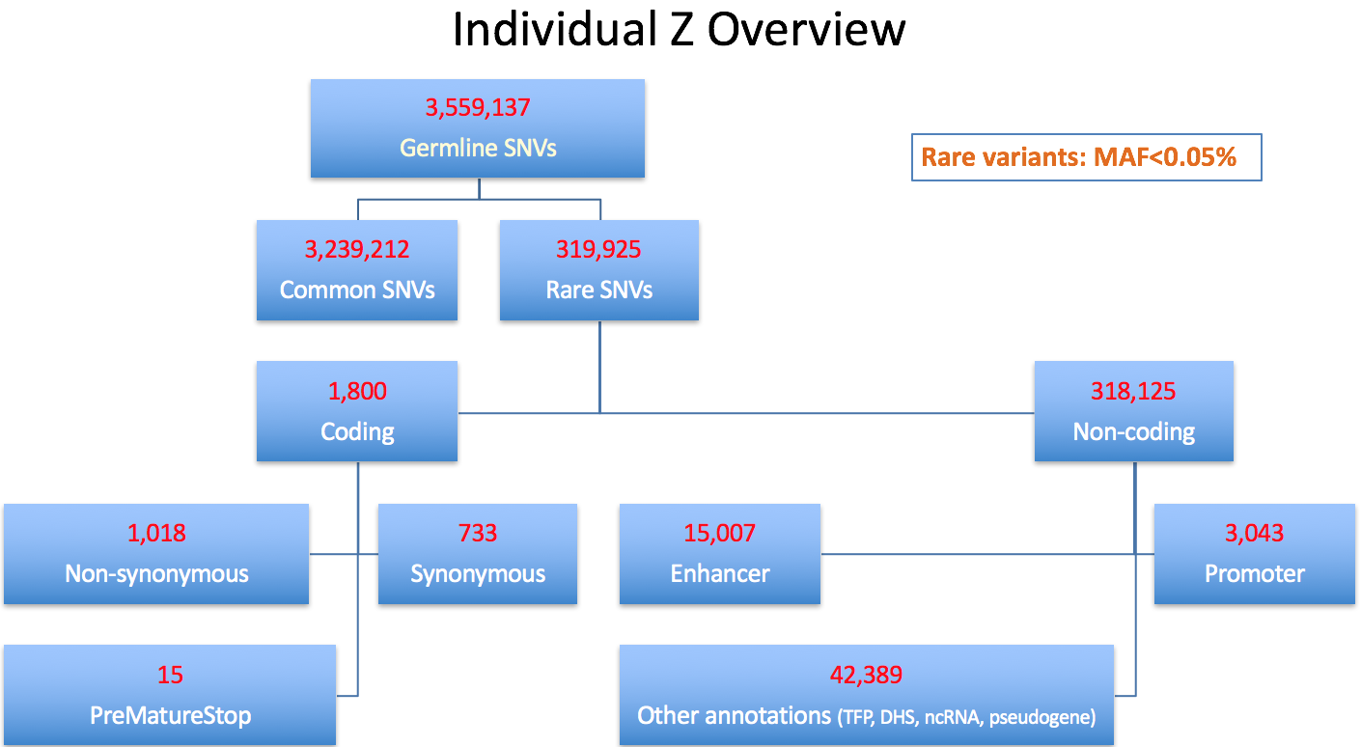

Slide 40
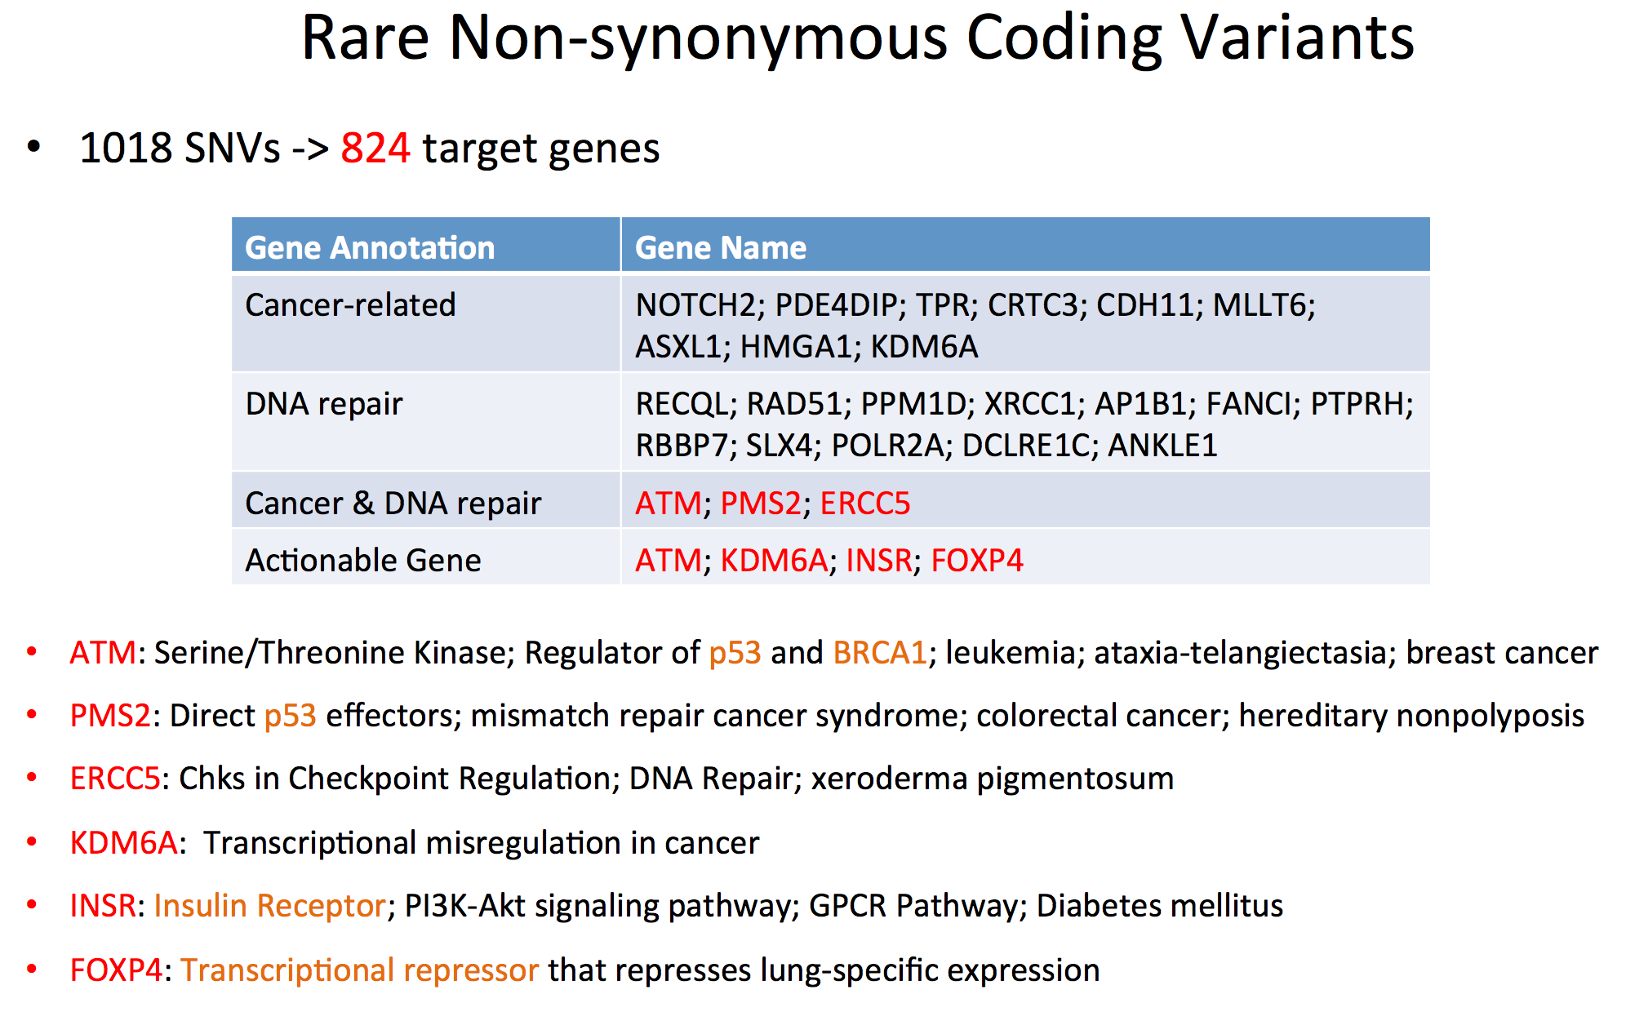

Slide 41
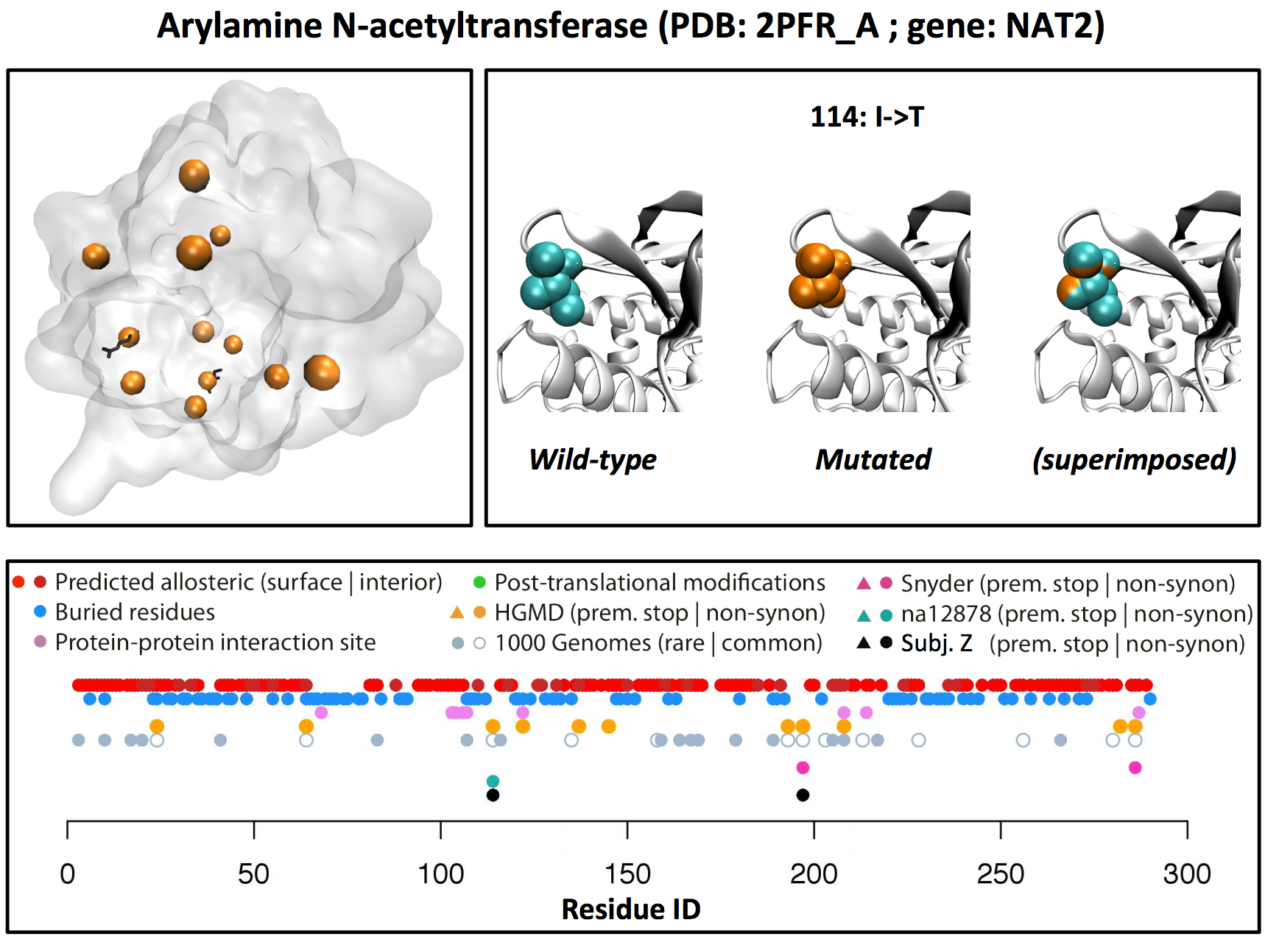

Slide 42
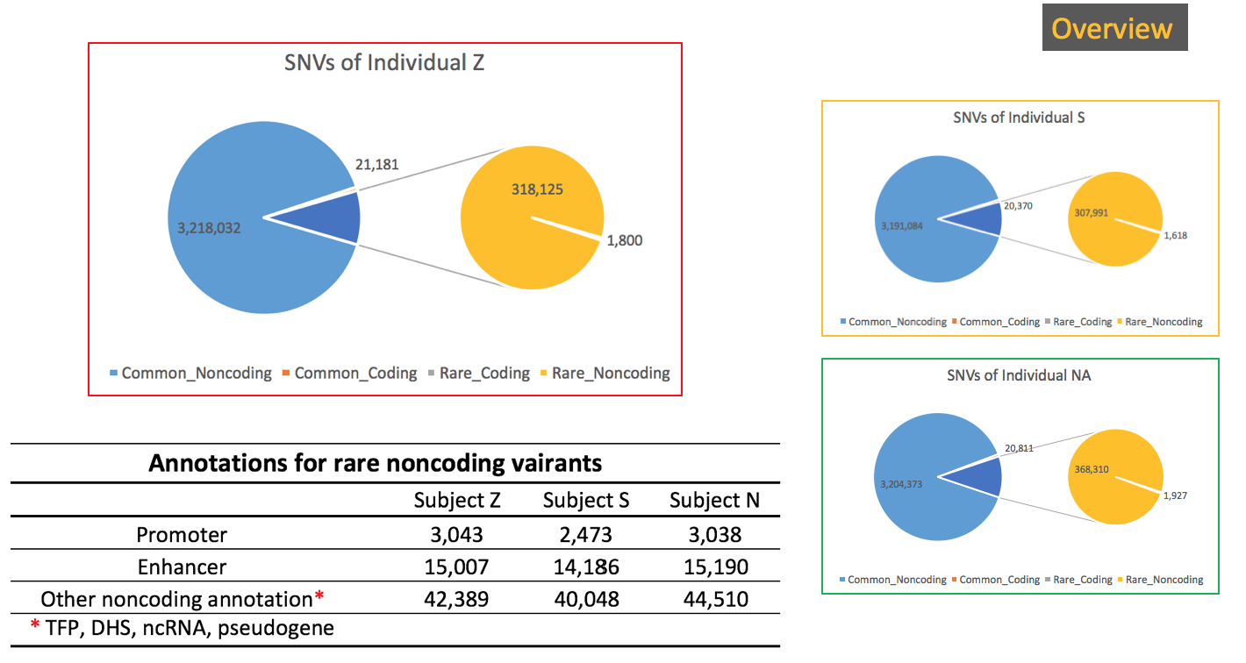

Slide 43
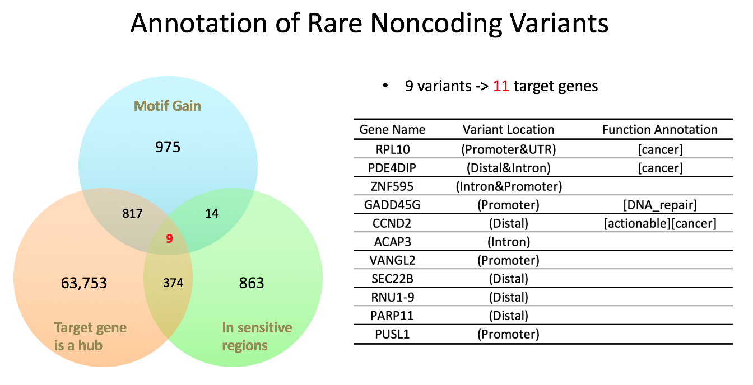

Slide 44
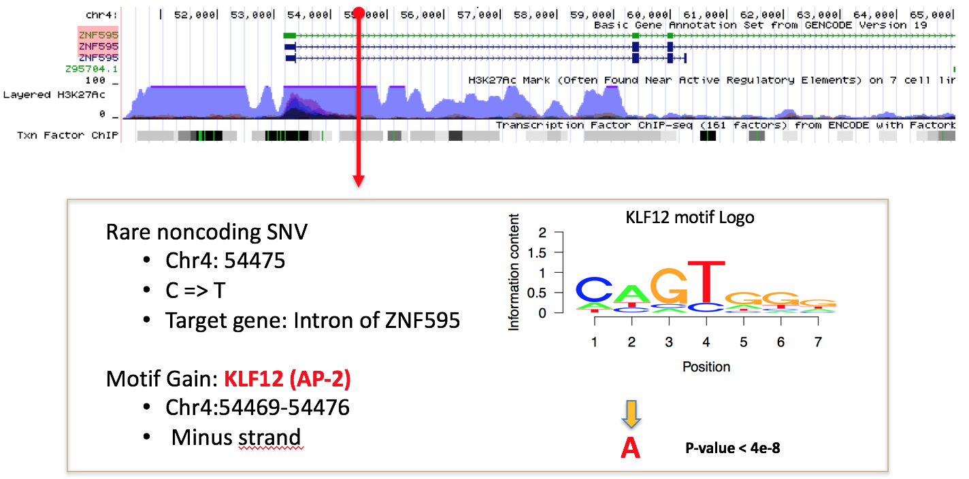

Slide 45
Conclusion
Each person has a vast number and diversity of variants in their genome – we still have to use power-through-population, variant prioritization, and basic biology to discover what it all means

Slide 46
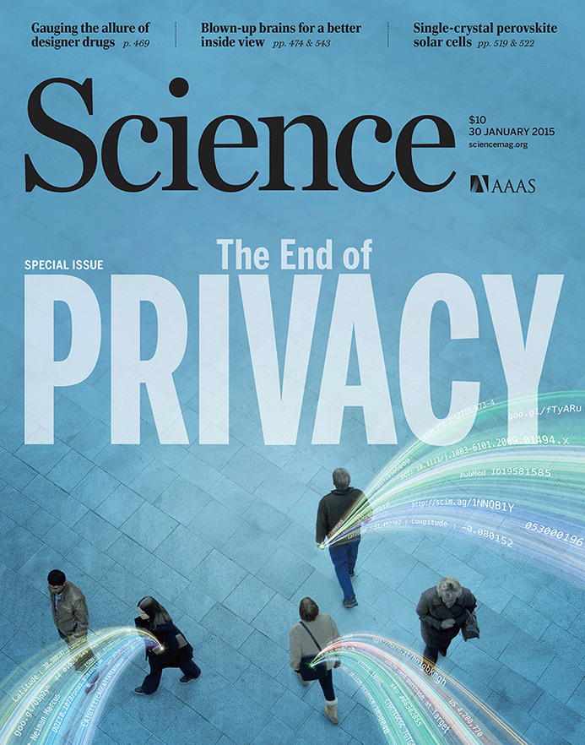

The Conundrum of Genomic Privacy: Is it a Problem?
Yes
Genetic Exceptionalism :
genome is potentially very revealing about one’s identity & characteristics
Most discussion of Identification Risk but what about Characterization Risk?
  Finding you were in study X vs identifying that you have trait Y from studying your identified genome
No
Shifting societal foci
No one really cares
about your genes
You might not care
[Klitzman & Sweeney ('11), J Genet Couns 20:98l; Greenbaum & Gerstein ('09), New Sci. (Sep 23) ]

Slide 47
Background:
The Conundrum of Genomic Privacy
The Genome is very fundamental data, potentially very revealing about one’s identity & characteristics
Identification Risk:
Find that someone participated in a study [Craig, Erlich]
Characterization Risk:
Finding that you have a particular trait from studying your identified genome
[eg Watson ApoE status]
Genetics has a problematic ethical history & might need to be particularly careful to keep public trust
  A single bad event (eg HELA like) could cause great damage to genomics research
Sharing helps research
  Large-scale mining of this information is essential for medical research
  For statistical association,
  1M is better than 1K
  Privacy is cumbersome, particularly for big data
Sharing is important for reproducible research
Data sharing & doing research on identifiable individuals is useful for education
  More interesting to study the genome of someone you know
[Yale Law Roundtable (‘10). Comp. in Sci. & Eng. 12:8; D Greenbaum & M Gerstein (‘09). Am. J. Bioethics; D Greenbaum & M Gerstein (‘10). SF Chronicle, May 2, Page E-4;
Greenbaum et al. PLOS CB (‘11)]
[Klitzman & Sweeney ('11), J Genet Couns 20:98l; Greenbaum & Gerstein ('09), New Sci. (Sep 23) ]

Slide 48
Genomics has similar "Big Data" Privacy Issues in the Rest of Society… or does it ?
Sharing & "peer-production" central to success of many new ventures, with the similar risks as in genomics
  EG web search: Large-scale mining essential, but we confront privacy risks every day we access the internet
Or is the genome exceptional?
  We can’t change it
  The individual (harmed?) v the collective (benefits)
    (Do sick patients care about their privacy?)
Different cultures of genomics (open-data) & clinical medicine (private data)
Genome is inherited so privacy risk is multi-generational
  What you can mine from a genome now is not clear, but what about in 20 years
[Seringhaus & Gerstein ('09), Hart. Courant (Jun 5); Greenbaum & Gerstein ('11), NY Times (6 Oct)]

Slide 49
Current Social & Technical Solutions
Notion of Consent
“Protected” distribution of data (dbGAP)
Local computes on secure computer
Practical Issues
  Non-uniformity of consents & paperwork
    Different international norms, leading to confusion
  Encryption & computer security creates burdensome requirements on data sharing & large scale analysis
  Many schemes get “hacked”
[Greenbuam et al ('04), Nat. Biotech; Greenbaum & Gerstein ('13), The Scientist]

Slide 50
How to Surmount the Dilemma
One approach is just using open data
  Maybe we need a few "test pilots” (ala PGP)?
    Sports stars & celebrities?
  Some public data & data donation is helpful but is this a realistic solution for an unbiased sample of ~1M
Hybrid Social & Tech Solution (a strawman)
  Fundamentally, researchers have to keep genetic secrets
  Legal framework for this (not charge of this group)
    Genetic licensure & training for individuals
    (similar to medical license, drivers license)
    Barriers shouldn't create a incentive for “hacking”
  Enabling Technologies
    We should develop technologies for Quantifying Leakage & allowing a small amounts of it
    We should develop technologies for the careful separation & coupling of private & public data
[D Greenbaum, M Gerstein (‘11). Am J Bioeth 11:39. Greenbaum & Gerstein, The Scientist ('13)]

Slide 51
More on Enabling Technologies
Making secure cloud computing easier
  Standard & open workflow systems cloud computing & enclaves (eg solution of Genomics England)
  Homomorphic encryption, Differential privacy
We should develop technologies for quantifying privacy
  What is acceptable risk? What is acceptable data leakage? Can we quantify leakage?
    Ex: photos of eye color
  Cost Benefit Analysis: how helpful is identifiable data in genomic research v. potential harm from a breach?
Separating but Linking Public & Private Data
  Lightweight, freely accessible secondary datasets coupled to underlying variants (eg gene expression quantifications)
  Selection of stub & "test pilot" datasets for benchmarking
  Developing standards for developing code on public stubs on your laptop; then move programs to the cloud for private production runs

Slide 52












Genomics has similar "Big Data" Dilemma in the Rest of Society
Sharing & "peer-production" is central to success of many new ventures, with the same risks as in genomics
We confront privacy risks every day we access the internet
(...or is the genome more exceptional & fundamental?)
[Seringhaus & Gerstein ('09), Hart. Courant (Jun 5); Greenbaum & Gerstein ('11), NY Times (6 Oct)]

Slide 53
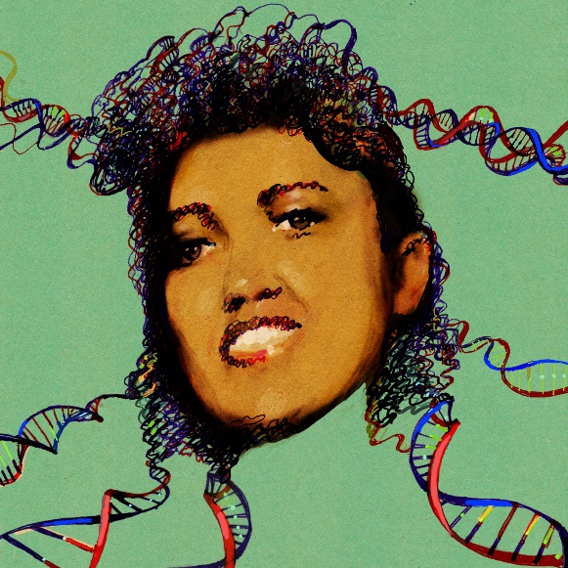
Tricky Privacy Considerations in Personal Genomics
Personal Genomic info. essentially meaningless currently but will it be in 20 yrs? 50 yrs?
  Genomic sequence very revealing about one’s children. Is true consent possible?
  Once put on the web it can’t be taken back
Culture Clash: Genomics historically has been a proponent of “open data” but not clear personal genomics fits this
Ethically challenged history of genetics
Ownership of the data & what consent means (Hela)
  Could your genetic data give rise to a product line?
[D Greenbaum & M Gerstein (’08). Am J. Bioethics; D Greenbaum & M Gerstein, Hartford Courant, 10 Jul. '08 ; SF Chronicle, 2 Nov. '08;
Greenbaum et al. PLOS CB (‘11) ; Greenbaum & Gerstein ('13), The Scientist; Photo from NY Times]

Slide 54

The Other Side of the Coin:
Why we should share
Sharing helps speed research
  Large-scale mining of this information is important for medical research
  Privacy is cumbersome, particularly for big data
Sharing is important for reproducible research
Sharing is useful for education
[Yale Law Roundtable (‘10). Comp. in Sci. & Eng. 12:8; D Greenbaum & M Gerstein (‘09). Am. J. Bioethics; D Greenbaum & M Gerstein (‘10). SF Chronicle, May 2, Page E-4;
Greenbaum et al. PLOS CB (‘11)]

Slide 55
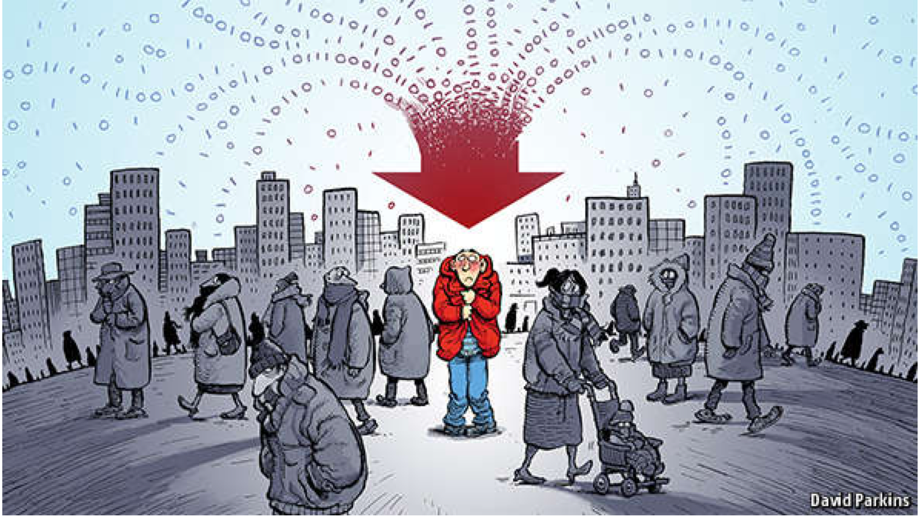
The Dilemma
[Economist, 15 Aug ‘15]
The individual (harmed?) v the collective (benefits)
  But do sick patients care about their privacy?
Quantification
  What is acceptable risk? What is acceptable data leakage? Can we quantify leakage?
    Ex: photos of eye color
  Cost Benefit Analysis: how helpful is identifiable data in genomic research v. potential harm from a breach?
Maybe a we need a few "test pilots” (ala PGP)?
  Sports stars & celebrities?

Slide 56
Current Social & Technical Solutions
Consents
“Protected” distribution of data (dbGAP)
Local computes on secure computer
Issues
  Non-uniformity of consents & paperwork
    Different international norms, leading to confusion
  Encryption & computer security creates burdensome requirements on data sharing & large scale analysis
  Many schemes get “hacked”
[Greenbuam et al ('04), Nat. Biotech; Greenbaum & Gerstein ('13), The Scientist]

Slide 57
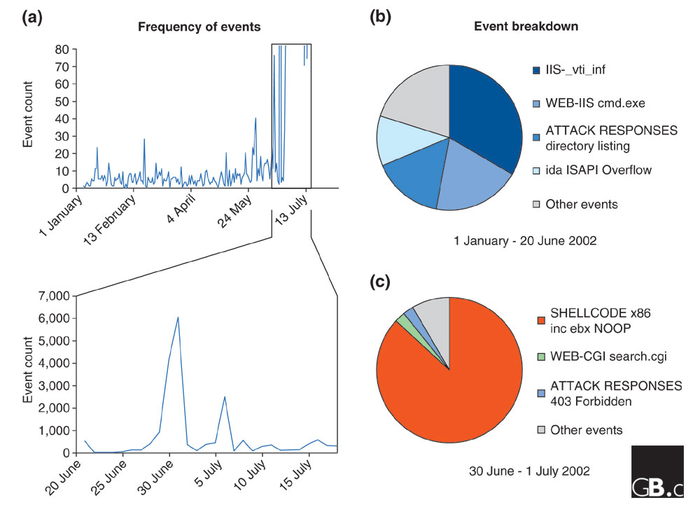
Difficulty in Securing Computers & Data
[Smith et al ('05), Genome Bio]

Slide 58
Genomic Privacy Hacks,
Mostly Focusing on Identification
Early genomic studies were based on small cohorts
  Individuals give consent to participate but request anonymity
    HAPMAP, PGP, 1000 Genomes…
  Focus on hiding the participation of individuals
  Attacks aimed at detecting whether an individual with known genotypes participated a study
    “Detection of genomes in a mixture” (Homer et al 2008, Im et al 2012)
As more people are genotyped, more individuals are in large private genomic databases
  Detection of an individual is irrelevant, as their participation is already known
    Current EX: “An individual’s genomic/phenotypic data is most certainly stored in their hospital”
    Future: >1M people’s health information is part of a NIH/PMI or NHS databases
Identification attacks now focus on pinpointing individuals by cross-referencing large seemingly independent datasets
  Illustrates that a leaked/hacker/stolen dataset, even when anonymized, can leak information
  Sweeney et al 2013, Gymrek et al 2013
Gymrek et al, “Identifying Personal Genomes by Surname Inference” (2013)
Homer et al, “Resolving individuals contributing trace amounts of DNA to highly complex mixtures using high-density SNP genotyping microarrays.” (2008)
Im et al, “On Sharing Quantitative Trait GWAS Results in an Era of Multiple-omics Data and the Limits of Genomic Privacy” (2012)
Sweeney et al, “Identifying Participants in the Personal Genome Project by Name” (2013)

Slide 59
Strawman Hybrid Social & Tech Proposed Solution?
Fundamentally, researchers have to keep genetic secrets
  Genetic Licensure & training for individuals
  (similar to medical license, drivers license)
Technology to make things easier
  Cloud computing & enclaves (eg solution of Genomics England)
Technological barriers shouldn't create a social incentive for “hacking”
Quantifying Leakage & allowing a small amounts of it
Careful separation & coupling of private & public data
  Lightweight, freely accessible secondary datasets coupled to underlying variants
  Selection of stub & "test pilot" datasets for benchmarking
  Develop programs on public stubs on your laptop, then move the program to the cloud for private production run
[D Greenbaum, M Gerstein (‘11). Am J Bioeth 11:39. Greenbaum & Gerstein, The Scientist ('13)]

