Slide 1

ENCODE Transcription Factor Network Analysis
Jason Liu
Mentor: JZ

Slide 2
ENCODE2&3 Data
K562
216 TF
GM12878
98 TF
66 TF in common
ENCODE narrowPeak file
From ENCODE2&3 ChIP-seq
Optimal IDR threshold peak calling
How can we compare these two cell lines and the paired behavior of the TFs?

Slide 3

Peak Intersection to Obtain Relative Importance (RI) Score
Partner TFs
TF₁
TF Binding Strength
TF₂
TF₃
Peak 1
Peak 2
Peak n
Focus TF Peak Regions
Algorithm for predictive learning via Rule Ensembles
Co-binding Potential
(Focus TF – Partner Tf_{i})
RI Score
TF Pair
Focus TF – Partner TF₁
Focus TF – Partner TF₂
Focus TF – Partner TF₃
RI Score is interpreted as co-binding potential between two TFs (0<=RI<=100)

Slide 4
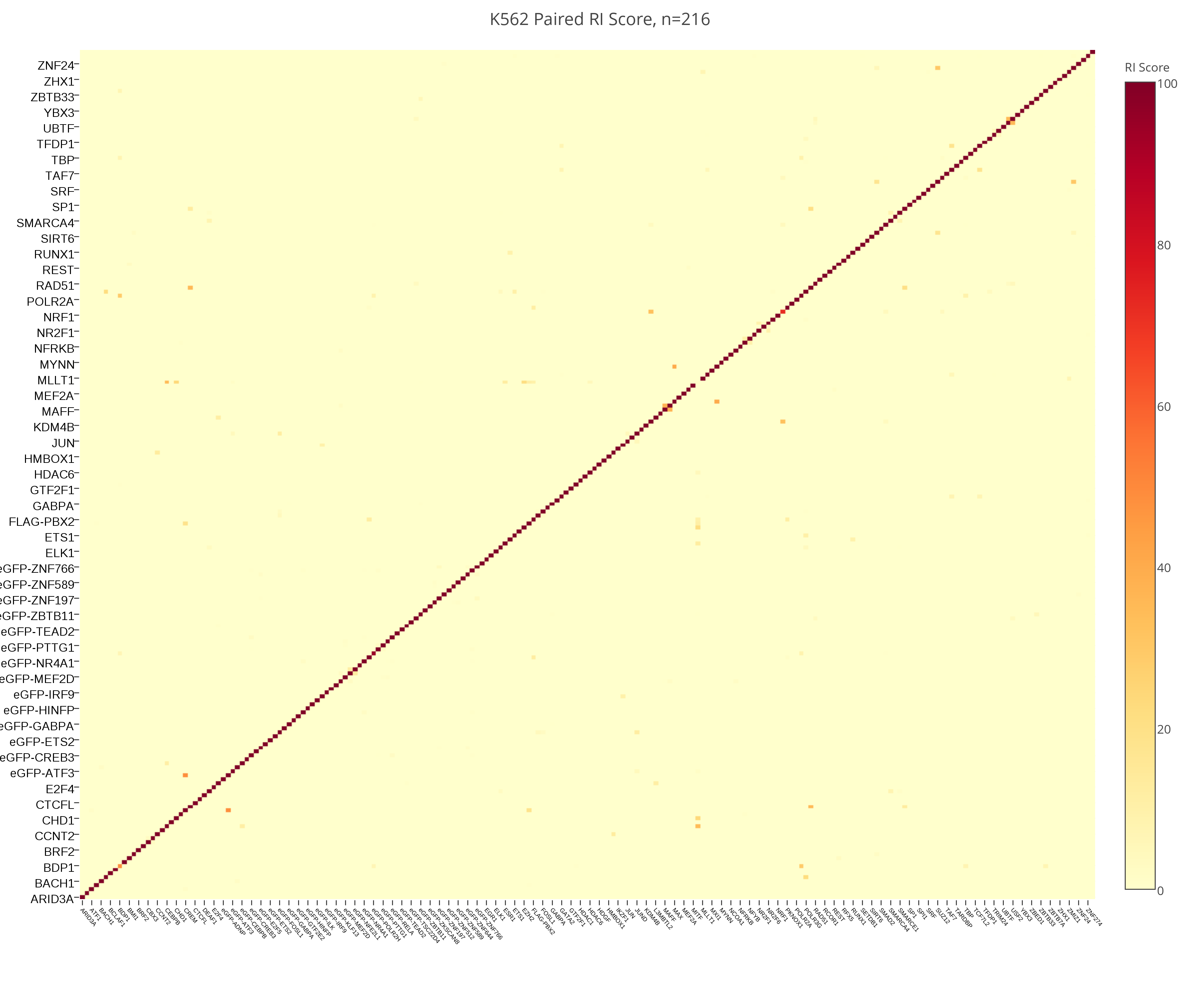
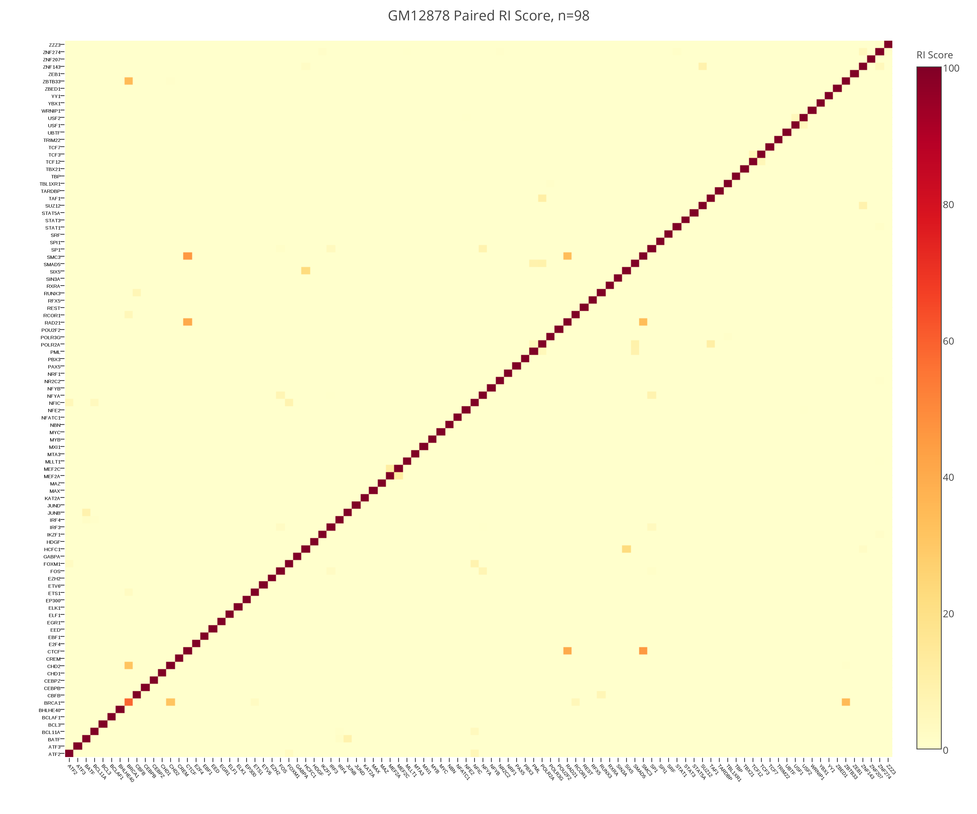
K562 RI score, n=216
GM12878 RI score, n=98
RI > 5 significant
K562: 92 significant TF pairs
GM12878: 40 significant TF pairs
*excludes matrix diagonal

Slide 5
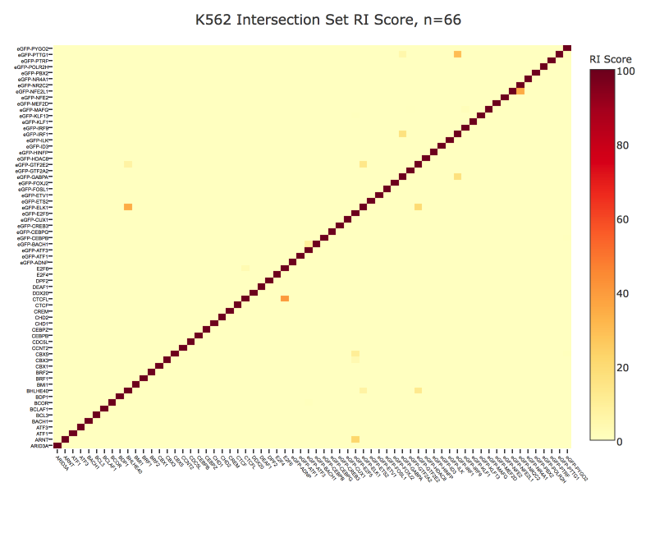
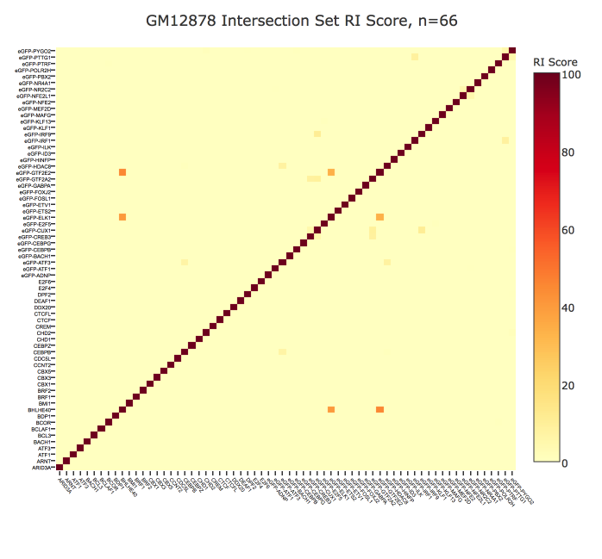
K562, n=66
GM12878, n=66
RI > 5 significant
K562: 22 significant TF pairs
GM12878: 20 significant TF pairs
*excludes matrix diagonal

Slide 6
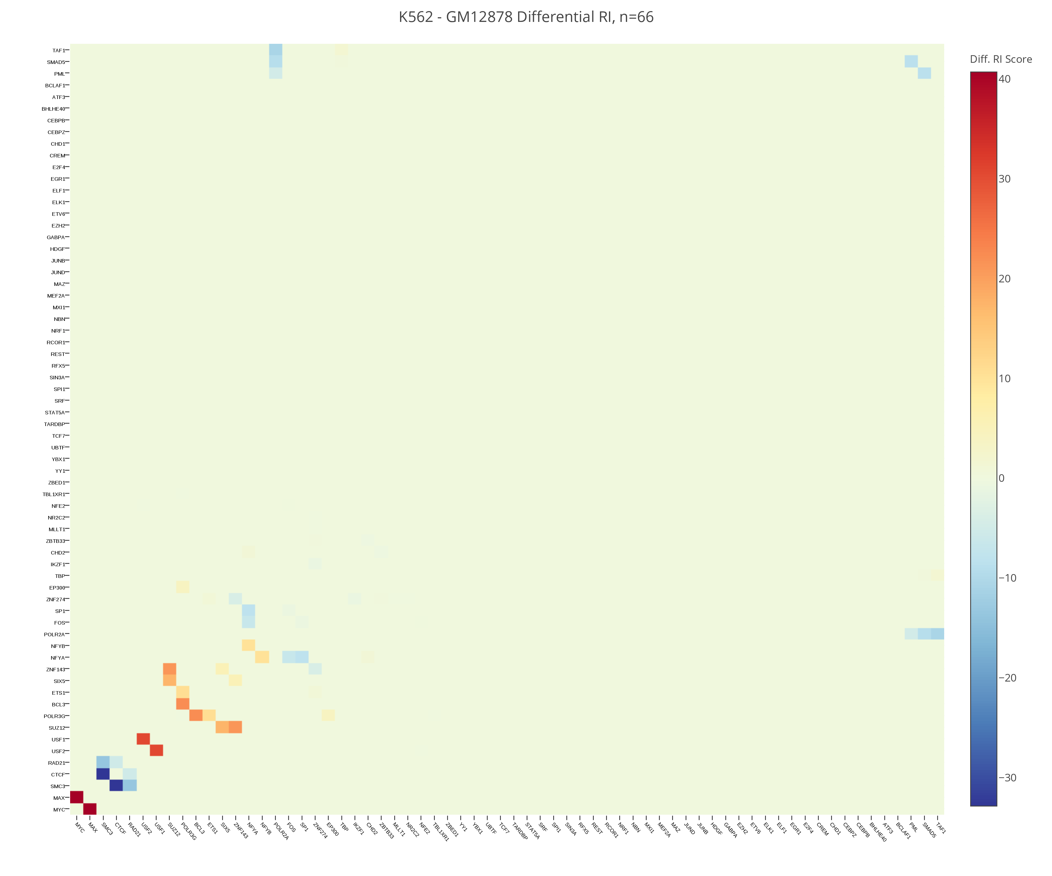

Slide 7
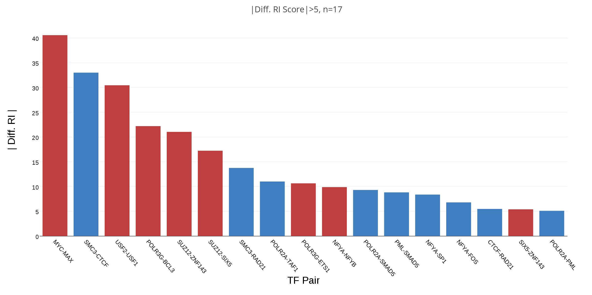
These TF pairs show significant change ( |Diff. RI| > 5) in co-binding potential
between K562 and GM12878

Slide 8
Relevant TF Pairs – Positive Differential RI Score
TF Pair | Description | PBMID
MYC-MAX | Heterodimer pair, MYC - Oncogene | 14663479
USF1-USF2 | USF1-USF2 – Promote gene expression | 18230803
POLR3G-BCL3 | POLR3G – transcription increase in cancer BCL3 – Oncogene | 19191868
SUZ12-ZNF143 | SUZ12 – needed for normal blood cell ZNF143 – targets genes for cell proliferation | 26036803
POLR3G-ETS1 | ETS1 – Oncogene | 12971829

Slide 9
Relevant TF Pairs – Negative Differential RI Score
TF Pair | Description | PBMID
SMC3-CTCF | SMC3 – subunit of cohesin, CTCF – binding protein | 26686651
SMC3-RAD21 | SMC3-RAD21 both are subunits of cohesin | 24335803
POLR2A-TAF1 | POLR2a – RNA Polymerase II Subunit A TAF1 – inhibits p53 | 15053879
POLR2A-SMAD5 | SMAD5 – inhibition of proliferation of normal blood cells | 15053879
PML-SMAD5 | PML – Tumor suppressor gene | 14630830
CTCF-RAD21 | RAD21 – unit of cohesin binds with CTCF for transcription | 24335803

Slide 10
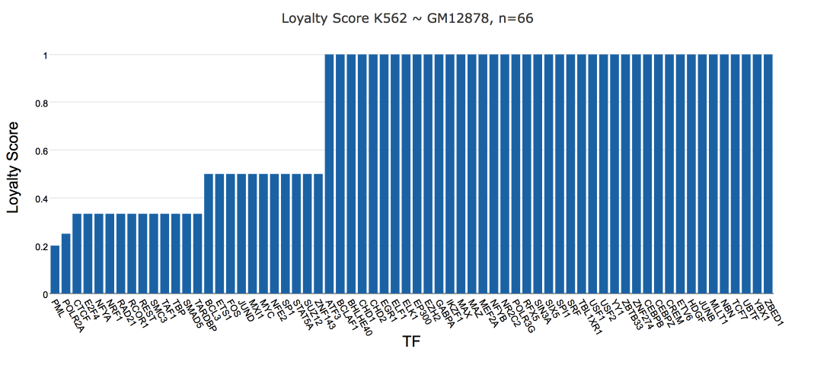
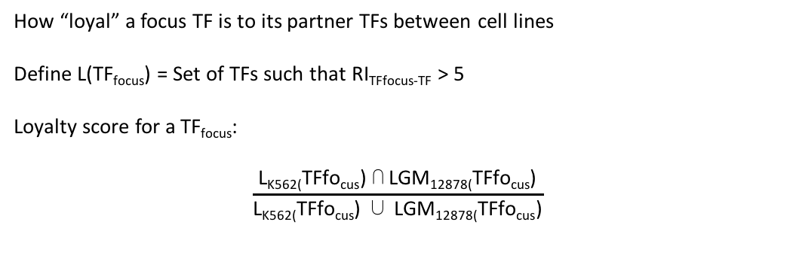
Loyalty Score – Do TFs Change Partners?
How “loyal” a focus TF is to its partner TFs between cell lines
Define L(TF_{focus}) = Set of TFs such that RI_{TFfocus-TF} > 5
Loyalty score for a TF_{focus}:
$$\frac{\text{L}\text{K}\text{562(}\text{TF}\text{fo}\text{cus}\text{) }\text{⋂} \text{LGM}\text{12878(}\text{TFfo}\text{cus}\text{)}}{\text{L}\text{K}\text{562(}\text{TFfo}\text{cus}\text{) }\text{∪} \text{LGM}\text{12878(}\text{TFfo}\text{cus}\text{)}}$$

Slide 11
Acknowledgements
Jing Zhang
Donghoon Lee
Mark Gerstein
Gerstein Lab Members

