Slide 1

Genomic Privacy & Individualized RNA-seq: Incompatible or Feasible?
Mark Gerstein, Yale
Slides freely
downloadable from Lectures.GersteinLab.org
& “tweetable” (via @markgerstein).
See last slide for more info.
Notes:
1

Slide 2
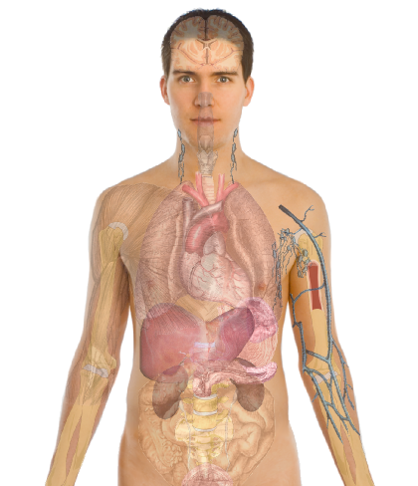
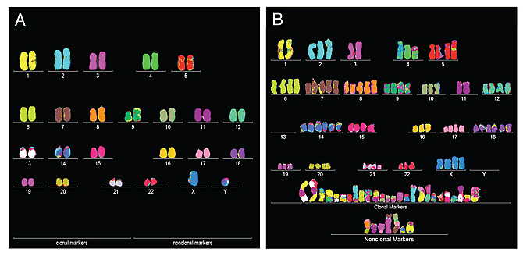
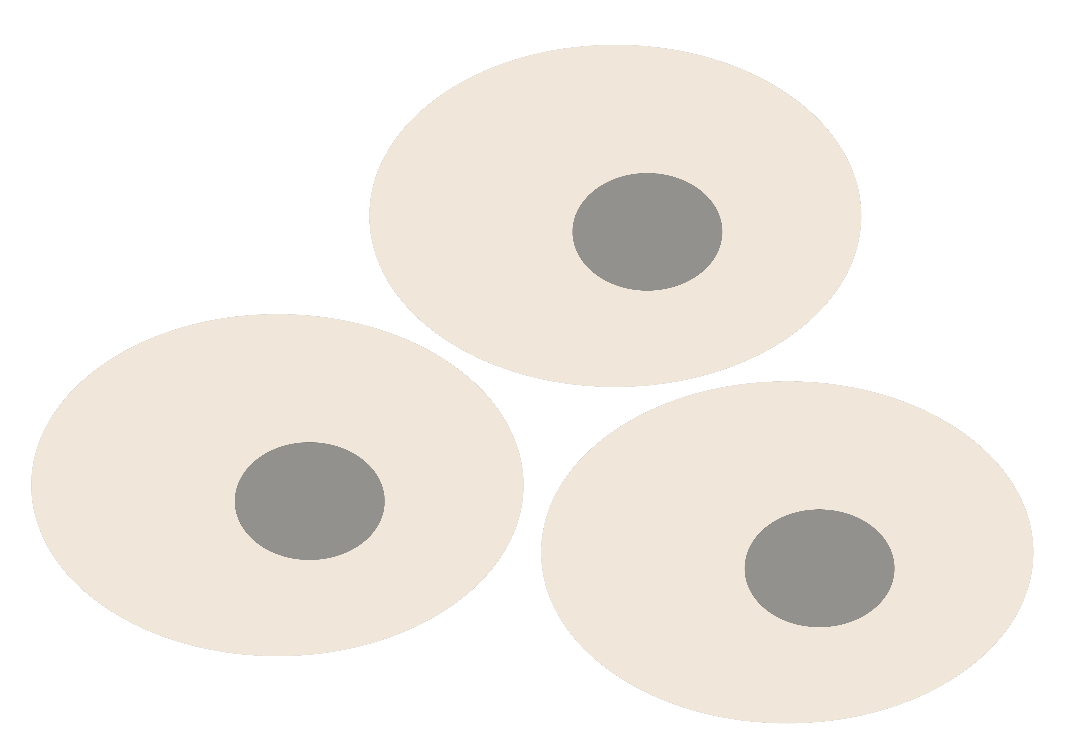
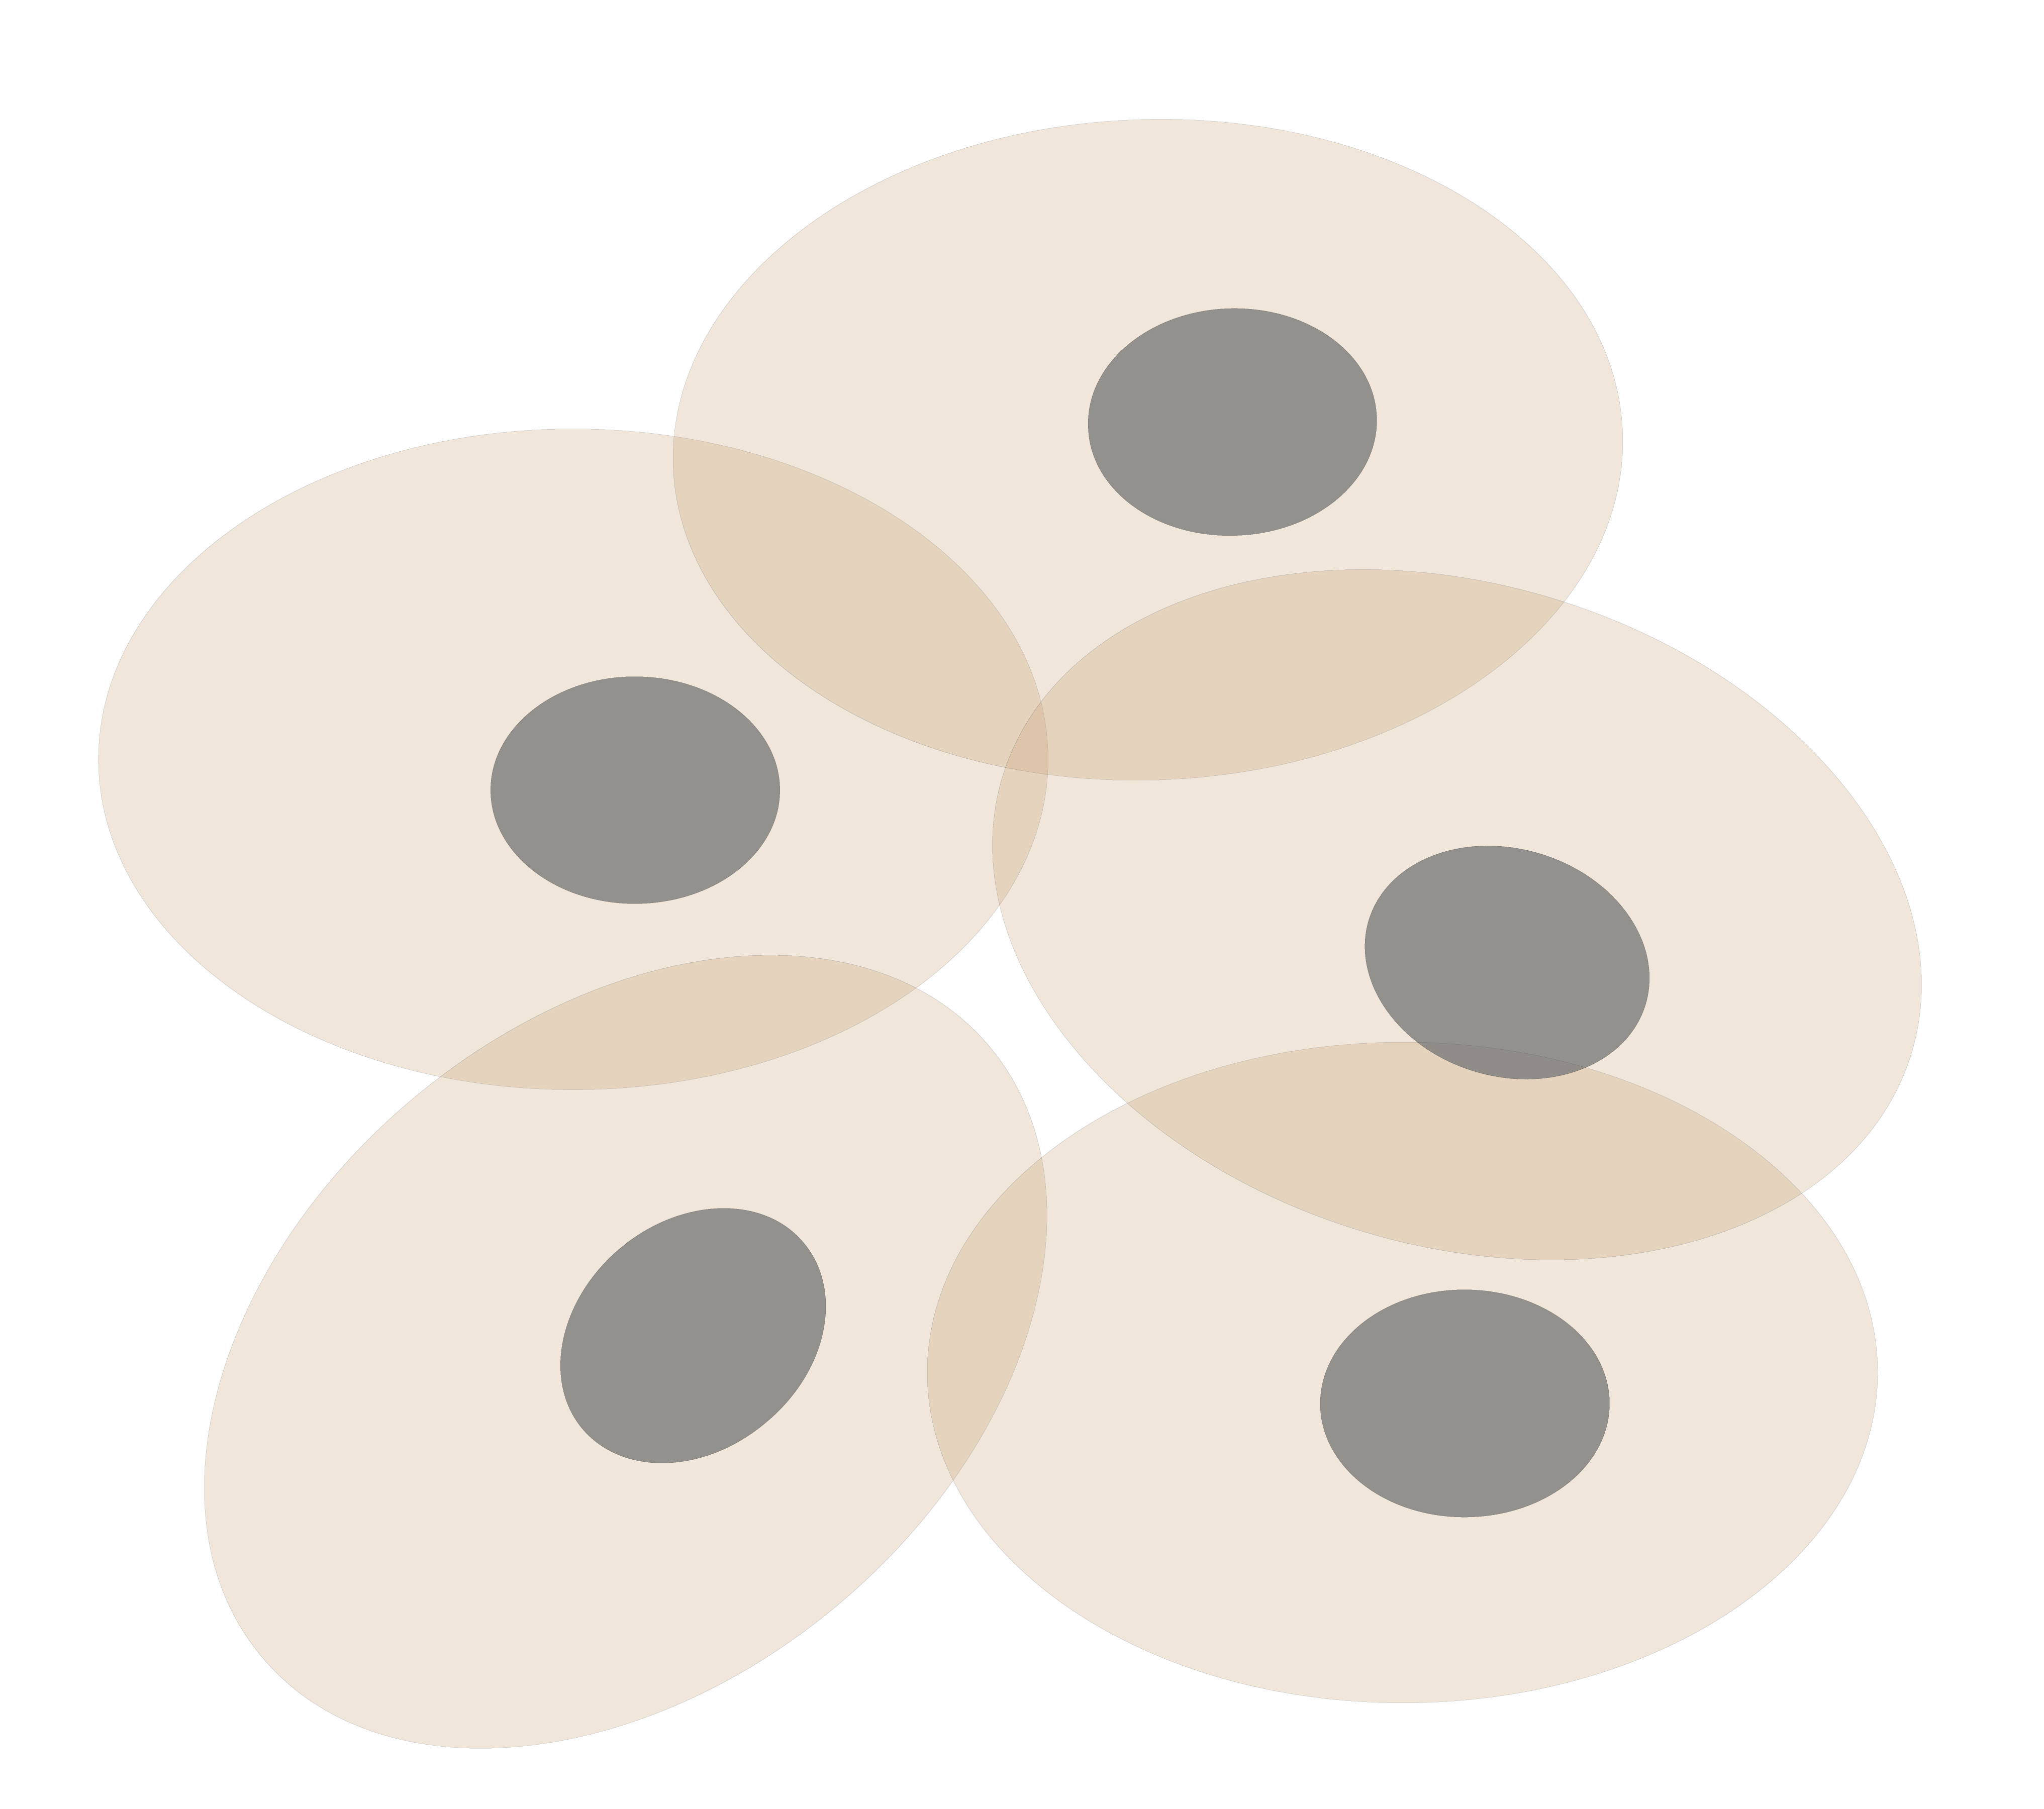
Personal Genomics & Transcriptomics
as a Gateway into Biology
Personal genomes (& Transcriptomes) soon will become a commonplace part of medical research & eventually treatment (esp. for cancer).
They will provide a primary connection for biological science to the general public.
normal
tumor

Slide 3
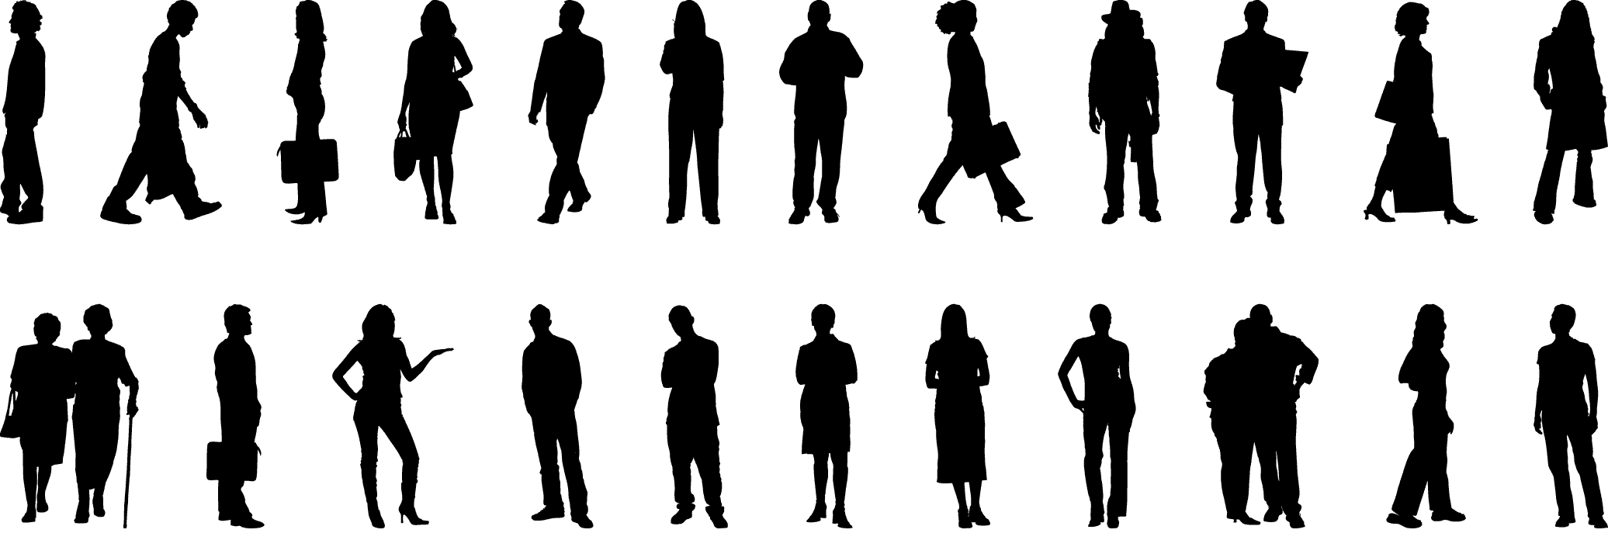
Placing the individual into the context of the population
&
using the population to build a interpretative model

Slide 4
Genomic Privacy & Individualized RNA-seq: Incompatible or Feasible?
RNA-seq: How to Publicly Share Some of it
  Presents a tricky privacy issue since much of the sequencing is for general, non-individual specific results yet it’s tagged with individual information
  Removing SNVs in reads w/ MRF
  Quantifying & removing variant info from expression levels + eQTLs using ICI & predictability
  Instantiating a practical linking attack using extreme expression levels
Allelic Expression & Binding Activity
  Difference in molecular activity between specific alleles
  RNA-seq calculations that fundamentally involve individual variants
  Aggregating results with AlleleDB to define allelic elements & subnetworks
  Allelic elements tend to be under weaker selection
The General Dilemma of Genomic Privacy
  Fundamental, inherited info that’s very private v need for large-scale mining for med. research
  Issues w/ current social & tech approaches: inconsistencies, burdensome security, various "hacks”
  Strawman Hybrid Soc-Tech Proposal (Cloud Enclaves. Quantifying Leaks & Closely Coupled priv.-public datasets)

Slide 5
Genomic Privacy & Individualized RNA-seq: Incompatible or Feasible?
RNA-seq: How to Publicly Share Some of it
  Presents a tricky privacy issue since much of the sequencing is for general, non-individual specific results yet it’s tagged with individual information
  Removing SNVs in reads w/ MRF
  Quantifying & removing variant info from expression levels + eQTLs using ICI & predictability
  Instantiating a practical linking attack using extreme expression levels
Allelic Expression & Binding Activity
  Difference in molecular activity between specific alleles
  RNA-seq calculations that fundamentally involve individual variants
  Aggregating results with AlleleDB to define allelic elements & subnetworks
  Allelic elements tend to be under weaker selection
The General Dilemma of Genomic Privacy
  Fundamental, inherited info that’s very private v need for large-scale mining for med. research
  Issues w/ current social & tech approaches: inconsistencies, burdensome security, various "hacks”
  Strawman Hybrid Soc-Tech Proposal (Cloud Enclaves. Quantifying Leaks & Closely Coupled priv.-public datasets)

Slide 6
Background:
The Conundrum of Genomic Privacy
The Genome is very fundamental data, potentially very revealing about one’s identity & characteristics
Identification Risk:
Find that someone participated in a study [Craig, Erlich]
Characterization Risk:
Finding that you have a particular trait from studying your identified genome
[eg Watson ApoE status]
Genetics has a problematic ethical history & might need to be particularly careful to keep public trust
  A single bad event (eg HELA like) could cause great damage to genomics research
Sharing helps research
  Large-scale mining of this information is essential for medical research
  For statistical association,
  1M is better than 1K
  Privacy is cumbersome, particularly for big data
Sharing is important for reproducible research
Data sharing & doing research on identifiable individuals is useful for education
  More interesting to study the genome of someone you know
[Yale Law Roundtable (‘10). Comp. in Sci. & Eng. 12:8; D Greenbaum & M Gerstein (‘09). Am. J. Bioethics; D Greenbaum & M Gerstein (‘10). SF Chronicle, May 2, Page E-4;
Greenbaum et al. PLOS CB (‘11)]
[Klitzman & Sweeney ('11), J Genet Couns 20:98l; Greenbaum & Gerstein ('09), New Sci. (Sep 23) ]

Slide 7
Genomics has similar "Big Data" Privacy Issues in the Rest of Society… or does it ?
Sharing & "peer-production" central to success of many new ventures, with the similar risks as in genomics
  EG web search: Large-scale mining essential, but we confront privacy risks every day we access the internet
Or is the genome exceptional?
  We can’t change it
  The individual (harmed?) v the collective (benefits)
    (Do sick patients care about their privacy?)
Different cultures of genomics (open-data) & clinical medicine (private data)
Genome is inherited so privacy risk is multi-generational
  What you can mine from a genome now is not clear, but what about in 20 years
[Seringhaus & Gerstein ('09), Hart. Courant (Jun 5); Greenbaum & Gerstein ('11), NY Times (6 Oct)]

Slide 8
Current Social & Technical Solutions
Notion of Consent
“Protected” distribution of data (dbGAP)
Local computes on secure computer
Practical Issues
  Non-uniformity of consents & paperwork
    Different international norms, leading to confusion
  Encryption & computer security creates burdensome requirements on data sharing & large scale analysis
  Many schemes get “hacked”
[Greenbuam et al ('04), Nat. Biotech; Greenbaum & Gerstein ('13), The Scientist]

Slide 9
How to Surmount the Dilemma
One approach is just using open data
  Maybe we need a few "test pilots” (ala PGP)?
    Sports stars & celebrities?
  Some public data & data donation is helpful but is this a realistic solution for an unbiased sample of ~1M
Hybrid Social & Tech Solution (a strawman)
  Fundamentally, researchers have to keep genetic secrets
  Legal framework for this (not charge of this group)
    Genetic licensure & training for individuals
    (similar to medical license, drivers license)
    Barriers shouldn't create a incentive for “hacking”
  Enabling Technologies
    We should develop technologies for Quantifying Leakage & allowing a small amounts of it
    We should develop technologies for the careful separation & coupling of private & public data
[D Greenbaum, M Gerstein (‘11). Am J Bioeth 11:39. Greenbaum & Gerstein, The Scientist ('13)]

Slide 10
More on Enabling Technologies
Making secure cloud computing easier
  Standard & open workflow systems cloud computing & enclaves (eg solution of Genomics England)
  Homomorphic encryption, Differential privacy
We should develop technologies for quantifying privacy
  What is acceptable risk? What is acceptable data leakage? Can we quantify leakage?
    Ex: photos of eye color
  Cost Benefit Analysis: how helpful is identifiable data in genomic research v. potential harm from a breach?
Separating but Linking Public & Private Data
  Lightweight, freely accessible secondary datasets coupled to underlying variants (eg gene expression quantifications)
  Selection of stub & "test pilot" datasets for benchmarking
  Developing standards for developing code on public stubs on your laptop; then move programs to the cloud for private production runs

Slide 11


The Conundrum of Genomic Privacy: Is it a Problem?
Yes
Genetic Exceptionalism :
genome is potentially very revealing about one’s identity & characteristics
Most discussion of Identification Risk but what about Characterization Risk?
  Finding you were in study X vs identifying that you have trait Y from studying your identified genome
The Genome is very fundamental data, potentially very revealing about one’s identity & characteristics
Identification Risk:
Find that someone participated in a study [Craig, Erlich]
Characterization Risk:
Finding that you have a particular trait from studying your identified genome
[eg Watson ApoE status]
No
Shifting societal foci
No one really cares
about your genes
You might not care
[Klitzman & Sweeney ('11), J Genet Couns 20:98l; Greenbaum & Gerstein ('09), New Sci. (Sep 23) ]

Slide 12


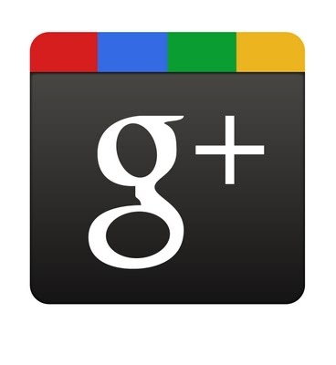









Genomics has similar "Big Data" Dilemma in the Rest of Society
Sharing & "peer-production" is central to success of many new ventures, with the same risks as in genomics
We confront privacy risks every day we access the internet
(...or is the genome more exceptional & fundamental?)
Different cultures of genomics (open-data) & clinical medicine (private data)
Genome is inherited so privacy risk is multi-generational
What you can mine from a genome now is not clear, but what about in 20 years
[Seringhaus & Gerstein ('09), Hart. Courant (Jun 5); Greenbaum & Gerstein ('11), NY Times (6 Oct)]

Slide 13
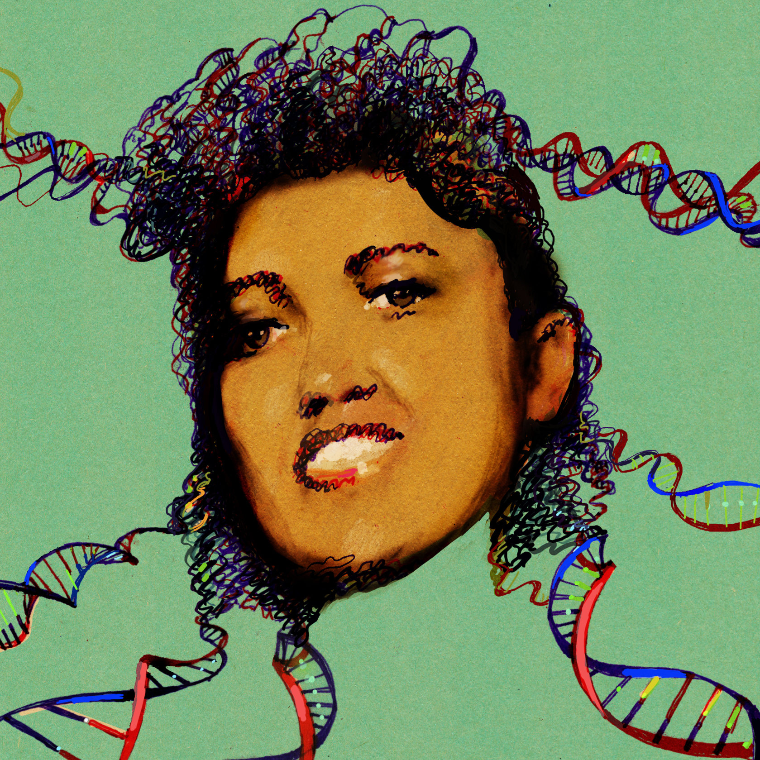
Tricky Privacy Considerations in Personal Genomics
Personal Genomic info. essentially meaningless currently but will it be in 20 yrs? 50 yrs?
  Genomic sequence very revealing about one’s children. Is true consent possible?
  Once put on the web it can’t be taken back
Culture Clash: Genomics historically has been a proponent of “open data” but not clear personal genomics fits this
Ethically challenged history of genetics
Ownership of the data & what consent means (Hela)
  Could your genetic data give rise to a product line?
[D Greenbaum & M Gerstein (’08). Am J. Bioethics; D Greenbaum & M Gerstein, Hartford Courant, 10 Jul. '08 ; SF Chronicle, 2 Nov. '08;
Greenbaum et al. PLOS CB (‘11) ; Greenbaum & Gerstein ('13), The Scientist; Photo from NY Times]

Slide 14

The Other Side of the Coin:
Why we should share
Sharing helps speed research
  Large-scale mining of this information is important for medical research
  Privacy is cumbersome, particularly for big data
Sharing is important for reproducible research
Sharing is useful for education
[Yale Law Roundtable (‘10). Comp. in Sci. & Eng. 12:8; D Greenbaum & M Gerstein (‘09). Am. J. Bioethics; D Greenbaum & M Gerstein (‘10). SF Chronicle, May 2, Page E-4;
Greenbaum et al. PLOS CB (‘11)]

Slide 15
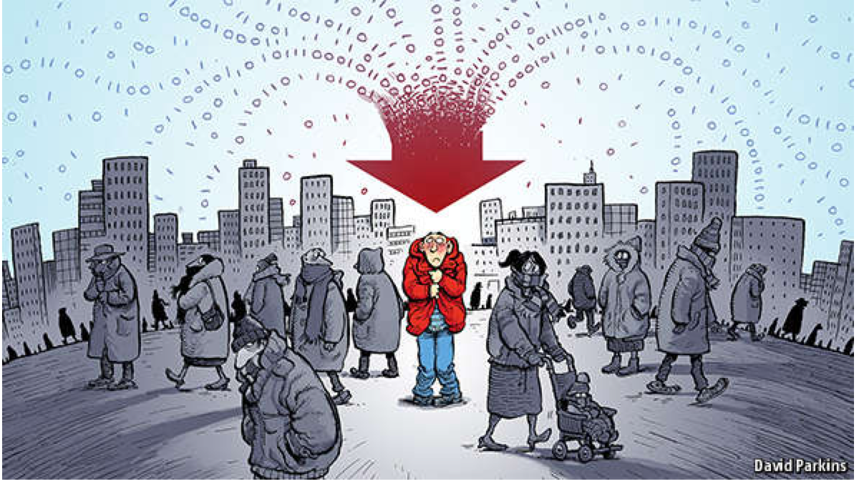
The Dilemma
[Economist, 15 Aug ‘15]
The individual (harmed?) v the collective (benefits)
  But do sick patients care about their privacy?
Quantification
  What is acceptable risk? What is acceptable data leakage? Can we quantify leakage?
    Ex: photos of eye color
  Cost Benefit Analysis: how helpful is identifiable data in genomic research v. potential harm from a breach?
Maybe a we need a few "test pilots” (ala PGP)?
  Sports stars & celebrities?

Slide 16
Current Social & Technical Solutions
Consents
“Protected” distribution of data (dbGAP)
Local computes on secure computer
Issues
  Non-uniformity of consents & paperwork
    Different international norms, leading to confusion
  Encryption & computer security creates burdensome requirements on data sharing & large scale analysis
  Many schemes get “hacked”
[Greenbuam et al ('04), Nat. Biotech; Greenbaum & Gerstein ('13), The Scientist]

Slide 17
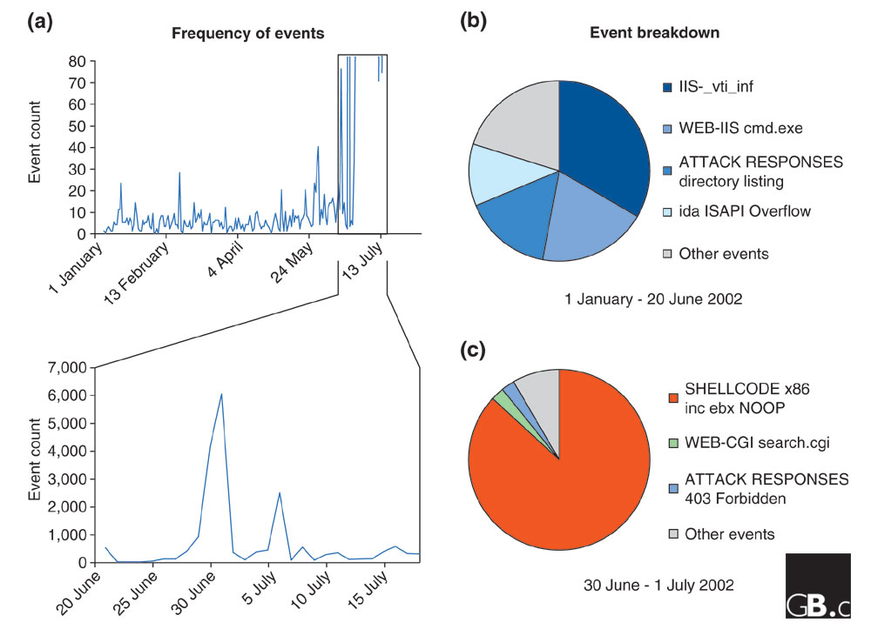
Difficulty in Securing Computers & Data
[Smith et al ('05), Genome Bio]

Slide 18
Genomic Privacy Hacks,
Mostly Focusing on Identification
Early genomic studies were based on small cohorts
  Individuals give consent to participate but request anonymity
    HAPMAP, PGP, 1000 Genomes…
  Focus on hiding the participation of individuals
  Attacks aimed at detecting whether an individual with known genotypes participated a study
    “Detection of genomes in a mixture” (Homer et al 2008, Im et al 2012)
As more people are genotyped, more individuals are in large private genomic databases
  Detection of an individual is irrelevant, as their participation is already known
    Current EX: “An individual’s genomic/phenotypic data is most certainly stored in their hospital”
    Future: >1M people’s health information is part of a NIH/PMI or NHS databases
Identification attacks now focus on pinpointing individuals by cross-referencing large seemingly independent datasets
  Illustrates that a leaked/hacker/stolen dataset, even when anonymized, can leak information
  Sweeney et al 2013, Gymrek et al 2013
Gymrek et al, “Identifying Personal Genomes by Surname Inference” (2013)
Homer et al, “Resolving individuals contributing trace amounts of DNA to highly complex mixtures using high-density SNP genotyping microarrays.” (2008)
Im et al, “On Sharing Quantitative Trait GWAS Results in an Era of Multiple-omics Data and the Limits of Genomic Privacy” (2012)
Sweeney et al, “Identifying Participants in the Personal Genome Project by Name” (2013)

Slide 19
Strawman Hybrid Social & Tech Proposed Solution?
Fundamentally, researchers have to keep genetic secrets
  Genetic Licensure & training for individuals
  (similar to medical license, drivers license)
Technology to make things easier
  Cloud computing & enclaves (eg solution of Genomics England)
Technological barriers shouldn't create a social incentive for “hacking”
Quantifying Leakage & allowing a small amounts of it
Careful separation & coupling of private & public data
  Lightweight, freely accessible secondary datasets coupled to underlying variants
  Selection of stub & "test pilot" datasets for benchmarking
  Develop programs on public stubs on your laptop, then move the program to the cloud for private production run
[D Greenbaum, M Gerstein (‘11). Am J Bioeth 11:39. Greenbaum & Gerstein, The Scientist ('13)]

Slide 20

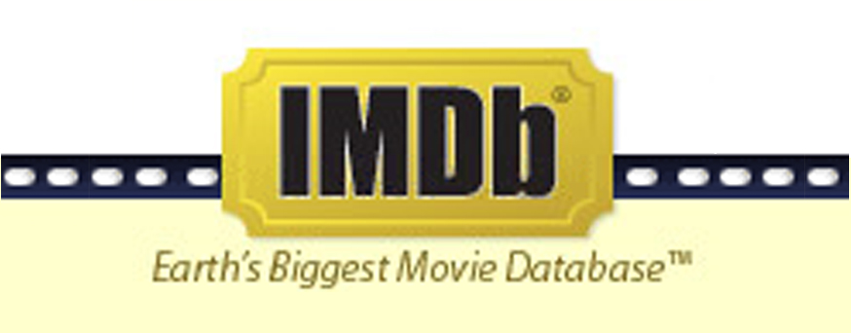
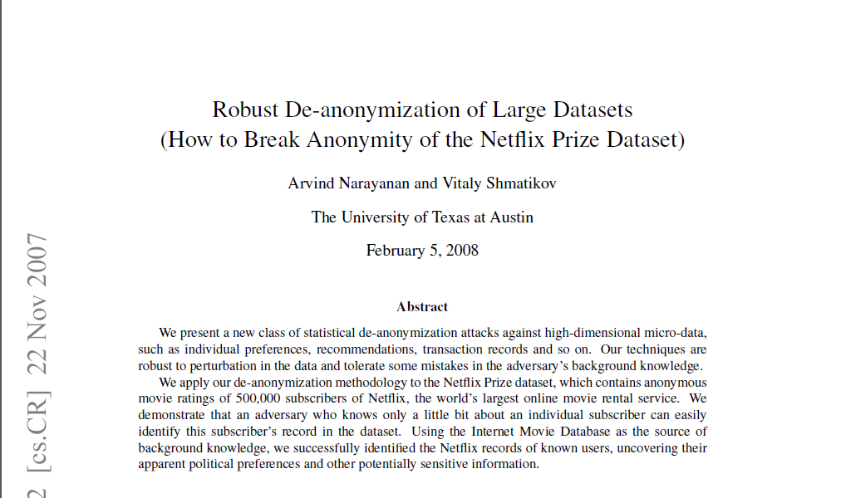
NetFlix challenge as an example of a “Linking Attack”,
characterizing already identified individuals in IMDB,
with their (previously hidden) movie viewing habits
Cross correlated small set of identifiable IMDB rating records with large set of “anonymized” Netflix customer ratings, which were being used for a Machine Learning competition

Slide 21


What is a linking attack? Case of Netflix Prize
Anonymized Netflix Prize Training Dataset
made available to contestants
Movie ratings database
User (ID) | Movie (ID) | Date of Rating | Rating [1,2,3,4,5]
NTFLX-0 | NTFLX-19 | 10/12/2008 | 1
NTFLX-1 | NTFLX-116 | 4/23/2009 | 3
NTFLX-2 | NTFLX-92 | 5/27/2010 | 2
NTFLX-1 | NTFLX-666 | 6/6/2016 | 5
… | … | … | …
… | … | … | …
100 million ratings
500,000 users
200 movie ratings/user
5,000 users/movie rating
Notes:
Before presenting our work in detail, I would like to motivate the our study with an example.
Netflix, the movie rental company, had organized these contests to improve their movie recommendation system.
The setup was like this: Netflix released this huge data matrix with user ids, movie titles, date of movie rating and the actual rating. There were 100 million entries for 500k users. On average each user rated 200 movies and each movie has been rated, on average by 5000 users.
This data matrix was used to train recommendation algorithms, which were then tested on other datasets.
This dataset was anonymized by removing names of users but Netflix also added noise and removed some other entries in the matrix to make it more secure.

Slide 22


What is a linking attack? Case of Netflix Prize
Very large datasets
A lot of users have a Netflix and an IMDb account
A user rates similar scores to a movie in Netflix and IMDb
A user rates a particular movie around the same date in Netflix and IMDb
Notes:
Two researchers, however, came up with a fairly simple scheme to reveal identities of users from this training dataset. They did this by linking the Netflix training data to IMDB’s online database.
There are several key points here. Firstly these two databases are independent, very large, and many users will be shared. Both datasets contain movie ratings and one user will likely rate a movie with similar scores and around the same date.

Slide 23


Linking Attacks: Case of Netflix Prize
Names available for many users!
User (ID) | Movie (ID) | Date of Grade | Grade [1,2,3,4,5]
NTFLX-0 | NTFLX-19 | 10/12/2008 | 1
NTFLX-1 | NTFLX-116 | 4/23/2009 | 3
NTFLX-2 | NTFLX-92 | 5/27/2010 | 2
NTFLX-1 | NTFLX-666 | 6/6/2016 | 5
… | … | … | …
… | … | … | …
User (ID) | Movie (ID) | Date of Grade | Grade [0-10]
IMDB-0 | IMDB-173 | 4/20/2009 | 5
IMDB-1 | IMDB-18 | 10/18/2008 | 0
IMDB-2 | IMDB-341 | 5/27/2010 | -
… | … | … | …
… | … | … | …
… | … | … | …
Many users are shared
The grades of same users are correlated
A user grades one movie around the same date in two databases
Notes:
This figure illustrates what these datasets look like. The movie titles can be matched directly. Date of ratings and rating values are expected to be similar to each other

Slide 24
Linking Attacks: Case of Netflix Prize
Names available for many users!
User (ID) | Movie (ID) | Date of Grade | Grade [1,2,3,4,5]
NTFLX-0 | NTFLX-19 | 10/12/2008 | 1
NTFLX-1 | NTFLX-116 | 4/23/2009 | 3
NTFLX-2 | NTFLX-92 | 5/27/2010 | 2
NTFLX-1 | NTFLX-666 | 6/6/2016 | 5
… | … | … | …
… | … | … | …
User (ID) | Movie (ID) | Date of Grade | Grade [0-10]
IMDB-0 | IMDB-173 | 4/20/2009 | 5
IMDB-1 | IMDB-18 | 10/18/2008 | 0
IMDB-2 | IMDB-341 | 5/27/2010 | -
… | … | … | …
… | … | … | …
… | … | … | …
Many users are shared
The grades of same users are correlated
A user grades one movie around the same date in two databases
Notes:
As you can see, Netflx-1 user can be matched to IMDB-0 user since the date of rating is very close and the ratings are very similar. The rating in imdb is from 0 to 10. So 5 is a similar score to 3 in Netflix rating system.

Slide 25
Linking Attacks: Case of Netflix Prize
Names available for many users!
User (ID) | Movie (ID) | Date of Grade | Grade [1,2,3,4,5]
NTFLX-0 | NTFLX-19 | 10/12/2008 | 1
NTFLX-1 | NTFLX-116 | 4/23/2009 | 3
NTFLX-2 | NTFLX-92 | 5/27/2010 | 2
NTFLX-1 | NTFLX-666 | 6/6/2016 | 5
… | … | … | …
… | … | … | …
User (ID) | Movie (ID) | Date of Grade | Grade [0-10]
IMDB-0 | IMDB-173 | 4/20/2009 | 5
IMDB-1 | IMDB-18 | 10/18/2008 | 0
IMDB-2 | IMDB-341 | 5/27/2010 | -
… | … | … | …
… | … | … | …
… | … | … | …
Many users are shared
The grades of same users are correlated
A user grades one movie around the same date in two databases
Notes:
The key idea is that in imdb, the names are available for many users. Also,
Secondly, although another movie in Netflix system is not rated by this user in imdb system, namely the netflx666, the adversary can see the rating of the individual for this movie.

Slide 26
Genomic Privacy & Individualized RNA-seq: Incompatible or Feasible?
RNA-seq: How to Publicly Share Some of it
  Presents a tricky privacy issue since much of the sequencing is for general non-individual specific results yet it’s tagged with individual information
  Removing SNVs in reads w/ MRF
  Quantifying & removing variant info from expression levels + eQTLs using ICI & predictability
  Instantiating a practical linking attack using extreme expression levels
Allelic Expression & Binding Activity
  Difference in molecular activity between specific alleles
  RNA-seq calculations that fundamentally involve individual variants
  Aggregating results with AlleleDB to define allelic elements & subnetworks
  Allelic elements tend to be under weaker selection
The General Dilemma of Genomic Privacy
  Fundamental, inherited info that’s very private v need for large-scale mining for med. research
  Issues w/ current social & tech approaches: inconsistencies, burdensome security, various "hacks”
  Strawman Hybrid Soc-Tech Proposal (Cloud Enclaves. Quantifying Leaks & Closely Coupled priv.-public datasets)

Slide 27
Large-scale RNA
Recent advent of much large scale RNA-seq (& other functional genomics data) following on DNA sequencing
Often this is of human subjects & produced by large consortia (eg TCGA, PCAWG, GTEx) and needs to be protected
Useful to build tools & approaches that interact with these data

Slide 28
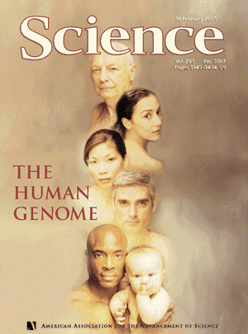
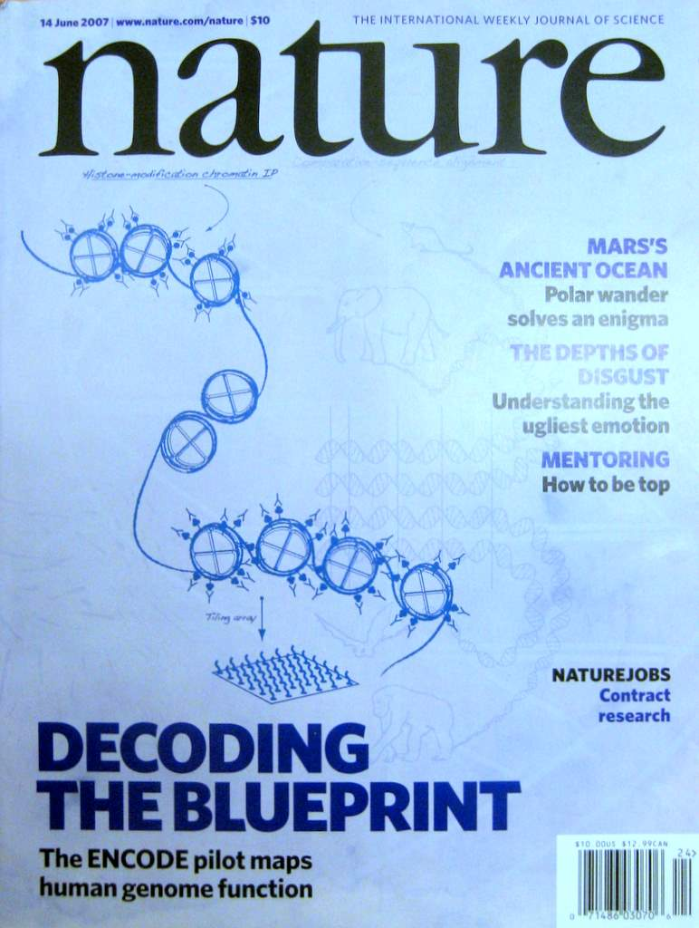
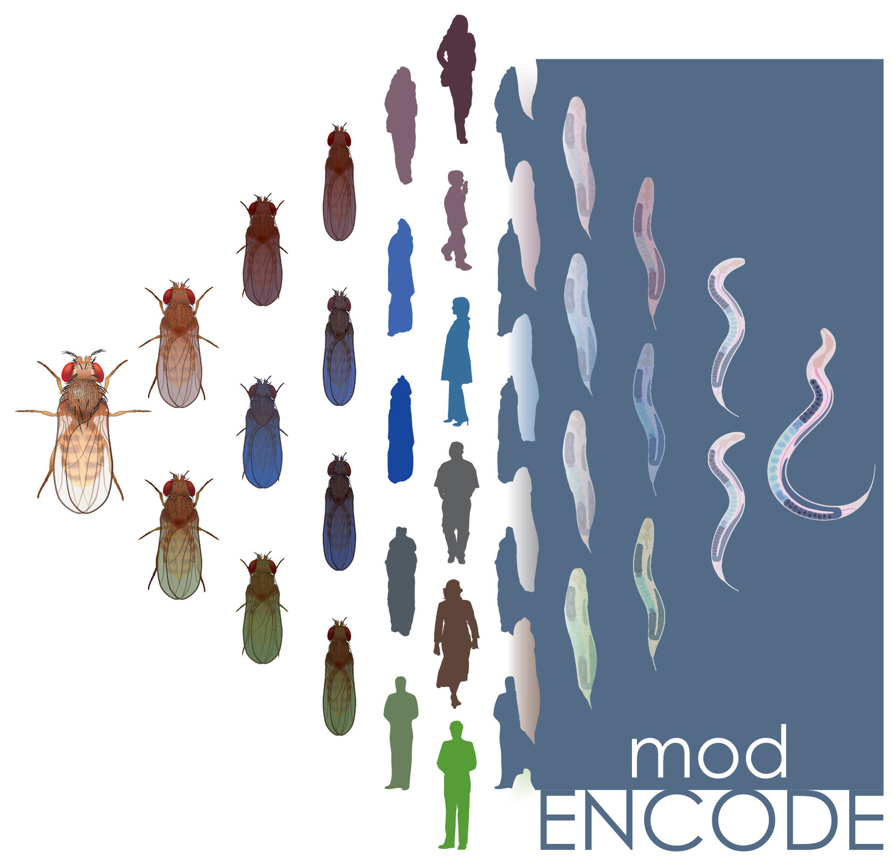

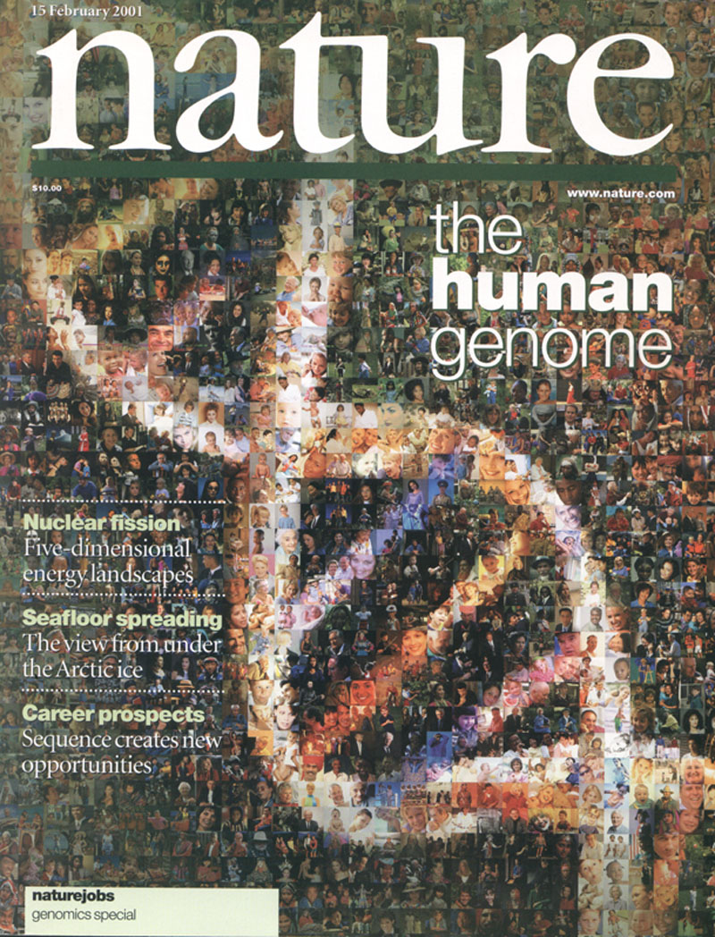
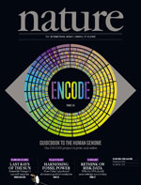


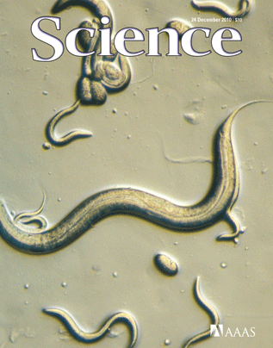

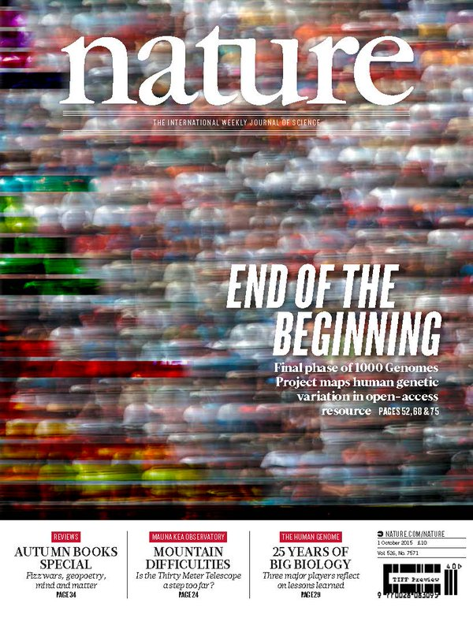

The Human
Genome Project
ENCODE
Pilot
ENCODE
Production
Comparative
ENCODE
Epigenome
Roadmap
2000
2005
2010
2015
Worm
Genome
modENCODE
1000 Genomes
Pilot
1000 Genomes
Phase 3
GTEx

Slide 29

2-side nature of functional genomics data: Analysis can be very General/Public or Individual/Private
General quantifications related to overall aspects of a condition & are not tied to an individual’s genotype - ie what genes go up in cancer
  However, data is derived from an individual & tagged with an individual’s genotype
Other calculations aim to use genotype & specific aspects of the quantification to derive general relations related to sequence variation & gene expression
Some calculations and data derive finding very specific to the variants in a particular individual

Slide 30
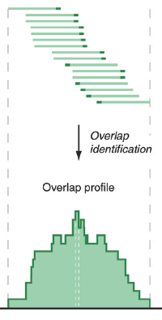
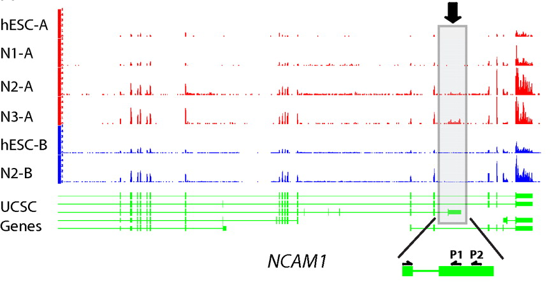
RNA-seq
RNA-seq uses next-generation sequencing technologies to reveal RNA presence and quantity within a biological sample.
ATACAAGCAAGTATAAGTTCGTATGCCGTCTT
GGAGGCTGGAGTTGGGGACGTATGCGGCATAG
TACCGATCGAGTCGACTGTAAACGTAGGCATA
ATTCTGACTGGTGTCATGCTGATGTACTTAAA
Reads (fasta)
－ Quality scores (fastq)
－ Mapping (BAM)
－ Contain variant information in transcribed regions
Quantitative information from RNA-seq signal: average signals at exon level (RPKMs)
Reads => Signal
[PLOS CB 4:e1000158; PNAS 4:107: 5254 ; IJC 123:569 ]

Slide 31
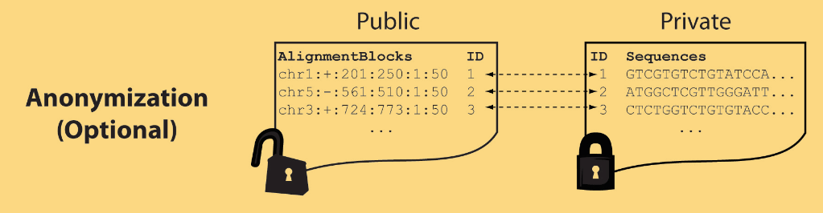
Light-weight formats
Some lightweight format clearly separate public & private info., aiding exchange
Files become much smaller
Distinction between formats to compute on and those to archive with – become sharper with big data
Reads
(linked via ID,
10X larger than
mapping coord.)
Mapping coordinates without variants (MRF)
[Bioinformatics 27: 281]

Slide 32
MRF Examples
chr2:+:601:630:1:30,chr2:+:921:940:31:50
TS
TE
TS
TE
Reference
AlignmentBlock 1
AlignmentBlock 2
Reference based compression
(ie CRAM)
is similar but it stores actual variant beyond just position of alignment block
Splice junction Read
QS
QE/QS
QE
Legend: TS = TargetStart, TE = TargetEnd, QS = QueryStart, QE = QueryEnd
chr9:+:431:480:1:50|chr9:+:945:994:1:50
TS
TE
TS
TE
Reference
AlignmentBlock 1
AlignmentBlock 2
Paired-end Read
QS
QE
QS
QE
Legend: TS = TargetStart, TE = TargetEnd, QS = QueryStart, QE = QueryEnd
[Habegger et al., Bioinformatics (‘11)]

Slide 33
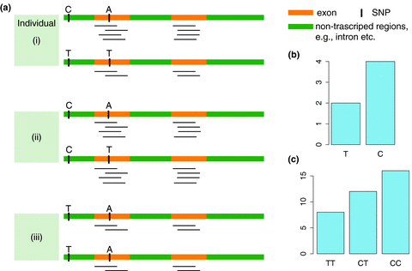
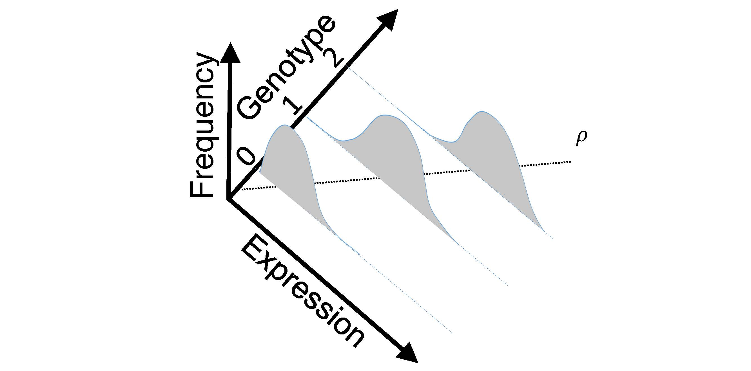
eQTL Mapping Using RNA-Seq Data
eQTLs are genomic loci that contribute to variation in mRNA expression levels
eQTLs provide insights on transcription regulation, and the molecular basis of phenotypic outcomes
eQTL mapping can be done with RNA-Seq data
[Biometrics 68(1) 1–11]
Notes:
A diagram to illustrate the RNA‐seq count variation of one gene due to an cis‐eQTL. (a) RNA‐seq measurements of a hypothetic gene with two exons in three diploid individuals. The target SNP which we test for association has the genotype CT, CC, and TT for the three individuals. There is an SNP on the first exon, which has genotype AT, AT, and AA for the three individuals. ASE can be measured by those sequence reads that overlap with a heterozygous exonic SNP. Therefore we can measure ASE for individuals (i) and (ii). However, association testing by ASE is only possible if the target SNP is heterozygous, thus only individual (i) can be used to test for eQTL by ASE (b) ASE measurements for individual (i). (c) TReC measured for the three individuals across the two exons of this gene.
© IF THIS IMAGE HAS BEEN PROVIDED BY OR IS OWNED BY A THIRD PARTY, AS INDICATED IN THE CAPTION LINE, THEN FURTHER PERMISSION MAY BE NEEDED BEFORE ANY FURTHER USE. PLEASE CONTACT WILEY'S PERMISSIONS DEPARTMENT ON PERMISSIONS@WILEY.COM OR USE THE RIGHTSLINK SERVICE BY CLICKING ON THE 'REQUEST PERMISSION' LINK ACCOMPANYING THIS ARTICLE. WILEY OR AUTHOR OWNED IMAGES MAY BE USED FOR NON-COMMERCIAL PURPOSES, SUBJECT TO PROPER CITATION OF THE ARTICLE, AUTHOR, AND PUBLISHER.

Slide 34
Information Content and Predictability
[Harmanciet al. Nat. Meth. (in revision)]

Slide 35
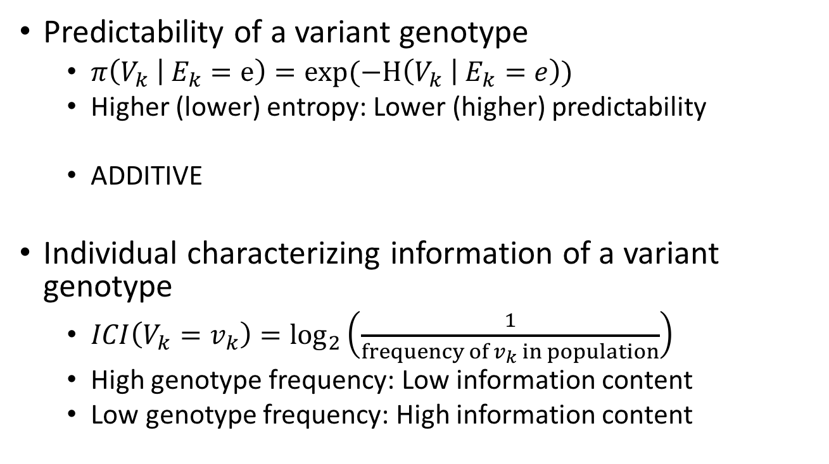
Quantification of Predictability and Information Leakage
Predictability of a variant genotype
  $π\left(V_{k} | E_{k}=e\right)=exp(−H\left(V_{k} | E_{k}=e\right))$
  Higher (lower) entropy: Lower (higher) predictability
  ADDITIVE
Individual characterizing information of a variant genotype
  $ICI\left(V_{k}=v_{k}\right)=\log_{2}\left(\frac{1}{frequency of v_{k} in population}\right)$
  High genotype frequency: Low information content
  Low genotype frequency: High information content
Notes:
The first thing that we did was formulating the predictability of a variant genotype and also the information content of a variant genotype

Slide 36
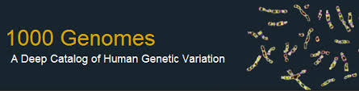

Representative Expression, Genotype, eQTL Datasets
Genotypes are available from the 1000 Genomes Project
mRNA sequencing for 462 individuals
  Publicly available quantification for protein coding genes
Approximately 3,000 cis-eQTL (FDR<0.05)

Slide 37
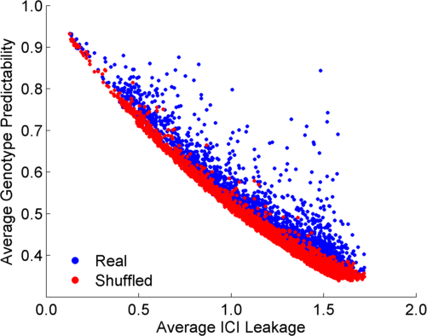
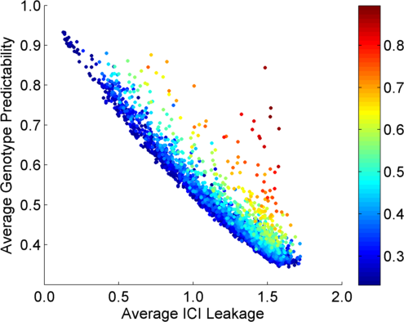
Per eQTL and ICI Cumulative Leakage versus Genotype Predictability
Colors by absolute correlation
Absolute Correlation
[Harmanciet al. Nat. Meth. (in revision)]

Slide 38
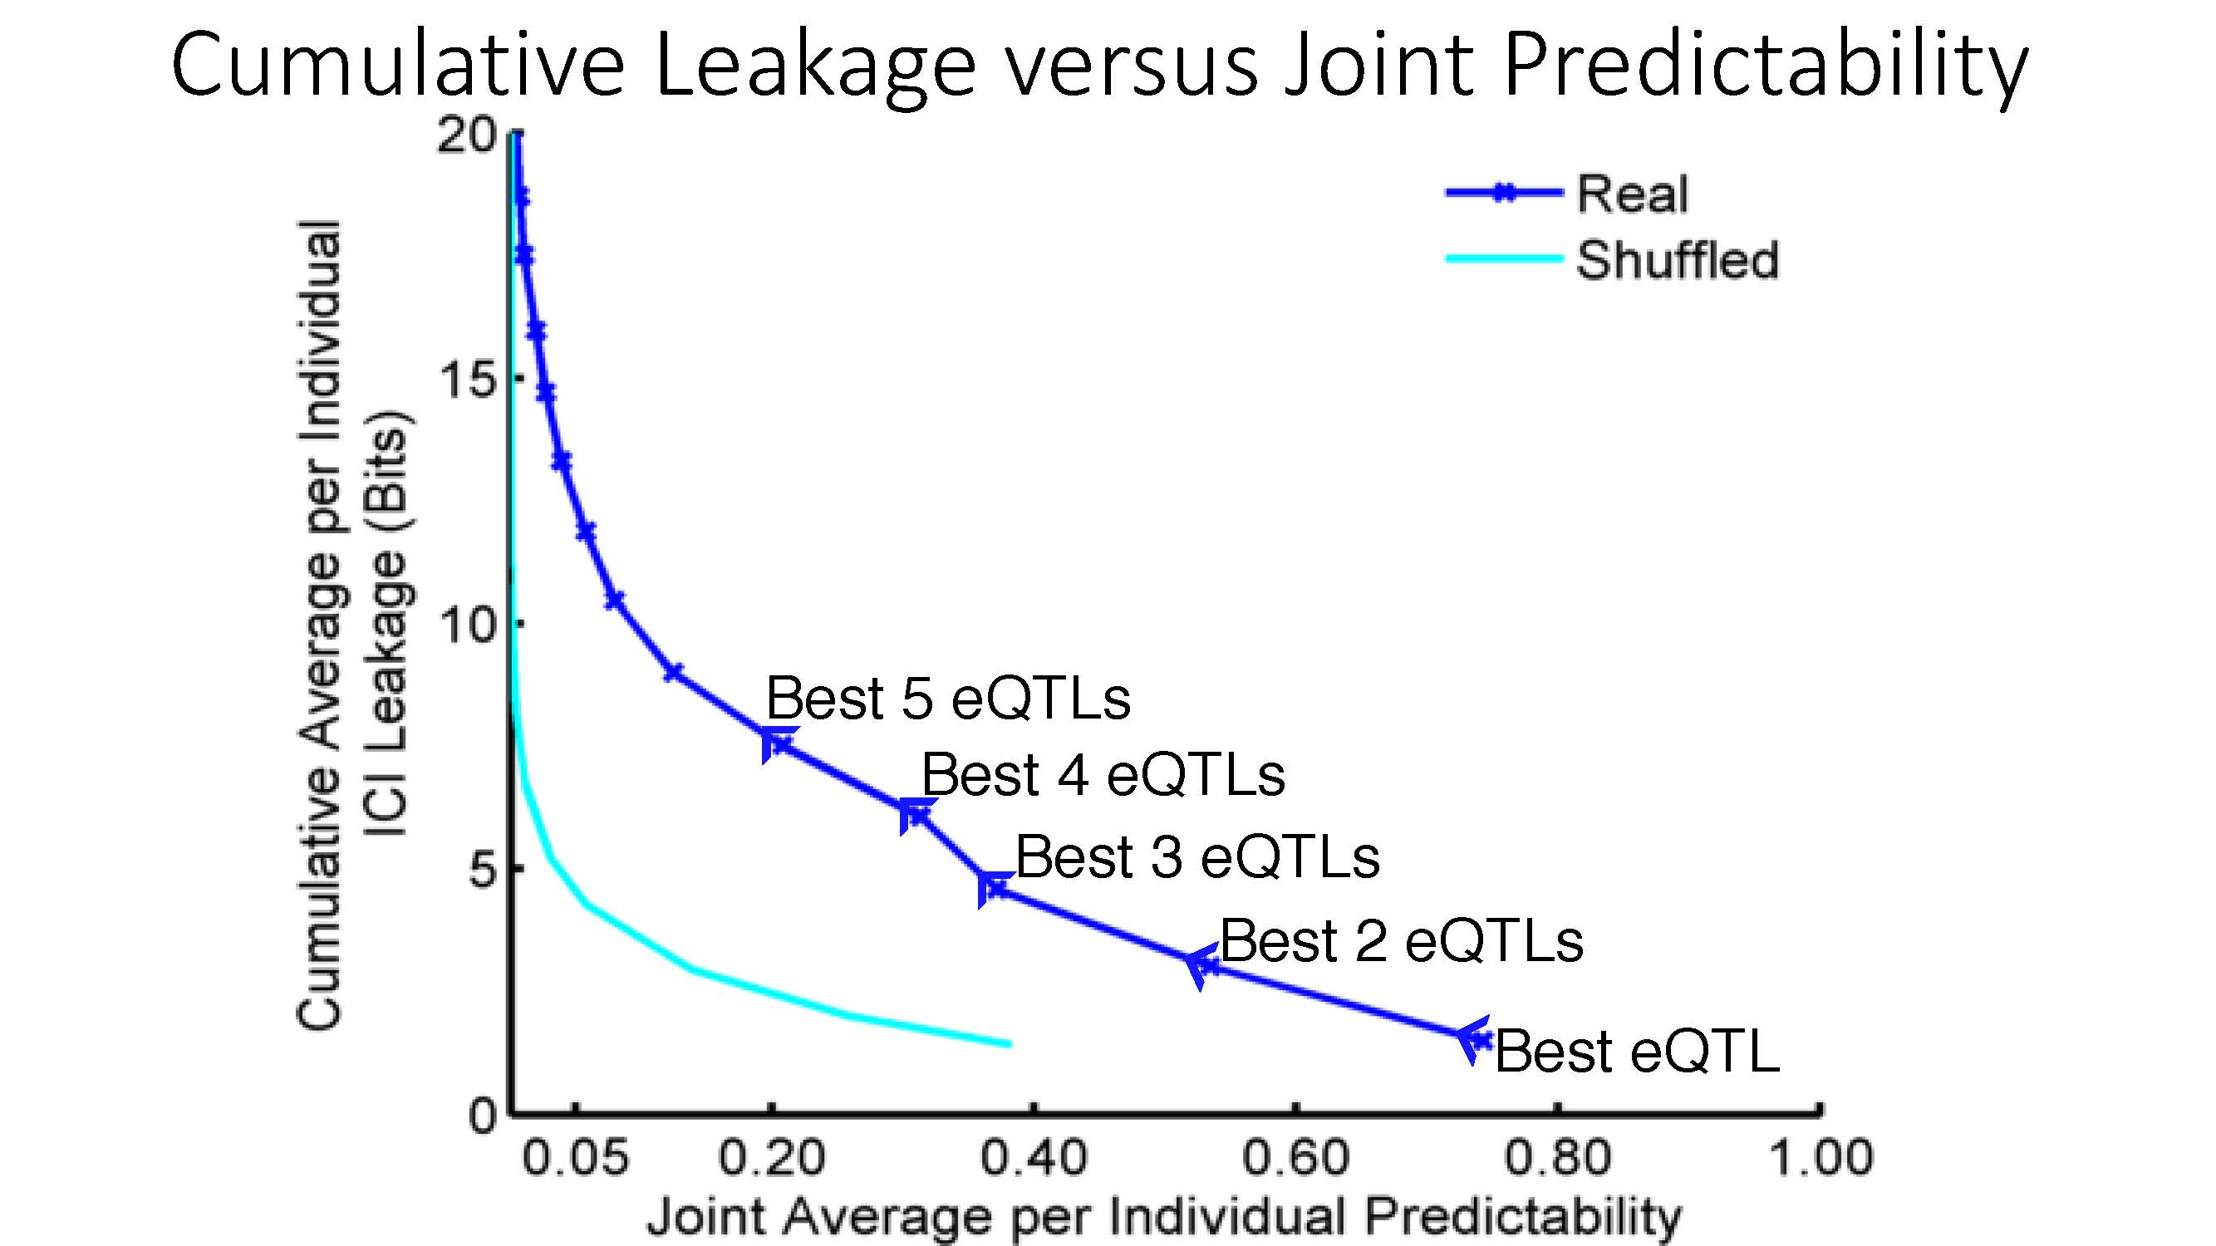
Cumulative Leakage versus Joint Predictability
[Harmanciet al. Nat. Meth. (in revision)]

Slide 39
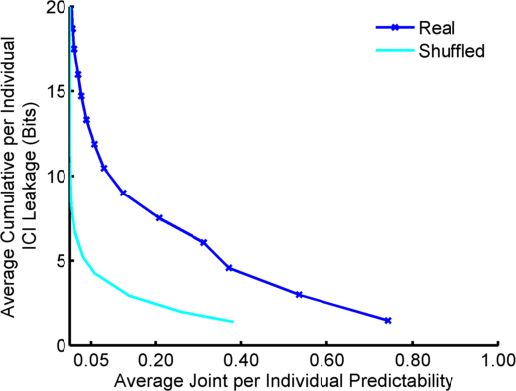
Predictability vs Leakage: Multiple eQTLs
More #
Vulnerable
Best 5 eQTLs
Best 4 eQTLs
Best 3 eQTLs
Best 2 eQTLs
Best eQTL
Less #
Vulnerable
Less
Accurate
More
Accurate
Notes:
But an adversary will use multiple eQTLs in a possible attack. We can also estimate the average predictability and information leakage cumulatively. This is shown in this plot. Starting from the best eQTL with highest correlation, we can evaluate the predictability at different levels of information leakage. For example top 5 eQTLs bring around 8 bits of information at around 20% predictability. This tradeoff plot is useful for assessing the leakage and predictability levels for risk assessment while eQTLs are being released.

Slide 40
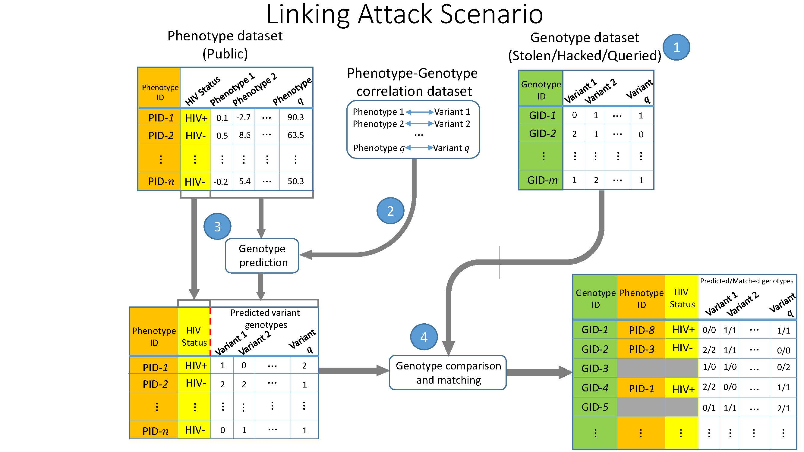
Linking Attack Scenario
[Harmanciet al. Nat. Meth. (in revision)]

Slide 41
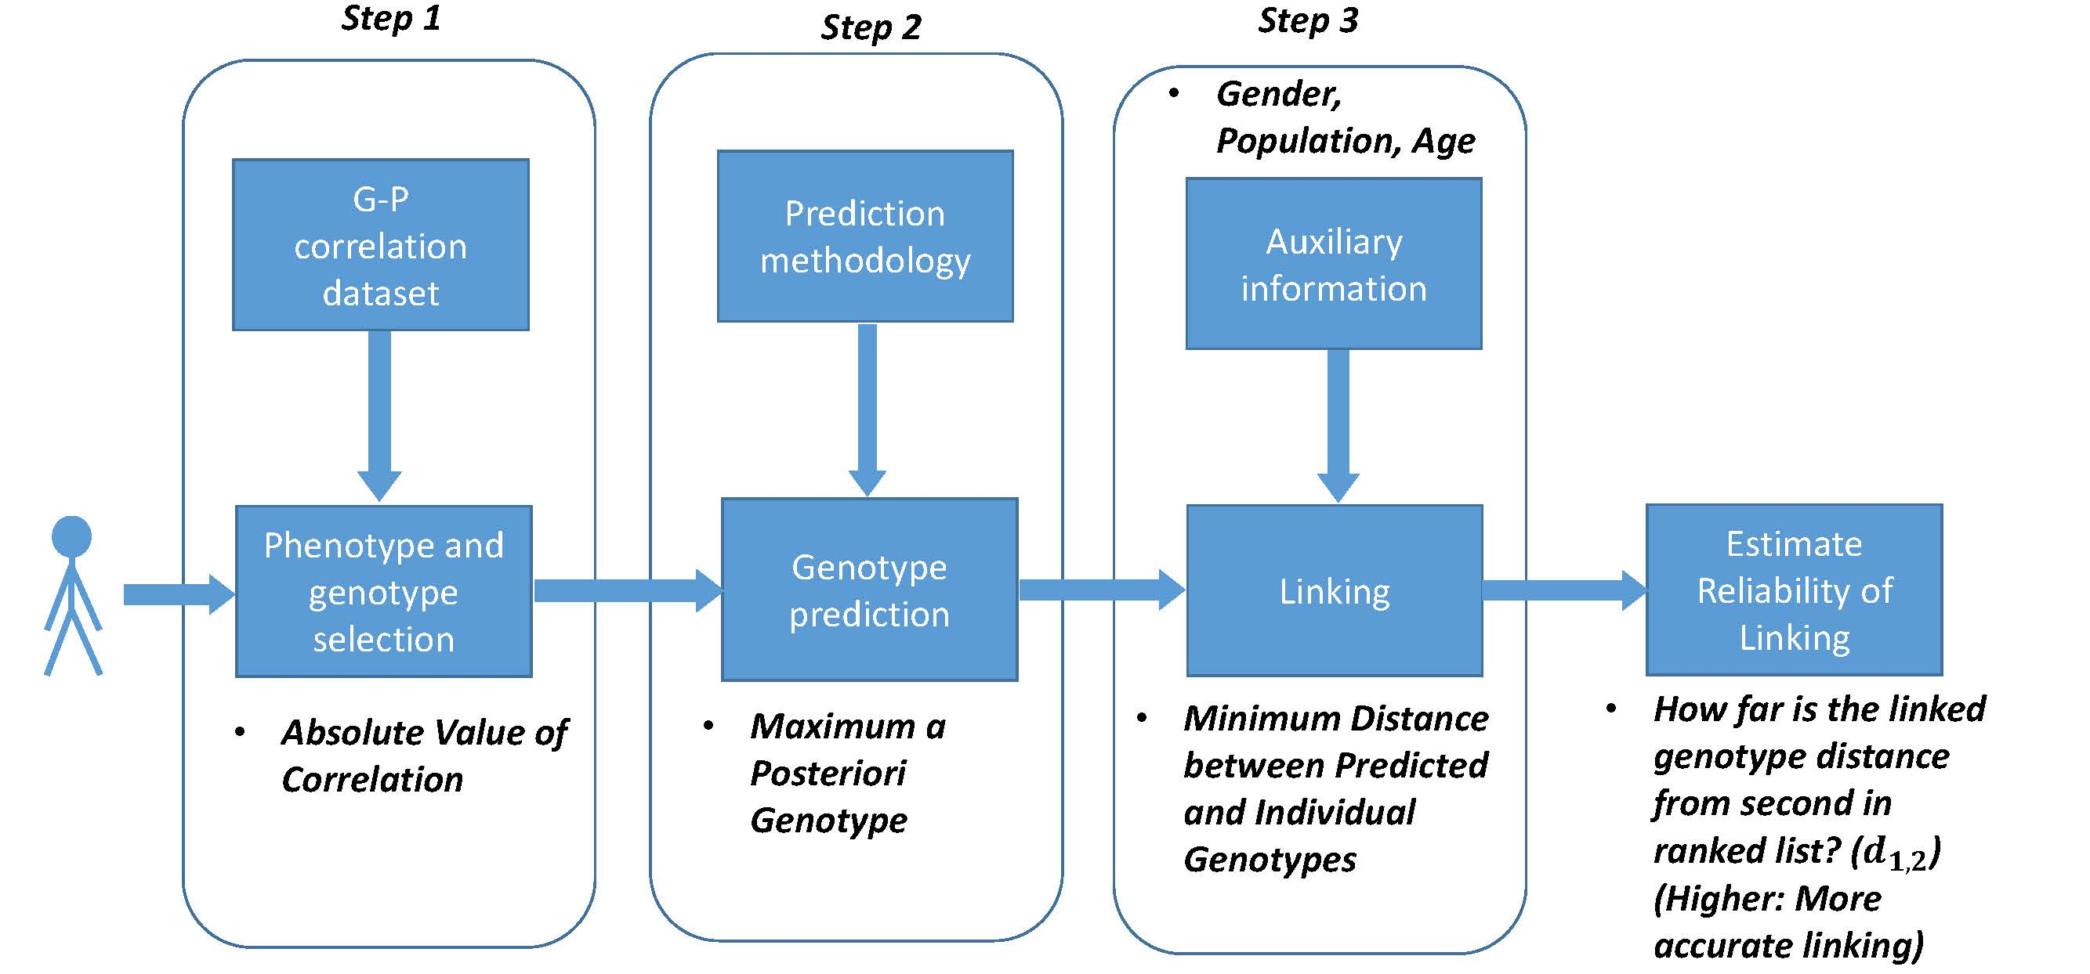
Steps in Instantiation of a (Mock) Linking Attack
[Harmanciet al. Nat. Meth. (in revision)]

Slide 42
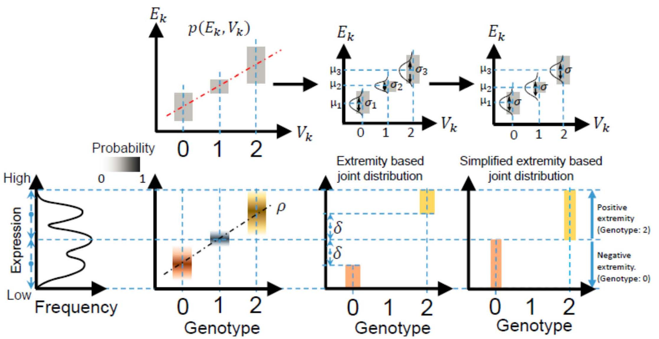
Levels of Expression-Genotype Model Simplifications
[Harmanciet al. Nat. Meth. (in revision)]

Slide 43
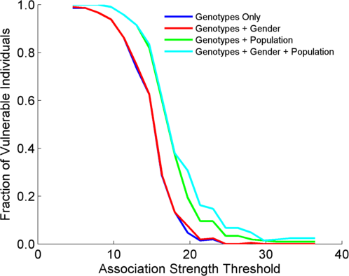
Linking Attack with Extremity based Genotype Prediction
Expalnations??
Decreasing number of eQTLs

Slide 44
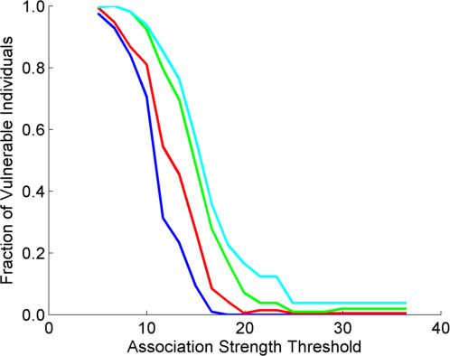
Linking Attack with Extremity based Genotype Prediction
200 individuals eQTL Discovery
200 individuals in Linking Attack
200 individuals eQTL Discovery
100,200 individuals in Linking Attack
Decreasing number of eQTLs

Slide 45
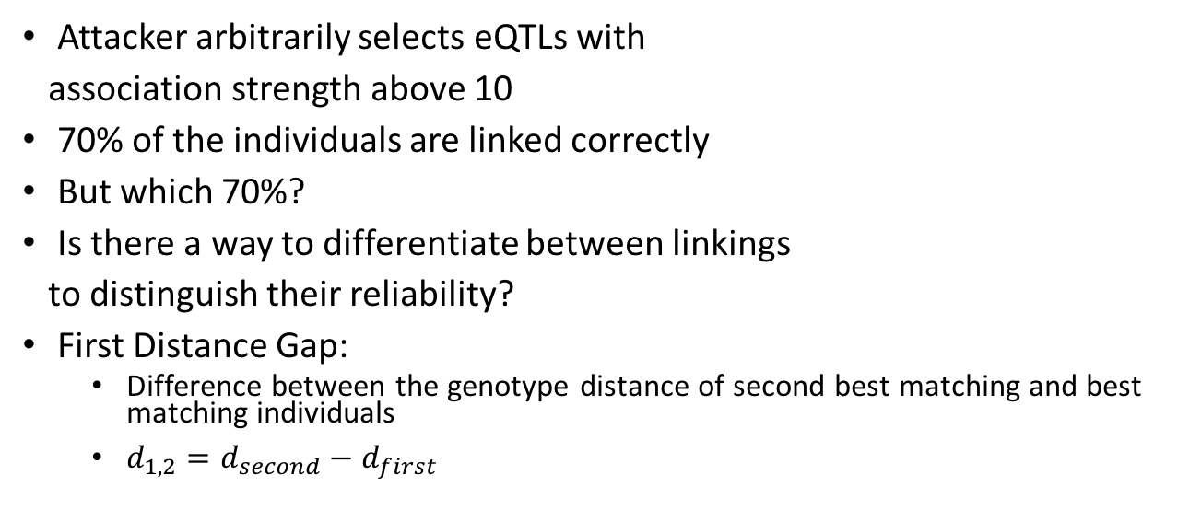
Which 70%?
70%
Attacker arbitrarily selects eQTLs with
association strength above 10
70% of the individuals are linked correctly
But which 70%?
Is there a way to differentiate between linkings
to distinguish their reliability?
First Distance Gap:
  Difference between the genotype distance of second best matching and best matching individuals
  $d_{1,2}=d_{second}−d_{first}$

Slide 46
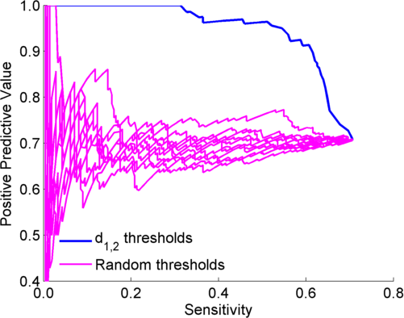

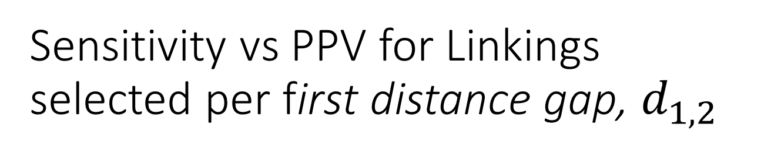
Sensitivity vs PPV for Linkings selected per first distance gap, $d_{1,2}$
Decreasing $d_{1,2}$
52%

Slide 47
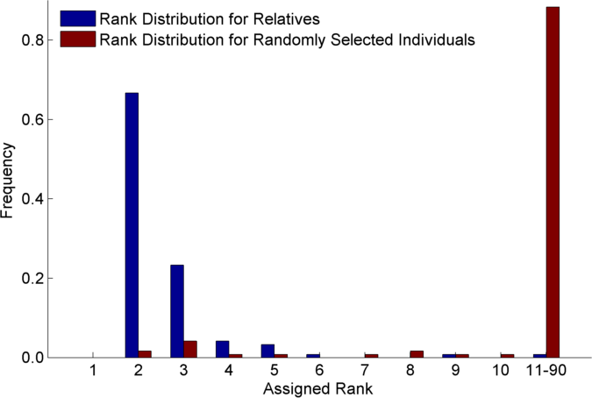
Relatives are also vulnerable (30 CEU Trios)
1st rank is individual’s
self

Slide 48
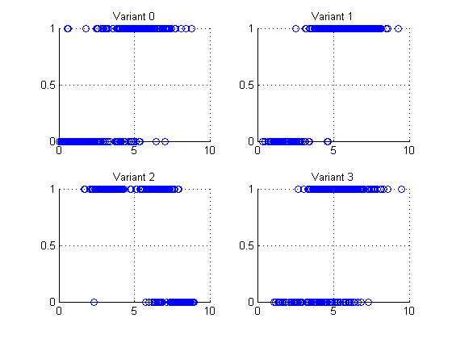
Small Data Leakage from just Gene Expression Data:
4 eQTL-SNP genotypes
Expression levels are outliers and are predictive of the genotype!
Example: Vulnerable sample variants, expressions
Variant 0 (1, 6)
Variant 1 (0, 2)
Variant 2 (1, 3)
Variant 3 (0, 2)
Genotype (0,1)
Log RPKM of overlapping gene

Slide 49
Genomic Privacy & Individualized RNA-seq: Incompatible or Feasible?
RNA-seq: How to Publicly Share Some of it
  Presents a tricky privacy issue since much of the sequencing is for general non-individual specific results yet it’s tagged with individual information
  Removing SNVs in reads w/ MRF
  Quantifying & removing variant info from expression levels + eQTLs using ICI & predictability
  Instantiating a practical linking attack using extreme expression levels
Allelic Expression & Binding Activity
  Difference in molecular activity between specific alleles
  RNA-seq calculations that fundamentally involve individual variants
  Aggregating results with AlleleDB to define allelic elements & subnetworks
  Allelic elements tend to be under weaker selection
The General Dilemma of Genomic Privacy
  Fundamental, inherited info that’s very private v need for large-scale mining for med. research
  Issues w/ current social & tech approaches: inconsistencies, burdensome security, various "hacks”
  Strawman Hybrid Soc-Tech Proposal (Cloud Enclaves. Quantifying Leaks & Closely Coupled priv.-public datasets)

Slide 50
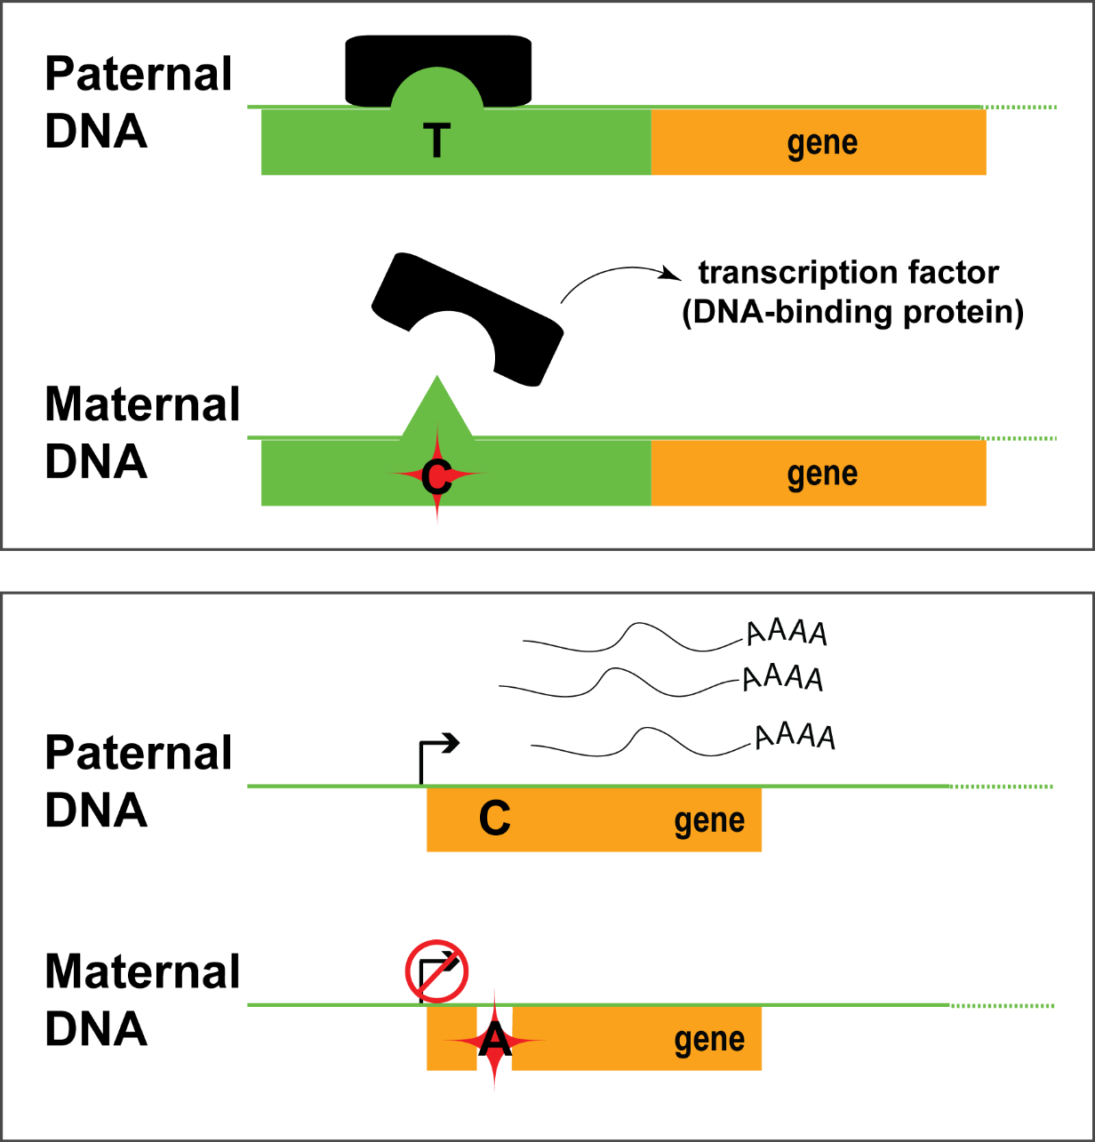
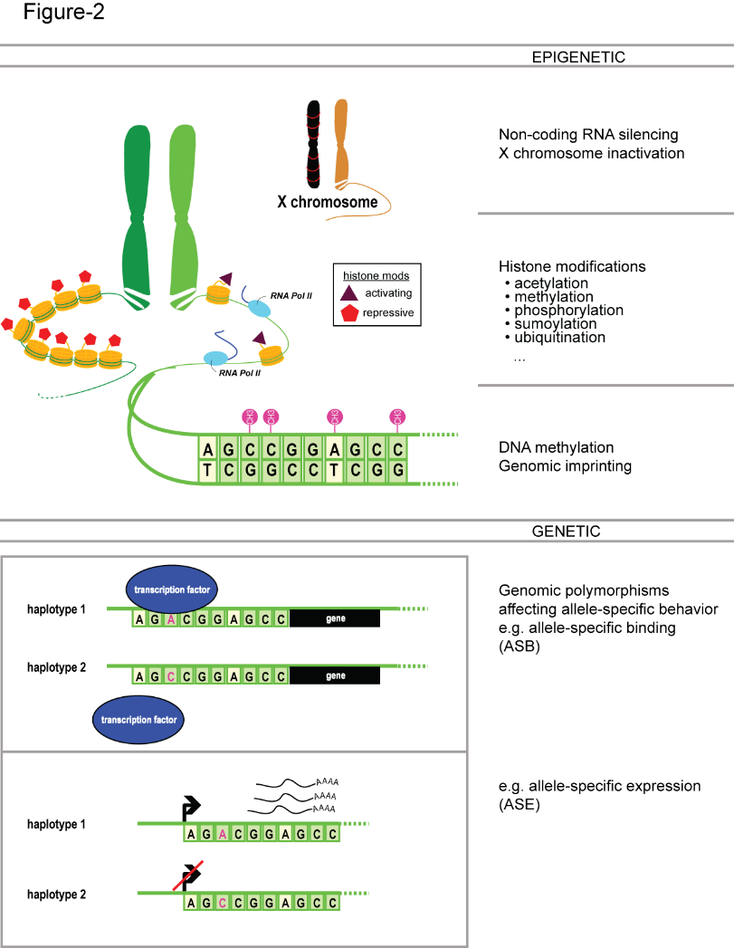
Allele-specific binding and expression
variants

Slide 51



Inferring Allele Specific Binding/Expression using Sequence Reads
RNA/ChIP-Seq Reads
ACTTTGATAGCGTCAATG
CTTTGATAGCGTCAATGC
CTTTGATAGCGTCAACGC
TTGACAGCGTCAATGCAC
TGATAGCGTCAATGCACG
ATAGCGTCAATGCACGTC
TAGCGTCAATGCACGTCG
CGTCAACGCACGTCGGGA
GTCAATGCACGTCGAGAG
CAATGCACGTCGGGAGTT
AATGCACGTCGGGAGTTG
TGCACGTTGGGAGTTGGC
10 x T
2 x C
…AACGC…
TF
…AATGC…
Haplotypes with a
Heterozygous Polymorphism
Interplay of the annotation and individual sequence variants
Does not format to std. theme

Slide 52
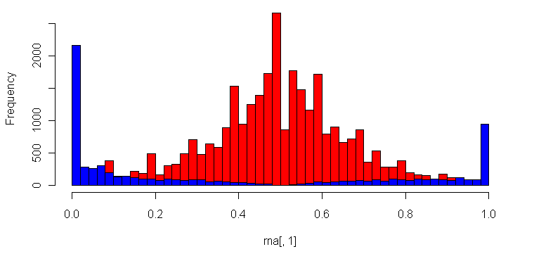
Many Technical Issues in Determining ASE/ASB:
Reference Bias
(naïve alignment against reference)
ASE/ASB Example:
…GTCAATGCAC
…GTCAATGCACG
…GTCAATGCACGTC
…GTCAATGCACGTCG
…GTCAACGCACGTCGGGA
GTCAATGCACGTCGAGAG
CAATGCACGTCGGGAGTT
AATGCACGTCGGGAGTTG
Null Example:
ACTTTGATAGCGTCAATG
CTTTGATAGCGTCAACGC
TTGACAGCGTCAATGCAC
ATAGCGTCAATGCACGT…
TAGCGTCAACGCACGT…
CGTCAACGCACGT…
CAATGCACGT…
AATGCACGT…
Allele-Specific SNPs
Binomial Null Distribution
(no allele-specific behavior)
Reference Allele
Alternate Allele
Fraction of Reads Mapping to Alternative Allele
[Rozowsky et al., MSB (‘11)]
Notes:
Alternative allele/Reference allele

Slide 53
Figure 1a
Construction of a Personal Diploid Genome & Transcriptome
[alleleseq.gersteinlab.org]
[Rozowsky et al., MSB ('11)]
Notes:
Construction of personal genome by vcf2diplod tool is made by incorporating personal variants into the reference genome. Personal variants may require addition pre-processing, i.e., filtering, genotyping, and/or phasing. The output is the two (paternal and maternal) haplotypes of personal genome. During the construction step the reference genome is represented as an array of nucleotides with each cell representing a single base. Iteratively the nucleotides in the array are being modified to reflect personal variations. Once all variation have been applied a personal haplotype is constructed by reading though the array. Simultaneously, equivalence map (MAP-file) between personal haplotypes and reference genome is being constructed.

Slide 54
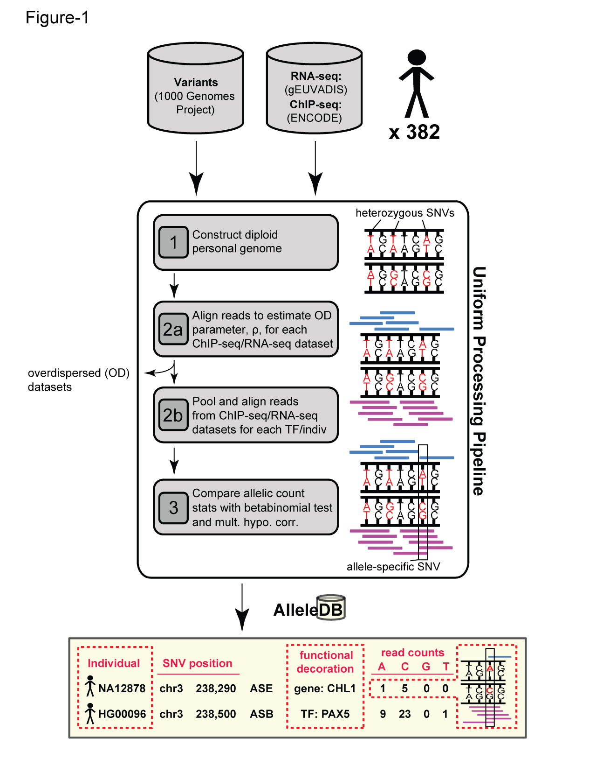
AlleleDB: Building 382 personal genomes to detect allele-specific variants on a large-scale
Build personal genomes
Align ChIP-seq & RNA-seq reads
Detect allele-specific variants
via a series of filters and tests
Many Technical Issues: Reference bias, Ambiguous mapping bias, Over-dispersed (non binomial null)
alleledb.gersteinlab.org
Chen J. et al. (Nature Commun, ‘16)

Slide 55
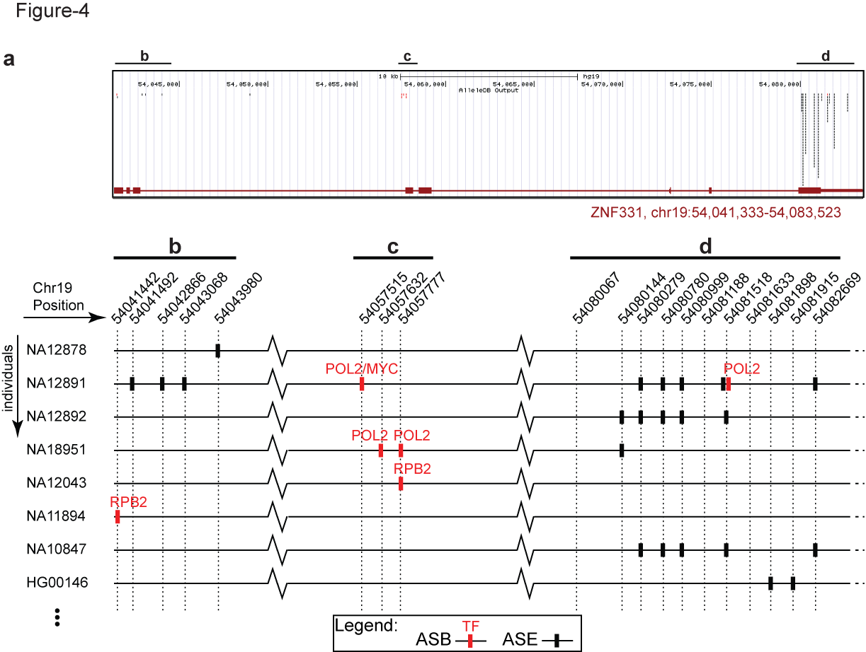
AlleleDB: Annotating rare & common allele-specific variants over a population
Interfaces with UCSC genome browser
Showing ZNF331 gene structure
AlleleDB output
UCSC track
alleledb.gersteinlab.org
Chen J. et al. (Nature Commun, in press)

Slide 56
AlleleDB: Annotating rare & common allele-specific variants over a population
Interfaces with UCSC genome browser
Showing ZNF331 gene structure
AlleleDB output
UCSC track
Allele-specific binding variants
Allele-specific expression variants
Chen J. et al. (Nature Commun, ‘16)

Slide 57



Collecting ASE/ASB variants into allele-specific genomic regions
Does a particular genomic element have a higher tendency to be allele-specific? Fisher’s exact test, for the enrichment of allele-specific variants in the element (with respect to non-allele-specific variants that could potentially be called as allelic)
allele-specific
non-allele-specific
Human reference
genome
alleledb.gersteinlab.org
Chen J. et al. (Nature Commun,’16)
Does not format to std. theme

Slide 58
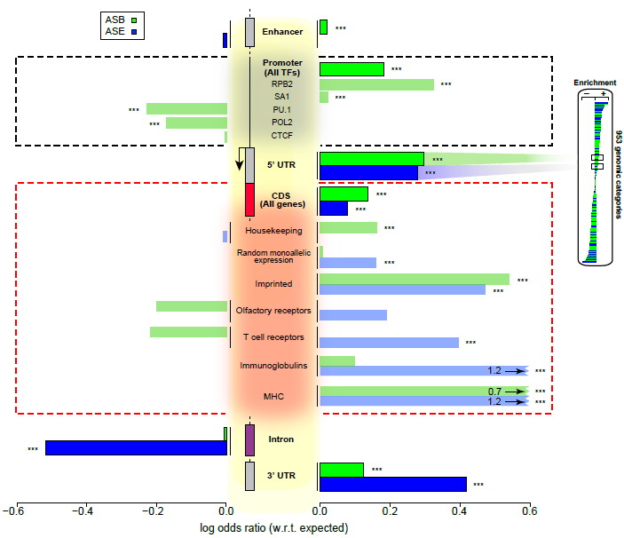
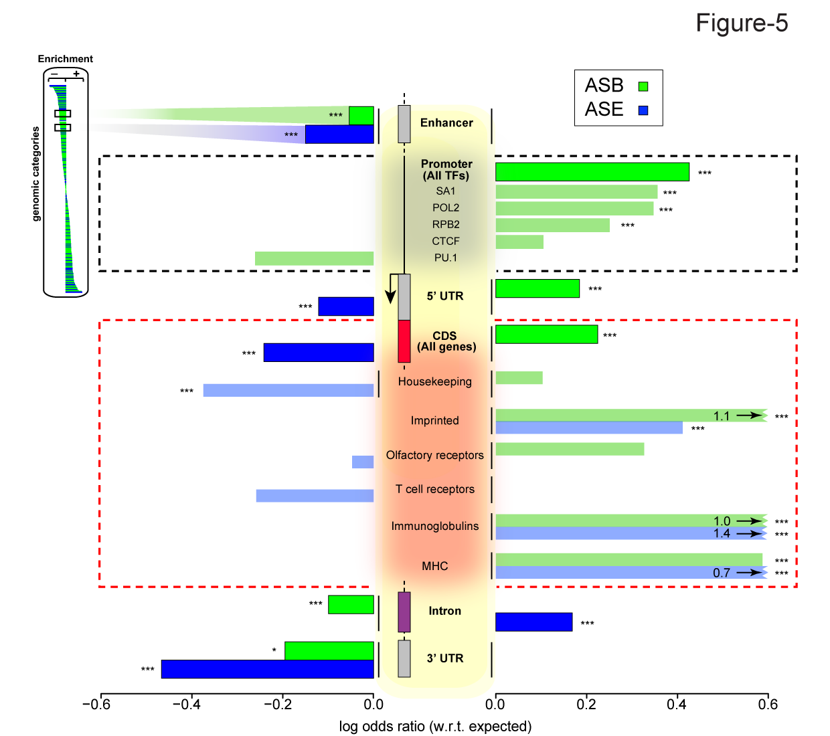
Groups of elements that are enriched or depleted in allelic activity
Chen J. et al. (Nature Commun, ’16)

Slide 59
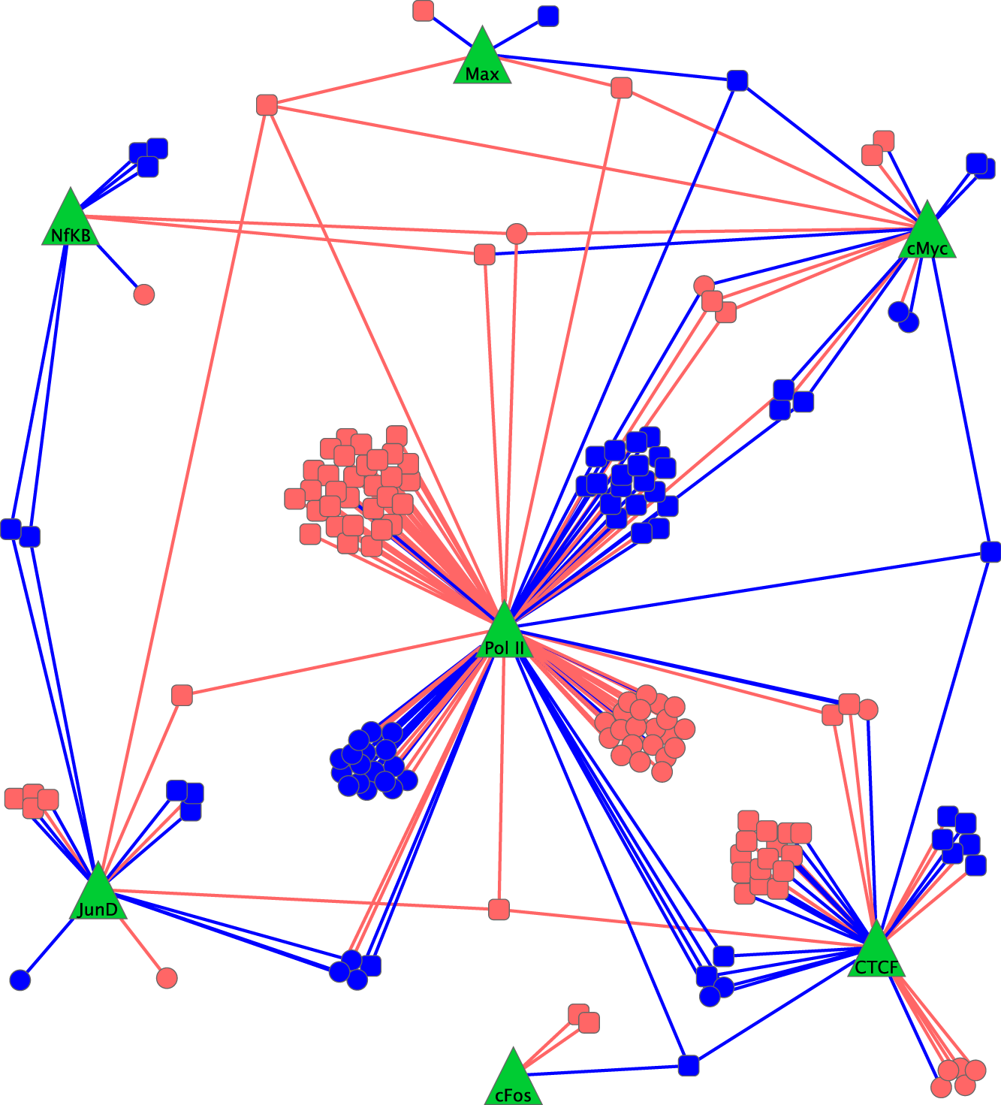
Allele-Specific Behavior in the Regulatory Network
In GM12878, determine ASB for ~50 TFs & ASE using RNA-Seq
  ~20% of expressed genes show ASE
  ~10% of binding sites show ASB
GM12878 Allele-Specific "Difference" Network
  Just proximal edges with ASB
  Just target nodes with ASE
[ Rozowsky et al. MSB ('11) ]

Slide 60
Maternal & Paternal Personal Regulatory Networks: combinatorial coordination of ASE & ASB
[ Rozowsky et al. MSB ('11) ]

Slide 61
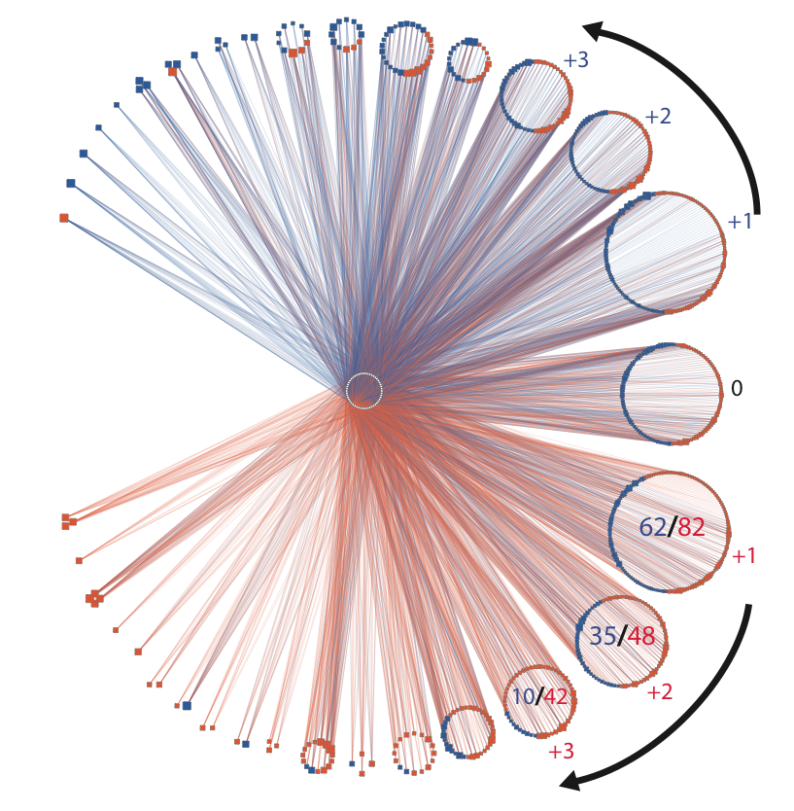
Maternal & Paternal Personal Regulatory Networks: combinatorial coordination of ASE & ASB
[ Rozowsky et al. MSB ('11) ]

Slide 62
(from 1000G pilot & phase I)
More "allelic" components under weaker selection
[ Gerstein et al. Nature ('12) ]

Slide 63
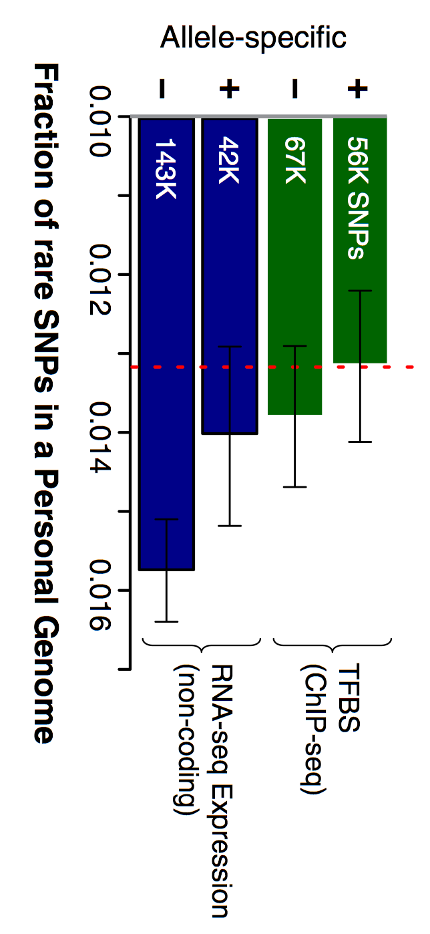
(from 1000G pilot & phase I)
More "allelic" components under weaker selection
[ Khurana et al. Science ('13) ]
[ Gerstein et al. Nature ('12) ]

Slide 64
Genomic Privacy & Individualized RNA-seq: Incompatible or Feasible?
RNA-seq: How to Publicly Share Some of it
  Presents a tricky privacy issue since much of the sequencing is for general, non-individual specific results yet it’s tagged with individual information
  Removing SNVs in reads w/ MRF
  Quantifying & removing variant info from expression levels + eQTLs using ICI & predictability
  Instantiating a practical linking attack using extreme expression levels
Allelic Expression & Binding Activity
  Difference in molecular activity between specific alleles
  RNA-seq calculations that fundamentally involve individual variants
  Aggregating results with AlleleDB to define allelic elements & subnetworks
  Allelic elements tend to be under weaker selection
The General Dilemma of Genomic Privacy
  Fundamental, inherited info that’s very private v need for large-scale mining for med. research
  Issues w/ current social & tech approaches: inconsistencies, burdensome security, various "hacks”
  Strawman Hybrid Soc-Tech Proposal (Cloud Enclaves. Quantifying Leaks & Closely Coupled priv.-public datasets)

Slide 65
Genomic Privacy & Individualized RNA-seq: Incompatible or Feasible?
RNA-seq: How to Publicly Share Some of it
  Presents a tricky privacy issue since much of the sequencing is for general, non-individual specific results yet it’s tagged with individual information
  Removing SNVs in reads w/ MRF
  Quantifying & removing variant info from expression levels + eQTLs using ICI & predictability
  Instantiating a practical linking attack using extreme expression levels
Allelic Expression & Binding Activity
  Difference in molecular activity between specific alleles
  RNA-seq calculations that fundamentally involve individual variants
  Aggregating results with AlleleDB to define allelic elements & subnetworks
  Allelic elements tend to be under weaker selection
The General Dilemma of Genomic Privacy
  Fundamental, inherited info that’s very private v need for large-scale mining for med. research
  Issues w/ current social & tech approaches: inconsistencies, burdensome security, various "hacks”
  Strawman Hybrid Soc-Tech Proposal (Cloud Enclaves. Quantifying Leaks & Closely Coupled priv.-public datasets)

Slide 66

papers.gersteinlab.org/subject/privacy - D Greenbaum
PrivaSeq.gersteinlab.org - A Harmanci
RSEQtools.gersteinlab.org [MRF]
L Habegger, A Sboner,
TA Gianoulis, J Rozowsky, A Agarwal, M Snyder
AlleleDB.gersteinlab.org
J Chen, J Rozowsky,
T Galeev, A Harmanci,
R Kitchen, J Bedford,
A Abyzov, Y Kong, L Regan
AlleleSeq.gersteinlab.org
J Rozowsky,
A Abyzov,
J Wang, P Alves, D Raha,
A Harmanci, J Leng,
R Bjornson,
Y Kong,
N Kitabayashi,
N Bhardwaj,
M Rubin,
M Snyder
Acknowledgements
Hiring Postdocs. See gersteinlab.org/jobs !

Slide 67
Default Theme
Default Outline Level 1
  Level 2

Slide 68
More Information on this Talk
SUBJECT: Networks
DESCRIPTION:
NOTES:
This PPT should work on mac & PC. Paper references in the talk were mostly from Papers.GersteinLab.org.
PERMISSIONS: This Presentation is copyright Mark Gerstein, Yale University, 2010. Please read permissions statement at http://www.gersteinlab.org/misc/permissions.html . Feel free to use images in the talk with PROPER acknowledgement (via citation to relevant papers or link to gersteinlab.org).
PHOTOS & IMAGES. For thoughts on the source and permissions of many of the photos and clipped images in this presentation see http://streams.gerstein.info . In particular, many of the images have particular EXIF tags, such as kwpotppt , that can be easily queried from flickr, viz: http://www.flickr.com/photos/mbgmbg/tags/kwpotppt .
Notes:
68

