Slide 1
A vision for the future…
What does genomics hold?.....

Slide 2
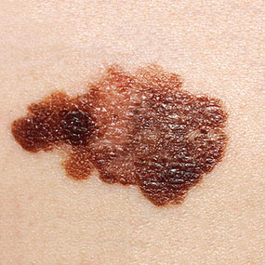
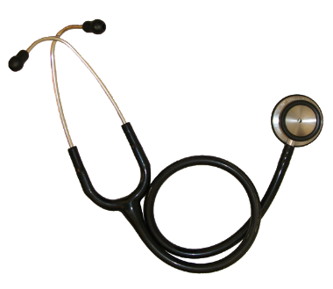
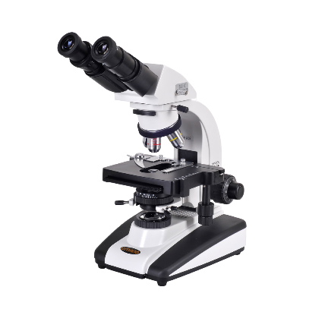
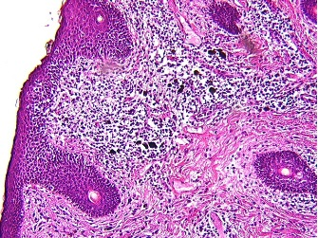
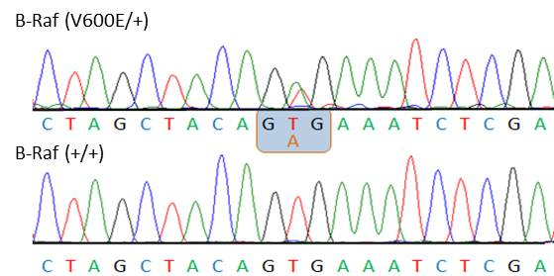
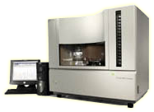
Molecular pathology extends the diagnostic precision gains of surgical pathology by probing even more fundamental elements of biology
Biological Causation
Diagnostic Precision
http://wrightstatephysicians.org/whatsnew/melanoma.html
http://pathology.osu.edu/residents/InternalGate/Area51/ResidentSlideCollection/images/A100.jpg
https://rikengenesis.jp/ori/50279/etc_img/BRAFV600E.jpg
https://upload.wikimedia.org/wikipedia/commons/d/d2/Stethoscope-2.png
http://www.microscope.com/student-microscopes/university-student-microscopes/omano-om139-infinity-corrected-plan-optics.html#gref
http://sequetech.com/

Slide 3
Technological barriers delay the widespread adoption of laboratory genomic methods in the clinic
… but these barriers are falling
High cost
Middling accuracy
Situations in which sample collection is impractical (e.g. if brain RNA needed)
Limited clinical significance outside of key domains (e.g. HR’s ~1.3)
… but costs are dropping rapidly
… but candidates from NGS can be validated with Sanger sequencing
… but liquid biopsies, gut microbiome, and other convenient sources abound
… but missing heritability calculations show that important genetic effects exist and are waiting to be discovered

Slide 4
What will it take for us to derive clinically relevant information from a patient’s –omics profile across a range of diseases?
80% of disease alleles occur in the noncoding genome – we need to better understand how to prioritize noncoding variants
Integrate information from many SNPs
Integrate information from multiple experimental strategies
  DNA to inform baseline risk and diagnose genetic diseases
  RNA and other measures to observe early changes of
Power to detect complex relationships between SNPs, other biomarkers, and disease will depend on more phenotypically-annotated sequences and new statistical and bioinformatics techniques

Slide 5
In the future, all stages of clinical care will depend on bioinformatics and genomics
Prevention – molecular well-visits for early cancer screening
Risk-prediction – large genomic and transcriptomic data-sets
Diagnosis – identify the molecular subtype of a patient’s condition
Personalized treatments
  Targeted therapy – treat a patient’s underlying molecular pathology
  Smarter experiential learning – treat patients based on what worked for patients who were most molecularly similar

Slide 6
Personal Genomics:
Identifying High-impact Variants in Coding & Non-coding Regions
Characterizing Rare Variants in Coding Regions
  Identifying with STRESS
  cryptic allosteric sites
    On surface & in interior bottlenecks
  Using changes in localized Frustration to find further sites sensitive to mutations
    Difference betw. TSGs & oncogenes
Evaluating the Impact of Non-coding Variants with Annotation
  Annotating non-coding regions on different scales with MUSIC
  Prioritizing rare variants with
  “sensitive sites” (human-conserved)
Putting it together in Workflows
  Using LARVA to do burden testing on non-coding annotation
    Need to correct for co-variates & over-dispersion mutation counts
    Parameterized according to replication timing
  Using FunSeq to integrate evidence on variants
    Systematically weighting all the features
    suggesting non-coding drivers
    Prioritzing rare germline variants

Slide 7
Population & power

Slide 8
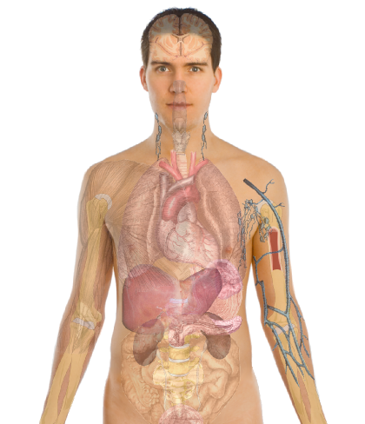
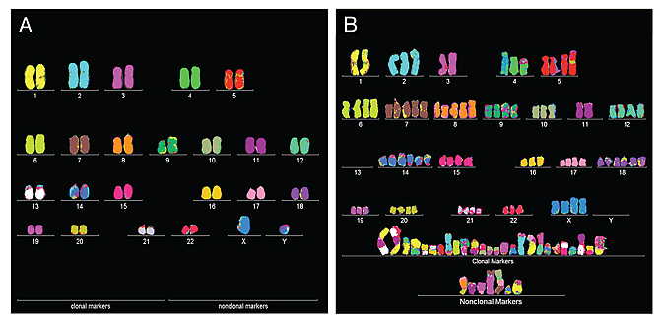
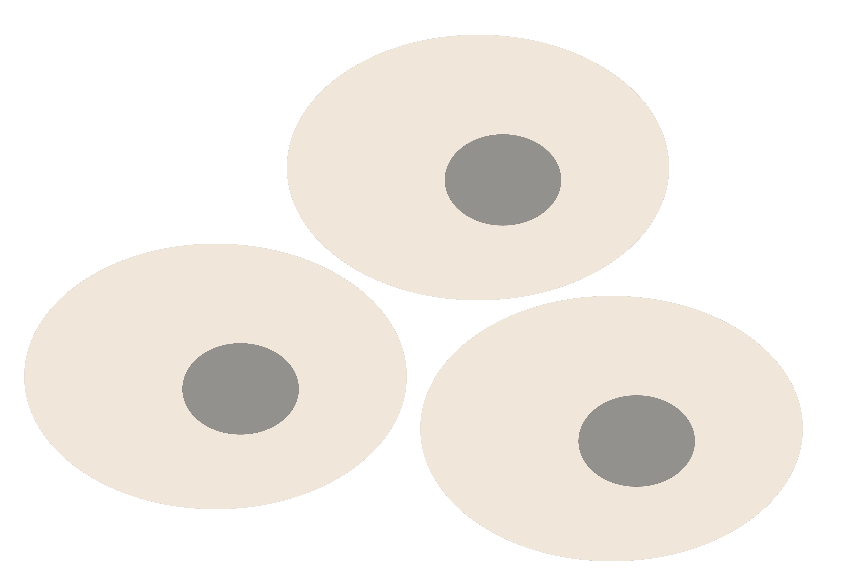
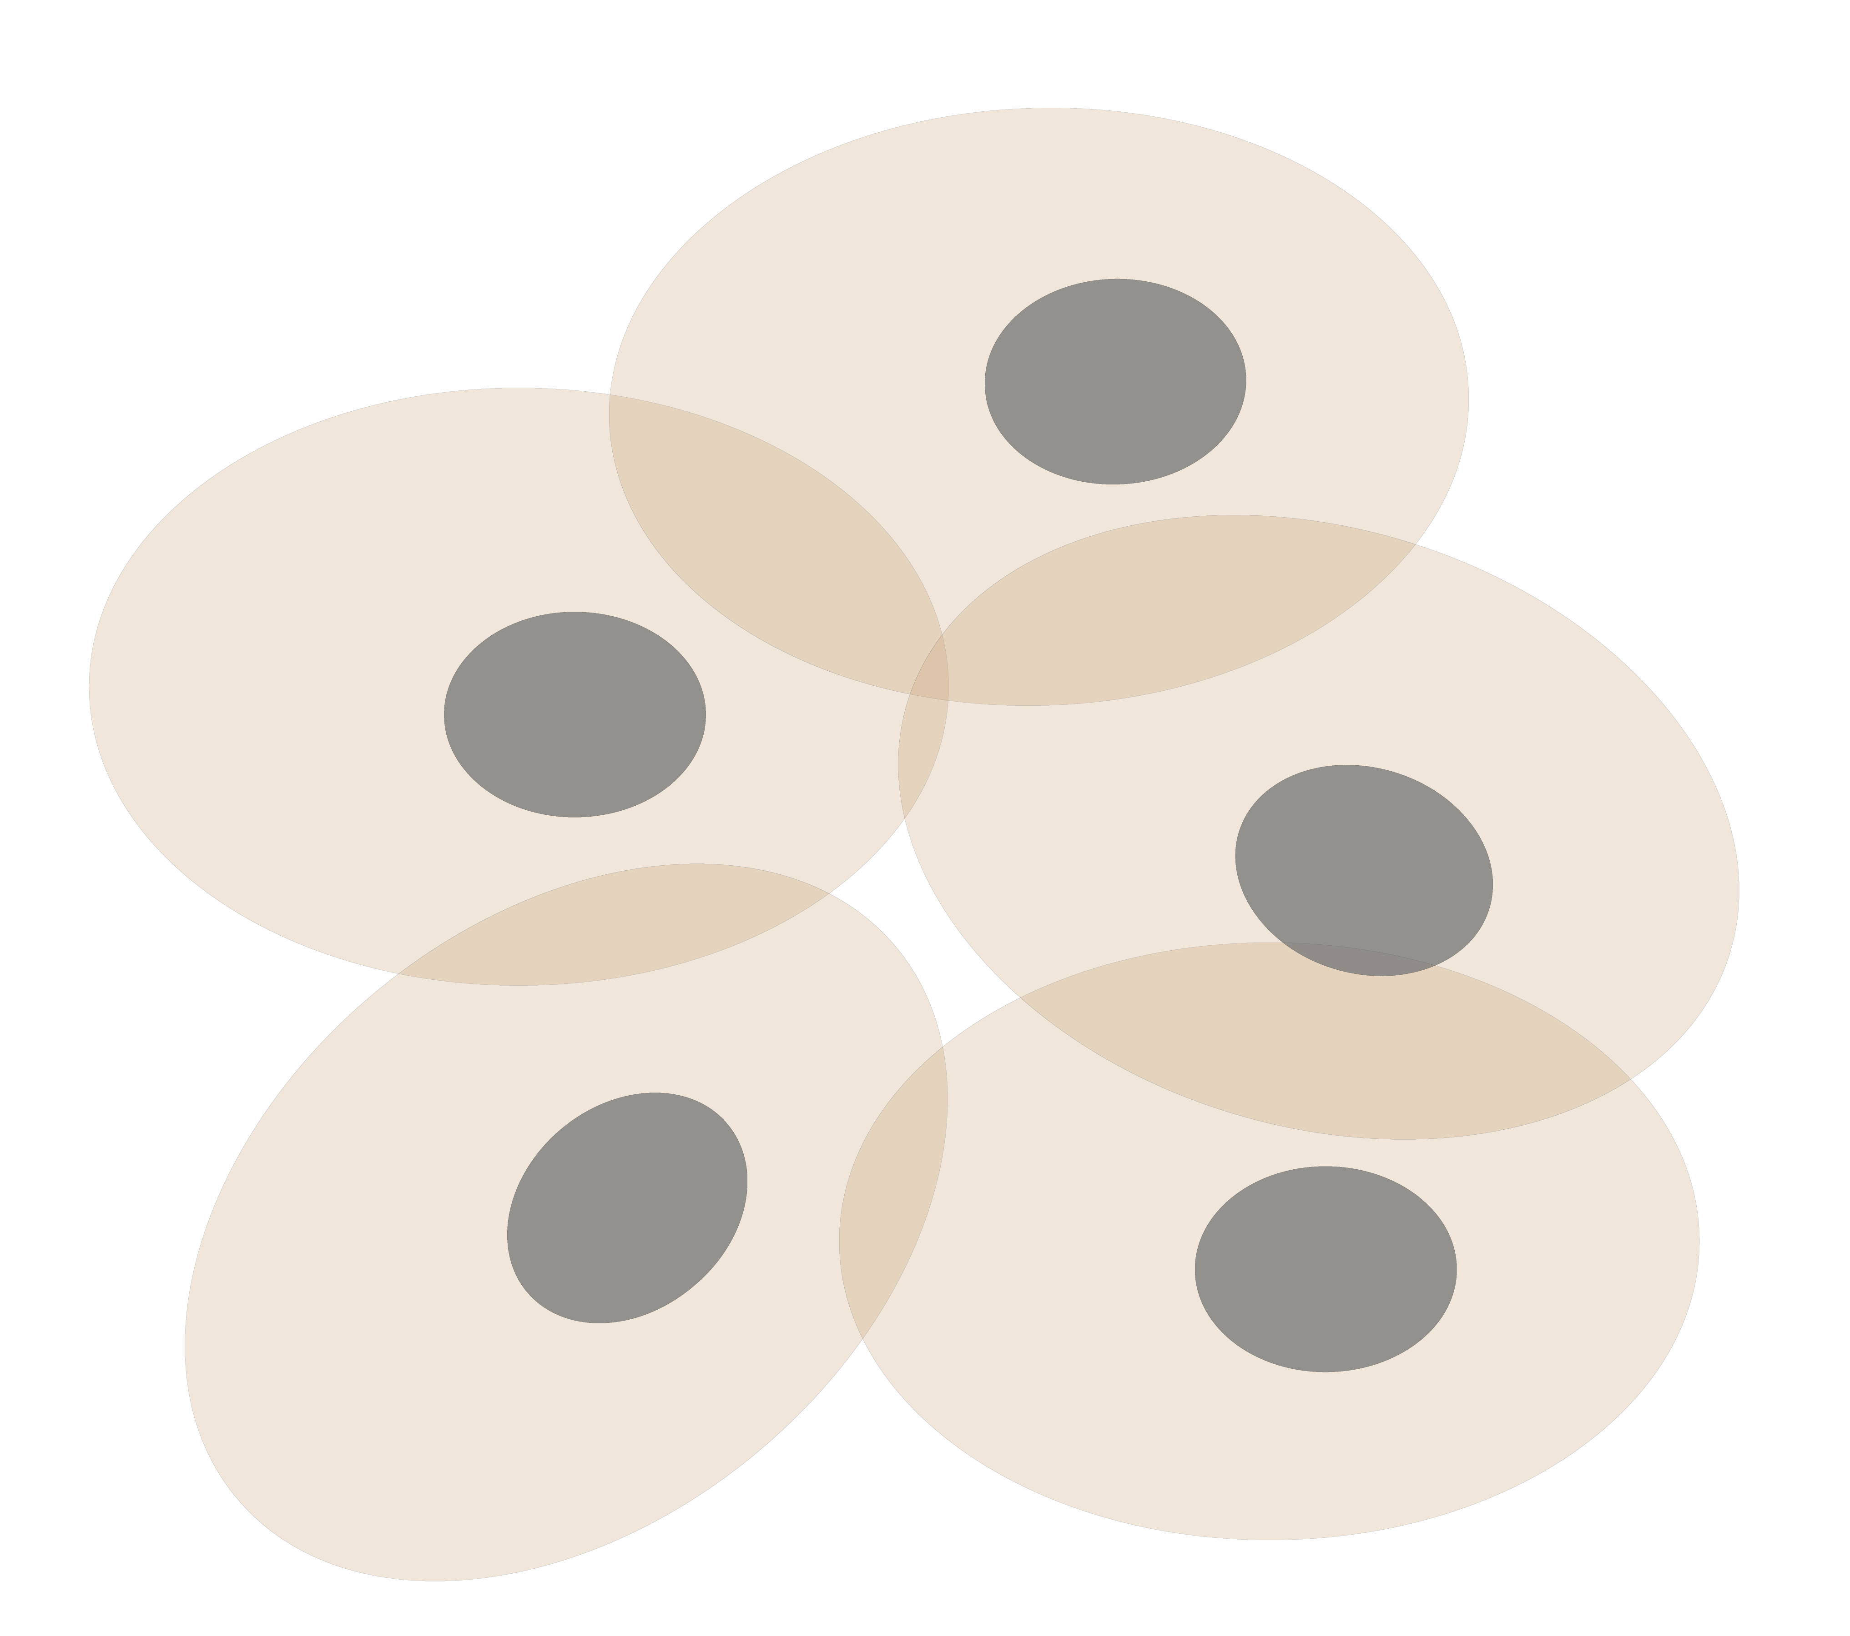
Personal Genomics & Transcriptomics
as a Gateway into Biology
Personal genomes (& Transcriptomes) soon will become a commonplace part of medical research & eventually treatment (esp. for cancer).
They will provide a primary connection for biological science to the general public.
normal
tumor

Slide 9

Placing the individual into the context of the population
&
using the population to build a interpretative model

Slide 10
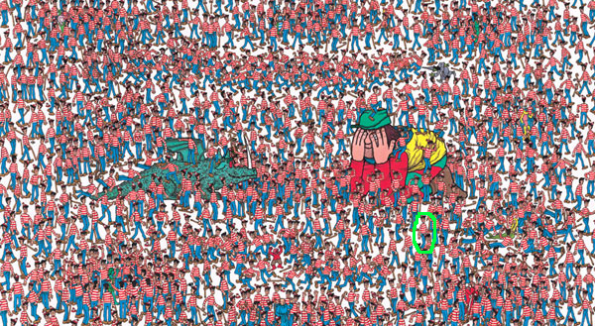
Where is Waldo?
(Finding the key mutations in ~3M Germline variants &
~5K Somatic Variants in a Tumor Sample)

Slide 11
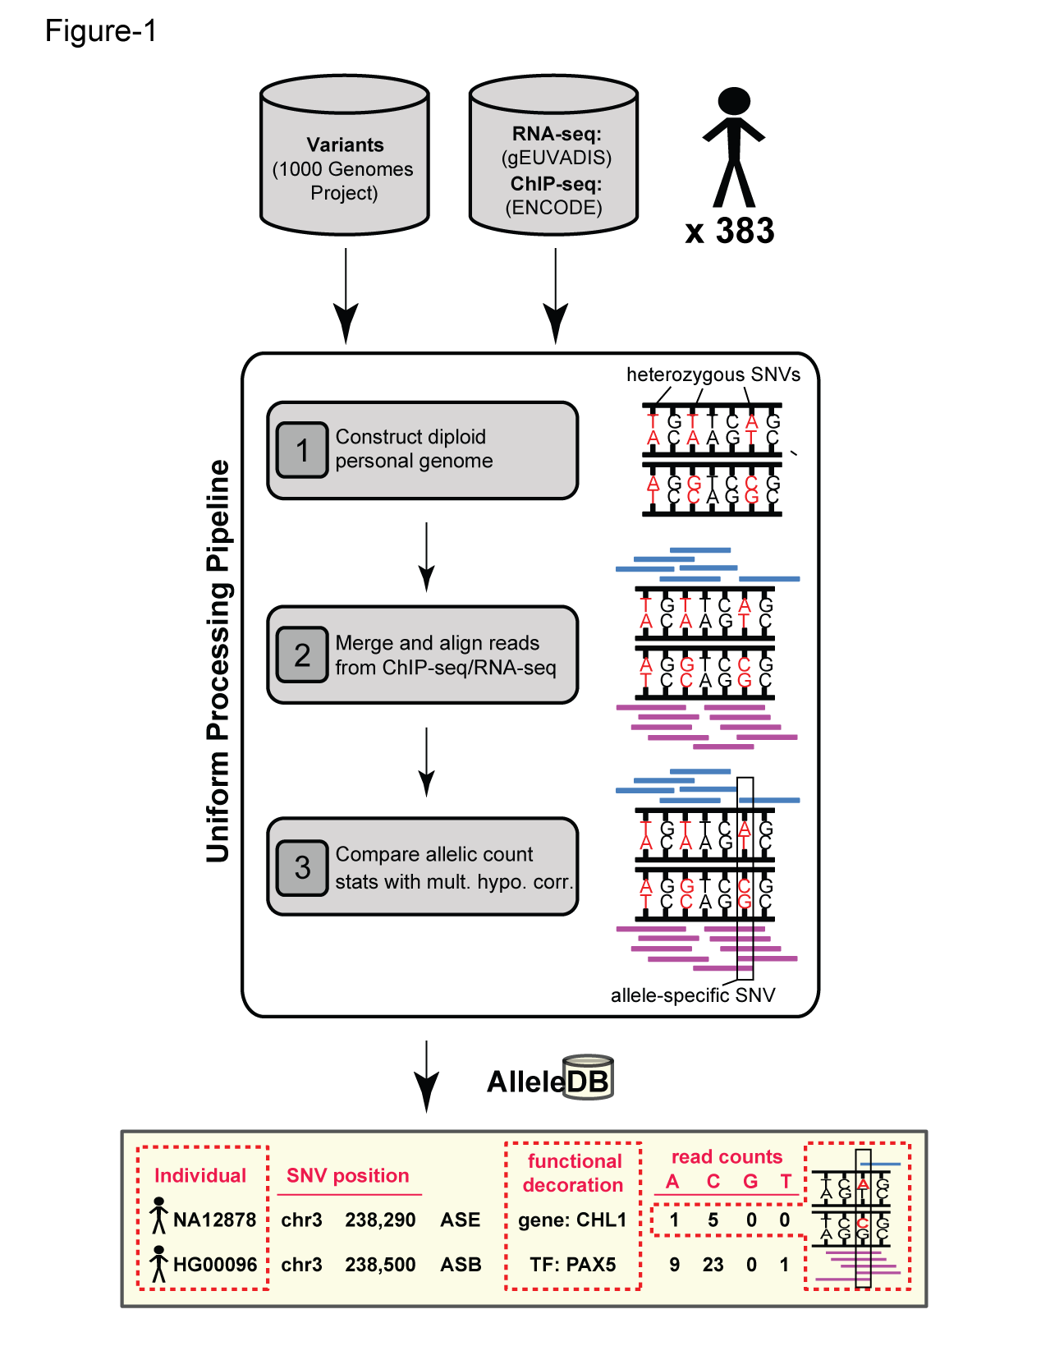
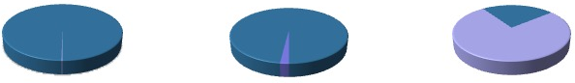
Human Genetic Variation
Population of
2,504 peoples
A Cancer Genome
A Typical Genome
Origin of Variants
Class of Variants
 | Coding | Non-coding
Germ-line | 22K | 4.1 – 5M
Somatic | ~50 | 5K
SNP | 3.5 – 4.3M
Indel | 550 – 625K
SV | 2.1 – 2.5K (20Mb)
Total | 4.1 – 5M
SNP | 84.7M
Indel | 3.6M
SV | 60K
Total | 88.3M
Prevalence of Variants
Common
Common
Passenger
Driver (~0.1%)
Rare* (1-4%)
Rare (~75%)
* Variants with allele frequency < 0.5% are considered as rare variants in 1000 genomes project.
The 1000 Genomes Project Consortium, Nature. 2015. 526:68-74
Khurana E. et al. Nat. Rev. Genet. 2016. 17:93-108

Slide 12
Association of Variants with Diseases
Common
Variants
Healthy
Rare or
Somatic
Variants
Pooled
Variants
High
Function
Impact
Diseased
Burden Test
GWAS Positive

Slide 13
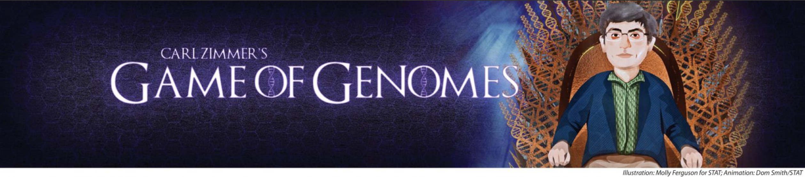
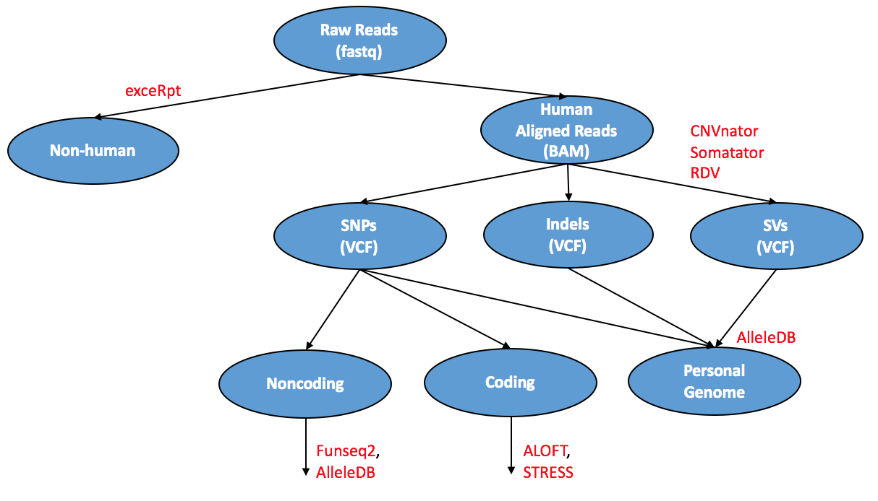

Slide 14
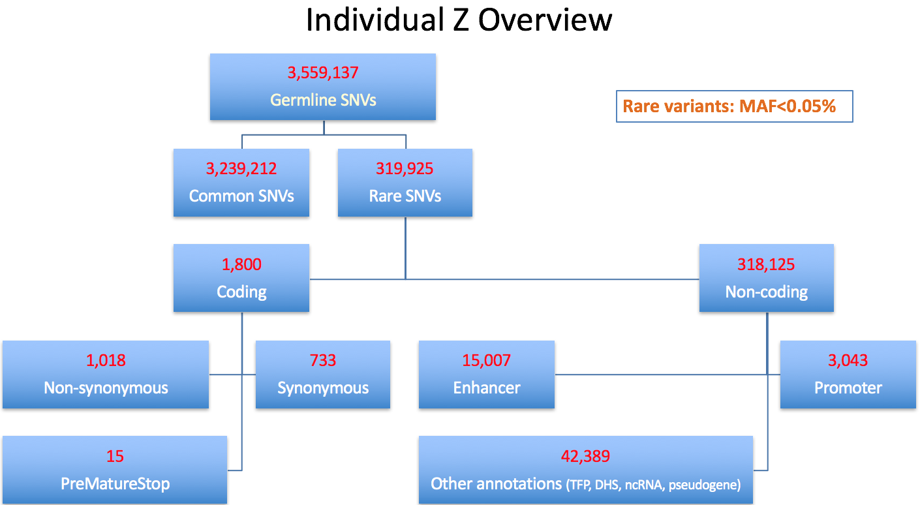

Slide 15
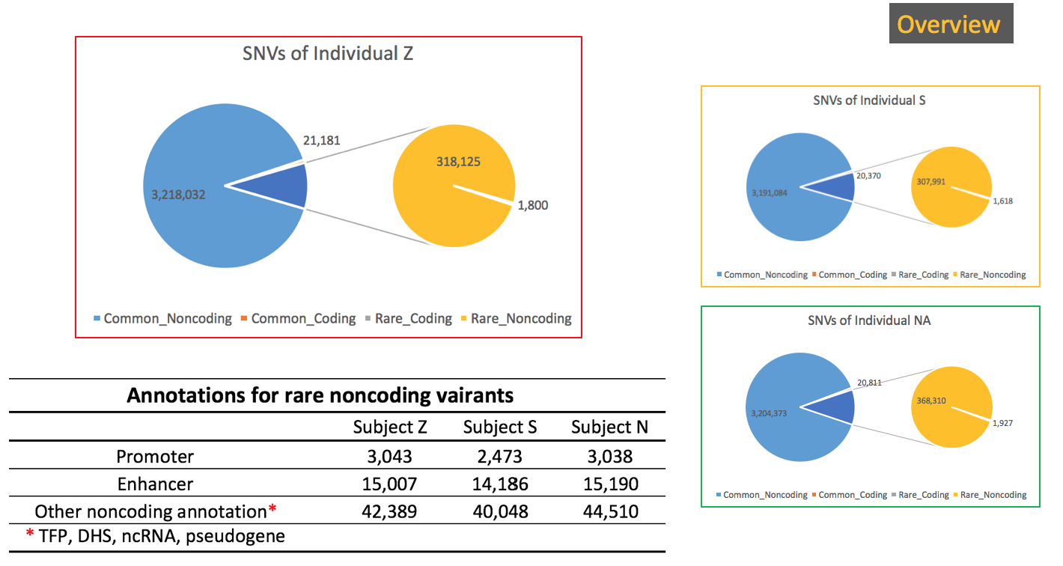

Slide 16
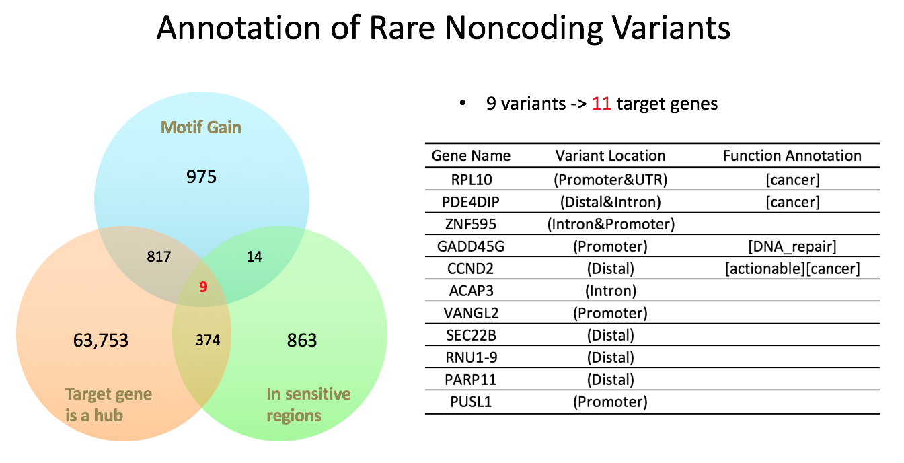

Slide 17
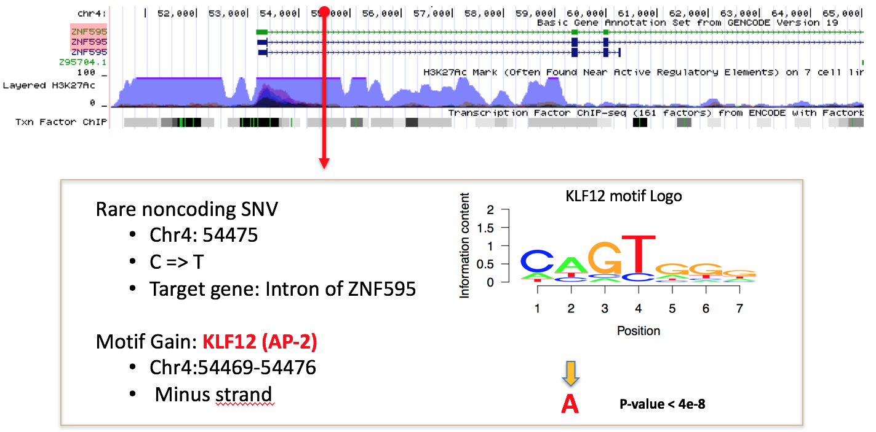

Slide 18
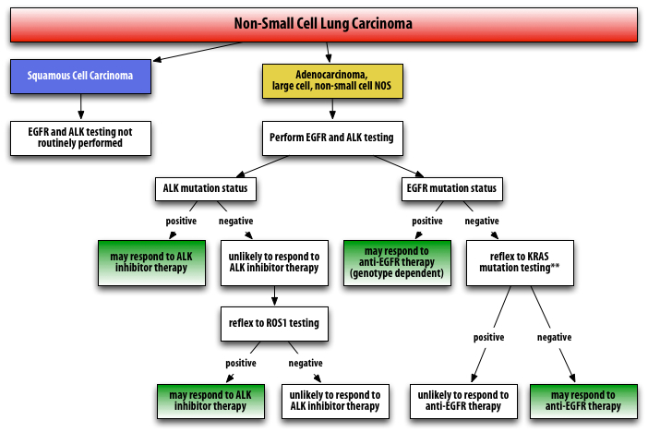
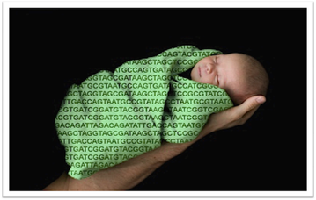
Genomic technologies have begun to enter the molecular pathology suite
Precision Oncology
Neonatal screening for Mendelian disease
http://www.apmggroup.net/innovation/molecular_testing/Lung_Pathways/lung.html
http://www.ngsleaders.org/blogs.aspx

Slide 19
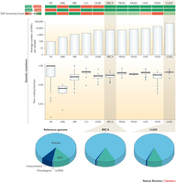
http://www.nature.com/nrg/journal/v17/n2/carousel/nrg.2015.17-f1.jpg

Slide 20
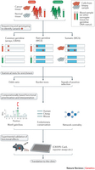

Slide 21
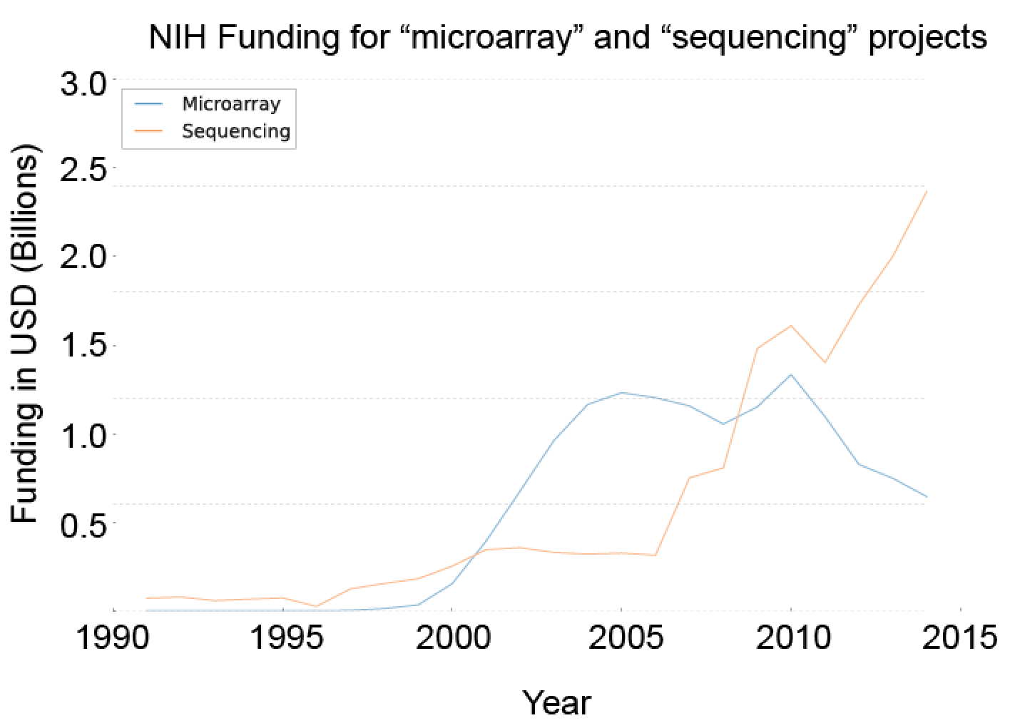
Sequencing cost reductions have resulted in an explosion of data
The type of sequence data deposited has changed as well.
  Protected data represents an increasing fraction of all submitted sequences.
  Data from techniques utilizing NGS machines has replaced that generated via microarray.
[Muir et al. (‘15) GenomeBiol.]

Slide 22












Sequence Universe
SRA ~1 petabyte
TCGA endpoint: ~2.5 Petabytes
~1.5 PB exome
~1 PB whole genome
TCGA 2.3 Petabytes
in CGHub
Clinical
RNASeq
Epigenome
222
TB
miRNA
ARRA
Autism
29
TB
32 TB
34 TB
NHLBI ESP
68 TB
40
TB
GTeX
ADSP
NHGRI LSSP
Star formation
100K Genomes England
Heidi Sofia, 7-16-15
Notes:
TCGA is the largest single project in the visible sequence universe to date.
TCGA is depicted at the center of the solar system because it integrates DNA, RNA-Seq, miRNA, epigenomic, and clinical data.
Currently there is over a Petabyte of TCGA data deposited in the CGHub cancer genomics repository (https://cghub.ucsc.edu/summary_stats.html).
This scale dwarfs its closest competitors which are shown as planets in orbit:
1000G 222 TB http://www.ncbi.nlm.nih.gov/bioproject/28889
ADSP 68 TB http://www.ncbi.nlm.nih.gov/bioproject/202226
NHGRI LSSP 40 TB http://www.ncbi.nlm.nih.gov/bioproject?term=NHGRI%20Large%20Scale%20Sequencing%20Program%5BTitle%5D
GTeX 34 TB http://www.ncbi.nlm.nih.gov/bioproject/75899
NHLBI ESP 32 TB http://www.ncbi.nlm.nih.gov/bioproject/165957
HMP 29 TB http://www.ncbi.nlm.nih.gov/bioproject/43021
ARRA Autism 24 TB http://www.ncbi.nlm.nih.gov/bioproject/74861
ENCODE 9 TB http://www.ncbi.nlm.nih.gov/bioproject/63441
Projects just starting now, like 100K Genomes England, may eventually overtake TCGA.

Slide 23
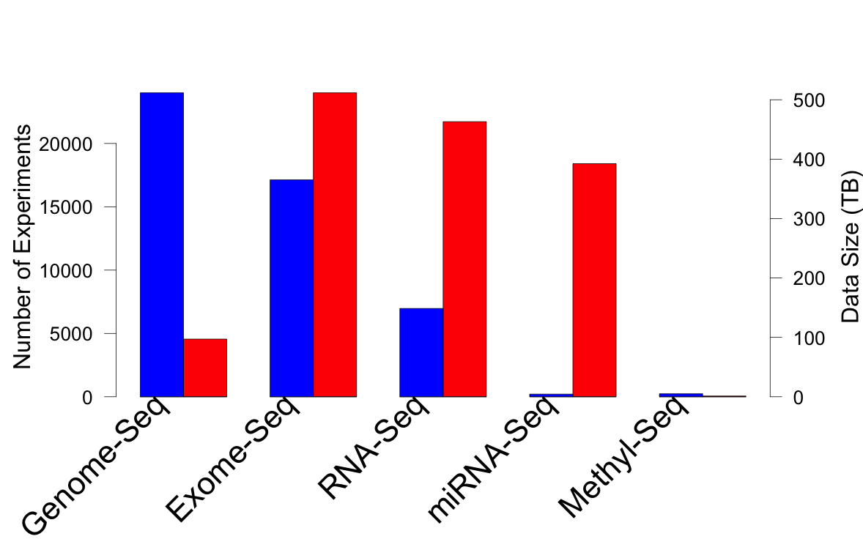
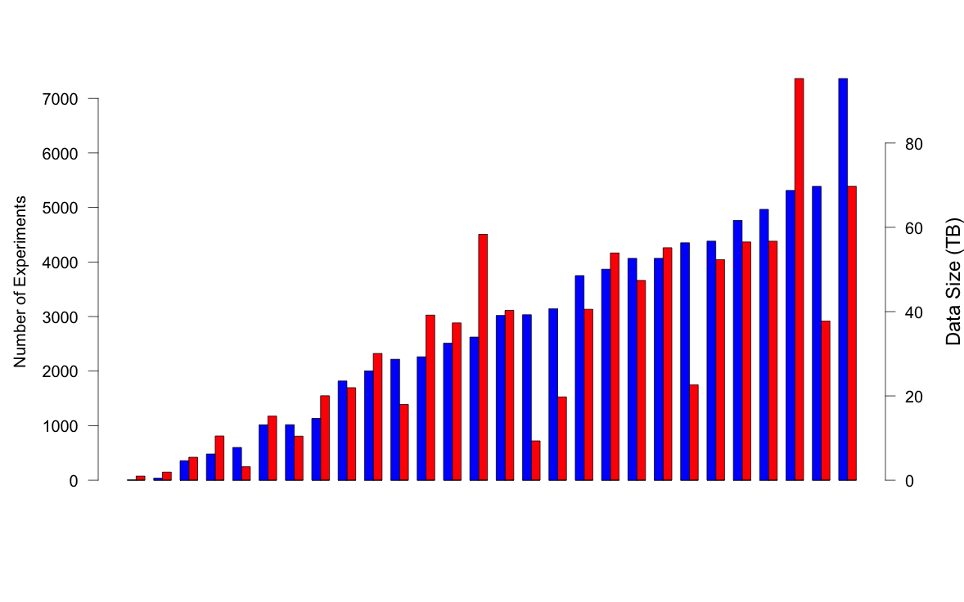
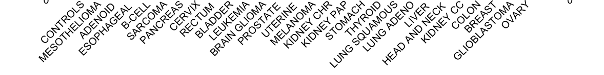
TCGA: What’s in a petabyte?
Breast Cancer
>30 TCGA Cancer Types
>73K Experiments
>11K Patients
https://cghub.ucsc.edu/

Slide 24
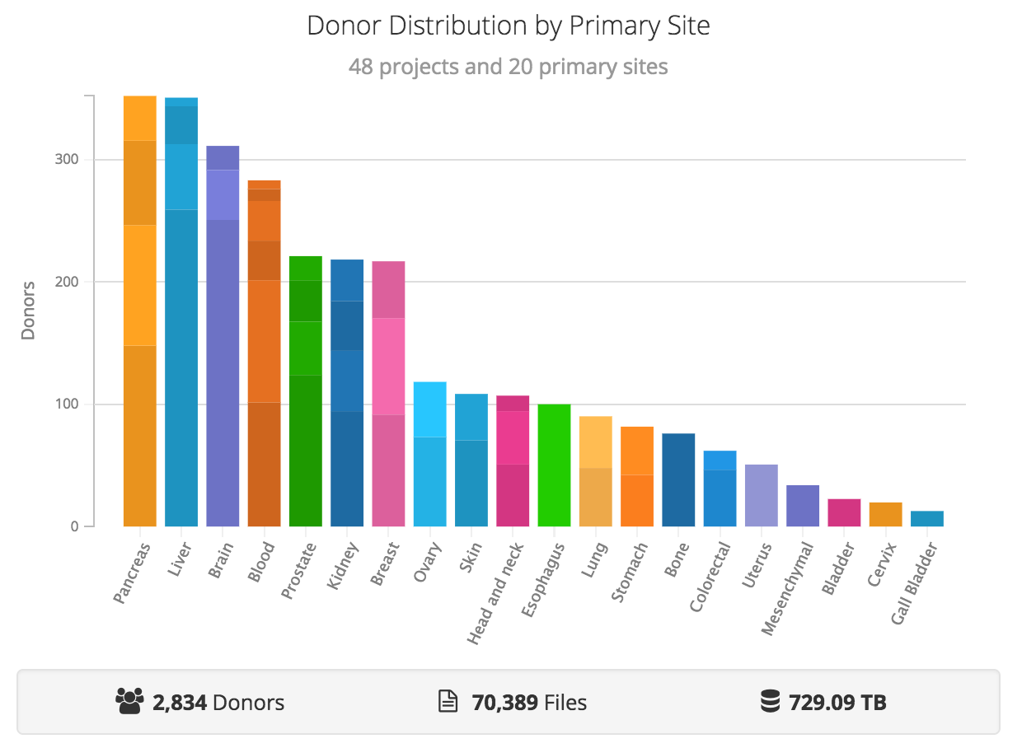
PCAWG: PANCANCER ANALYSIS OF WHOLE GENOMES

Slide 25
Personal Genomics:
Identifying High-impact Variants in Coding & Non-coding Regions
Characterizing Rare Variants in Coding Regions
  Identifying with STRESS
  cryptic allosteric sites
    On surface & in interior bottlenecks
  Using changes in localized Frustration to find further sites sensitive to mutations
    Difference betw. TSGs & oncogenes
Evaluating the Impact of Non-coding Variants with Annotation
  Annotating non-coding regions on different scales with MUSIC
  Prioritizing rare variants with
  “sensitive sites” (human-conserved)
Putting it together in Workflows
  Using LARVA to do burden testing on non-coding annotation
    Need to correct for co-variates & over-dispersion mutation counts
    Parameterized according to replication timing
  Using FunSeq to integrate evidence on variants
    Systematically weighting all the features
    suggesting non-coding drivers
    Prioritzing rare germline variants

Slide 26
Outline - WM
Intro - the big data explosion - XL
- declining cost of sequencing, increasing number of sampels, massive amounts of data
--helps frame this as an important field that the audience should pay attention to
Cool sequencing techs - XL
-WGS, chip-seq, RNA-seq: what's so cool about them, what can we do with them
-ENCODE, PCAWG
Transition to clinic - WM
-limited clinical adoption
-barriers to further adoption
-how we're going to overcome those barriers

Slide 27
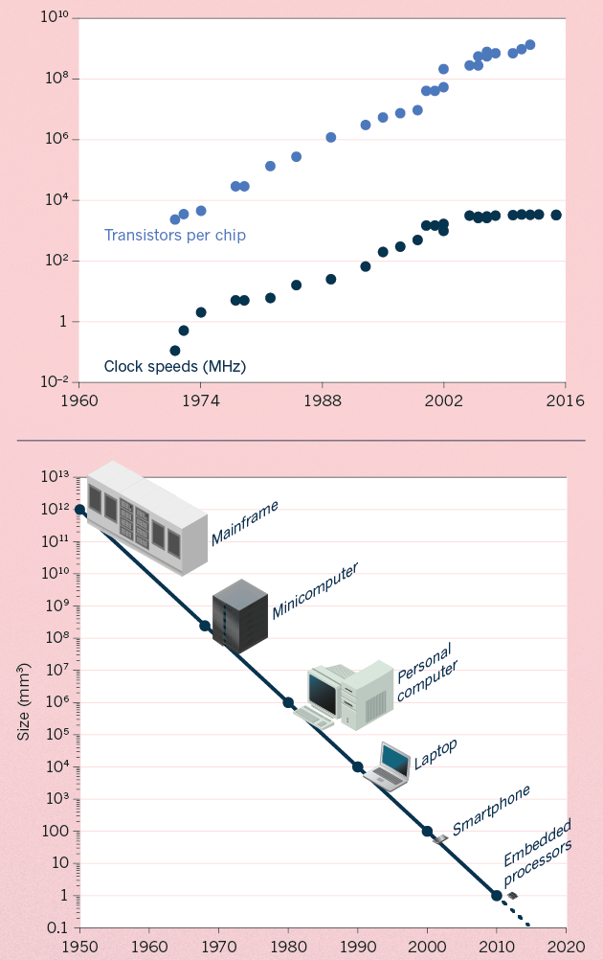
Moore’s Law:
Exponential Scaling of Computer Technology
Exponential increase in the number of transistors per chip.
Led to improvements in speed and miniaturization.
Drove widespread adoption and novel applications of computer technology.
[Waldrop (‘15) Nature]

Slide 28
Kryder’s Law and S-curves underlying exponential growth
Moore’s & Kryder’s Laws
  As important as the increase in computer speed has been, the ability to store large amounts of information on computers is even more crucial
Exponential increase seen in Kryder’s law is a superposition of
S-curves for different technologies
[Muir et al. (‘15) GenomeBiol.]

Slide 29
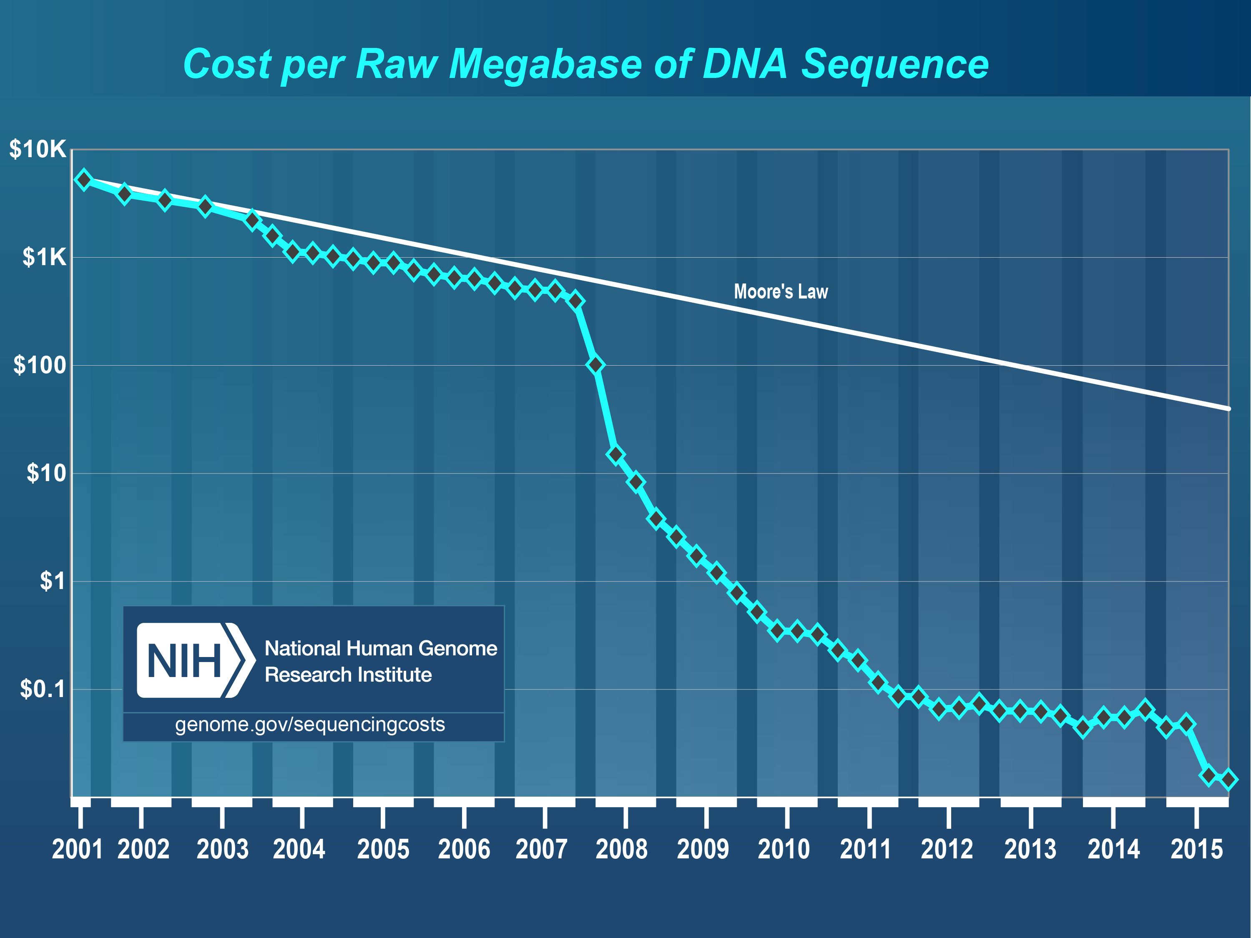
Sequencing Data Explosion:
Faster than Moore’s Law for a Time (or a S-curve)
DNA sequencing has gone through technological S-curves
  In the early 2000’s, improvements in Sanger sequencing produced a scaling pattern similar to Moore’s law.
  The advent of NGS was a shift to a new technology with dramatic decrease in cost).

Slide 30
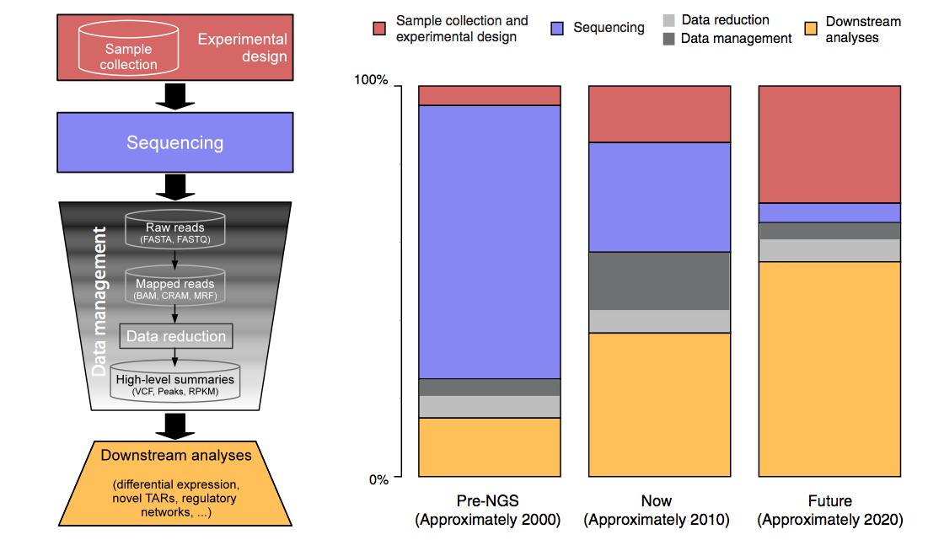
The changing costs of a sequencing pipeline
From ‘00 to ~’20,
cost of DNA sequencing expt. shifts from the actual seq. to sample
collection & analysis
[Sboner et al. (‘11), Muir et al. (‘15) Genome Biology]

Slide 31
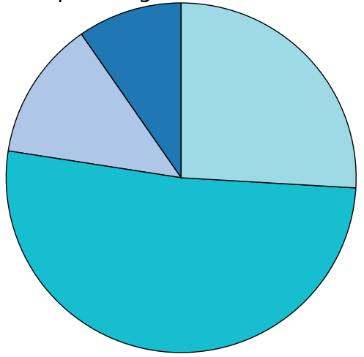
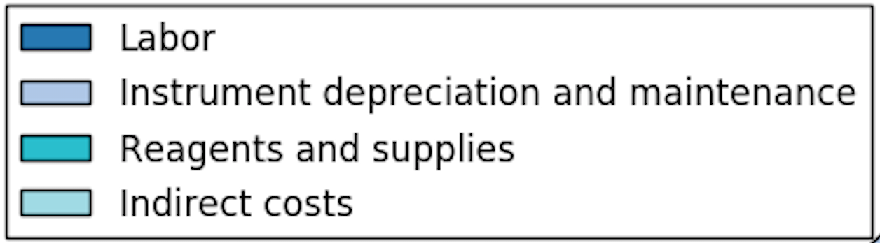
The changing costs of a sequencing pipeline
From ‘00 to ~’20,
cost of DNA sequencing expt. shifts from the actual seq. to sample
collection & analysis
[Sboner et al. (‘11), Muir et al. (‘15) Genome Biology]

Slide 32
The changing costs of a sequencing pipeline
From ‘00 to ~’20,
cost of DNA sequencing expt. shifts from the actual seq. to sample
collection & analysis
Alignment algorithms scaling to keep pace with data generation
[Sboner et al. (‘11), Muir et al. (‘15) Genome Biology]

Slide 33
The changing costs of a sequencing pipeline
From ‘00 to ~’20,
cost of DNA sequencing expt. shifts from the actual seq. to sample
collection & analysis
Alignment algorithms scaling to keep pace with data generation
[Sboner et al. (‘11), Muir et al. (‘15) Genome Biology]

Slide 34
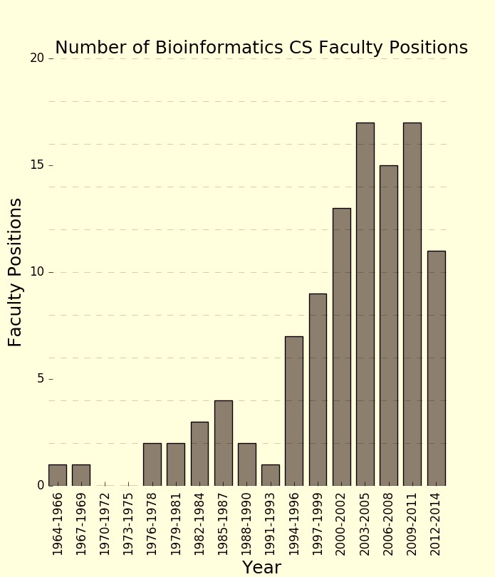
The changing costs of a sequencing pipeline
From ‘00 to ~’20,
cost of DNA sequencing expt. shifts from the actual seq. to sample
collection & analysis
[Sboner et al. (‘11), Muir et al. (‘15) Genome Biology]

Slide 35
Personal Genomics:
Identifying High-impact Variants in Coding & Non-coding Regions
Characterizing Rare Variants in Coding Regions
  Identifying with STRESS
  cryptic allosteric sites
    On surface & in interior bottlenecks
  Using changes in localized Frustration to find further sites sensitive to mutations
    Difference betw. TSGs & oncogenes
Evaluating the Impact of Non-coding Variants with Annotation
  Annotating non-coding regions on different scales with MUSIC
  Prioritizing rare variants with
  “sensitive sites” (human-conserved)
Putting it together in Workflows
  Using LARVA to do burden testing on non-coding annotation
    Need to correct for co-variates & over-dispersion mutation counts
    Parameterized according to replication timing
  Using FunSeq to integrate evidence on variants
    Systematically weighting all the features
    suggesting non-coding drivers
    Prioritzing rare germline variants

Slide 36
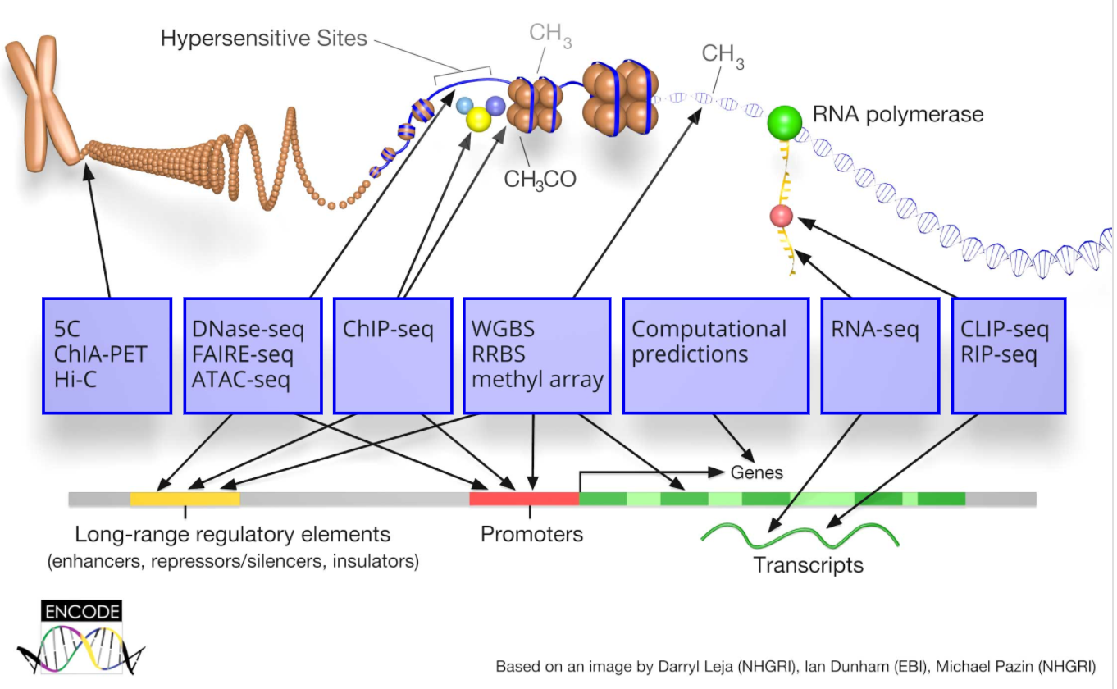
ENCODE: Encyclopedia of DNA Elements

Slide 37
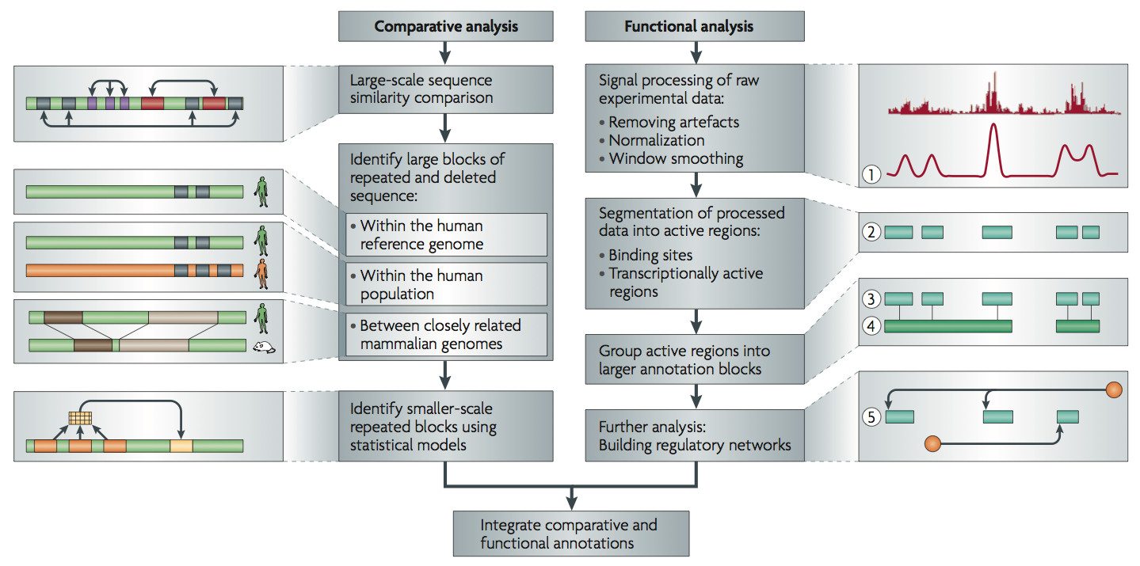
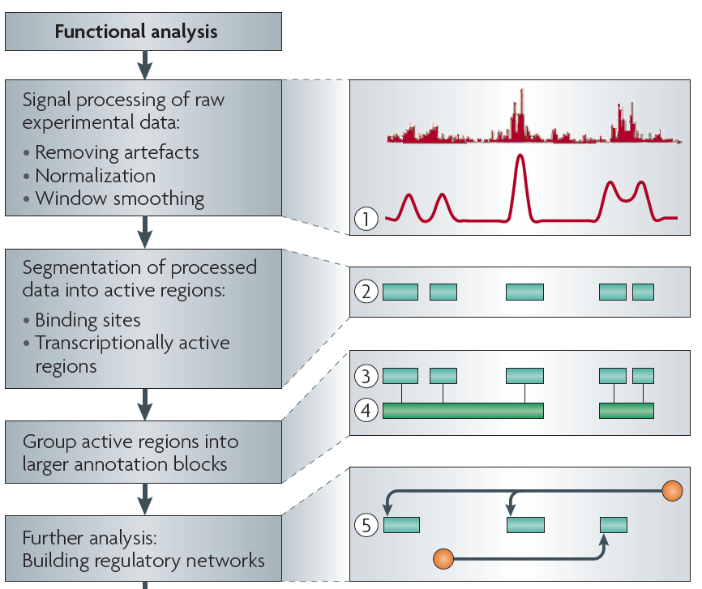
Non-coding Annotations:
Overview
Sequence features, incl. Conservation
Functional Genomics
Chip-seq (Epigenome & seq. specific TF) and ncRNA & un-annotated transcription
[Alexander et al., Nat. Rev. Genet. (’10)]

Slide 38
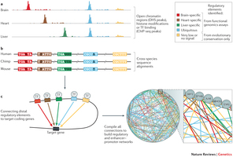
Nrg ?

Slide 39
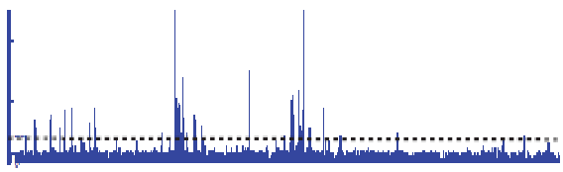

Summarizing the Signal:
"Traditional" ChipSeq Peak Calling
ChIP
Generate & threshold the signal profile to identify candidate target regions
  Simulation (PeakSeq),
  Local window based Poisson (MACS),
  Fold change statistics (SPP)
Threshold
Potential Targets
Normalized Control
Score against the control
Significantly Enriched targets
Now an update: "PeakSeq 2" => MUSIC
[Rozowsky et al. ('09) Nat Biotech]

Slide 40
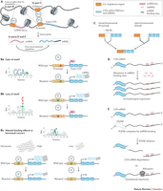

Slide 41
Personal Genomics:
Identifying High-impact Variants in Coding & Non-coding Regions
Characterizing Rare Variants in Coding Regions
  Identifying with STRESS
  cryptic allosteric sites
    On surface & in interior bottlenecks
  Using changes in localized Frustration to find further sites sensitive to mutations
    Difference betw. TSGs & oncogenes
Evaluating the Impact of Non-coding Variants with Annotation
  Annotating non-coding regions on different scales with MUSIC
  Prioritizing rare variants with
  “sensitive sites” (human-conserved)
Putting it together in Workflows
  Using LARVA to do burden testing on non-coding annotation
    Need to correct for co-variates & over-dispersion mutation counts
    Parameterized according to replication timing
  Using FunSeq to integrate evidence on variants
    Systematically weighting all the features
    suggesting non-coding drivers
    Prioritzing rare germline variants

Slide 42
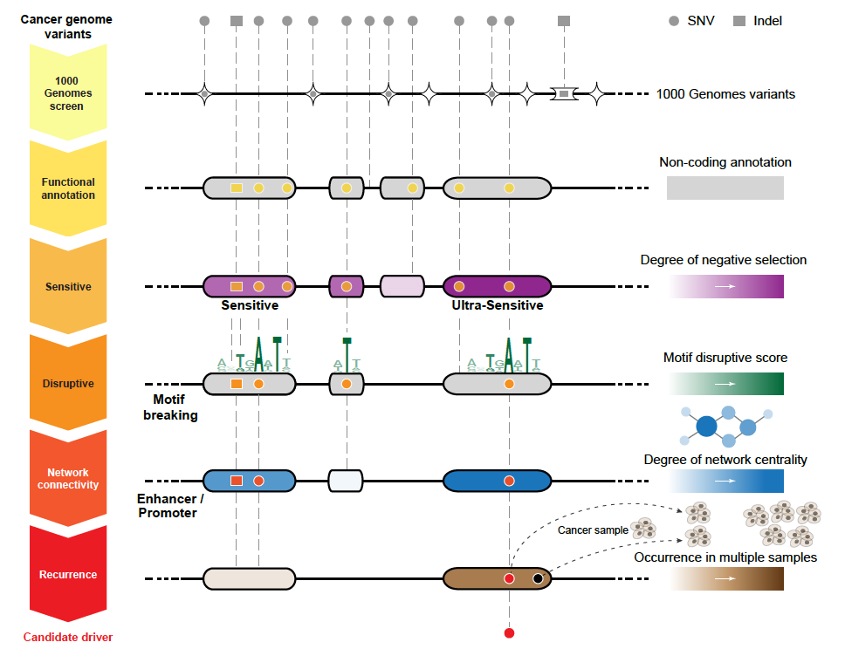
Identification of non-coding candidate drivers amongst somatic variants: Scheme
[Khurana et al., Science (‘13)]

Slide 43
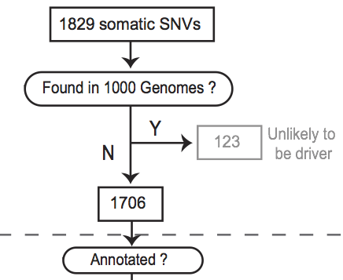
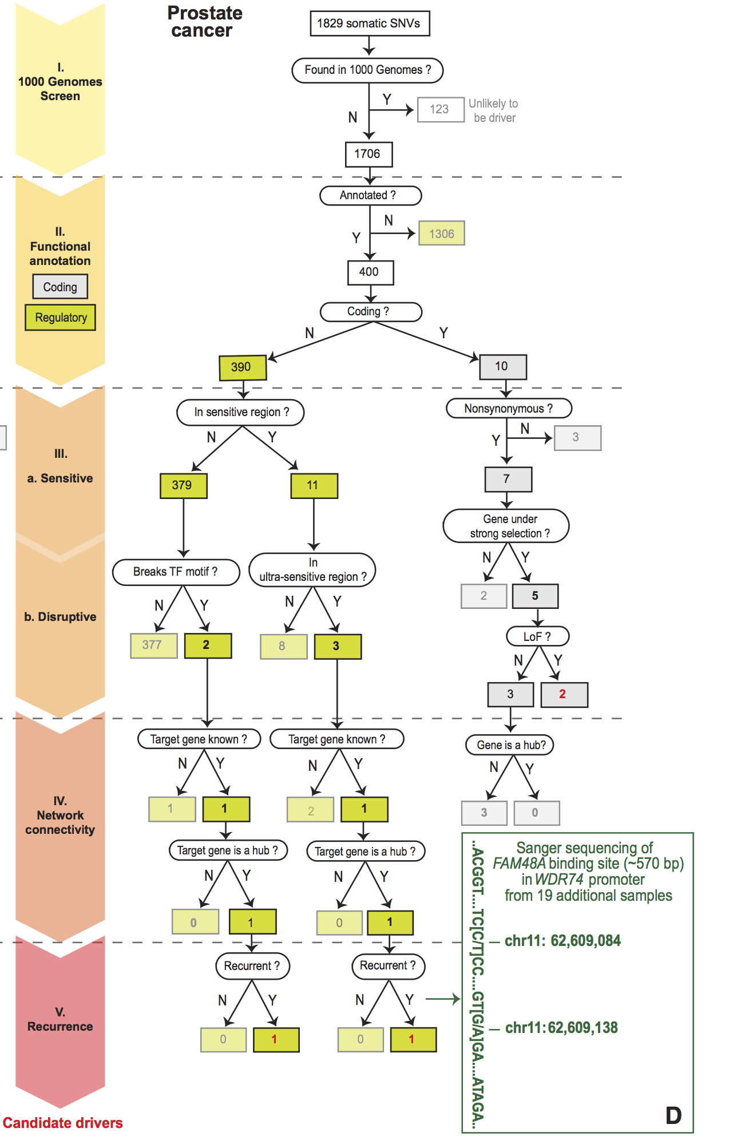
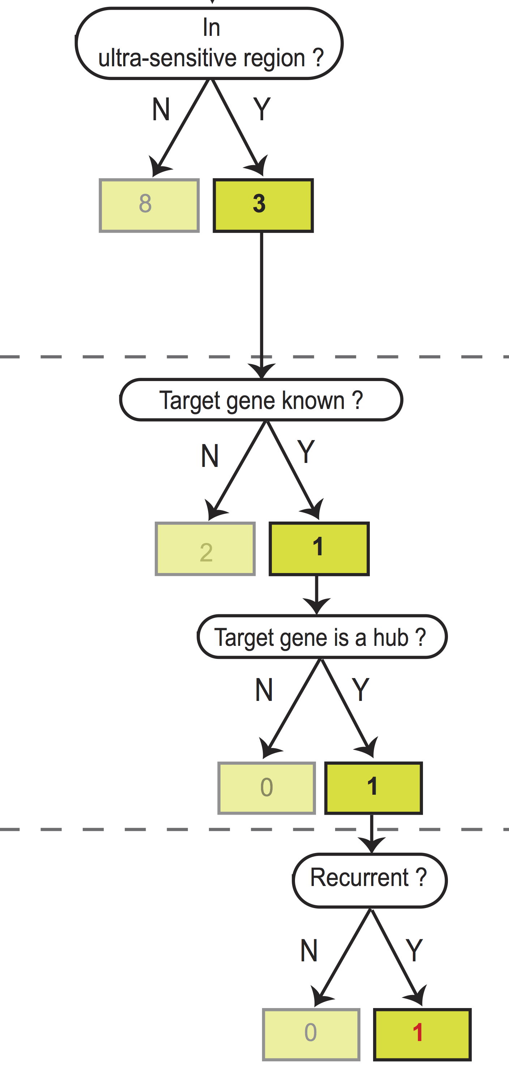
Flowchart for 1 Prostate Cancer Genome (from Berger et al. '11)
[Khurana et al., Science (‘13)]
Notes:
Just have one path

Slide 44
Personal Genomics:
Identifying High-impact Variants in Coding & Non-coding Regions
Characterizing Rare Variants in Coding Regions
  Identifying with STRESS
  cryptic allosteric sites
    On surface & in interior bottlenecks
  Using changes in localized Frustration to find further sites sensitive to mutations
    Difference betw. TSGs & oncogenes
Evaluating the Impact of Non-coding Variants with Annotation
  Annotating non-coding regions on different scales with MUSIC
  Prioritizing rare variants with
  “sensitive sites” (human-conserved)
Putting it together in Workflows
  Using LARVA to do burden testing on non-coding annotation
    Need to correct for co-variates & over-dispersion mutation counts
    Parameterized according to replication timing
  Using FunSeq to integrate evidence on variants
    Systematically weighting all the features
    suggesting non-coding drivers
    Prioritzing rare germline variants

Slide 45


The Conundrum of Genomic Privacy: Is it a Problem?
Yes
Genetic Exceptionalism :
genome is potentially very revealing about one’s identity & characteristics
Most discussion of Identification Risk but what about Characterization Risk?
  Finding you were in study X vs identifying that you have trait Y from studying your identified genome
No
Shifting societal foci
No one really cares
about your genes
You might not care
[Klitzman & Sweeney ('11), J Genet Couns 20:98l; Greenbaum & Gerstein ('09), New Sci. (Sep 23) ]

Slide 46
Background:
The Conundrum of Genomic Privacy
The Genome is very fundamental data, potentially very revealing about one’s identity & characteristics
Identification Risk:
Find that someone participated in a study [Craig, Erlich]
Characterization Risk:
Finding that you have a particular trait from studying your identified genome
[eg Watson ApoE status]
Genetics has a problematic ethical history & might need to be particularly careful to keep public trust
  A single bad event (eg HELA like) could cause great damage to genomics research
Sharing helps research
  Large-scale mining of this information is essential for medical research
  For statistical association,
  1M is better than 1K
  Privacy is cumbersome, particularly for big data
Sharing is important for reproducible research
Data sharing & doing research on identifiable individuals is useful for education
  More interesting to study the genome of someone you know
[Yale Law Roundtable (‘10). Comp. in Sci. & Eng. 12:8; D Greenbaum & M Gerstein (‘09). Am. J. Bioethics; D Greenbaum & M Gerstein (‘10). SF Chronicle, May 2, Page E-4;
Greenbaum et al. PLOS CB (‘11)]
[Klitzman & Sweeney ('11), J Genet Couns 20:98l; Greenbaum & Gerstein ('09), New Sci. (Sep 23) ]

Slide 47
Genomics has similar "Big Data" Privacy Issues in the Rest of Society… or does it ?
Sharing & "peer-production" central to success of many new ventures, with the similar risks as in genomics
  EG web search: Large-scale mining essential, but we confront privacy risks every day we access the internet
Or is the genome exceptional?
  We can’t change it
  The individual (harmed?) v the collective (benefits)
    (Do sick patients care about their privacy?)
Different cultures of genomics (open-data) & clinical medicine (private data)
Genome is inherited so privacy risk is multi-generational
  What you can mine from a genome now is not clear, but what about in 20 years
[Seringhaus & Gerstein ('09), Hart. Courant (Jun 5); Greenbaum & Gerstein ('11), NY Times (6 Oct)]

Slide 48
Current Social & Technical Solutions
Notion of Consent
“Protected” distribution of data (dbGAP)
Local computes on secure computer
Practical Issues
  Non-uniformity of consents & paperwork
    Different international norms, leading to confusion
  Encryption & computer security creates burdensome requirements on data sharing & large scale analysis
  Many schemes get “hacked”
[Greenbuam et al ('04), Nat. Biotech; Greenbaum & Gerstein ('13), The Scientist]

Slide 49
How to Surmount the Dilemma
One approach is just using open data
  Maybe we need a few "test pilots” (ala PGP)?
    Sports stars & celebrities?
  Some public data & data donation is helpful but is this a realistic solution for an unbiased sample of ~1M
Hybrid Social & Tech Solution (a strawman)
  Fundamentally, researchers have to keep genetic secrets
  Legal framework for this (not charge of this group)
    Genetic licensure & training for individuals
    (similar to medical license, drivers license)
    Barriers shouldn't create a incentive for “hacking”
  Enabling Technologies
    We should develop technologies for Quantifying Leakage & allowing a small amounts of it
    We should develop technologies for the careful separation & coupling of private & public data
[D Greenbaum, M Gerstein (‘11). Am J Bioeth 11:39. Greenbaum & Gerstein, The Scientist ('13)]

Slide 50
More on Enabling Technologies
Making secure cloud computing easier
  Standard & open workflow systems cloud computing & enclaves (eg solution of Genomics England)
  Homomorphic encryption, Differential privacy
We should develop technologies for quantifying privacy
  What is acceptable risk? What is acceptable data leakage? Can we quantify leakage?
    Ex: photos of eye color
  Cost Benefit Analysis: how helpful is identifiable data in genomic research v. potential harm from a breach?
Separating but Linking Public & Private Data
  Lightweight, freely accessible secondary datasets coupled to underlying variants (eg gene expression quantifications)
  Selection of stub & "test pilot" datasets for benchmarking
  Developing standards for developing code on public stubs on your laptop; then move programs to the cloud for private production runs

Slide 51












Genomics has similar "Big Data" Dilemma in the Rest of Society
Sharing & "peer-production" is central to success of many new ventures, with the same risks as in genomics
We confront privacy risks every day we access the internet
(...or is the genome more exceptional & fundamental?)
[Seringhaus & Gerstein ('09), Hart. Courant (Jun 5); Greenbaum & Gerstein ('11), NY Times (6 Oct)]

Slide 52
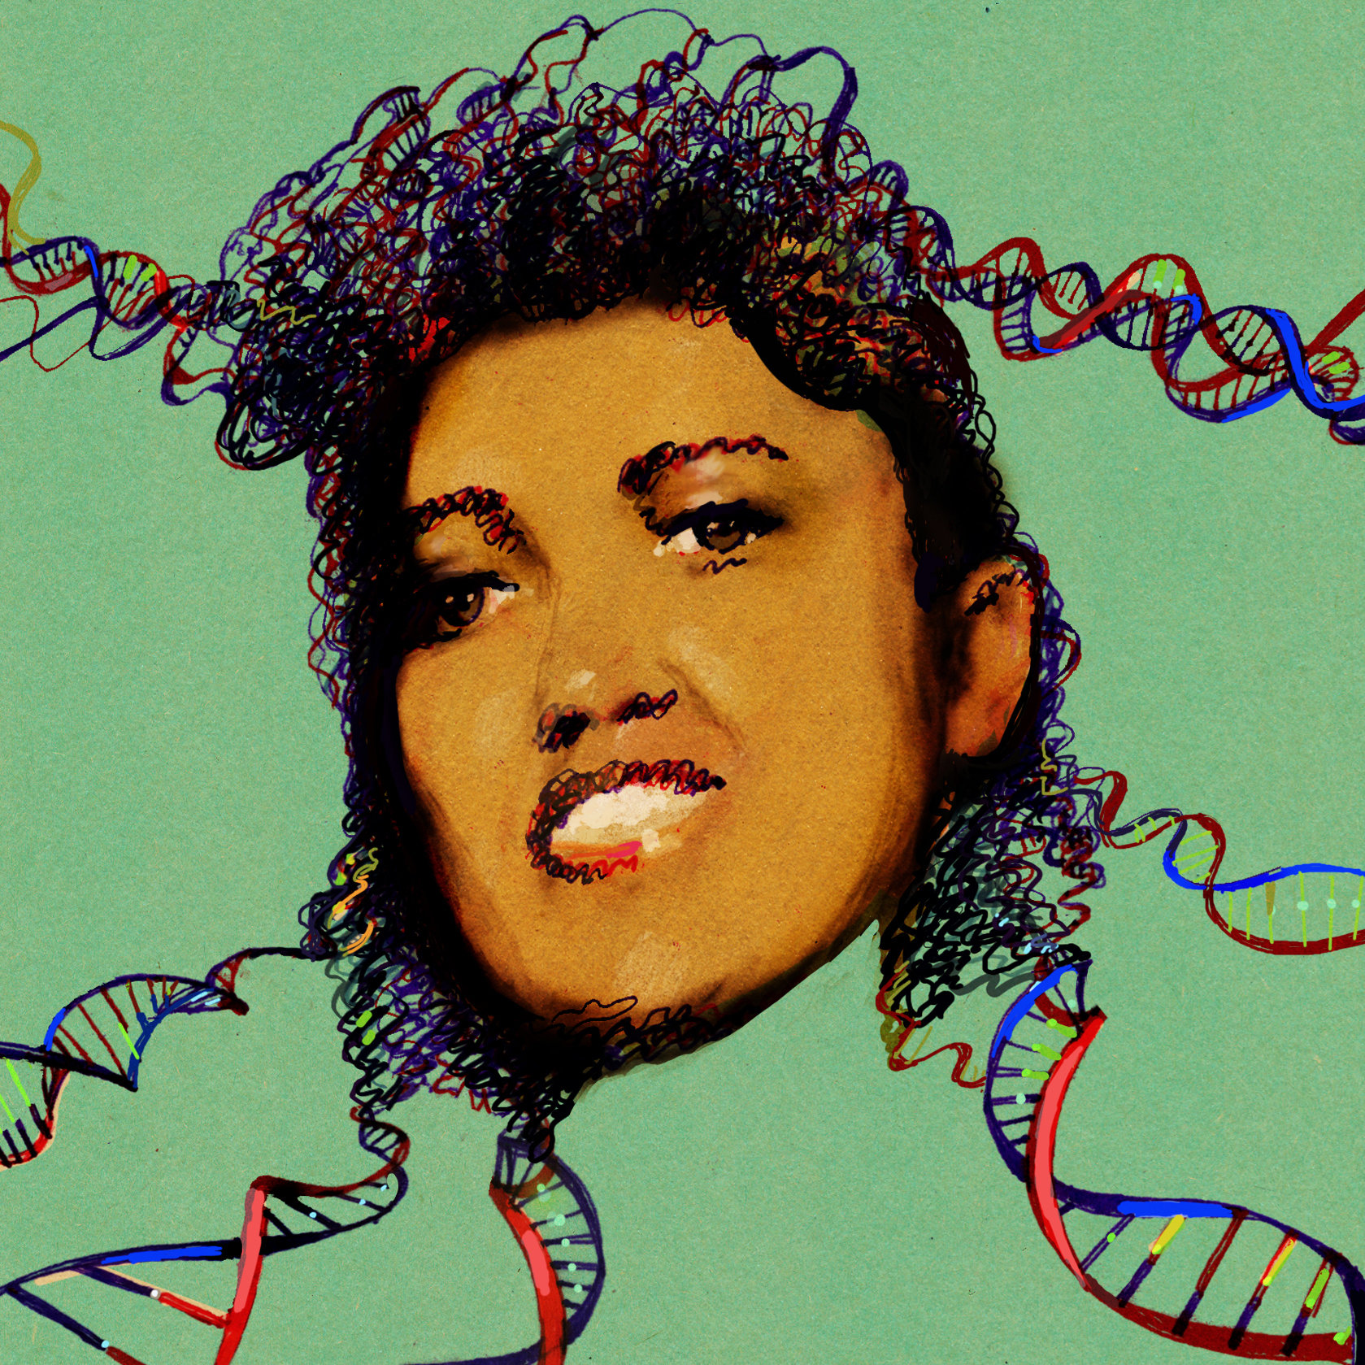
Tricky Privacy Considerations in Personal Genomics
Personal Genomic info. essentially meaningless currently but will it be in 20 yrs? 50 yrs?
  Genomic sequence very revealing about one’s children. Is true consent possible?
  Once put on the web it can’t be taken back
Culture Clash: Genomics historically has been a proponent of “open data” but not clear personal genomics fits this
Ethically challenged history of genetics
Ownership of the data & what consent means (Hela)
  Could your genetic data give rise to a product line?
[D Greenbaum & M Gerstein (’08). Am J. Bioethics; D Greenbaum & M Gerstein, Hartford Courant, 10 Jul. '08 ; SF Chronicle, 2 Nov. '08;
Greenbaum et al. PLOS CB (‘11) ; Greenbaum & Gerstein ('13), The Scientist; Photo from NY Times]

Slide 53

The Other Side of the Coin:
Why we should share
Sharing helps speed research
  Large-scale mining of this information is important for medical research
  Privacy is cumbersome, particularly for big data
Sharing is important for reproducible research
Sharing is useful for education
[Yale Law Roundtable (‘10). Comp. in Sci. & Eng. 12:8; D Greenbaum & M Gerstein (‘09). Am. J. Bioethics; D Greenbaum & M Gerstein (‘10). SF Chronicle, May 2, Page E-4;
Greenbaum et al. PLOS CB (‘11)]

Slide 54
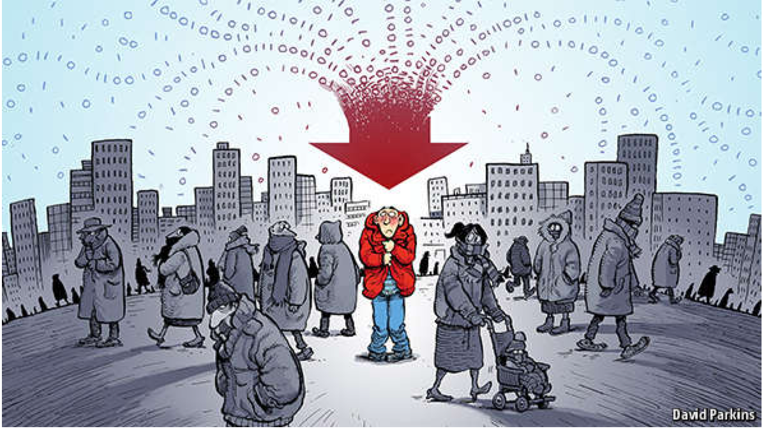
The Dilemma
[Economist, 15 Aug ‘15]
The individual (harmed?) v the collective (benefits)
  But do sick patients care about their privacy?
Quantification
  What is acceptable risk? What is acceptable data leakage? Can we quantify leakage?
    Ex: photos of eye color
  Cost Benefit Analysis: how helpful is identifiable data in genomic research v. potential harm from a breach?
Maybe a we need a few "test pilots” (ala PGP)?
  Sports stars & celebrities?

Slide 55
Current Social & Technical Solutions
Consents
“Protected” distribution of data (dbGAP)
Local computes on secure computer
Issues
  Non-uniformity of consents & paperwork
    Different international norms, leading to confusion
  Encryption & computer security creates burdensome requirements on data sharing & large scale analysis
  Many schemes get “hacked”
[Greenbuam et al ('04), Nat. Biotech; Greenbaum & Gerstein ('13), The Scientist]

Slide 56
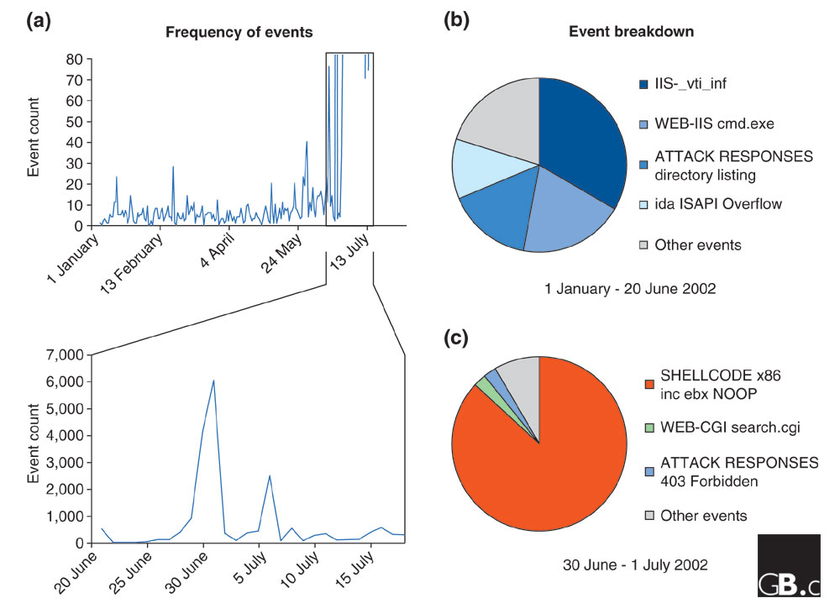
Difficulty in Securing Computers & Data
[Smith et al ('05), Genome Bio]

Slide 57
Genomic Privacy Hacks,
Mostly Focusing on Identification
Early genomic studies were based on small cohorts
  Individuals give consent to participate but request anonymity
    HAPMAP, PGP, 1000 Genomes…
  Focus on hiding the participation of individuals
  Attacks aimed at detecting whether an individual with known genotypes participated a study
    “Detection of genomes in a mixture” (Homer et al 2008, Im et al 2012)
As more people are genotyped, more individuals are in large private genomic databases
  Detection of an individual is irrelevant, as their participation is already known
    Current EX: “An individual’s genomic/phenotypic data is most certainly stored in their hospital”
    Future: >1M people’s health information is part of a NIH/PMI or NHS databases
Identification attacks now focus on pinpointing individuals by cross-referencing large seemingly independent datasets
  Illustrates that a leaked/hacker/stolen dataset, even when anonymized, can leak information
  Sweeney et al 2013, Gymrek et al 2013
Gymrek et al, “Identifying Personal Genomes by Surname Inference” (2013)
Homer et al, “Resolving individuals contributing trace amounts of DNA to highly complex mixtures using high-density SNP genotyping microarrays.” (2008)
Im et al, “On Sharing Quantitative Trait GWAS Results in an Era of Multiple-omics Data and the Limits of Genomic Privacy” (2012)
Sweeney et al, “Identifying Participants in the Personal Genome Project by Name” (2013)

Slide 58
Strawman Hybrid Social & Tech Proposed Solution?
Fundamentally, researchers have to keep genetic secrets
  Genetic Licensure & training for individuals
  (similar to medical license, drivers license)
Technology to make things easier
  Cloud computing & enclaves (eg solution of Genomics England)
Technological barriers shouldn't create a social incentive for “hacking”
Quantifying Leakage & allowing a small amounts of it
Careful separation & coupling of private & public data
  Lightweight, freely accessible secondary datasets coupled to underlying variants
  Selection of stub & "test pilot" datasets for benchmarking
  Develop programs on public stubs on your laptop, then move the program to the cloud for private production run
[D Greenbaum, M Gerstein (‘11). Am J Bioeth 11:39. Greenbaum & Gerstein, The Scientist ('13)]

